Slide 1
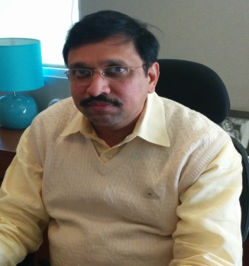
Rajiv K Bansal
Title
Managing Director – Hitech Engineers & Consultants Pvt Ltd
Qualifications
  Bachelor of Engineering (Electrical), YMCA, Faridabad
Contact detail: rkubansal@gmail.comI Mobile: +91-9811156471
Areas of Expertise
Project management
Technical due diligence
Risk assessment & management
Pre-contract services
Independent commercial assurance
Quality assurance
Performance improvement
Project planning and on site construction
Industry Expertise
Building & Infrastructure
Manufacturing plants
Country Experience
India
Japan
ASEAN
Middle East
UK
Summary
Rajiv has 30 years of experience as a developer and project management. He has worked with the Indian development and construction industry for most of his career and has commissioned multiple projects ranging from industrial, commercial, hospitality, medi-care, residential, data centers, network operating centers and mixed land use projects.
Sector Expertise
He has acquired key experience in developing commercial projects for fixed rental income and residential projects for direct sale purposes as a developer. Rajeev has been the key in developing and delivering over 12 projects for his company as a promoter.
Self Owned/Direct sale projects
  Commercial - 65,000 sqft of commercial space in Gurgaon, Haryana - Currently rented out
  Commercial/Retail - 10,000 sqft retail space rented out to a bar in Gurgaon, Haryana
  Hospital - 80,000 sqft of hospital Space in Gurgaon, Haryana - Currently rented out
  Residential - Mayfield Gardens - #4 nos builder floor built and sold within a span of 8 months
  Kindergarten School - 28,000 sqft space in Gurgaon, Haryana - Currently under construction

