Slide 1
Support Vector Machine Model on Iris dataset
SA Data Science Meetup:
Lightning Talks hosted by Booz Allen Hamilton
6/22/2017

Slide 2
Outline
SVM: Introduction & Theory
Model Evaluation:
-confusion matrix: accuracy, precision & recall
Application in Python: Iris Data Set

Slide 3
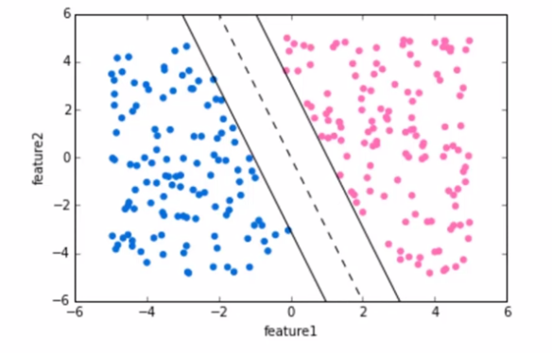
SVM
Supervised learning model used for classification
Large margin classifier
Choosing Hyperplane that maximizes margin between classes

Slide 4
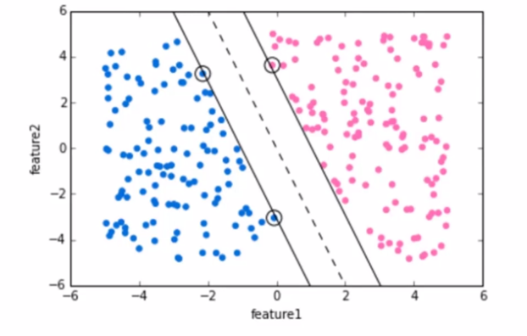
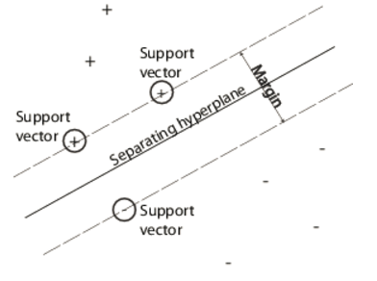
SVM
Support Vectors: vector points that the margin line touch
Notes:
Margin of a linear classifier as the width that the boundary could be increased by before hitting a datapoint

Slide 5
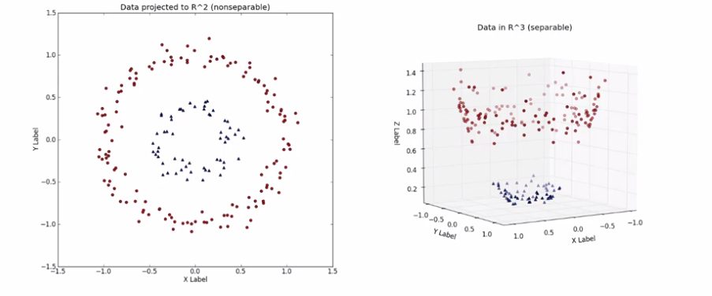
Non-Linearly Separable Data
“Kernel Trick”: function computes dot product between dimensional inputs x & y
Transformation K: R² ->R³
3D visualization

Slide 6
Some Kernel Functions
Linear: K(x_{i},x_{j})= x_{i} ^{T}x_{j}
Polynomial of power p: K(x_{i},x_{j})= (1+ x_{i} ^{T}x_{j})^{p}
Gaussian (radial-basis function network):
Sigmoid: K(x_{i},x_{j})= tanh(β₀x_{i} ^{T}x_{j} + β₁)

Slide 7
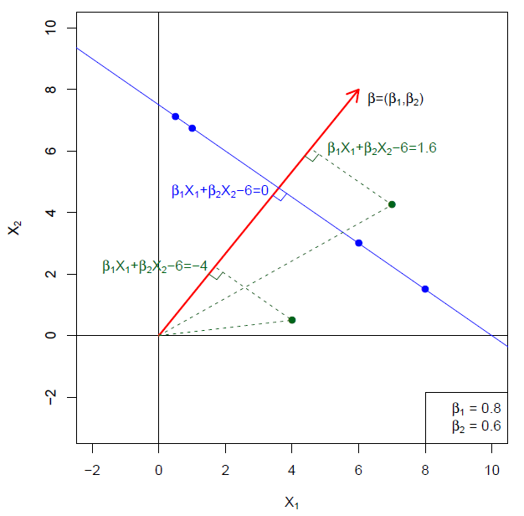


Hyperplane in 2 Dimensions
Hyperplane equation:
p=2: line
Normal Vector:

Slide 8
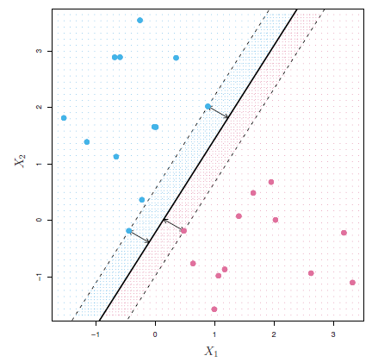
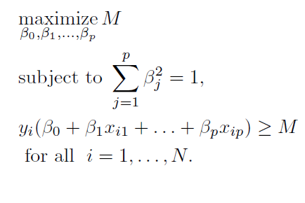
Optimization Problem

Slide 9
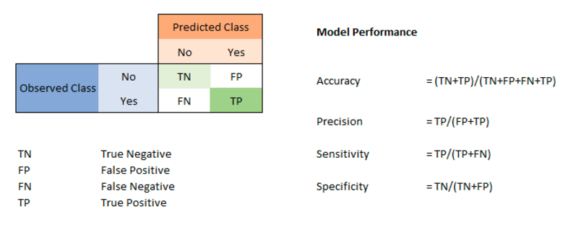
Model Evaluation: Confusion Matrix
(Recall)
Precision measure accuracy of a class, when predicts "Yes" how often it is correct
Sensitivity or Recall: When it is actually "yes" how often it predicts "Yes"
Specificity: Specificity measures true negative rate. When it is actually "No", how often it is "No"
Notes:
Sensitivity or recall

Slide 10
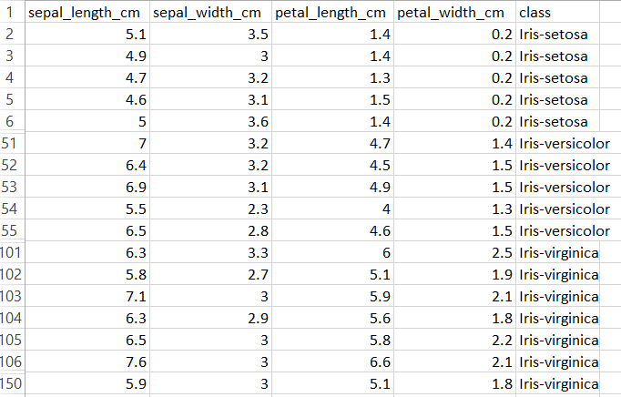
Support Vector Machine with Python
Iris flower data set:

Slide 11
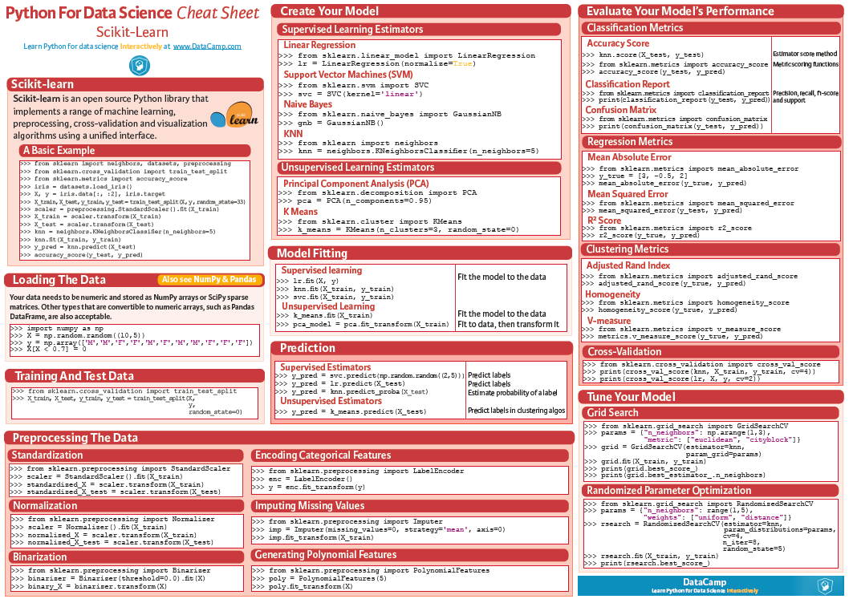

Slide 12
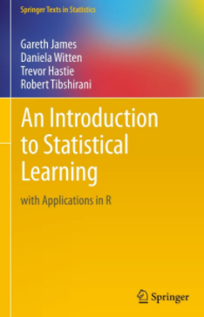
References
An Introduction to Statistical Learning with Applications in R (Free)
https://www.r-bloggers.com/in-depth-introduction-to-machine-learning-in-15-hours-of-expert-videos/

