Slide 1
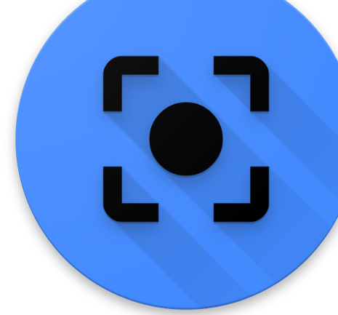
ChromaVision

Slide 2
What is ChromaVision?
Chroma in Greek is the ”Purity of Color”, hence the name ChromaVision.
ChromaVision is a Web App and a Chrome Extension build upon the Google Accessibility API and extension for the color-blind allowing you to correct your vision in real time for better results

Slide 3
So we have a plug-in that helps us correct vision for color-blind people.
LET’S TAKE IT LIVE

Slide 4
This makes the use of the research paper “A Physiologically-based Model for Simulation of Color Vision Deficiency” by Gustavo M. Machado, Manuel M. Oliveira to determine the RGB values of different types of color-blind people.
It uses Confusion Lines of the CIE 1931 Color Space to alter the color on the extension. This method justifies that chromaticity is used to alter colors for color-blind people.

Slide 5
Challenges Faced
Using python scripts to run in the backend with web framework which was ultimately non-feasible so we just went with JavaScript.
Low familiarity with JavaScript made this a heavy learning experience.

Slide 6
Accomplishments
Making a Chrome Extension over an existing API and extension
Incorporating Chromaticity by altering the RGB values in real-time
Tracking the color in real-time using the web player on a fixed axis

Slide 7
Next Steps
Implementing the extension for mobile browsers.
Mounting a camera with Raspberry Pi and using it to convert colors in real-time for users and try to replace the $2000 glasses available in the market. A Raspberry Pi Kit costs $40 with the Pi Camera included and the screen costs around $20 to be mounted on any glasses giving us a net cost of around $80 which is way lesser than $2000

Slide 8
Thank You

