Slide 1
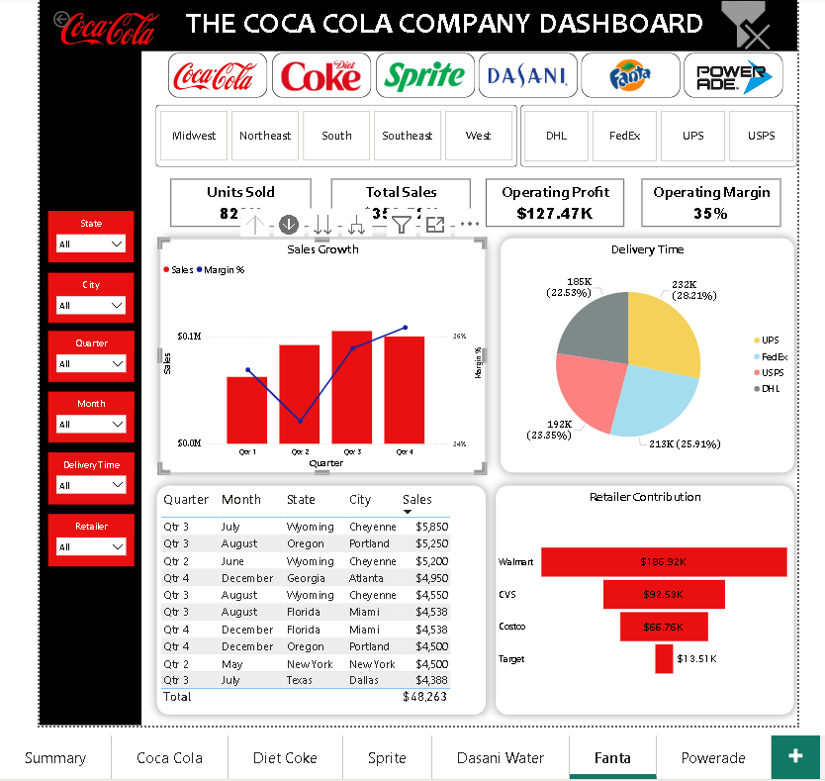
‘Summary’ Page
Navigation
Clear all filters
Button Slicers
Page Navigation
Drill Down & Through
KPIs
Category- Filtered Pages
Navigation Slicers

