Slide 1
Painless C++ comparators

Slide 2

About me
Yuri Gribov
Compiler engineer
Gmail: tetra2005
t.me/the_real_yugr
https://github.com/yugr
https://www.linkedin.com/in/yugr/

Slide 3
Plan
What is a comparator
Example of UB
Comparator axioms
Common mistakes
And ways to diagnose them

Slide 4
Comparators
Generalization of operator<
Predicate functor for comparing objects of some class/type
Used by various STL algorithms and containers to sort and search objects
auto comp = [](T x, T y) { return pr(x) < pr(y); };
std::sort(begin, end, comp);
std::sort(begin, end); // Uses operator<

Slide 5
Usage of comparators
Standard containers:
std::map, std::multimap
std::set, std::multiset
Standard algorithms:
std::sort, std::stable_sort
std::binary_search, std::equal_range, std::{lower,upper}_bound
std::{min,max}_element, std::nth_element
etc.

Slide 6
Example of comparator
int main() {
std::vector<int> vals;
srand(0);
for (size_t i = 0; i < SIZE; ++i)
vals.push_back((double)rand() / RAND_MAX * 10);
std::sort(vals.begin(), vals.end(),
[](int l, int r) { return l <= r; });
for (auto v : vals)
std::cout << v << "\n";
return 0;
}

Slide 7
Does it work?
$ g++ -g -DSIZE=10 bad.cc && ./a.out
1
2
3
3
5
7
7
7
8
9

Slide 8
It does not…
$ g++ -g -DSIZE=50 bad.cc && ./a.out
1
4
1
1
9
2
5
...
double free or corruption (out)
Aborted

Slide 9
Buffer overflow!
$ g++ -g -DSIZE=50 -fsanitize=address -D_GLIBCXX_SANITIZE_VECTOR=1 bad.cc && ./a.out
=================================================================
==143607==ERROR: AddressSanitizer: container-overflow on address 0x611000000108
READ of size 4 at 0x611000000108 thread T0
#0 0x55fa93254d5c in operator()<__gnu_cxx::__normal_iterator<int*, std::vector<int> >, __gnu_cxx::__normal_iterator<int*, std::vector<int> > > /usr/include/c++/10/bits/predefined_ops.h:156
#1 0x55fa93255164 in __unguarded_partition<__gnu_cxx::__normal_iterator<int*, std::vector<int> >, __gnu_cxx::__ops::_Iter_comp_iter<main()::<lambda(int, int)> > > /usr/include/c++/10/bits/stl_algo.h:1904
#2 0x55fa9325428b in __unguarded_partition_pivot<__gnu_cxx::__normal_iterator<int*, std::vector<int> >, __gnu_cxx::__ops::_Iter_comp_iter<main()::<lambda(int, int)> > > /usr/include/c++/10/bits/stl_algo.h:1926
#3 0x55fa93253d1f in __introsort_loop<__gnu_cxx::__normal_iterator<int*, std::vector<int> >, long int, __gnu_cxx::__ops::_Iter_comp_iter<main()::<lambda(int, int)> > > /usr/include/c++/10/bits/stl_algo.h:1958
#4 0x55fa93253d3d in __introsort_loop<__gnu_cxx::__normal_iterator<int*, std::vector<int> >, long int, __gnu_cxx::__ops::_Iter_comp_iter<main()::<lambda(int, int)> > > /usr/include/c++/10/bits/stl_algo.h:1959
#5 0x55fa93253d3d in __introsort_loop<__gnu_cxx::__normal_iterator<int*, std::vector<int> >, long int, __gnu_cxx::__ops::_Iter_comp_iter<main()::<lambda(int, int)> > > /usr/include/c++/10/bits/stl_algo.h:1959
#6 0x55fa93253a6f in __sort<__gnu_cxx::__normal_iterator<int*, std::vector<int> >, __gnu_cxx::__ops::_Iter_comp_iter<main()::<lambda(int, int)> > > /usr/include/c++/10/bits/stl_algo.h:1974
#7 0x55fa932537fb in sort<__gnu_cxx::__normal_iterator<int*, std::vector<int> >, main()::<lambda(int, int)> > /usr/include/c++/10/bits/stl_algo.h:4894
#8 0x55fa932534ca in main /home/yugr/tasks/CppRussia/bad.cc:11
#9 0x7f9bba05ad09 in __libc_start_main ../csu/libc-start.c:308
#10 0x55fa93253249 in _start (/home/yugr/tasks/CppRussia/a.out+0x2249)

Slide 10
Root cause
Partitioning array by pivot element (main step of quicksort)
_RandomAccessIterator
__unguarded_partition(_RandomAccessIterator __first,
_RandomAccessIterator __last,
T __pivot, _Compare __comp) {
while (true) {
// There must be an element which is not less than __pivot
while (__comp(*__first, __pivot))
++__first;
--__last;
while (__comp(__pivot, *__last))
--__last;
if (!(__first < __last))
return __first;
std::iter_swap(__first, __last);
++__first;
}
}

Slide 11
Root cause
__pivot is selected as median of first, second and last array elements
So on loop entry we have a and b such that
__comp(a, __pivot) && __comp(__pivot, b)
This condition is a loop invariant
In theory we can conclude a followup condition which guarantees loop termination:
!__comp(__pivot, a) && !__comp(b, __pivot)
Simplification

Slide 12
Root cause
For our comparator
auto comp = [](int l, int r) { return l <= r; }
the implication is wrong:
comp(__pivot, b) ⇒ !comp(b, __pivot)
when __pivot == b.
Thus the loop invariant is violated which results in buffer overflow.

Slide 13
Comparator requirements

Slide 14

Comparator requirements
To avoid errors in standard algorithms comparators must meet several requirements (axioms)
These requirements are specified in Standard: bit.ly/3LpH5Nc
Violation of axioms leads to Undefined Behavior (crashes, invalid results, hangs)
Not specific to C++: C, Java, Lua, Swift, JavaScript и Rust

Slide 15
Strict partial ordering axioms
Irreflexivity:
!comp(a, a)
Asymmetry:
comp(a, b) ⇒ !comp(b, a)
Transitivity:
comp(a, b) && comp(b, c) ⇒ comp(a, c)
In algebra such comparators are called strict partial orderings and corresponding sets/classes are called partially ordered (posets)

Slide 16
Equivalence relation
Any comparator has a corresponding “equivalence function” (equivalence relation):
bool equiv(T a, T b) {
return !comp(a, b) && !comp(b, a);
}
Also known as “incomparability relation”
Shows whether two elements are indiscernible by comparator
Behaves similar to operator== but is different

Slide 17
Transitivity of equivalence
Equivalence relation must be transitive:
equiv(a, b) && equiv(b, c) ⇒ equiv(a, c)
Objects of class can be partitioned to groups of equivalent elements
Elements of the group behave similarly in comparisons:
Comparing any element of the group to any other element of the set gives the same result

Slide 18

Transitivity of equivalence
Necessary condition for all “quick” sorting algorithms
Why do we need transitivity of equivalence
Not all STL algorithms really need transitivity of equivalence!
E.g. partial ordering is enough for std::min/min_element
But Standard requires all 4 axioms for all algorithms (except for std::binary_search and friends)
Presumably to simplify things

Slide 19
Strict weak ordering
Strict weak ordering
Partial ordering + transitivity of equivalence
Excerpts from n4868:
alg.sorting:
For algorithms other than those described in [alg.binary.search], comp shall induce a strict weak ordering on the values.
utility.arg.requirements (Cpp17LessThanComparable):
< is a strict weak ordering relation

Slide 20
Common errors

Slide 21
Common errors: invalid lexicographical ordering
Most common error
Violation of asymmetry axiom:
A(100, 2) < A(200, 1) && A(200, 1) < A(100, 2)
bool operator<(const A &rhs) {
if (x < rhs.x)
return true;
else if (y < rhs.y)
return true;
else
return false;
}

Slide 22
Common errors: invalid lexicographical ordering
Simple fix:
if (x < rhs.x)
return true;
else if (rhs.x < x)
return false;
else if (y < rhs.y)
return true;
else
return false;

Slide 23
Common errors: invalid lexicographical ordering
Better options:
use std::tie and builtin comparison of tuples:
return std::tie(lhs.x, lhs.y) < std::tie(rhs.x, rhs.y);
(C++20) use default implementation of operator<:
bool operator<(const SomeClass &) const = default;

Slide 24
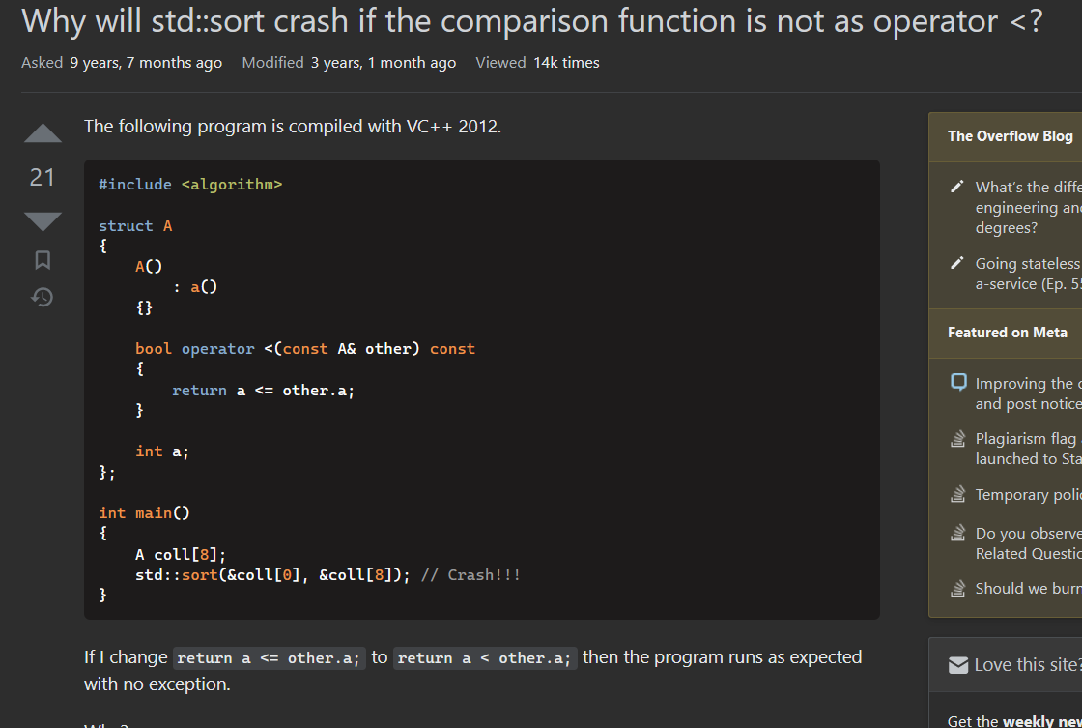
Common errors: non-strict ordering
Violation of irreflexivity and asymmetry

Slide 25

Common errors: negation of strict ordering is non-strict
Another variant of this error:
auto lt = std::less<int>();
auto inv_lt = std::not2(lt);
std::sort(..., ..., inv_lt);
Negation of strict ordering is a non-strict ordering (and thus violates the asymmetry axioms)
Real-world example:
Bug hunting fun with std::sort

Slide 26
Common errors: NaN
int main() {
double a[] = {
100, 5, 3, NAN, 200, 11
};
std::sort(&a[0], &a[std::size(a)]);
for (auto x : a)
std::cout << x << "\n";
return 0;
}

Slide 27
Common errors: NaN
$ g++ bad.cc && ./a.out
3
5
100
nan
11
200

Slide 28
Common errors: NaN
Floating-point types support special NaN values
Generated during incorrect FP computations
E.g. sqrt of negative number or dividing 0/0
Comparison with NaN always returns false so NaNs are equivalent to all other numbers
This causes intransitivity of equivalence:
NAN ~ 1.0
NAN ~ 2.0
But ! 1.0 ~ 2.0

Slide 29
Common errors: NaN
Get rid of NaNs before sorting via std::partition:
auto end = std::partition(&a[0],
&a[std::size(a)],
[](double x) {
return !isnan(x); });
std::sort(&a[0], end);
In case of std::map wrap floats in a class with overloaded comparison

Slide 30
Common errors: approximate comparisons
bool cmp(double a, double b) {
if (abs(a - b) < eps) return false;
return a < b;
}
Treat “close” numbers as equivalent
But this violates transitivity of equivalence:
equiv(0, 0.5 * eps) == true
equiv(0.5 * eps, eps) == true
cmp(0, eps) == false

Slide 31
Common errors: special case
[](std::unique_ptr<SomeClass> a,
std::unique_ptr<SomeClass> b) {
if (!a.get())
return true;
else if (!b.get())
return false;
else
return *a < *b;
}
Violation of irreflexivity and asymmetry when both operands are nullptrs

Slide 32
Common errors: special case
Generic pattern:
Generic fix:
[](A lhs, A rhs) {
if (pred(lhs))
return true;
...
}
[](A lhs, A rhs) {
if (pred(lhs) || pred(rhs))
return pred(rhs) < pred(lhs);
...
}

Slide 33
Common errors: custom comparator for “special” objects
Generic pattern:
auto comp = [](Object a, Object b) {
if (is_special(a) && is_special(b))
return comp_special(a, b);
else
return comp_default(a, b);
}
y
Special
Default

Slide 34
Common errors: custom comparator for “special” objects
Transitivity axiom:
comp(sp1, sp2) && comp(sp2, def) ⇒ comp(sp1, def)
Substitute terms:
comp_special(sp1, sp2) && comp_default(sp2, def) ⇒ comp_default(sp1, def)
Comp_special и comp_default are usually logically and algorithmically unrelated and implication does not hold
?
y
sp1 < sp2 < def

Slide 35

Common errors: custom comparator for “special” objects
Violation of transitivity:
A(true, 1, 3) < A(true, 2, 1)
A(true, 2, 1) < A(false, 1, 2)
! A(true, 1, 3) < A(false, 1, 2)
Real-world example:
GCC Bugzilla #68988
class A {
bool special;
int x, y;
bool operator<(A rhs) {
if (special && rhs.special)
return x < rhs.x;
return y < rhs.y;
}
};

Slide 36
Common errors: custom comparator for “special” objects
Generic fix:
auto comp = [](Object a, Object b) {
if (is_special(a) != is_special(b))
return is_special(a) < is_special(b);
else if (is_special(a) && is_special(b))
return comp_special(a, b);
else
return comp_default(a, b);
}

Slide 37
Tooling

Slide 38
Debug mode in libstdc++
Libstdc++ uses macro -D_GLIBCXX_DEBUG to enable irreflexivity checks
Would have found error from the beginning of this presentation
$ cat /usr/include/c++/10/bits/stl_algo.h
...
inline void
sort(_RandomAccessIterator __first, _RandomAccessIterator __last,
_Compare __comp)
{
...
__glibcxx_requires_irreflexive_pred(__first, __last, __comp);
std::__sort(__first, __last, __gnu_cxx::__ops::__iter_comp_iter(__comp));
}
...

Slide 39
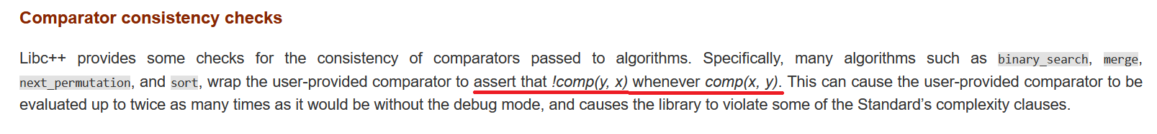
Debug mode in libc++
Libc++ uses macro
-D_LIBCPP_ENABLE_DEBUG_MODE to enable asymmetry checks:

Slide 40
Debug mode
Both options have significant (2x) overhead and should be used only for testing
Checkers can not change the algorithmic complexity of std::sort
O(N*logN)
Thus full correctness can not be checked
E.g. violation of transitivity axioms is O(N³)

Slide 41
SortChecker++
https://github.com/yugr/sortcheckxx
Dynamic checker that verifies comparators in C++ code
Intercepts and checks STL APIs like std::sort and std::map-like containers
Based on source-to-source instrumentation via Clang
Found 5 errors in OSS projects
TODO: support all relevant algorithms (nth_element, etc.)

Slide 42
SortChecker
https://github.com/yugr/sortcheck
Dynamic checker that verifies comparators in C code
Intercepts and checks libc API like qsort и bsearch
Based on runtime instrumentation via LD_PRELOAD
Found 15 errors in various OSS projects (GCC, Harfbuzz, etc.)

Slide 43
How to use SortChecker++
Instrument code:
$ sortcheckxx/bin/SortChecker bad.cc -- -DSIZE=50
Compile and run instrumented code:
$ g++ -g -DSIZE=50 -Isortcheckxx/include bad.cc && ./a.out
sortcheck: bad.cc:14: irreflexive comparator at position 0
Aborted
sortcheck::sort_checked(begin, end,
cmp, __FILE__, __LINE__);
std::sort(begin, end, cmp);

Slide 44
Pseudocode
Each run of std::sort (or similar APIs) is preceded by these checks:
for x in array
if comp(x, x)
error
for x, y in array
if comp(x, y) != comp(y, x)
error
for x, y, z in array
if comp(x, y) && comp(y, z) && !comp(x, z)
error
for x, y, z in array
if equiv(x, y) && equiv(y, z) && !equiv(x, z)
error
Complexity is O(N³)
Too large even for std::sort so only small array prefix is verified (30 elements)

Slide 45

Fast verification algorithm
https://github.com/danlark1/quadratic_strict_weak_ordering
Proposed by D. Kutenin in January 2023
Idea of the algorithm:
Sort array by stable algorithm
Go over prefixes of equivalent elements in sorted array
Verify their transitivity with remaining part of the array
Complexity is O(N²) which is still larger than std::sort’s O(N*logN)
Will likely be integrated in debug libc++ (D150264) and SortChecker

Slide 46
Reading materials
Danila Kutenin Changing std::sort at Google’s Scale and Beyond
Jonathan Müller Mathematics behind Comparison

Slide 47
Recommendations
Avoid common errors
Turn on _GLIBCXX_DEBUG и _LIBCPP_ENABLE_DEBUG_MODE in your CI
Apply SortChecker и SortChecker++ to your codebase
Bug reports and feedback are welcome
As well as stars on GitHub :)

Slide 48
Other types of errors in comparator API
Unsorted arrays in std::binary_search and friends
Diagnosed by SortChecker/SortChecker++
Relying on particular order of equivalent elements in sorted array
Diagnosed by debug libc++ (-D_LIBCPP_ENABLE_DEBUG_MODE) via randomization
Randomization also helps to provoke other types of bugs

Slide 49
Thank you for attending!

Slide 50
Spaceship operator and comparison categories
Standard is changing towards explicit representation of orderings in the language
C++20 has a new comparison operator: operator<=>
Reduces amount of code needed to implement all comparison operators (==, !=, <, >, <=, >=)
Allows for more efficient code
Returns value of one of three types (comparison categories) depending on ordering type implemented by the class:
std::partial_ordering
std::weak_ordering
std::strong_ordering

Slide 51

Semantics of comparison categories?
One could expect that selection of particular category gives guarantees about class behavior
std::partial_ordering – class is partially ordered ?
std::weak_ordering – class is weakly ordered ?
In fact not guaranteed by the current Standard
Selection of category does not give any guarantees of behavior
Implied meaning of ordering types

Slide 52
Common errors: invalid lexicographical ordering
Examples:
https://stackoverflow.com/questions/48455244/bug-in-stdsort
https://stackoverflow.com/questions/53712873/sorting-a-vector-of-a-custom-class-with-stdsort-causes-a-segmentation-fault
https://stackoverflow.com/questions/68225770/sorting-vector-of-pair-using-lambda-predicate-crashing-with-memory-corruption
https://stackoverflow.com/questions/72737018/stdsort-results-in-a-segfault
https://stackoverflow.com/questions/33547566/strict-weak-ordering-operator-in-c

Slide 53
Common errors: non-strict ordering
https://stackoverflow.com/questions/40483971/program-crash-in-stdsort-sometimes-cant-reproduce
https://stackoverflow.com/questions/65468629/stl-sort-debug-assertion-failed
https://stackoverflow.com/questions/18291620/why-will-stdsort-crash-if-the-comparison-function-is-not-as-operator
https://stackoverflow.com/questions/19757210/stdsort-from-algorithm-crashes
https://stackoverflow.com/questions/64014782/c-program-crashes-when-trying-to-sort-a-vector-of-strings
https://stackoverflow.com/questions/70869803/c-code-crashes-when-trying-to-sort-2d-vector
https://stackoverflow.com/questions/67553073/std-sort-sometimes-throws-seqmention-fault

Slide 54
Common errors: special case
Example:
https://stackoverflow.com/questions/55815423/stdsort-crashes-with-strict-weak-ordering-comparing-with-garbage-values
https://stackoverflow.com/questions/48972158/crash-in-stdsort-sorting-without-strict-weak-ordering

Slide 55
Common errors: NaN
Пример:
https://stackoverflow.com/questions/9244243/strict-weak-ordering-and-stdsort

Slide 56
Common errors: approximate comparison
Example:
https://stackoverflow.com/questions/68114060/does-using-epsilon-in-comparison-of-floating-point-break-strict-weak-ordering

