Slide 1
Performance of Rust language
May 2026

Slide 2


About us
Yuri Gribov (yugr, the_real_yugr), https://github.com/yugr
Developer and fan of system SW (compilers, runtimes, verification tools, etc.)
Compiler teamlead
Zakhar Akimov, https://github.com/z-inform
Developer of general-purpose and AI compilers
ML-in-compilers expert

Slide 3
Rust language features
Language for high-performance system programming
Zero cost/overhead abstractions: don’t pay for what you don’t use + no (or minimal) runtime overhead (iterators, closures, traits, etc.)
Allows low-level tuning (SIMD, inline assembler, compiler intrinsics like __builtin_expect, etc.)
Supports modern programming paradigms
Procedural, functional and object-oriented programming
Static and runtime polymorphism
Metaprogramming
Reduces number of UBs through stricter language rules and runtime checks
Especially memory safety

Slide 4

Rust performance: Disadvantages
Runtime checks
Forced initialization
Integer overflows are defined behavior
Performance-robustness tradeoffs in stdlib
...

Slide 5
Rust performance: Advantages
More aggressive alias analysis
Basically restrict-by-default
Structure layout optimizations
Field reorder and niche optimizations
More efficient standard library containers
...

Slide 6

Goals of this talk
How “expensive” are Rust checks in practice?
Compared to Rust without checks and/or C/C++
What are the immediate (extra instructions) and indirect (disabling optimizations, I$/BTB pressure) consequences
Can Sufficiently Smart (Heroic) Compilers © help to mitigate overheads?
And if not, can developer help compiler to get rid of them?
On the contrary, what language features help compiler to optimize code better?
https://pxhere.com/ru/photo/870592

Slide 7
Opinion of language creators
Steven Klabnik:
"Generally Rust is the same order of magnitude as C. Sometimes faster, sometimes slower”
“Rust prioritizes memory safety above all else. But speed is a close second"

Slide 8
Overhead analysis
How can we estimate overheads caused by checks?
Rust compiler does not provide flags to disable safety checks
We will compare regular Rust with patched Rust with disabled checks
Repo with modified compiler: yugr/rust-private
Baseline branch yugr/baseline (on top of 1.87.0)
Disabled hashtable randomization and forced function alignment for better measurement stability

Slide 9



Benchmarks
Rust compiler runtime benchmarks
Benchmarks from large open-source Rust projects from various domains:
Gamedev (Bevy, Veloren)
Databases (SpacetimeDB)
Text processing (Zed, Ruff, regex)
Codecs (rav1e, oxipng)
Linear algebra (nalgebra)
Asynchronous runtime (tokio)
Packet managers (uv)
Many benchmarks have already been optimized (via unsafe, etc.)
Akovin, https://commons.wikimedia.org/wiki/File:Olympic_types_of_sport_with_icons.png

Slide 10


Rust and C++
Rust and C++ are similar in expressive power:
Support several programming paradigms (procedural, OOP, functional)
Different types of polymorphism
Etc.
Similar application domain (high-performance system programming)
Zero cost/overhead abstractions
Support for low-level tuning
Same backend optimizers (LLVM, GCC) and optimization technology (PGO, LTO, etc.)
“Safe” C++ dialect (Hardened C/C++) has similar runtime checks

Slide 11
Not covered: Other language aspects
Ergonomics, expressiveness (e.g. self-referential data structures), safety, etc.
A lot of talks on these topics already!
Rust Features that I Want in C++ (David Sankel, CppNow 2022)
The existential threat against C++ and where to go from here (Helge Penne, NDC 2024)
Rust vs C++ with Steve Klabnik and Herb Sutter (SW Engineering Daily podcast)

Slide 12
Not covered: Parallel programming
Easy and reliable parallel programming is considered one of the big advantages of Rust
Fearless Concurrency with Rust
But this requires a separate talk and deeper expertise
RustCon 2027 anyone?

Slide 13

Not covered: Unsafe code
Rust language consists of two parts:
Safe code (most of Rust code)
Unsafe code:
“Things the Rust authors will implore you not to do” (Rustonomicon)
“Aspects of the language you may not use every day and useful in very specific situations” (Rust Book)
Used for hotspot optimizations
Used for tuning in real-world projects (including benchmarks that we consider)
In this talk we focus on safe code optimizations:
(Also not covering third-party libraries, SIMD and compiler intrinsics)
Unsafe constructs remove the main advantage of the language
Unsafe optimizations are well-known and often trivial
Tricia J, https://www.flickr.com/photos/cazatoma/8746664127

Slide 14
Not covered: Non-idiomatic code
Nikita Popov, LLVM lead maintainer:
“Languages like C, C++ and Rust are by-design on equal footing“
“You can only compare how easy it is to write performant code or how performant idiomatic code is”
Scott McMurray, Rust compiler team:
“Clang and rustc are both producing LLVM IR and running mostly the same LLVM optimization passes”
“Given enough work they can always produce essentially the same thing, making the comparisons pointless”

Slide 15
Bounds checks
Detailed analysis

Slide 16

Buffer overflows
Morris Worm (1988)
Writing excessively large volume of data into program variable
char local_buf[32];
sprintf(buf, “Message from user: %s”, received_data);
Stack overflow
Stack Smashing, Return-to-libc, Return-Oriented Programming attacks
The most standardized and widely used type of attacks
Heap overflow
https://www.rawpixel.com/image/5958324/free-public-domain-cc0-photo

Slide 17

Prevalence of buffer overflow vulnerabilities
Leads ratings of the most dangerous vulnerabilities
Mitre CWE Top 25 2024 (2, 6, 20 places)
70% vulnerabilities in Microsoft products and Chromium caused by memory errors
And up to 80% memory errors are caused buffer overflow
CVE and KEV statistics (2024)
Google Project Zero (2024)

Slide 18

Memory safety in Rust
Frontend generates bounds checks for standard index accesses
Arrays, slices, containers, etc.
Checks may be eliminated later if optimizer can guarantee correctness
Uses safer algorithms in stdlib
E.g. sorting won’t crash on incorrect comparators
Nick Youngson, https://www.picpedia.org/highway-signs/s/safety.html

Slide 19
Overheads
Comparison and non-taken conditional jump (1-2 ALU slots)
Extra register for keeping object length for comparison
I$ pressure (cache misses) due to checking code and panic handlers
Branch predictor pressure for never-taken branches is likely none
Disabling other optimizations
Mainly vectorizer

Slide 20
Compiler optimizations
In many cases compiler can
Prove correctness of memory access and remove checks
Or extract checks from loops (O(N) -> O(1))
Such optimizations are done in LLVM optimizer
InstCombine, SimpleLoopUnswitch, LoopVectorize, etc.
Also help Hardened C/C++
Optimizer has been significantly improved and many older issues are successfully optimized in modern Rust
E.g. well-known examples of Alex Kladov (matklad)

Slide 21
Successful optimization
All checks moved to function prologue
foo:
.cfi_startproc
test rsi, rsi
je .LBB0_1 // n == 0 => return 0
lea rax, [rsi - 1]
cmp rcx, rax
jbe .LBB0_6 // b.len() < n => panic
xor eax, eax
xor ecx, ecx
.p2align 4
.LBB0_4: // Loop (without checks!)
mov r8d, dword ptr [rdx + 4*rcx]
imul r8d, dword ptr [rdi + 4*rcx]
lea r9, [rcx + 1]
add eax, r8d
mov rcx, r9
cmp rsi, r9
jne .LBB0_4
...
pub fn foo(a: &[i32], b: &[i32]) -> i32 {
let mut ans = 0;
let n = a.len();
for i in 0..n {
ans += a[i] * b[i];
}
ans
}
https://godbolt.org/z/aY744zdfe
Compiled with -Cno-vectorize-loops
-Cno-vectorize-slp
-Cllvm-args=-unroll-allow-remainder=0

Slide 22
Unsuccessful optimization
Checks remain within the loop
bar:
...
.p2align 4
.LBB0_2: // Loop (with checks!)
lea rcx, [r8 - 3]
cmp rcx, rsi
jae .LBB0_7
lea rcx, [r8 - 2]
cmp rcx, rsi
jae .LBB0_7
lea rcx, [r8 - 1]
cmp rcx, rsi
jae .LBB0_7
cmp r8, rsi
jae .LBB0_6
add eax, dword ptr [rdi + 4*r8 - 12]
add eax, dword ptr [rdi + 4*r8 - 8]
add eax, dword ptr [rdi + 4*r8 - 4]
add eax, dword ptr [rdi + 4*r8]
add r8, 4
dec rdx
jne .LBB0_2
pub fn foo(v: &[i32]) -> i32 {
let mut ans = 0;
let chunk_len = 4;
let num_chunks = v.len() / chunk_len;
for i in 0..num_chunks {
for j in 0..chunk_len {
ans += v[i * chunk_len + j];
}
}
ans
}
https://godbolt.org/z/176s9nEfE
Compiled with -Cno-vectorize-loops
-Cno-vectorize-slp
-Cllvm-args=-unroll-allow-remainder=0

Slide 23
Problem with optimizer: delayed panics
Rust RFC 560 suggested that compiler could combine several checks together
If it helps optimization
And observed program behavior won’t change (modulo error message)
Similar to classical concept of Imprecise Exceptions
This has not been decided and optimization currently isn’t enabled for bounds checks ☹
Example: rust #50759
use std::fs::{read, write};
fn main() -> Result<(), std::io::Error> {
let h = read("/tmp/test")?;
// Each access checked separately ☹
// (would be enough to check only h[15])
let b = [h[0], h[1], ... h[15]];
write("/tmp/test", &b)?;
Ok(())
}

Slide 24
Workarounds: Overview
Use slices (rather than containers like Vec) in loops
This simplifies job of alias analysis
Example: fschutt/fastblur #3
Avoid complex index computations
Anything more complicated than adding a constant or adding two variables
Even affine operations may break optimizer: Taking Advantage of Auto-Vectorization in Rust
Do not rely on optimizer in non-trivial cases
Optimizations vary (non-monotonically) across compiler versions
“Auto-vectorization is not a programming model”
Same advices are relevant for Hardened C/C++!

Slide 25
Workarounds
Checks elimination
Reducing number of checks
Reducing cost of checks

Slide 26
Workarounds
Checks elimination
Reducing number of checks
Reducing cost of checks

Slide 27

Workarounds: Unsafe-code
The simplest and most robust solution
Used in stdlib containers and iterators
Several variants:
Explicit pointers in unsafe blocks
Check-less APIs like get_unchecked, etc.
Compiler hints std::hint::unreachable_unchecked and std::hint::assert_unchecked
fn drop(&mut self) {
// fill the hole again
unsafe {
let pos = self.pos;
ptr::write(
self.data.get_unchecked_mut(pos),
self.elt.take().unwrap());
}
}
rust #36072
https://workinjurysource.com/preventing-slip-and-fall-injuries-at-work/
27

Slide 28
Workarounds: Bounded types
Index range can be expressed via type system:
Enums or bool
Example: rust #102303
pub enum Enum {
A, B, C
}
pub fn foo(array: &[i16; 3],
i: Enum) -> i16 {
array[i as usize]
}
pub fn foo(array: &[i16; 3],
i: usize) -> i16 {
array[i]
}

Slide 29
Workarounds
Checks elimination
Reducing number of checks
Reducing cost of checks

Slide 30
Workarounds: Manual asserts
// optimizer hint to eliminate bounds checks
// within loops
assert!(coefficients.len() == 64);
let mut temp = [Wrapping(0); 64];
// columns
for i in 0..8 {
if coefficients[i + 8] == 0
&& coefficients[i + 16] == 0
&& coefficients[i + 24] == 0
&& coefficients[i + 32] == 0
&& coefficients[i + 40] == 0
&& coefficients[i + 48] == 0
&& coefficients[i + 56] == 0
{
...
Replaces many checks with one
Example: jpeg-decoder #167

Slide 31

Workarounds: Reslicing
Reslicing, preslicing or subslicing
Pre-construct slices of known size
Forces compiler to perform single check when creating slice
Example: dropbox/rust-brotli
let slice = &vec[0..n];
for i in 0..n {
black_box(slice[i]);
}
for i in 0..n {
black_box(vec[i]);
}
Lalada, https://www.pexels.com/photo/close-up-of-a-person-cutting-bread-19359855/

Slide 32
Workarounds: Reslicing
Offsetted slices should better be constructed in two steps to avoid potential integer overflow
Example: Optimizing rav1d, an AV1 Decoder in Rust
&vec[i..(i + n)]
&vec[i..][..n]

Slide 33
Workarounds: Limiting iteration range
When iterating over several containers explicitly compute common safe range
pub fn foo(x: &mut [i32], y: &[i32]) {
let n = x.len();
for i in 0..n {
x[i] ^= y[i];
}
}
.LBB1_2:
cmp rcx, rax
je .LBB1_5
mov r8d, dword ptr [rdx + 4*rax]
xor dword ptr [rdi + 4*rax], r8d
lea r8, [rax + 1]
mov rax, r8
cmp rsi, r8
jne .LBB1_2
pub fn foo(x: &mut [i32], y: &[i32]) {
let n = std::cmp::min(x.len(), y.len());
for i in 0..n {
x[i] ^= y[i];
}
}
.LBB0_2:
mov ecx, dword ptr [rdx + 4*rax]
xor dword ptr [rdi + 4*rax], ecx
lea rcx, [rax + 1]
mov rax, rcx
cmp rsi, rcx
jne .LBB0_2
https://godbolt.org/z/P8de874c1
https://godbolt.org/z/6TzEPaaEs
Compiled with
-Cno-vectorize-loops -Cllvm-args=-unroll-allow-remainder=0

Slide 34
Workarounds: Iterators
Many iterators know container size and can utilize this information to remove bounds checks
pub fn foo(x: &mut [i32], y: &[i32]) {
let n = x.len();
for i in 0..n {
x[i] ^= y[i];
}
}
.LBB1_2:
cmp rcx, rax
je .LBB1_5
mov r8d, dword ptr [rdx + 4*rax]
xor dword ptr [rdi + 4*rax], r8d
lea r8, [rax + 1]
mov rax, r8
cmp rsi, r8
jne .LBB1_2
pub fn foo(x: &mut [i32], y: &[i32]) {
// This also works:
// for (x, y) in x.iter_mut().zip(y)
x.iter_mut()
.zip(y)
.for_each(|(x, y)| *x ^= *y);
}
.LBB0_2:
mov ecx, dword ptr [rdx + 4*rax]
xor dword ptr [rdi + 4*rax], ecx
lea rcx, [rax + 1]
mov rax, rcx
cmp rsi, rcx
jne .LBB0_2
https://godbolt.org/z/P8de874c1
https://godbolt.org/z/je69173xv
Compiled with
-Cno-vectorize-loops -Cllvm-args=-unroll-allow-remainder=0

Slide 35

Disadvantages of iterators
“Miracle of zero cost abstraction has a limit" (fridsun at Reddit)
Significant slowdown and code size increase for debug builds
Compiler sometimes fails to inline long iterator chains
Iterator lambdas take references to container elements which may cause issues with alias analysis (rust #106539)
Chained iterators (chain, flat_map, flatten, ..=, etc.) may generate inefficient code in for-loops (“external iteration”)
Use only with .for_each, .fold, .find, etc. (“internal iteration”)
Are iterators even efficient?
Karen Arnolds, https://www.publicdomainpictures.net/en/view-image.php?image=235675&picture=man-carrying-stack-of-boxes

Slide 36
Workarounds: Order of accesses
Prefer to access data starting with farthest element
let a = x[0];
let b = x[1];
let c = x[2];
let c = x[2];
let b = x[1];
let a = x[0];
or
let a = x[0];
let b = x[1];
let c = x[2];
let [a, b, c] = data[..3] else {
panic!()
};
or
let a = x[0];
let b = x[1];
let c = x[2];
let [a, b, c] = data[..3]
.try_into().unwrap();

Slide 37
Workarounds: SIMD
Developer can manually vectorize code
Stdlib provides
Portable std::simd API (nightly only)
Platform vector intrinsics std::arch (unsafe)
There are also many third-party libraries
pub fn sum_simd(data: &[i32]) -> i32 {
const LANES: usize = 8; // AVX
let mut acc = i32x8::splat(0);
for chunk in data.chunks_exact(LANES) {
let v = i32x8::from_slice(chunk);
acc += v;
}
let mut tail_acc = 0i32;
for &x in data.chunks_exact(LANES).remainder() {
tail_acc += x;
}
acc.reduce_sum() + tail_acc
}
https://godbolt.org/z/G3bfGEhnG

Slide 38
Workarounds
Checks elimination
Reducing number of checks
Reducing cost of checks

Slide 39
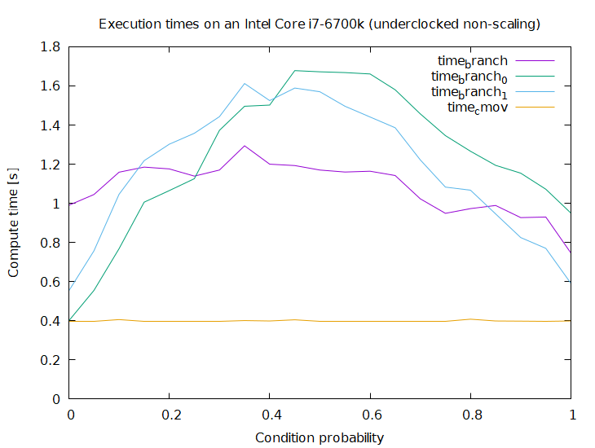
Workarounds: Arithmetic instead of checks
Checks may be replaced with conditional move
let i = cmp::min(i, sums.len() - 1);
sums[i] = ...
CMOV may be faster or slower than branch
Disadvantage: bounds errors will now be ignored
https://github.com/marcin-osowski/cmov

Slide 40
Workarounds: Arithmetic instead of checks
Bounds checks may be replaced with masking if length is 2^{N} (or can be padded to 2^{N}):
const SIZE: usize = 100;
const LOOKUP_TABLE_SIZE: usize = SIZE.next_power_of_two();
let table: [u64; LOOKUP_TABLE_SIZE] = ...
... table[table & (LOOKUP_TABLE_SIZE - 1)] ...
AND is usually faster (e.g. can run on more ALUs in processor)
Unfortunately optimization (currently) applicable only to arrays

Slide 41
Prevalence
20% of checks in Rust compiler are bounds checks
Based on analysis of binary code
In inner loops checks 80% contain only bounds checks
These checks prevent vectorization of surrounding loops
Data collected with LLVM plugin based on rustc and oxipng analysis
Analysis methodology
Compiler branch

Slide 42
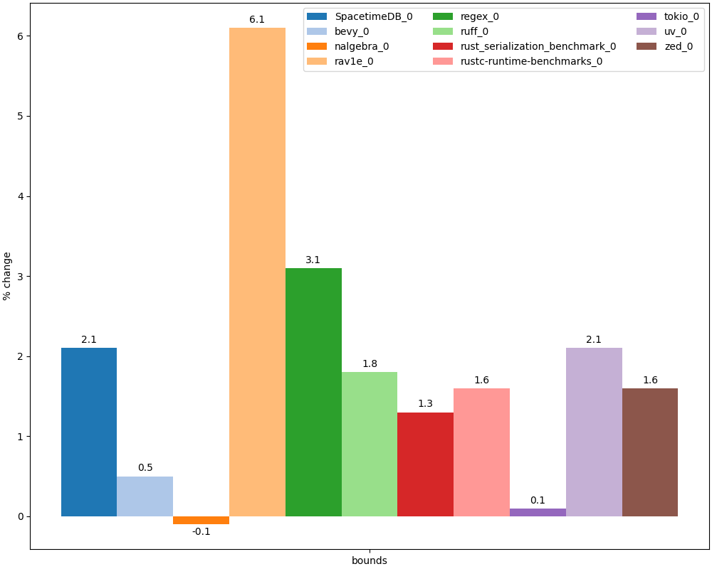
Performance improvement after disabling bounds checks
We disabled instrumentation in user code and checks in stdlib (containers, slices, strings, etc.)
Compiler branch

Slide 43

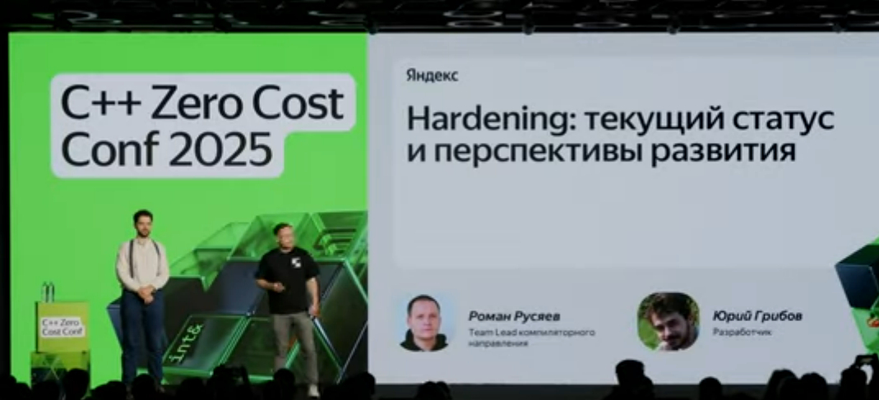
Hardened C/C++
C/C++ provides limited support for memory safety:
StackProtector
_FORTIFY_SOURCE
Hardened STL (C++ only)
-fsanitize=bounds, -fsanitize=object-size
Complete, Rust-like correctness checks are impossible due to lack of information about lengths for raw pointers
E.g. only 20% of non-trivial memory accesses in Clang code can be checked
C++ Safe Buffers may solve this but requires non-trivial code mofications
More information:
Hardening: current status and trends (C++ Zero Cost 2026)
Mario Simoes, https://snl.no/Mount_Everest
Mario Simoes, https://snl.no/Mount_Everest

Slide 44
Rust vs. Hardened C++
pub fn foo(x: &[i32], i: usize) -> i32 {
x[i]
}
extern “C”
int foo(std::span<int> s, size_t i) {
return s[i];
}
https://godbolt.org/z/jGT6adEYM
https://godbolt.org/z/6MG5vdefK
rustc -O -Cpanic=abort
gcc -O2 -D_GLIBCXX_ASSERTIONS
foo:
cmp rdx, rsi
jae .LBB0_2
mov eax, dword ptr [rdi + 4*rdx]
ret
.LBB0_2:
push rax
lea rax, [rip + .Lanon.1]
...
call qword ptr [rip + panic_bounds_check]
foo:
.LFB821:
cmp rdx, rsi
jnb .L3
mov eax, DWORD PTR [rdi+rdx*4]
ret
.foo.cold:
.L3:
push rax
...
call std::__glibcxx_assert_fail

Slide 45
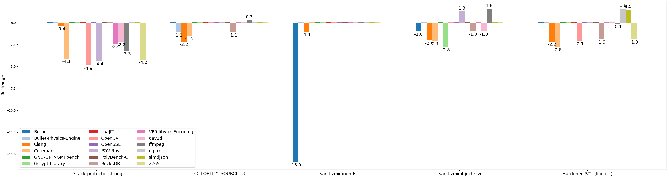
Overheads in Hardened C++
Unexpected performance improvements due to optimizer anomalies (bad vectorization, enabled inlining, etc.)

Slide 46
Conclusions
Bounds checks in Rust are applied much more aggressively than in Hardened C/C++
Hardened C/C++ checks 5x accesses than Rust
Overheads may reach 3-4% (and are comparable to Hardened C/C++)
But some tests may degrade by 10% and more (same applies to Hardened C/C++)
There are many ways to avoid checks in hot code
Some of them won’t be needed if delayed panics are finally implemented (rust #50759)

Slide 47
Recommended readings
How to avoid bounds checks in Rust without unsafe (Sergey Davidoff aka Shnatsel, Rust Secure WG lead)
“Bible” of bounds check elimination
Story-time: C++, bounds checking, performance, and compilers (Chandler Carruth, SW foundations & PLs technical lead, creator of Carbon language)

Slide 48
Aliasing rules
Detailed analysis

Slide 49

Pointer aliasing
Universal feature in programming languages
Can two different references (pointers) address same object in program?
Different languages make different choices:
No two pointers in program may refer to same data (e.g. Fortran 77)
Any two pointers may address same data (e.g. pre-C89)
Intermediate variants
E.g. strict (type-based) aliasing in C89 and restrict annotations in C99
https://commons.wikimedia.org/wiki/File:Hercules_slaying_the_Hydra.gif

Slide 50
Why aliasing is important?
Unlimited aliasing is convenient for developer but reduces optimization opportunities for compiler
Reduced aliasing enables many optimizations
E.g. vectorizers, CSE, GVN, LICM, DSE, etc.
Even used in CPU (for speculative execution of loads)
Alias Analysis is one of the main components of any mature compiler
Identifies pointers that may (or may not) alias
int alias(int *a, int *b) {
*a = 0;
*b = 1;
return *a;
}
int noalias(int * restrict a, int * restrict b) {
*a = 0;
*b = 1;
return *a;
}
alias:
mov DWORD PTR [rdi], 0
mov DWORD PTR [rsi], 1
mov eax, DWORD PTR [rdi]
ret
noalias:
mov DWORD PTR [rdi], 0
xor eax, eax
mov DWORD PTR [rsi], 1
ret
https://godbolt.org/z/nqdax4vEP

Slide 51
Alias analysis theory
Precise intraprocedural alias analysis is
NP-complete without dynamic allocations (Pointer-induced aliasing, 1991)
Undecidable otherwise (Undecidability of static analysis, 1992)
Aliasing is very rare in real programs
98% of pointers in SPEC benchmarks address only one object
Dynamic Points-To Sets (Mock et al., 2001)
Existing alias analyses are conservative and overestimate aliasing 1.5-20x
Dynamic Points-To Sets (Mock et al., 2001)
Speculative Alias Analysis for Executable Code (Fernandez et al., 2002)
ORAQL — Optimistic Responses to Alias Queries in LLVM (Doerfert et al., 2023)

Slide 52
Aliasing in Rust
pub fn foo(a: &mut i32,
b: &mut i32) -> i32 {
*a = 0;
*b = 1;
*a
}
Limitations imposes by Borrow checker simplify alias analysis:
Mutable reference may not alias any other (mutable or shared) reference
While it exists, mutable reference is the only pointer to object
Object addressed by shared reference may not be changed while reference exists
In practice this achieves similar effect as restrict in C/C++
define i32 @foo(
ptr noalias ... %a,
ptr noalias ... %b) {
store i32 0, ptr %a
store i32 1, ptr %b
ret i32 0
}
foo:
mov dword ptr [rdi], 0
mov dword ptr [rsi], 1
xor eax, eax
ret
https://godbolt.org/z/6WoTzoo5v

Slide 53
Limitations
pub fn foo(a: *mut i32,
b: *mut i32) -> i32 {
let a = unsafe { &mut *a };
let b = unsafe { &mut *b };
*a = 1;
*b = 2;
*a
}
Information about aliasing is represented via noalias attribute in function arguments
References that appear inside functions are not marked and can alias from LLVM standpoint
May be solved via alias.scope metadata in future (#16515)
Workaround: create dummy-functions specifically for noalias annotations
Example: rustc
foo:
mov dword ptr [rdi], 1
mov dword ptr [rsi], 2
mov eax, dword ptr [rdi]
ret
https://godbolt.org/z/WjY9rxex7

Slide 54
Limitations
pub fn foo(a: &mut Vec<i32>,
b: &Vec<i32>) {
let n = a.len();
let b = &b[..n];
for i in 0..n {
a[i] = b[i] + 100;
}
}
One case of above problem is aliasing of references to structure fields
E.g. when passing two vectors to function compiler fails to understand that their buffers do not alias
Workaround: pass raw slices to functions
pub fn foo(a: &mut [i32],
b: &[i32]) {
let n = a.len();
let b = &b[..n];
for i in 0..n {
a[i] = b[i] + 100;
}
}

Slide 55
Limitations
Aliasing rules apply only to references
Raw pointers will still alias in Rust
This is worse than in C/C++ due to lack of strict aliasing rules

Slide 56
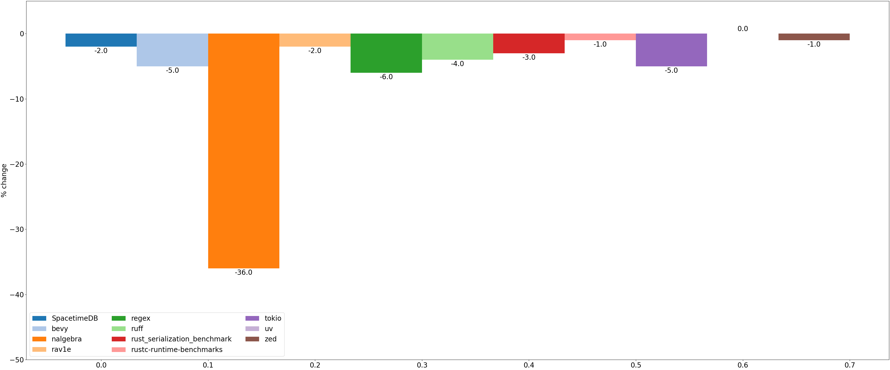
Efficiency of Rust aliasing rules
Precision of alias analysis – number of pointer pairs for which analysis could give definite answer (MustAlias / NoAlias)
Degradation of alias analysis precision in Rust after turning of reference rules
Analysis methodology
Compiler branch

Slide 57
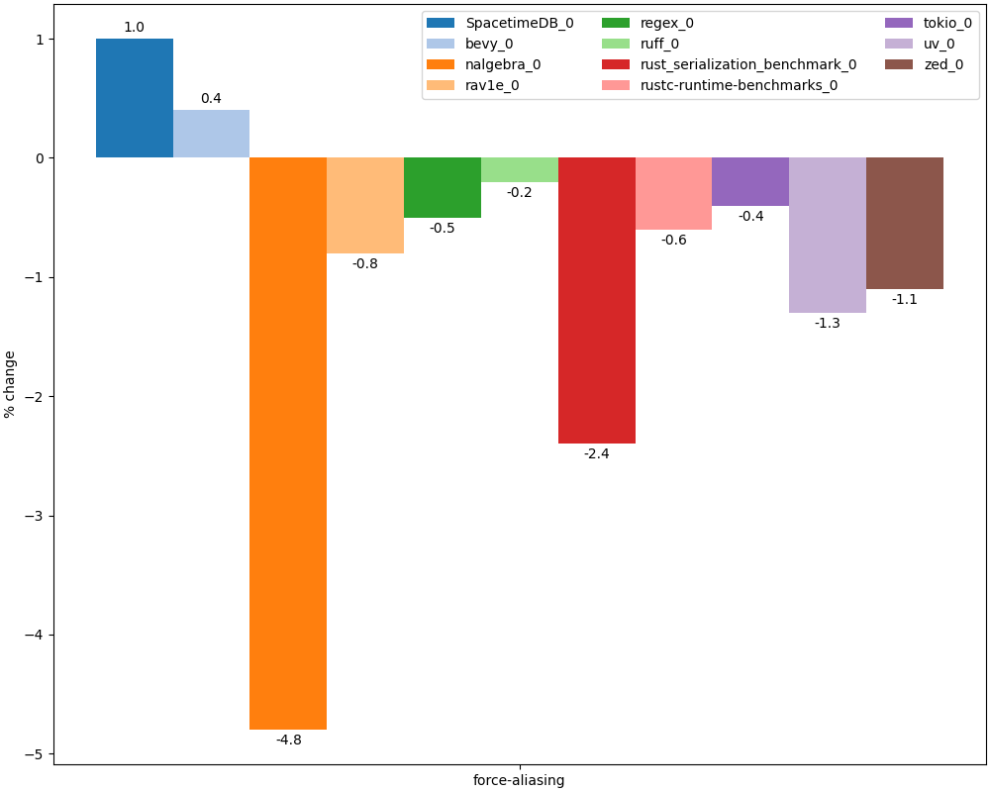
Performance degradation after disabling aliasing rules
Compiler branch

Slide 58

Situation in C/C++
C and C++ disallow aliasing of pointers to different types
Except char *, signed/unsigned, scalar/vector, etc.
But many projects ignore this rule via -fno-strict-aliasing flag
C and C++ also allow developer to explicitly prohibit aliasing via restrict keyword
In practice this is seldomly used (Rust couldn’t enable its aliasing rules for long time due to lots of hidden bugs in LLVM)

Slide 59
Conclusions
Rust aliasing rules allow to
Increase analysis precision by 5% on average
Improve performance by 1-2% on average
Can expect performance increase after further codegen improvements (aliasing metadata)

Slide 60
Recommended readings
Complexity of alias analysis:
Pointer-induced aliasing (Landi, 1991)
Undecidability of static analysis (Landi, 1992)
Aliasing in real code:
Dynamic Points-To Sets (Mock et al., 2001)
Speculative Alias Analysis for Executable Code (Fernandez et al., 2002)
ORAQL — Optimistic Responses to Alias Queries in LLVM (Doerfert et al., 2023)
De-aliasing in CPU:
Memory Disambiguation on Skylake

Slide 61
Mandatory initialization
Detailed analysis

Slide 62

Mandatory initialization
Uninitialized variables may cause information leaks and other errors
Password or address leaks (the latter compromises ASLR)
Prevalence:
10% CVE root cause in Microsoft products in 2018 (see Killing Uninitialized Memory)
12% exploitable bugs in Android (see P2723)
Alex Dos Santos, https://www.pexels.com/photo/vintage-water-tap-dripping-in-black-and-white-29725026/

Slide 63
Example
void foo() {
char password[32];
...
}
void bar() {
char message[1024];
if (cond) strcpy(message, “...”);
// Leaking password under !cond
printf(message);
}
void baz() {
foo();
bar();
}

Slide 64
Rust approach
Rust requires initialization of all variables
Local, global, heap
Each variable must be assigned on all paths before first use
pub fn foo() {
let x = 10;
x
}
pub fn foo(cond: bool) -> i32 {
let x; // No mut needed
if cond {
x = 10;
} else {
x = 20;
}
x
}
pub fn foo(cond: u32) -> i32 {
let x; // No mut needed
if cond > 10 {
x = 10;
} else if cond <= 10 {
x = 20;
}
x
}
OK
OK
NOT OK

Slide 65
Other languages
Many other languages also require initialization (or autoinitialize with zeroes):
C#, Swift, Go, Java
Hardened C/C++ (-ftrivial-auto-var-init), C++26 (P2795)
Only local varibles
Global variables and sbrk/mmap-buffers already zero-initialized
Heap can be zero-initialized via hardened allocator
Enabled by default in Android user/kernel-space and Chrome

Slide 66
Issue with mandatory initializations
Initializations are often redundant in practice
Will be overwritten with other values later without being read
Compiler can’t always eliminate such redundant initializations
Example:
let mut file = File::open("example.bin")?;
while (...) {
let mut buffer = [0u8; 1024]; // memset not removed
let n = file.read_exact(&mut buffer)?;
...
}

Slide 67
Prevalence of redundant initializations
How many initializations are redundant?
Static estimate (via LLVM plugin):
Hardened Clang: +4% stores in loops (Clang benchmark)
Dynamic estimate (via Valgrind plugin):
Compiling large C++ source file:
Clang: 11% unused writes
Hardened Clang (-ftrivial-auto-var-init): 23% unused writes (i.e. 2x increase)

Slide 68
Overheads in benchmarks
Unfortunately it’s not possible to directly measure initialization overheads in Rust benchmarks
That would require extensive code rewrites
We will illustrate overheads
Reported in various Rust projects
Measured for Hardened C/C++

Slide 69
Example overheads in Rust programs
What are the potential consequences for performance?
7% in stdlib file IO (rust #26950)
20-30% in Hyper HTTP (see tokio #1744)
30% in Shadow simulator (shadow #1643)
25% in stdlib TcpStream (RFC #837)
1.5% in rav1d (Making the rav1d Video Decoder 1% Faster)

Slide 70
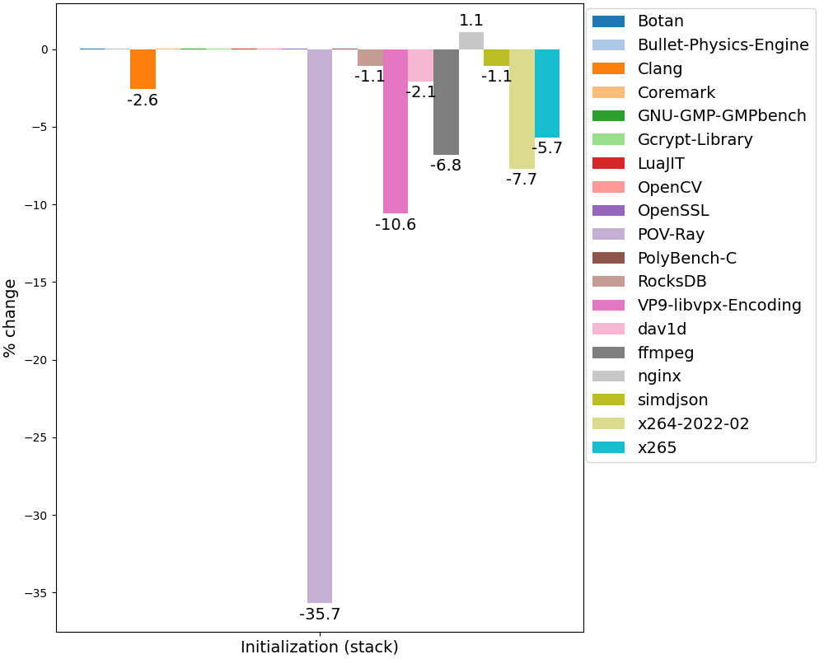
Overheads with forced stack initialization for C++

Slide 71
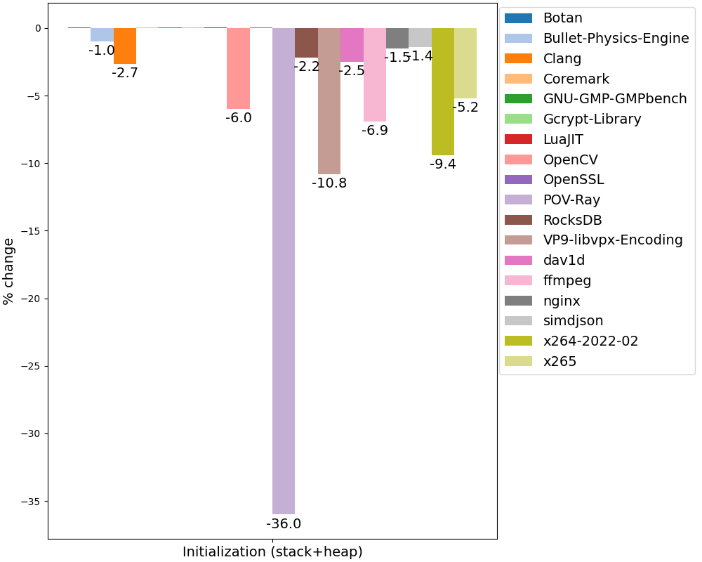
Overheads with forced stack+heap initialization for C++
We used crude approach to heap initialization (LD_PRELOAD + memset)
More sophisticated implementation would have smaller overheads

Slide 72
Compiler optimizations
Redundant scalar initializations can be optimized away by many SSA passes in LLVM (and are very cheap anyway)
DCE, BDCE, ADCE, InstCombine, etc.
Redundant array initializations pose the main problem
DeadStoreElimination, MoveAutoInit, MemCpyOptimizer
To a lesser degree InstCombine

Slide 73
Workarounds
One does not simply create a reference to uninitialized object and fill it:
“Creating a reference with &/&mut is only allowed if the pointer is properly aligned and points to initialized data” (addr_of_mut)
Recommended solution is to use MaybeUninit type and various API around it
Unfortunately MaybeUninit APIs are not always convenient

Slide 74
Workarounds: Standard types
Arrays:
let buf :: [u8; 4] = unsafe {
let mut buf = MaybeUninit::<[u8; 4]>::uninit();
let ptr = buf.as_mut_ptr();
for i in ... {
ptr.offset(i).write(...);
}
buf.assume_init()
};
Structures:
let role :: Role = unsafe {
let mut uninit = MaybeUninit::<Role>::uninit();
let ptr = uninit.as_mut_ptr();
// Need write
// (instead of explicit assign)
// to avoid dropping
// uninitialized String
addr_of_mut!((*ptr).name)
.write("basic".to_string());
(*ptr).flag = 1;
(*ptr).disabled = false;
uninit.assume_init()
};

Slide 75
Workarounds: Vectors
let mut buf = Vec<u8>::new();
let old_len = buf.len();
buf.reserve(data.len());
unsafe {
let ptr = buf.spare_capacity_mut();
for i in ... {
ptr[idx].write(...);
}
buf.set_len(len + data.len());
}

Slide 76
Workarounds: IO
let mut buf = [MaybeUninit::uninit(); 4096];
let mut buf = BorrowedBuf::from(&mut buf[..]);
rd.read_buf(buf.unfilled())?;
let data : &[u8] = buf.filled();
// Work with buf.filled()

Slide 77
Conclusions
Initialization overheads in Rust and Hardened C++ are on par
Higher than in C++26 due to heap initializations
These overheads can be large in some scenarios (5-10% or more) and require manual code tuning:
Using dedicated APIs like MaybeUninit

Slide 78
Recommended readings
Killing Uninitialized Memory (video)
Report from Microsoft about enabling similar checks in Visual Studio
P2795: Erroneous behavior for uninitialized reads
To be integrated to C++26

Slide 79
Symbol localization
Detailed analysis

Slide 80
Symbol localization
Functions in translation unit (crate in Rust, cpp file in C++) can be used locally or globally (in other translation units)
Controlled with static keyword and anonymous namespaces in C++
Or with pub, pub(crate), etc. in Rust
Rust and C++ make opposing default choice:
In Rust functions are local for their module by default (top-level functions are local to their crate)
pub(crate)-functions are local to crate
Only pub-functions are visible across whole program

Slide 81
Localization in Rust
pub(crate) fn foo1(x: i32) {
println!("Hello world {}", x);
}
mod mymod {
pub(super) fn foo2(x: i32) {
println!("Goodbye world {}", x);
}
pub fn foo3(x: i32) {
println!("Nice world {}", x);
}
}
pub use mymod::foo3;
pub fn bar() {
foo1(1);
mymod::foo2(2);
mymod::foo3(3);
}
$ rustc +baseline test.rs -O --emit=asm --crate-type=rlib -o- \
| rustfilt \
| grep globl
.globl test::mymod::foo3
.globl test::bar
Only foo3 and bar are exported!

Slide 82
Compiler optimizations
Local functions are much better optimized by compiler
Usually such optimizations are related to API or ABI changes:
Interprocedural constant propagation (IPSCCP)
Replacing pass-by-reference with pass-by-value (ArgumentPromotion)
Removing dead arguments or return values (DeadArgumentElimination)
Relaxed calling convention (using coldcc in Transforms/IPO/GlobalOpt.cpp)
Interprocedural register allocation (IPRA)
And also
More aggressive inlining (e.g. local functions which are only called once are always inlined)
Better dead code elimination

Slide 83
Linker optimizations
For shared libraries (DLLs) local functions
May be called directly (bypassing PLT/GOT)
Do not need to be resolved by loader at startup
See more details in Dynamic libraries and how to optimize them

Slide 84
Example
#[inline(never)] // Simulate inliner fail
fn foo(b: bool, seed: i32, s: &[i32]) -> i32 {
let mut ans = seed;
for &x in s {
ans += if b { 1 } else { ans ^ x }
}
ans
}
pub fn bar(n: i32, s: &[i32]) -> i32 {
let mut ans = 0;
for i in 0..n {
ans += foo(true, i, s);
}
ans
}
https://godbolt.org/z/MM7Tchx49
foo:
lea eax, [rsi + rdi]
ret
Loop in foo was optimized out

Slide 85
Comparison to C/C++
Many authoritative coding guidelines suggest to localize functions:
Google C++ Style Guide
LLVM Coding Standard (Restrict Visibility)
C++ Core Guidelines
Chromium C++ Style Guide
No way to localize private class methods in C++
Prototype optimization

Slide 86
Prevalence
80-90% of functions in Rust programs are local
Statistics collected via this patch
In C/C++ results depend on the project:
80-90% (clang, ffmpeg, git, opencv, bitcoin)
40-50% (openssl, tmux, gcc, libuv)
(Statistics collected with Localizer tool)

Slide 87
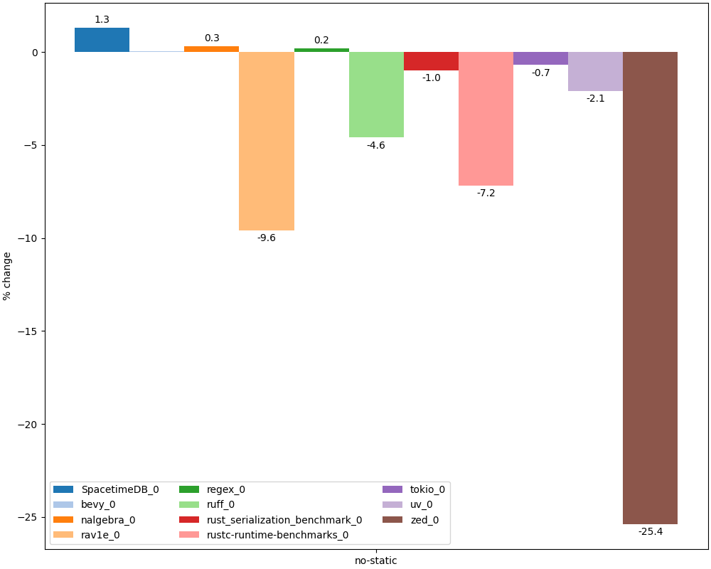
Slowdown with disabled localization
Compiler patch

Slide 88
Conclusions
Function localization allows compiler to generate much more performant code (over 5%)
Rust has more optimal performance-wise defaults

Slide 89
Recommended readings
Efficient C Tips #5 – Make ‘local’ functions ‘static’

Slide 90
No inplace-initialization
Detailed analysis

Slide 91
Overview
C++ has placement-new mechanism for constructing objects in arbitrary memory buffer:
void *addr = some_alloc(sizeof(A));
A *ptr = new(addr) A(...); // Or std::construct_at
Complemented by perfect forwarding:
std::vector<LargeStruct> vec;
vec.emplace_back(large_struct_initializer);
Rust lacks similar mechanism
Caused by mandatory object initialization
Problem:
// Can compiler eliminate copy (from stack to heap)?
let b = Box::new(LargeStruct { ... });

Slide 92
Why placement new is needed?
const SIZE: usize = 1024 * 1024 * 1024;
fn main() {
let b: Box<[usize]> = if cfg!(fast) {
vec![15; SIZE].into_boxed_slice()
} else {
// Problematic copy
Box::new([15; SIZE])
};
black_box(&b);
}
# Can compiler eliminate copy?
$ LIMIT=$((8 * 1024))
$ rustc +baseline -O test.rs
$ (ulimit -s $ LIMIT; ./test)
thread 'main' has overflowed its stack
fatal runtime error: stack overflow
# Works with dedicated non-copying API
$ rustc +baseline --cfg fast -O test.rs
$ (ulimit -s $ LIMIT; ./test)

Slide 93
Why placement new is needed?
struct A {
std::array<int, 1024> vals = {};
A() = default;
A(const A &) = default;
A(int val) {
std::fill(vals.begin(), vals.end(), val);
}
};
int main() {
std::vector<A> aa;
aa.reserve(NITER);
for (size_t i = 0; i < NITER; ++i) {
#ifdef USE_PLACEMENT_NEW
aa.emplace_back(i);
#else
A a(i);
aa.push_back(a);
#endif
asm("" :: "r"(&aa) : "memory");
}
return 0;
}
USE_PLACEMENT_NEW ~10% faster!

Slide 94
Compiler optimizations
Move/copy elision
Detects and removes redundant moves and copies
Can work more aggressively (compared to C++)
High-level IR (MIR)
Shallow move/copy (essentially move/copy in Rust is just a memcpy)
Modern C++ compilers do not support complete copy elision optimization
Only limited optimizations like RVO, NRVO, etc.
Mainly due to lack of high-level IR (ClangIR to the rescue?)
See Ultimate Copy Elision work by Roman Rusyaev (GitHub)
Implementation in compiler:
MIR (high-level IR): CopyProp, DeadStoreElimination, DestinationPropagation, RenameReturnPlace
LLVM: MemCpyOptPass
Detailed analysis

Slide 95
Issues with move/copy elision
Depends on compiler version
Not always monotonically
Works only for release builds
Copies in debug builds are not optimized and may cause stack overflow or significant slowdown
Language support for inplace-initialization is one of project goals in 2026:
In-place initialization

Slide 96
Workarounds
Same as for mandatory initialization:
Use dedicated APIs to create uninitialized buffers and then initialize them:
E.g. Box/Rc::new_uninit, Vec::with_capacity/set_len
Also other APIs e.g. Vec::into_boxed_slice

Slide 97
Conclusions
Copy elision has more opportunities in Rust than in C++
But can’t fully compensate for lack of language support for inplace initialization
Like placement new and perfect forwarding
Language developers are aware of this problem and try to solve it:
Rust Project Goals 2026: In-place initialization
Rust Project Goals 2026: MIR move elimination

Slide 98
Recommended readings
Ultimate Copy Elision
Comprehensive overview of C++ copy elision by Roman Rusyaev

Slide 99
Structure optimizations
Detailed analysis (not filled yet)

Slide 100
Alignment of structure fields
Many languages (C, C++, C#, Swift) preserve order of fields in structures according to source code
Fields need to be properly aligned by adding padding bytes in between
Alignment is necessary due to HW constraints
Unaligned memory access may cause exception or slowdown
Alignment speeds up access to fields but reduces D$ locality
struct RandomOrder {
uint8_t m_byte1;
uint64_t m_long;
uint8_t m_byte2;
uint32_t m_int;
uint8_t m_byte3;
};
Image source

Slide 101
Structures in Rust
Rust ABI does not guarantee order of fields in structs
This allows compiler to freely modify it
Fields can be reordered to
Reduce D$ pressure (by reducing amount of padding)
Optimize placement of niches (see below)
In theory compiler could also co-allocate fields that are frequently used together
Could be enabled via PGO or static analysis (like -fipa-struct-reorg in GCC)
And extract rarely used fields (structure peeling)

Slide 102
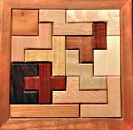
Layout optimizations
Struct fields are sorted according to decreasing alignment to reduce struct size
#[repr(C)]
pub struct Foo {
pub b: bool,
pub a: i64,
pub c: i16,
} // 24 bytes total
pub struct Foo {
pub b: bool,
pub a: i64,
pub c: i16,
} // 16 bytes total
pub fn fun(val: Foo) -> i64 {
val.a
+ (val.b as i64)
+ (val.c as i64)
}
fun:
movzx ecx, byte ptr [rdi + 10]
add rcx, qword ptr [rdi]
movsx rax, word ptr [rdi + 8]
add rax, rcx
ret
fun:
movzx ecx, byte ptr [rdi]
add rcx, qword ptr [rdi + 8]
movsx rax, word ptr [rdi + 16]
add rax, rcx
ret
https://godbolt.org/z/MxYh7bv34
https://godbolt.org/z/GMoejn7rd
Jeffrey Bary, https://www.flickr.com/photos/70118259@N00/3173642531

Slide 103
C++ status
Many static analyzers detect suboptimal field order:
-Wpadded, clang-tidy, PVS-studio, etc.
Pahole (uses debuginfo)
clang-reorder-fields – LLVM-based tool for reordering fields to minimize padding
In theory with Fat LTO compiler could reorder fields automatically
Already done in LCC compiler for Elbrus

Slide 104
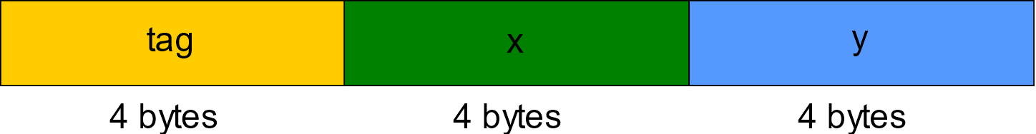
Internals of Rust enums
Rust enums are analogous to std::variant in C++
The may contain different types, identified by hidden tag field
Enum object consists of
Tag (or discriminant) – index of actual type
This type’s data
https://godbolt.org/z/n8a1x9nWr
pub enum Foo {
A {x: i32, y: i32},
B {x: i32, y: i32},
}
pub fn fun(val: Foo) -> i32 {
match val {
Foo::A {x, ..} => x,
Foo::B {y, ..} => y,
}
}
fun:
mov eax, dword ptr [rdi]
mov eax, dword ptr [rdi + 4*rax + 4]
ret

Slide 105

Niches
Some bit combinations may not correspond to any valid value of encoded type
For example
&x or NonZero<i32> may not be zero
bool (8 bits) can only be 0b0 or 0b1
Remaining 254 values are invalid
char (32 bits) may only contain values in [0x0, 0xD7FF] and [0xE000, 0x10FFFF] ranges
Such invalid value ranges (not bits!) are called niches
They may be used to keep tag of enum types (instead of using separate field)
So called Discriminant Elision
https://nowmediagroup.tv/blog/10-must-read-books-why-multidisciplinary-reading-is-a-must/

Slide 106
Examples of niches
The most common (and guaranteed by the language) example: Option<T> with T being a NonNull type (e.g. &U)
Same niche may be used for multiple tags:
size_of::<Option<Option<Option<bool>>>>() == 1
Similar optimization possible to lower bits of reference (or pointer)
Lower bits of aligned pointers are always 0
Can be used as niche
Currently only supported in nightly (-Zreference-niches, rust #3204)
None = 0x0
Option<&U> =
Some(&u) = addr_of!(u)

Slide 107
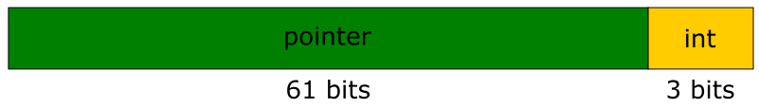
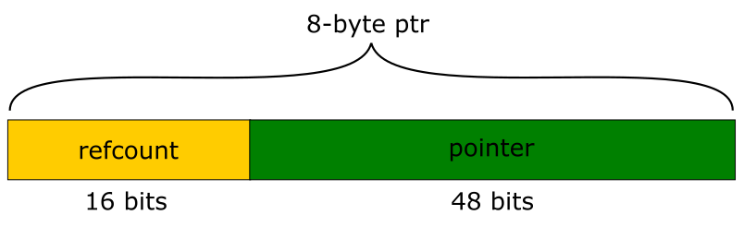
C++ status
std::optional and std::variant do not optimize for niches
Analog of std::optional with niched tags can be implemented
llvm::PointerIntPair
Uses lower pointer bits to store int value
Similar to -Zreference-niches in Rust
Lock-free implementations of atomic shared_ptr (e.g. in Folly) use free address bits for reference count
Allows for shorter and faster atomic operations

Slide 108
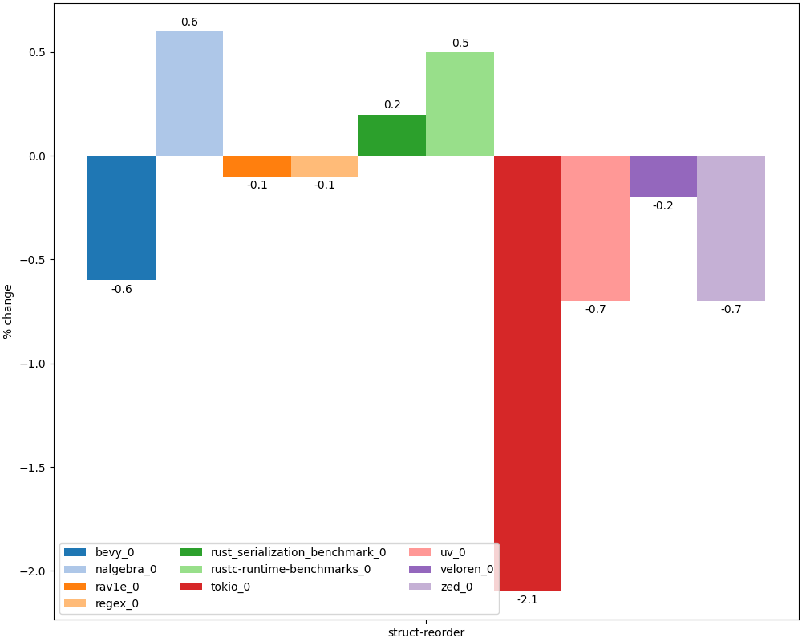
Slowdown with disabled struct reorder
Disabled shouldMergeGEPs and store merging as they were too sensitive to field order
Compiler patch

Slide 109
Conclusions
Rust does not guarantee order of fields in structs
Allows more aggressive optimizations
And care in unsafe code
Compiler may aggressively reorder fields and use them for tags
Analogous optimizations can be done manually in C++
Field reordering in itself does not significantly affect performance but can enable or disable other important optimizations
Both in compiler and in processor
With both positive and negative performance effects

Slide 110
Recommended readings
The Lost Art of Structure Packing (by ESR)

Slide 111
Arithmetic checks
Detailed analysis

Slide 112

Overview
Arithmetic overflows may cause serious system crashes
~1% CVE and 1.5% KEV in 2024
23 place in Mitre CWE Top 25 2024 (8 in 2019 rating)
Well-known incidents:
Therac-25 radiation therapy machine (1985)
Ariane 5 catastrophe (1996)
History (pre-Rust):
-ftrapv added in 2000 in GCC (patch for -ftrapv option)
Wasn’t well maintained and rotted quickly (e.g. BZ #35412 opened 2008 and still not fixed)
John Regehr’s works on IOC checker in 2010
UBsan created in 2014
State-of-the-art solution
Additional info:
Hardening: current status and trends (C++ Zero Cost 2026)
J.R. Armstrong, Famous Failures Revisited

Slide 113
Example error (OpenSSH 3.3)
nresp = packet_get_int();
if (nresp > 0) {
// Overflow to zero ...
response = xmalloc(nresp*sizeof(char*));
// ... and cause heap buffer overflow here
for (i = 0; i < nresp; i++)
response[i] = packet_get_string(NULL);
}

Slide 114
Default arithmetic checks in Rust
Some (not very important...) arithmetic checks enabled by default
Division by zero
Signed overflow on division (INT_MIN / -1)
Float-to-integer saturation
Can be disabled via -Zsaturating-float-casts=off
Integer overflows in stdlib containers
Via assert!, checked_add, etc.

Slide 115
Important missing checks
For historical reasons some important checks are missing
And can’t even be enabled via flag
E.g. overflow check on casing types via as
Need to use other APIs like try_into/ try_from
fn main() {
0x100i32 as i8;
}
use std::convert::TryFrom;
fn main() {
i8::try_from(0x100i32).unwrap();
}
$ ./test
0
$ ./test
thread 'main' panicked at test.rs:5:32:
called `Result::unwrap()` on an `Err` value: TryFromIntError(())

Slide 116
Integer overflow checks in Rust
By default integer overflows in user code are checked only in debug builds
Two’s complement semantics in release
Can be enabled in release via -C overflow-checks=on
Reason: too large overheads
“Plan is to turn on checking by default if we can get the performance hit low enough and also that it should leave room in the future to move towards universal overflow checking if it becomes feasible” (Niko Matsakis, co-lead of Rust language design team)

Slide 117
Other overheads
pub fn foo(xs: &[i32]) -> i32 {
let mut ans = 0;
for x in xs {
ans += x;
}
ans
}
Overheads for overflow checks:
Compare + predictable conditional branch (1-2 ALU slots + I$ pressure)
Hurt other optimizations (vectorizer, etc.)
The first (less important) issue could potentially be fixed with hardware support
https://godbolt.org/z/1x49jffv3
$ rustc ... test.rs
...
.LBB0_5:
// Loop successfully vectorized
movdqu xmm2, xmmword ptr [rdi + 4*rax]
paddd xmm0, xmm2
...
$ rustc ... -Coverflow-checks=on test.rs
...
.LBB0_3:
// Loop not vectorized
add eax, dword ptr [rdi + rcx]
jo .LBB0_6
add rcx, 4
cmp rsi, rcx
jne .LBB0_3
...
https://godbolt.org/z/43h1c87M5

Slide 118
Defined overflow
Unlike C/C++ integer overflows are not Undefined Behavior
Panic or Two’s complement
This deprives optimizer of some important information
Can reduce precision of some analyses (especially ScalarEvolution) and disable some optimizations in LLVM
See How undefined signed overflow enables optimizations in GCC

Slide 119
Defined overflow: Example
From Garbage In, Garbage Out (Chandler Carruth)
for (;;) {
int c1 = buf[i1];
int c2 = buf[i2];
if (c1 != c2)
return c1 - c2;
i1++;
i2++;
}
.LBB0_1:
movzx eax, byte ptr [rdx + rsi]
movzx edi, byte ptr [rdx + rcx]
inc rdx
cmp al, dil
je .LBB0_1
https://godbolt.org/z/Yssq68Gja
loop {
let c1 = unsafe {
*buf.get_unchecked(i1 as usize)
} as i32;
let c2 = unsafe {
*buf.get_unchecked(i2 as usize)
} as i32;
if c1 != c2 {
return c1 - c2;
}
i1 += 1;
i2 += 1;
}
.LBB0_2:
movsxd rdi, edi
movzx eax, byte ptr [rdx + rdi]
movsxd rsi, esi
movzx ecx, byte ptr [rdx + rsi]
inc edi
inc esi
cmp al, cl
je .LBB0_2
Compiler has to assume potential overflow
https://godbolt.org/z/c1sMcxfsP

Slide 120
Problem with inclusive ranges
Loops with included upper bound are less optimized by compiler:
for i in 1..=n {
total += i;
}
Due to potential overflow (when n==T::MAX) compiler has to perform additional check:
while i <= n {
total += i;
if i >= n {
break;
}
i += 1;
}
Developers can help compiler by converting to exclusive loop:
for i in 1..(n+1)
Or using internal iteration (.for_each, .fold, etc.)

Slide 121
Compiler optimizations
Integer overflows are not well optimized by compiler
E.g. Presburger arithmetic is decidable but its complexity is O(2^2^N)
Only ~30% of arithmetic checks are eliminated when building Rust compiler (with -Coverflow-checks=on)
Based on analysis of binary code
This is the main reason for lack of arithmetic checks in release builds

Slide 122
Workarounds
Unsafe APIs:
unchecked_add, wrapping_add, checked_add, etc.
to_int_unchecked
std::hint::unreachable_unchecked
if x <= i32::MIN >> 1 || x >= i32::MAX >> 1 {
unsafe { std::hint::unreachable_unchecked() }
}
x * 2 / 2
(checks in stdlib can not be disabled)
Special stdlib types:
NonZeroU32 to disable divide-by-zero checks
Wrapping<T> for overflows

Slide 123
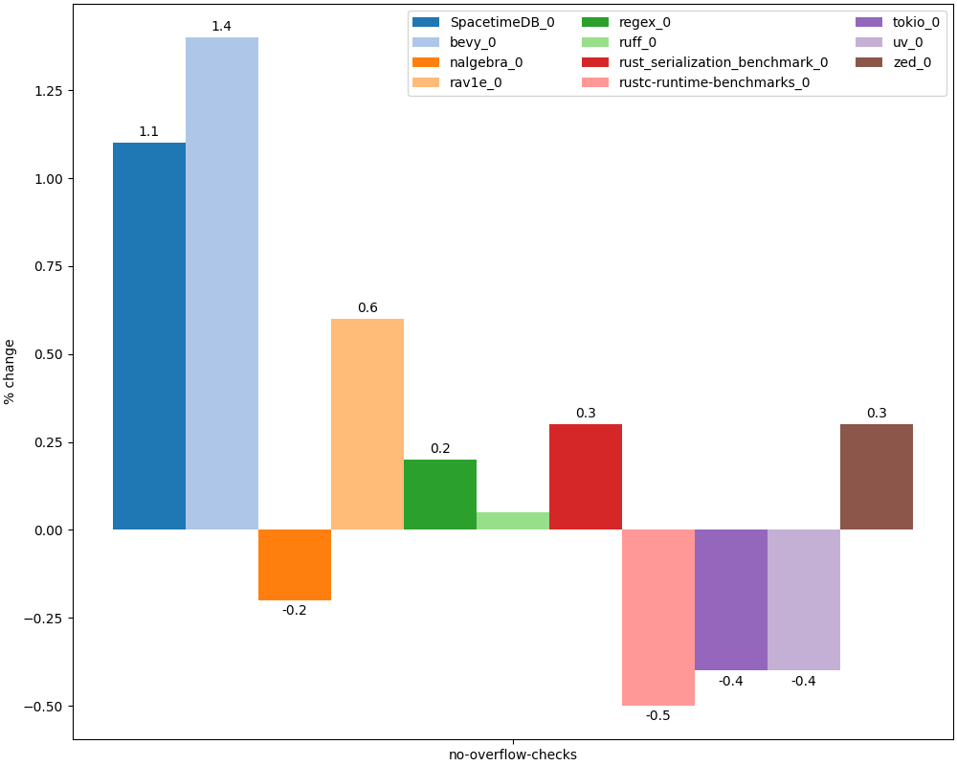
Improvements without default checks (division by zero, etc.)
Compiler branch

Slide 124
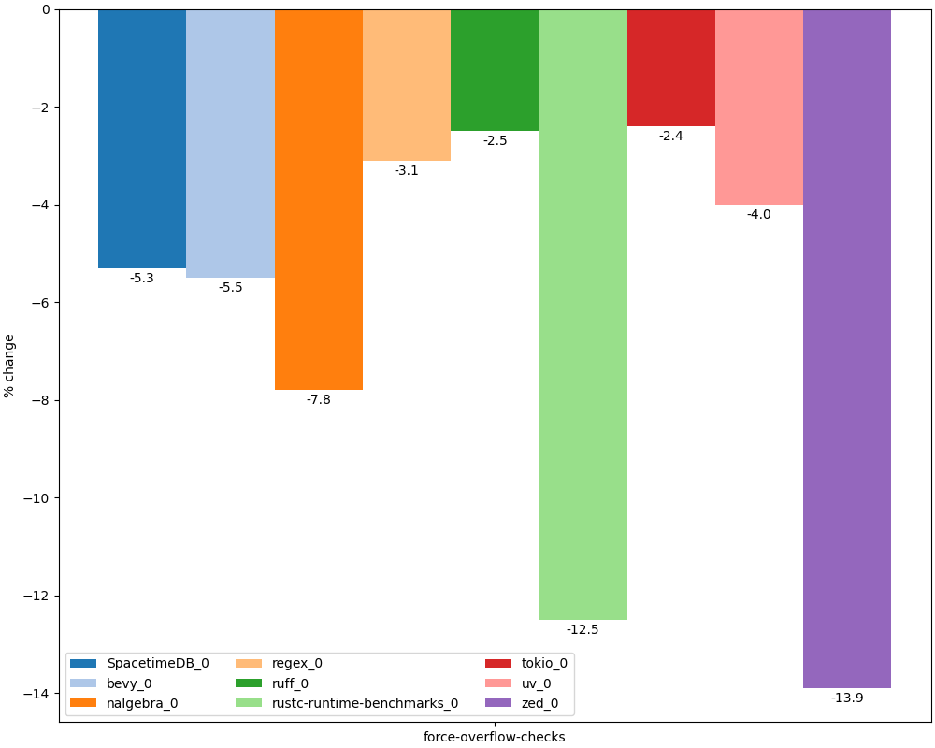
Slowdown with integer overflow checks
Some tests missing due to crashes
+30% checks in rustc
Compiler branch

Slide 125
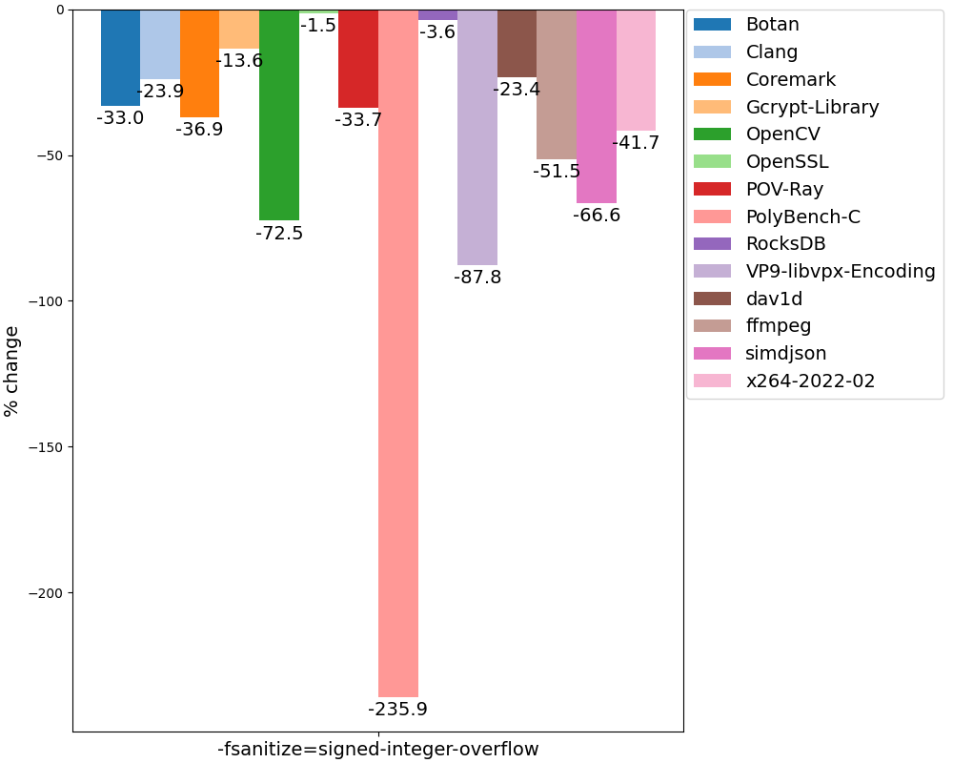
Slowdown in C++
Some tests missing due to crashes
Even larger overheads in C/C++ with UBsan

Slide 126
Conclusions
Integer overflow is not UB in Rust
Prevents compiler from performing some aggressive optimizations
Rust makes non-obvious choice about default arithmetic checks
Some really important errors like lossy casts are not checked but zero divisions are
Rare but may cause slowdown of ~1%
Integer overflow checks have very large overhead (up to 10%)
Same as UBsan
Unlikely to be enabled by default in future

Slide 127
Recommended readings
RFC 560: Integer Overflow (also discussion and overview)
Attempt to enable integer overflow checks in release
Understanding Integer Overflow in C/C++
Paper by John Regehr
How undefined signed overflow enables optimizations in GCC
Paper about performance benefits of Integer Overflow UB in C/C++
Exploiting Undefined Behavior in C/C++ Programs for Optimization: A Study on the Performance Impact
Paper about benefits of UB, including signed overflow, with benchmarks

Slide 128
Standard library
Detailed analysis

Slide 129
Overview
Rust stdlib has more mandatory checks and in some cases uses more robust (and slow) algorithms compared to STL
Cargo build system greatly simplifies experiments with alternate implementations though
On the other hand in other cases it can use faster container and algorithm implementations (compared to STL)

Slide 130
Standard library checks
Stdlib contains a lot of mandatory checks (assert!, checked_add, etc.)
Main types of checks:
Correctness of indices in containers (bounds checks, already considered above)
Size overflow checks in containers (capacity overflow)
Successful allocations in containers
Correctness of indices in UTF-8 container accesses (&str and String)
API-specific checks (comparator axioms, etc.)
Similar checks are available in STL
Under _GLIBCXX_ASSERTIONS and _LIBCPP_HARDENING_MODE (Hardened STL)

Slide 131
Example
lea r15, [4*rsi]
xor r13d, r13d
mov rax, rsi
// Check that 4*length does not overflow
shr rax, 62
jne .LBB0_11
// Check that 4*length <= isize::max
movabs rax, 9223372036854775804
cmp r15, rax
ja .LBB0_11
...
// Check that alloc is successful
call qword ptr [rip + rustc::rust_alloc]
test rax, rax
je .LBB0_11
...
pub fn foo(length: usize) -> Vec<i32> {
vec![-1; length]
}
https://godbolt.org/z/oa67f1j5z

Slide 132
Example
use std::io;
fn main() {
let mut input = String::new();
io::stdin()
.read_line(&mut input)
.unwrap();
println!("{}", input);
}
$ echo Привет | ./test
Привет
$ echo Привет | iconv -f UTF-8 -t KOI8-RU | ./test
thread 'main' panicked at test.rs:5:39:
called `Result::unwrap()` on an `Err` value:
Error { kind: InvalidData, message: "stream did not contain valid UTF-8" }

Slide 133
Other overheads
Default hashing algorithm in hashtables (SipHash) is resilient against DoS attacks bit is slower than analogs in STL
2x slowdown against fxhash in simple microbenchmark
Rust IO is unbuffered by default
Without BufReader programs may be 10x slower
io::stdout() is line-buffered for non-TTY output (rust #60673)
This may significantly slow down command-line tools (for cases like “./prog > file”)
print!/println! macros use locked access to stdout for stable output from parallel threads

Slide 134
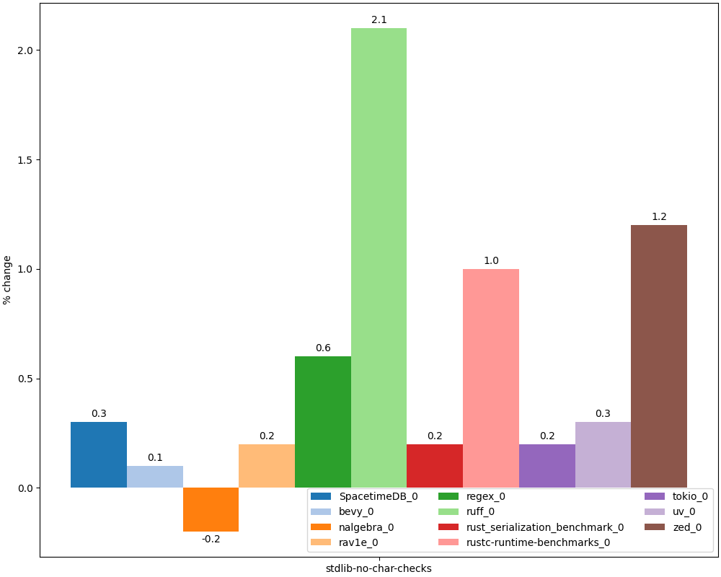
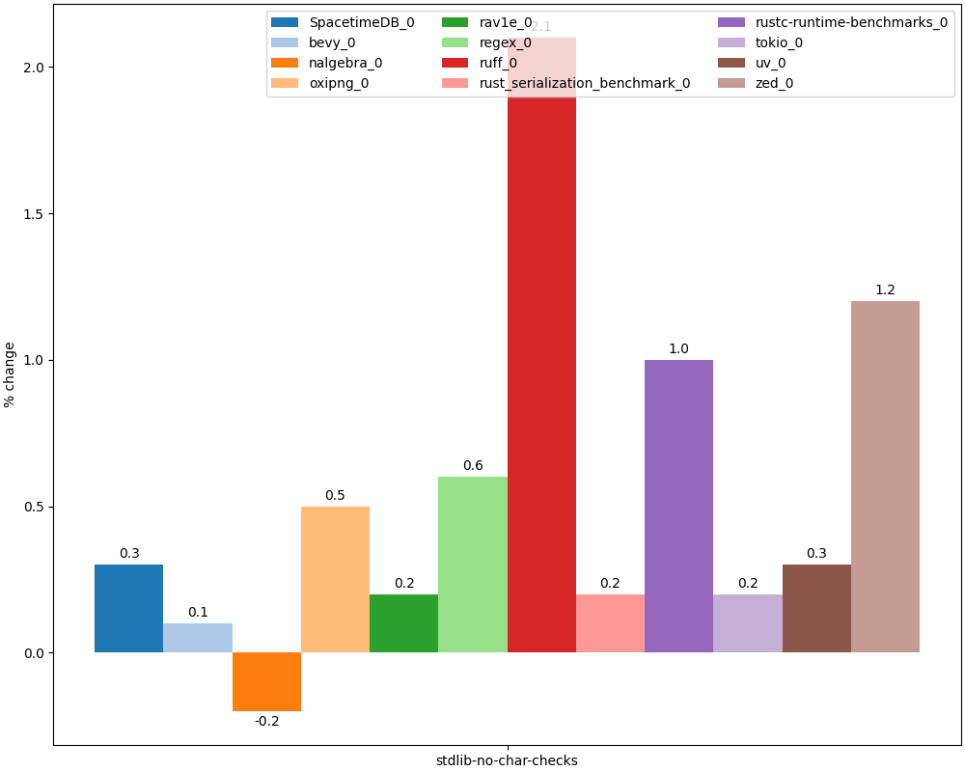
Improvements with disabled UTF-8 checks
Compiler branch

Slide 135
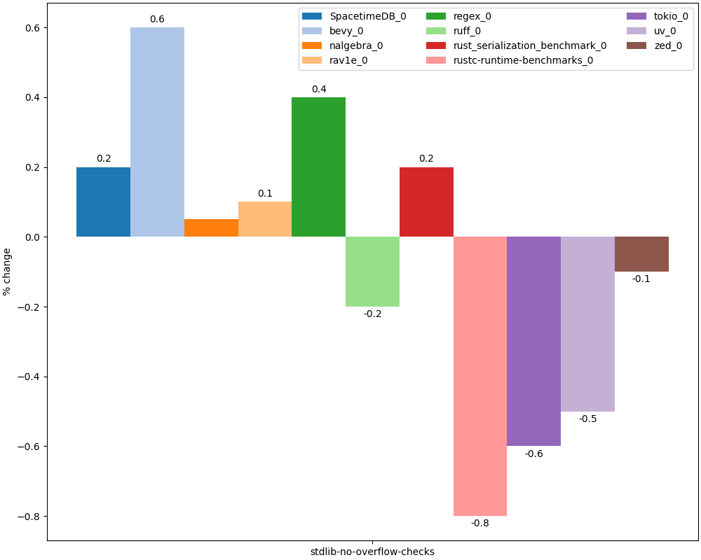
Improvements with disabled container overflow checks
Compiler branch

Slide 136
Optimizations in standard library
Hashtables:
No requirement for element reference validity after modification (as in std::unordered_map)
Allows to use open-addressing instead of chaining (fewer allocations, cache-friendly)
Search trees use B-tree (instead of RB-tree as std::map)
Fewer allocations, cache-friendly
4x speedup on simple microbenchmark
Modern ILP-friendly sorting algorithms (ipnsort, driftsort)
Modern STLs are implemented to simplify vectorization when sorting primitive types
65% speedup on simple microbenchmark

Slide 137
Conclusions
Rust stdlib includes both factors which negatively affect performance and more efficient (over STL) algorithms and containers
Stdlib issues are not critical due to
Availability of many alternative implementations
Ease of integration of external libraries in Cargo ecosystem

Slide 138
Recommended readings
Safety vs Performance. A case study of C, C++ and Rust sort implementations

Slide 139
Lack of fast-math
Detailed analysis

Slide 140
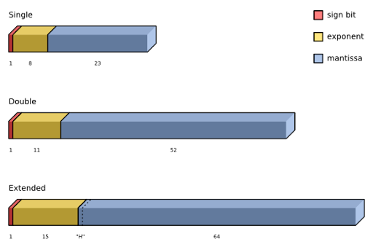
Floating point computations
IEEE 754 standard
Types and their binary representation
Operations on types
Rounding
Most architectures and languages follow the standard (mostly)
Reasons for discrepancies:
Architecture specifics
More opportunities for optimizations
Fast math – umbrella term for optimizations that are enabled under relaxed IEEE 754 rules

Slide 141
Types of fast-math flags
double foo(double val) {
return (val + 3.0) / 3.0;
}
Algebraic:
Associativity
Unsignedness of zero
Replacing division with multiplication
Fusion of operations (e.g. FMA)
Disallowing non-standard values:
NaN, Infinity
.LCPI0_0:
.quad 0x4008000000000000 # 3.0
foo:
movsd xmm1, qword ptr [rip + .LCPI0_0]
addsd xmm0, xmm1
divsd xmm0, xmm1
ret
clang-21 -O2
https://godbolt.org/z/Tqvsv4Tqs
.LCPI0_0:
.quad 0x4008000000000000 # 3.0
.LCPI0_1:
.quad 0x3fd5555555555555 # 1/3
foo:
addsd xmm0, qword ptr [rip + .LCPI0_0]
mulsd xmm0, qword ptr [rip + .LCPI0_1]
ret
clang-21 -O2 -freciprocal-math
https://godbolt.org/z/6sn7G4r4P

Slide 142
Fast math in other languages
Different languages have different approach towards IEEE 754
C Standard disallows fast-math optimizations (in Annex F)
Usually can be enabled with flags (e.g. -ffast-math)
Used e.g. in game engines
Same applies for Swift language
Java and C# allow to perform computations with higher precision than resulting type
Go allows fusion of operations
Only if there are no explicit casts
Fortran allows IEEE 754 violations to improve performance

Slide 143
Optimizations: Vectorization
#include <math.h>
float sum256(float *arr1,
float *arr2) {
float s;
int i;
s = 0.0f;
for (i = 0; i < 256; i++) {
s += arr1[i] * arr2[i];
}
return s;
}
-fassociative-math and -fno-signed-zeros allow compiler to reorder loop iterations and vectorize loop
.LBB0_1:
movups xmm1, xmmword ptr [rdi + 4*rax]
movups xmm2, xmmword ptr [rsi + 4*rax]
mulps xmm2, xmm1
addps xmm0, xmm2
# Loop vectorized
add rax, 4
cmp rax, 256
jne .LBB0_1
.LBB0_1:
movss xmm1, dword ptr [rdi + 4*rax]
mulss xmm1, dword ptr [rsi + 4*rax]
addss xmm0, xmm1
# Loop NOT vectorized
inc rax
cmp rax, 256
jne .LBB0_1
clang-21 -O2 -fno-unroll-loops
https://godbolt.org/z/v5vvEb1Th
clang-21 -O2 -fno-unroll-loops -fassociative-math -fno-signed-zeros
https://godbolt.org/z/j6P1ohcTr

Slide 144
Optimizations: Algebraic simplifications
Fast-math may allow more simplifications or compile-time evaluation
-fassociative-math + -fno-signed-zeros
-fassociative-math + -fno-signed-zeros + -freciprocal-math
double foo(double val) {
return 3.0 + val - 3.0;
}
foo:
addsd xmm0, qword ptr [rip + .LCPI0_0] # +3.0
addsd xmm0, qword ptr [rip + .LCPI0_1] # -3.0
ret
foo:
ret
clang-21 -O2
https://godbolt.org/z/hjzWejv38
clang-21 -O2 -fassociative-math -fno-signed-zeros
https://godbolt.org/z/a5GME55MM
foo:
movsd xmm1, qword ptr [rip + .LCPI0_0]
mulsd xmm0, xmm1 # * 3.0
divsd xmm0, xmm1 # / 3.0
ret
double foo(double val) {
return 3.0 * val / 3.0;
}
foo:
ret
clang-21 -O2
https://godbolt.org/z/nancn6j8x
clang-21 -O2 -fassociative-math -fno-signed-zeros -freciprocal-math
https://godbolt.org/z/dMeKc8PW9

Slide 145
Optimizations: Fused instructions
Some architectures support fusion of floating point instructions
E.g. Fused Multiply Add in x86-64
Rounding of these instructions may be different from sequence of roundings of their primitive operations
Enabled via -ffpcontract=on flag
double foo(double *val) {
double acc = 1;
for (int i = 0; i < 100; ++i) {
acc = acc * val[i] + val[i + 1];
}
return acc;
}
.LBB0_1:
mulsd xmm0, xmm1 # multiply
movsd xmm1, qword ptr [rdi + 8*rax]
addsd xmm0, xmm1 # add
inc rax
cmp rax, 101
jne .LBB0_1
ret
.LBB0_1:
vmovsd xmm2, qword ptr [rdi + 8*rax]
vfmadd213sd xmm0, xmm1, xmm2 # fused multiply-add
inc rax
vmovapd xmm1, xmm2
cmp rax, 101
jne .LBB0_1
ret
clang-21 -O2 -fno-unroll-loops
https://godbolt.org/z/qTTY4r7Yx
clang-21 -O2 -fno-unroll-loops -ffp-contract=on -march=haswell
https://godbolt.org/z/zvPTo9fz4

Slide 146
Optimizations: Finite only
-ffinite-math-only enables optimizations that rely on lack of NaN or Inf values (and corresponding runtime exceptions)
This allows to
Remove NaN and Inf checks
x == x => true
x / x => 1
With -fno-signed-zeros:
x – x => 0
0 / x => 0
x * 0 => 0
int foo(double val) {
return val == val;
}
double foo(double val) {
return val * 0;
}
foo:
ucomisd xmm0, xmm0
setnp al
ret
foo:
xorpd xmm1, xmm1
mulsd xmm0, xmm1
ret
clang-21 -O2
https://godbolt.org/z/v5YEq7hbY
clang-21 -O2
https://godbolt.org/z/3e8sM1dh9
foo:
mov al, 1
ret
foo:
xorps xmm0, xmm0
ret
clang-21 -O2 -ffinite-math-only
https://godbolt.org/z/TYab9sndr
clang-21 -O2 -ffinite-math-only -fno-signed-zeros
https://godbolt.org/z/zoWrsfr1h

Slide 147
Optimizations: Errno
-fno-math-errno flag allows compiler to ignore errno global variable effects in math functions
In particular this enables better inlining and simplification of library functions
In Rust standard math operations are compiled to LLVM intrinsics which do not set errno
#include <math.h>
double foo(double x) {
return sqrt(x);
}
foo:
xorpd xmm1, xmm1
ucomisd xmm0, xmm1
jb sqrt@PLT
sqrtsd xmm0, xmm0
ret
foo:
sqrtsd xmm0, xmm0
ret
clang-21 -O2
clang-21 -O2 -fno-math-errno
pub fn foo(num: f64) -> f64 {
num.sqrt()
}
foo:
sqrtsd xmm0, xmm0
ret

Slide 148
Issues with fast-math: Checks
Usage of Inf or NaN with -ffinite-math-only is UB
Explicit checks for such values will be removed by compiler
#include <math.h>
int foo(float f) {
return isnan(f);
}
foo:
xor eax, eax
ucomiss xmm0, xmm0
setp al
ret
foo:
xor eax, eax
ret
clang-21 -O2
https://godbolt.org/z/MPPoc5oea
clang-21 -O2 -ffinite-math-only
https://godbolt.org/z/nv33ffaqx

Slide 149
Issues with fast-math: Rounding
Some algorithms use special order of computations to reduce rounding error
With -fassociative-math compiler may ignore this order and “optimize” these algorithms as if there is no rounding
E.g. Kahan algorithm
sum_kahan:
xorps xmm0, xmm0
xor eax, eax
.LBB0_1:
addss xmm0, dword ptr [rdi + 4*rax]
inc rax
cmp rax, 256
jne .LBB0_1
ret
float sum_kahan(float *arr) {
float s, c, t, y;
int i;
s = c = 0.0f;
for (i = 0; i < 256; i++) {
y = arr[i] - c;
t = s + y;
c = (t - s) - y;
s = t;
}
return s;
}
float sum(float *arr) {
float s;
int i;
s = 0.0f;
for (i = 0; i < 256; i++) {
s = s + arr[i];
}
return s;
}
clang-21 -O2 -ffast-math -fno-unroll-loops -fno-vectorize
https://godbolt.org/z/rYebWsfco

Slide 150
Rust approach
Developers of Rust rejected to enable opportunities for global fast-math optimizations
Due to potentially unsafe usage of these optimizations by users (especially in project dependencies)
“Everything about this flag fundamentally clashes with the idea of robust, compositional system design. It was a terrible mistake to ever add it to C compilers, and Rust should not repeat that mistake. Rust should instead explore alternative, less fragile ways of exposing those semantics.” (Ralf Jung, rust #21690)

Slide 151
Workarounds: Intrinsics
Rust provides dedicated intrinsics for enabling fast-math optimizations locally
std::intrinsics::f{op}_fast
std::intrinsics::f{op}_algebraic
f(16/32/64)::algebraic_{op}
Disadvantages:
Currently require nightly (unstable) compiler build
Currently there are no wrapper types which hide usage of intrinsics
Authors of math libraries have to implement two versions of code (fast-math and normal)

Slide 152
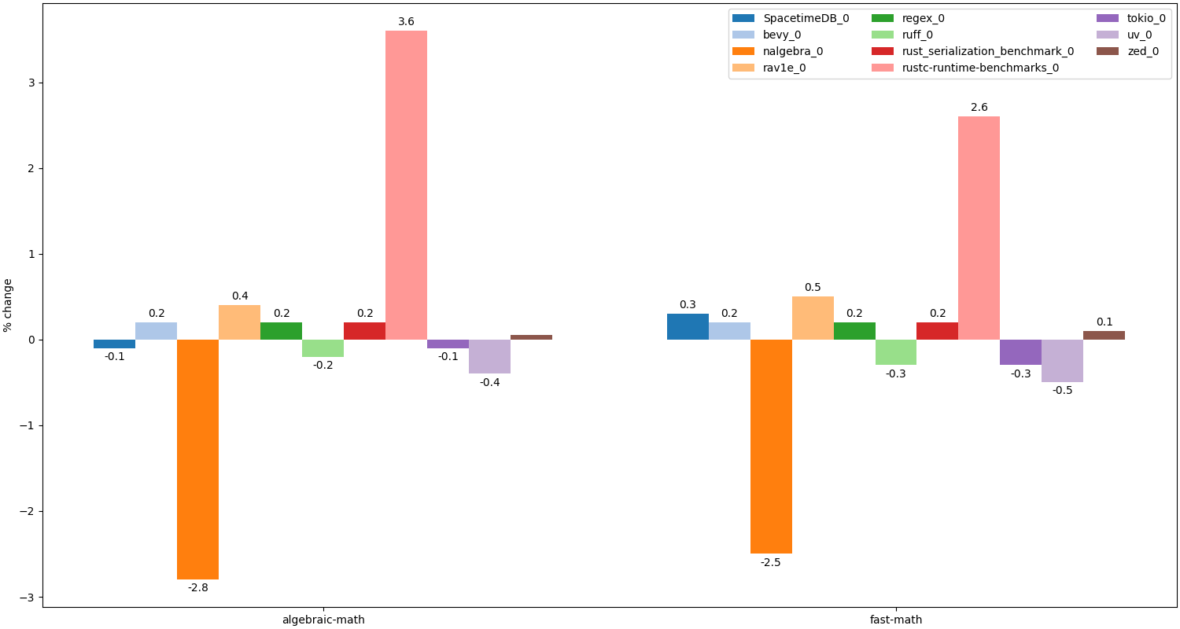
Performance with fast-math
Issues in autovectorizer
Compiler branch
Compiler branch

Slide 153
Conclusions
Rust does not provide a way to enable fast-math optimizations globally
Can be enabled for particular operations via intrinsics
Currently only in nightly toolchain
Fast-math may both improve and degrade performance

Slide 154
Recommended readings
Optimizations enabled by -ffast-math (Krister Walfridsson, GCC)
Towards Useful Fast-Math (LLVM Dev Meeting 2024)
Beware of fast-math
P3715R0: Tightening floating-point semantics for C++
Taming Floating-Point Sums

Slide 155
Conclusions

Slide 156
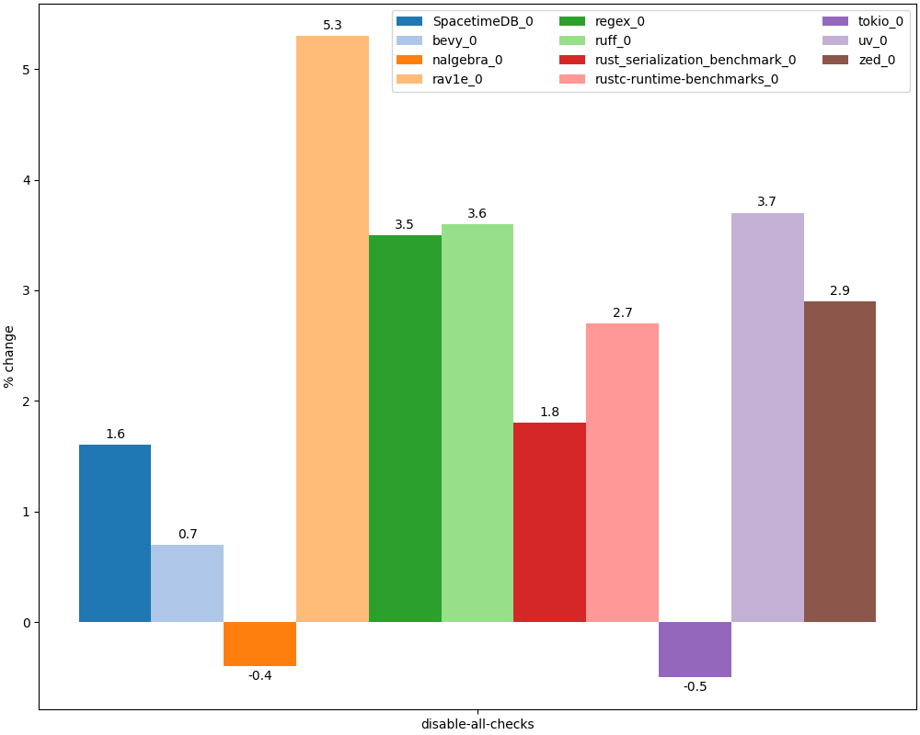
Speedup with disabling (most) Rust checks
Disabled bounds and arithmetic checks, overflow checks in stdlib containers, UTF-8 string checks
Not counting overheads for redundant initializations (expecting >= 1%)
Compiler branch

Slide 157
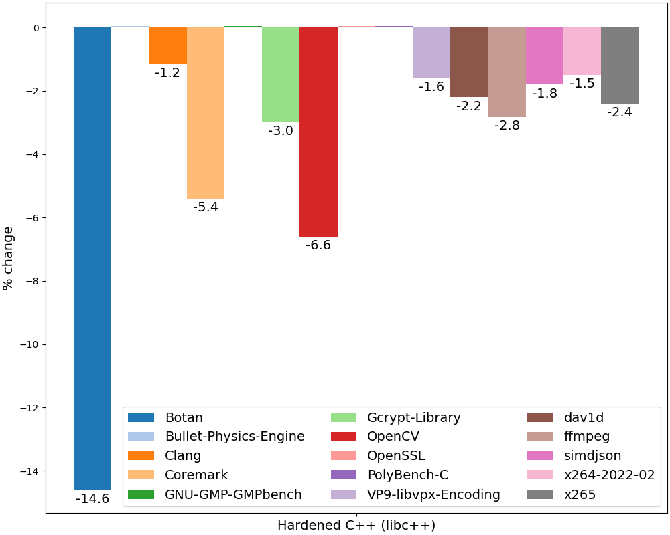
Slowdown in Hardened C++
Enabled hardening:
-D_FORTIFY_SOURCE=3
-fsanitize=bounds,object-size
Hardened STL
(initialization not enabled to match Rust)
Unlike Rust majority of benchmarks have not been tuned for Hardened C++ case
Compiler branch

Slide 158
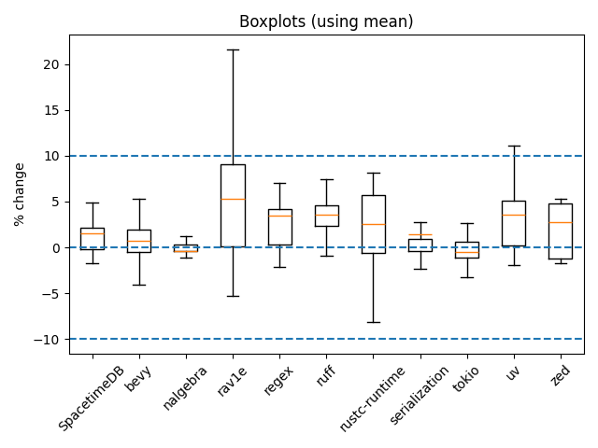
Distribution of overheads in benchmarks
Distribution of all benches in each project
Similar tests with different parameters were averaged
Data is biased:
Scenarios which are covered by many benches dominate
Expecting at least +1% mean due to forced initialization
Plotting script

Slide 159
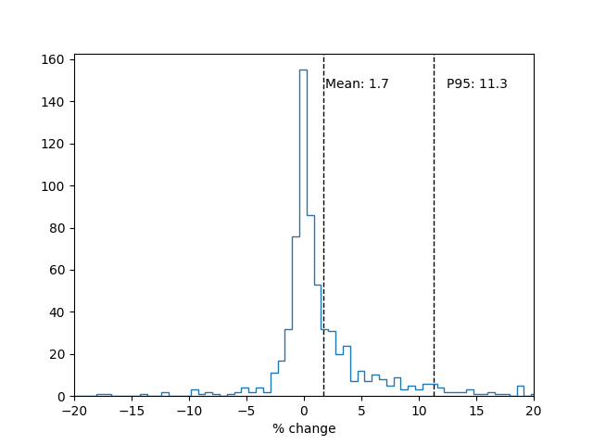
Distribution of overheads in benchmarks
This graph is a pure illustration and does not prove anything!
Distribution of all benches in all projects
Similar tests with different parameters were averaged
Data is biased:
Projects with larger numbers of benches dominate
Scenarios which are covered by many benches dominate
Expecting at least +1% mean due to forced initialization
Plotting script

Slide 160
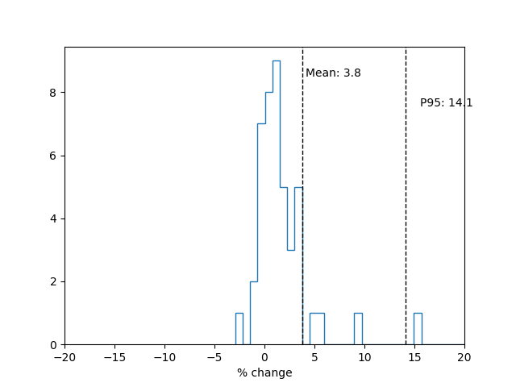
Distribution of overheads in Hardened C++ benchmarks
This graph is a pure illustration and does not prove anything!
Much fewer benchmarks than for Rust
Unlike Rust majority of benchmarks have not been tuned for Hardened C++ case
Plotting script

Slide 161

Conclusions
Rust community keeps balance between safety and performance:
Main focus is on memory safety guarantees
Other checks are enabled if they do not hurt performance
For example integer overflow errors are disabled by default
Overhead of runtimes checks depends on the project
Usually under 5% on average (P95 11%) and comparable to Hardened C++
Language features which affect performance the most:
Bounds checks, mandatory initialization, lack of inplace initialization
These checks will most likely be further optimized in future versions of Rust and LLVM
But their negative effects will never be completely avoided (at least in current language version)
So they will always require workarounds (e.g. unsafe code) to reach optimal performance
3dman_eu, https://www.needpix.com/photo/1171460/weigh-plus-minus-horizontal-plus-minus-balance-sheet-cost-calculation-course

Slide 162

What we didn’t talk about ...
Codegen units
Similar to unity builds in C/C++
Implementation of panics (exceptions)
Similar to C++ exceptions
GC-sections by default
ABI features
Disabled PLT
Implementation of virtual methods
Stack Clashing checks
https://vectorportal.com/vector/timeglass/34811

Slide 163

The End
Many thanks to our kind reviewers:
Vadim Petrochenkov
https://github.com/petrochenkov
Alexander Chichigin
https://github.com/Gabriel-Fallen
Jakub Beránek
https://github.com/kobzol
Alexander Monakov
https://github.com/amonakov
https://codeberg.org/amonakov
Per Vognsen
https://mastodon.social/@pervognsen
Latest version of this presentation: https://github.com/yugr/rust-slides/blob/main/EN.pdf

Slide 164
Appendix

Slide 165
Preparation of this talk
We collected and analyzed over 350 papers, blogposts and discussions about the topic (see materials)
Overall time spent on preparation (Apr 2026):
> 3 man-months
Analysis was conducted for
Rust 1.87.0 (May 2025)
Clang llvmorg-20.1.7 (June 2025)

Slide 166
Rust benchmarks
Used standard Criterion benchmarks in each project (cargo bench), averaged with geomean
Some especially slow tests in oxipng were disabled
To counteract system noise we took minimum of average from several runs
Note that 1% geomean may mean that
All tests in project slowed down by 1%
10% of tests slowed down by 10% (more likely)
Some tests could slow down (or speedup) by more than 10%
Geomeans are not ideal
Biased by scenarios with more benches
Further details here

Slide 167
C++ benchmarks
Used Clang llvmorg-20.1.7
Llvm-bench (benchmarks/cpp/llvm-bench)
Measured median time of -O2 compilation of CGBuiltin.cpp (the largest and slowest-to-compile file in LLVM) with Clang
Tested Clang was built with itself
Ffmpeg-bench (benchmarks/cpp/ffmpeg-bench)
Based on Stack Smashing Protection and Its Performance Impact
Measured median time to convert FLV to MP4
Phoronix Test Suite (benchmarks/cpp/PTS)
Popular benchmark suite from phoronix-test-suite.com
Measured botan, bullet, coremark, c-ray, dav1d, gcrypt, gmpbench, luajit, nginx, opencv, openssl, polybench-c, povray, rocksdb, simdjson, vpxenc, x265 (see #55)
Used median time of benchmark
Ignored tests with Stdev > 0.5% or changes < 1%
To counteract system noise we took minimum of average from several runs

Slide 168
Hardware
All benchmarks (except no-static) were run on Intel Xeon E-2236
With fixed 2 GHz frequency
With Ubuntu 24.04 OS
Servers have been set up according to uInit methodology

Slide 169
TODO
(Yugr) Benchmark meilisearch
(Zak) Fast-math: update analysis (P3715, -fno-math-errno and -fno-trapping-math)
(Zak) Struct reorder: fill analysis

