Slide 1
DSP processors Overview of architecture and SDKs

Slide 2
Disclaimer
Presentation focuses on DSP compilers, not architectures (but …)
All information is publicly available
All opinions are my own, not of my employer

Slide 3
Plan of the talk
Why DSPs exist
History of DSPs
Target applications and how they shape DSPs
Traditional and modern DSP architectures
DSP ecosystem
DSP tools
Compilers as critical part of DSP products
How DSP compilers are special (or not)
Wrap-up

Slide 4
What is a DSP
Digital Signal Processors
Appeared in 1970-s
First computational accelerators
Built to compete with analog ASIC signal processors (“programmable Signal Processors”)
Pros: reprogrammable => lower cost, reduced TTM, field updates in case of bugs, changes in standards, etc.
Notoriously hard to program
ASIC – Application Specific Integrated Circuit
TTM – time-to-market

Slide 5
DSP vs general-purpose processors (GPPU)
 | GPPU | DSP
Frequency | 2-3 GHz | ~500 MHz
Power consumption | Very high (~100 W) | Very low (~1 W)
Out-of-order | Yes | No
Price | $1000+ | ~$50
Target applications | General-purpose | Loop-intensive, data-parallel, highly regular
Over 100x Perf/W/$ improvement
Drinking from the Firehose: How the Mill CPU Decodes 30+ Instructions per Cycle

Slide 6
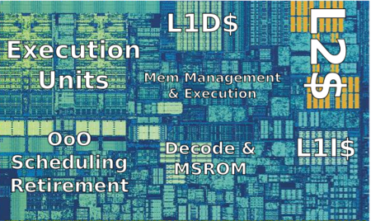
GPPU control overhead
“While a simple arithmetic operation requires around 0.5–20 pJ, modern cores spend about 2000 pJ to schedule it.” [2]
+TLB
[1] https://en.wikichip.org/wiki/intel/microarchitectures/skylake_(client) [2] The Rise and Fall of Dark Silicon
[3] Understanding sources of inefficiency in general-purpose chips

Slide 7
DSP: applications (1)
Real-time embedded systems
Need predictable performance
Power consumption is very important
Single program (size of developed code is smaller)
Consists of few functions which implement of some standard (or performance-critical parts of it)
Each function is a bunch of loops
Data processing is one of the main functions
Number crunching loops over linear arrays
Data-parallel or reductions (convolutions, stencils)
IIR/FIR, dot products, Fourier transforms, etc.
Most common operations: additions and multiplications (MACs)
Unlimited ILP

Slide 8
DSP: applications (2)
Predictable data ranges
Fixed point arithmetic
Saturation on overflow (instead of wrap-around)
Economy of scale
Consequence of embeddedness
Same program runs on millions of devices
Program optimization has very high ROI
Compile time or developer convenience is a lesser issue
Binary compatibility not an issue (source/assembler compatibility often is!)

Slide 9
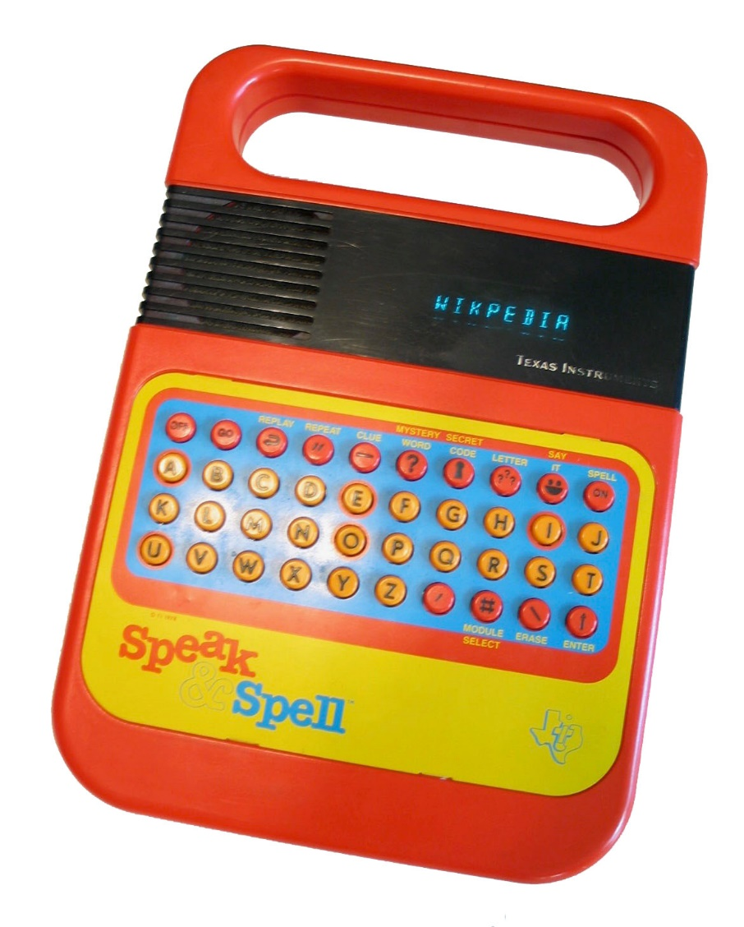
DSP success story: Speak&Spell
Toy speech synthesizer
Appeared in 1978
Based on dedicated TI DSP
Used Linear Predictive Coding for synthesis which allowed dramatic reduction of required ROM
Human vocal tract modelled as series of linear filters
Speech is a sequence of phonemes
Each phonem is determined by filter coefficients and excitation signal
Audio processing still one of the main DSP markets (sound cards, codecs, etc.)
By FozzTexx at English Wikipedia

Slide 10
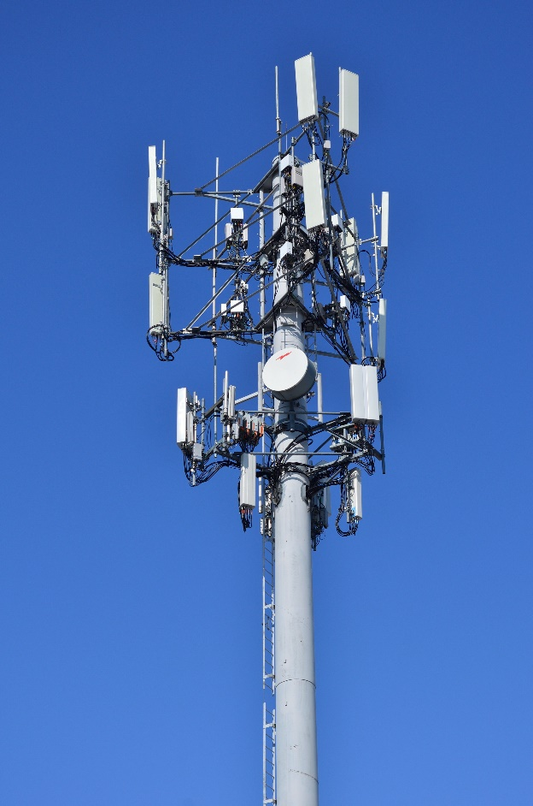
DSP success story: GSM
First widely used digital mobile standard
First deployed in 1991
Originally planned to use ASICs but switched to DSPs as protocol complexity increased
Example chip – TMS320C50
Communications is one of the main DSP markets to date (modems, mobile base stations, etc.)
By Raysonho @ Open Grid Scheduler / Scalable Grid Engine
DSPs in Mobile Communications

Slide 11

DSP success story: image processors
Appeared in early 2000-s in digital cameras
Various postprocessing (real-time denoising, sharpening, etc.) and encoding functions
Example chip – TMS320C50
Image/video processing and computer vision is one of the main DSP markets (cameras, surveillance systems in drones and automotive, etc.)
By Dave Dugdale from Superior, USA
5 Things Made Possible with DIGIC Image Processor

Slide 12
Gene’s law
Named after Gene Frantz from TI
Gene’s law:
Power dissipation of DSP cores halves every 1.5 years
Or alternatively Koomey’s law:
GFLOPS/W doubles every 1.5 years
Consequence of Moore’s law ...
Number of transistors doubles every 1.5 years
... and Dennard scaling:
Power density of chip remains constant as transistors get smaller
Allowed DSPs to cover more computationally-intensive markets over years while still staying into 1W power limit
From sound synthesizers to video, AI, SDR
No longer working :(

Slide 13
DSP: architecture
“Architecture of DSP is molded by algorithms“:
Unlimited ILP (in loops)
High-school math computations (complex math, convolutions, Fourier series, etc.)
No need for binary compatibility
Two key features:
Simplify control unit to reduce power
Exploit ILP to improve performance

Slide 14
DSP: Power reduction
Simple control
In-order
No HW interlocks (i.e. no HW hazard detection)
“Exposed pipeline”: compiler explicitly marks parallel instructions and inserts nops as needed
Non-orthogonal ISA
Different opcodes support different register subsets
Lack of caches:
Explicit tightly-coupled (AKA local, AKA scratchpad) memory instead of cache
Access to external memory stalls the core (organizing efficient data upload to local memory is a important part of DSP program)
Delay slots, branch hints, zero-overhead loops instead of BTB

Slide 15
DSP: ILP increase
Explicitly parallel instructions
SIMD (vector operations)
Complex instructions
Heavy math: MACs, sqrt/isqrt, complex numbers, histograms, etc.
Post-shifter (important for fixed-point multiply)
Rich addressing modes (strided pre/post-modifications, cyclic/bit-reversed addressing)
Domain-specific instructions (e.g. Hexagon has IP checksum, H.264 decode)
Extensible ISAs (Tensilica, CEVA)
Multi-banked memory (through multiple parallel loads/stores)
Reduce branch overheads
Full predication
Delay slots
Zero-overhead loops
Fixed-function units for computationally-intensive algorithms (Viterbi, CDNN, FFT, QR)
Offload periodic data transfers from core via complex DMA blocks

Slide 16
DSP classification
Ultra low-power
Example: TI C28x
uC with a single-cycle MAC
50 MHz
Lots of peripherals
Standby mode(s)
Low-end (“traditional”)
Example: TI C55x
No VLIW (or limited 2-way) or SIMD
0.1 GHz, 0.1 W
Standby mode(s)
Less compiler friendly
High-end (“modern”)
Example: TI C64x
Aggressive VLIW (5-8 way) and SIMD
0.5-1 GHz, 0.5-5 W
Compiler-only

Slide 17
Low-end (“traditional”) DSPs
Killer features:
Single-cycle MAC
HW loops (“zero-overhead loops”)
Address postmodification
Multiple loads per cycle (multiple memory banks)
Execute filtering step in 1 cycle:
// This loop ...
for (i = 0; i < N; ++i)
y += h[i] * x[i];
// ... compiles to a single complex instruction:
RPT AR5 || MAC R7, R3, *XAR6++, *XAR7++

Slide 18
High-end (“modern”) DSPs
Revolutionary change in 5-th DSP generation (ca. 2000)
Caused by:
Integration level advances (Moore’s law)
New markets
Increased complexity and size of DSP applications (over 10 KLOC assembly)
TTM constraints
Transition to compiler-friendly VLIW and/or SIMD architectures
Also major compiler improvements in compiler theory (thanks to Itanium’s Open64 compiler)
Loop from previous slide:
loop:
BR delay1 .CU loop || LD .LS0 (A0)+, R0 || LD .LS1 (A1)+, R1
MAC R0, R1, R2

Slide 19
VLIW in DSPs (1)
Very Long Instruction Word architectures (parallel instructions are explicitly marked by compiler/developer in code)
Traditional VLIW disadvantages which plagued Itanium/Transmeta are not (or less) critical for DSP
Lack of static ILP in typical apps: unlimited ILP in typical DSP program
Stalling on cache misses: regular data structures, scratchpad memory, users (or vendor) willing to rewrite/annotate apps to squeeze performance
Do not need “heroic compilers” anymore
Compiler technology has advanced a lot
Several open-source solutions are available
No need for binary compatibility and legacy ISA support
Apps are always rebuilt (and often rewritten) for new devices
Imprecise static branch prediction: users are fine with providing profile data
To a lesser extent same arguments apply to GPU accelerators
Nvidia GeForce FX and now, pre-2011 AMD, Mali use VLIW architectures

Slide 20
VLIW in DSPs (2)
Statically scheduled AKA exposed pipeline: in-order, no register renaming, stall on cache miss
Exposed uarch (instruction latencies, delay slots)
Homogeneous registers
Most ISA is RISC
Complex and CISC instructions to save space
HW loops
Multi-banked memory
Combined with SIMD (and uSIMD)
Very hard to debug
Single-stepping not available

Slide 21
VLIW vs SIMD (ILP vs DLP)
Modern VLIWs are typically combined with SIMD
Allow to express more parallelism than pure in-order SIMD:
for(i = 0; i < N; ++i) {
z[i] = a*x[i] + b*y[i];
}
// VLIW saves 2 cycles due to parallelism
vload (x)+, vx || vload (y)+, vy
vmuls ra, vx, vx || vmuls ra, vy, vy
vadd vx, vy, vz
vstore vz, (z)+

Slide 22
DSP: ecosystem
DSP integration:
Discrete (TI, Qualcomm)
IP (Cadence/Tensilica, CEVA)
Important peripherals:
Often paired with uC e.g. ARM in TI OMAP, RISCV in CEVA Wifi SoCs (system split to control and data “planes”)
Include sophisticated DMA for efficient data supply
Often combined with domain-specific accelerators (e.g. NN, Viterbi, multimedia codecs)
Algorithms originally developed and investigated in MATLAB/Simulink (using floating point)

Slide 23
DSP: benchmarks
Operation-level (microbenchmarks)
GMACs (critical for marketing)
Sqrts/sec.
Various data sizes (32x32, 16x16, etc.)
Kernel-level
Most typical DSP loops
FIR/IIR, FFT, DCT, Viterby, GEMM
BDTImark2000 family (also dedicated benchmarks for video and communications)
EEMBC (former EDN) Telebench
Full applications
Standard embedded benchmarks (mainly EEMBC Coremark)

Slide 24
DSP: tools
Tools are special as well
Standard components: assemblers, optimizing linkers, profilers, various types of simulators (cycle-accurate, functional), compilers
Special components: power profilers, linear/optimizing assemblers, boilerplate code generators (RPC calls, etc.), host intrinsic libraries, autotuners, etc.
This talk focuses on compilers
(Relatively) simple programs
Small size
May reliably estimate performance at compile-time
More (much more) resources allocated for optimization:
Spend much more time on tuning (mainly loops)
Allow more complex flows (feedback-driven compilation, analyse optimization remarks from compiler)
Kernels (re)written with compiler intrinsics (or even assembler), pragmas and restrict/noalias annotations
Allow longer compile times for LTO or parameter sweep
Need more control over tools behaviour
Normally less attention to “fancy” technologies like autovec
No binary compatibility expected
No ISA compatibility for higher-end DSPs (all code in high-level languages)
Retargetable Estimation Scheme for DSP Architecture Selection

Slide 25
DSP compilers: overview
Extremely important for performance and overall product success
Also for experimenting with architecture decisions at design time
10x performance difference of -O3/-O0 is not unusual (vs typical 2-3x on desktops)
Manual assembly programming not possible
Mainly based on open-source offerings:
Open64 – open-sourced Itanium compiler (dead, used by Tensilica/Cadence and others)
GCC (used by TI and old Hexagons)
LLVM (new CEVA and Hexagon cores)
Multilevel intermediate representations (IR): AST, SSA, RTL
Compared to GPPUs, much more work has to be done at RTL-level
Need much more precise modelling of architecture (pipeline, resource conflicts, instruction sizes, etc.)
Flaw in model will cause invalid code generation
Main goal is to extract maximum ILP from user’s code
Hide data dependencies via SW register renaming, loop unrolling and SW pipelining
Hide control dependencies via delay slots, predication and speculation
Break memory dependencies through special aliasing rules
Most companies have moved (or are moving) to LLVM
Corporate-friendly license
Reduce frontend development costs
OpenCL and Halide support

Slide 26
Compiler intrinsics
Special functionality exposed to user as functions:
int32x4_t acc;
int *p, coeff;
for (i = 0; i < N; I += 4) {
int32x4_t x = vload(&p[i]);
acc = vmac(acc, coeff, x);
}
Provide access to most of ISA (at least vector ISA)
Easier to write than inline (or outline) assembly due to automatic register allocation, scheduling and packetizing
Assembler is still widely used, to the point that TI and QC ship optimizing assemblers in their toolchains
Often also provides better performance (due to compiler optimizations like SWP or CSE over intrinsics)
Most natural way for exploiting dedicated instructions
Allows for (limited) source-level compatibility with old cores
Disadvantage: vendor lock-in

Slide 27
Compiler pragmas
TI compiler pragmas (same for other vendors)
#pragma MUST_ITERATE(min, max, multiple)
#pragma FUNC_NO_GLOBAL_ASG(func)
#pragma FUNC_NO_IND_ASG(func)
_nassert(assume_this_condition_is_true);
Etc.

Slide 28
Language extensions: stricter aliasing
Relieve users from manually annotating pointers with “restrict”s
Example: TI’s --no-bad-aliases
Non-standard (stricter) aliasing rules
Pointers do not alias globals
Functions do not cache pointer arguments
Distinct source-level pointer variables can not alias
TI Compiler UG: Indicating Whether Certain Aliasing Techniques Are Used

Slide 29
Compiler optimizations: software pipelining
A critical VLIW optimization
Depends on other transformations to linearize loop bodies (unroll, inlining, data speculation, if-conversion, IV rename)
Coupled with loop unrolling
Compare two loops:
tmp2 = b[0] * 3;
tmp1 = b[1];
for (i = 0; i < N - 2; ++i) {
a[i] = tmp2
tmp2 = tmp1 * 3;
tmp1 = b[i + 2]
}
a[N - 2] = tmp2;
a[N - 1] = tmp1 * 3;
for (i = 0; i < N; ++i)
a[i] = b[i] * 3;

Slide 30
Compiler optimizations: speculation
Boosts ILP at the cost of code size
Depends on good frequency estimation
x = *p;
nop;
y = x + t;
if (cond)
z = y * 3;
x = *p;
if (cond) {
y = x + t;
z = y * 3;
} else {
// Compensation code
y = x + t;
}

Slide 31
Compiler optimizations: if-conversion
Removes complex control flow at the cost of higher power consumption
Depends on good frequency estimation
for (i = ...) {
if (p[i])
x[i] = a * y;
else
x[i] = b * z;
}
for (i = ...) {
tmp1 = a * y;
tmp2 = b * z;
x[i] = p[i] ? tmp1 : tmp2;
}

Slide 32
Compiler optimizations: IV renaming
Removes false dependencies on address increments at the cost of higher register pressure
for (i = ...) {
z[i] = a * x[i]
++i;
z[i] = a * x[i];
++i;
}
for (i1, i2 = ...) {
z[i1] = a * x[i1]
++i1;
z[i2] = a * x[i2];
++i2;
}

Slide 33
Compiler optimizations: optimization remarks
All important optimization phases can produce compiler dumps with information on why optimization failed
Information integrated to generated assembly code and IDE
Optimization hints with suggestions for code optimization (adding pragmas, potentially redundant dependencies, etc.)
No autofixes in production yet

Slide 34
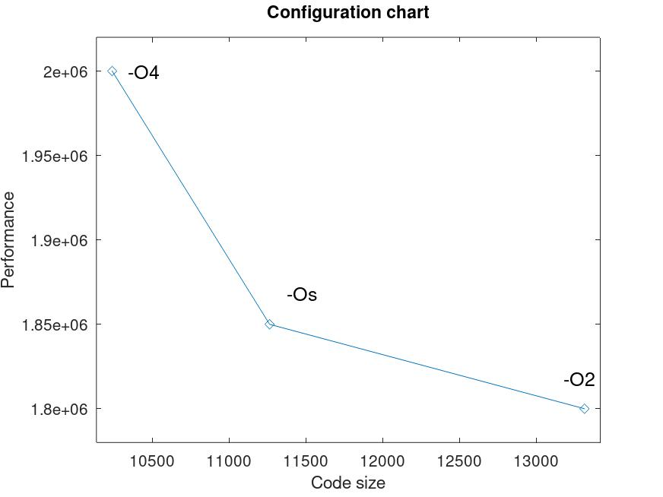
Compiler optimizations: parameter sweep (“autotuning”)
DSP applications are typically smaller than general purpose ones
Users are fine with trading compile time for better performance
Break hard compilation problems with brute-force
State-space exploration of compiler parameters
Trying different unroll/SWP factors, tile/vector sizes, etc.
Static estimation of generated assembly
Can be done in
Compiler
IDE
External tool ( “auto-tuner”)
Autotuning in HPC Applications

Slide 35
Example DSP compiler: Open64
Based on SGI MIPSpro compiler for MIPS, later ported to Itanium
Later open-sourced and adopted by various VLIW shops (Nvidia, Tensilica, etc.)
Used by Pathscale in their highly-optimizing HPC compiler
Uses GCC C/C++ frontend (=> stuck in GCC 4.2 C++98 times due to GPLv3)
Split to multiple phases (with dedicated executable per phase):
Frontend
Inliner
SSA optimizer
Backend
Highly-influential at it’s time (some decisions adopted by GCC/LLVM):
Dedicated IRs for front, middle and back-ends
Multi-level middle-end IR (from very high-level to machine-oriented)
Memory SSA
SSA-based partial redundancy elimination and induction variable optimization
Register allocation via prioritized coloring
Development of an Efficient DSP Compiler Based on Open64

Slide 36
Example DSP compiler: LLVM Hexagon
One of the largest non-mainstream backends in LLVM
Largest intrinsics definition file
Custom scheduler and VLIW packetizer
LLVM VLIW representation added specifically for Hexagon
Very strict and precise scheduling rules (due to exposed pipeline)
Non-data hazards represented via DAG mutations
A lot of new generic data structures and optimization passes in MIR:
SSA bit tracker
Bit-level symbolic evaluator
Post-SSA reaching definitions
Generic MIR constant propagation/algebraic simplification
SSA if-converter (default converter is post-RA)
Predicator
Address mode optimizer
Mask operations generator
Load/store widener
Most of above in lib/Target/Hexagon
Plans to merge to lib/Codegen for general use (maybe, some day...)
Stock LLVM does not provide enough support for MIR optimization
Most work is done on LLVM IR
K. Parzyszek. Register Data Flow Framework

Slide 37
DSP: past trends
Increase performance/power (GMACS/W)
Gene’s law: GMACS/W doubles every 18 months
Vector length increase
Less arch innovation (main arch features available for decades)
Improve productivity/usability
Higher-level languages (assembler to C and now C++)
Autovectorization
Optimization assistants
Floating-point support
Using IDE for automation of complex tasks (profile-guided optimization, etc.)
Simplify integration with customer’s accelerators
Specialization
Different chips (ISAs) for different markets (see CEVA product lines or Tensilica Customizable Processors)
Custom built-in accelerators
GMACS = MACs/second

Slide 38
DSP: current/future trends
Increased arch and compiler innovation due to expiration of Moore/Gene’s law
Arch
Multicore DSPs
Heterogeneous memories (with sophisticated DMAs to manage transfers)
Extensible ISAs, domain-specific accelerators, automatic ISA generation (Tensilica)
Register clustering
Compiler improvements
Optimization/analysis improvements (alias analysis, autovec, whole-program optimizations)
Generic backend optimizations (SWP, peepholes, if-conversion, etc.)
Support for DSP features (native complex types, HW loops, etc.)
Autotuning (Halide, TVM, etc.)
Improvements in other tools
Support for standard libraries (OpenCV, Eigen, etc.), frameworks (Tensorflow, Caffe, TVM, etc.), languages (OpenCL, Halide) and development platforms (PX4, Dronecode, GNURadio, etc.)
Autofix support in assistants
Improved debugging experience
Code generation to simplify redundant work (Hexagon FastRPC for offloading, TI C2x peripheral customizations, etc.)
New markets
Neural networks
IoT, EDGE, etc.
Control MCUs (CEVA BX for Edge computing)
HPC (Matrix-2000 GPDSP in China’s Tianhe-2)
Bioinformatics (?)
Etc.

Slide 39
Further reading
General VLIW:
J.A. Fisher et al. “Embedded Computing: A VLIW Approach to Architecture, Compilers and Tools”
“Mill computing” series of lectures on Youtube (and their site https://millcomputing.com)
VLIW compilers:
P.G. Lowney The Multiflow Trace Scheduling Compiler
The Making of a Compiler for the Intel Itanium Processor
DSP-C Specification and Embedded-C extensions
TI compiler manuals (User and Programmer guides)
CEVA arch:
CEVA Launches Machine Learning DSP Solution: CEVA-XM6 (anandtech)
CEVA-XC12 The world's most advanced communications DSP
CEVA compilers:
E. Belaish Combining C code with assembly code in DSP applications
E. Belaish Architecture Oriented C Optimizations
E. Belaish Compiler optimization for DSP applications

Slide 40
The End

Slide 41
DSP vs general-purpose processors (GPPU)
Intel Skylake Xeon Platinum 8180M
Frequency: 2.5 GHz
Cores: 28
Peak issue width: 8
Peak performance: 560 GIPS
Power: 205 W
Price: $13K (plus coolant!)
Perf/W/$/core: 7.5 KIPS/W/$/core
TI TMS320C6713BZDP300
Frequency: 300 MHz
Cores: 1
Peak issue width: 6
Peak performance: 1.8 GIPS
Power: around 1 W
Price: $35 (for 1KU)
Perf/W/$/core: 51 MIPS/W/$/core (7000x over Xeon!)
Caveat:
DSPs only achieve peak performance on highly-regular loops and data structures.
Drinking from the Firehose: How the Mill CPU Decodes 30+ Instructions per Cycle

Slide 42
Changelog
0.3
First public version
0.4
Multi-banked memory in “Modern VLIW architectures”
Host emulators in “DSP: tools”
0.5
Final version for Samsung
0.6
Update content

