Slide 1
Hardening: current status and trends

Slide 2


Authors
Roman Rusyaev
Compiler developer
Compiler team leader
Yuri Gribov (yugr, the_real_yugr), https://github.com/yugr
System software developer and enthusiast (compilers, runtimes, verification tools, etc.)

Slide 3

What is hardening
Tools to detect and/or prevent various types of vulnerabilities
Reduction of attack surface
E.g. buffer overflow, invalid address access, integer overflow, etc.
Can be used in release version of product
Mario Simoes, https://snl.no/Mount_Everest

Slide 4
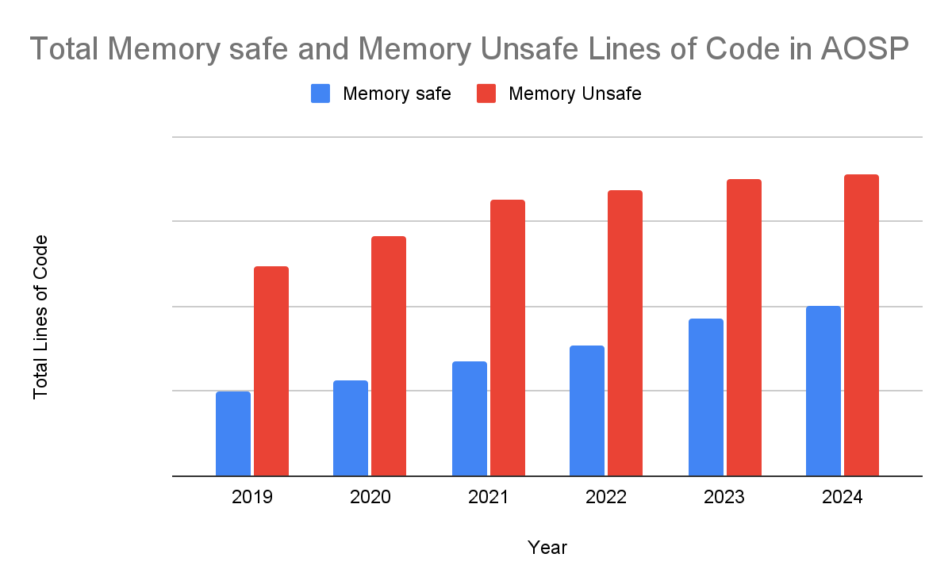
Relevance
Why safety and stability is relevant for C/C++:
70% of vulnerabilities in Microsoft products are memory errors
MSRC Blog: A proactive approach to more secure code (2019)
70% of high/critical bugs in Chromium are memory errors
Chromium Security: Memory Safety (2025)
70% of memory errors are 0-day vulnerabilities
Improving Memory Safety without a Trillion Dollars (2024)
75% of 0-days are memory errors
Safer with Google: Advancing Memory Safety (2024)
Memory errors are the most dangerous vulnerabilities
Mitre CWE Top 25 2024 (2, 6, 8, 20, 21 places)
Adoption of new memory safe languages
Customers and governments in many countries suggest to use memory safe languages
The case for memory safe roadmaps (US CISA, NSA, FBI)
Google Security Blog

Slide 5
Relevance
Safer with Google: Advancing Memory Safety (2024)
The first pillar of our strategy is centered on further increasing the adoption of memory-safe languages
While we won't make C and C++ memory safe, we are eliminating sub-classes of vulnerabilities in the code we own
The Case for Memory Safe Roadmaps (2023)
Authoring agencies urge senior executives at every software manufacturer to reduce customer risk by prioritizing design and development practices that implement Memory Safe Languages

Slide 6

Goal of our talk
Detailed overview of hardening
Existing tools
How to use them
What overhead to expect
Integration of hardening into C++
https://itoldya420.getarchive.net/amp/media/dart-board-darts-target-sports-6aa47e

Slide 7
Intro

Slide 8
What is Hardening
Rules to safely
Develop SW (secure development process)
Deploy SW
E.g. symbol stripping, hidden visibility
Execute SW
Protection in compiler, libraries, OS

Slide 9
Secure development rules
Concept of Secure Development Lifecycle (e.g. Safe Coding)
Safe alternatives for dangerous library functions
Annex K (memset_s et al.) and other extensions
Can be easily faked if not controlled !
Restrict usage of unsafe functions
rand, strcpy, etc.
Static analysis
Mandatory -Wall -Wextra -Werror
Suggested -Wformat=2 -Wconversion -Wsign-conversion
Tools: Clang Static Analyzer, Clang-Tidy, etc.
Specifications (Design-by-Contract)
Asserts and C++ contracts

Slide 10
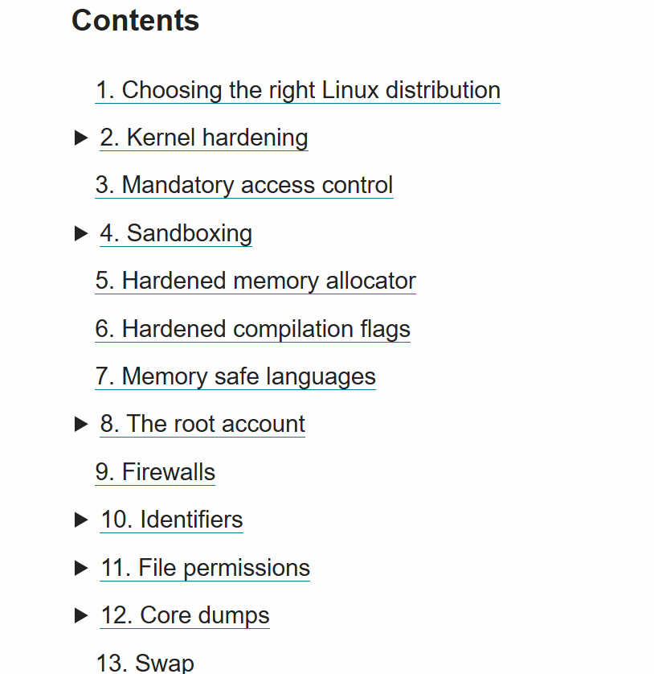
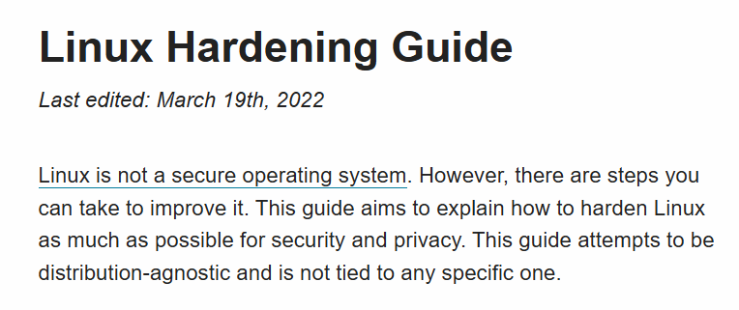
What is Hardening
Hardening is an integral activity
In this talk we consider only runtime checks
Compiler, library, OS
Mitigation, not prevention

Slide 11
Hardening requirements
Minimal overhead (2-3% max)
High precision (no false positives)
Easy integration
ABI compatibility
Easy-to-use

Slide 12
Detecting vulnerabilities at QA stage
Hardening is the last resort – it’s much better to detect vulnerabilities at QA
QA tools are more powerful and can detect more issues
Fuzzing, concolic testing, property-based testing, etc.
AddressSanitizer (≥ 2x overhead)
Stack/heap/static overflow, double free, use-after-free/return, etc.
State-of-the-art
Can be sporadically used in production code for A/B testing
Especially low-overhead variants like GWP-Asan and HWASan
STL debug checks (≥ 2x overhead)
-D_GLIBCXX_DEBUG in libstdc++ and -D_LIBCPP_ABI_BOUNDED_ITERATORS in libc++
Change ABI => need full rebuild of all dependencies
Valgrind (20-50x overhead)
Only heap errors (heap overflow, double free, use-after-free, etc.)
Much slower than Asan but can sometimes find more errors
Other tools
ElectricFence (only heap overflows), DirtyFrame, etc.

Slide 13
Buffer overflow vulnerabilities

Slide 14

Buffer overflow
Morris Worm (1988)
Writing excessive amount of data into program variable
char local_buf[32];
sprintf(buf, “Message from user: %s”, received_data);
Stack overflow
Stack Smashing, Return-to-libc, Return-Oriented Programming attacks
Heap overflow
https://www.rawpixel.com/image/5958324/free-public-domain-cc0-photo

Slide 15

Prevalence of buffer overflows
One of the most dangerous vulnerabilities
Mitre CWE Top 25 2024 (2, 6, 20 places)
70% vulnerabilities in Microsoft products and Chromium caused by buffer overflows
40% of memory-error-based attacks exploit buffer overflows
Google Project Zero(2024)
80% of Memory Safety CVEs and 46% of Memory Safety KEVs in 2024
20%+ are stack overflows (most dangerous vulnerability)

Slide 16
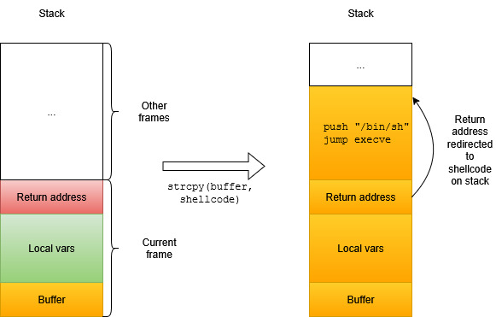
Stack attacks: Stack Smashing
Smashing The Stack For Fun And Profit (Aleph One, 1996)
Write malicious code on stack and executes it on return from function
No longer relevant due to modern protections

Slide 17
Example: Stack Smashing
int main() {
char buf[32];
strcpy(buf, code);
}
// Input string from hacker
const char code[] =
"\x31\xc0" // xorl %eax, %eax
"\x50" // pushl %eax
"\x68""//sh" // pushl $0x68732f2f
"\x68""/bin" // pushl $0x6e69622f
...
PAD
// Return address
"\x0c\xde\xff\xff"
;
$ CFLAGS=‘-Wl,-z,execstack -fno-stack-protector –w’
$ PAD=
$ for i in `seq 1 128`; do
echo PAD=$i
gcc -m32 -DPAD="\"$PAD\"" -march=i686 $CFLAGS repro.c
setarch -R env -i ./a.out
PAD="$PAD\\xff"
done
PAD=1
PAD=2
PAD=3
...
PAD=20
Segmentation fault (core dumped)
PAD=21
Segmentation fault (core dumped)
...
PAD=25
$ # Got shell access

Slide 18
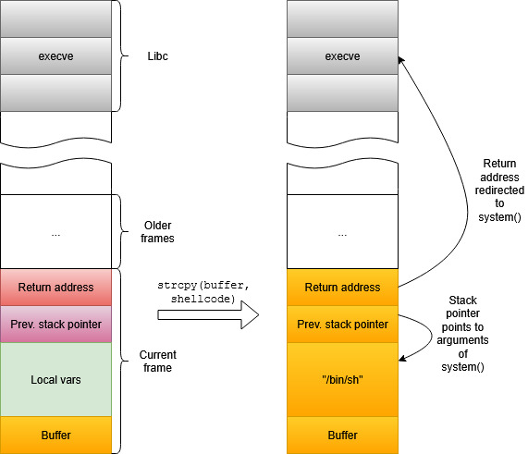
Stack attacks: Return-to-libc
Solar Designer, 1997
Jump to standard library API on return from attacked function
Usually execve(“bin/sh”) or system(“/bin/sh”)
Variant of attack: return-to-plt
Mainly applicable to 32-bit x86 (arguments passed on stack)

Slide 19
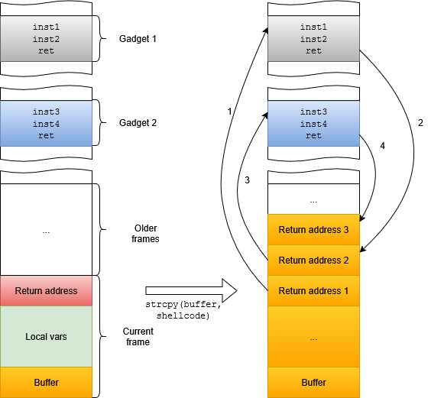
Stack attacks: Return-oriented programming
Nergal, 2001 and Shacham, 2007
State-of-the-art
Malicious program constructed from epilogues of normal functions
Stack contains many return addresses

Slide 20

Heap attacks
Based on Heap Overflow vulnerabilities
More complex and diverse than Stack Overflow
Main types:
Corrupt data in unrelated buffer (e.g. function or vtable pointers)
Corrupt allocator metadata
E.g. force allocator to write arbitrary address in unrelated malloc/free
E.g. corrupt address of malloc hook and call it on next malloc (House of Force attack)
https://kingsvilletimes.ca/2022/10/common-sense-health-rake-up-the-leaves-this-fall/

Slide 21
Non-executable data segments

Slide 22
Intro
W^X / NX bit / Data Execution Prevention
Disable execution of code in stack segment
Done by OS and startup code
Also applied to other writable-segments (heap and globals)
One of the first hardening defenses
First appeared in OpenBSD (2003) and Windows (2004)
Fully protects against Stack Smashing attacks
Enabled by default in all modern Linux distros and on Windows

Slide 23
Issues
All program code needs to support noexecstack
Including linked shared libraries
But not dynamically loaded (via dlopen) shared libraries (BZ #32653)
Linker will issue warning if noexecstack can’t be enabled
Suggest to use LDFLAGS += -Wl,--fatal-warnings
Main reasons for execstack:
Legacy assembly code missing the .note.GNU-stack directive
Pointers to GNU nested functions (rare!)
No runtime overhead

Slide 24
Address Space Layout Randomization (and PIE)

Slide 25
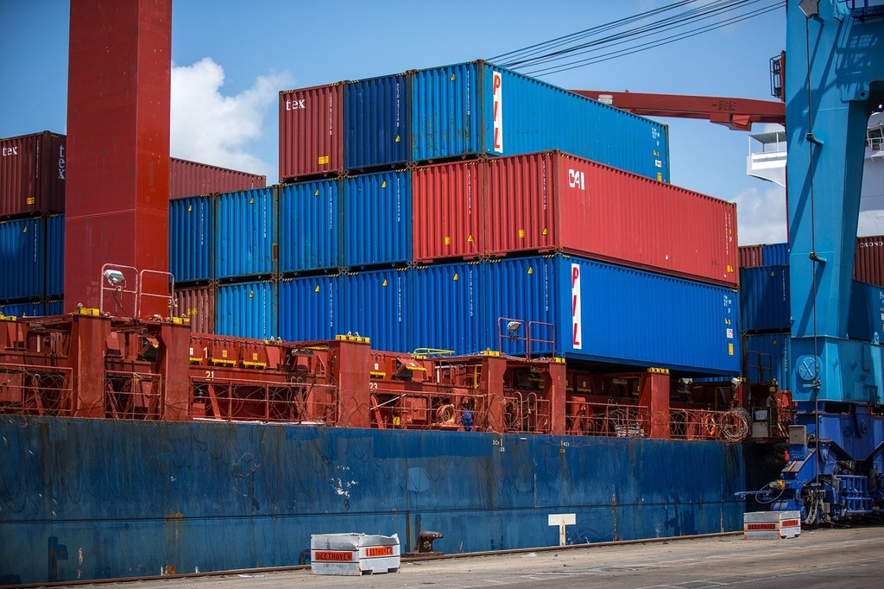
Intro
Address Space Layout Randomization
Random placement of main program segments (stack, heap, libraries) by OS
Hacker no longer knows which return addresses to use in Stack Overflow attacks
Greatly complicates buffer overflow attacks (ROP, heap overflow, etc.)
E.g. Stack Smashing example crashes with SEGV
Lib A
Stack
Heap
https://picryl.com/media/shipping-containers-cargo-port-industry-craft-9326e8
One of the first hardening defenses:
PaX patch, 2001
Linux, 2005
Windows, 2007 (Vista, 32-bit Windows overhead was too high due to DLL architecture)
Takes decades to add security ... (Theo de Raadt)

Slide 26
Position-independent Executable (PIE)
Required for Full ASLR:
Main program needs to be compiled in special PIE mode
Generated code will not use absolute addressing
Allows OS to load main program at random address
Turned on by default in Ubuntu/Debian (GCC and Clang) and Windows
Not default in all Linux distros (e.g. not in Fedora)
Even in Debian some critical programs are built without PIE
/usr/bin/python3 (Launchpad #1452115)
Suggest to explicitly use -fPIE –pie in buildscripts
-fPIE ≈ fPIC + -fno-semantic-interposition + -Bsymbolic

Slide 27
Overhead
Overhead on modern CPUs is negligible
No slowdown in Clang benchmark
32-bit x86 used to have 20% slowdowns
Too much PIE is bad for performance (2012)
ASLR is incompatible with prelinking
In the past Prelink was used to speed up library loading at startup in large applications

Slide 28
False negatives
Vulnerable to info leakage attacks (e.g. Format string attacks):
Only base addresses of program and libraries are randomized
Hacker knows relative offsets of code, globals, GOT/PLT tables, etc.
If address of one object is known the defense is compromised
E.g. fork compromises ASLR (Zygote-process in Android)

Slide 29
False negatives
Not enough randomization
Randomization done once (at program start)
Only start of mmap addresses is randomized (delta_mmap)
Relative offsets of libraries and other mmap regions is fixed
Android randomizes order of libraries and inserts random gaps
Few bits randomized
16 or even 8 in 32-bit Windows and early Android
Not all bits are equally random
Windows-specific issues:
Every program is randomized once on first execution (for performance)
Library loaded at same address in different programs (for performance)
It’s recommended to regularly restart services to avoid brute-forcing !

Slide 30
ASLR: extensions
Compile-time randomization
Linking object files (or functions) of program in random order
Used in OpenBSD (kernel relinked on every boot), Safe Compiler (ISP RAS), etc.
Runtime diversification:
Placing functions in random order at startup
Used in Safe Compiler (ISP RAS)
Moving Target Defense
Dynamically relocate functions at runtime

Slide 31
Stack Protector

Slide 32
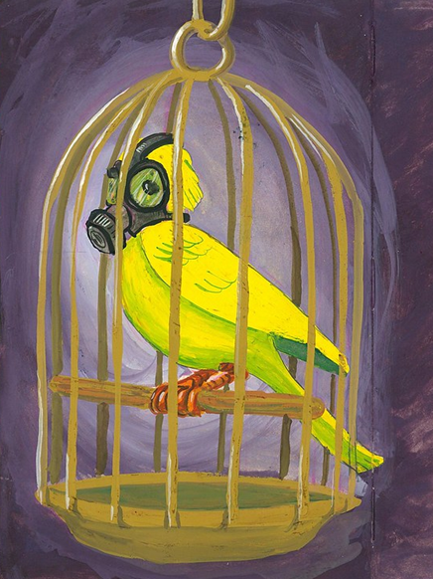
Stack Protector (Stack Canary)
Stack Overflow attacks are based on corruption of return address
Idea:
Place a known random number before return address (stack canary, stack cookie)
Prior to return from function check that canary wasn’t changed
Attacker can’t change return address via buffer overflow without also modifying the canary
One of the first hardening defenses:
StackGuard (1997)
ProPolice (2001, IBM)
StackProtector (2005, RedHat), StackProtectorStrong (2012, Google)
Greatly reduces risks of all stack overflow attacks (return-to-libc, ROP)
E.g. Stack Smashing example fails with
*** stack smashing detected ***: terminated
Aborted (core dumped)
David & Angie, https://www.flickr.com/photos/studiomiguel/3946174063

Slide 33
More safety features
Scalar variables are placed lower in stack than arrays
So that array overflow does not allow hacker to modify scalar flags, function addresses, etc.
One of canary bytes is always zero (to stop string buffer overflow)

Slide 34
Disadvantages
Overhead:
Need to load canary value, save it on stack, read and check on return
2% on Clang benchmark
The Performance Cost of Shadow Stacks and Stack Canaries: 0-9% (2015)
False negatives:
Vulnerable to info leakage: if canary is leaked, protection is compromised
Does not protect from corruption of return address by non-overflow attacks
Does not protect from heap overflows

Slide 35
Stack split

Slide 36

Intro
SafeStack, ShadowStack, backward-edge CFI
Root cause of stack overflow attacks – return address is stored together with local arrays
We can split stack to 2 disjoint parts:
Return address (+ maybe scalar variables whose address is never taken)
Everything else
First implemented in StackShield (~2000)
Comparison with StackProtector:
Additional randomization for critical data
Protects user pointers to functions on stack
StackProtector can still be applied to unsafe part to detect overflows
https://picryl.com/media/reaching-shadow-heart-nature-landscapes-d62bda

Slide 37
Disadvantages
Overhead:
3% in Clang benchmark
0.1% reported by authors (Clang documentation: SafeStack)
False negatives:
SafeStack currently does not support instrumentation of shared libraries (maybe easy to add: OpenSSF #267)
ShadowStack:
Supports only AArch64 and RISC-V
Protects only return addresses

Slide 38
Stack Clashing (Stack Probes)

Slide 39
Intro
Stack separated from other segments by unmapped guard page
Detects stack exhaustion
First appeared in Linux (2010)
Problem:
May not detect stack exhaustion for large (>4096 bytes) frames
Attacker may corrupt heap or stack of another thread
Vulnerability reported by Qualys in 2017:
The Stack Clash (10 proof-of-concept attacks)
Idea:
In function prologue touch each 4096-th byte of frame (to provoke SEGV)

Slide 40
Overhead
Overheads are negligible:
No slowdown detected in Clang benchmark
No performance regressions in Firefox
Bringing Stack Clash Protection to Clang / X86 (2021)

Slide 41
Fortification (_FORTIFY_SOURCE)

Slide 42
Example
#include <stdlib.h>
#include <string.h>
unsigned n = 4096;
int main() {
char *a = malloc(1);
memset(a, 0, n);
asm("" :: "r"(&a) : "memory");
a = malloc(200);
asm("" :: "r"(&a) : "memory");
return 0;
}
# No _FORTIFY_SOURCE
$ gcc -U_FORTIFY_SOURCE repro.c -O2 && ./a.out
Fatal glibc error: malloc.c:2599 (sysmalloc): assertion failed: (old_top == initial_top (av) && old_size == 0) || ((unsigned long) (old_size) >= MINSIZE && prev_inuse (old_top) && ((unsigned long) old_end & (pagesize - 1)) == 0)
Aborted (core dumped)
# _FORTIFY_SOURCE=3
$ gcc repro.c -O2 && ./a.out
*** buffer overflow detected ***: terminated
Aborted (core dumped)

Slide 43
Implementation
From Glibc string.h:
#if _FORTIFY_SOURCE > 0
__attribute__((always_inline, __nothrow__, leaf))
void *memset (void *__dest, int __ch, size_t __len)
{
// memset_chk defined in libc.so.6 and performs range check
return __builtin___memset_chk (__dest, __ch, __len,
__glibc_objsize0 (__dest));
}
#endif
__glibc_objsize0 calls compiler intrinsic __builtin_object_size or __builtin_dynamic_object_size (depending on level of protection)
__builtin_object_size checks pointers to stack variables
__builtin_dynamic_object_size performs dataflow analysis to also check heap variables

Slide 44
Intro
Checks valid ranges in C standard library functions (when possible)
First appeared in Glibc 2.3.4 (2004)
~80 protected functions (exact list of functions in Glibc headers)
string.h APIs (memcpy, memset, strcpy, strcat, bzero, bcopy, etc.) – range checks
unistd.h APIs (read, pread, readlink, etc.) – range cehcks
Protects from all types of buffer overflows (stack, heap)
Implemented via collaboration between
Standard library (replaces standard functions with checked versions)
Compiler (computes valid ranges)

Slide 45
Overhead
-D_FORTIFY_SOURCE=2: no slowdown in Clang benchmark
-D_FORTIFY_SOURCE=3: 2% in Clang benchmark
3% -D_FORTIFY_SOURCE=2 in ffmpeg (FORTIFY_SOURCE and Its Performance Impact, 2017)

Slide 46
Disadvantages
Conflicts with Address- and MemorySanitizer:
Asan can’t analyze XXX_chk functions (sanitizers #247)
Combining Asan with fortification causes false negatives (i.e. missed bugs)
GCC (not Clang) inserts additional checks for memcpy_chk and memset_chk but it’s not enough
Fortification is turned on by default in many distros so need to explicitly turn it off in sanitized builds:
-U_FORTIFY_SOURCE or -D_FORTIFY_SOURCE=0
Supported only in Glibc and Bionic (not in musl or Visual Studio)
Standalone implementation: fortify-headers
Works only under -O and only when standard .h files are used (not implicit declarations)
Does not check trailing arrays in structs by default (need -fstrict-flex-arrays)
Compiler often can’t infer allowed range from context
Analysis limited by single function

Slide 47
-fsanitize=bounds
Fortification approach can be extended to scalar accesses to arrays of known length
-fsanitize=bounds flag in GCC and Clang
Analogue of -D_FORTIFY_SOURCE=2: checks arrays of known size and VLAs
Enabled in Android for some critical modules
Android Developers Blog: System hardening in Android 11
No overhead in Clang benchmark
Same as -D_FORTIFY_SOURCE=2

Slide 48
STL checks

Slide 49
Example
#include <stdio.h>
#include <vector>
int main() {
std::vector<int> v(5, 0);
asm(“”
:: "r"(&v)
: "memory");
return v[10];
}
$ g++ tmp.cc
$ ./a.out
$ g++ -D_GLIBCXX_ASSERTIONS tmp.cc
$ ./a.out /usr/include/c++/12/bits/stl_vector.h:1123: ... : Assertion '__n < this->size()' failed.
Aborted

Slide 50
Intro
Hardened STL
List of checks depends on compiler and protection level
Index accesses are always checked (also front, back, etc.) for std::vector, std::deque and std::string
Protects from buffer overflow errors
GCC:
NULL checks in smart pointers (protects from NULL dereference vulnerabilities)
Precondition checks (parameters of math. functions, etc.)
LLVM:
Strict Weak Ordering checks of comparators
Painless C++ comparators
Visual Studio:
Similar checks have very large overheads and will be reimplemented

Slide 51
History and future
History:
First appeared in GCC debug containers as QA check (~2000)
Can still (and should) be enabled as -D_GLIBCXX_DEBUG
ABI-incompatible with normal build
-D_GLIBCXX_ASSERTIONS option for hardening in GCC (2015)
ABI-compatible with normal build
Analogous check in libc++ and Safe Buffers proposal (2022)
In future STL hardening will likely become part of C++ Standard
More on this below

Slide 52
Disadvantages
Overhead:
3.5% in Clang benchmark
0.3% in Google server applications
Retrofitting spatial safety to hundreds of millions of lines of C++ (2024)
Only with ThinLTO and PGO, otherwise 1-2% (2024)
False negatives:
Detects only subset of overflows (invalid indexing, only STL containers)
Other errors are too costly to detect (e.g. iterator errors)

Slide 53
Hardened allocators

Slide 54
Example (1)
#include <string.h>
#include <stdlib.h>
void *a, *b;
unsigned n = 4096;
int main() {
a = malloc(100);
memset(a, 0xff, n);
b = malloc(100);
}
$ gcc -O2 repro.c
$ ./a.out
malloc(): corrupted top size
Aborted

Slide 55
Example (2)
#include <stdlib.h>
void *a, *b;
int main() {
a = malloc(1);
free(a);
b = malloc(1);
// Copy-paste error
free(a);
return 0;
}
$ gcc -O2 repro.c
# Glibc does not catch error
$ ./a.out
# But hardened allocator does
$ LD_PRELOAD=libhardened_malloc.so ./a.out
fatal allocator error: double free (quarantine)
Aborted

Slide 56
Intro
Additional efforts in heap allocator to complicate exploits and quickly detect heap errors
Scudo (Android), hardened_malloc, OpenBSD allocator, Glibc MALLOC_CHECK_, etc.
Protect against various heap errors (heap overflow, double free, use-after-free, free of invalid address)
Separate metadata from heap buffers (no “headers")
Randomization of addresses in chunks
Checksums and/or canaries to detect data/metadata overflows
Quarantine (delayed reuse of freed memory)
Zeroing of data in free and verifying this in malloc

Slide 57
Disadvantages
Overhead:
9% in Clang benchmark (hardened_malloc vs Glibc allocator)

Slide 58
GOT protection (Full RELRO)

Slide 59
Intro
Calls to library functions are done through special trampolines (PLT stubs)
Trampolines read and update table which holds actual function addresses (GOT)
AKA lazy binding
Speeds up application startup
Table kept writable segment where hackers can corrupt it
This attack is more rare than buffer overflow
Solution (read-only relocations, RELRO):
Fully initialize table contents at program start and mark it as readonly

Slide 60
Example
#include <stdio.h>
void shellcode() {
printf("You have beeen pwned%s\n", "");
}
extern void *_GLOBAL_OFFSET_TABLE_[];
int main() {
// Simulate attck
_GLOBAL_OFFSET_TABLE_[POS] = shellcode;
puts("Hello world!\n");
return 0;
}
$ for i in `seq 0 16`; do
gcc -Wl,-z,norelro repro.c -DPOS=$i
./a.out
i=$((i + 1))
done
Segmentation fault
Segmentation fault
Segmentation fault
You have beeen pwned
Hello world!
Hello world!
Hello world!
...

Slide 61
History
RELRO has been used for initialization of vtables and global dtors (partial RELRO)
Ian Lance Taylor: Linker relro
Needed small adaptations to enable it for GOT (Full RELRO)

Slide 62
Disadvantages
Negligible overhead
No slowdown in Clang benchmark
May slow down startup of large programs because all symbols have to be resolved at startup
Useful to combine with -fno-plt on X86 (up to 10% performance improvement)
False positives:
May break some programs which reference missing symbols in non-executed parts of code
False negatives:
Does not protect user/library function tables (e.g. atexit handlers)

Slide 63
Autoinitialization

Slide 64
Example
void foo() {
char password[32];
...
}
void bar() {
char message[1024];
if (cond) strcpy(message, “...”);
// Leak password to hacker if !cond
printf(message);
}
void baz() {
foo();
bar();
}

Slide 65
Intro
Forced initialization of local variables
Random values for QA run, zeros for hardening
Only if compiler failed to prove that they will be always initialized in program
History:
Has been available in commercial toolchains for long time
InitAll added to Visual Studio in 2019
CppCon 2019: Killing Uninitialized Memory
Added to GCC in 2021
First discussion in mailing list in 2014
Planned for C++26 (P2795, more on this below)
Prevalence:
10% CVE root cause in Microsoft products in 2018 (from Killing Uninitialized Memory)
12% exploitable bugs in Android (from P2723)

Slide 66
Overheads
Measurements:
4.5% in Clang benchmark
1% in Firefox (from Trivial Auto Var Init Experiments)
Up 10% in hot code (virtio, Chrome)
1-3% on average in Postgres but up to 20% in some scenarios (Ubuntu #1972043)
<1% in Windows (Killing Uninitialized Memory)
Common problem: large local array (e.g. used for IO) on hot path
while (std::getline(maps, line)) {
char modulePath[PATH_MAX + 1] = "";
// -ftrivial-auto-var-init
// will insert memset...
ret = sscanf(line.c_str(),
"%lx-%lx %6s %lx %*s %*x %" PATH_MAX_STRING(PATH_MAX)
"s\n",
&start, &end, perm, &offset, modulePath);
}

Slide 67
Other disadvantages
Autoinitialization breaks bug detection in Valgrind and Msan
Turn it off in QA builds
At least compiler warnings still work (-Wuninitialized -Wmaybe-uninitialized)
May rarely enable additional vulnerabilities:
Zero initialization (recommended for release builds): “0” is a super-user id in Linux
Non-zero initialization: may provoke buffer overflows
Applied only to local variables
Globals are initialized anyway
Hardened allocators initialize heap data

Slide 68
Integer overflow checks

Slide 69
Example
// From OpenSSH 3.3
nresp = packet_get_int();
if (nresp > 0) {
// Overflow multiplication to zero ...
response = xmalloc(nresp*sizeof(char*));
// ... to cause buffer overflow here
for (i = 0; i < nresp; i++)
response[i] = packet_get_string(NULL);
}

Slide 70
Intro
Check integer arithmetic for overflow
Default UBsan reports too much debug info so isn’t suitable for release builds
So use special minimal runtime (with immediate abort)
Prevalence:
Most famous incidents:
Therac-25 radiation therapy machine (1985)
Ariane 5 rocket crash (1996)
~1% CVE and 1.5% KEV in 2024
23-rd place in Mitre CWE Top 25 2024 (8 in 2019)
History:
-ftrapv implemented in GCC in 2000 (patch for -ftrapv option)
Wasn’t maintained and quickly rotted (e.g. BZ #35412 opened in 2008)
Work of John Regehr in 2010
Finally UBsan in 2014 (following Asan success)
State-of-the-art

Slide 71
Disadvantages
Overhead:
30% slowdown in Clang benchmark
Up to 2x in SPEC (from PartiSan paper, 2018)
Disabled by default in Rust due to high overhead
We suggest to apply “locally”
Other issues:
UBsan is incompatible with -fno-strict-overflow and -fwrapv
False positives:
Isan may report false positives (e.g. need blacklist for code in <random> which relies on unsigned overflow)
False negatives:
May not detect some bugs which have been “exploited" by optimizer (especially under -O2)

Slide 72
Disabling unsafe optimizations

Slide 73
Example error
static void
__devexit agnx_pci_remove (struct pci_dev *pdev)
{
struct ieee80211_hw *dev = pci_get_drvdata(pdev);
struct agnx_priv *priv = dev->priv;
// Compiler removes this check
if (!dev) return;
... do stuff using dev ...
}

Slide 74
Intro
Some compilers may too aggressively optimize code that contains easy-to-miss errors and generate unsafe asm
Most common problem is dropping user checks
Visual Studio is less aggressive than GCC/Clang
Compiler Introduced Security Bugs
Introduced in Silent Bugs Matter: A Study of Compiler-Introduced Security Bugs (2023)
Few corresponding CVEs (e.g. CVE-2009-1897) but hundreds of CISBs found in open-source code
May need to disable such optimizations in code with higher safety requirements

Slide 75
Overhead
4.5% slowdown in Clang benchmark
Small (~1%) overhead in Phoronix Test Suite
Performance Impact of Exploiting Undefined Behavior in C/C++ (2025)

Slide 76
How to use ?
In GCC/Clang disable
-fno-delete-null-pointer-checks
-fno-strict-overflow (== -fwrapv -fwrapv-pointer)
-fno-strict-aliasing
Corresponding bugs can also be detected by UBSanitizer and TypeSanitizer
Usage:
These flags are disabled by default in all compilers/distros
But many packages enable at least -fno-strict-aliasing
Aliasing rules are particularly easy to violate
Chrome compiles with all three flags
build/config/compiler/BUILD.gn
Firefox compiles with -fno-strict-aliasing

Slide 77
Control-Flow Integrity

Slide 78
Example
include <stdio.h>
struct A { virtual void foo() {} };
struct B : A { void foo() override {} };
struct Evil { virtual void foo() {
printf("You have been pwned\n"); }
};
A *tmp = new B;
int main() {
A *a = new A;
Evil *e = new Evil;
// Corrupt vtable
asm("mov %1, %0" : "+r"(a) : "r"(e));
a->foo();
}
$ clang++ repro.cc -O2
$ ./a.out
You have been pwned
# CFI detects corruption
$ clang++ -fsanitize=cfi -flto -fvisibility=hidden repro.cc -O2
$ ./a.out
Illegal instruction

Slide 79
History
Control Flow Integrity is a generic term for any для violation of original program control flow
Including return address corruptions
First introduced by Abadi et al. in 2005 (CFI: Principles, Implementations and Applications)
Two types:
forward-edge (call/jump)
backward-edge (return)
A lot of proposed approaches
E.g. Stack Protector and Shadow Stack are CFI too
But nowadays CFI is reserved one of these methods:
LLVM CFI, 2015 (2015, Clang 3.7)
Microsoft Control Flow Guard, 2014
grsecurity RAP, 2016
Hardware protections: Intel CET, 2020 (spec 2016) and AArch64 BTI/PAC (2018)

Slide 80
LLVM CFI
Compiler instrumentation for forward-edge checks
Implemented only in Clang (not supported by GCC)
Checks that static and runtime prototype match before calling function by pointer
Support vtables and ordinary function pointers
(verification algorithms for them are totally different)
Can also be use for related checks (verify correctness of C++ casts, vtable hijacking, etc.)

Slide 81
Hardware support: Intel CET and AArch64 CFI
Supported in GCC and Clang
Much more crude than LLVM CFI
Check indirect jumps (indirect calls, returns):
All valid branch targets are marked with special pseudo-instruction (ENDBR64 on X86)
Hardware verifies that target of indirect jump is valid
Pointer Authentication (AArch64)
Top bits of return address hold checksum of return address, frame address and process secret
Checksum is, well, checked before return from function

Slide 82
Overhead
Clang benchmark:
No changes under Intel CET
6% overhead under LLVM CFI
LLVM CFI ~1% in Chrome (Chrome: Control Flow Integrity, 2025)
10% code size increase (so increased I$ and BTB pressure)
No overhead in Android under LLVM CFI (Android: Security: Control flow integrity, 2025)

Slide 83
Disadvantages
Fragmentation
Three unrelated approaches with different defenses
GCC does not support LLVM CFI
False positives:
Many programs need to be updated for LLVM CFI (fix reinterpret_cast<void *>, etc.)
E.g. vanilla Clang does not pass LLVM CFI (need blacklists)
False negatives:
LLVM CFI:
Only type mismatches (hacker can still call wrong function if types match)
Harder to integrate (need LTO, issues with cross-DSO type checks)
Intel/AArch64: do not check types at all
Jump tables not checked (only in CET with -mcet-switch which is disabled by default)

Slide 84
Compiler options

Slide 85
Protection | Flags
Noexecstack | On by default
Full ASLR (PIE) | -fPIE –pie
Stack Protector | -fstack-protector-strong
Safe Stack | -fsanitize=safe-stack
Stack Clashing | -fstack-clash-protection
_FORTIFY_SOURCE=2 | -D_FORTIFY_SOURCE=2 (or 3), -fsanitize=bounds (also recommend -fstrict-flex-arrays=1)
STL hardening | -D_GLIBCXX_ASSERTIONS (libstdc++), -D_LIBCPP_HARDENING_MODE=... (libc++)
Hardened allocator | LD_PRELOAD=path/to/allocator.so MALLOC_CHECK_=3 or GLIBC_TUNABLES=glibc.malloc.check=3 (Glibc)
Full RELRO | -Wl,-z,relro -Wl,-z,now
Autoinitialization | -ftrivial-auto-var-init=zero
Integer Overflow | GCC: -fsanitize-trap=signed-integer-overflow,pointer-overflow Clang: -fsanitize=signed-integer-overflow,pointer-overflow -fsanitize-minimal-runtime (also recommend integer)
Disable optimizations | -fno-delete-null-pointer-checks -fno-strict-overflow (== -fwrapv -fwrapv-pointer) -fno-strict-aliasing
Control-flow integrity | LLVM: -fsanitize=cfi -flto=thin -fvisibility=hidden -fsanitize-cfi-cross-dso Intel CET: -fcf-protection AArch64: -mbranch-protection=standard (why not –fcf-protection ?!)

Slide 86
Real-world adoption

Slide 87
Linux distros
Default protections differ across distros
Clang enables much fewer protections by default
New protections not enabled by default
Distro packages are protected better than user programs
Default distro protections may be disabled even in critical packages (e.g. no PIE/Full RELRO in python3 in Debian 12, only 85% packages in Debian 10 enabled StackProtector)
* Will be enabled in next Debian version
Protection | Ubuntu 24.04 |  |  | Debian 12 |  |  | Fedora 42
 | GCC | Clang | Pkgs | GCC | Clang | Pkgs | GCC | Clang | Pkgs
Noexecstack | Y | Y | Y | Y | Y | Y | Y | Y | Y
Full ASLR (PIE) | Y | Y | Y | Y | Y | Y | N | N | Y
Stack Protector | Y | N | Y | N | N | Y | N | N | Y
Safe Stack | N | N | N | N | N | N | N | N | N
Stack Clashing | Y | N | Y | N | N | N* | N | N | Y
_FORTIFY_SOURCE | Y (2) | N | Y (2) | N | N | Y (2) | N | N | Y (3)
STL hardening | N | N | N | N | N | N | N | N | Y (libstdc++)
Hardened allocator | N | N | N | N | N | N | N | N | N
Full RELRO | Y | N | Y | N | N | Partial | N | N | Y
Autoinitialization | N | N | N | N | N | N | N | N | N
Integer Overflow | N | N | N | N | N | N | N | N | N
Disable optimizations | N | N | N | N | N | N | N | N | N
Hardware CFI (Intel CET, AArch64 BP) | Y | N | Y | N | N | N* | N | N | Y

Slide 88
Browsers
Protection | Chrome (140.0.7313.1) | Firefox (142.0b1)
Noexecstack | Y | Y
Full ASLR (PIE) | Y | Y
Stack Protector | Y (weak) | Y
Safe Stack | N | N
Stack Clashing | N | Y
_FORTIFY_SOURCE=2 | Y | Y
STL hardening | Y (libstdc++) | N
Hardened allocator | Y | N
Full RELRO | Y | Y
Autoinitialization | Y | N
Integer Overflow | N | N
Disable optimizations | Y | Y
CFI | Y (LLVM on X86, AArch64 CFI) | N
Considered default flags on Linux

Slide 89
Hardening in memory-safe languages

Slide 90

Hardening in Rust
Protection | Needed ? | Rust status | Notes
Noexecstack | Only unsafe/external code | On | Prooflink
ASLR | Only unsafe/external code | On | Prooflink
Stack Protector | Only unsafe/external code | Nightly flag | Prooflink
Safe Stack | Only unsafe/external code | Nightly flag | Prooflink
Stack Clashing | Yes | On | Prooflink
_FORTIFY_SOURCE, STL hardening | No | No | Already in lang.
Hardened allocator | Only unsafe/external code | hardened_malloc bindings | Prooflink
Full RELRO | Only unsafe/external code | On | Prooflink
Autoinitialization | No | N/A | Already in lang.
Integer Overflow | Yes | Flag (default off)
CFI | Only unsafe/external code | Nightly flag | Prooflink
All memory-related Rust CVEs are caused by errors in unsafe code (Xu et al., 2021)
50% popular crates have unsafe blocks (Evans et al., 2020)
stdlib::core 8.5% unsafe, nalgebra 4.5%, rav1e 7%, tokio 5%, veloren 15%
(modulo errors in my scripts…)
Stable Rust lacks flags for some key defenses

Slide 91
Options that we didn’t cover
Options for cleaning secrets (passwords, keys, etc.):
Stack scrubbing – clear stack on return from function (-fstrub)
Clear registers on return from function (-fzero-call-used-regs)
Options for side-channel attacks (Spectre, etc.)
-fhardened – umbrelly flag for most important hardening protections
Good default flag but currently available only in GCC (LLVM #122687)
Enables all flags recommended by OpenSSF (see --help=hardened)

Slide 92
Anatomy of fortification

Slide 93
How fortification works
When _FORTIFY_SOURCE macro is enabled, standard functions are implemented as inline stubs which call special compiler builtins
Builtins expand to
Normal function calls
If compiler failed to determine size of dst
If compiler can prove that size of dst >= size of src
*_chk versions which check sizes at runtime

Slide 94
__builtin_object_size
size_t __builtin_object_size (const void *ptr, /*detail*/)
Returns
Size of object addressed by ptr
-1 if size is not known at compile time
size_t __builtin_dynamic_object_size(const void *ptr, /*detail*/)
Same as __builtin_object_size but size may also be computed at runtime
Needed for malloc, alloca, VLA

Slide 95
Strcpy example
int main(int argc, char *argv[]) { strcpy(a, argv[1]); puts(a); }
int main(int argc, char *argv[]) { __builtin___strcpy_chk (a, argv[1], __builtin_object_size(a, ...)); puts(a); }
__builtin_object_size(...) > src_len
__builtin_object_size(...) ≷ src_len
extern char a[];
int main(int argc, char *argv[]) { strcpy(a, argv[1]); puts(a); }
char a[4];
int main(int argc, char *argv[]) { __strcpy_chk(a, argv[1], dst_len); puts(a); }

Slide 96
Strcpy example
int main(int argc, char *argv[]) { __strcpy_chk (a, argv[1], dst_size); puts(a); }
char * __strcpy_chk(char *dest, const char *src, size_t destlen){ size_t len = strlen(src);
if (len >= destlen) abort(); return memcpy(dest, src, len + 1); }

Slide 97
Side effect in Clang
int main() { void *p; size_t n; if (getenv("TEST")) { p = &n; n = sizeof n; puts("Hello"); } else { p = nullptr; n = 0; } memset(p, 0, n); }
With fortification
int main() { getenv("TEST"); puts("Hello"); }
With fortification memset argument has nonnull attribute
So compiler will drop the nullptr branch
More details in LLVM #60389

Slide 98
Support for hardening in language

Slide 99
New behavior type in C++
Types of behavior in C++
Undefined
Optimizer can do arbitrary transforms
Unspecified
Depends on implementation (undocumented)
Implementation-defined
Depends on implementation (documented)

Slide 100
New behavior type in C++
Types of behavior in C++
Undefined
Optimizer can do arbitrary transforms
Unspecified
Depends on implementation (undocumented)
Implementation-defined
Depends on implementation (documented)
Erroneous

Slide 101
Erroneous behavior
int foo(){
int x; return x ? 1 : 1; }
Defined behavior for incorrect code
Should not enable vulnerabilities
Opposite of UB
С++26 uses erroneous behavior for uninitialized variables (P2795)
Maybe also for some missing returns (P2973)
Most likely will be implemented on top of existing -ftrivial-auto-var-init flag
C++23 (UB)
C++26 (Erroneous)
int foo(){ abort(); }
int foo(){ while(true);
}
int foo(){ return 0x42;
}
int foo(){ return 1; }

Slide 102
[[indeterminate]] attribute
Disables Erroneous Behavior for local variable or function parameter (no initialization, back to UB)
Used for optimizations
void f(int); void g() { int x [[indeterminate]]; // indeterminate value int y; // erroneous value f(x); // undefined behavior f(y); // erroneous behavior }

Slide 103
STL hardening in C++ Standard
P3471
Preconditions for some functions of standard library
Hardened preconditions
E.g. idx < size in vector::operator[]
Will be implemented via contracts (precondition assertions)
Toolchains will provide special flags to enable them
E.g. -fhardened or -D_LIBCPP_HARDENING_MODE

Slide 104
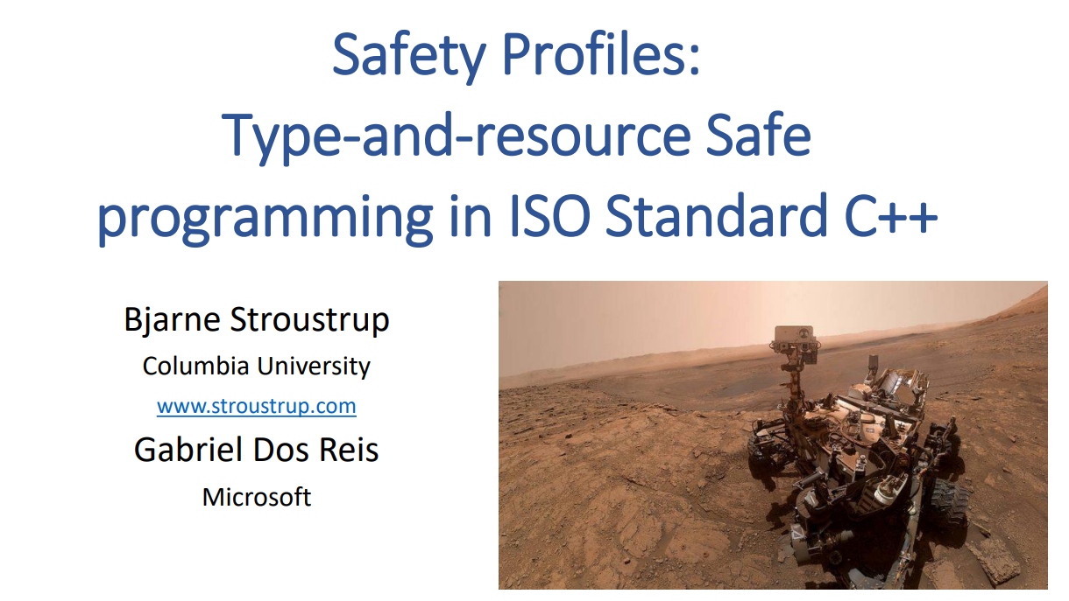
С++ Profiles
Evolution and standardization of C++ Core Guidelines
Language dialects
Prohibit unsafe or uncheckable constructs
Enforced by local static analysis
Migration tools
C++ Safe Buffers, Clang-Tidy fix-its
Already used in Chrome
Candidates for Safety Profiles:
STL hardening
Prohibit raw pointers
RAII
Prohibit unsafe casts
Etc.
Will profiles unify all hardening protections in future?

Slide 105
Conclusions

Slide 106
Conclusions
Hardening is a state-of-the-art part of modern C/C++ development
There are many methods with different protection levels and overhead
Will be used more and more due to adoption of memory-safe languages and tightening of government requirements
Also standardized in the language
Will this make C++ more competitive against memory safe languages?

Slide 107
Some suggestions
Check compile flags used in your release build and for external libraries/programs (e.g. distro packages that your service relies on)
Check what hardening flags are enabled by default in your toolchain
Decide with Security Team what hardening methods to enable in which components
Minimal recommended protection:
ASLR: -fPIE -pie
Stack Protector: -fstack-protector-strong
Fortification: -D_FORTIFY_SOURCE=2
Full RELRO: -Wl,-z,relro -Wl,-z,now
Stack Clash protection: -fstack-clash-protection
Control-flow Integrity: -fcf-protection on X86, -mbranch-protection on AArch64

Slide 108
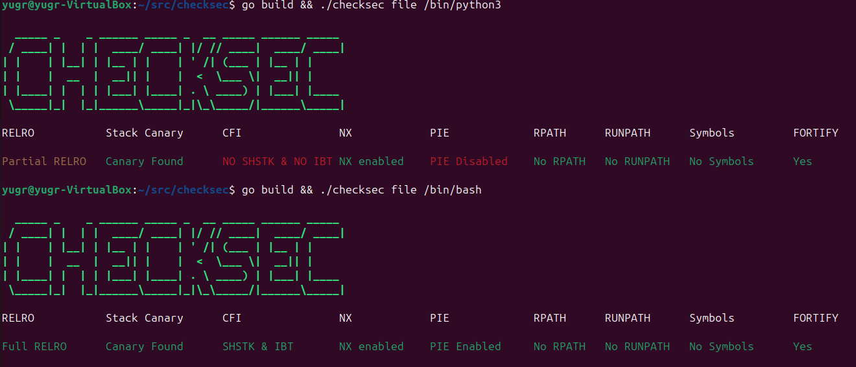
Some suggestions
Automatically detect under-protected components (no-PIE, etc.) with checksec
Need to build it yourself (distros have legacy checksec.sh which doesn’t support many defenses)
Can detect missing noexecstack, PIE, _FORTIFY_SOURCE, RELRO, etc.
Supports only dynamically linked apps/libraries
Does not (yet ?) support new defenses: Stack Clashing (#300), Safe Stack (#301), LLVM CFI

Slide 109
What we didn’t cover
Hardening in other popular Linux distros (RedHat/Alma, OpenSUSE, Alpine, etc.) and embedded systems
Building Embedded Systems Like It’s 1996 (2022)
Hardening in other OSes (Android, Windows, macOS, BSDs)
Hardening in OS kernel
Linux Kernel Defence Map (2025)
Hardening in critical SW
Chats, mail clients, multimedia, interpreters, DB, office SW, readers
Hardening in other memory-safe languages (Java, Swift, Ada, Solidity, etc.)
Hardening in JIT compilers
Hardware support for hardening (AArch64 TBI and MTE, CHERI)

Slide 110
Recommended reading
Hardening guides
OpenSSF Compiler Options Hardening Guide for C and C++
Linux Hardening Guide
Overview of attacks
Nightmare
Overview of GLIBC heap exploitation techniques
Blogs
Google Security Blog
Embedded in Academia (John Regehr): A Guide to Undefined Behavior in C and C++ and UB in 2017

Slide 111
Acknowledgements
Serge Bronnikov (VK Tech/Tarantool)
https://bronevichok.ru/
Roman Lebedev (Spectral::Technologies)
Organizers of C++ Zero Cost conference

Slide 112

The End
Latest version
https://github.com/yugr/slides/blob/main/CppZeroCost/2025/EN.pptx
Questions ?

Slide 113
Appendix

Slide 114
Reproducing results
Distro versions:
We checked the latest stable versions
Debian 12 (bookworm), Fedora 42, Ubuntu 24.04 (noble)
Browser versions:
Firefox: https://github.com/mozilla-firefox/firefox (FIREFOX_142_0b1_RELEASE tag)
Chrome: https://chromium.googlesource.com/chromium/src (140.0.7313.1 tag)
Clang benchmark:
Compiled CGBuiltin.cpp with -O2 (the largest file in LLVM codebase)
https://github.com/yugr/slides/tree/main/CppZeroCost/2025/bench
Script to compute CVE/KEV metrics:
https://github.com/yugr/slides/tree/main/CppZeroCost/2025/scripts
Prooflinks and additional info (in Russian):
https://github.com/yugr/slides/blob/main/CppZeroCost/2025/plan.md

Slide 115
Stack Protector: How to enable ?
Turned on by default only in Ubuntu GCC (not in Fedora and Debian, not in Clang) and Windows
We suggest to explicitly specify -fstack-protector-strong
Packages in Debian, Fedora, Ubuntu are built with this flag
Only 85% packages in Debian 10 used SP (Building Embedded Systems Like It’s 1996)
Turned on in release build of Firefox
Weak mode turned on in release build of Chrome

Slide 116
Safe Stack: How to enable ?
Several implementations:
SafeStack: -fsanitize=safe-stack (most commonly used)
Intel CET Shadow Stack: -fcf-protection (most commonly used)
ShadowCallStack: -fsanitize=shadow-call-stack
Not turned on by default in distros and Chrome/Firefox

Slide 117
Stack Clashing: How to enable ?
Turned on by default only in Ubuntu GCC (not in Fedora and Debian, not in Clang)
We suggest to explicitly specify -fstack-clash-protection
Packages in Debian, Fedora, Ubuntu are build with this flag
Firefox uses Stack Clash (BZ #1852202), Chrome does not

Slide 118
_FORTIFY_SOURCE: How to enable ?
Can be turned on via -D_FORTIFY_SOURCE=2 or -D_FORTIFY_SOURCE=3
Until -D_FORTIFY_SOURCE=4 is introduced ☺
Turned on by default in Ubuntu GCC (-D_FORTIFY_SOURCE=3)
Not in Debian and Fedora, not in Clang
Real-world adoption
Debian packages are compiled with -D_FORTIFY_SOURCE=2 by default
Ubuntu packages with -D_FORTIFY_SOURCE=3
Fedora packages with -D_FORTIFY_SOURCE=3 (since 2023)
Chrome and Firefox are compiled with -D_FORTIFY_SOURCE=2

Slide 119
STL hardening: How to enable ?
Libstdc++: -D_GLIBCXX_ASSERTIONS
(default STL in GCC and Clang)
Libc++: -D_LIBCPP_HARDENING_MODE=...
(enabled in Clang via -stdlib=libc++)
Visual Studio: -D_ITERATOR_DEBUG_LEVEL=1
Not enabled by default in Debian, Ubuntu and Fedora compilers
Real-world adoption:
Enabled by default for packages in Fedora but not in Debian and Ubuntu
Google: Chrome and server systems
Retrofitting spatial safety to hundreds of millions of lines of C++

Slide 120
Hardened allocators: How to enable ?
Usually just LD_PRELOAD=path/to/allocator.so
Additional Glibc checks can be enabled via MALLOC_CHECK_=3 or GLIBC_TUNABLES=glibc.malloc.check=3
Real-world adoption:
Most Linux distros use Glibc
Android uses Scudo
Chrome uses PartitionAlloc (hardened allocator)
Efficient And Safe Allocations Everywhere!
Firefox does not use hardened allocator :(
Firefox and Chromium: Memory Allocator Hardening

Slide 121
Full RELRO: How to enable ?
Linker flags for Full RELRO: -Wl,-z,now -Wl,-z,relro
Enabled by default in Ubuntu GCC but not in Clang (Clang has only partial RELRO)
Not enabled by default in Debian and Fedora (neither in GCC, nor in Clang)
Real-world adoption
Ubuntu and Fefora packages are compiled with Full RELRO by default
Debian packages do not have Full RELRO by default
Enabled in Chrome (BUILD.gn) and Firefox (flags.configure)

Slide 122
Autoinit: How to enable ?
-ftrivial-auto-var-init=zero flag in GCC and Clang
Not enabled by default in compilers in Ubuntu, Debian, Fedora
Hidden flag -initiall in Visual Studio
Real-world adoption:
Not enabled by default for packages in Ubuntu, Debian, Fedora
Discussion in Ubuntu tracker ongoing (#1972043)
Enabled in Chrome (Chromium #40633061)
Fixing hot paths took ~4 months
Not yet enabled in Firefox (Trivial Auto Var Init Experiments)
Enabled in Android user- and kernelspace (System hardening in Android 11)

Slide 123
Integer overflow checks: How to enable ?
GCC: -fsanitize-trap=signed-integer-overflow,pointer-overflow
GCC does not supportinteger
Note that -ftrapv does not work
Clang: -fsanitize=signed-integer-overflow,pointer-overflow -fsanitize-minimal-runtime
Suggest to use -fsanitize=integer (may need to add some STL headers e.g. <random> to blacklist)
Real-world adoption:
Not used in Ubuntu, Debian, Fedora, not used in Chrome and Firefox
Enabled in Android media stack:
Android Developers Blog: Hardening media stack
Android Developers Blog: Compiler-based security mitigations in Android P

Slide 124
CFI adoption
Enabled by default in Android
LLVM CFI not enabled by default for packages in Ubuntu, Debian, Fedora
LTO + lack of support in GCC
Intel CET and AArch64 CFI enabled by default for packages in Ubuntu, Fedora and Debian
Chrome uses LLVM CFI on X86 and AArch64 CFI on ARM
Firefox does not enable any CFI

Slide 125
CFI: How to enable ?
LLVM CFI:
Not enabled by default in compilers in Ubuntu, Debian, Fedora
Turn on via -fsanitize=cfi (also needs -flto=thin -fvisibility=hidden)
(LTO for building program call graph, visibility to reduce number of edges)
Cross-DSO calls require -fsanitize-cfi-cross-dso (hurts performance)
Intel CET:
Turn on via -fcf-protection
In past also needed -mcet, -mshstk and -mibt
On by default in Ubuntu GCC (Toolchain: Compiler flags)
AArch64 CFI:
Turn on via -mbranch-protection=standard
Noone knows why -fcf-protection wasn’t reused :(

