Slide 1

Team Name : Neural Mavericks
Team Leader Name : Yugraj Prabhakar Mangate
Team Size : 01
Problem Statement : Customer 360 and Next Best Action — PolicyPulse 360

Slide 2

1. Problem Brief
Business problem: Indian insurers run policy admin, claims, billing and the call centre as separate systems, so churn is discovered at lapse and offers are generic.
Persona: retention agent / relationship manager at a multi-line Indian insurer (Motor · Health · Life · Home).
Pain point today: ~20 min per customer across 4+ screens and call recordings. The strongest churn signals ("I'll port my policy", "claim pending 45 days") are buried in unstructured transcripts.
How PolicyPulse 360 improves it: one 360 card that unifies all touchpoints, an explainable churn score, and a next best action with cited call evidence plus a ready-to-send message.
Industry context: high lapse at renewal, aggregator price-shopping, health portability and IRDAI grievance norms make proactive, explainable retention critical.

Slide 3
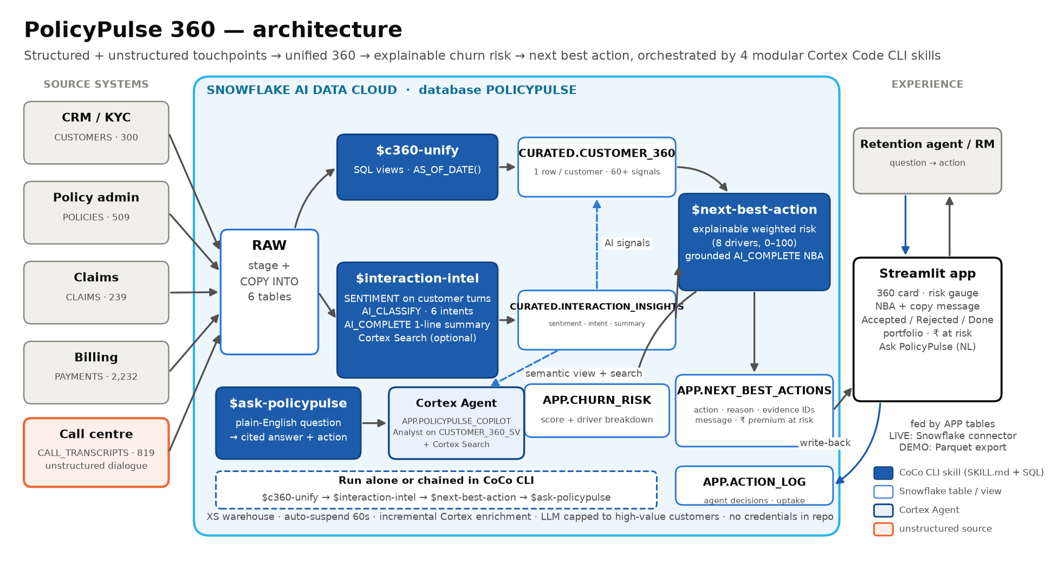
2. Architecture Diagram
4 CoCo CLI skills: $c360-unify → $interaction-intel → $next-best-action → $ask-policypulse
Structured: customers, policies, claims, payments · Unstructured: call transcripts

Slide 4
3. Impact Statement
Measured on synthetic data (real Cortex run): 67 of 300 customers (22%) flagged High risk, catching 81% of truly at-risk customers at 91% precision.
Measured on synthetic data: ₹32.9 L of ₹1.45 Cr annual premium (23%) sits in the High-risk band; 41 High-risk renewals are due within 30 days.
Projected: agent prep time ~20 min → under 30 s per customer (4 systems + recordings → one 360 card).
Projected: saving 20% of High-risk premium = ₹6.6 L per 300 customers, about ₹219 Cr per 1M customers.
Scalability: incremental Cortex enrichment and an LLM capped to high-value customers, so cost tracks new calls, not book size. Runs on an XS warehouse with auto-suspend.
Beyond the demo: portable skills on real RAW tables; next up are AI_TRANSCRIBE for call audio, dynamic tables for real-time scoring, and CRM / WhatsApp push.

Slide 5
Additional Slide: Solution Walkthrough
Customer 360 + NBA: explainable risk gauge and drivers, next best action with cited call IDs, a copyable message, and a call timeline with AI summaries.
Portfolio: ₹ premium at risk by product × risk band, intent × sentiment, the 90-day renewal pipeline, and a ranked call list.
Ask PolicyPulse: plain-English questions answered with Cortex AI_COMPLETE text-to-SQL (read-only). How it works: architecture + skills.
Cortex used: SENTIMENT · AI_CLASSIFY · AI_COMPLETE (GPT-4.1 writes the next best action) · Cortex Search · PolicyPulse Copilot agent with cited answers ($ask-policypulse).
GitHub: https://github.com/yugrajmangate-dev/neural-mavericks-policypulse360
Live app (React): https://yugrajmangate-dev.github.io/neural-mavericks-policypulse360/
Live app (Streamlit): https://neural-mavericks-policypulse360.streamlit.app/
Demo video: https://drive.google.com/file/d/1sbVZ61HSDpibyNr2ZdpOXsHa40tJKOqP/view

Slide 6


