Slide 1
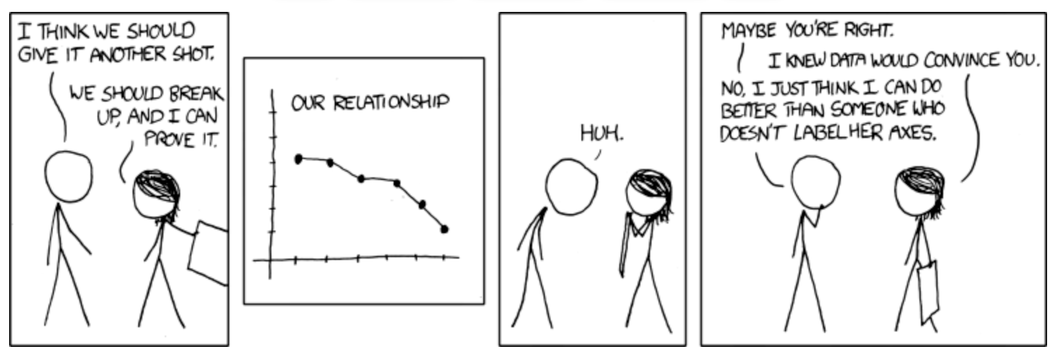
Stat 20 Fall 2020
Brief intro to ggplot2
Lecture 9: 9/16/2020
Content from Prof. Nolan’s lecture slides and Hadley Wickham’s Rpubs document: https://rpubs.com/hadley/ggplot-intro

Slide 2
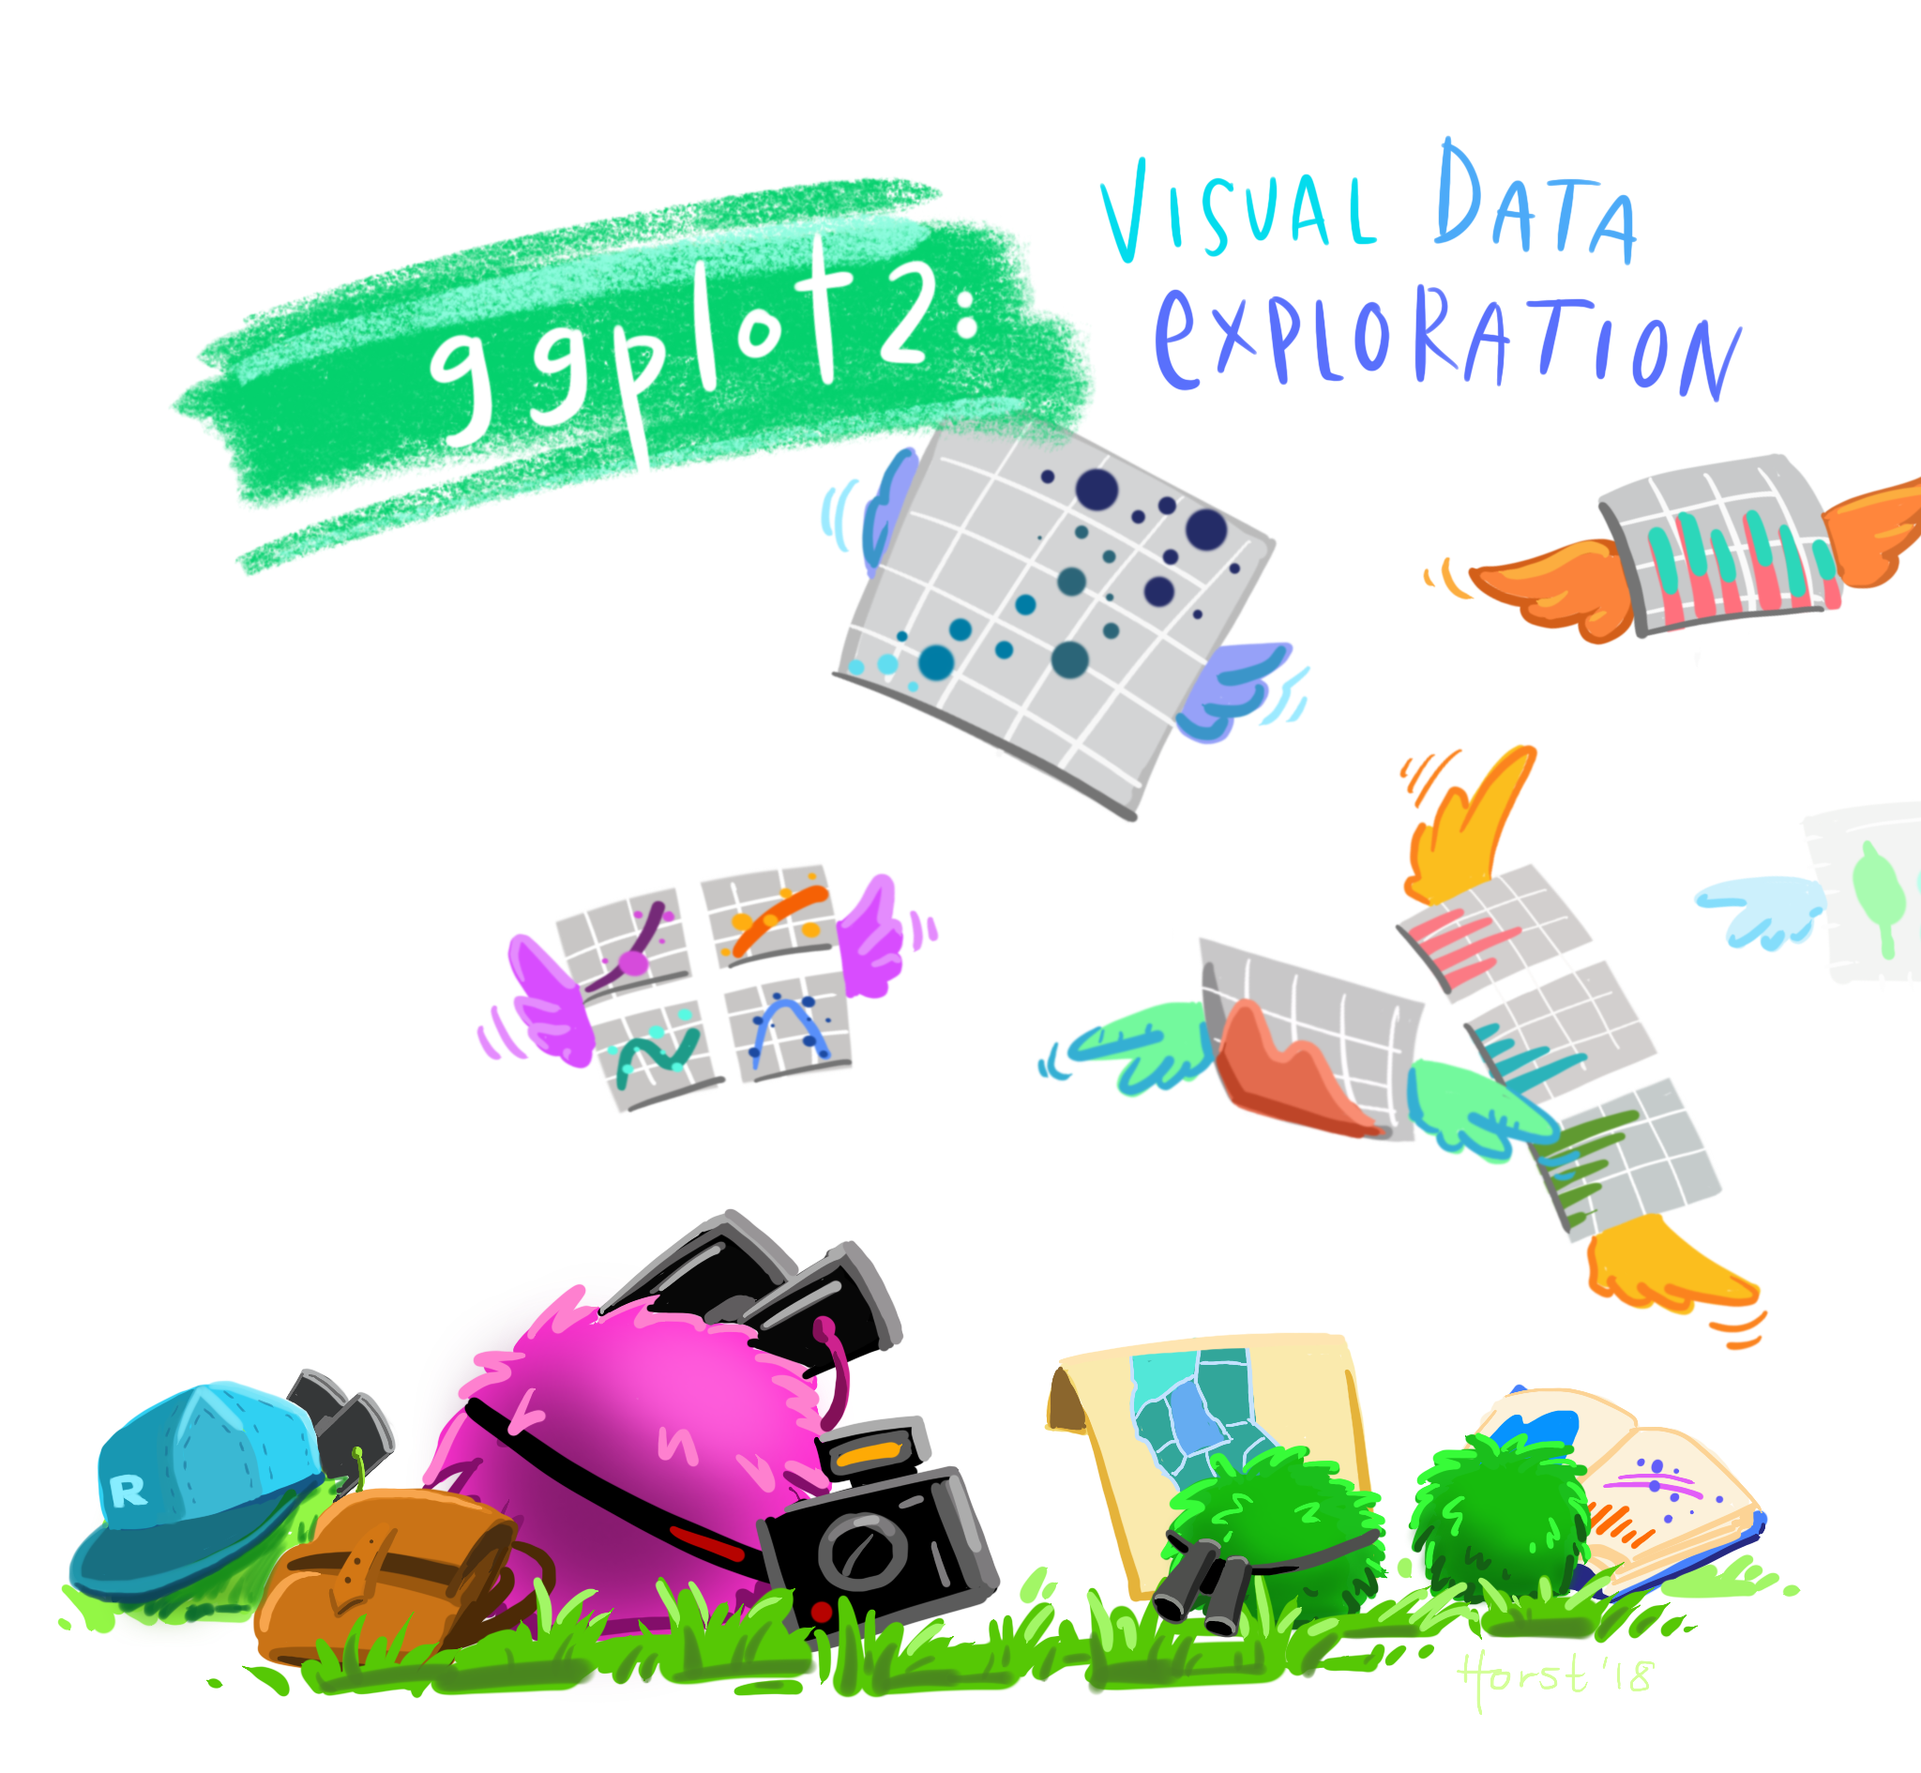
ggplot2
Functions from the package ggplot2 produce plot components (aka layers) where the argument is a data frame
Combine components in different ways with the + operator to produce a variety of plots
Artwork by @allison_horst
Notes:
gg stands for grammar of graphics

Slide 3
ggplot2 plots- key components
Every ggplot2 plot has three key components:
data (which data frame to use)
A set of ”aesthetic” mappings between variables in the data and visual properties
At least one geom (geometric object) which describes how to render each observation: points, histograms, line plots, box plots etc

Slide 4
ggplot2 - steps
Create a plot object with ggplot()
Define the data frame you want to plot
Map the aesthetics/features used to represent the data, e.g., x, y locations, color, symbol size
Specify what graphics shapes, aka, geoms, to view the data, e.g., point, bars, lines. Add these to the plot with geom_point, geom_bar or geom_line
Notes:
ggplot() creates a coordinate system that you can add layers to. The first argument of ggplot() is the dataset to use in the graph.
The function geom_point()adds a layer of points to your plot, which creates a scatterplot.

Slide 5
ggplot2 - steps
ggplot(data = <DATA>) + <GEOM_FUNCTION>(mapping=aes(<MAPPINGS>))
> ggplot(data = family)+geom_point(mapping = aes(x=height, y = weight, color = sex), size = 2, alpha = 0.6)
> ggplot(data = family,mapping = aes(x=height, y = weight,color=sex))+geom_point( size = 2, alpha = 0.6)
Notes:
ggplot() creates a coordinate system that you can add layers to. The first argument of ggplot() is the dataset to use in the graph. You can also put your aesthetic mapping there, or put it in
In the arguments for the plot that you are creating.
The function geom_point()adds a layer of points to your plot, which creates a scatterplot.

Slide 6
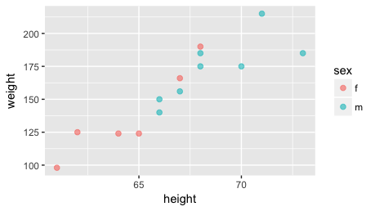
ggplot(family)+ geom_point(mapping=aes(height,weight,color=sex),size=2,alpha=0.6)
Notes:
a scatter plot, plotting each family members weight against their height, the geom is “point”
Almost every plot maps a variable to x and y, so naming these aesthetics is tedious. For that reason, the first two unnamed arguments to aes() will be mapped to x and y.

Slide 7
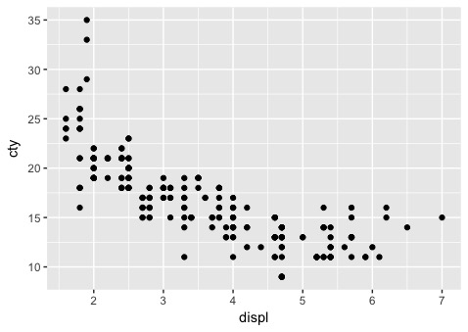
ggplot(mpg) + geom_point(aes(displ, cty))
Notes:
a scatter plot, plotting each family members weight against their height, the geom is “point”
Almost every plot maps a variable to x and y, so naming these aesthetics is tedious. For that reason, the first two unnamed arguments to aes() will be mapped to x and y.
This is a plot using data with a dataset called mpg that is included with ggplot2. It includes information about the fuel economy of popular car models in 1999 and 2008, collected by the US Environment Protection Agency, http://fueleconomy.gov. You can access the data by loading ggplot2.
hwy is highway miles per gallon and displ is engine displacement (internal size of the engine)

Slide 8
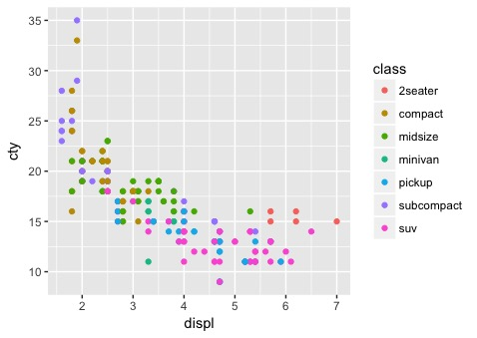
ggplot(mpg) + geom_point(aes(displ, cty, color = class))
Notes:
Let’s make the plot more informative by adding an aesthetic of color to the map and mapping it to class (kind of car).
ggplot will assign colors here by class. there is some default palette.

Slide 9
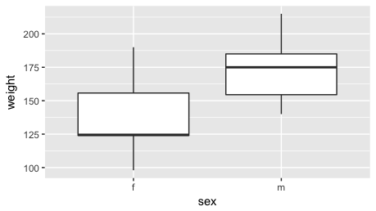
ggplot(family) + geom_boxplot( aes(x = sex, y = weight))

Slide 10
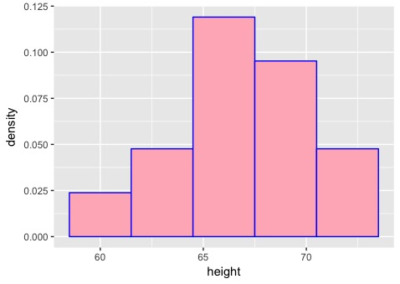
ggplot(family)+ geom_histogram(aes(x = height, y = ..density..), bins = 5, fill="light pink", color = "blue")
Notes:
note that the default on ggplot is 30 bins.

Slide 11
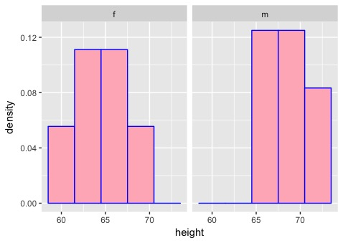
ggplot2: using facet_wrap
If we want to split the plot by some attribute, say sex, we can use facet_wrap:
ggplot(family) + geom_histogram(aes(height, ..density..), bins = 5, fill="light pink", color = "blue")+facet_wrap(~sex)

Slide 12
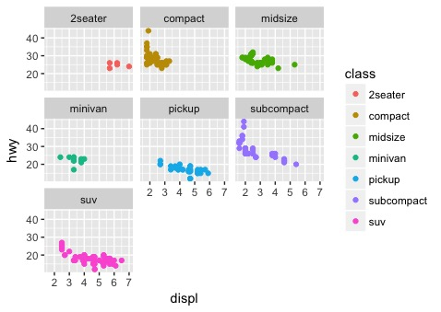
ggplot(mpg)+ geom_point(aes(displ, hwy,color=class)) + facet_wrap(~class)
Notes:
note here color is an aesthetic, mapping a variable, So ggplot will use whatever colors it uses. The first one is a red.

Slide 13
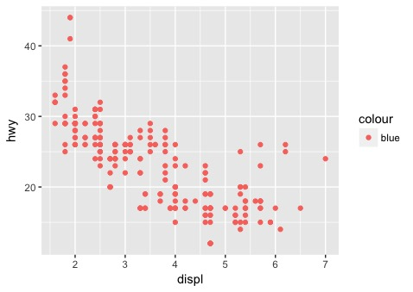
ggplot(mpg) +geom_point(aes(displ, hwy, colour = "blue"))

Slide 14
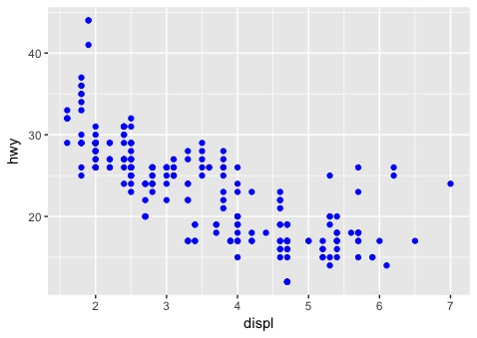
ggplot(mpg) + geom_point(aes(displ, hwy),color = "blue")

Slide 15
Structure of the function call
the data is supplied to ggplot()
The geom is added on with a + and we put the aes mappings in here.
Alternatively, the data and aes mappings are supplied to ggplot() and the geom is added on with a +
This is the general pattern, and we can make the plots more complicated by adding on more types of components.

