Slide 1

ECE795 Final Project
Stack Overflow (SO) Data Analysis
Tony Liu
Department of Electrical and Computer Engineering
University of Miami

Slide 2
Introduction

Slide 3
Contents
1. User-based Analysis
User Type
User Reputation
User Posting Frequency
2. Question-based Analysis
Answered and Unanswered Question
SO Question-answering Pyramid
3. Tag-based Analysis
Topical Trend
Variance-based Event Detection

Slide 4
Dataset and Tool
Google Cloud Platform BigQuery Public Data: Stack Overflow
Table Name | Description | Size
posts_answers | Detail for each answer: creation date, score, etc. | 22.82GB
posts_questions | Similar as above | 28.91GB
tags | All tags used to label question including how many times each tag is used | 2.21MB
users | Detail information of all users: reputation, age, etc. | 1.71GB
votes | Every vote made by users | 5.44GB
comments | The comments to all kinds of post | 13.3GB
…… | …… | ……
The data ranges from 2008-08-01 to 2019-12-01
The tables are imported into the HDFS of my GCP cluster and queried by PySpark

Slide 5
User-based Analysis
User-based Analysis
User Type
User Reputation
User Posting Frequency
Question-based Analysis
Answered & Unanswered Question
SO Question-answering Pyramid
Improve Answer Rate
Tag-based Analysis
Topical Trend
Variance-based Event Detection

Slide 6
User Type
Four Types of User
Questioner: Users who only ask questions
Answerer: Users who only answer questions
Question-and-answerer: Users who both ask and answer questions
Do-Nothinger*: Users who neither ask nor answer any question
User Type | Users | Percent (%)
Questioner | 2,277,145 | 19.19
Answerer | 923,351 | 7.78
Question-and-answer-er | 1,332,988 | 11.23
Do-Nothinger | 7,333,760 | 61.70
Total | 11,867,244 | 100.00
Most users are inactive. It is those 38% active users that makes SO successful
* Do-Nothinger are not really doing nothing in SO. They do not ask or answer questions, but they would upvote or downvote other posts

Slide 7
User Reputation
What is the reputation distribution of all users ?
Level 1: 1-100
Level 2: 101-1000
Level 3: 1001-10000
Level 4: 10001-100000
Level 5: >100000
How many questions are asked by each level of users ?
What is the reputation of the users providing answers ?
Reputation | Users (%) | Asked (%) | Unanswered (%) | Answer (%)
1-100 | 91.94 | 33.69 | 46.70 | 9.56
101-1000 | 6.35 | 31.35 | 30.74 | 19.36
1001-10000 | 1.53 | 26.86 | 19.18 | 34.17
100001-100000 | 0.17 | 7.70 | 3.28 | 26.76
>100000 | 0.0073 | 0.41 | 0.10 | 10.15
Total # of each item | Total # of users: 11,867,244 | Total # of questions: 18,276,362 | Total # of unanswered questions: 2,542,464 | Total # of answer: 27,970,762

Slide 8
User Reputation
Reputation | Users (%) | Asked (%) | Unanswered (%) | Answer (%)
1-100 | 91.94 | 33.69 | 46.70 | 9.56
101-1000 | 6.35 | 31.35 | 30.74 | 19.36
1001-10000 | 1.53 | 26.86 | 19.18 | 34.17
100001-100000 | 0.17 | 7.70 | 3.28 | 26.76
>100000 | 0.0073 | 0.41 | 0.10 | 10.15
Total # of each item | Total # of users: 11,867,244 | Total # of questions: 18,276,362 | Total # of unanswered questions: 2,542,464 | Total # of answer: 27,970,762
More than 90% users are novice user (level 1 user)
Only 1.7073% users are professional user (level 3,4,5 user).
However, these 1.7073% users provided more than 70% answers (98.13 answer / user)
A few of users are providing most answers

Slide 9
User Posting Frequency
How often do users post ?
Reputation | Post | Per user | Per user per month
1-100 | 8,831,773 | 0.81 | 0.0059
101-1000 | 11,143,718 | 14.79 | 0.11
1001-10000 | 14,465,667 | 79.23 | 0.58
100001-100000 | 8,892,982 | 454.02 | 3.31
>100000 | 2,912,984 | 3379.33 | 24.67
 |  | Avg: 3.65 | Avg: 0.027
Level 5 users are most active (almost 1 post / day)

Slide 10
User-based Analysis — Conclusion
SO users are highly polarized
User Type: 38% Doers while 62% Do-Nothingers
Reputation: More than 90% novice user while 1.7073% professional user
Posting Frequency: level 5 users are 8 times more active than other users

Slide 11
Question-based Analysis
User-based Analysis
User Type
User Reputation
User Posting Frequency
Question-based Analysis
Answered & Unanswered Question
SO Question-answering Pyramid
Tag-based Analysis
Topical Trend
Variance-based Event Detection

Slide 12
Answered and Unanswered Question
Where are the answered and unanswered questions from?
Reputation | Asked (%) | Answered (%) | Unanswered (%) | Get Answered Rate (%)
1-100 | 33.69 | 31.59 | 46.70 | 80.72
101-1000 | 31.35 | 31.45 | 30.74 | 86.36
1001-10000 | 26.86 | 28.10 | 19.18 | 90.07
100001-100000 | 7.70 | 8.41 | 3.28 | 94.07
>100000 | 0.41 | 0.46 | 0.10 | 96.61
Total # of each item | Total # of questions: 18,276,362 | Total # of answered questions: 15,733,898 | Total # of unanswered questions: 2,542,464 | 86.09
More than 60% questions are from level 1 and level 2 users
Almost half of the unanswered questions are from level 1 users
Question from higher level user is more likely to be answered
Higher level users are better at asking a clear question

Slide 13
SO Question-answering Pyramid
What will happen when a new question is asked ?
Some of the new questions will never be answered (not discussed here)
Some of them will be answered (discussed here)
How users of different level react to a new question ?
What is the reputation of the user providing the 1st answer ?
What is the reputation of the user providing the 2nd answer ?
What is the reputation of the user providing the 3rd answer ?
…..
What is the reputation of the user providing the 10th answer ?

Slide 14
SO Question-answering Pyramid
How users of different level react to a new question ?
Level 1 and 2 users are relatively increasing in later-order answer
Level 3 users are the main answer-provider in the answer of any order
Level 4 and 5 users are relatively decreasing in later-order answer

Slide 15
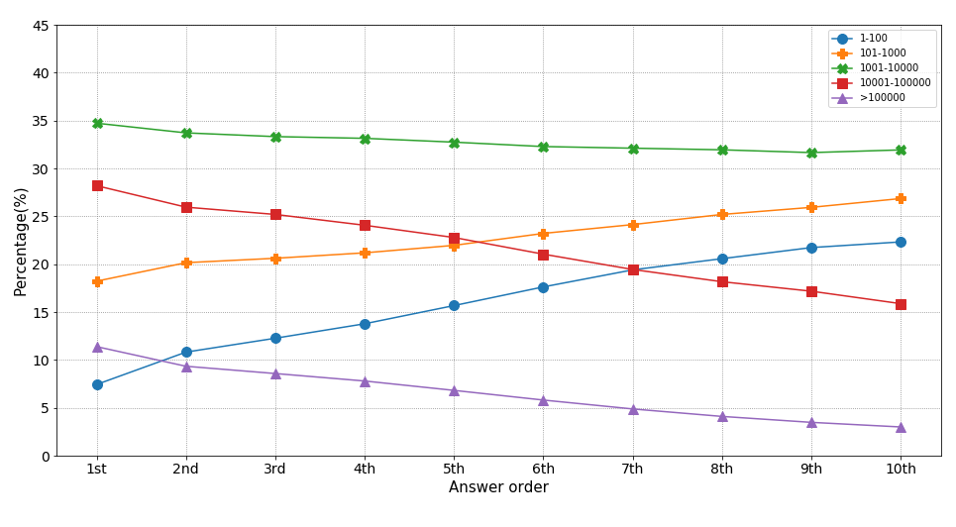
SO Question-answering Pyramid
How users of different level react to a new question ?
question
User percentage in the answer of each order
5th
Level 5 user
Level 4 user
Level 3user
Level 2 user
Level 1user
Higher level users answer the question, lower level user complete or improve the previous answers
SO is not working explicitly like this pyramid

Slide 16
Tag-based Analysis
User-based Analysis
User Type
User Reputation
User Posting Frequency
Question-based Analysis
Answered & Unanswered Question
SO Question-answering Pyramid
Tag-based Analysis
Topical Trend
Variance-based Event Detection

Slide 17
Topical Trend
Only the top 25 tags* are discussed in this part
Top N tag | Number of Relevant Questions | Percentage of Relevant Questions over All Questions (%)
25 | 11736633 | 63.11
50 | 13132132 | 70.61
100 | 14178585 | 76.24
The top 25 tags covered more than 60% questions. They are representative enough for analysis
* The top 25 tags are: javascript, java, c#, python, php, android, jquery, html, c++, css, ios, mysql, sql, asp.net, r, c, arrays, ruby-on-
rails, node.js, .net, objective-c, json, sql-server, angularjs, swift

Slide 18
Topical Trend
3 months
Count number of question of each tag
3 months
Time
08-01-2008
3 months
Count number of question of each tag
3 months
Time
Count number of question of each tag
……
3 months
Time
Count number of question of each tag
3 months
Time
12-01-2019

Slide 19
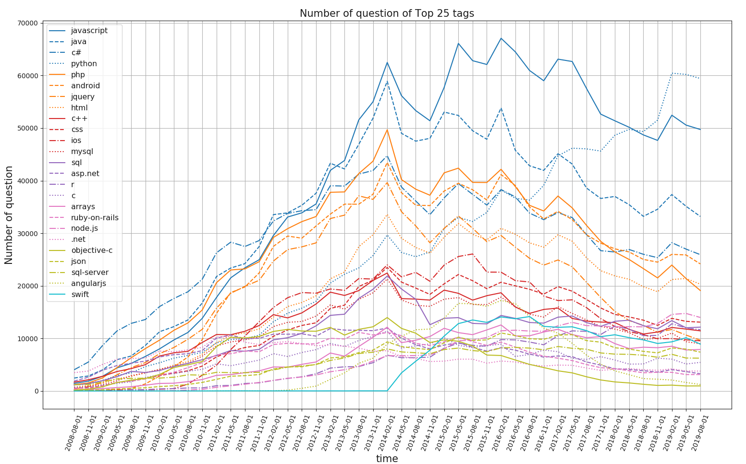
Topical Trend
In terms of absolute number of questions:
Javascript has most questions before 2018.8.1
Python has been receiving more and more attention over the years
javascript
python
java
The growing number of questions is the result of:
Growing number of users
The tag itself is more and more popular
To cancel the influence brought by increasing number of user, the result is further normalized by the total number of question within each 3 months

Slide 20
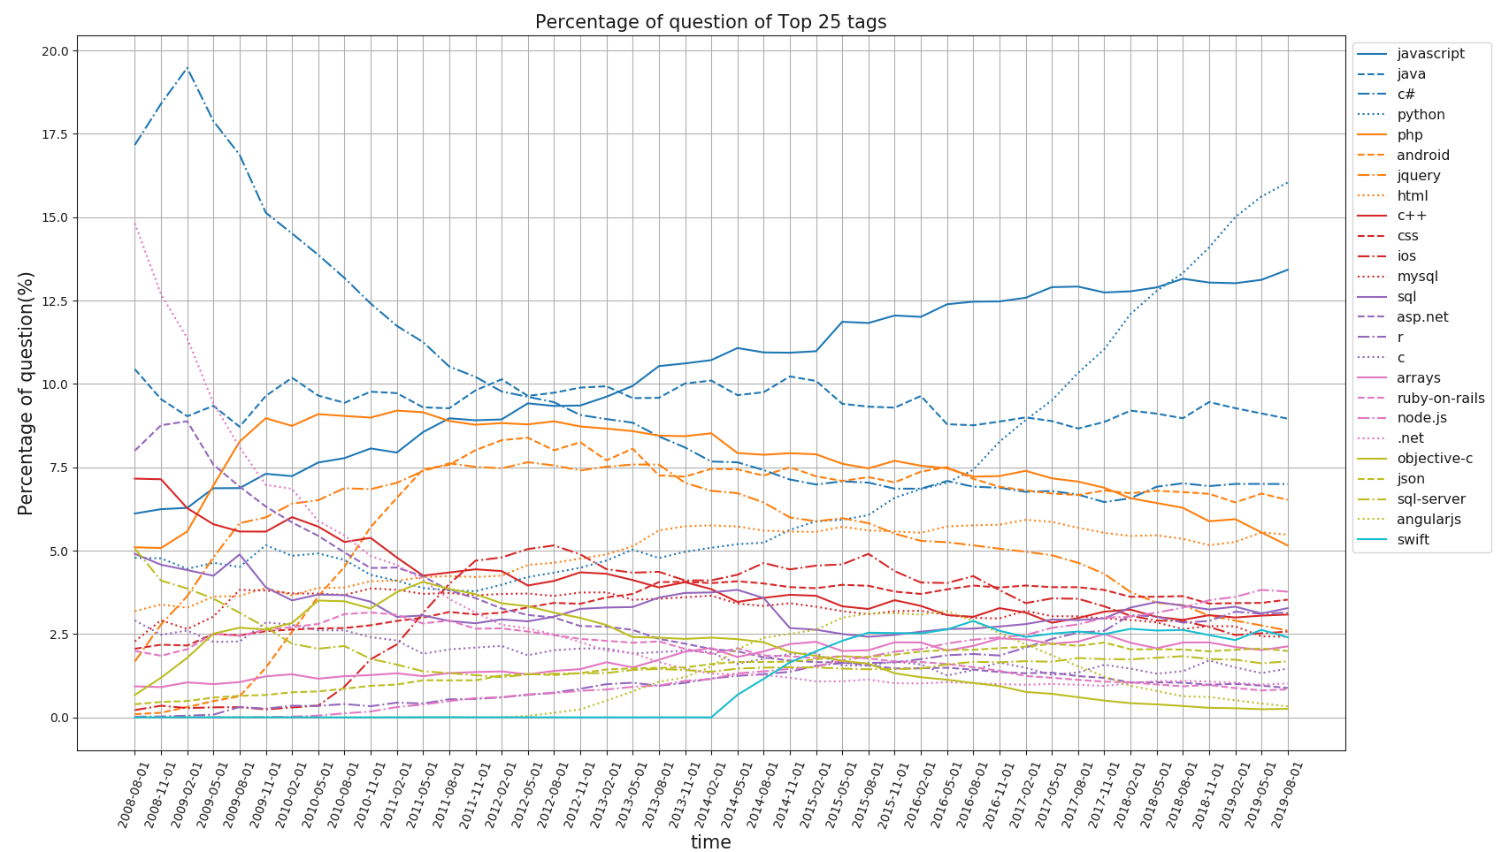
Topical Trend
c# used to be very popular, but the spotlight is gradually stolen by javascript and python
Java curve is steady, reflecting that java is always a big topic for developers
c#
python
javascript
java

Slide 21
Variance-based Event Detection
1 week
Compute the variance of the number of question of each tag
1 month
Time
Variance
08-01-2008
Compute the variance of the number of question of each tag
1 week
1 month
Time
Compute the variance of the number of question of each tag
……
1 month
Time
Time
Some event has to be happening at this peak
Compute the variance of the number of question of each tag
1 month
Time
12-01-2019

Slide 22
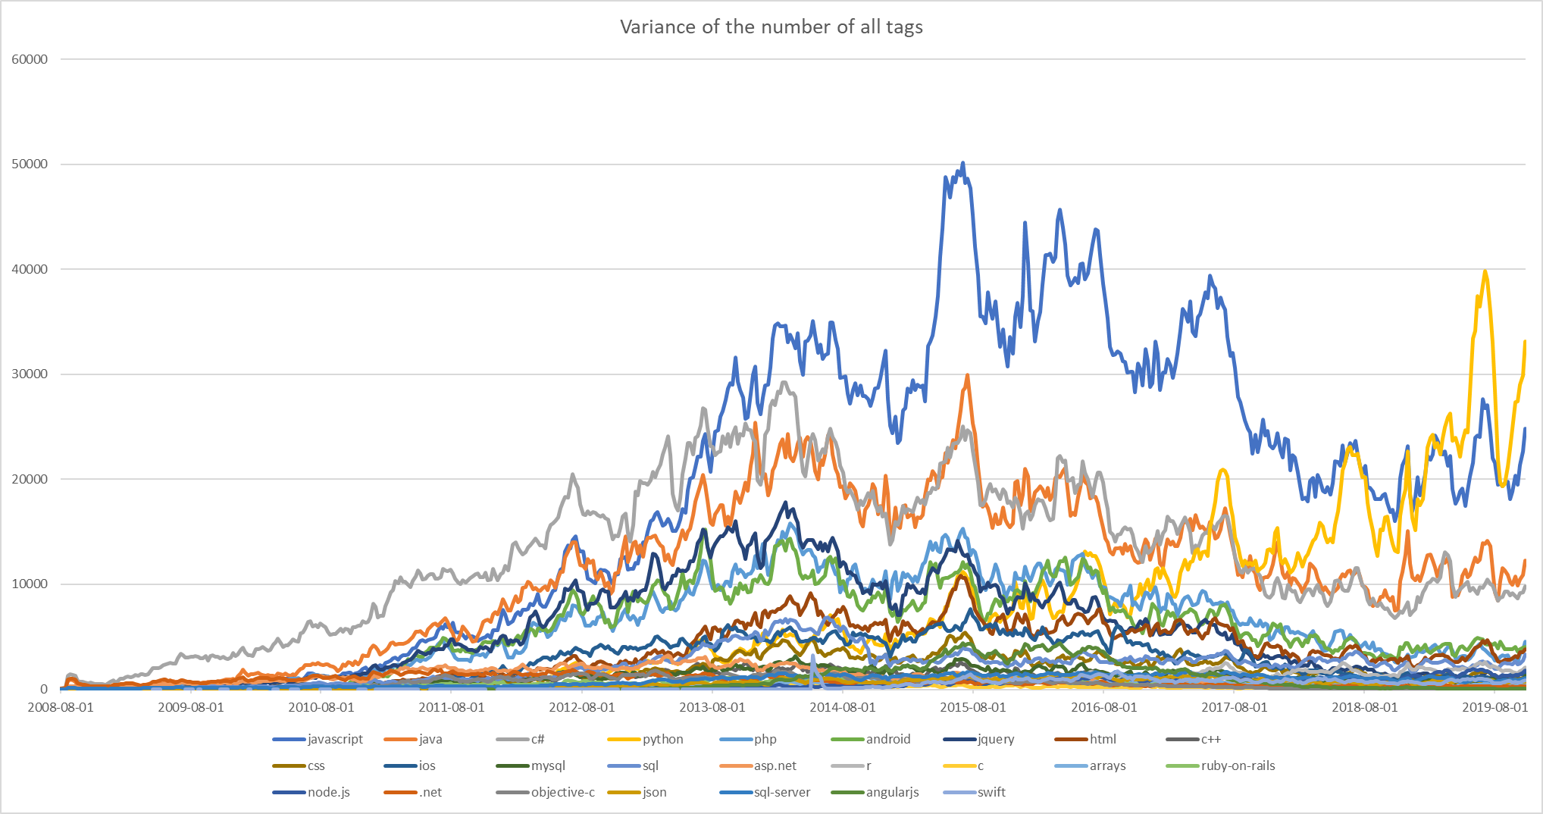
Variance-based Event Detection

Slide 23
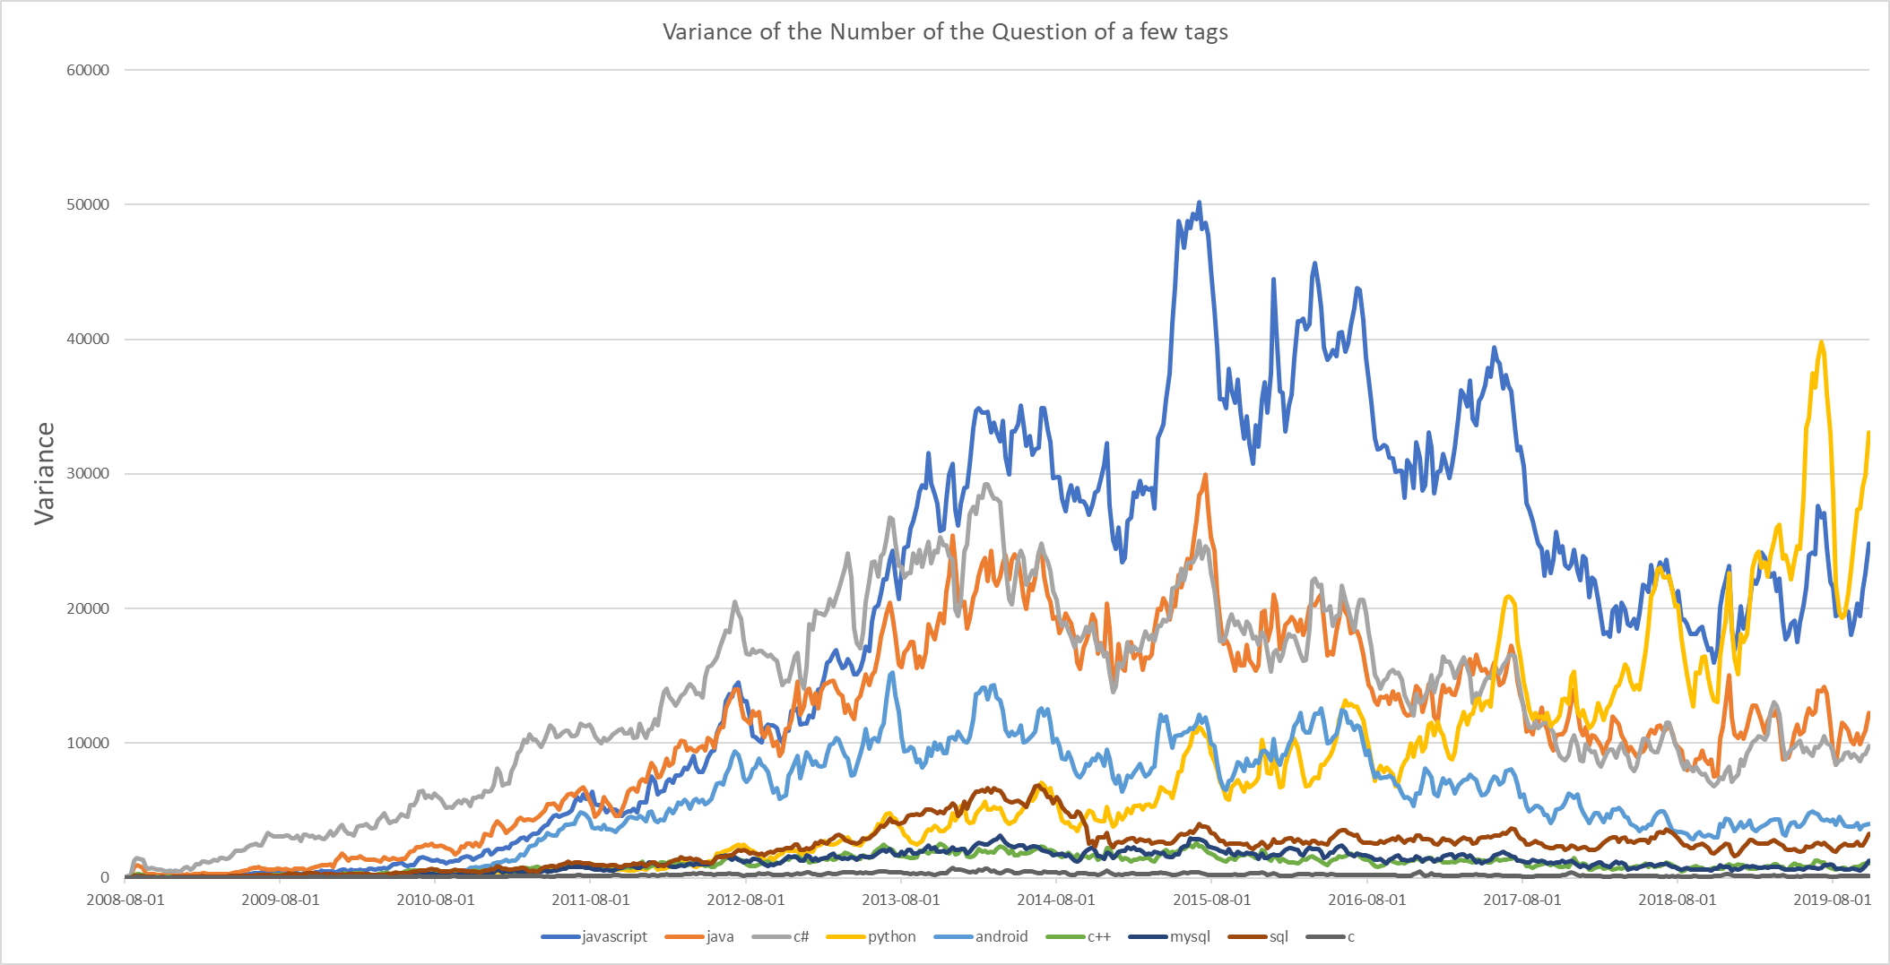
Variance-based Event Detection
(partial)
javascript
2015.5 Polymer 1.0 is released by Google
2015.6 ECMAScript 6 is released
Python
peak5
Python
peak4
Python
peak2
Python
peak3
Python
peak1

Slide 24
Variance-based Event Detection
Most of the time we just know there is an event
It is difficult to find out which event cause the variance peak:
One strong event alone may cause the peak
Many weak events together can also cause the peak

Slide 25
Thank you !
Tony Liu

