Slide 1
Two-Level Prediction Based Hybrid Transactional Memory
Yong Li
Song Zhang
Tianhao Zheng
Yuhao Zhu

Slide 2
Introduction
What is Transactional Memory (TM)
Benefits of TM
Ease parallel programming
Parallel execution of transactions
Problems of TM
Design complexity
Performance issues
Our goal: improve STM performance

Slide 3
Outline
Background and Motivation
Our Approach
Two-level prediction adaptive scheme
Evaluation
Conclusion

Slide 4
Background
HTM vs. STM
HTM: faster but more complicated
STM: flexible but slower
STM Algorithms
Acquisition and Versioning
Models & Algorithms (LLT)
Improve STM Efficiency
Hybrid Approach
Adaptive Approach

Slide 5
Motivation
Observation
Example: CounterBench in RSTM
TM vs. Lock:
Speculation & Conflict vs. Stall & Conflict-free
Key: Better to stall than speculative if doomed to abort
Start from a STM Implementation
Propose Conflict Prediction
Accelerate STM in Hardware

Slide 6
Two-Level Prediction Scheme
Goal: precisely predict if a transaction will be aborted later
First Level Prediction
based on (coarse-grained) abort ratio information
simple, fast, but less precise
Second Level Prediction
based on (fine-grained) conflict history
more accurate, but higher bookkeeping overhead

Slide 7
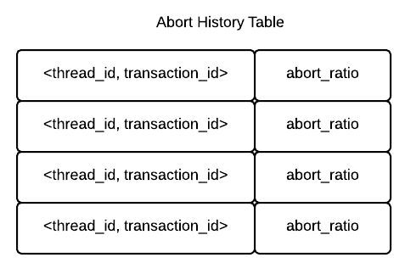
First Level Predictor
Abort History Table (AHT)
maintain per thread per transaction abort ratio
maintain overhead negligible
Quick decision: Enter TM or NOT
low abort ratio
using LLT
high abort ratio
Second Level Prediction

Slide 8
Second Level Predictor
To decide whether a thread should enter a TM even when the abort ratio is high
Hypothesis
Two transactions are very likely to conflict with each other as long as they conflict once.
Three different schemes
Brute Force Searching
Simple Hashing
Conflicted Cache

Slide 9
Brute Force Searching
Two global structures:
Conflict History Table (CHT)
One entry for each transaction
Each entry is a vector indicating the number of a particular transaction aborts current one
Active Transaction Vector (AVT)
One element for each transaction
Each element is the number of threads currently executing the transaction

Slide 10
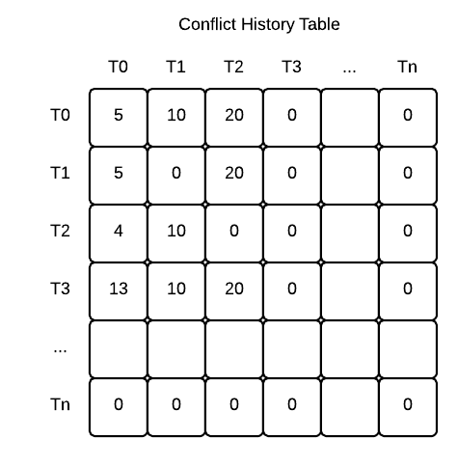
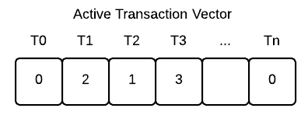
Brute Force Searching (cont.)

Slide 11
Brute Force Searching (cont.)
Prediction Scheme
check corresponding entry in CHT
for each element in the entry of CHT
check whether the transaction is alive
if any conflict transaction is alive
stall the current thread, and keep pulling status of all conflict transactions until none of them is alive
allow the thread to enter the transaction
Trade-offs
Most accurate in prediction
Unaffordable memory and computation overhead

Slide 12
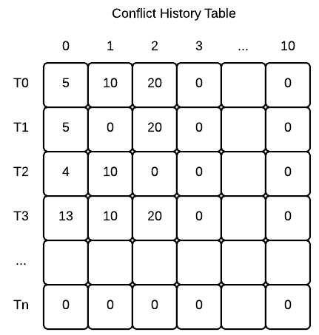
Simple Hashing
To tackle the overhead of brute force scheme
map multiple different transactions into the same vector element in CHT entry
Trade-offs
reduce entry size of CHT
false positive

Slide 13
Conflict Cache
Low Cost & Fast search
→Most recently conflicted → Conflict cache
Indexed by the transaction id
Store transaction ids that previously aborted the indexed transaction (called conflicting txs)
If any conflicting tx is active (consulting ATV), stall the indexed transaction
Avoid false positive in simple hashing
Notes:
As mentioned before, we ideally hope the table that store conflicts be low cost and can perform fast search.
It is similar to the context of cache.

Slide 14
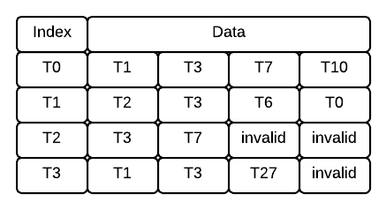
Conflict Cache
Logically set associative
Physically direct mapped
Notes:
Logically, we design the conflict cache as an set associative cache. Thus can use different policy to maintain limited number of conflict transactions in the cache.
But physically, because transaction id is very short (e.g. one byte in our configuration). It is possible and better to assign all ways to one cache line to achieve parallel search.

Slide 15
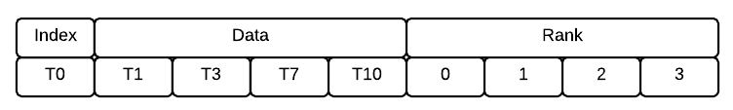
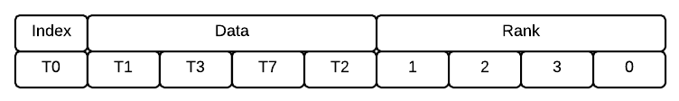
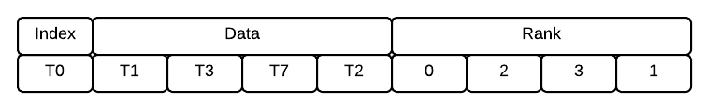
Conflict Cache
Replacement policy:
LRC: Last Recently Conflict
T0 aborted by T2
T0 aborted by T1

Slide 16
Conflict Cache
Performance
Cost
Temporal Locality
No false positive

Slide 17
ISA Support
Two new instruction (to perform AHT, CHT, conflict cache, etc. manipulation)
TM_Cond_Enter
TM_End
New programming model
TM_Cond_Enter()
some TM transaction work...
TM_End()
Notes:
TM_Cond_Enter hashes the current PC to a transaction ID to index various hardware tables (AHT, CHT, conflict cache etc.) depending on which level-2 prediction scheme to use. If the transaction is scheduled to execute (speculatively) according to our prediction, ATV will be updated to indicate that this transaction becomes active and the thread continues executing the rest instructions in the transaction. If a transaction is scheduled to stall, a conditional branch will point the control flow to the TM_Cond_Enter instruction again.

Slide 18
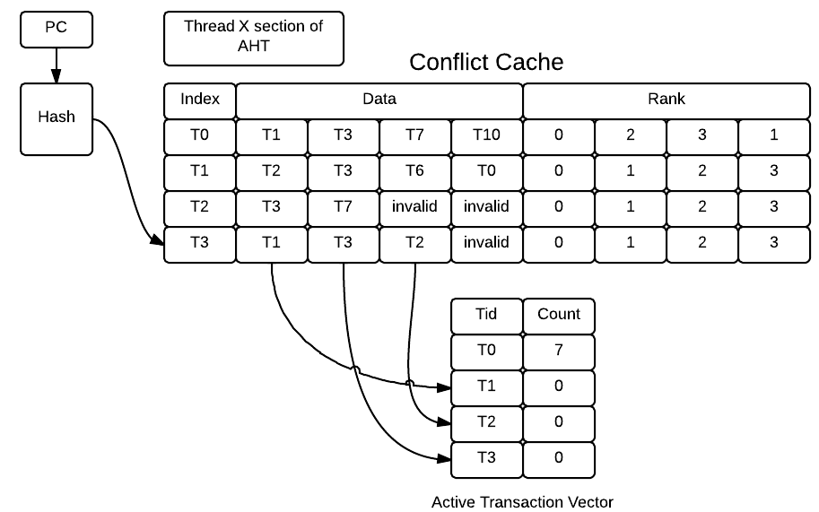
Microarchitecture Support
Switch with thread

Slide 19
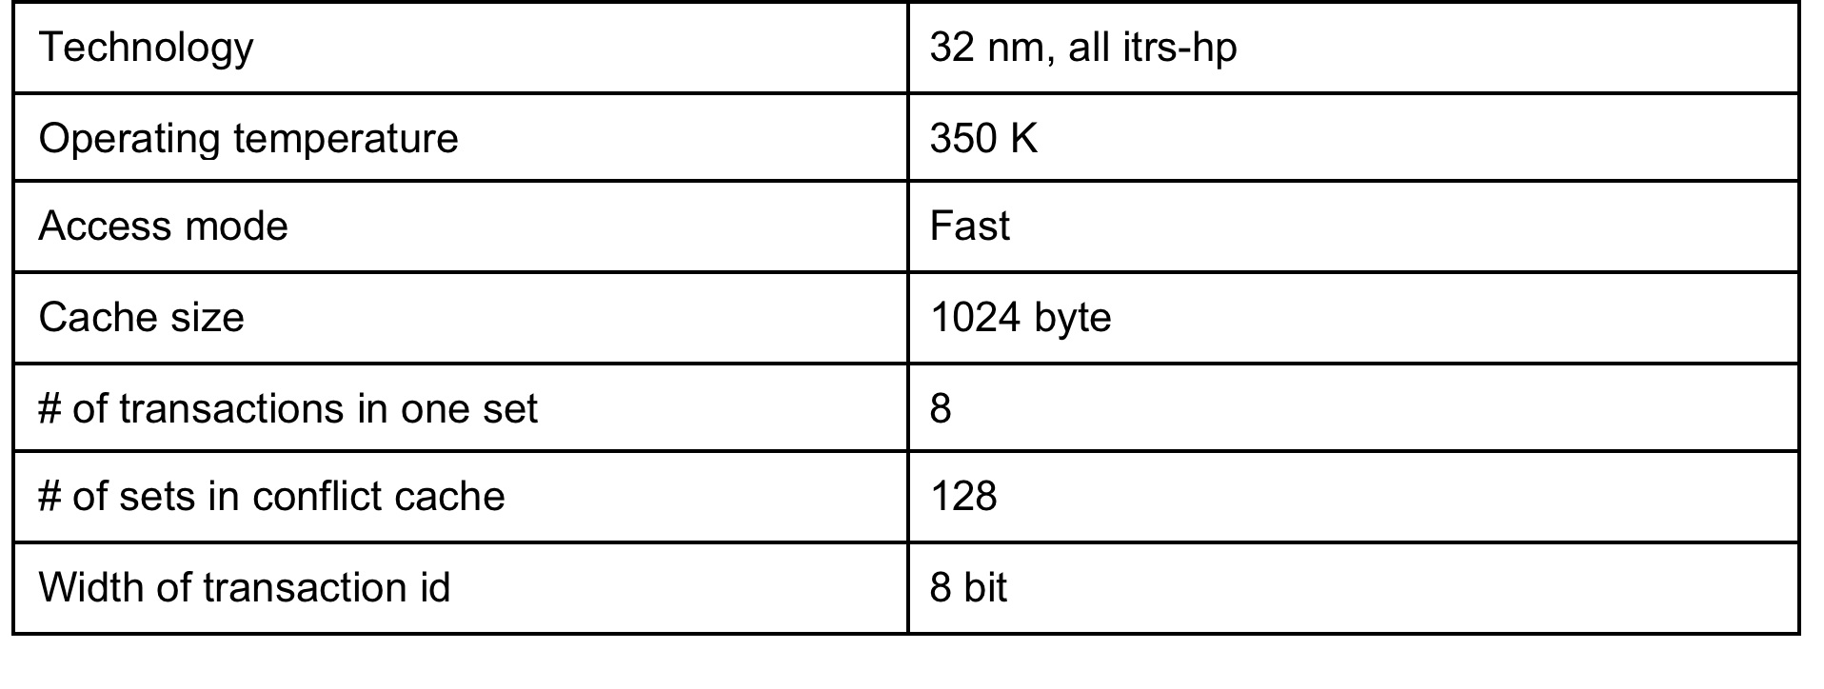
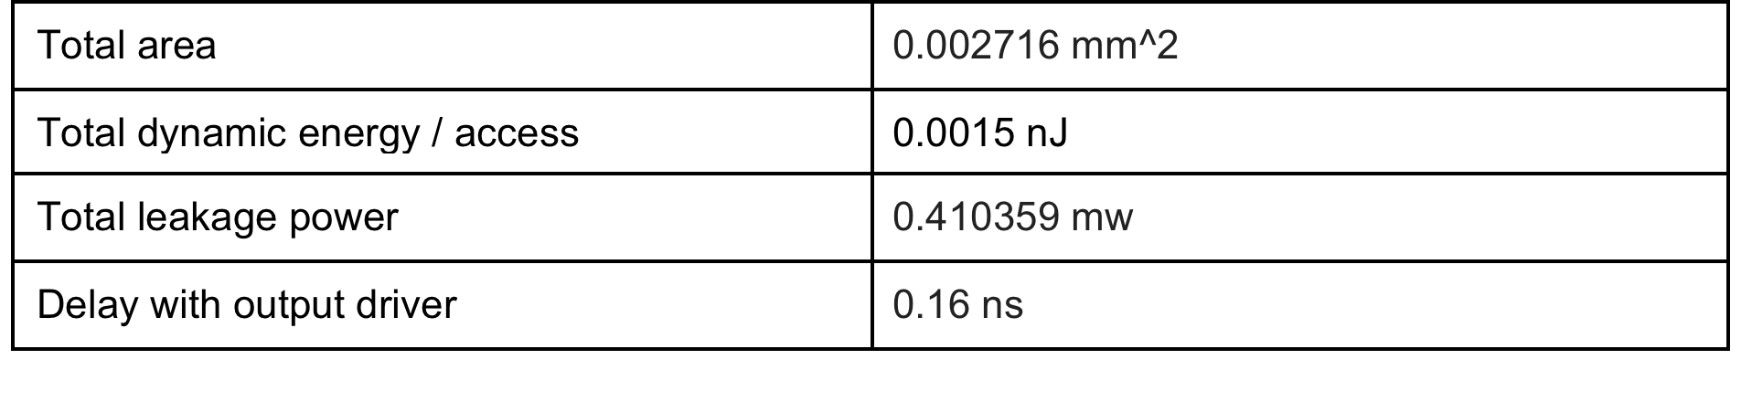
Power, Area and Timing Estimation
Configuration
Results
CACIT 6.5

Slide 20
Evaluation
Modified RSTM for software implementation
LLT as the baseline
Only libraries modified, no application source-level change required
Carefully use fine-grained locks...
Evaluated on STAMP Benchmark
Both high/low contention applications
Both long/short transaction applications
24-core Xeon X5560 system
4-socket, penalize lock synchronizations
256 threads to create contentions; mean of 5 runs
RSTM: http://www.cs.rochester.edu/research/synchronization/rstm
STAMP: http://stamp.stanford.edu

Slide 21
Evaluation
Two-level prediction effectively reduces the abort rate significantly
Abort Rate
 | bayes | genome | intruder | kmeans1 | kmeans2 | vacation1 | vacation2 | ssca2
LLT | 79.2% | 2.51% | 1004% | 98.24% | 388.27% | 0.87% | 6.64% | 0.0067%
Two-level | 3.39% | 0.47% | 8.01% | 7.31% | 8.91% | 0.49% | 1.56% | 0.00043%

Slide 22
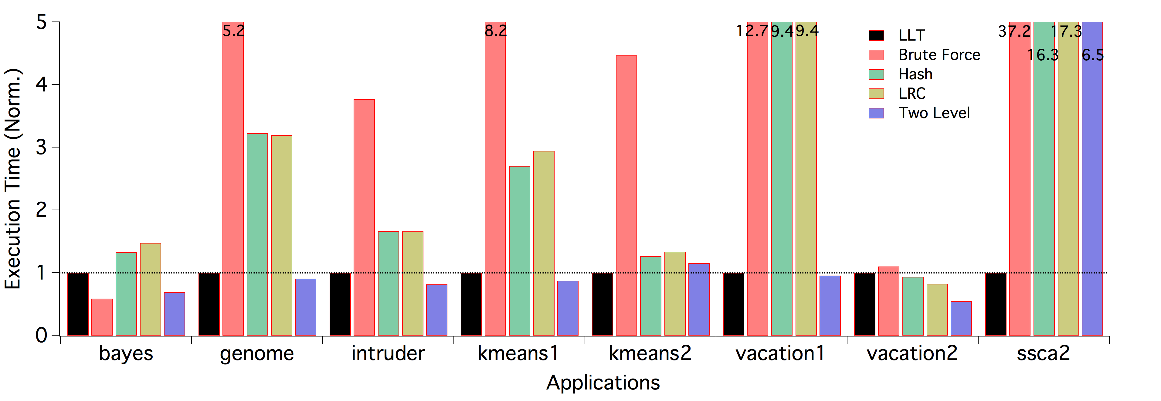
Evaluation
Execution time normalized to LLT

Slide 23
Evaluation
Brute force overhead generally is unaffordable
Very few transactions
Very long transactions
Very high contention (79.2%)

Slide 24
Evaluation
Simple hashing reduces searching overhead
False Positive!

Slide 25
Evaluation
Pure conflict cache only checks most recently conflicted transactions
No Temporal Locality!

Slide 26
Evaluation
Two-level scheme generally outperforms LLT
Very low contention (0.0067%)
Very short transactions

Slide 27
Conclusion
We asked a fundamental question: when do we choose between transactional memory and locks?
Better to stall a transaction if it will be aborted later
We proposed a two-level prediction strategy that dynamically adapts between TM and locks
Our pure STM implementation achieves 17.2% improvement on high-contention applications
Preliminary analysis also shows hardware acceleration is promising

Slide 28
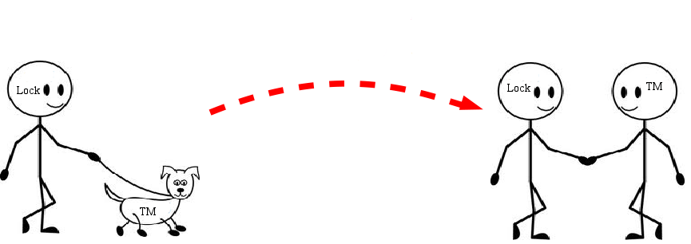
Thanks!

Slide 29
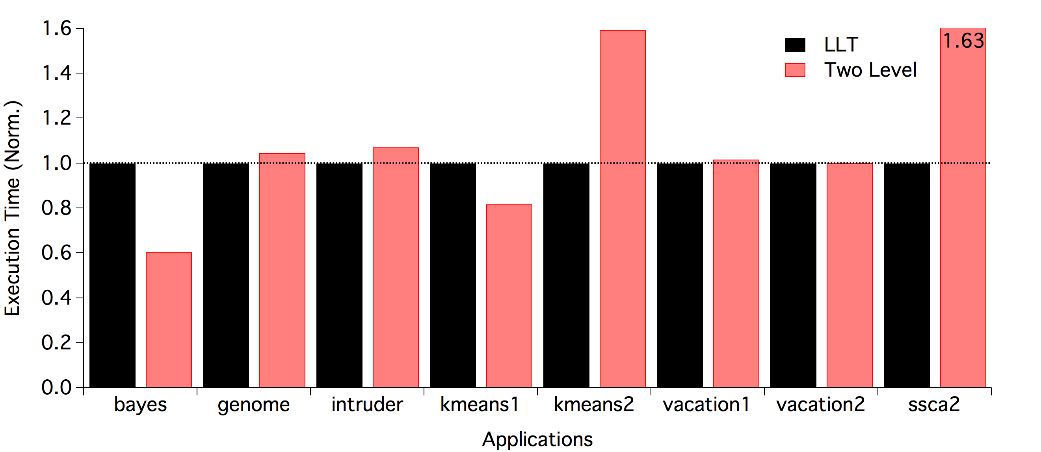
Evaluation
Dual core: less contention

