Slide 1
AOS reading report
2018311763 于灏

Slide 2
The UNIX Time Sharing System
D. M. Ritchie and K. Thompson

Slide 3
Abstract
Hardware and software environment
File system
Type
Protection
IO
Process
Shell
Trap

Slide 4
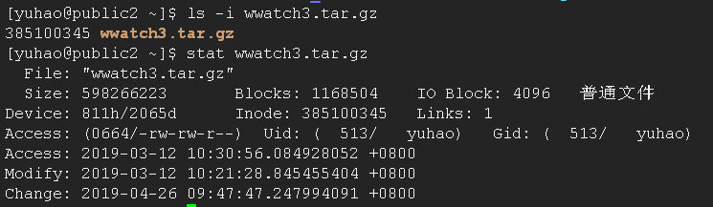
File system
When a new file is created, an i-node is allocated for it and a directory entry is made that contains the name and i-node number.
OS finds the i-node number corresponding to the file name.
The i-node information is obtained through the i-node number.
According to the i-node information, the block in which the file data is located is found.
Notes:
Inode
* 文件的字节数
* 文件拥有者的User ID
* 文件的Group ID
* 文件的读、写、执行权限
* 文件的时间戳，共有三个：ctime指inode上一次变动的时间，mtime指文件内容上一次变动的时间，atime指文件上一次打开的时间。
* 链接数，即有多少文件名指向这个inode
* 文件数据block的位置

Slide 5
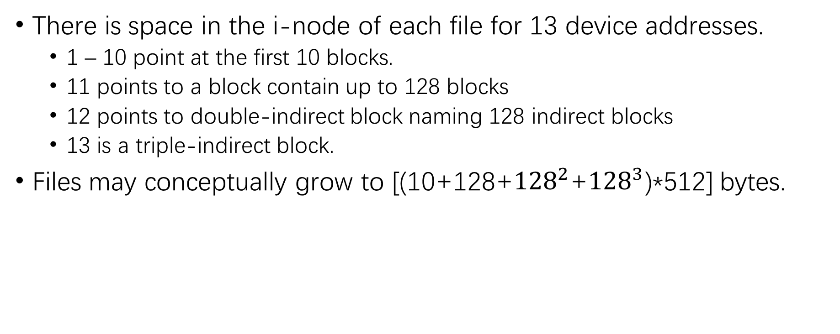
File system
There is space in the i-node of each file for 13 device addresses.
1 – 10 point at the first 10 blocks.
11 points to a block contain up to 128 blocks
12 points to double-indirect block naming 128 indirect blocks
13 is a triple-indirect block.
Files may conceptually grow to [(10+128+${128}^{2}$+${128}^{3}$)*512] bytes.
1 | …… | 9 | 10 | 11 | 12 | 13
128
128
128
128
128
128

Slide 6
Shell
Implementation
“read” call returns;
Shell analyzes the command line;
“fork” is called and a child process is created;
Child perform an “execute” with arguments;
Parent “wait” for child process to DIE.
Also use “<”, “>”, “&”, “|”, etc.
Notes:
fork用来创建一个子进程。用fork函数创建子进程后，子进程往往要调用一种exec函数以执行另一个程序，当进程调用一种exec函数时，该进程完全由新程序代换，而新程序则从其main函数开始执行，因为调用exec并不创建新进程，所以前后的进程id 并未改变，exec只是用另一个新程序替换了当前进程的代码段，数据，堆和栈段没有替换。
在ucore操作系统中，当一个用户父进程创建自己的子进程时，父进程会把其申请的用户空间设置为只读，子进程可共享父进程占用的用户内存空间中的页面（这就是一个共享的资源）。当其中任何一个进程修改此用户内存空间中的某页面时，ucore会通过page fault异常获知该操作，并完成拷贝内存页面，使得两个进程都有各自的内存页面。这样一个进程所做的修改不会被另外一个进程可见了。

Slide 7
Perspective
Our goals have always been to build a comfortable relationship with the machine and to explore ideas and inventions in operating systems and other software.
1. make it easy to use;
2. the size constraint has encouraged not only economy, but also a certain elegance of design;
3. willing to revise and rewrite the system and its software when new ideas were invented or discovered.
Notes:
我们的目标始终是与机器建立舒适的关系，并探索操作系统和其他软件中的想法和发明。
尺寸限制
愿意在发明或发现新想法时修改和重写系统及其软件。

Slide 8
Locating Cache Performance Bottlenecks Using Data Profiling
Aleksey Pesterev, Nickolai Zeldovich, Robert T. Morris

Slide 9
Main idea
DProf helps programmers understand cache miss costs by attributing misses to data types instead of code, and locate data structures that experience misses in many place.
It introduces a number of new views of cache miss data:
Data profile
Working Set
Miss Classification
Data flow graph
Notes:
DProf帮助程序员理解缓存未命中开销，通过将未命中归因于数据类型而不是代码，并定位在许多地方遇到未命中的数据结构。
它介绍了许多缓存未命中数据的新视图：

Slide 10
Introduction
DProf ’s goal is to help programmers understand and eliminate cache misses.
Accumulate traces of running software’s references to memory addresses;
Categorize all types of cache misses;
Identifies the types of data participating in each miss;
Generate four different views;
Notes:
DProf的目标是帮助程序员理解并消除缓存未命中。
收集运行软件对内存地址的引用;
分类所有类型的缓存未命中;
标识参与每个未命中的数据类型;
生成四种不同的视图;

Slide 11
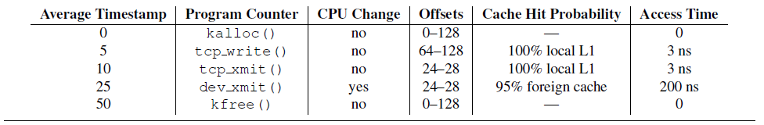
Generating Views
DProf collects two kinds of data to help it generate views.
path traces:
Records the life history of a particular data object, from allocate to free.
Collects path traces for a objects and combines the traces of objects of the same type if those objects are touched by the same sequence of instructions.
address set:
includes the address and type of every object allocated during execution.
DProf uses the address set to map objects to associativity sets in the cache.
Notes:
每个路径跟踪根据读取或写入对象的指令位置序列记录特定数据对象的从分配到释放的生命历史，从分配到释放。该序列可以来自单个执行线程，但也可以涉及来自同时使用相同对象的多个核的指令.
这个表就是path trace
DProf收集在执行期间分配的随机选择的对象的路径跟踪，并且如果这些对象的指令序列相同，且类型相同，就把对其路径的跟踪组合起来。 对于组合跟踪中的每个访问指令，DProf记录指令在高速缓存层次结构的不同级别中的命中概率，访问数据的平均时间，自对象分配以来的平均时间，以及指示执行的指令的标志。
CPU change flag指示该程序计数器是否在与前一个CPU相同的CPU上遇到，或者在另一个CPU上遇到。 offset表示在此程序计数器位置访问的数据结构的偏移量。 缓存命中概率指示使用系统中的不同缓存满足内存访问的时间百分比，访问时间指示等待该内存引用所花费的平均时间。 执行路径由程序计数器值序列和CPU更改标志定义，DProf跟踪每种数据类型的每个执行路径的查看频率。

Slide 12
Generating Views
Data Profile:
For type T, DProf combines all of the path traces for T. The CPU bounce flag in T’s data profile will be set if any path trace for T indicates a CPU change.
Working Set:
DProf run a cache simulation, randomly picks objects from the address set and paths from the path traces and simulates the memory accesses.
Then counts how many distinct pieces of memory are ever stored in each associativity;
The associativity sets with the highest counts are the most likely to be suffering associativity conflict misses;
Also count the number of each data type that is present in the cache, suggest ways to reduce the working set size.
Notes:
DProf计算每个关联集中存储的不同内存块数。 具有最高计数的关联性集最有可能遭受相关性冲突未命中。 程序员可以使用直方图来查找使用高度竞争关联集的数据类型，从而导致冲突未命中。 DProf报告关联集所包含的类型以及集中每种类型的不同实例的数量。
DProf还计算缓存中存在的每种数据类型的数量，在模拟中取平均值。 程序员可以使用这些计数来建议减少工作集大小的方法，以避免容量丢失。 查找主导工作集的数据类型可能并不总能揭示为什么这些类型的实例太多。为了解决这个问题，DProf的工作集视图不仅报告在缓存中找到的最常见的数据类型，还报告这些数据类型所采用的执行路径。

Slide 13
Generating Views
Miss Classification
DProf use path traces to classify cache misses into three categories:
Invalidations
DProf uses path traces to identify misses due to invalidations, and thus to identify instructions that cause invalidations.
Conflict misses
Determine what associativity sets a particular data type falls into;
Determine whether those associativity sets are used to store significantly more data than other sets.
Capacity misses
The total amount of data actively used by the software is greater than the size of the cache.
Notes:
当一个核心的缓存中有数据而第二个核心写入数据时，会发生失效; 处理器的缓存一致性协议从第一个核心的缓存中删除数据，并且核心对数据的下一次访问将会丢失。 DProf使用路径跟踪来识别由于失效而导致的未命中，从而识别导致失效的指令。 对于每个路径跟踪中的每个未命中，DProf在跟踪中向前搜索以从不同的CPU写入相同的高速缓存行。 如果存在这样的写入，那么未命中是由于无效。
当软件频繁访问映射到同一关联集的N个不同缓存行时，会发生冲突未命中。 为了检测冲突未命中，DProf必须首先确定特定数据类型所属的关联集，然后确定这些关联集是否用于存储比其他集更多的数据。
当软件（工作集）主动使用的数据总量大于缓存大小时，会发生容量未命中。 DProf通过估计工作集的主要内容来帮助程序员理解容量缺失。

Slide 14
Collecting Path Traces and Address Sets
DProf constructs an address set by instrumenting the allocator to record allocation and deallocation of all objects.
DProf pieces together path traces by sampling raw data from CPU performance monitoring hardware.
access samples: records information for a memory-referencing instruction execution;
object access histories: a complete trace of all instructions that read or wrote a particular data object.
Notes:
DProf通过检测分配器来记录所有对象的分配和释放以及它们的类型信息来构造地址集。
raw data有两种
访问样本：记录内存引用指令执行的信息
对象访问历史记录:读取或写入特定数据对象的所有指令的完整跟踪，从分配时到释放时。

Slide 15
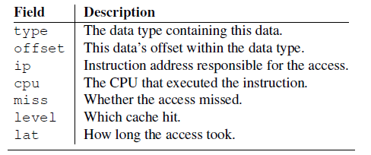
Collecting Path Traces and Address Sets
Access Samples
DProf use Instruction Based Sampling(IBS) to collect access samples.
IBS tags an instruction that is about to enter the CPU’s pipeline. As a tagged instruction moves through the pipeline, built-in hardware counters keep track of major events.
Notes:
IBS是一种硬件功能，允许详细的CPU执行采样。
IBS标记即将进入CPU管道的指令。 当标记指令在管道中移动时，内置硬件计数器会跟踪主要事件，如缓存未命中，分支未命中预测和内存访问延迟。 当标记的指令退出时，CPU发出中断，提醒操作系统IBS样本已准备就绪。
IBS报告每个样本的指令地址以及访问存储器的指令的物理和虚拟内存地址。 IBS结果偏向于在流水线阶段花费更多时间的指令。

Slide 16
Collecting Path Traces and Address Sets
Access Samples
DProf use Instruction Based Sampling(IBS) to collect access samples.
Software start IBS
Wait for interrupt
Collect information
Resolve data type
IBS begin
Tag instruction
instruction begin
Instruction retired
core issue interrupt

Slide 17
Collecting Path Traces and Address Sets
To construct an access sample, DProf needs to compute the type and offset that corresponds to the memory address.
DProf implements a memory type resolver whose job is to generate a type and offset for any memory address at runtime.
Dynamically-allocated memory:
Modifies the allocator to keep track of the type of all outstanding allocations.
Statically-allocated memory:
Look the debug information.
Notes:
DProf采用C风格的数据类型。 它的对象在内存中是连续的，字段位于顶层对象基址的众所周知的偏移处。
对于给定的地址，解析器查找该地址所属的对象类型以及该对象的基址。 从地址中减去基地址会将偏移量提供给类型，该类型用于推断字段。

Slide 18
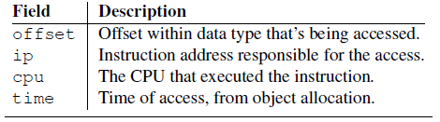
Collecting Path Traces and Address Sets
Object Access Histories:
Recording all instruction pointers that access a given object.
DProf use debug registers that generate an interrupt for every access to a given address to monitor object.
When an allocation happens, DProf configures the debug registers to trace the given offset within the memory region.
Notes:
DProf在所有CPU上一次监视一个对象。 当一个调试寄存器变得可用时，DProf决定它想要监视的对象类型，重点关注访问样本中最常见的对象。 DProf在该数据类型中选择要监视的偏移量。 然后DProf与内核内存分配器协作以等待直到分配该类型的对象。 当分配发生时，DProf在每个CPU上配置调试寄存器以跟踪新分配的内存区域内的给定偏移量，直到最终释放对象，并释放调试寄存器。

Slide 19
Collecting Path Traces and Address Sets
Path Trace Generation
Combines the two data sets to create path traces for each data type.
First, aggregates all access samples that are same.
Augments object access histories with data from the access samples by adding the miss, level.
Combines all augmented object access histories that have the same execution path.
Notes:
一旦收集了访问样本和对象访问历史记录，DProf就会将这两个数据集组合在一起，为每种数据类型创建路径跟踪。
首先，DProf聚合具有相同type，offset和ip值的所有访问样本，以计算通过给定指令访问特定类型的存储器的平均cost。
然后，DProf通过将来自访问样本的miss，level和lat添加到具有相同type，offset和ip值的对象访问历史记录中，使用来自访问样本的数据来增强对象访问历史。最后，DProf通过聚合它们的time，miss，level和lat，组合具有相同执行路径（相同的ip值序列和等效的cpu值序列）的所有增强对象访问历史。给定类型的所有组合历史记录都是该类型的路径跟踪。

Slide 20
Collecting Path Traces and Address Sets
What DProf need?
Hardware: AMD Instruction Based Sampling (IBS)
Detailed CPU execution sampling and report instructions address.
Hardware: Debug Registers
Monitor data object and report the resulting offset access histories
OS: Linux memory allocator
Record allocation and deallocation of all object and type for address set.

Slide 21
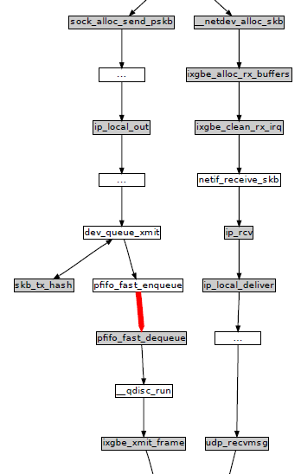
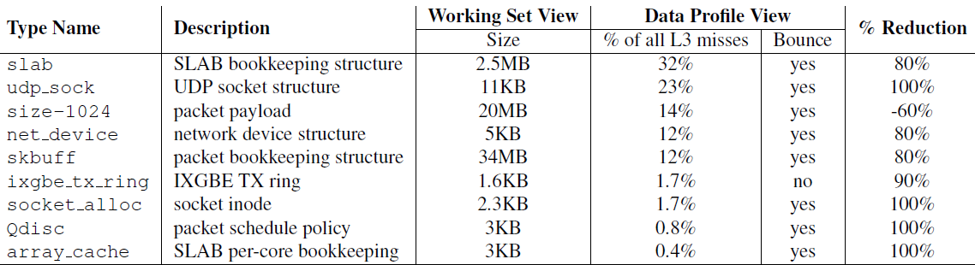
Evaluation—Memcached
Data flow for skbuffs. ‘skbuffs’ on the transmit path jump from one core to another between a call to pfifo_fast_enqueue and pfifo_fast_dequeue.
Choose the local queue rather than balancing transmit load by hashing to a remote queue.
Modifying the kernel in this way increased performance by 57%.
Notes:
Ture-sharing
In-memory key-value store often used in speedup web application
Skbuffs在pfifo_fast_enqueue and pfifo_fast_dequeue两个函数时进行了核之间的转换（粗线）
改变了队列选择策略后提升了效率

Slide 22
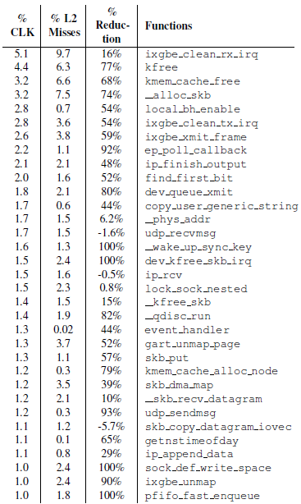
Evaluate with OProfile
OProfile is an execution profiler, reporting the cost of each function or line of code.
It is hard to tell which functions are potential performance problems, since none stand out.
Notes:
memcached基准测试强制内核每秒分配，传输和释放数百万个数据包; ixgbe_clean_rx_irq，kfree和kmem_cache_free位于列表的顶部是合理的。
在检测dev_queue_xmit之前有很多函数需要一一检查，
占用的时钟周期，cache miss率，改进之后提高的

Slide 23
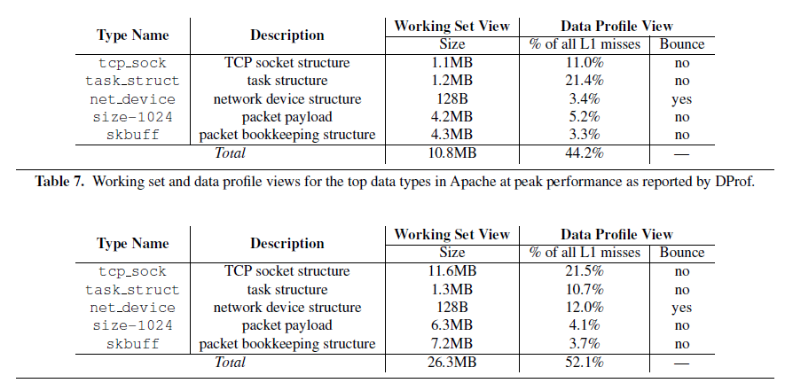
Evaluation—Apache
Notes:
Working set
上图是Apache峰值运行的时候，下图是Apache的性能下降的时候。
Data flow图体现了tcp_sock在性能下降时从分配空间到释放空间的时间延长了
在峰值运行时，Apache的请求队列比较少，可以迅速处理请求，
在性能下降时，队列到达极限，tcp_sock已经被L1赶出去了

Slide 24
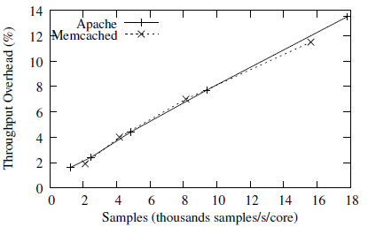
Access Sample Overhead
The overhead comes from taking an interrupt to save an access sample.
The overhead is proportional to the sampling rate
Notes:
开销与采样率成比例

Slide 25
Conclusion
This paper presents DProf, a data-oriented profiler that attributes cache misses to specific data types.
Programmers can use DProf’s data-oriented views to locate and fix different causes of cache misses in their applications, which may be difficult to locate using CPU profilers.
Our fixed Linux kernel achieves 16–57% throughput improvement running a range of workloads.
Notes:
第一个57
第二个16

Slide 26
Similar projects on Linux
Pin: Building Customized Program Analysis Tools with Dynamic Instrumentation
A tool for instrumentation — a technique for inserting extra code into an application to observe its behavior — to build a wide variety of program analysis tools.
Notes:
Intel搞的

Slide 27
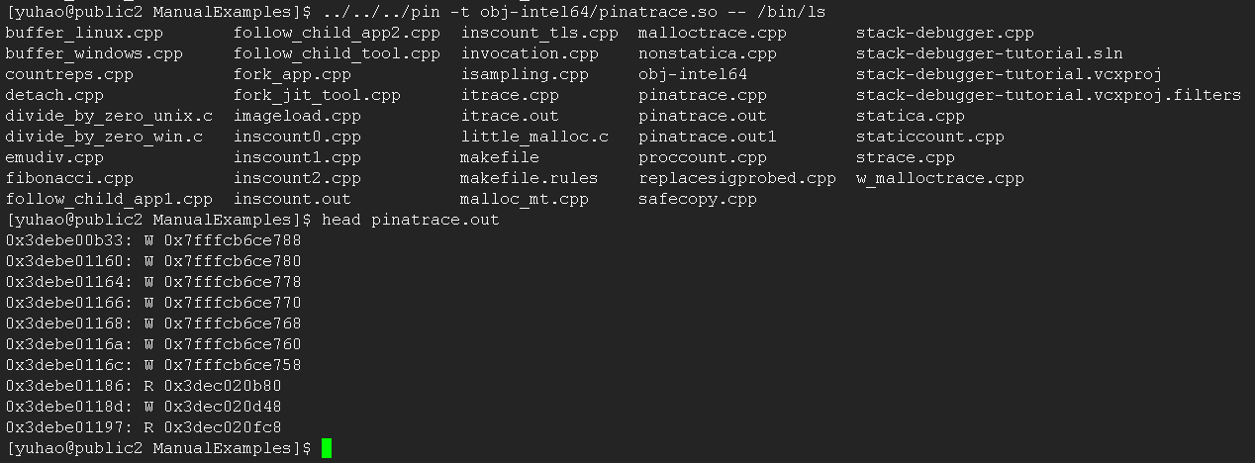
“pinatrace” generates a trace of all memory addresses referenced by a program

Slide 28
Thank you

