Slide 1
Fault in Linux: Ten Years Later
于灏 2018311763

Slide 2
Abstract
Chou et al. published a study of faults found and they found that the drivers directory contained up to 7 times more of certain kinds of faults than other directories.
We find that Linux has more than doubled in size, but the number of faults per line of code has been decreasing.
Drivers contains the most faults, but its fault rate is now below that of other directories, such as arch (HAL) and fs (file systems).

Slide 3
Introduction
Transport Chou’s experiments to Linux 2.6 and reevaluate their results.
Propose an experimental protocol based on:
Coccinelle: automatically finding faults in source code;
Herodotos: tracking these faults across multiple versions.

Slide 4
Contribution
A repeatable methodology for finding faults in Linux;
The rate of introduction of faults continues to rise, as well as the rate of their elimination.
The rate of fault kinds in drivers is falling while the arch and fs have a higher fault rate.
The lifespan of faults in Linux 2.6 is comparable to that in previous versions.
Notes:
基于开源工具的可重复的找bug的思路，故障引入率和消除率同步增长，

Slide 5
Experimental protocol
Block: identify blocking functions, etc..
Lock and Intr: check operation with lock and interrupts
Null: function that may return NULL.
Inull: a null test on a pointer.
Free: check the use of freed argument.
Range: check bounds of array indices.
Var: local variables that are declared large.
Float: report parts of floating point constant.
Size: check if the allocated region is too large/small
Fault finding checker

Slide 6

Experimental protocol
Block: the number of call to blocking function.
Var: local array declaration
Inull: null test of a value
Etc.
The number of occurrences of code relevant to the fault
Notes:
实际出现错误的数量 除以 可能出现错误的语句数量

Slide 7

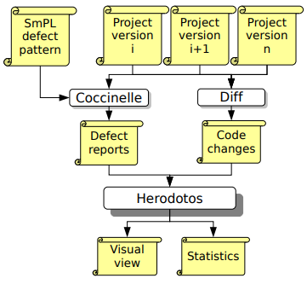
Experimental protocol
Coccinelle:
perform control-flow based pattern searches in C.
Does not expand preprocessor directives, so our process is not limited by the architecture.
Herodotos: understand the evolution of faults in Linux.
Use diff to find the changes in different version.
Allow the user to classify each group of correlated bug reports.
Herodotos: A Tool to Expose Bugs’ Lives
Notes:
使用diff找到不同版本之间的变化，如果一个错误报告在文件中不变的地方，认为代表了同一个错误。

Slide 8
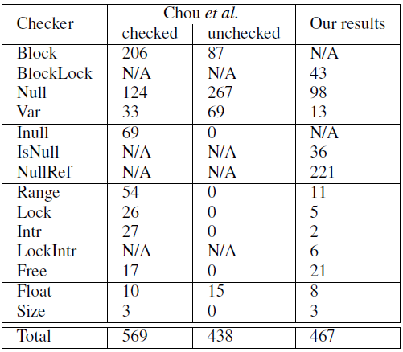
Experience—Linux 2.4.1
Compare our result with Chou’s.
Consider the entire kernel source code.
In most cases, this paper found fewer faults.
Notes:
标准不同，检查器定义不同，Chou等人的工作数据无法找到，没有结果的精确解释

Slide 9
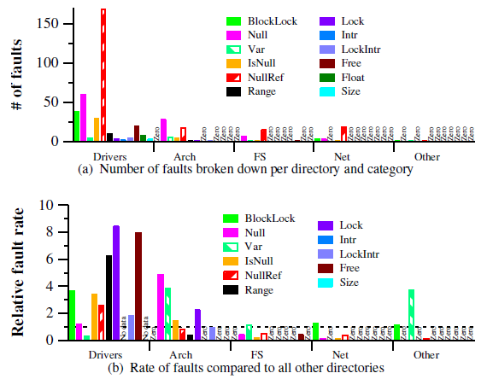
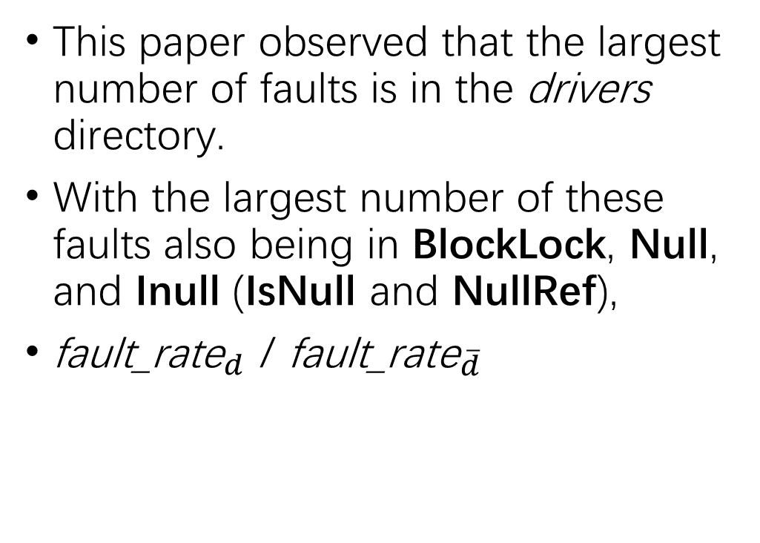
Experience—Linux 2.4.1
This paper observed that the largest number of faults is in the drivers directory.
With the largest number of these faults also being in BlockLock, Null, and Inull (IsNull and NullRef),
${\text{fault}\text{_}\text{rate}}_{d}$ / ${\text{fault}\text{_}\text{rate}}_{\overline{d}}$
Notes:
我这个文件夹的错误率除以所有其他文件夹的错误率

Slide 10
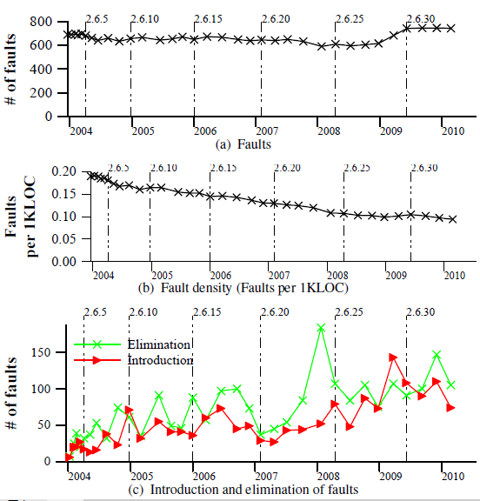
Experience—Linux 2.6 kernel
The number of faults has held roughly steady.
The rate of faults per line of code has decreased.
Faults are still introduced, as well as eliminated.

Slide 11
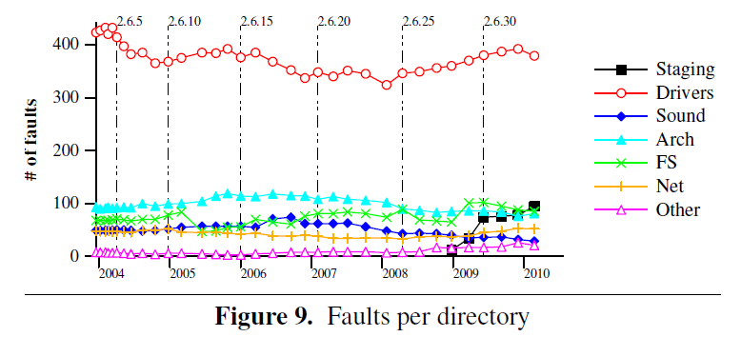
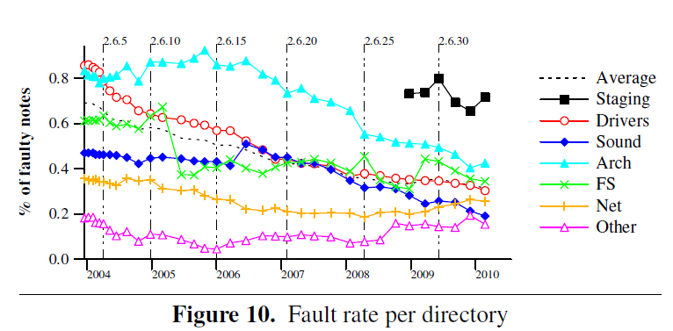
Experience—Linux 2.6 kernel
Drivers still has the largest number of faults.
Drivers has a higher fault rate for certain kinds of faults than other directories.
Arch has the highest fault rate.

Slide 12
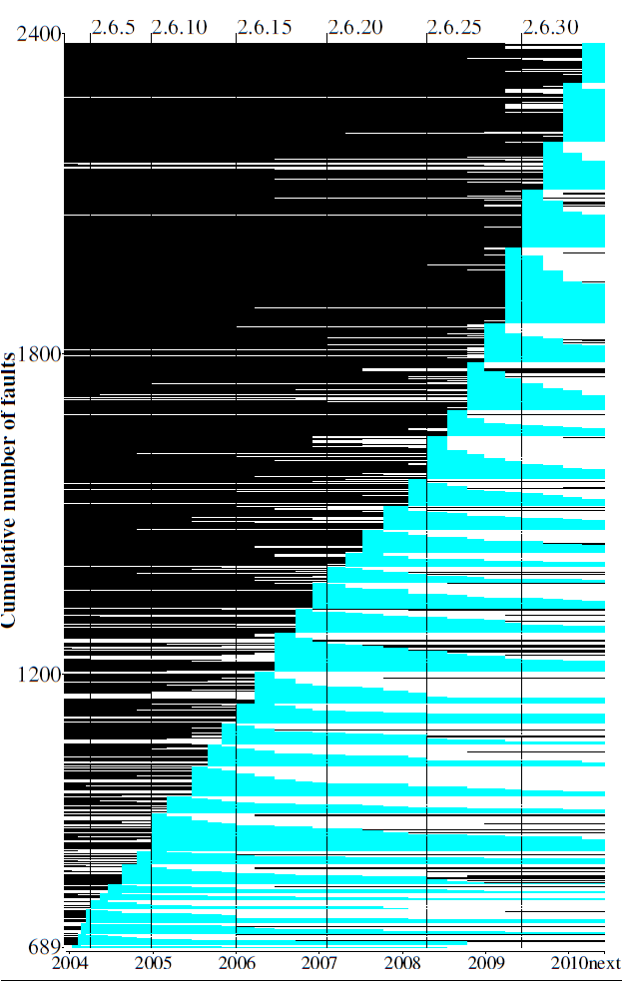
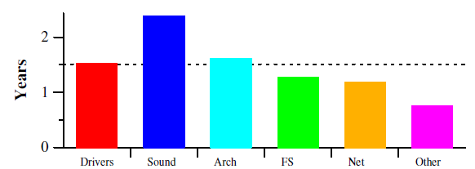
Experience—Linux 2.6 kernel
The average fault lifespan is 1.5 years.
Sound has the longest average lifespan.
Since Linux 2.6.27 a significantly larger number of faults have been introduced.
Notes:
黑色代表文件不存在
白色代表文件存在但是bug不在了
蓝色代表bug存在

Slide 13
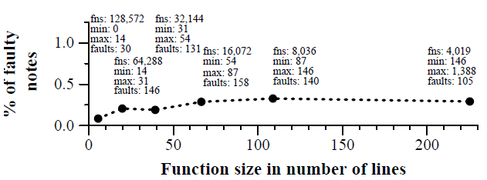
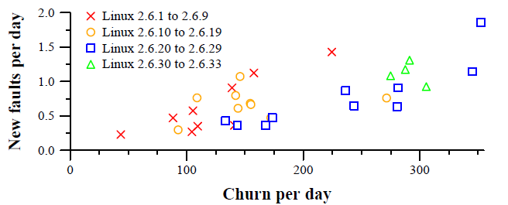
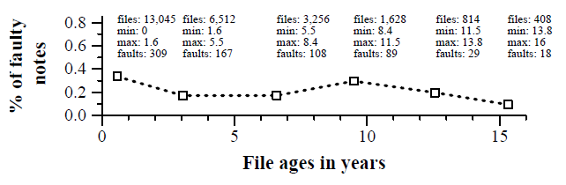
Experience—Linux 2.6 kernel
Use code churn, file age, function size to evaluate the quality of Linux.
High-churn versions have more new faults.
The relation between file age and fault rate is less clear.
The average fault rate clearly increase as the function size increases.
Notes:
代码质量评估，高频率代码改动往往有更多错误

Slide 14
Conclusion
While drivers still has the largest number of faults, it no longer has the highest fault rate in Linux kernel code.
Even though faults are continually being introduced, the overall code quality is improving.
Some services have no maintainer but remain in the kernel source tree.

Slide 15
Specifying and Checking File System Crash-Consistency Models

Slide 16
Abstract
It is difficult to understand the ordering of file system operation.
This paper presents crash-consistency model to describe the behavior of a file system across crashes.
Present a formal framework and a toolkit called FERRITE.

Slide 17
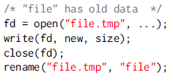
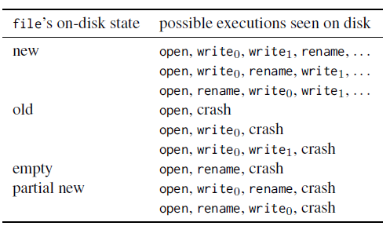
Introduction
Due to file system optimizations, the effect of the program do not reach disk in the order they are executed.
The POSIX standard is largely silent on the guarantees it should provide in crashes.
It is critical to describe crash guarantees in an unambiguous and accessible manner.

Slide 18
Introduction
Crash-consistency models take two forms:
Litmus tests: demonstrate behaviors across crashes
Formal specification: axiomatic and operational description.
FERRITE:
Explore all possible crash behaviors of a given litmus test.
Focuses on distilling the crash guarantees provided by a fs interface.
Two proof-of-concept tools:
Verifier: proves that a program provides crash guarantees.
Synthesizer: insert fsync invocations into a program.
Notes:
这些形式的规范用于不同的目的，也不能取代另一个。 Litmus测试提供了一个精确而直观的描述，非常适合与应用程序开发人员进行通信，以及针对文件系统实现验证正式模型。正式规范提供了（不）允许的崩溃行为的完整描述，因此，为应用程序的崩溃保证提供了自动推理的基础。

Slide 19
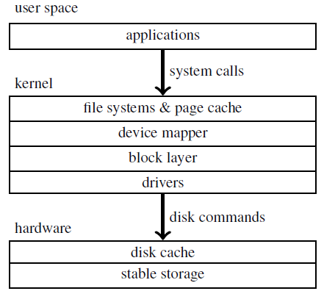
Background
The fsync is key to providing data integrity in the face of crashes.
POSIX does not specify what should happen when a crash occurs.
IO stack consists of multiple layers and persists data to disk out of program order.
Notes:
POSIX计算机环境可移植操作系统接口

Slide 20
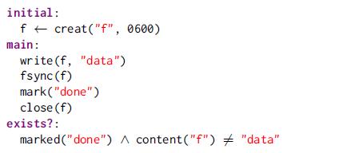
Litmus test
Adopt it to document the crash behavior of fs.
Initial setup: create an initial fs state, ends with an implicit sync
Main body: may crash at any point and use mark label events.
Final checking: a list of predicates to be tested.
Notes:
采用它来记录fs的崩溃行为
content returns the file content.
marked returns true iff the program crashes after the given label.

Slide 21
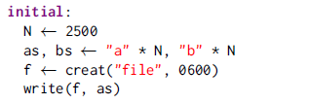
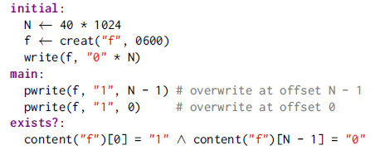

Litmus test
Litmus tests for file/directory operations.
Use FERRITE to develop existing litmus tests for append and overwrite
Order-file-overwrites
Prefix-append
Notes:
prefix-appennd检查在崩溃后是不是一个文件会包含一个前缀，这个前缀本来是要被追加进去的

Slide 22
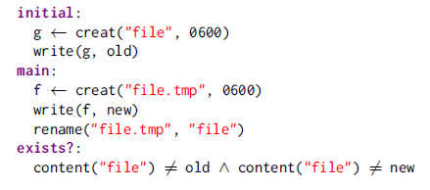
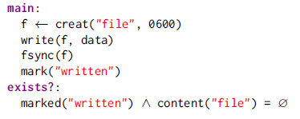
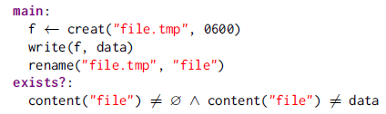
Litmus test
Whether updates to a file and to its parent directory can be reordered, and two atomicity properties of rename
Atomic-replace-via-rename
Implied-directory-fsync
Atomic-create-via-rename

Slide 23
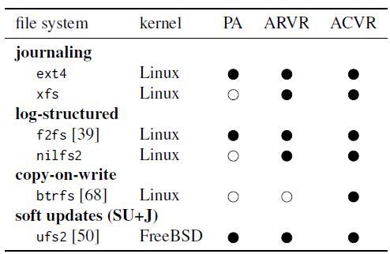
Litmus test
Prefix-append is not guaranteed by some fs.
Atomic-replace-via-rename (ARVR) is not guaranteed by most fs.
Atomic-create-via-rename (ACVR) offers atomicity guarantees different to those of ARVR on some fs.
Litmus tests provide a precise and intuitive way of communicating crash-consistency behavior.

Slide 24
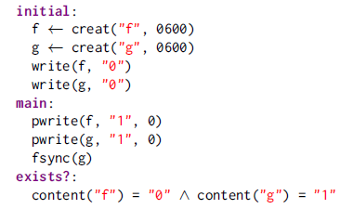
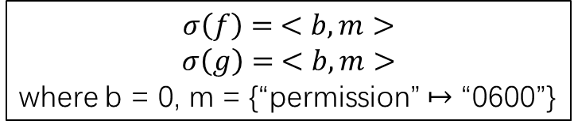

Formal specifications — Axiomatic
An axiomatic crash-consistency model consists of a set of rules(axioms), that specify whether a given execution of a program is allowed.
$$σ\left(i\right)= ⊥$$
$$σ\left(f\right)= <b, m>$$
$$σ\left(g\right)= <b, m>$$
where b = 0, m = {“permission” $↦$ “0600”}
τ = [e₀, e₁, e₂]
t₁ = [e₁, e₂, e₀]
t₂ = [e₂, e₀, e₁]
Notes:
通过例子介绍一些定义
首先这个文件系统是未定义的，第二个框表明了f和g的内容是b，属性是m。
只有这三种是合法的，其他的是这三种的前缀排列，都表明系统崩了。

Slide 25
Formal specifications — Axiomatic
Crash-Consistency-Model: which valid program traces are permissible, and what states may be observed after crash.
Sequential Crash-Consistency(SCC)
SCC permits only τ = [e₀, e₁, e₂]
so NO crash trace of τ results in
“exists?” stage.
Notes:
SCC不允许所有的重排事件permit no re-ordering of events

Slide 26
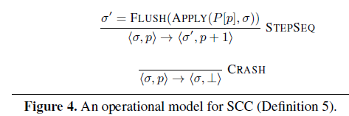
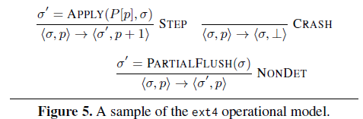
Formal specifications—Operational
An operational crash-consistency models takes the form of a non-deterministic state machine M, which use maps and tuples to abstract fs.
σ = <σ_{inCore}, σ _{onDisk}>
p = program counter
Notes:
σ二元组是文件系统当前的状态，p是程序计数器，就是pc，
APPLY：execute event
FLUSH：flush state
STEPSEQ：flush at every step
CRASH: 任意位置停止程序
NONDEF：转换状态而不执行程序中的下一个事件

Slide 27
Making specification executable
FERRITE consists of two tools:
enumerator
execute litmus tests to determine the set of all possible crash behaviors.
ensure that the litmus tests are indeed representative of the behavior of fs.
model checker
execute litmus tests against axiomatic specification.
ensure that the formalization allow representative behaviors encoded in litmus tests
Notes:
枚举
执行石蕊试验以确定所有可能的崩溃行为的集合。
确保石蕊试验确实代表了行为。
模型检查员
针对公理规范执行石蕊试验。
确保形式化允许在石蕊试验中编码的代表性行为

Slide 28
Making specification executable
against file system implementations
produce all possible re-orderings of the trace, as well as all possible prefixes.
produce a disk image and verify the predicates.
against specification
check whether the predicates specified in the exists? are satisfied.
if so, the model will give you some surprise.
Notes:
执行针对文件系统实现的测试和针对规范的测试
模拟器运行测试来得到一个所有崩溃行为集合，再把恢复出来的文件系统挂载到系统上，
检查器检查

Slide 29

Experience with specification
The synthesizer transforms a program by inserting fsync and optimizing the insertion to guarantee the desired safety properties.
Develop a verification framework in Dafny to prove crash safety, which made proof automation highly effective.
Notes:
Dafny proves its crash-safety with respect to all possible file sizes. FERRITE, in contrast, expects a bound on the file size, as provided in our litmus tests.
在Dafny开发一个验证框架，以证明崩溃安全性，使证明自动化非常有效
Dafny是一种带有程序验证程序的编程语言。 当您输入程序时，验证程序会不断地查看您的肩膀并标记任何错误。

Slide 30
Conclusion
OS support:
expose the key characteristics of fs’s crash-consistency behavior to the application.
reduce or eliminate the kernel from IO path.
We showed:
the crash-consistency model in the form of litmus tests and formal specifications.
FERRITE for exploring the possible crash behaviors.
synthesis and verification tools.

