Slide 1
Numerical simulation of wave propagation
-- Recursive green’s function
Yuhao Kang

Slide 2
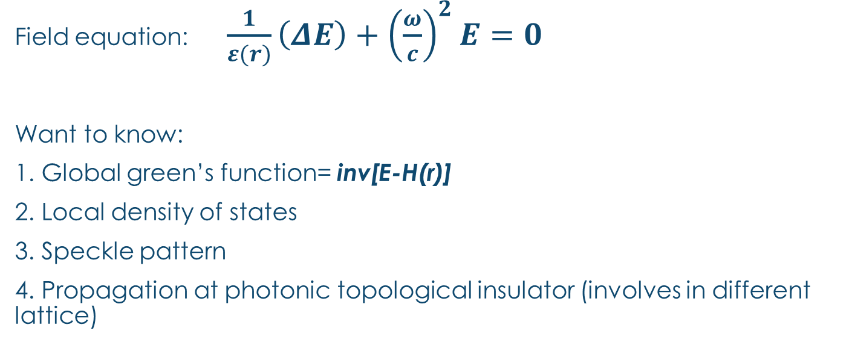
problem
Field equation: $\frac{1}{ε(r)}\left(ΔE\right)+{\left(\frac{ω}{c}\right)}^{2}E=0$
Want to know:
1. Global green’s function= inv[E-H(r)]
2. Local density of states
3. Speckle pattern
4. Propagation at photonic topological insulator (involves in different lattice)

Slide 3
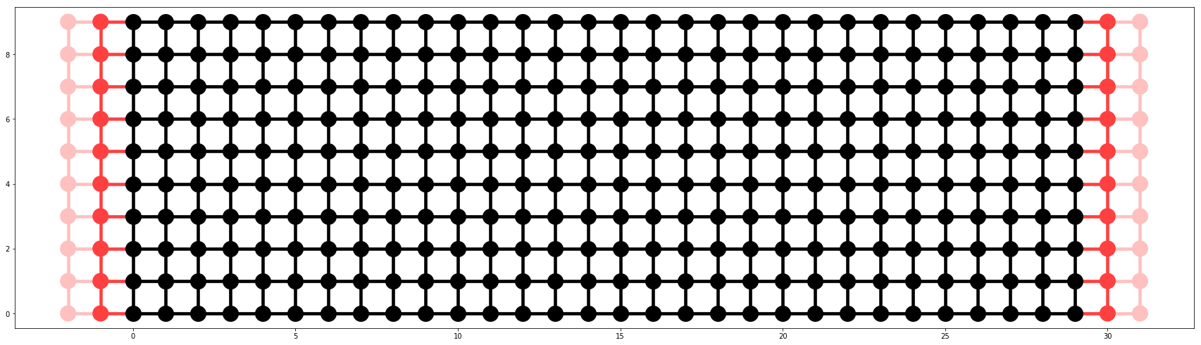
method
1. Map system to tight binding model
2. Hamiltonian lead greens function
3. Expand lead greens function to the whole space, iteration
Open lead
Close boundary

Slide 4


Step1
$g_{0}$: lead greens function
$h_{0}$: hopping between nearest layer
h0=4*diag(ones(n))-diag(ones(n-1),1)-diag(ones(n-1),-1)
g0 =?

Slide 5
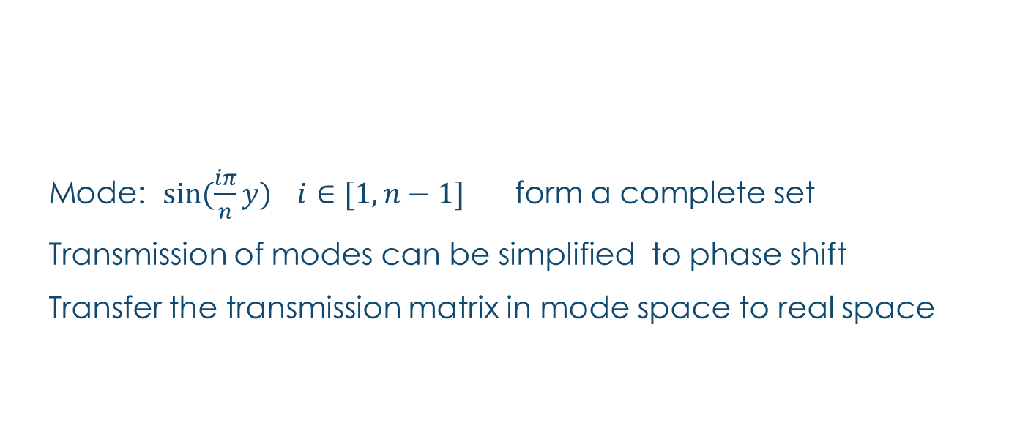
Step 2 how to get g0
Mode: $sin⁡(\frac{iπ}{n}y)$ $i∈[1,n−1]$ form a complete set
Transmission of modes can be simplified to phase shift
Transfer the transmission matrix in mode space to real space
g0=phi.dot(diag(g_mode)).dot(phi.T)

Slide 6
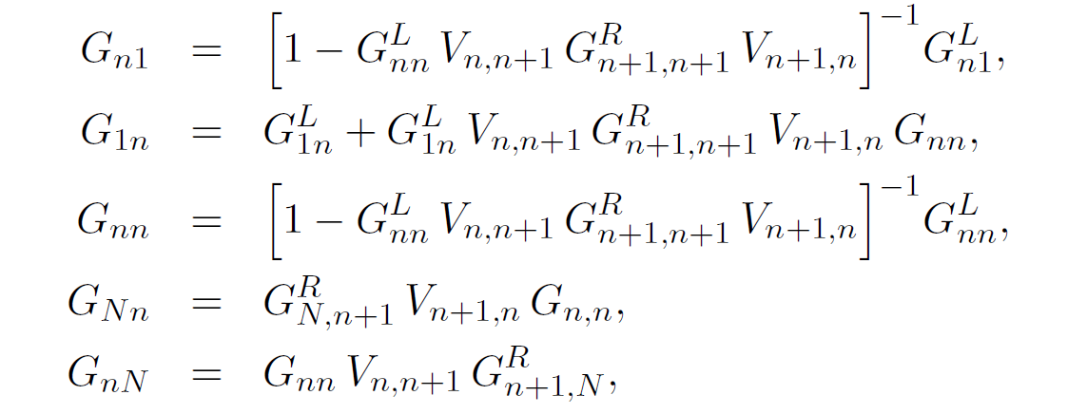
Step 3 iteration
Use LU decomposition to get the inverse of matrix

Slide 7
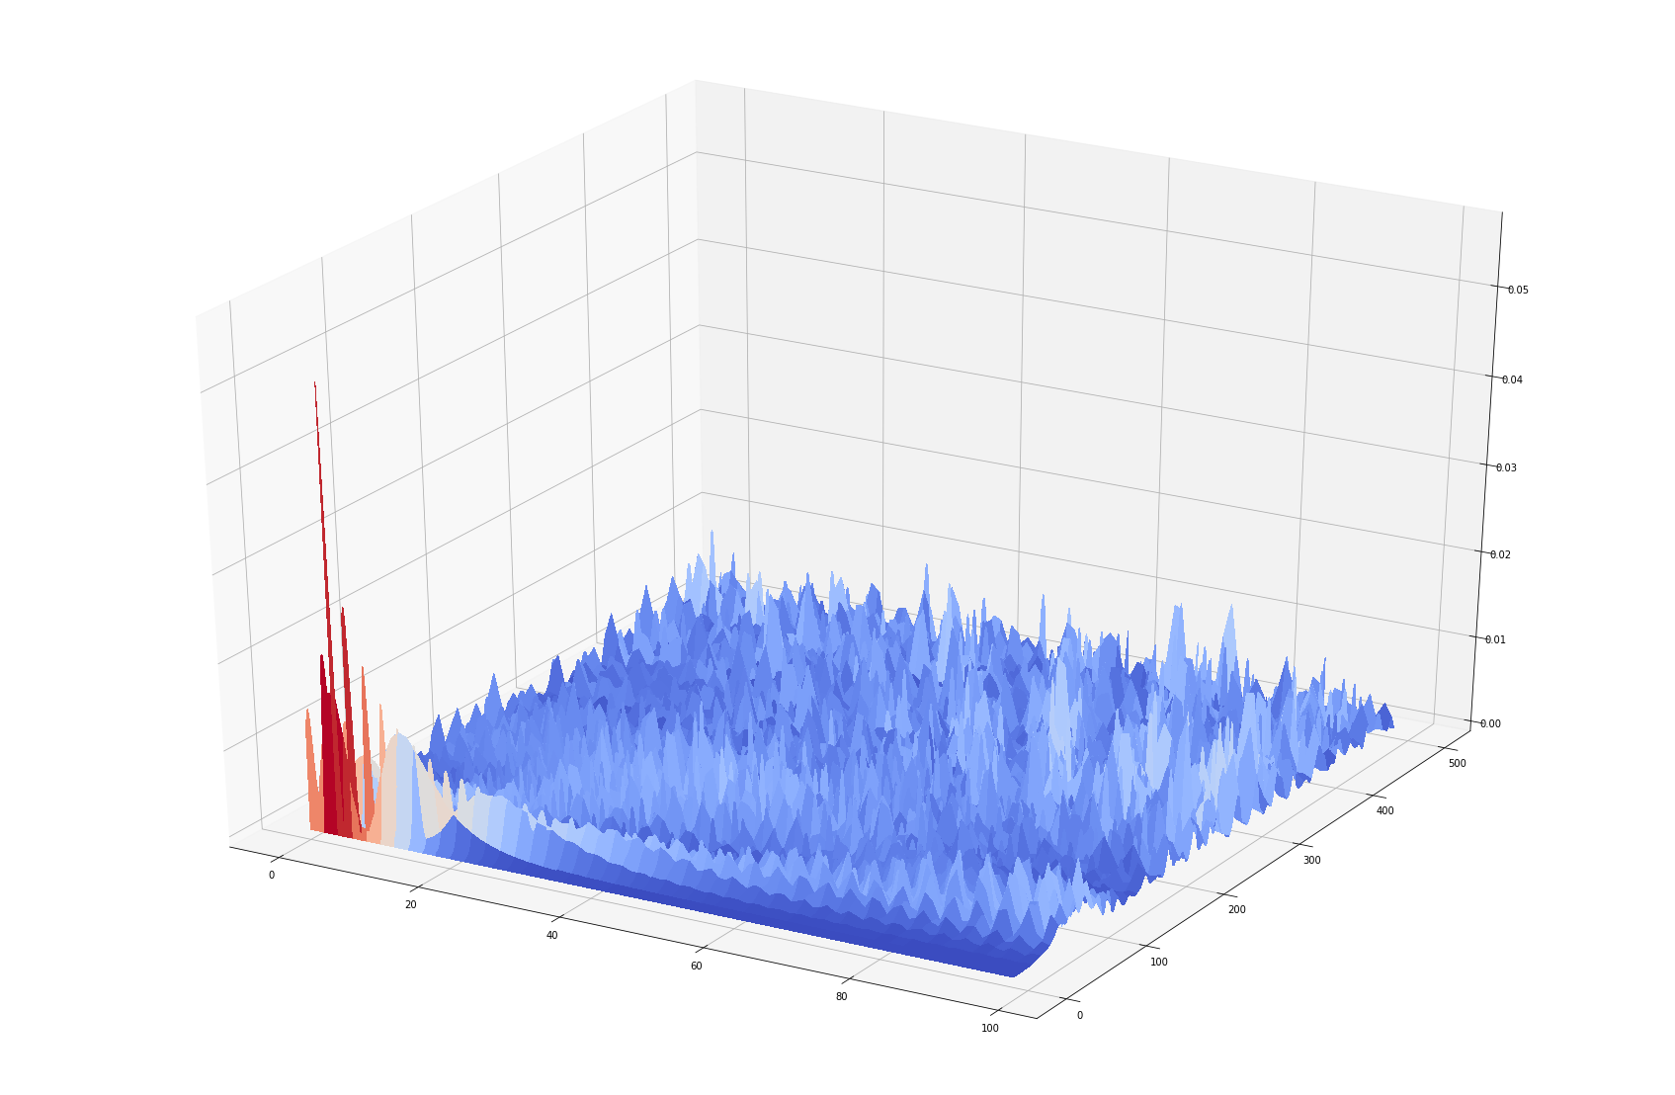
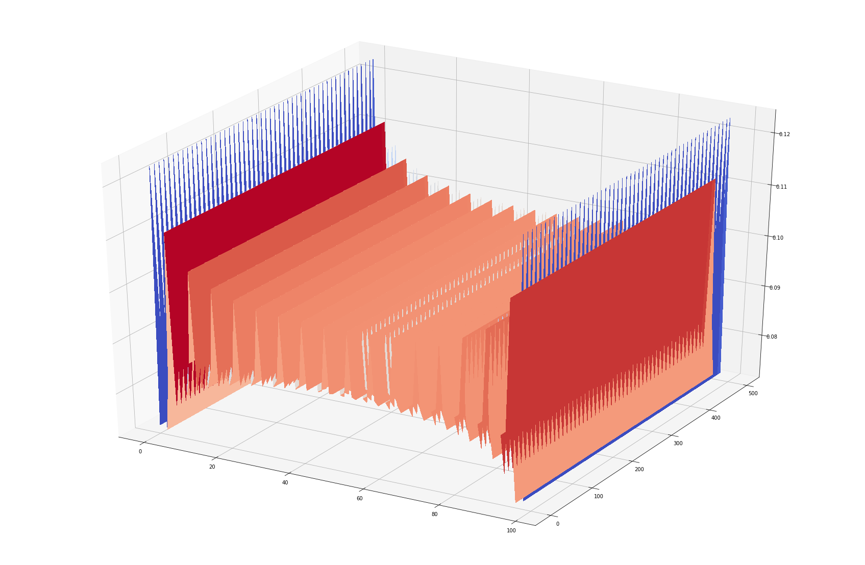
Speckle pattern and LDOS

Slide 8

time consuming
Length: M width: N
Calculation amount: $θ(M×N×N)$~$e^{γ}$
Dense mesh ~ $γ=3$
Wider sample ~ $γ=2$

Slide 9
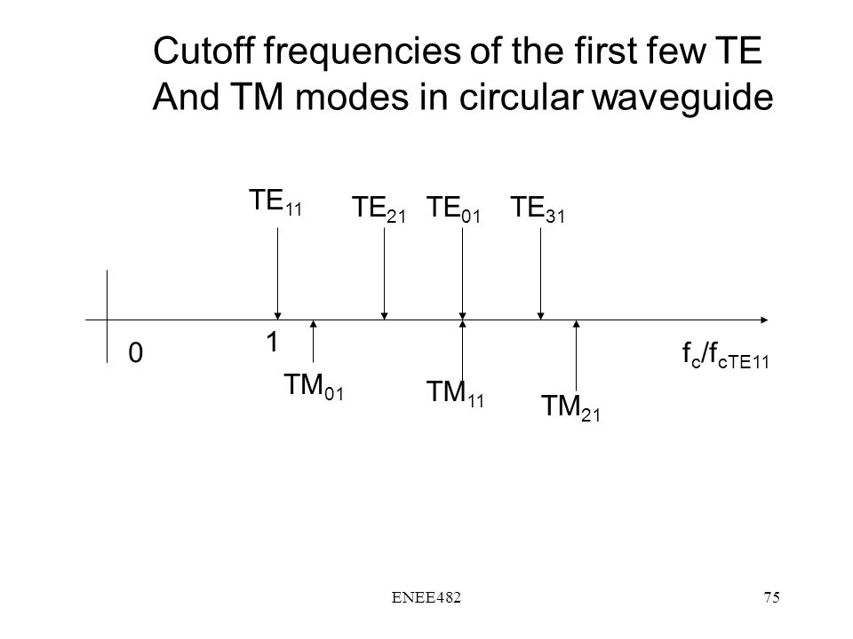



improvement
We consider N modes before, which is mathematically accurate, but physically unnecessary
mode_max=int(floor(arccos(1-kd**2/2)*(n+1)/pi))
Dense mesh ~ $γ=1$
Wider sample ~ 0.2
$$N th mode$$
$$we are here$$

Slide 10
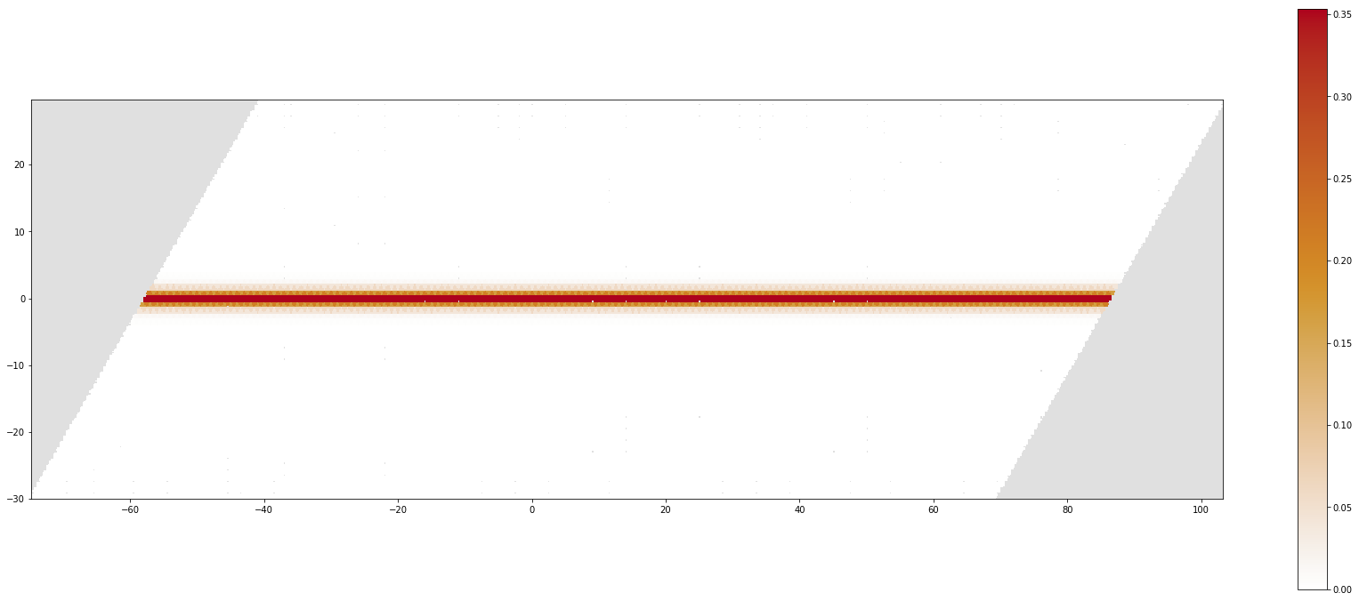
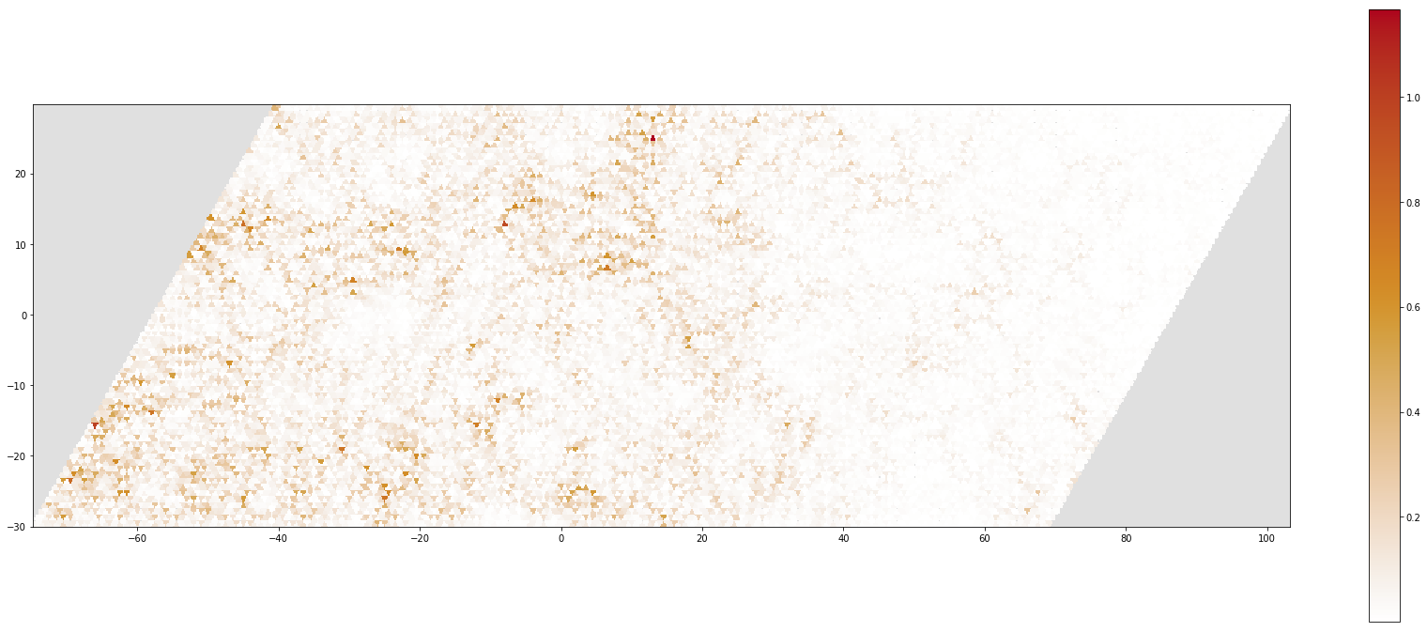
Kwant package
Transform to different lattice
From robust edge states to diffusion

