Slide 1
TAMU Datathon Walmart Technology Team name: AutoPath
Yuhao Wang: Ph.D student, Mechanical Engineering, TAMU;
Xueqin Huang: Ph.D student, Materials Science, TAMU;
Yu Liu: Ph.D student, Materials Science, TAMU;
Quyuan Lin: Ph.D student, Mathematics, TAMU.

Slide 2
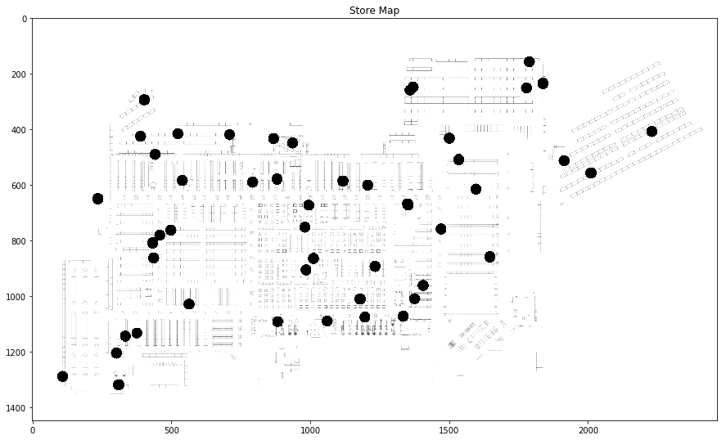
Task

Slide 3
Method
Step1: Using Multi-path Dijkstra to quantify the min path between paired target points
Step2: Using greedy algorithm to find the lowest weighted path which travel all points

Slide 4
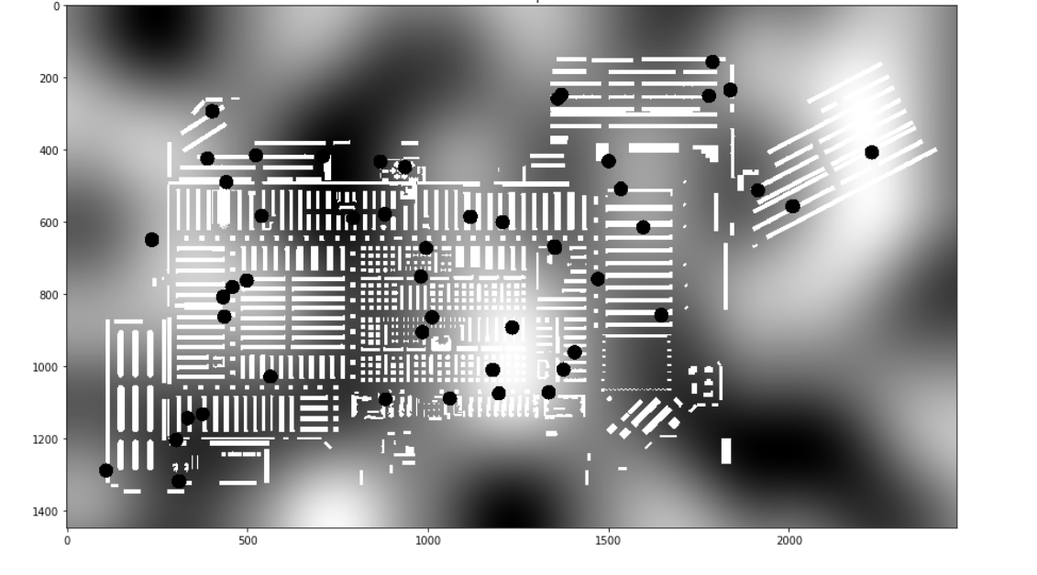
Step1: Multi-path Dijkstra
Store Map
Graph
Set up graph and quantify the min path between paired target points

Slide 5
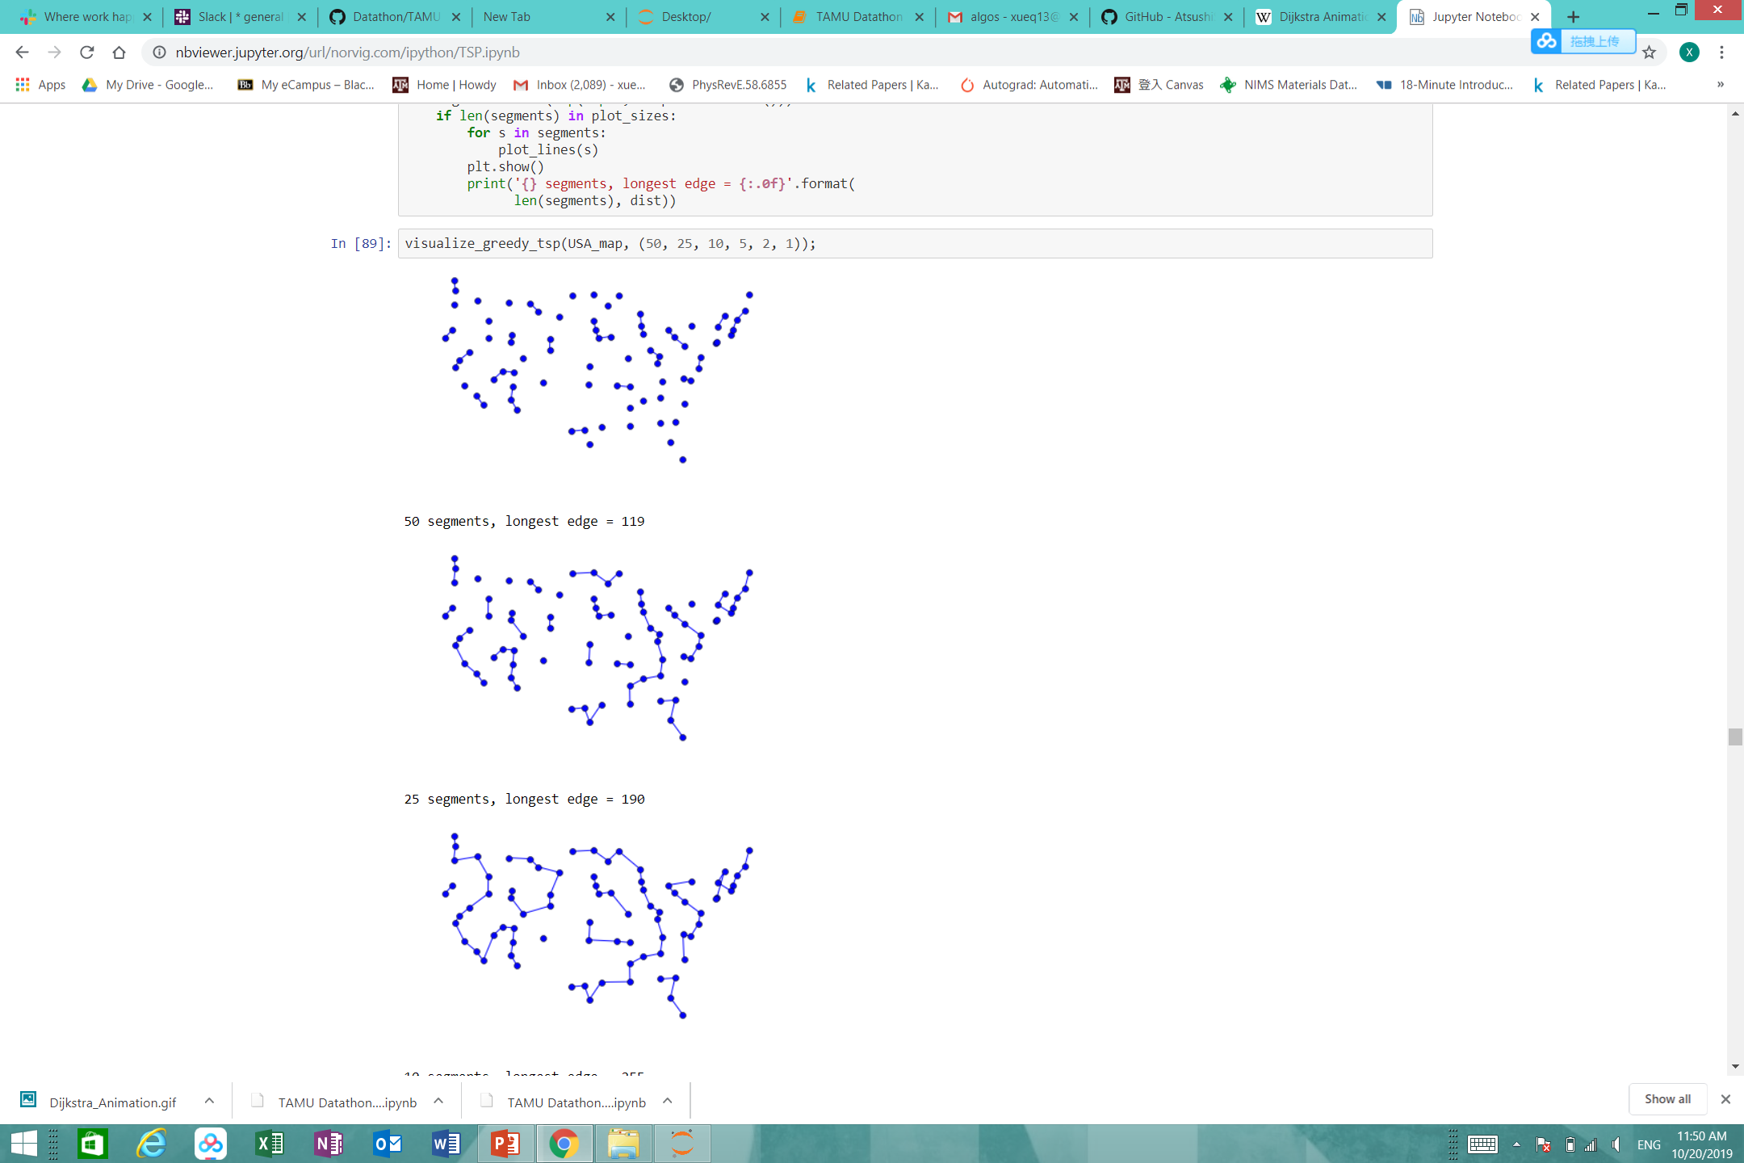
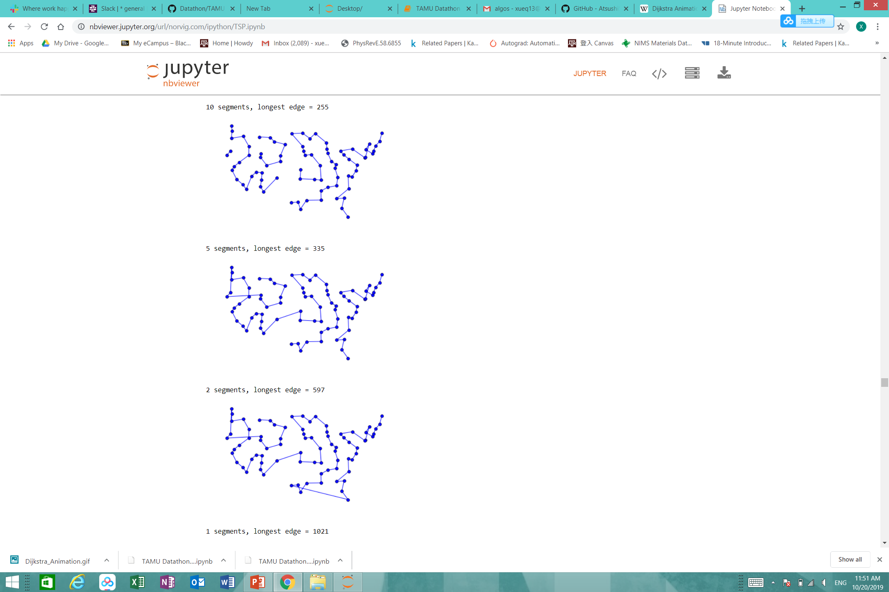
Step2: Greedy Algorithm
Find global min graph with greedy algorithm based on the graph built on the previous step

Slide 6
Approximation Method
Using geometry distance to simplify the problem by finding the shortest distance path first
Using two points Dijkstra to find the minimal weighted path to iterate the target points in previous order.
In the Dijkstra Process, we ignore the far away boundary pixels points to consider the information condensed parts.

Slide 7
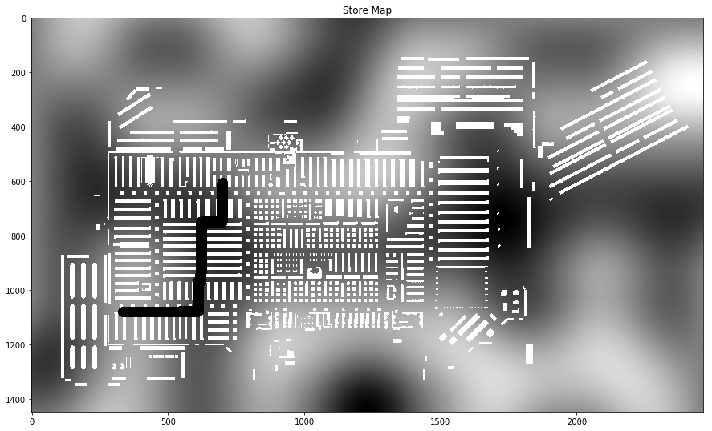
Results
Simple example of lowest weighted path between two points
Point2
Point1

Slide 8

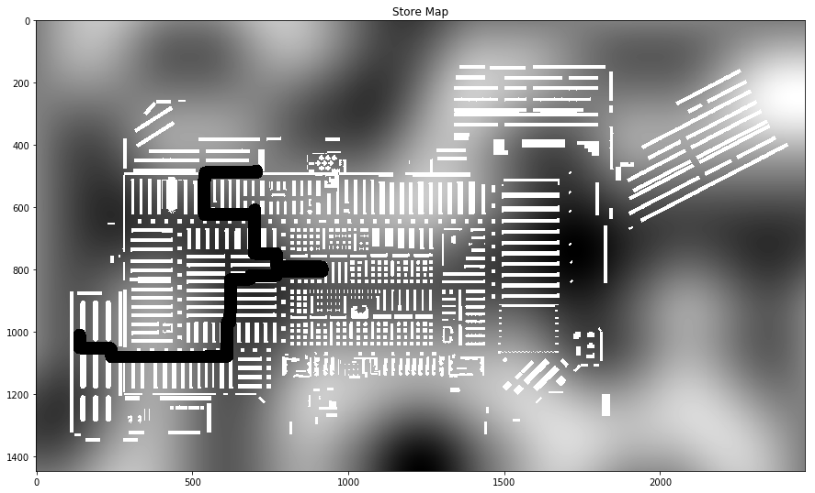
Results
Lowest weighted path for five targets
Targets
Path

Slide 9
Future work
Using KDS to cluster the target nodes.
In each clusters find the min weighted path cover all the cluster-points.
Find the path along each cluster mean point to obtain the final path

