Slide 1
Nearest Neighbor Methods

Slide 2
Two Different Learning Approaches
Eager Learning
Explicit description of a target function on the whole training set
Instance-based Learning
Learning=storing all training instances
Classification=assigning target function to a new instance
Referred to as “Lazy” learning
E.g., K-Nearest Neighbor (KNN) Algorithm

Slide 3
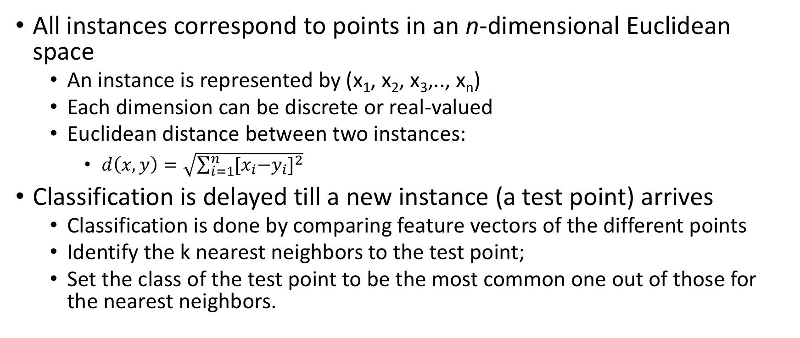
K-Nearest Neighbor
All instances correspond to points in an n-dimensional Euclidean space
An instance is represented by (x₁, x₂, x₃,.., x_{n})
Each dimension can be discrete or real-valued
Euclidean distance between two instances:
$d\left(x,y\right)=\sqrt{\sum_{i=1}^{n}{{{[x}_{i}−y_{i}]}^{2}}}$
Classification is delayed till a new instance (a test point) arrives
Classification is done by comparing feature vectors of the different points
Identify the k nearest neighbors to the test point;
Set the class of the test point to be the most common one out of those for the nearest neighbors.

Slide 4
Voronoi Diagram
Decision surface formed by the training examples

Slide 5
Choice of k may determine the decision boundary

Slide 6
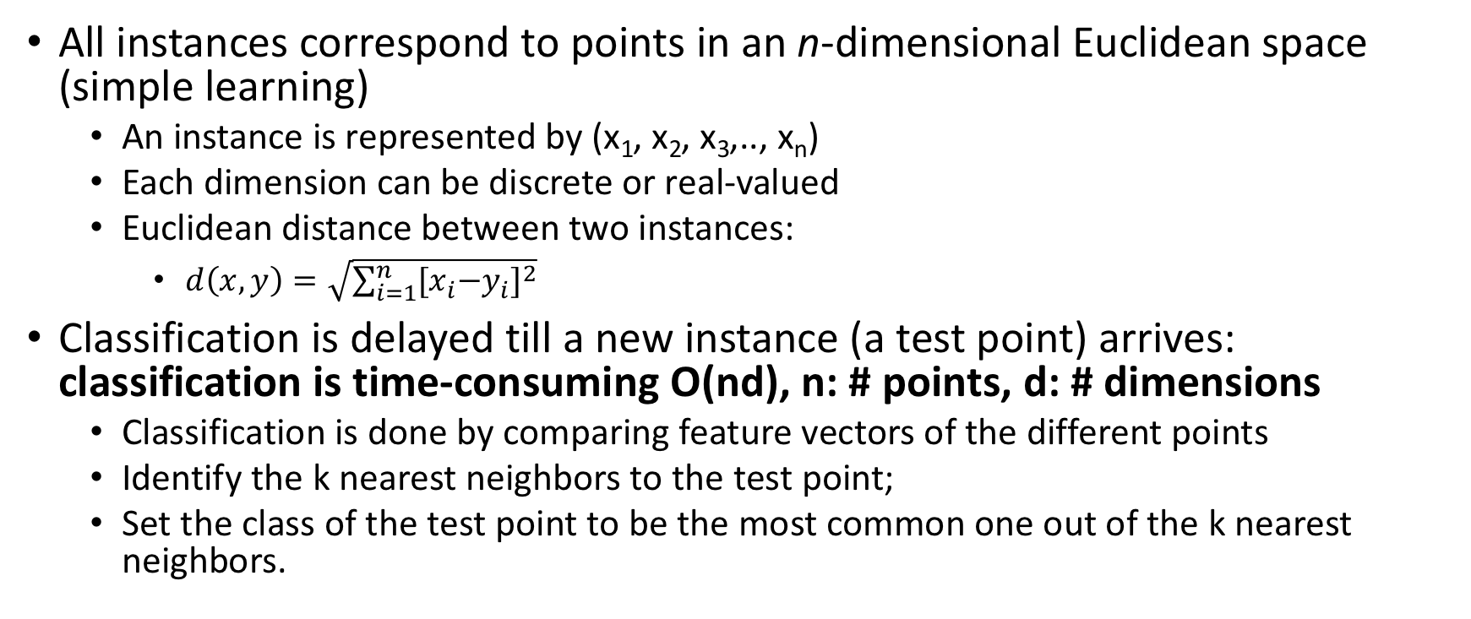
K-Nearest Neighbor
All instances correspond to points in an n-dimensional Euclidean space (simple learning)
An instance is represented by (x₁, x₂, x₃,.., x_{n})
Each dimension can be discrete or real-valued
Euclidean distance between two instances:
$d\left(x,y\right)=\sqrt{\sum_{i=1}^{n}{{{[x}_{i}−y_{i}]}^{2}}}$
Classification is delayed till a new instance (a test point) arrives: classification is time-consuming O(nd), n: # points, d: # dimensions
Classification is done by comparing feature vectors of the different points
Identify the k nearest neighbors to the test point;
Set the class of the test point to be the most common one out of the k nearest neighbors.

Slide 8
Speedup of KNN using KD-tree: 2-dimensional KD-trees
A data structure to support range queries in R²
Preprocessing time: O(nlogn)
Space complexity: O(n)
Query time: O(n^{1/2}+p), p is the number of reported queries

Slide 9
2D KD-trees
Algorithm:
Choose x and y coordinates alternatively
Recursively choose the median of the coordinate (a horizontal or vertical line) to partition the data points into a binary tree
We get a binary tree:
Size O(n)
Depth O(logn)
Construction time O(nlogn)

Slide 10
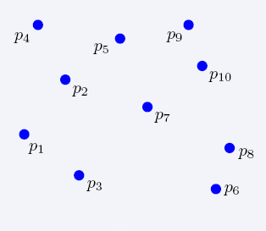
Construction of KD-trees

Slide 11
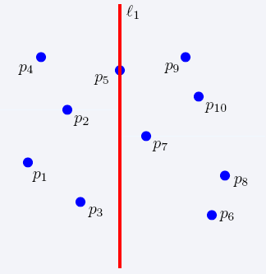
Construction of KD-trees

Slide 12
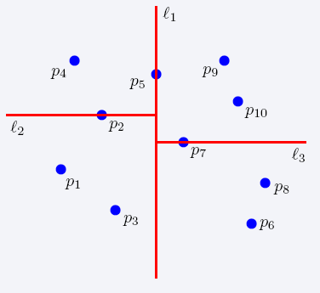
Construction of KD-trees

Slide 13
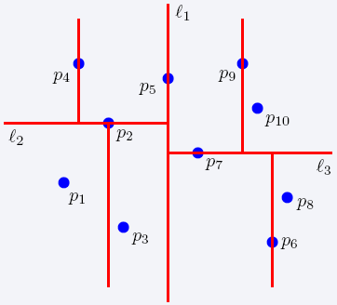
Construction of KD-trees

Slide 14
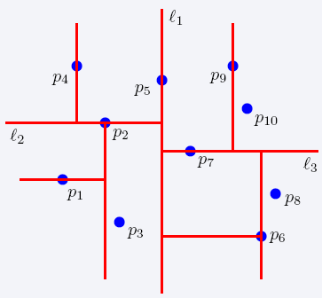
Construction of KD-trees

Slide 15
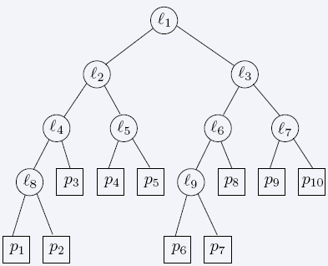
The complete 2D KD-tree

Slide 16
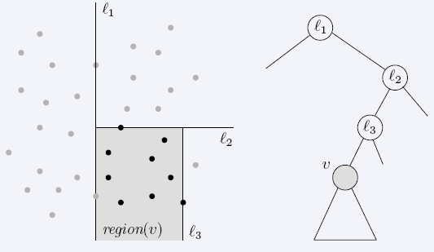
Region of node v
Region(v) : the subtree rooted at v stores the points in black dots

Slide 17
2D KD-tree for KNN
Cut s.t. each region contains ~k points

Slide 18
Search a data point: find the leave node v such that region(v) contains the point

Slide 19
Search a data point in the region and its neighboring regions
The Search takes at most O(n^{1/2}+P) time, where P is the number of reported points
The total time needed to report all points in all sub-trees is O(P)
We just need to bound the number of nodes u such that region(u) intersects region(v)
gross overestimation: bound the number of region(v) which are crossed by any of the 4 horizontal/vertical lines
The number of regions is Q(n)=2+2Q(n/4) → Q(n)=(n^{1/2})

Slide 20
d-dimensional KD-trees
Preprocessing time: O(nlogn)
Space complexity: O(n)
Query time: O(n^{1-1/d}+k)

Slide 21
Construction of the d-dimensional KD-trees
Similar as in 2D
At the root we split the set of points into two subsets of same size by a hyperplane vertical to x₁-axis
At the children of the root, the partition is based on the second coordinate: x₂-coordinate
At depth d, we start all over again by partitioning on the first coordinate
The recursion stops until there is only k point left, which is stored as a leaf

