Slide 1
Support Vector Machines
Some slides are taken from
Prof. Andrew Moore’s
SVM tutorial at
http://www.cs.cmu.edu/~awm/tutorials

Slide 2
Linear Classifiers
α
x
f
y^{est}
denotes +1
denotes -1
f(x,w,b) = sign(w x + b)
w x + b>0
w x + b=0
How would you classify this data?
w x + b<0

Slide 3
α
Linear Classifiers
x
f
y^{est}
denotes +1
denotes -1
f(x,w,b) = sign(w x + b)
How would you classify this data?

Slide 4
α
Linear Classifiers
x
f
y^{est}
denotes +1
denotes -1
f(x,w,b) = sign(w x + b)
How would you classify this data?

Slide 5
α
Linear Classifiers
x
f
y^{est}
denotes +1
denotes -1
f(x,w,b) = sign(w x + b)
Any of these would be fine..
..but which is best?

Slide 6
α
Linear Classifiers
x
f
y^{est}
denotes +1
denotes -1
f(x,w,b) = sign(w x + b)
How would you classify this data?
Misclassified
to +1 class

Slide 7
α
Classifier Margin
α
x
x
f
f
y^{est}
y^{est}
denotes +1
denotes -1
f(x,w,b) = sign(w x + b)
f(x,w,b) = sign(w x + b)
Define the margin of a linear classifier as the width that the boundary could be increased by before hitting a datapoint.
Define the margin of a linear classifier as the width that the boundary could be increased by before hitting a datapoint.

Slide 8
α
Maximum Margin
x
f
y^{est}
denotes +1
denotes -1
f(x,w,b) = sign(w x + b)
The maximum margin linear classifier is the linear classifier with the, um, maximum margin.
This is the simplest kind of SVM (Called an LSVM)
Support Vectors are those datapoints that the margin pushes up against
Linear SVM

Slide 9
Linear SVM: Math formulation
x⁺
M=Margin Width
“Predict Class = +1” zone
X⁻
wx+b=1
“Predict Class = -1” zone
wx+b=0
wx+b=-1
What we know:
w . x⁺ + b = +1
w . x⁻ + b = -1
w . (x⁺-x⁻) = 2

Slide 10
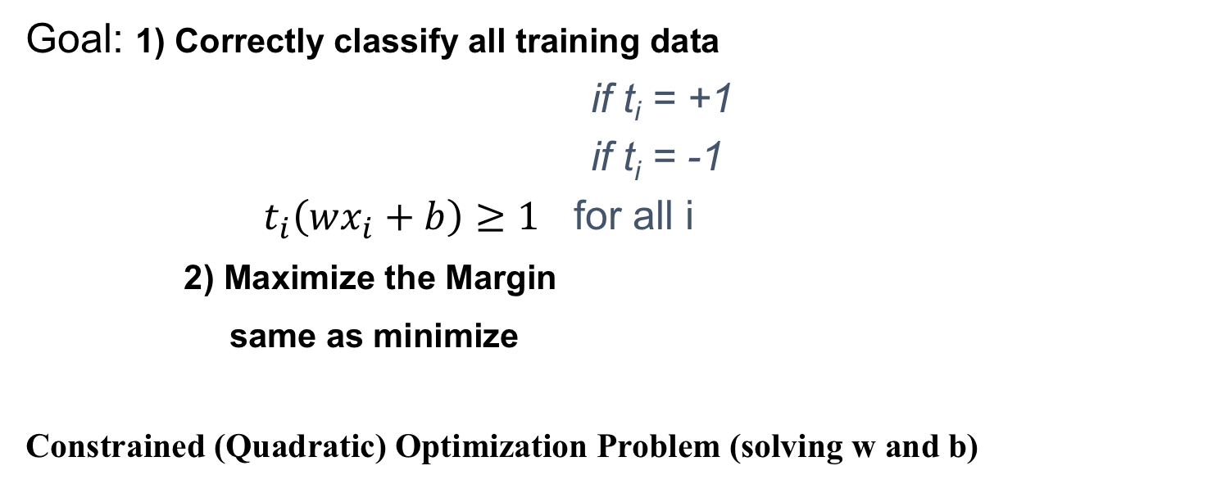
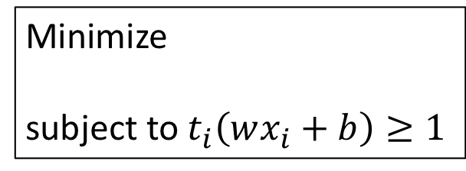
Linear SVM Mathematically
Goal: 1) Correctly classify all training data
if t_{i} = +1
if t_{i} = -1
$t_{i}\left(wx_{i}+b\right)≥1$ for all i
2) Maximize the Margin
same as minimize
Constrained (Quadratic) Optimization Problem (solving w and b)
Minimize
subject to $t_{i}\left(wx_{i}+b\right)≥1$

Slide 11
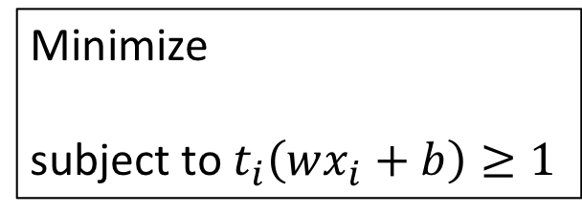
Solving the Optimization Problem
Minimize
subject to $t_{i}\left(wx_{i}+b\right)≥1$
Quadratic optimization: to optimize a quadratic function subject to linear constraints.
A well-known class of mathematical programming problems, and many algorithms exist.
The solution satisfies the Karush–Kuhn–Tucker (KKT) conditions, 𝛌_{i} are positive values known as Lagrange multipliers
Only support vectors are considered.

Slide 13
The Optimization Problem Solution
dual problem:
Notice that it relies on an inner product between the test point x and the support vectors x_{i}.
for a new point z:

Slide 14
Dataset with noise
denotes +1
denotes -1
Hard Margin: So far we require all data points be classified correctly
- No training error
What if the training set is noisy?
- Solution 1: use very powerful kernels
OVERFITTING!

Slide 15

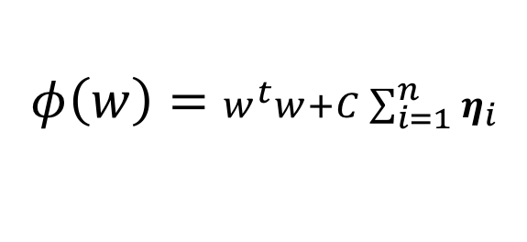


Soft Margin Classification
Slack variables $η$_{i} can be added to allow misclassification of difficult or noisy examples.
What should our quadratic optimization criterion be?
Minimize
$η$₁₁
$η$₂
$$φ\left(w\right)=w^{t}w+C\sum_{i=1}^{n}{η_{i}}$$
wx+b=1
$η$₇
wx+b=0
wx+b=-1

Slide 16
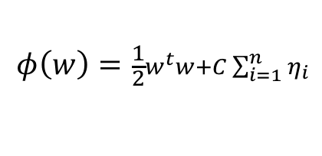
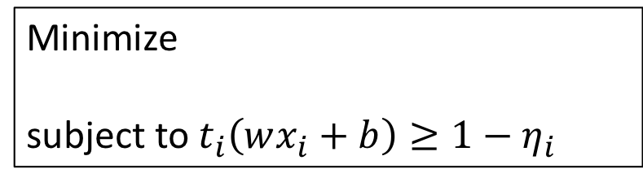
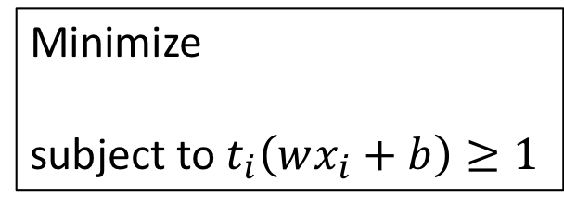
Hard Margin v.s. Soft Margin
The old formulation:
The new formulation
incorporating slack variables:
Parameter C can be viewed as a way to control overfitting: small C means we reward a large margin over a few errors, while large C means the opposite.
Minimize
subject to $t_{i}\left(wx_{i}+b\right)≥1$
Minimize
subject to $t_{i}\left(wx_{i}+b\right)≥1−η_{i}$
$$φ\left(w\right)=\frac{1}{2}w^{t}w+C\sum_{i=1}^{n}{η_{i}}$$

Slide 17
Linear SVMs: Overview
The classifier is a separating hyperplane.
Most “important” training points are support vectors; they define the hyperplane.
Quadratic optimization algorithms can identify which training points x_{i} are support vectors with non-zero Lagrangian multipliers α_{i}.
Both in the dual formulation of the problem and in the solution training points appear only inside dot products:

Slide 18
Non-linear SVMs: Feature spaces
General idea: the original input space can always be mapped to some higher-dimensional feature space where the training set is separable:
Φ: x → φ(x)

Slide 19
The “Kernel Trick”
The linear classifier relies on dot product between vectors K(x_{i},x_{j})=x_{i}^{T}x_{j}
If every data point is mapped into high-dimensional space via some transformation Φ: x → φ(x), the dot product becomes:
K(x_{i},x_{j})= φ(x_{i}) ^{T}φ(x_{j})
kernel function: some function that corresponds to an inner product in some expanded feature space: the new features should be derived from the current ones.
Ex.
Basis:
Polynomial Kernel function
O(n) time

Slide 20
What Functions are Kernels?
For some functions K(x_{i},x_{j}) checking that
K(x_{i},x_{j})= φ(x_{i}) ^{T}φ(x_{j}) can be cumbersome.
Mercer’s theorem:
Every semi-positive definite symmetric function is a kernel
Semi-positive definite symmetric functions correspond to a semi-positive definite symmetric Gram matrix:
K(x₁,x₁) | K(x₁,x₂) | K(x₁,x₃) | … | K(x₁,x_{N})
K(x₂,x₁) | K(x₂,x₂) | K(x₂,x₃) |  | K(x₂,x_{N})
… | … | … | … | …
K(x_{N},x₁) | K(x_{N},x₂) | K(x_{N},x₃) | … | K(x_{N},x_{N})
K=

Slide 21
Examples of Kernel Functions
Linear: K(x_{i},x_{j})= x_{i}^{T}x_{j}
Polynomial of power s: K(x_{i},x_{j})= (1+ x_{i}^{T}x_{j})^{s}
Gaussian (radial-basis function RBF kernel):
Sigmoid: K(x_{i},x_{j})= tanh(β₀x_{i} ^{T}x_{j} + β₁)

Slide 22
Nonlinear SVM - Overview
SVM locates a separating hyperplane in the feature space and classify points in that space
It does not need to represent the space explicitly, simply by defining a kernel function
The kernel function simplify the dot product in the expanded feature space.

Slide 23
The Exclusive Or (XOR) Function
The training algorithm does not converge, but keeps on cycling through two different wrong solutions.

Slide 24
XOR using SVM
introduce a basis of all terms up to quadratic in our two features:
Minimize:
Subject to:
Solution:

Slide 25
Some Issues
Choice of kernel
- Gaussian or polynomial kernel is default
- if ineffective, more elaborate kernels are needed
- domain experts can give assistance in formulating appropriate similarity measures
Choice of kernel parameters
- e.g. σ in Gaussian kernel
- σ is the distance between closest points with different classifications
- In the absence of reliable criteria, applications rely on the use of a validation set or cross-validation to set such parameters.
Optimization criterion – Hard margin v.s. Soft margin
- a series of experiments in which various parameters are tested

