Slide 1

OFDM基础与PAPR抑制经典方法
综合课程设计中期汇报
答 辩 人 ：赵宇恒

Slide 2

目录
CONTENTS
后续任务与参考文献
PAPR抑制的经典方法
绪论

Slide 3

第一部分
绪论
What is OFDM?
Defect of OFDM signal.

Slide 4


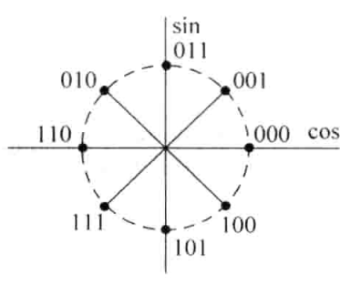


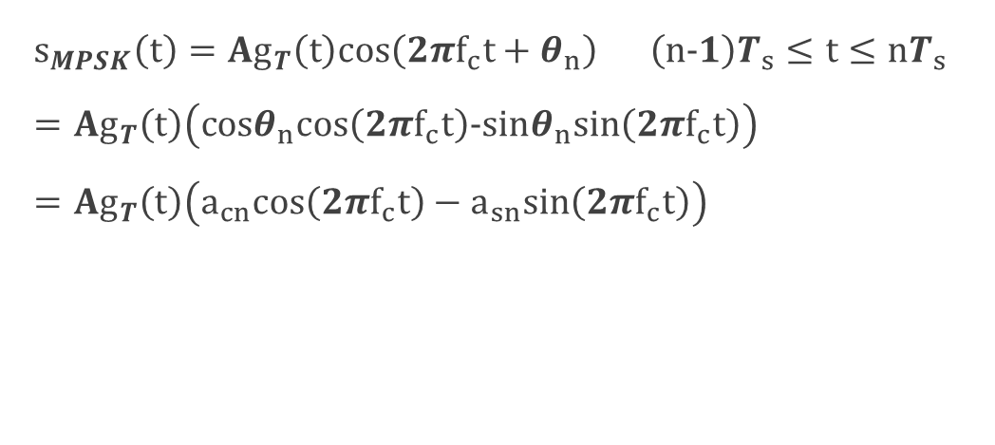
星座图
MPSK信号
$$s_{MPSK}\left(t\right)=Ag_{T}\left(t\right)cos\left(2πf_{c}t+θ_{n}\right) \left(n−1\right)T_{s}≤t≤nT_{s} =Ag_{T}\left(t\right)\left(cosθ_{n}cos\left(2πf_{c}t\right)−sinθ_{n}sin\left(2πf_{c}t\right)\right)=Ag_{T}\left(t\right)\left(a_{cn}cos\left(2πf_{c}t\right)−a_{sn}sin\left(2πf_{c}t\right)\right)$$
$$θ_{n}=\frac{2πi}{M} i=0,1,…,(M−1)$$
每点代表一个特定相位的信号，对应于一种符号值(或比特组)——星座映射关系
星座图
$$(a_{cn},a_{sn})$$

Slide 5
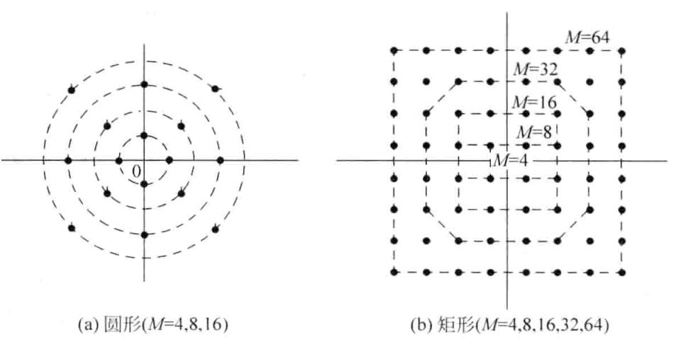
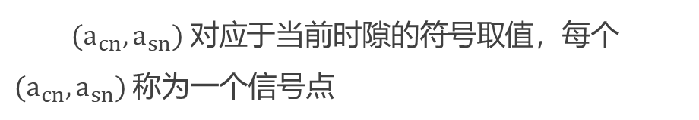
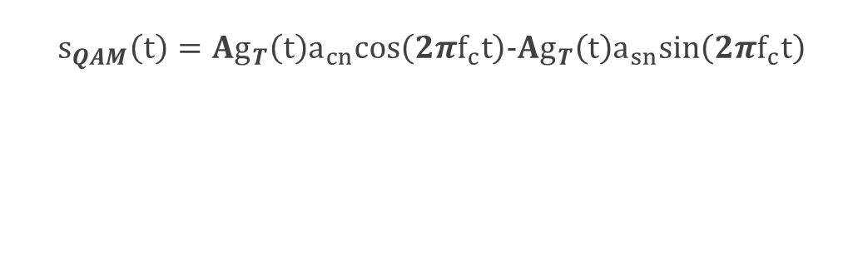
星座图
$$s_{QAM}\left(t\right)=Ag_{T}\left(t\right)a_{cn}cos\left(2πf_{c}t\right)−Ag_{T}\left(t\right)a_{sn}sin\left(2πf_{c}t\right)$$
QAM信号
$(a_{cn},a_{sn}) 对应$于当前时隙的符号取值，每个$(a_{cn},a_{sn})$称为一个信号点
QAM充分利用整个二维平面安排信号点，通过振幅与相位的多种组合来联合携带信息，因此QAM是一种幅度/相位混合调制
星座图

Slide 6
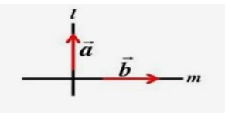
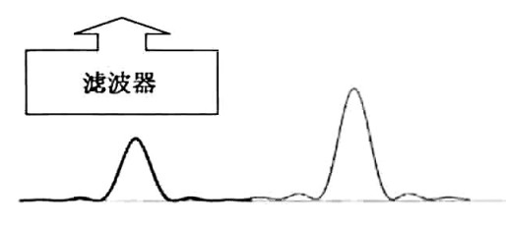
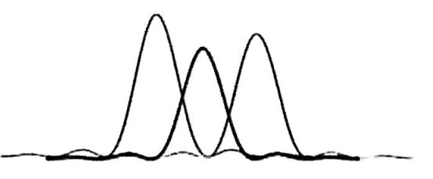
何为正交？
空间正交
几何学
如果两个矢量垂直，就称这两个矢量正交
如果两个矢量正交，一个矢量在另外一个矢量上的投影为0
信号正交
频率正交
如果两个信号正交，代表两个信号互不影响，即正交的信号即使混合在一起，也可以分辨彼此
时间正交
复用使得多个信号混合后使用同一资源，从而提高了资源的利用率，正交是复用技术的基石

Slide 7

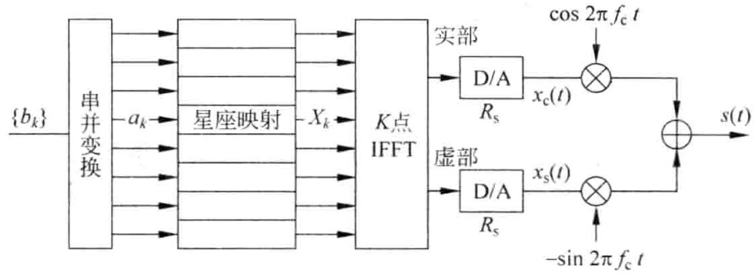
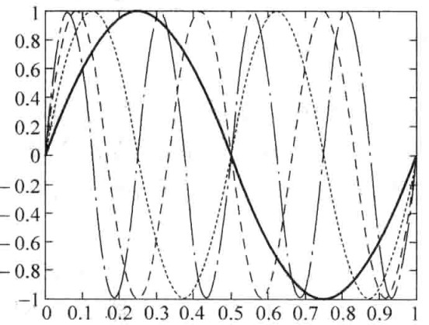
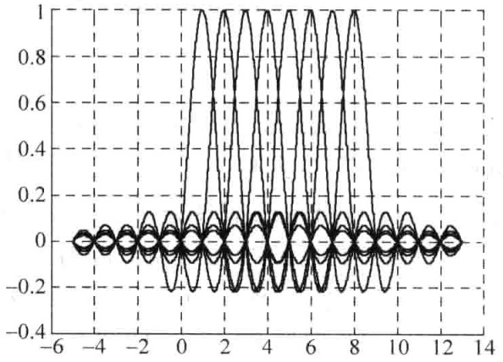
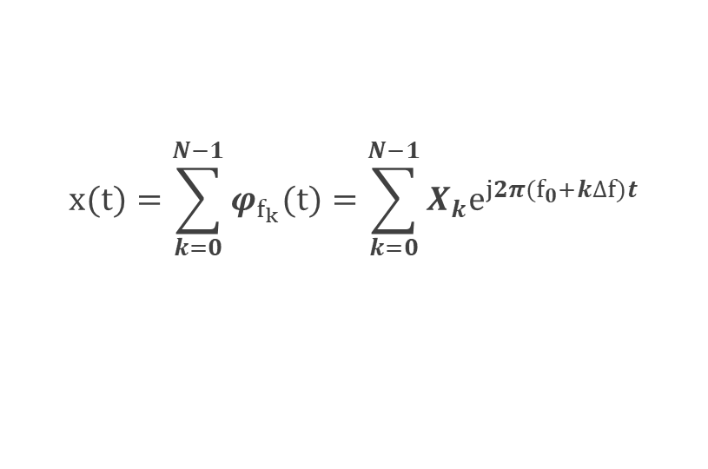


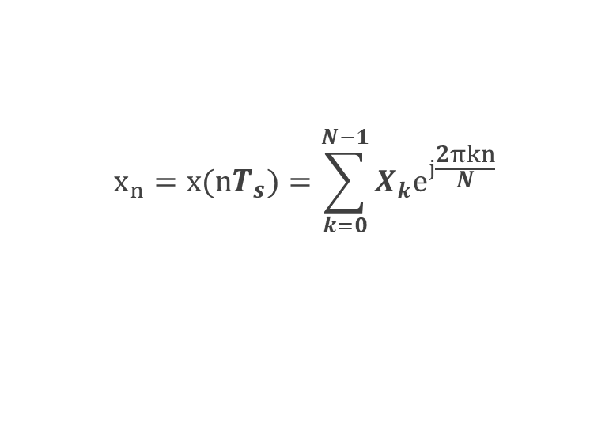

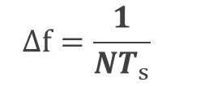

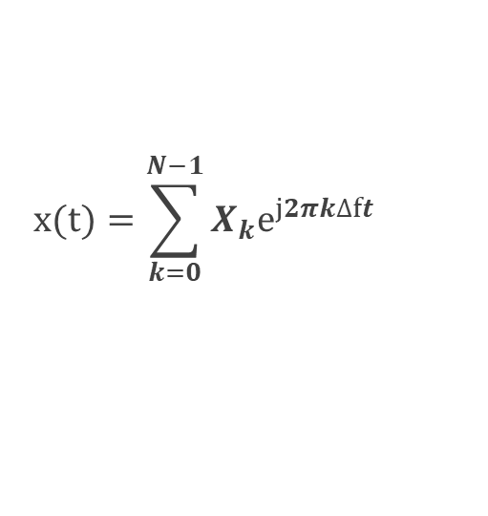
OFDM信号
$f_{k}上$的调制信号
$$φ_{f_{k}}(t)=X_{k}e^{j2πf_{k}t}$$
$$f_{k}=f_{0}+k∆f$$
OFDM信号
$$x(t)=\sum_{k=0}^{N−1}{φ_{f_{k}}(t)}=\sum_{k=0}^{N−1}{X_{k}e^{j2π(f_{0}+k∆f)t}}$$
OFDM基带调制信号
$$x(t)=\sum_{k=0}^{N−1}{X_{k}e^{j2πk∆ft}}$$
$T_{s}=\frac{T}{K}$采样
$$x_{n}=x(nT_{s})=\sum_{k=0}^{N−1}{X_{k}e^{j\frac{2πkn}{N}}}$$
$$∆f=\frac{1}{NT_{s}}$$

Slide 8
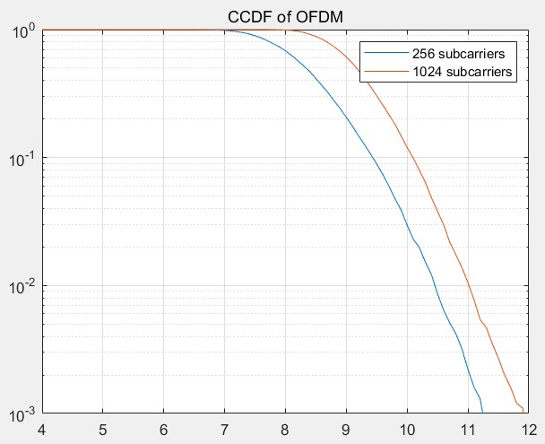
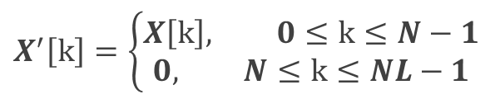
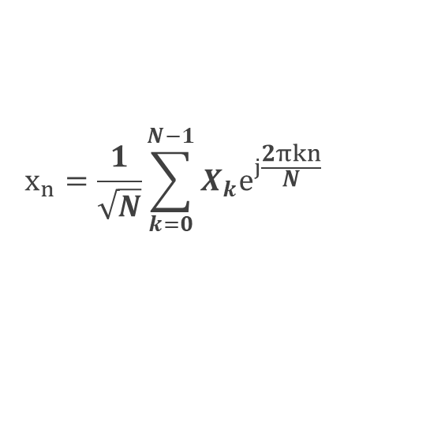

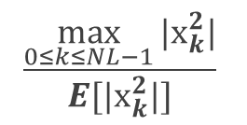

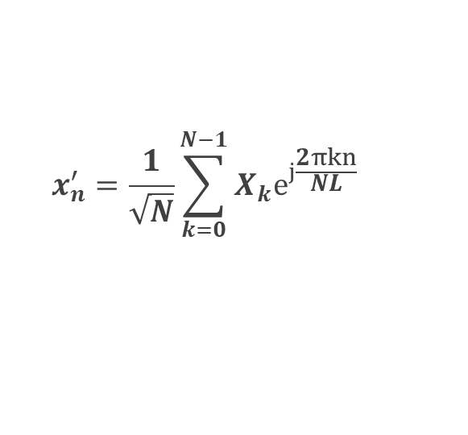
OFDM信号的PAPR
$$\frac{\max_{0≤k≤NL−1}{|x_{k}^{2}|}}{E[|x_{k}^{2}|]}$$
PAPR
CCDF
$$P\left(PAPR>z\right)=1−P\left(PAPR≤z\right)$$
256,1024子载波 QPSK调制 4倍过采样
关于过采样(L-times)
$$X^{′}\left[k\right]=\left\{\begin{aligned}X\left[k\right], 0≤k≤N−1 \\ &0, N≤k≤NL−1\end{aligned}\right.$$
$$x_{n}=\frac{1}{\sqrt{N}}\sum_{k=0}^{N−1}{X_{k}e^{j\frac{2πkn}{N}}}$$
$$x_{n}^{′}=\frac{1}{\sqrt{N}}\sum_{k=0}^{N−1}{X_{k}e^{j\frac{2πkn}{NL}}}$$
$$n=0,1,…,NL−1$$
n=0,L,…时， $x_{n}^{′}=x_{n}$

Slide 9
第二部分
PAPR抑制的经典方法
amplitude clipping, SLM, PTS

Slide 10
PAPR抑制经典方法
amplitude clipping
PAPR抑制
PTS
SLM

Slide 11
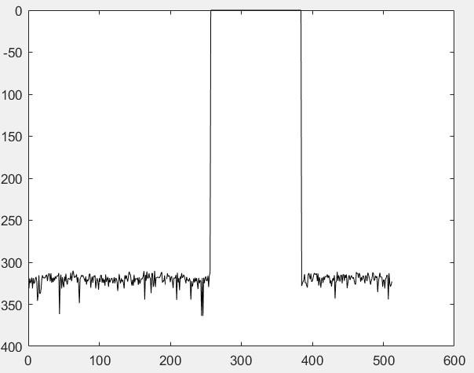
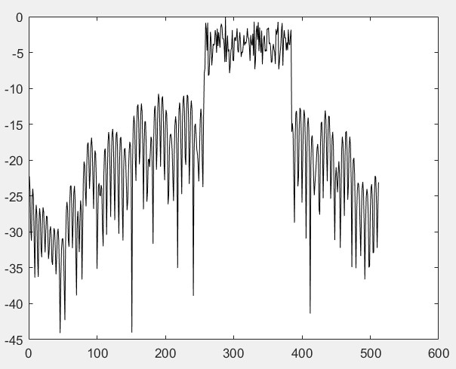
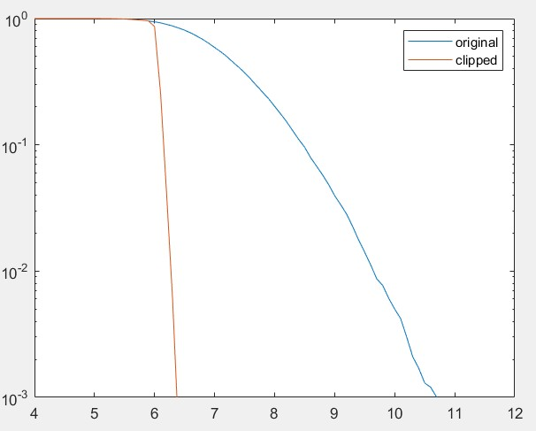
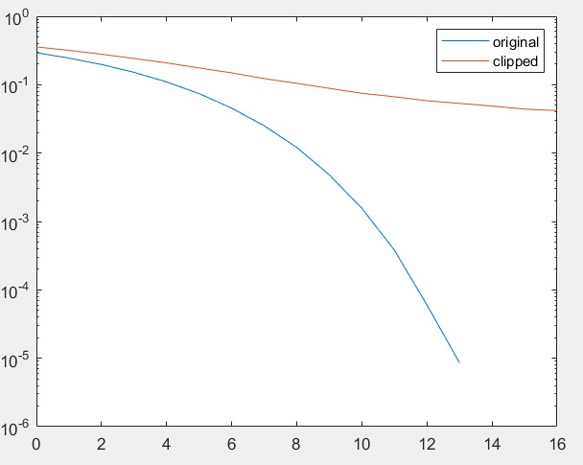
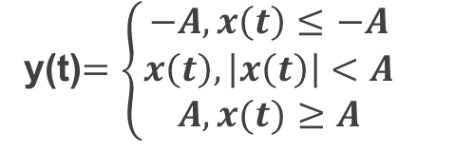

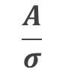
amplitude clipping
y(t)$=\left\{\begin{aligned}−A, x\left(t\right)≤−A \\ x\left(t\right), \left|x\left(t\right)\right|<A \\ A, x(t)≥A\end{aligned}\right.$
clipping ratio
$$\frac{A}{σ}$$
$σ$:rms signal power
CCDF
BER

Slide 12
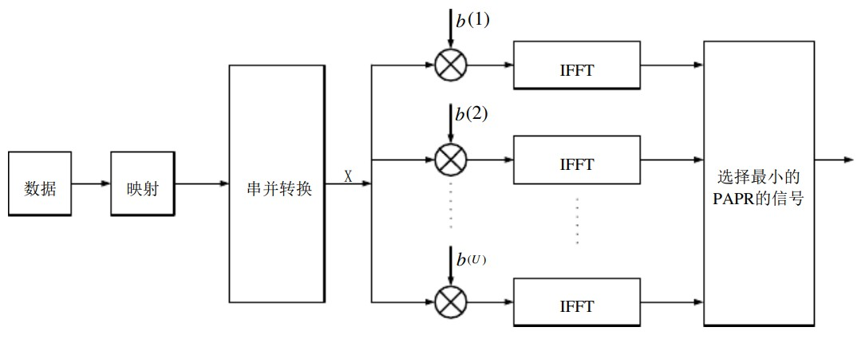
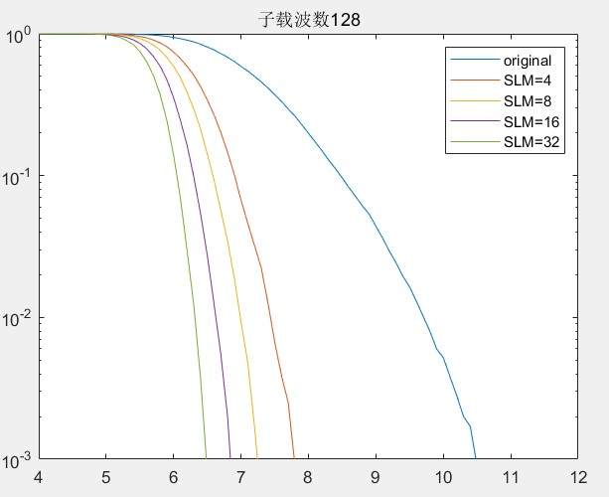
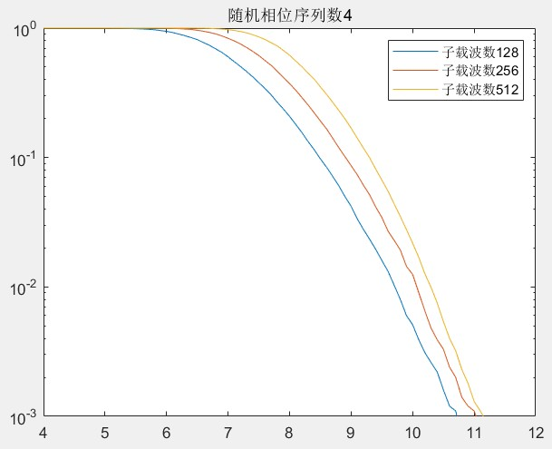
selected mapping(SLM)
随机相位序列
128子载波
4相位随机序列

Slide 13
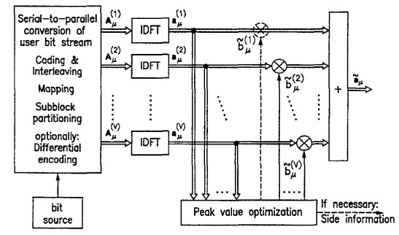
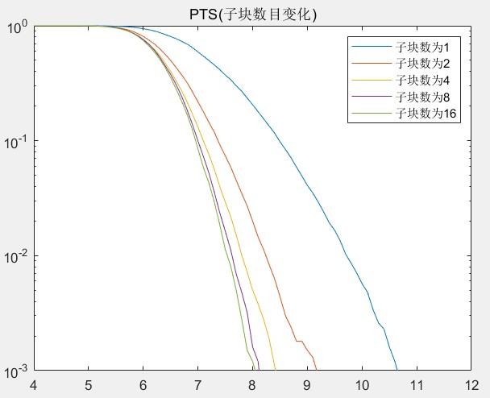
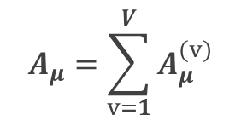


partial transmit sequence(PTS)
subcarrier vector $A_{μ}$
$$A_{μ}=\sum_{v=1}^{V}{A_{μ}^{(v)}}$$
partitioned $A_{μ}^{(v)}$
partial transmit sequence $a_{μ}^{(v)}=IDFT\{A_{μ}^{\left(v\right)}\}$

Slide 14
第三部分
后续任务和参考文献
Arrangement and Reference

Slide 15
添加论文第五部分内容标题
探索神经网络方案，与经典方案进行比较
后续任务
基于经典PAPR抑制方法的OFDM通信系统仿真
clipping and filtering仿真

Slide 16






参考文献
1
Seung Hee Han and Jae Hong Lee, "An overview of peak-to-average power ratio reduction techniques for multicarrier transmission," in IEEE Wireless Communications, vol. 12, no. 2, pp. 56-65, April 2005, doi: 10.1109/MWC.2005.1421929.
2
Weinstein S , Ebert P . Data Transmission by Frequency-Division
Multiplexing Using the Discrete Fourier Transform
[J]. IEEE Trans.commun.techn, 1971, 19(5):628-634.
3
O'Neill R , Lopes L B . Envelope variations and spectral
splatter in clipped multicarrier signals[C]// IEEE Conference Pmirc. 1995.
4
Li X , Cimini L J . Effects Of Clipping And Filtering
On The Performance Of Ofdm[C]// IEEE Vehicular
Technology Conference. IEEE, 1998.
5
Armstrong, J. Peak-to-average power reduction for OFDM
by repeated clipping and frequency domain filtering[J].
Electronics Letters, 2002, 38(5):246-247.

Slide 17
参考文献
6
Muller S H , Huber J B . A comparison of peak power reduction schemes for OFDM[C]// IEEE Global Telecommunications Conference. IEEE, 1997.
7
Bauml R W , Fischer R . Reducing the peak-to-average power ratio of
multicarrier modulation by selected mapping[J].
Electronics Letters, 1996, 32(22):2056-2057.
8
Muller S H , Huber J B . OFDM with reduced peak-to-average
power ratio by optimum combination of partial transmit sequences[J].
Electronics Letters, 1997, 33(5):368-369.
9
SH Müller, Huber J B . A novel peak power reduction
scheme for OFDM[J]. Personal Indoor & Mobile Radio
Communications. waves of the Year. pimrc, 1997, 3:1090 - 1094.

Slide 18
感谢批评指正
综合课程设计中期汇报
答 辩 人 ：赵宇恒

