Slide 1
Histograms and Main Memory DBs
Sam Madden
6.830 Lecture 10
3.24.21
Project Proposal Due Today
PS2 Due Next Monday
Q1 Next Wednesday

Slide 2
Quiz Format
In class, 75 minutes, on Zoom
Answers are all short answer or multiple choice
Write answers in provided text file template
5 minutes at end to upload to Gradescope
If something doesn’t work, you can email to us
Contact us if you need special accommodations

Slide 3
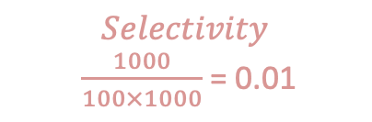
Query Optimization Recap
SELECT * FROM emp, dept, kids
WHERE sal > 10k
AND emp.dno = dept.dno
AND emp.eid = kids.eid
100 tuples/page
10 pages RAM
10 KB/page
3000
|dept| = 100 records = 1 page = 10 KB
|emp| = 10K = 100 pages = 1 MB
|kids| = 30K = 300 pages = 3 MB
$$Selectivity$$
$\frac{1000}{100×1000}$ = 0.01
⨝ eno=eno
1000
30000
Join algo?
⨝ dno=dno
kids
Steps:
For each plan alternative:
Estimate sizes of relations
Estimate selectivities
Compute intermediate sizes
Evaluate cost of plan operations
Select best plan
1000
100
𝛔_{sal>10k}
0.1 (selectivity)
10K (cardinality)
dept
emp
Index vs scan?

Slide 4
Selinger Statistics
Steps:
Estimate sizes of relations
Estimate selectivities
Compute intermediate sizes
Evaluate cost of plan operations
Find best overall plan
NCARD(R) - "relation cardinality" - number of records in R
TCARD(R) - # pages R occupies
ICARD(I) - # keys (distinct values) in index I
NINDX(I) - pages occupied by index I
Min and max keys in indexes
Modern databases use much more sophisticated stats – will look at Postgres

Slide 5
Enumerating Plans
Steps:
Estimate sizes of relations
Estimate selectivities
Compute intermediate sizes
Evaluate cost of plan operations
Find best overall plan
Selinger combines several heuristics with a search over join orders
Heuristics
Push down selections
Don’t consider cross products
Only “left deep” plans
Right side of all joins is base relation
Still have to order joins!
⨝ eno=eno
Predicate push down
𝛔_{sal>10k}
kids
⨝ dno=dno
dept
emp

Slide 6
Selinger Algorithm
R ←set of relations to join
For i in {1...|R|}:
for S in {all length i subsets of R}:
optcost_{s} = ∞
optjoin_{S} = ø
for a in S: //a is a relation
c_{sa} = optcost_{s-a} +
min. cost to join (S-a) to a +
min. access cost for a
if c_{sa} < optcost_{s} :
optcost_{s} = c_{sa}
optjoin_{s} = optjoin(S-a) joined optimally w/ a
Cached in previous step!

Slide 7
Example
Relations | Best Plan | Cost
A | Index Scan | 5
B | Seq Scan | 15
…
{A,B} | BA | 75
{A,C} | AC | 12
{B,C} | CB | 22
4 Relations: ABCD
Optjoin:
A = best way to access A
(e.g., sequential scan,
or predicate pushdown into index...)
B = " " " " B
C = " " " " C
D = " " " " D
{A,B} = AB or BA
{A,C} = AC or CA
{B,C} = BC or CB
{A,D}
{B,D}
{C,D}
Dynamic Programming Table

Slide 8
Example (con’t)
Relations | Best Plan | Cost
A | Index Scan | 5
B | Seq Scan | 15
…
{A,B} | BA | 75
{A,C} | AC | 12
{B,C} | CB | 22
..
{A,B,C} | (CB)A | 35
…
{B,C,D} | (CB)D | 42
..
{A,B,C,D} | ((CB)D)A | 57
Already computed!
Optjoin
{A,B,C} = remove A: compare A({B,C}) to ({B,C})A
remove B: compare ({A,C})B to B({A,C})
remove C: compare C({A,B}) to ({A,B})C
{A,C,D} = …
{A,B,D} = …
{B,C,D} = …
…
{A,B,C,D} = remove A: compare A({B,C,D}) to ({B,C,D})A
remove B: compare B({A,C,D}) to ({A,C,D})B
remove C: compare C({A,B,D}) to ({A,B,D})C
remove D: compare D({A,C,C}) to ({A,B,C})D

Slide 9
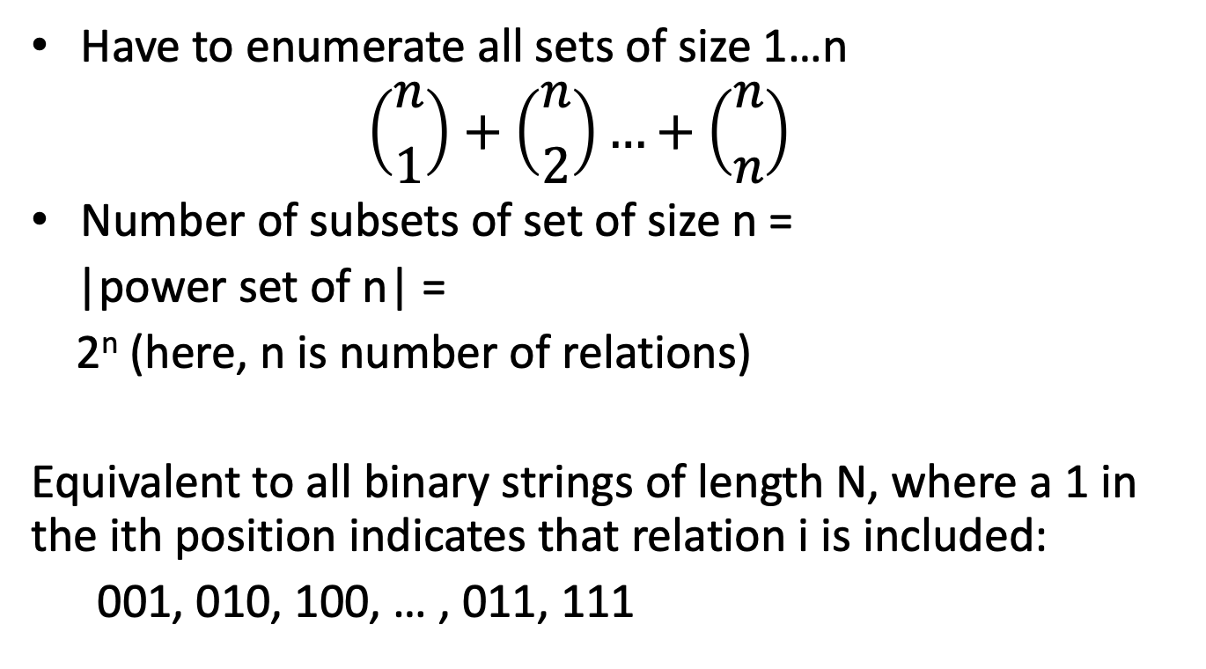
Complexity
Have to enumerate all sets of size 1…n
$$\left({n \atop 1}\right)+\left({n \atop 2}\right)…+\left({n \atop n}\right)$$
Number of subsets of set of size n =
|power set of n| =
2^{n} (here, n is number of relations)
Equivalent to all binary strings of length N, where a 1 in the ith position indicates that relation i is included:
001, 010, 100, … , 011, 111
Notes:
(string of length n, 0 if element is in, 1 if it is out; clearly, 2^n such strings)

Slide 10
Complexity (cont.)
2^{n} Subsets
How much work per subset?
Have to iterate through each element of each subset, so this at most n
n2^{n} complexity (vs n!)
n=12 ➔ 49K vs 479M

Slide 11
Interesting Orders
Some query plans produce data in sorted order – E.g., scan over a primary index, merge-join – Called interesting order
Next operator may use this order – E.g., can be another merge-join
For each subset of relations, compute multiple optimal plans, one for each interesting order
Increases complexity by factor k+1, where k=number of interesting orders

Slide 12
Improved Statistics
Selinger assumes data is uniformly distributed across whole table
Instead, we can compute some additional statistics per table, for example:
Distribution of values in each column, e.g., as a histogram
Frequent values in each column
Sample of values in each column
Co-occurrence statistics about several columns

Slide 13
Histogram Example
Summary of the distribution of values of some attribute
Selectivity(Attr <= 25)?
Bin 1 + Bin 2 + ½ * Bin 3 = .07 + .04 + 1/2 *.15 = .185

Slide 14
Equi-depth Histogram
Each bin is the same height (fraction of values)
Lookups are very easy!
87
.1
Frac Values
0
11
24
43
55
69
74
82
85
100
Attribute Value
Selectivity(Attr <= 25)?
← Equivalent →
.1 + .1 + .1 * (25-24)/(43-24)
= .205

Slide 15
Frequent Values
Histograms work well for range queries, but what about exact value queries?
Idea: store a list of frequent values, and their frequencies
Selectivity Attr = 7?
.09
Value | Frequency
7 | .09
18 | .04
44 | .03
50 | .03
For values not in table use:
(1- ∑(FV freqs))/(num distinct - num FV)
E.g., if 100 distinct vals,
(1 – .19) / (100 – 4) = .0085
∑ = .19

Slide 16
Combining Frequent Values and Histograms
If we have frequent values and histograms, and a range predicate, how to combine?
Value | Frequency
7 | .09
18 | .04
44 | .03
50 | .03
.205
.13
87
.1
Frac Values
0
11
24
43
55
69
74
82
85
100
Attribute Value
∑ = .19
Treat as a weighted sum of two distributions, where the weight of the FVs is the sum of the frequencies in the table
P_{FVS}(pred) + (1- ∑(FV freqs) x P_{HIST}(pred) =
.13 + (1-.19) x .205 = .296
Selectivity(Attr <= 25)?

Slide 17
Multicolumn Statistics
Consider
SELECT count(*) FROM people
WHERE state = ‘MA’ AND zip = ‘02459’
selectivity 1/50
selectivity 1/1000
Is the combined selectivity 1/(50 * 1000)?
No! All 02459 zips are in MA, so true selectivity is 1/1000

Slide 18
Multicolumn Stats (2)
Functional dependencies
For each pair A1, A2, compute the fraction FD_{A1,A2} of values A2 that are completely determined by A1
E.g., for (state, zip), this is 1.0, because each distinct zip occurs in the same state
To estimate selectivity of a query with predicate over A1 and A2, replace the selectivity of A1 with FD_{A1,A2}
SELECT count(*) FROM people
WHERE state = ‘MA’ AND zip = ‘02459’
selectivity 1.0
selectivity 1/1000

Slide 19
Multicolumn Stats(3)
Frequent Value Pairs
Straightforward Extension of Frequent Value Lists
Value 1 | Value 2 | Frequency
7 | A | .09
18 | AA | .04
44 | CAA | .03
50 | BAA | .03
Selectivity A1 = 7 and A2 = ‘A’
.09

Slide 20
Postgres Statistics
Histograms + Frequent Values for each attribute
Configurable number of bins/values
Number of distinct values for each column
Multicolumn Statistics
Functional dependencies for pairs of attributes
Number of distinct values of pairs of attributes
Frequent values for pairs of attributes
Multicolumn stats are only computed for user-specified column pairs, and only within the same table

Slide 21
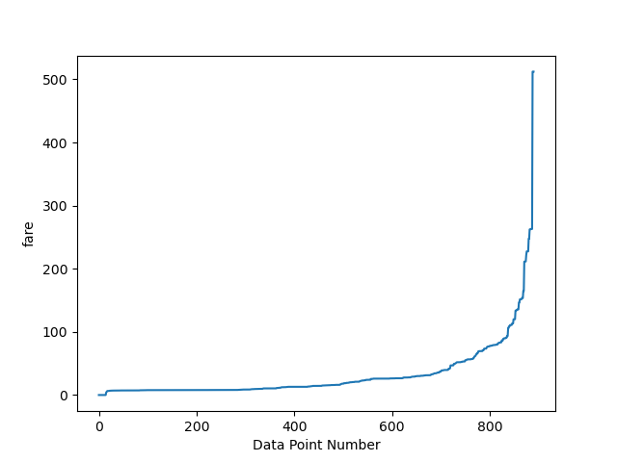
Demo – Titanic Passengers Fares
Non-uniform (most people paid base fare, a few paid a lot)
Some very frequent values

Slide 22
Study Break
Frequent Values
Value | Frequency
22 | .09
38 | .05
40 | .04
51 | .03
Q1. Using just the histogram, estimate the selectivity of the predicate Attr <= 50
Q2. Using the histogram and the frequent values, estimate the selectivity of the predicate Attr <= 50

Slide 23
Study Break
Frequent Values
Value | Frequency
22 | .09
38 | .05
40 | .04
51 | .03
.18
Sum = 0.21
Q1. Using just the histogram, estimate the selectivity of the predicate Attr <= 50
Q2. Using the histogram and the frequent values, estimate the selectivity of the predicate Attr <= 50
.12 + .25 + ½ x .3 = .52
(.18) + (1-.21) x .52 = .5908

Slide 24
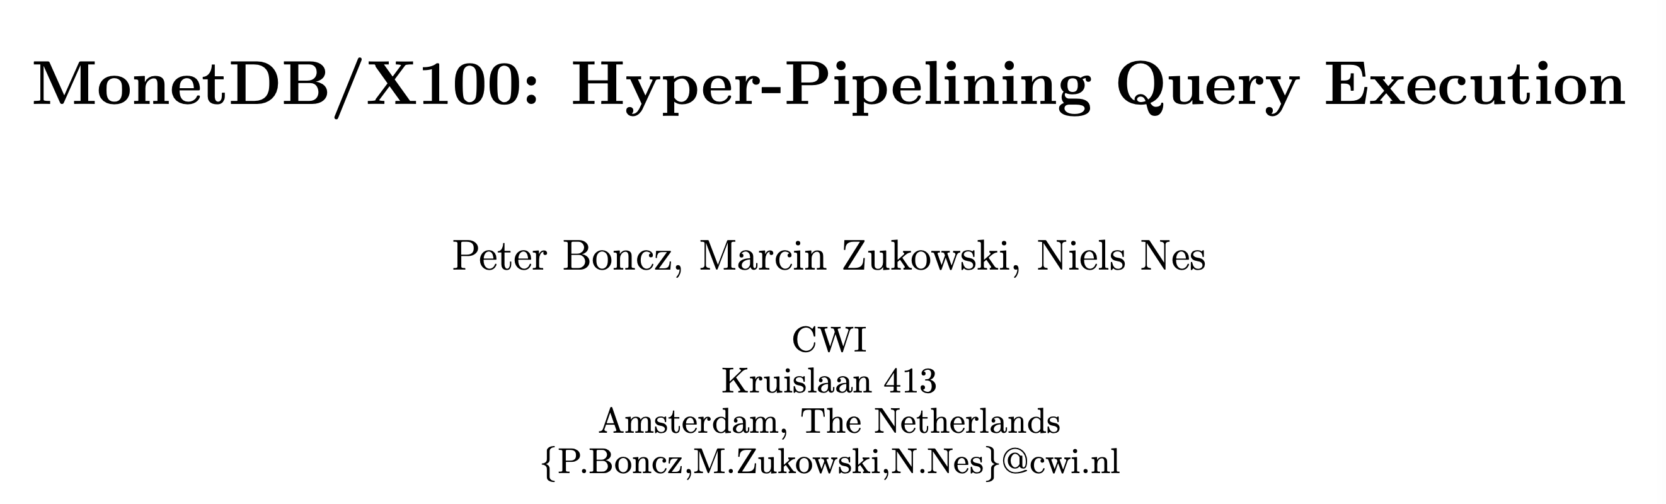

Slide 25
Overview
Main memory DB
Though many of the principles apply to disk as well
Primarily focused on high-performance read operations
Though there is a discussion of inserts and updates
Key ideas:
Batch-at-a-time “vectorized” processing
Good cache locality
Minimize overheads of lots of branches, etc
Column-wise operators, generated from patterns

Slide 26
Primer: CPU Performance
Main memory latency ~ 100 cycles
L1 cache ~4 cycles
CPUs read cache lines
16-32 bytes
CPUs Prefetch data & instructions
On a cache miss to address A, stream A, A+1, A+2, ... into cache
Implications:
Sequential access to memory is much faster than random access
If working set fits in cache, orders of magnitude faster than if not
Jumping to random instructions can result in instruction misses and stalls
Core1
Core2
Core1
Core2
4 cycles
L1 Cache
L1 Cache
L1 Cache
L1 Cache
32 KB
12 cycles
L2 Cache
L2 Cache
256 KB
36 cycles
L3 Cache
8 MB
50-100ns
(~ 150-300 cycles)
Memory Bus
System Memory
64 GB
SSD (Flash) Disk
4 TB

Slide 27
Primer: Branch Mispredictions and Indirect Branches
Function calls and if statements are both branches
CPUs try to predict which branches will be executed
Fetch instructions & execute these branches before they happen
Some branches are hard to predict:
Nearly 50/50 or random loop conditions
Indirect branches, or function calls via pointers
FunctionPtr myFun = &aDatabaseOperation
…
(*myFun)(x,y,z) /* Object oriented programs do this a lot */
A branch misprediction results in flushing the instruction pipeline; new instructions must be reloaded from memory (not cache!)
Functions calls also have some overhead due to passing arguments, etc.

Slide 28
Why are row-oriented, record-at-a-time systems slow?
Record at a time → function call per record per op
Often operations are implemented as function pointers
Resulting in branch mispredictions
Operating on larger batches would amortize this cost
Row-oriented → expensive field offset ops
Especially with variable length data
Resulting in difficult to predict random memory accesses
Since operations work a column-at-a-time (usually), column-stores avoid these random accesses
F3 offset = Header[F1].len + Header[F2].len
F3 address is result of arithmetic; load is unpredictable and random
Header
F1
F2
F3

Slide 29
Example: TPC-H Q1
SELECT l_returnflag,
l_linestatus,
sum(l_quantity) AS sum_qty,
sum(l_extendedprice) AS sum_base_price,
sum(l_extendedprice * (1 - l_discount)) AS sum_disc_price,
sum(l_extendedprice * (1 - l_discount) * (1 + l_tax)) AS sum_charge,
avg(l_quantity) AS avg_qty,
avg(l_extendedprice) AS avg_price,
avg(l_discount) AS avg_disc,
count(*) AS count_order lineitem l_shipdate <= date ’1998-09-02’
FROM lineitem
WHERE l_shipdate <= date ’1998-09-02’
GROUP BY l_returnflag,
l_linestatus

Slide 30
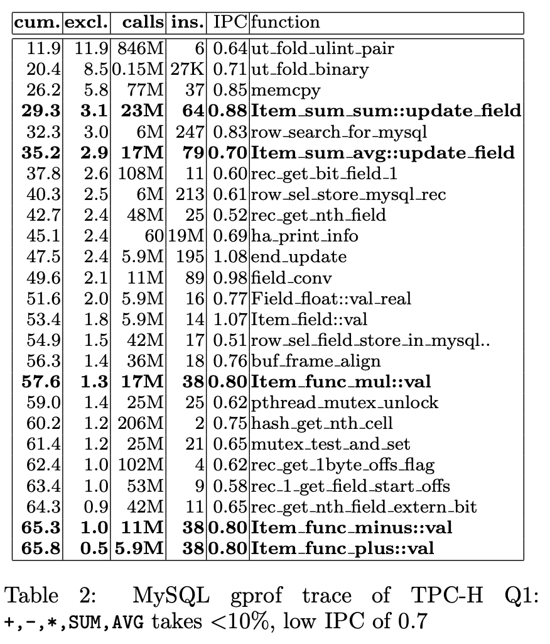
TPC-H Q1 in MySQL

Slide 31
Hand-optimized Code
static void tpch_query1(int n, int hi_date,
unsigned char*__restrict__ p_returnflag,
unsigned char*__restrict__ p_linestatus,
double*__restrict__ p_quantity,
double*__restrict__ p_extendedprice,
double*__restrict__ p_discount,
double*__restrict__ p_tax,
int*__restrict__ p_shipdate
aggr_t1*__restrict__ hashtab)
{
for(int i=0; i<n; i++) {
if (p_shipdate[i] <= hi_date) {
aggr_t1 *entry = hashtab +
(p_returnflag[i]<<8) + p_linestatus[i];
double discount = p_discount[i];
double extprice = p_extendedprice[i];
entry->count++;
entry->sum_qty += p_quantity[i];
entry->sum_disc += discount;
entry->sum_base_price += extprice;
entry->sum_disc_price += (extprice *= (1-discount));
entry->sum_charge += extprice*(1-p_tax[i]);
} } }

Slide 32
MonetDB/X100
Record at a time → Batch (“Vector”) at a time
Each operator processes a whole batch, writes output vector
Amortizes cost of function calls
Keeps working set in cache
Good when there are multiple cores: batches can run in parallel
Tricky for joins, will discuss more later
Row oriented → Column oriented
Operators iterate over values in a single column
No complex offset calculations
Batches read sequentially
Code generation to create type-specific op implementations
Query compiler emits calls to these directly (note inlineable)
Eliminates indirect function calls

Slide 33
Operator Example
any::1 +(any::1 x,any::1 y) plus = x + y
becomes
map_plus_double_col_double_col(int n,
double*__restrict__ res,
double*__restrict__ col1,
double*__restrict__ col2,
int*__restrict__ sel)
{ if (sel) {
for(int j=0;j<n; j++) {
int i = sel[j];
res[i] = col1[i] + col2[i];
} } else {
for(int i=0;i<n; i++)
res[i] = col1[i] + col2[i];
}}

Slide 34
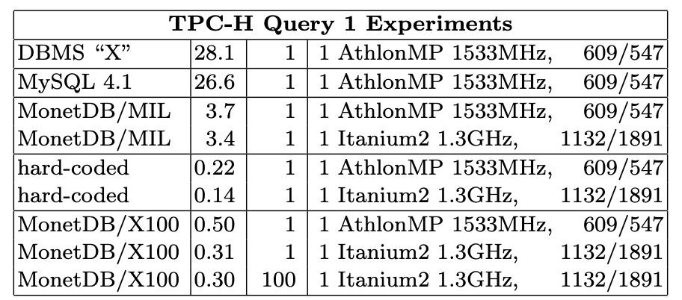
Performance Summary
56x speedup vs Oracle, 52x vs MySQL
Withing a factor of 2 of hand-coded
Comparable speedups on other queries; some are trickier, e.g., those with extensive joins.

Slide 35
Takeaway
For memory resident workloads, CPU optimizations make a huge difference
Key optimizations
Batch at a time processing to promote sequential access, amortize function calls
Column oriented architecture and generated operators avoid expensive offset computations, indirect branches

