Slide 1
6.830/6.814 Lecture 5
Database Internals Continued
March 3, 2021

Slide 2
Plan for Next Few Lectures
Admission Control
Connection Management
Query System
Lec 7 – Column Stores
Parser
Last Lec
Rewriter
Lec 9
Planner
Optimizer
This Lec
Lec 8 – Join Algos
Executor
Storage System
Access Methods
Buffer Manager
Lock Manager
Log Manager
Lec 6

Slide 3
SimpleDB Overview
3/3/2021

Slide 4
What is SimpleDB?
A basic database system
SQL Front-end (Provided for later labs)
Heap files (Lab 1)
Buffer Pool (Labs 1-6)
Basic Operators (Labs 1 & 2)
Scan, Filter, JOIN, Aggregate
Query optimizer (Lab 3)
Transactions (Lab 4)
B-Tree Indexes (Lab 5)
Recovery (Lab 6)
Javadoc is your friend!

Slide 5
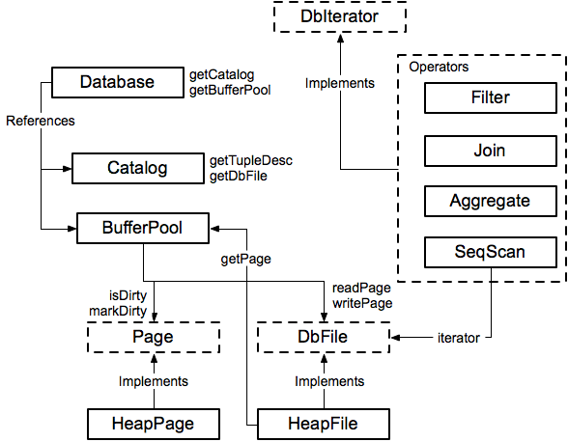
Module Diagram

Slide 6
Database
Singleton Database:
Database.getCatalog()
Database.getBufferPool()
Catalog
=> List of DB tables
BufferPool
=> Caches DB pages in memory
Database.getLogFile()
LogFile (Ignore for Lab 1)

Slide 7
Catalog
Catalog:
DbFile ID | Table
001 | Table1
002 | Table2
003 | Table3
Table:
DbFile file
String name
String primary_key
=> Stores a list of all tables in the database
Notes:
Catalog stores a list of available tables, TupleDesc
void addTable(DbFile d, TupleDesc d)‏
DbFile getTable(int tableid)‏
TupleDesc getTupleDesc(int tableid)‏
Not persisted to disk

Slide 8
BufferPool
Buffer Pool:
Page ID | Page
001 | Page1
003 | Page3
007 | Page7
Page:
PageId id
Tuple tuples[]
Byte header[]
=> Caches recently accessed database pages in memory
Notes:
Manages cache of pages
Evicts pages when cache is full [not lab 1]
All page accesses should use getPage
Even from inside DbFile!
You will eventually implement
locking for transactions
Flushing of pages for recovery

Slide 9
HeapFile (Implements DbFile)
File (on disk):
_______________
Heap File:
File file
TupleDesc td
DbFileIterator it
Tuple Descriptor:
Field1 Type Field1 Name | Field2 Type Field2 Name | Field3 Type Field3 Name | …
Iterate through Tuples in Heap Pages:
Page1 | Page2 | Page3 | …
Notes:
An array of HeapPages on disk
Javadoc is your friend!
Implement everything except addTuple and removeTuple

Slide 10
HeapPage (Implements Page)
Tuple Descriptor:
Heap Page:
Field1 Type Field1 Name | Field2 Type Field2 Name | Field3 Type Field3 Name | …
HeapPageId pid
TupleDesc td
Byte header[]
Tuple tuples[]
Header:
01100110 | 11111111 | 11101101 | …
Tuples:
Empty | Tuple1 | Tuple2 | …
Tuple:
Field1 | Field2 | Field3 | …
Fields and Tuples are Fixed Width!
Notes:
Format
Header is a bitmap
Page contents are an array of fixed-length Tuples
Full page size = BufferPool.PAGE_SIZE
Number of bits in Header = number of Tuples
Header size + size of tuples = BufferPool.PAGE_SIZE
Note endianness!

Slide 11
SeqScan (Implements DbIterator)
DbIterator class implemented by all operators
open()‏
close()‏
getTupleDesc()‏
hasNext()‏
next()‏
rewind()‏
Iterator model: chain iterators together
Use DbFileIterator from HeapFile

Slide 12
// construct a 3-column table schema
Type types[] = new Type[]{ Type.INT_TYPE, Type.INT_TYPE, Type.INT_TYPE };
String names[] = new String[]{ "field0", "field1", "field2" };
TupleDesc descriptor = new TupleDesc(types, names);
// create the table, associate it with some_data_file.dat
// and tell the catalog about the schema of this table.
HeapFile table1 = new HeapFile(new File("some_data_file.dat"), descriptor);
Database.getCatalog().addTable(table1);
// construct the query: we use a simple SeqScan, which spoonfeeds
// tuples via its iterator.
TransactionId tid = new TransactionId();
SeqScan f = new SeqScan(tid, table1.id());
// and run it
f.open();
while (f.hasNext()) {
Tuple tup = f.next();
System.out.println(tup);
}
f.close();
Database.getBufferPool().transactionComplete();

Slide 13
HeapFileEncoder.java
Because you haven’t implemented insertTuple, you have no way to create data files
HeapFileEncoder converts CSV files to HeapFiles
Usage:
java -jar dist/simpledb.jar convert csv-file.txt numFields
Produces a file csv-file.dat, that can be passed to HeapFile constructor.

Slide 14
Query Processing Steps
Admission Control
Query Rewriting
Plan Formulation (SQL → Tree)
Optimization

Slide 15
Plan Formulation
Π_{ename,count}
emp (eno, ename, sal, dno)
dept (dno, dname, bldg)
kids (kno, eno, kname, bday)
SELECT ename, count(*)
FROM emp, dept, kids
WHERE emp.dno=dept.dno
AND kids.eno=emp.eno
AND emp.sal > 50000
AND dept.name = 'eecs'
GROUP BY ename
HAVING count(*) > 7
𝛔_{count > 7}
𝛂_{agg:count(*), group by ename}
⨝
eno=eno
⨝
dno=dno
kids
𝛔_{name=‘eecs’}
𝛔_{sal>50k}
dept
emp

Slide 16
Plan questions
Π_{ename,count}
Logical planning: operator ordering (exponential search space)
Physical planning: operator implementation & access methods (indexes vs heap files)
𝛔_{count > 7}
𝛂_{agg:count(*), group by ename}
⨝
eno=eno
Order?
⨝
dno=dno
kids
𝛔_{name=‘eecs’}
𝛔_{sal>50k}
Implementation?
Storage model & access methods?
dept
emp

Slide 17
Accessing Data
Access Method: way to read data from disk
Heap File: unordered arrangement of records
Arranged in pages
Hdr | R1 | R2 | R3 | R4
Hdr | R4 | R5 | R6 | R7
Hdr | R8 | R9 | R10 | R11
…
Page 1 Page 2 Page 3
Header: Start offset of each record, which parts of page are occupied, etc

Slide 18
Tree Index
<3 | ≥3, <5 | ≥5, <7 | ≥8, 9
Index File
0 | 1 | 2 | 2 | 2
3 | 4
5 | 6
8 | 9 | 9
Hdr | R1 | R2 | R3 | R4
 | 3 | 2 | 9 | 4
Hdr | R4 | R5 | R6 | R7
 | 6 | 1 | 0 | 2
Hdr | R8 | R9 | R10 | R11
 | 9 | 8 | 2 | 5
Heap File
Attr1
…
Attrn

Slide 19
Connecting Operators: Iterator Model
Each operator implements a simple iterator interface:
open(params)
getNext() → record
Any iterator can compose with any other iterator
Π_{movieTitle}
⨝
starName = name
𝛔_{birthday…}
starsIn
Data flows from bottom to top
it1 = Scan.open(“movieStar”, …)
it2 = Filter.open(it1, bday=x, …)
it3 = Scan.open(“starsIn”, …)
it4 = Join.open(it2, it3,
starName=name)
it5 = Proj.open(it4, movieTitle)
movieStar

Slide 20

Iterator Model
it1 = Scan.open(“movieStar”, …)
it2 = Filter.open(it1, bday=x, …)
it3 = Scan.open(“starsIn”, …)
it4 = Join.open(it2, it3,
starName=name)
it5 = Proj.open(it4, movieTitle)
getNext
(”Brad Pitt”)
it5
(”Brad Pitt”, “Ad Astra”)
getNext
it4
“Brad Pitt”
getNext
”Ad Astra”
getNext
it2
it3
starsIn
“Brad Pitt”
getNext
it1
movieStar

Slide 21
Scan
Scan(tableName)
this.tableName = tableName
open():
f = fopen(this.tableName)
next():
tuple = readTuple(f)
return tuple

Slide 22
Filter
Filter(pred,child):
this.pred = pred
this.child = child
open():
this.child.open()
next():
do:
tuple = child.next()
if (tuple == null)
return null
if (pred(tuple))
return tuple

Slide 23
Nested Loops Join
Join(outer,inner,pred)
for t1 in outer:
for t2 in inner:
if p(t1,t2)
emit join(t1,t2)
Problem:
If inner is a sub-query, e.g.
C ⨝ D, have to continually recompute it, or store it to disk (materialize it)
If inner is just a base relation (e.g., C or D), then no need for additional materialization

Slide 24
This Lecture
What makes a good query plan?
Cost Estimation
Buffer Management
Postgres Examples

Slide 25
Cost Estimation
Π_{ename,count}
Query optimization goal: find plan that has lowest cost?
What is cost?
𝛔_{count > 7}
𝛂_{agg:count(*), group by ename}
⨝
eno=eno
Order?
Disk I/O (Pages Read)
Memory Accesses
CPU Cycles
Comparisons
Records Processed
⨝
dno=dno
kids
𝛔_{name=‘eecs’}
𝛔_{sal>50k}
dept
emp

Slide 26
Memory Hierarchy
Core1
Core2
Core1
Core2
4 cycles
L1 Cache
L1 Cache
L1 Cache
L1 Cache
32 KB
12 cycles
L2 Cache
L2 Cache
256 KB
36 cycles
L3 Cache
8 MB
Memory Bus
50-100ns
(~ 150-300 cycles)
System Memory
64 GB
SSD (Flash) Disk
4 TB
Notes:
(F

Slide 27
Bandwidth vs Latency
1st access latency often high relative to the rate device can stream data sequentially (bandwidth)
RAM: 50 ns per 16 B cache line
random access bandwidth of 16 * 1/5x10⁻⁸ = 320 MB / sec
If streaming sequentially, bandwidth 20-40 GB/sec
Flash disk: 250 us per 4K page
Random access bandwidth of 4K * 1/2.5x10⁻⁴= 16 MB / sec
If streaming sequentially, bandwidth 2+ GB/sec
(100x difference)
(125x difference)

Slide 28
Bandwidth v Latency (cont.)
(250x difference)
Spinning disk: 10 ms latency vs 100 MB seq bandwidth
Random access BW per 4KB page = 400 KB/sec
Local network: 100 us latency vs 10 GB seq bandwidth
Random access BW per byte = 10K / sec
Wide area net: 10 ms latency vs 1 GB seq bandwidth
Random access BW per byte = 100 B / sec
(1Mx difference)
(100Mx difference)

Slide 29
Important Numbers
CPU Cycles / Sec | 2+ Billion (.5 nsec latency)
L1 latency | 2 nsec (4 cycles)
L2 latency | 6 nsec (12 cycles)
L3 latency | 18 nsec (36 cycles)
Main latency | 50 – 100 ns (150-300 cycles)
Sequential Mem Bandwidth | 20-40+ GB/sec
SSD Latency | 250+ usec
SSD Seq Bandwidth | 2-4 + GB/sec
HD (spinning disk) latency | 10 msec
HD Seq Bandwidth | 100+ MB
Local Net Latency | 10 – 100 usec
Local Net Bandwidth | 1 – 40 Gbit /sec
Wide Area Net Latency | 10 – 100 msec
Wide Area Net Bandwidth | 100 – 1 Gbit / sec

Slide 30
Database Cost Models
Typically try to account for both CPU and I/O
I/O = ”input / output”, i.e., data access costs from disk
Database algorithms try to optimize for sequential access (to avoid massive random access penalties)
Simplified cost model for 6.814/6.830:
# seeks (random I/Os) x random I/O time +
sequential bytes read x sequential B/W

Slide 31
Example
SELECT * FROM emp, dept, kids
WHERE sal > 10k
AND emp.dno = dept.dno
AND emp.eid = kids.eid
100 tuples/page
10 pages RAM
10 KB/page
3000
|dept| = 100 records = 1 page = 10 KB
|emp| = 10K = 100 pages = 1 MB
|kids| = 30K = 300 pages = 3 MB
⨝ eno=eno
1000
30000
kids
Spinning Disk:
10 ms / random access page
100 MB/sec sequential B/W
Assume nested loops joins, no indexes
⨝ dno=dno
1000
100
𝛔_{sal>10k}
10%
10K
dept
emp

Slide 32
Example w/ Simple Cost Model
# seeks (random disk I/Os) x random I/O time + sequential bytes read / sequential disk B/W
100 tuples/page
10 pages RAM
10 KB/page
|dept| = 100 records = 1 page = 10 KB
|emp| = 10K = 100 pages = 1 MB
|kids| = 30K = 300 pages = 3 MB
Spinning Disk:
10 ms / random access page
100 MB/sec sequential B/W
Dept is outer in NL Join:
1 scan of dept
100 scans of emp (cannot cache)
1 scan of dept:
1 seek + 10KB / 100 MB/sec
10 ms + .1ms = 10.1 ms
1 scan of emp:
1 seek + 1 MB / 100 MB/sec
10 ms + 10 ms = 20 ms
100 x 20 ms + 10.1 ms = 2.1001 s
⨝ eno=eno
⨝ dno=dno
kids
𝛔_{sal>10k}
dept
emp

Slide 33
Example w/ Simple Cost Model
# seeks (random disk I/Os) x random I/O time + sequential bytes read/sequential disk B/W
100 tuples/page
10 pages RAM
10 KB/page
|dept| = 100 records = 1 page = 10 KB
|emp| = 10K = 100 pages = 1 MB
|kids| = 30K = 300 pages = 3 MB
Spinning Disk:
10 ms / random access page
100 MB/sec sequential B/W
Dept is inner in NL Join:
1 scan of emp
1K scans of dept (but cacheable!)
Load dept:
1 seek + 10KB / 100 MB/sec
10 ms + .1ms = 10.1 ms
1 scan of emp:
1 seek + 1 MB / 100 MB/sec
10 ms + 10 ms = 20 ms
10.1 ms + 20 ms = 30.1 ms
⨝ eno=eno
⨝ dno=dno
kids
1000
𝛔_{sal>10k}
(Caching has huge benefit!)
dept
emp

Slide 34
Example w/ Simple Cost Model
# seeks (random disk I/Os) x random I/O time + sequential bytes read / sequential disk B/W
100 tuples/page
10 pages RAM
10 KB/page
|dept| = 100 records = 1 page = 10 KB
|emp| = 10K = 100 pages = 1 MB
|kids| = 30K = 300 pages = 3 MB
Spinning Disk:
10 ms / random access page
100 MB/sec sequential B/W
2nd join – kids is inner
1000 scans x
1 seek + 3 MB / 100 MB / sec
1000 x .04 = 40 sec
⨝ eno=eno
1000
⨝ dno=dno
kids
Many query planners will not consider plans where “inner” (e.g., kids) is not a base relation – so called “left deep” plans
𝛔_{sal>10k}
dept
emp

Slide 35
Buffer Pool
Buffer pool is a cache for memory access. Caches pages of files / indices.
When page is in buffer pool, don't need to read from disk
Updates can also be cached
Discuss more w/ transactions

Slide 36
Eviction Policy
Least Recently Used (LRU)
Evict oldest page accessed
Intuitively, makes sense because recently accessed data is likely to be accessed again
Is LRU always optimal?

Slide 37
Is LRU Always Optimal?
No! What if some relation doesn't fit into memory?
Consider: 2 pages RAM, 3 pages of a relation R -- a, b c, accessed sequentially in a loop
 | Access
RAM Page | 1 | 2 | 3 | 4
1 | a | a | c | c
2 |  | b | b | a
LRU Always misses!

Slide 38
Consider MRU
Consider: 2 pages RAM, 3 pages of a relation R -- a, b c, accessed sequentially in a loop
 | Access
RAM Page | 1 (a) | 2 (b) | 3 (c) | 4 (a) | 5 (b) | 6 (c) | 7 (a) | 8 (b)
1 | a | a | a | A - hit | b | b | b | B - hit
2 |  | b | c | c | c | C – hit | a | a
MRU hits on 1 out of 2!

Slide 39
Postgres Query Plans
create table dept (dno int primary key, bldg int);
insert into dept (dno, bldg) select x.id, (random() * 10)::int FROM generate_series(0,100000) AS x(id);
create table emp (eno int primary key, dno int references dept(dno), sal int, ename varchar);
insert into emp (eno, dno, sal, ename) select x.id, (random() * 100000)::int, (random() * 55000)::int, 'emp' || x.id from generate_series(0,10000000) AS x(id);
create table kids (kno int primary key, eno int references emp(eno), kname varchar);
insert into kids (kno,eno,kname) select x.id, (random() * 1000000)::int, 'kid' || x.id from generate_series(0,3000000) AS x(id);
Notes:
explain select ename, count(*)
from emp, dept, kids
where emp.dno=dept.dno
and kids.eno=emp.eno
and emp.sal > 50000
and dept.bldg = 1
group by ename
having count(*) > 7
;

Slide 40
Postgres Costs
explain select * from emp;
QUERY PLAN
----------------------------------------------------------------
Seq Scan on emp (cost=0.00..163696.15 rows=10000115 width=22)
(1 row)
test=# select relpages from pg_class where relname = 'emp';
relpages
----------
63695
(1 row)
test=# show cpu_tuple_cost;
cpu_tuple_cost
----------------
0.01
(1 row)
Cost =
cpu_tuple_cost * rows + pages =
.01 * 10000115 + 63695 = 163696.15

Slide 41
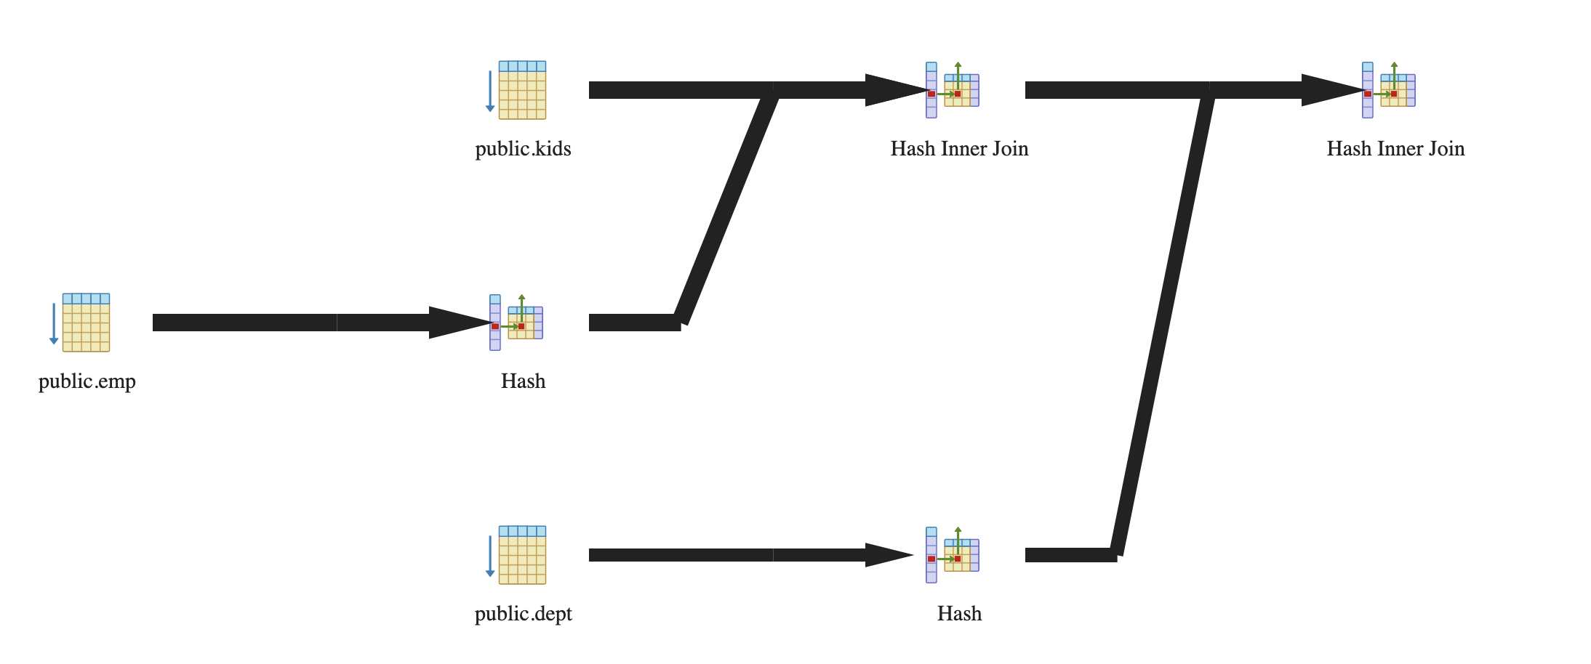
Postgres Plans
SELECT * FROM emp, dept, kids
WHERE sal > 10000
AND emp.dno = dept.dno
AND emp.eno = kids.eno
QUERY PLAN
---------------------------------------------------------------------------------
Hash Join (cost=342160.30..527523.82 rows=2457233 width=48)
Hash Cond: (emp.dno = dept.dno)
-> Hash Join (cost=339076.28..479202.29 rows=2457233 width=40)
Hash Cond: (kids.eno = emp.eno)
-> Seq Scan on kids (cost=0.00..49099.01 rows=3000001 width=18)
-> Hash (cost=188696.44..188696.44 rows=8190867 width=22)
-> Seq Scan on emp (cost=0.00..188696.44 rows=8190867 width=22)
Filter: (sal > 10000)
-> Hash (cost=1443.01..1443.01 rows=100001 width=8)
-> Seq Scan on dept (cost=0.00..1443.01 rows=100001 width=8)
(10 rows)

Slide 42
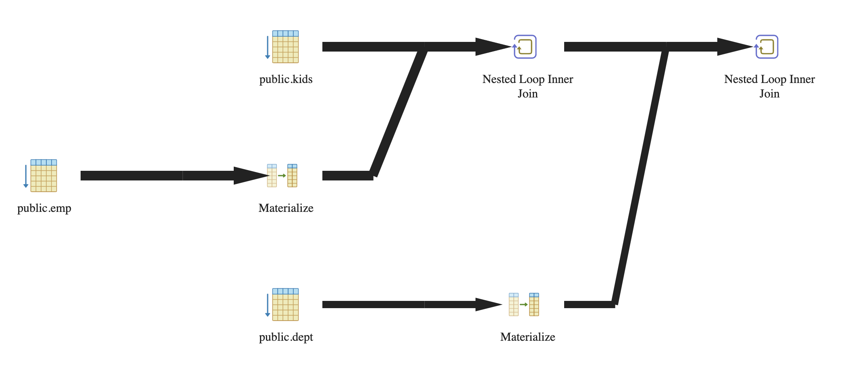
Nested Loops Version

