Slide 1
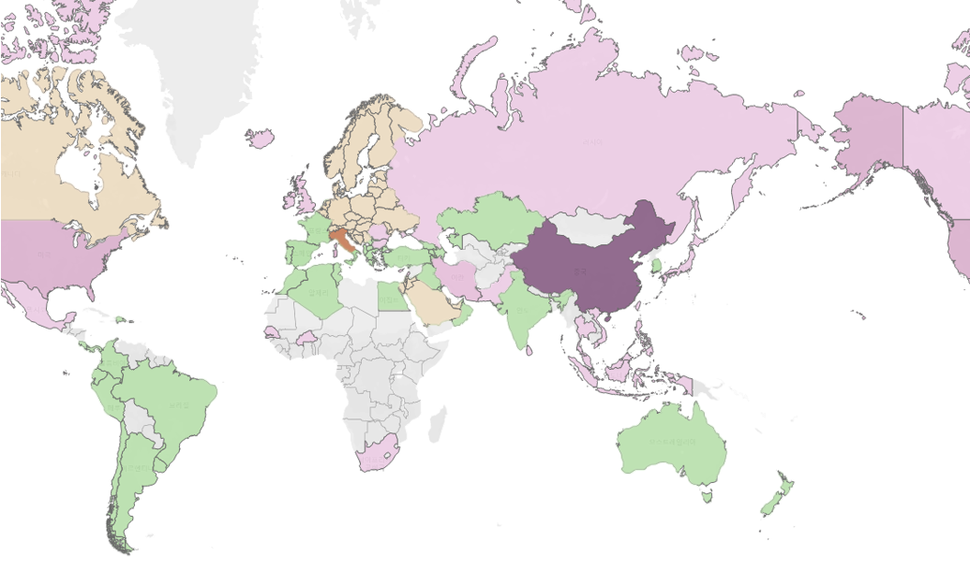

DTW Analysis for Time-series Factors
Factor List
+
Total
_
Temperature
Air Pollution
Weather
Change of the number of confirmed cases
‘ ‘ ‘ ‘ ‘ ‘ ‘
‘ ‘ ‘ ‘ ‘ ‘
‘ ‘ ‘ ‘ ‘
‘ ‘ ‘ ‘
‘ ‘ ‘

Slide 2
DTW Analysis for Time-series Factors
Factor List
+
Total
_
Russia
DTW value:
Weather (0.6)
Temperature
Air Pollution
Weather
Change of the number of confirmed cases
‘ ‘ ‘ ‘ ‘ ‘ ‘
‘ ‘ ‘ ‘ ‘ ‘
‘ ‘ ‘ ‘ ‘
‘ ‘ ‘ ‘
‘ ‘ ‘

Slide 3
DTW Analysis for Time-series Factors
Factor List
+
Total
_
Temperature
Air Pollution
Weather
Change of the number of confirmed cases
‘ ‘ ‘ ‘ ‘ ‘ ‘
Brazil
DTW value:
Air Pollution (0.8)
‘ ‘ ‘ ‘ ‘ ‘
‘ ‘ ‘ ‘ ‘
‘ ‘ ‘ ‘
‘ ‘ ‘

Slide 4
DTW Analysis for Time-series Factors
Factor List
+
Total
_
Temperature
Air Pollution
Weather
Change of the number of confirmed cases
‘ ‘ ‘ ‘ ‘ ‘ ‘
‘ ‘ ‘ ‘ ‘ ‘
‘ ‘ ‘ ‘ ‘
‘ ‘ ‘ ‘
‘ ‘ ‘

Slide 5
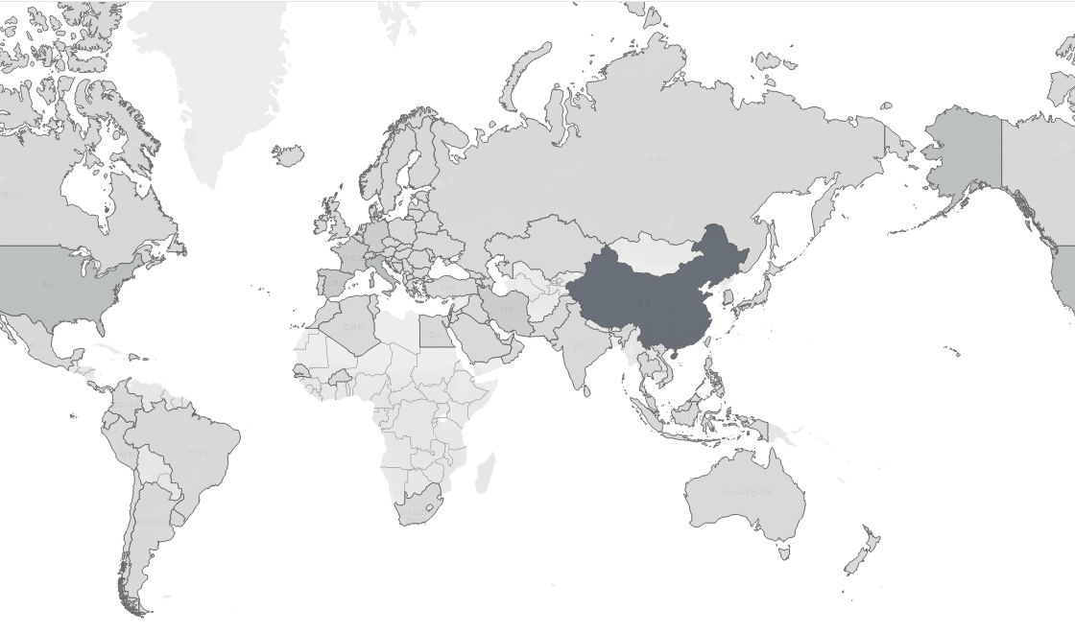
DTW Analysis for Time-series Factors
Factor List
+
Total
_
Temperature
Air Pollution
Weather
Change of the number of confirmed cases
‘ ‘ ‘ ‘ ‘ ‘ ‘
‘ ‘ ‘ ‘ ‘ ‘
‘ ‘ ‘ ‘ ‘
‘ ‘ ‘ ‘
‘ ‘ ‘

Slide 6
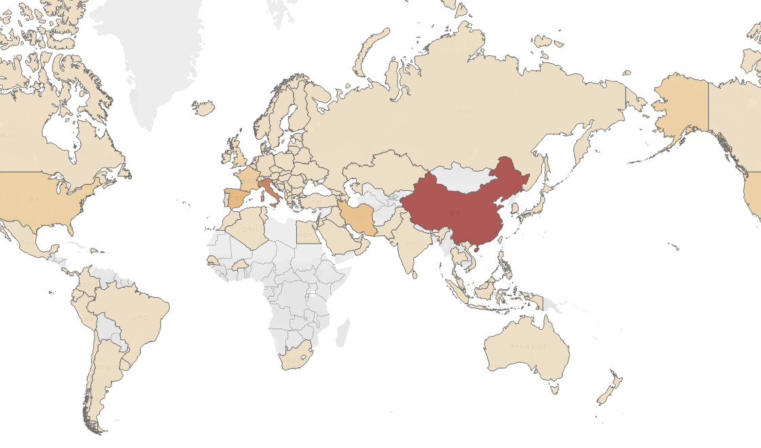
DTW Analysis for Time-series Factors
Factor List
+
Total
_
Temperature
Air Pollution
Weather
Change of the number of confirmed cases
‘ ‘ ‘ ‘ ‘ ‘ ‘
‘ ‘ ‘ ‘ ‘ ‘
‘ ‘ ‘ ‘ ‘
‘ ‘ ‘ ‘
‘ ‘ ‘

Slide 7
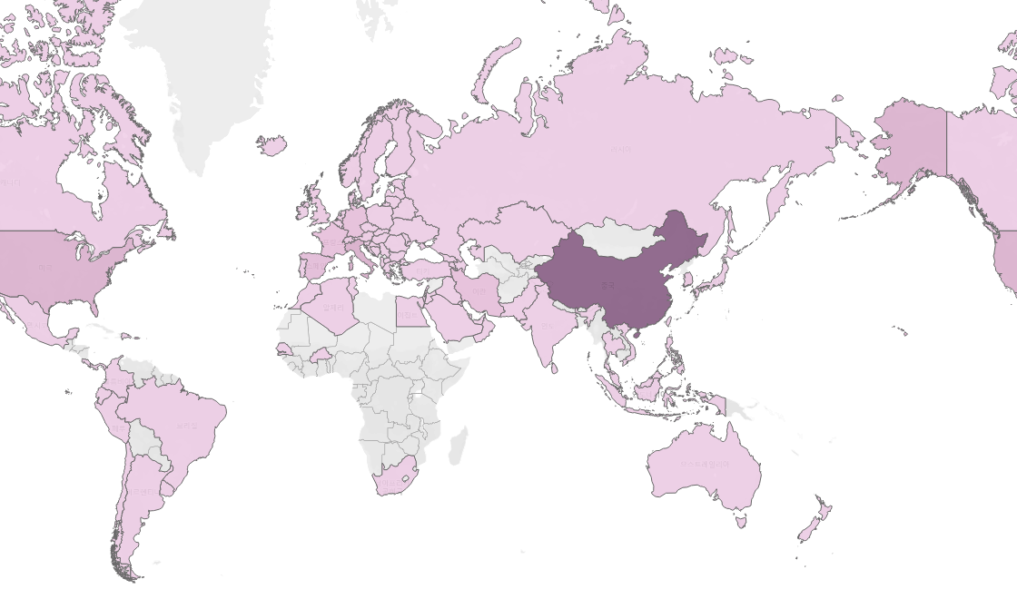
DTW Analysis for Time-series Factors
Factor List
+
Total
_
Temperature
Air Pollution
Weather
Change of the number of confirmed cases
‘ ‘ ‘ ‘ ‘ ‘ ‘
‘ ‘ ‘ ‘ ‘ ‘
‘ ‘ ‘ ‘ ‘
‘ ‘ ‘ ‘
‘ ‘ ‘

Slide 8
DTW Analysis for Time-series Factors
Factor List
+
Total
_
Temperature
Air Pollution
S. Korea
DTW value:
Temperature (0.1)
Weather
Change of the number of confirmed cases
‘ ‘ ‘ ‘ ‘ ‘ ‘
‘ ‘ ‘ ‘ ‘ ‘
‘ ‘ ‘ ‘ ‘
‘ ‘ ‘ ‘
‘ ‘ ‘

