Slide 1
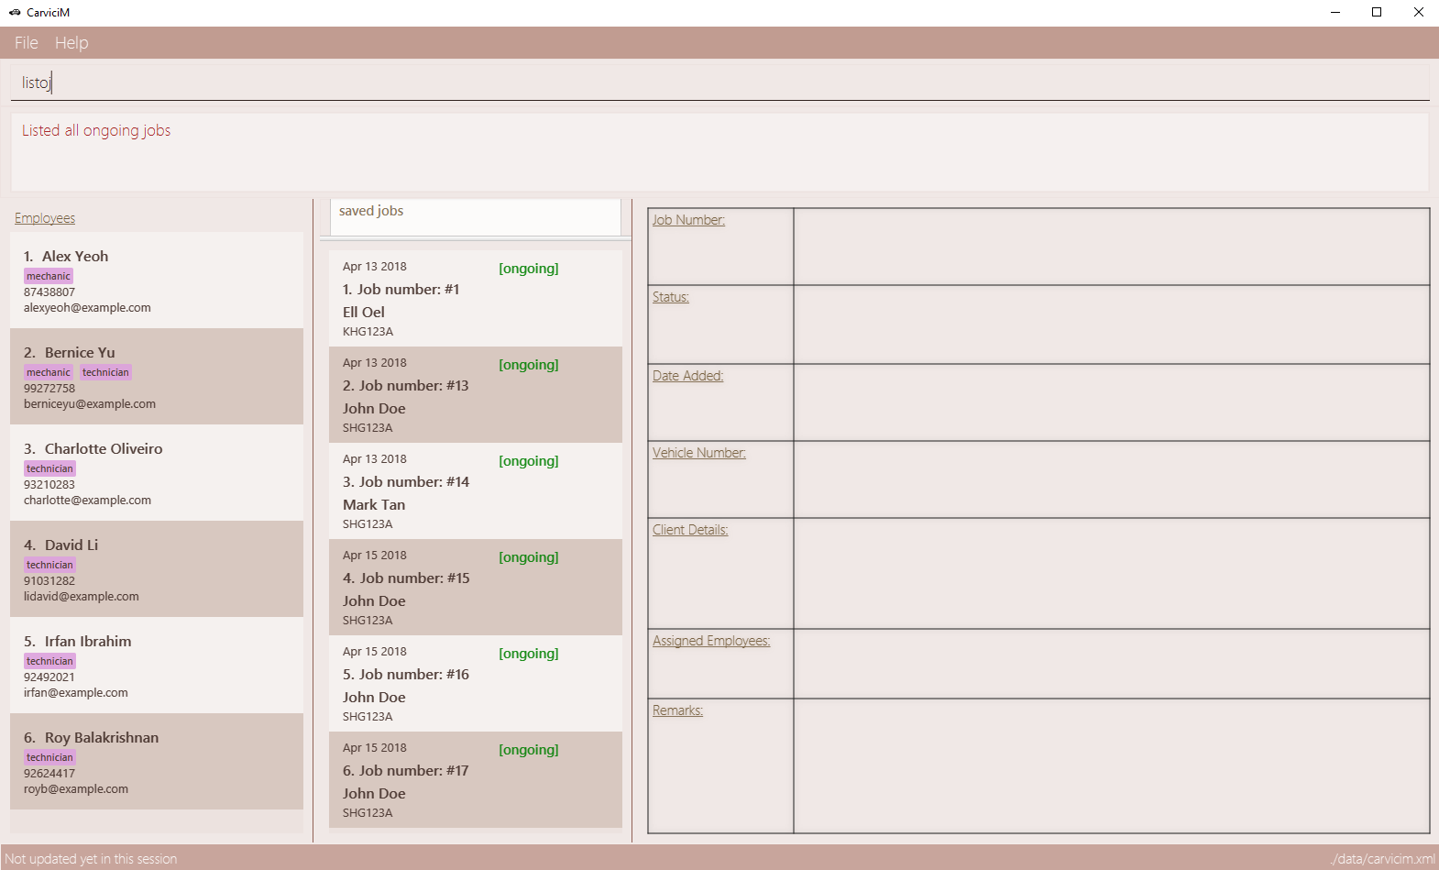
Command Box
Result Display
Employee List Panel
Job List Panel
Job Display Panel

