Slide 1
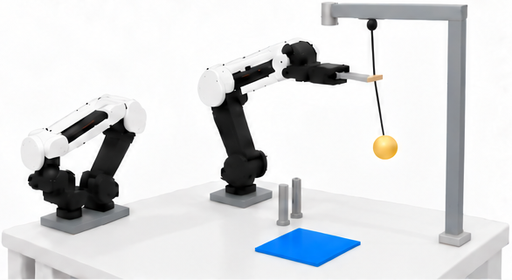
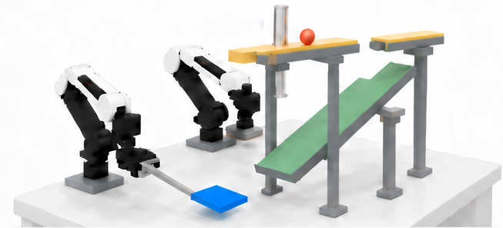
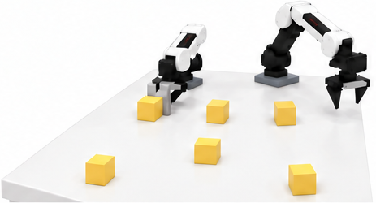
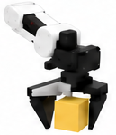
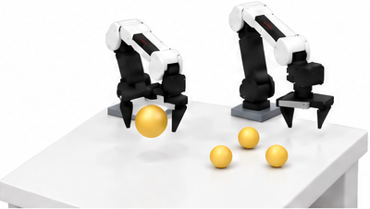
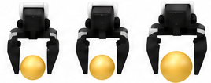
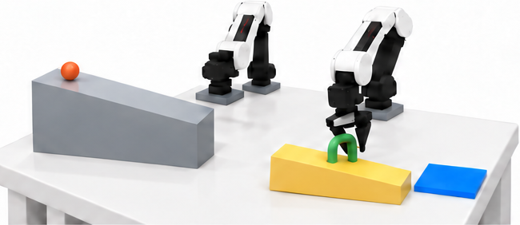
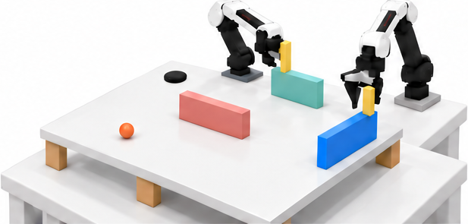
ForesightBench
6 tasks × 3 difficulty levels
Physical evidence for robotic decisions
OD
OD1
Ramp-Split Interception
OD2
Timed Rope Cutting
Predict route and landing
Time the blade actuation
Observe for
Decision
Swing
Motion history
After cut
PD
PD1
Friction Anomaly Sorting
PD2
Gripper-Based Size Sorting
Push, compare, then retrieve the highest-friction cube
2
Retrieve
Measure all, then retrieve the size outlier
2
Retrieve outlier
Property for
Decision
1
Push & compare
1
Measure & compare
Size outlier
Interaction
feedback
Shortest slide
Highest friction
Compare gripper openings
SD1
Ramp Placement
SD2
Bank-Shot Routing
SD
Move and rotate the yellow ramp
Configure the rebound path
Simulate for
Decision
Target pose
Robot-controlled pose
Action
consequences
Choose where, when, and how to act from physical evidence.
Notes:
Editable reconstruction of the user-selected orange-trajectory ForesightBench figure. All readable labels, trajectories, arrows, dividers and simple highlights/target regions are native editable PowerPoint objects. Eight separately replaceable clean 3D scene assets preserve the selected illustration. Source: source.png supplied by user.

Slide 2
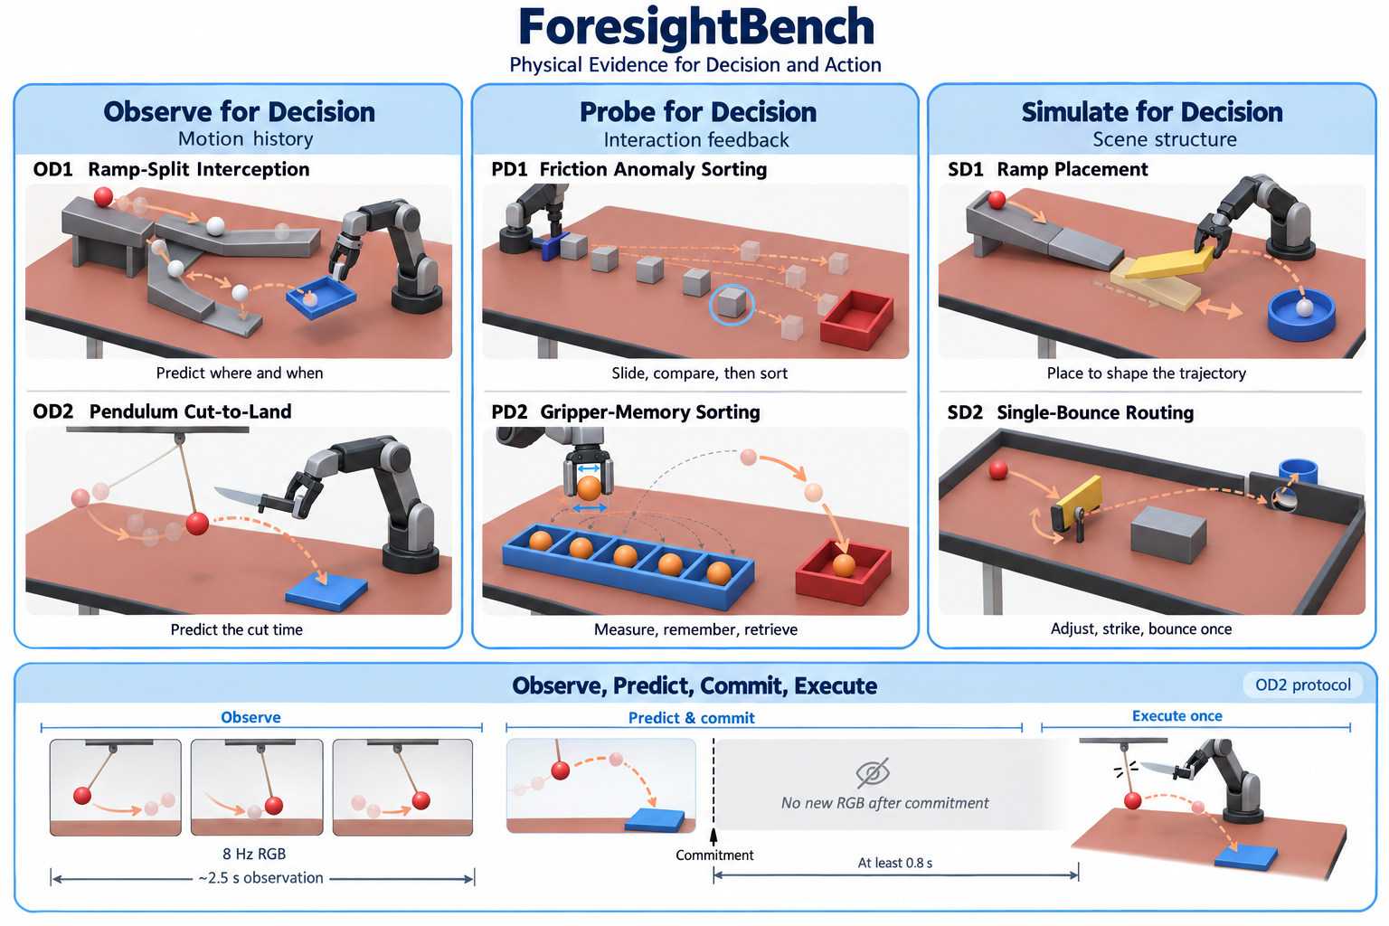

Slide 3
OD1
Ramp-Split Interception
OD2
Timed Rope Cutting
Predict route and landing
Time the blade actuation
Swing
After cut
PD1
Friction Anomaly Sorting
PD2
Gripper-Based Size Sorting
1
Push & compare
2
Retrieve
Measure all, then retrieve the size outlier
2
Retrieve outlier
1
Measure & compare
Size outlier
Highest friction
Compare gripper openings

Slide 4
Foresight Bench
OD
OD1
Ramp-Split Interception
OD2
Timed Rope Cutting
Predict route and landing
Time the blade actuation
Observe for
Decision
Swing
Motion history
After cut
PD
PD1
Friction Anomaly Sorting
PD2
Gripper-Based Size Sorting
1
Push & compare
2
Retrieve
2
Retrieve outlier
1
Measure & compare
Property for
Decision
Size outlier
Interaction
feedback
Highest friction
Compare gripper openings
SD1
Ramp Placement
SD2
Bank-Shot Routing
SD
Move and rotate the yellow ramp
Configure the rebound path
Simulate for
Decision
Target pose
Robot-controlled pose
Action
consequences
Notes:
Editable reconstruction of the user-selected orange-trajectory ForesightBench figure. All readable labels, trajectories, arrows, dividers and simple highlights/target regions are native editable PowerPoint objects. Eight separately replaceable clean 3D scene assets preserve the selected illustration. Source: source.png supplied by user.

Slide 5

Foresight Bench
OD1
Ramp-Split Interception
OD2
Timed Rope Cutting
Predict route and landing
Time the blade actuation
Swing
After cut
PD1
Friction Anomaly Sorting
PD2
Gripper-Based Size Sorting
1
Push & compare
2
Retrieve
2
Retrieve outlier
1
Measure & compare
Size outlier
Compare gripper openings
Highest friction
SD1
Ramp Placement
SD2
Bank-Shot Routing
Move and rotate the yellow ramp
Configure the rebound path
Target pose
Robot-controlled pose
Notes:
Editable reconstruction of the user-selected orange-trajectory ForesightBench figure. All readable labels, trajectories, arrows, dividers and simple highlights/target regions are native editable PowerPoint objects. Eight separately replaceable clean 3D scene assets preserve the selected illustration. Source: source.png supplied by user.

Slide 6
Foresight Bench
OD1
Ramp-Split Interception
PD1
Friction Anomaly Sorting
SD1
Ramp Placement
Predict route and landing
Move and rotate the yellow ramp
1
Push & compare
2
Retrieve
Target pose
Robot-controlled pose
Highest friction
OD2
Timed Rope Cutting
PD2
Gripper-Based Size Sorting
SD2
Bank-Shot Routing
Time the blade actuation
2
Retrieve outlier
Configure the rebound path
1
Measure & compare
Size outlier
Swing
After cut
Compare gripper openings
Notes:
Editable reconstruction of the user-selected orange-trajectory ForesightBench figure. All readable labels, trajectories, arrows, dividers and simple highlights/target regions are native editable PowerPoint objects. Eight separately replaceable clean 3D scene assets preserve the selected illustration. Source: source.png supplied by user.

Slide 7
Foresight Bench
OD1
Ramp-Split Interception
PD1
Friction Anomaly Sorting
SD1
Ramp Placement
Predict route and landing
Move and rotate the yellow ramp
1
Push & compare
2
Retrieve
Target pose
Robot-controlled pose
Highest friction
OD2
Timed Rope Cutting
PD2
Gripper-Based Size Sorting
SD2
Bank-Shot Routing
Time the blade actuation
2
Retrieve outlier
Configure the rebound path
1
Measure & compare
Size outlier
Swing
After cut
Compare gripper openings
Notes:
Editable reconstruction of the user-selected orange-trajectory ForesightBench figure. All readable labels, trajectories, arrows, dividers and simple highlights/target regions are native editable PowerPoint objects. Eight separately replaceable clean 3D scene assets preserve the selected illustration. Source: source.png supplied by user.

