Slide 1
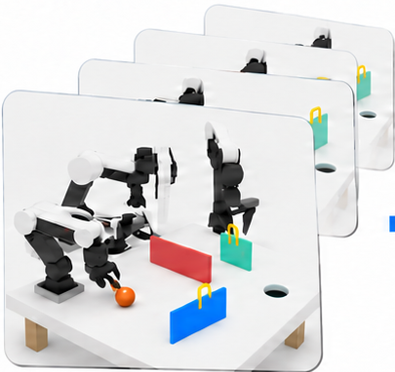
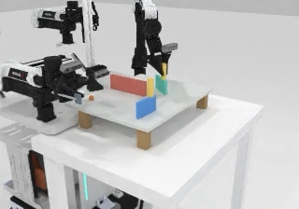

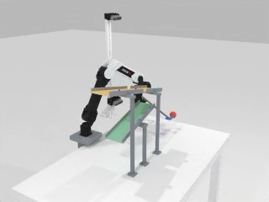
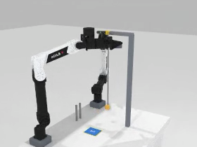
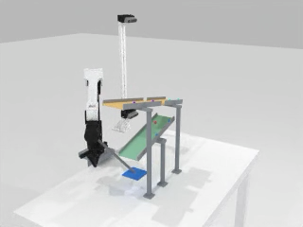
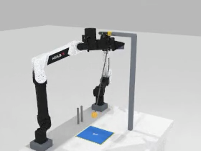
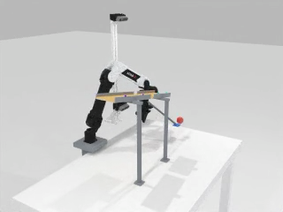
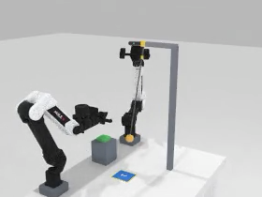


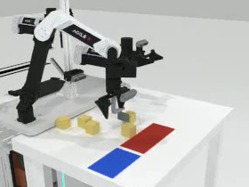
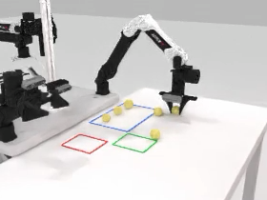
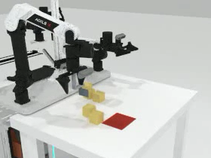
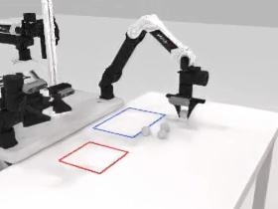
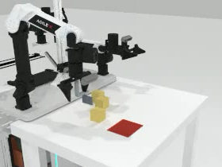
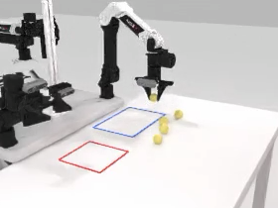

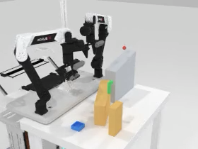
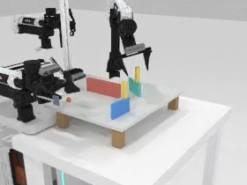
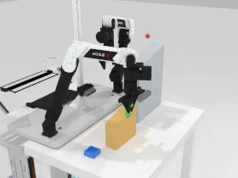
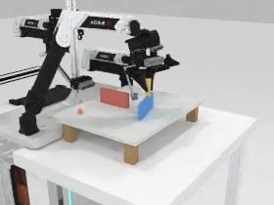
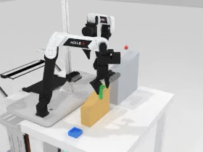
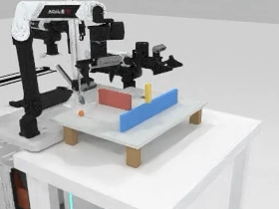
ForesightBench Data Construction Pipeline
1
Scene Construction
2
Expert Rollout
3
Validation
4
Data Integration
5
ForesightBench
Task success
OD1
Hard
OD2
Hard
Head
Left wrist
Medium
Medium
Easy
Easy
Valid state & action
Video / frame
consistency
SD2
Right wrist
PD1
PD2
B
Hard
Hard
Easy
Medium
Easy
Medium
Pass
B
B
State
30 Hz · 14D
θ
SD1
Hard
SD2
Hard
B
Action
Easy
Medium
Easy
Medium
A
t
p
A
0
A
“
θ
Fail
A
Goal instruction
6 Tasks × 3 Difficulties
Use both arms to set the boards,
then bank the ball into the hole.
Geometry · Physics · Initial states
Train demos
Test scenes + prompts
Train scenes
Test scenes
Configure
Strike
Record
Rejected / logged
RGB + State + Action + Language
Policy
training
Trained
policy
Closed-loop
evaluation

