Slide 1
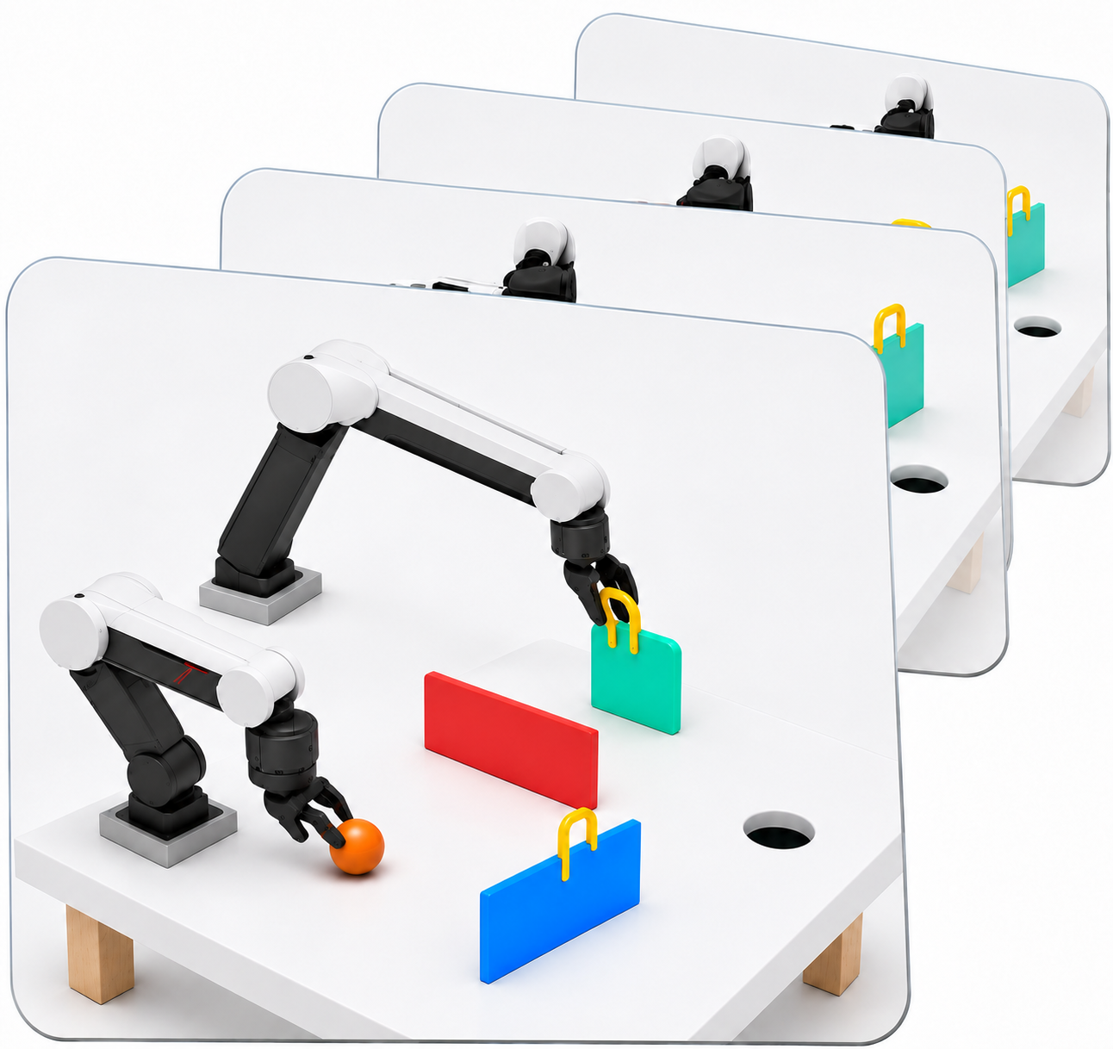
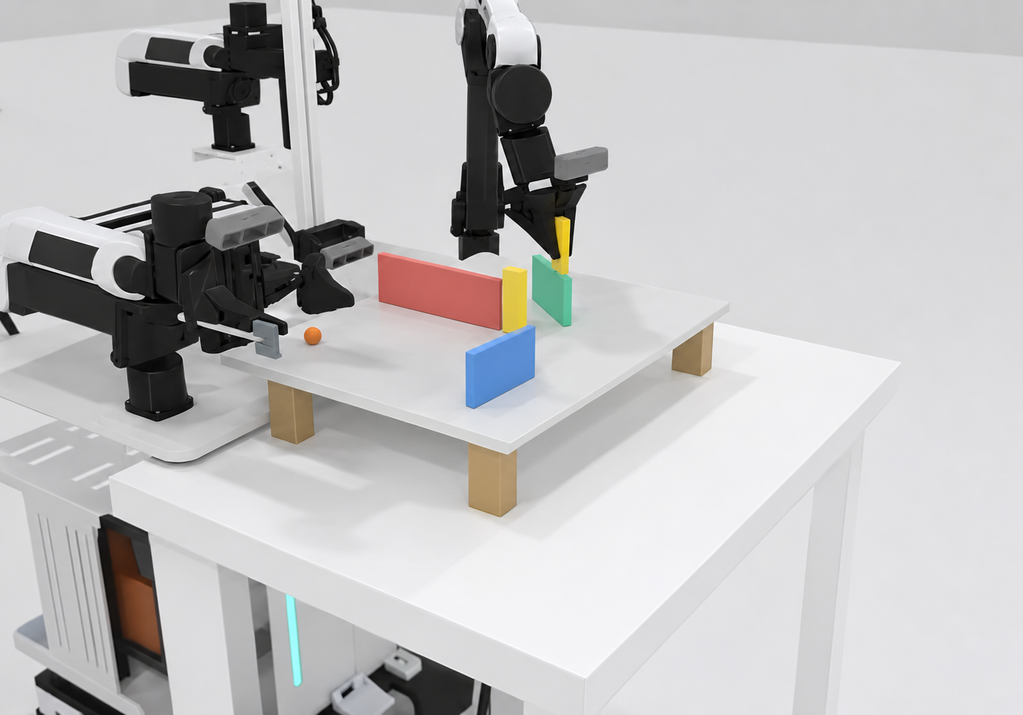

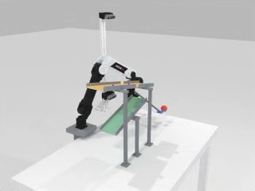
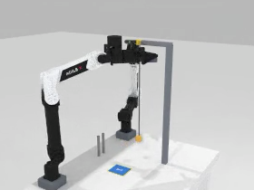
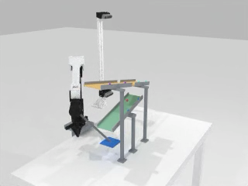
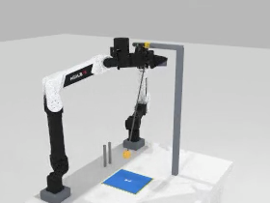
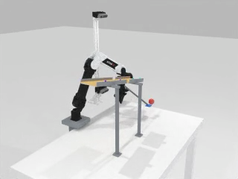
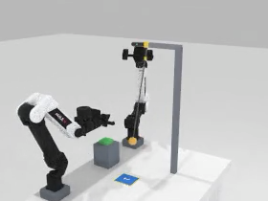


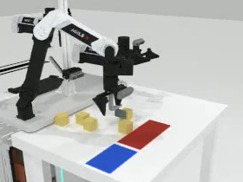
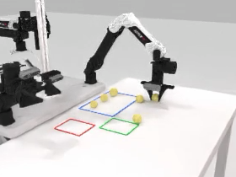
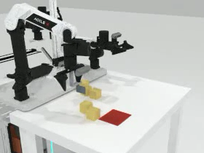
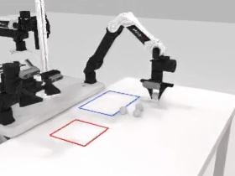
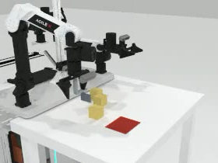
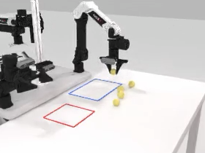


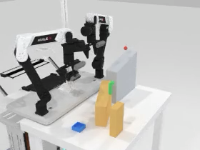
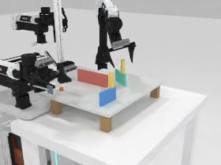
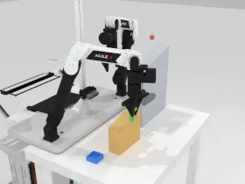
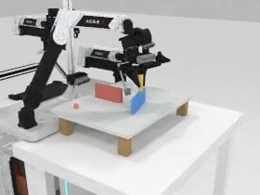
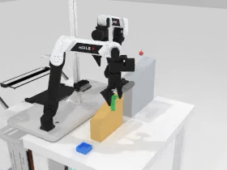
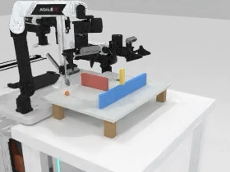
ForesightBench Data Construction Pipeline
1
Scene Construction
2
Expert Rollout
3
Validation
4
Data Integration
5
ForesightBench
Task success
OD1
Hard
OD2
Hard
Head
Left wrist
Medium
Medium
Easy
Easy
Valid state & action
Video / frame
consistency
Right wrist
PD1
PD2
B
Hard
Hard
Easy
Medium
Easy
Medium
Pass
B
B
State
30Hz·14D
θ
SD1
Hard
SD2
Hard
B
Action
Easy
Medium
Easy
Medium
A
t
p
A
0
A
“
θ
Fail
A
Goal instruction
6 Tasks × 3 Difficulties
Use both arms to set the boards,
then bank the ball into the hole.
Geometry · Physics · Initial states
Train demos
Test scenes + prompts
Train scenes
Test scenes
Configure
Strike
Record
Rejected / logged
RGB + State + Action + Language
Policy
training
Trained
policy
Closed-loop
evaluation

Slide 2
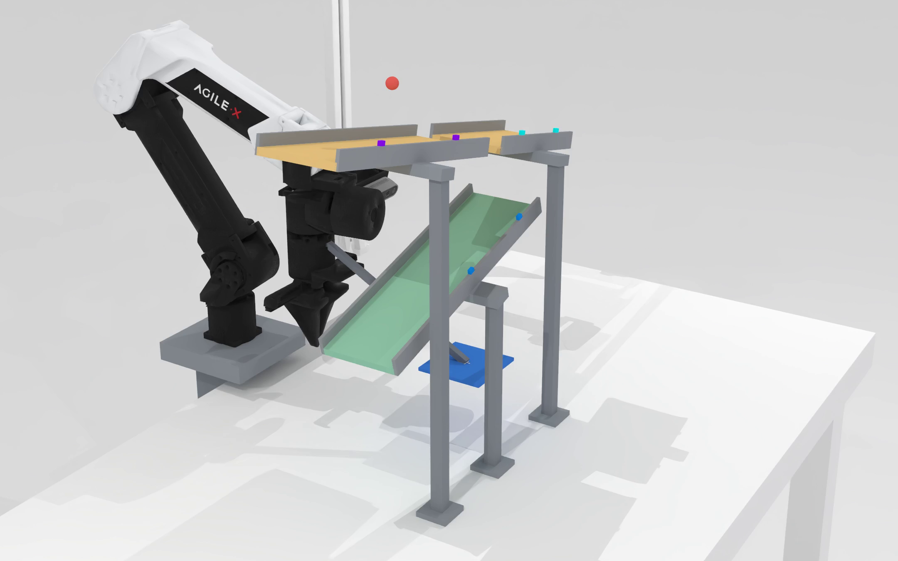
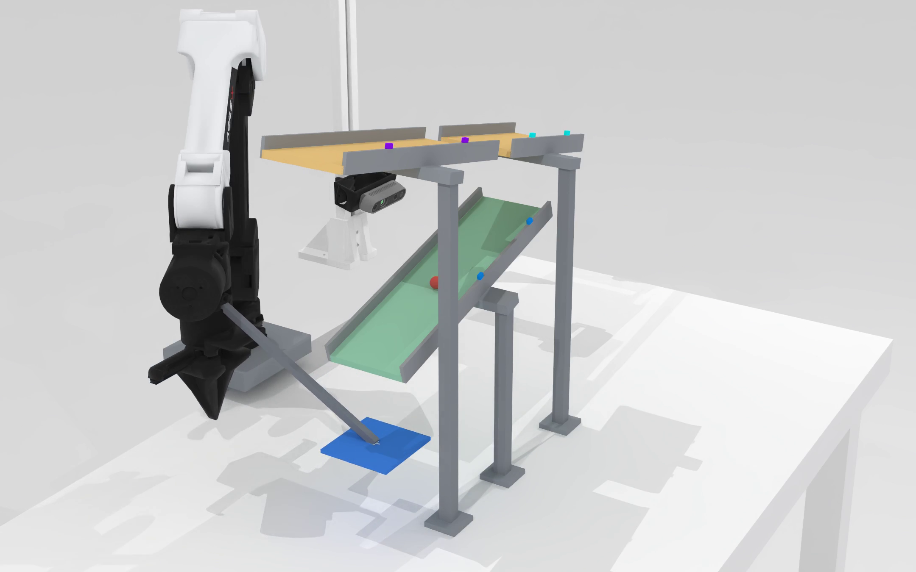
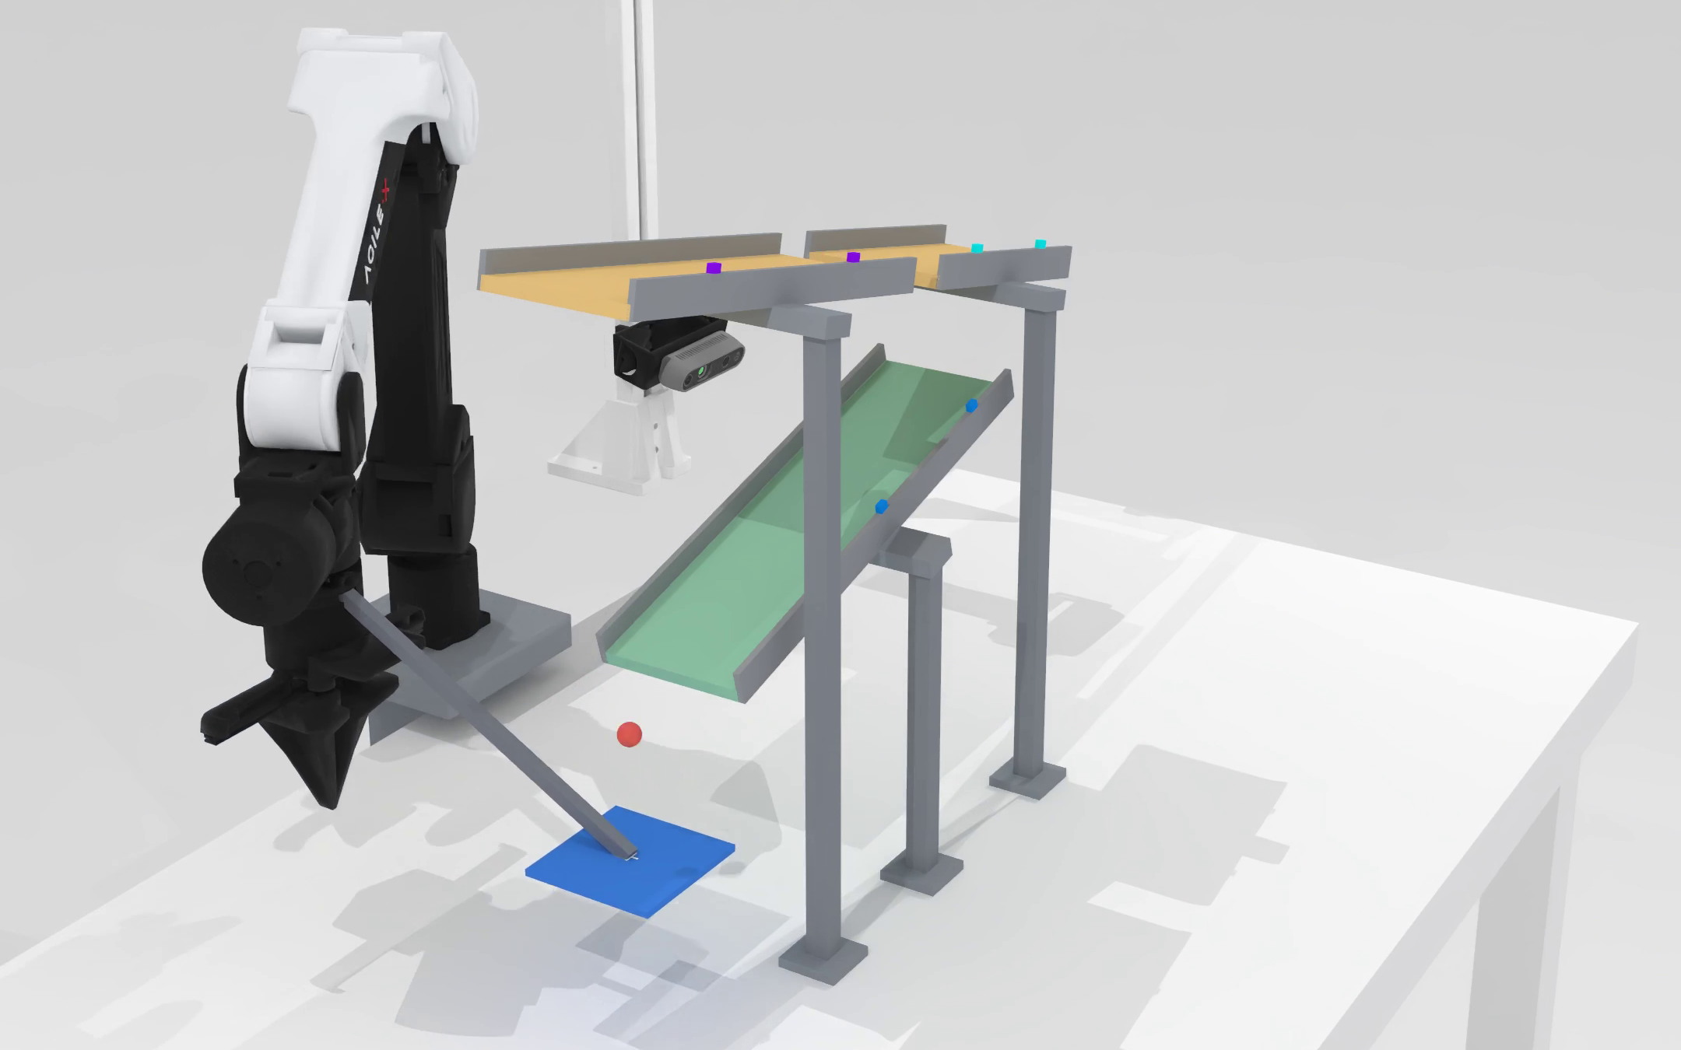
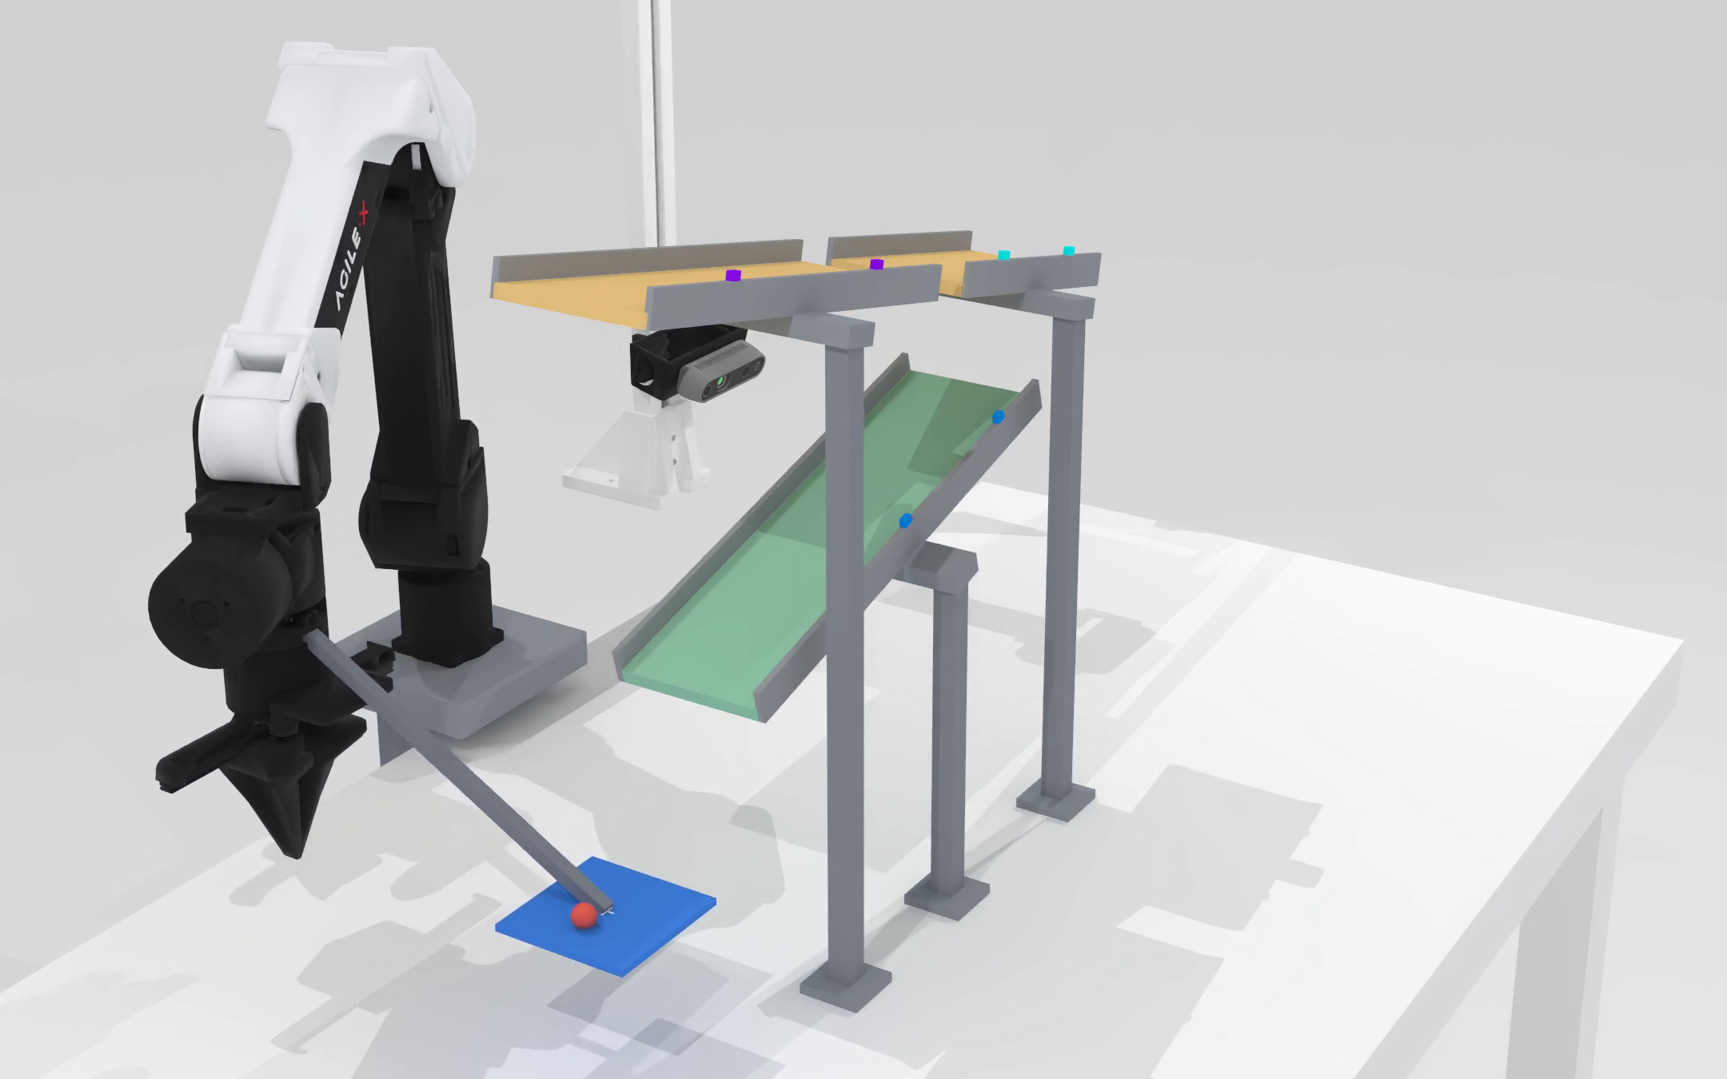
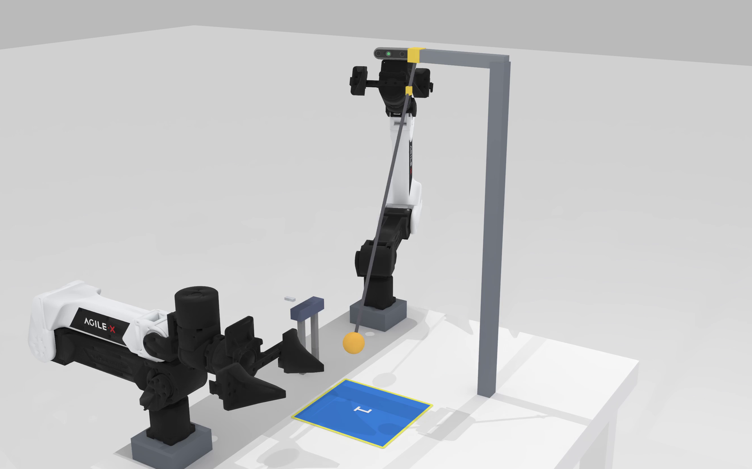
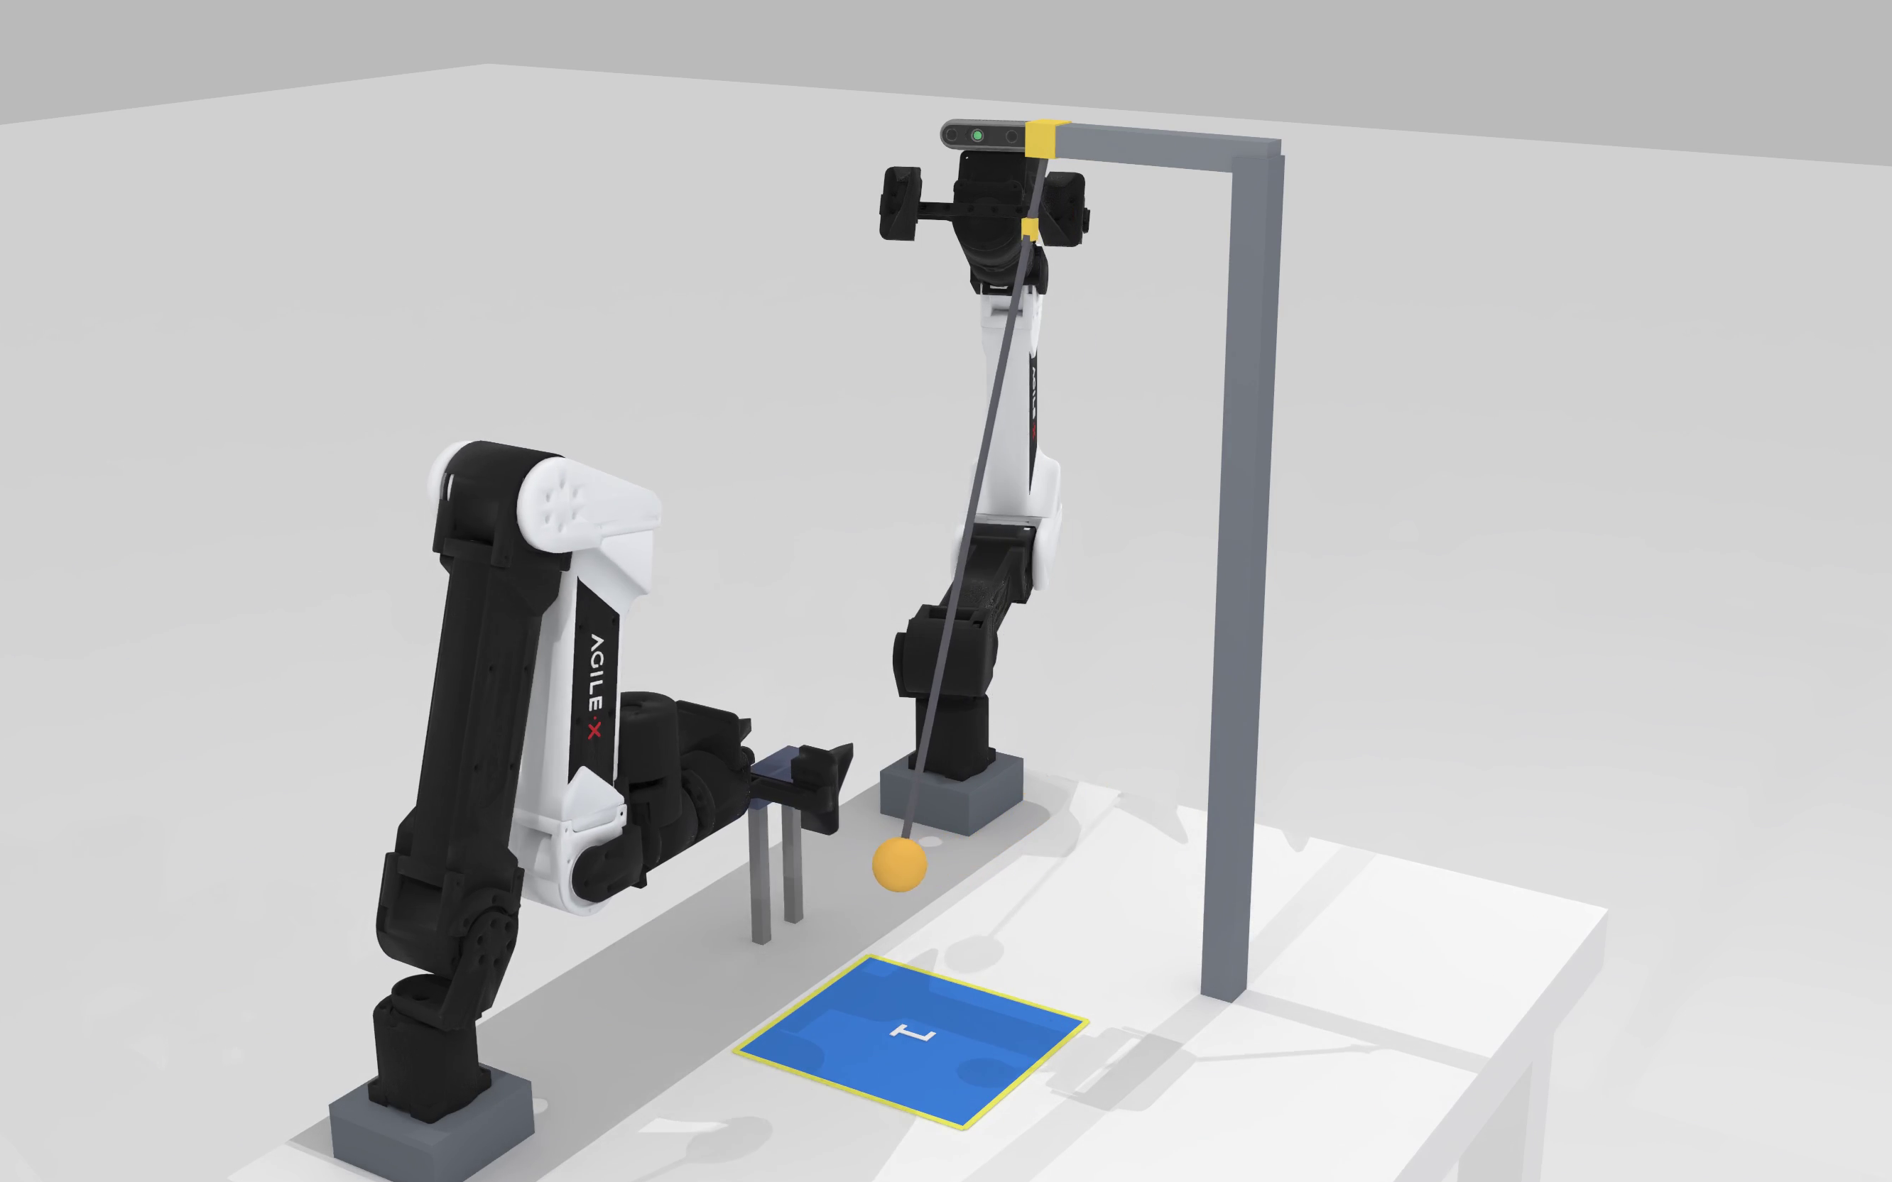
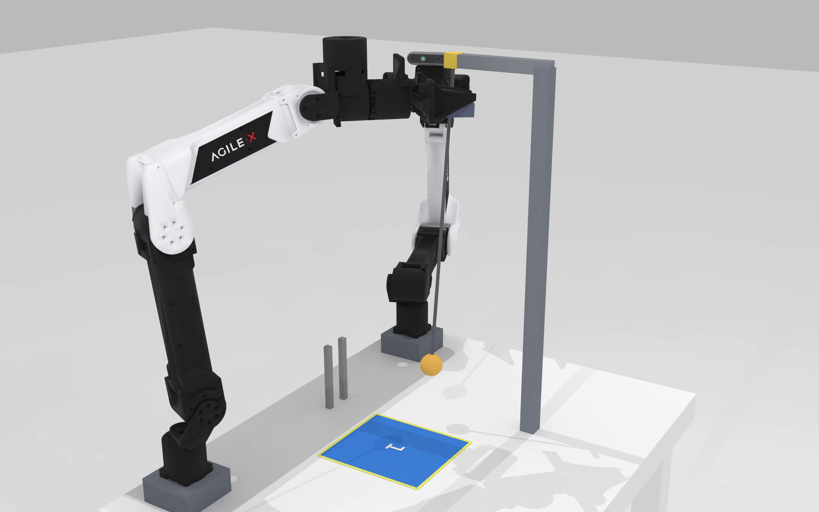
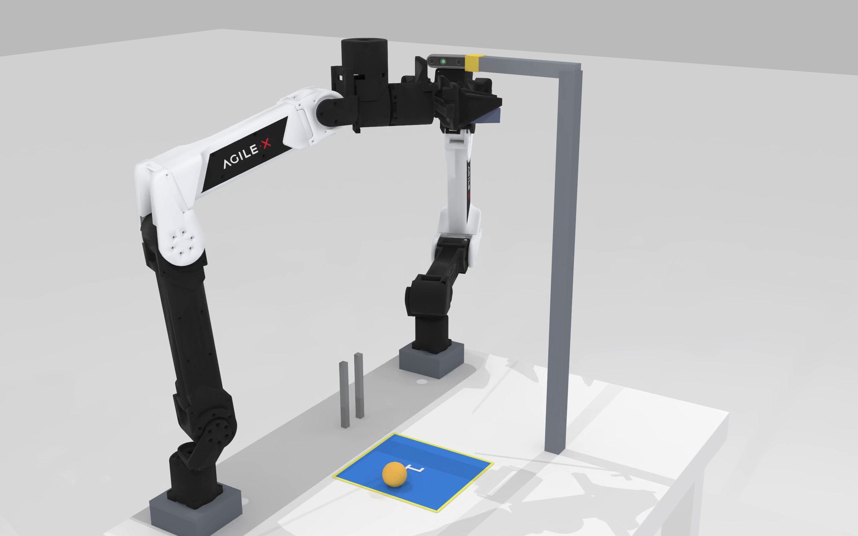
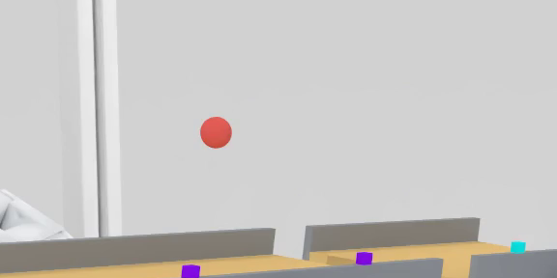
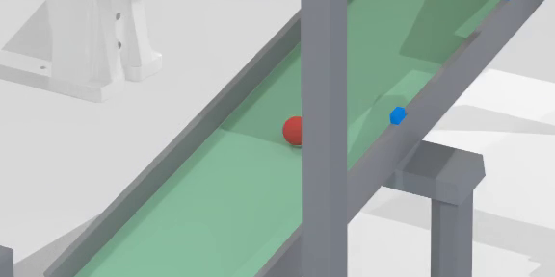
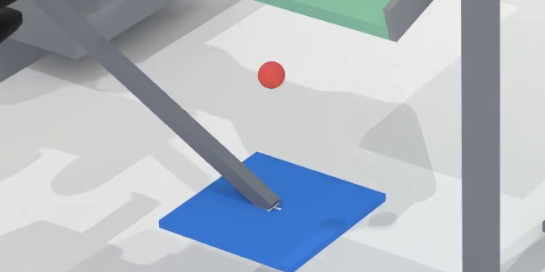
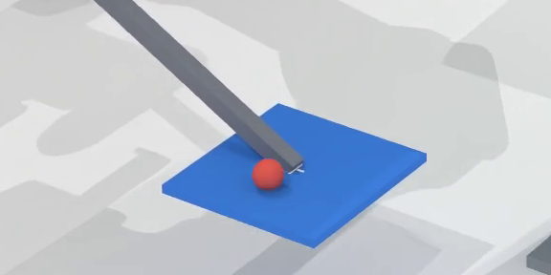
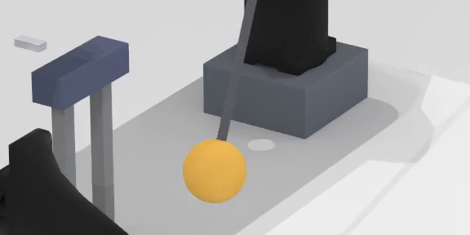
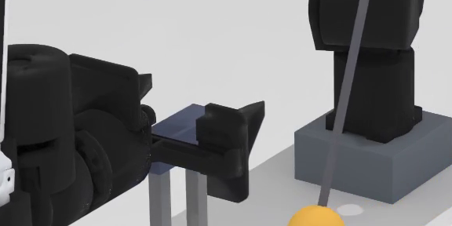
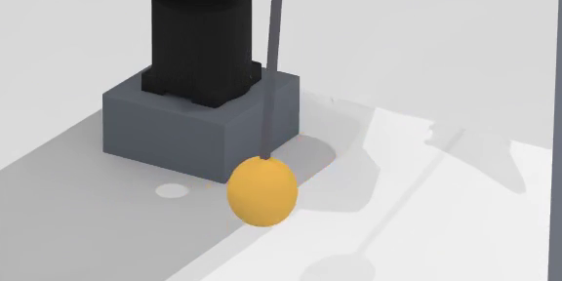
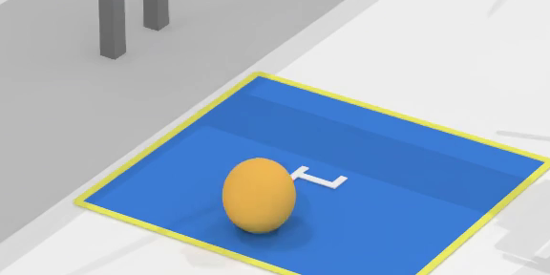
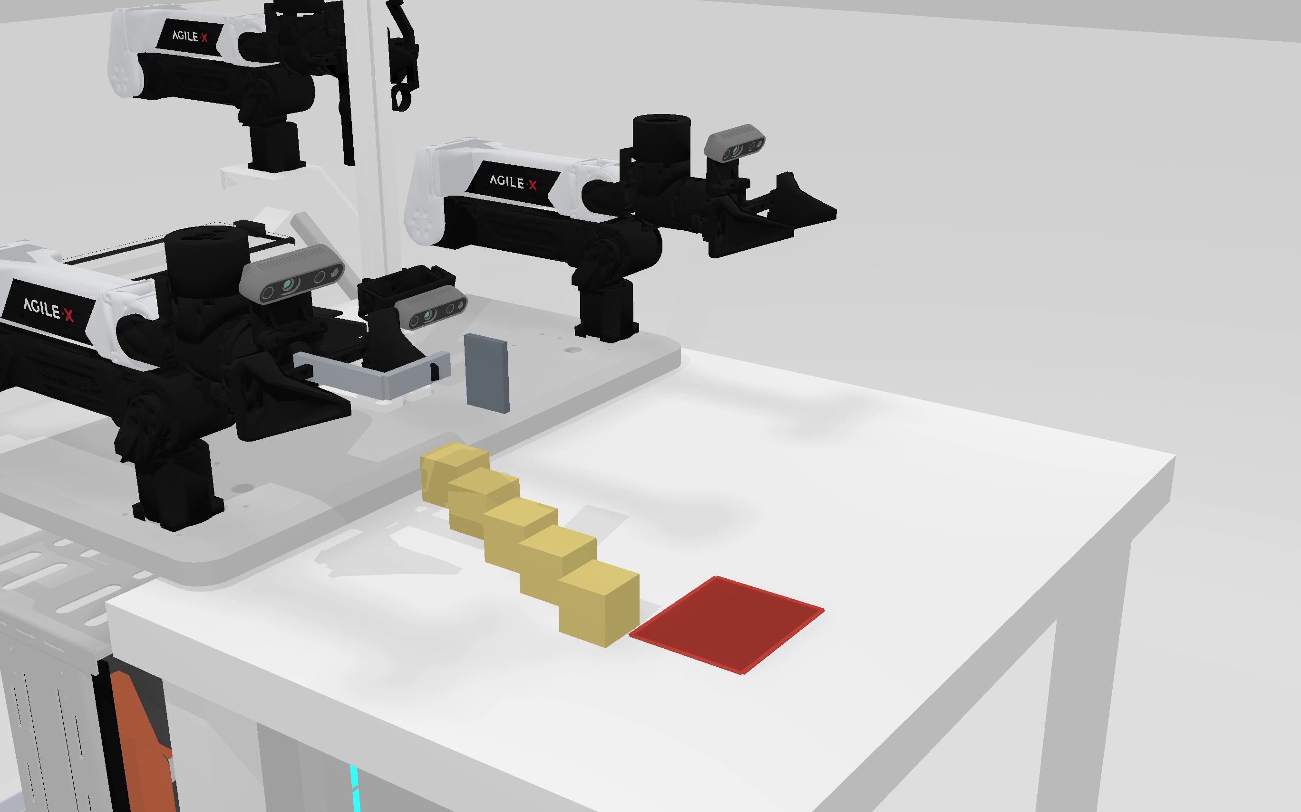
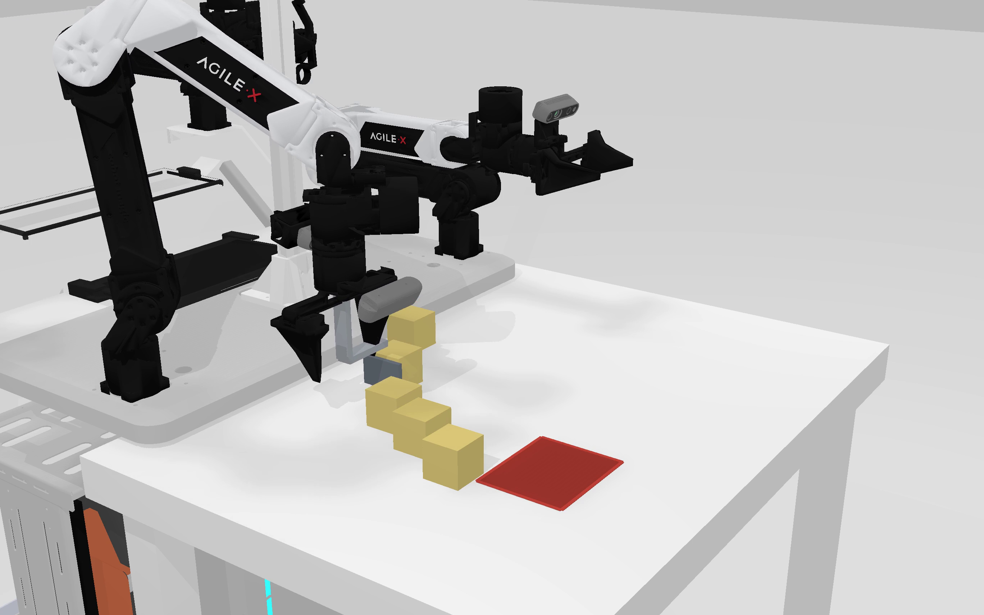
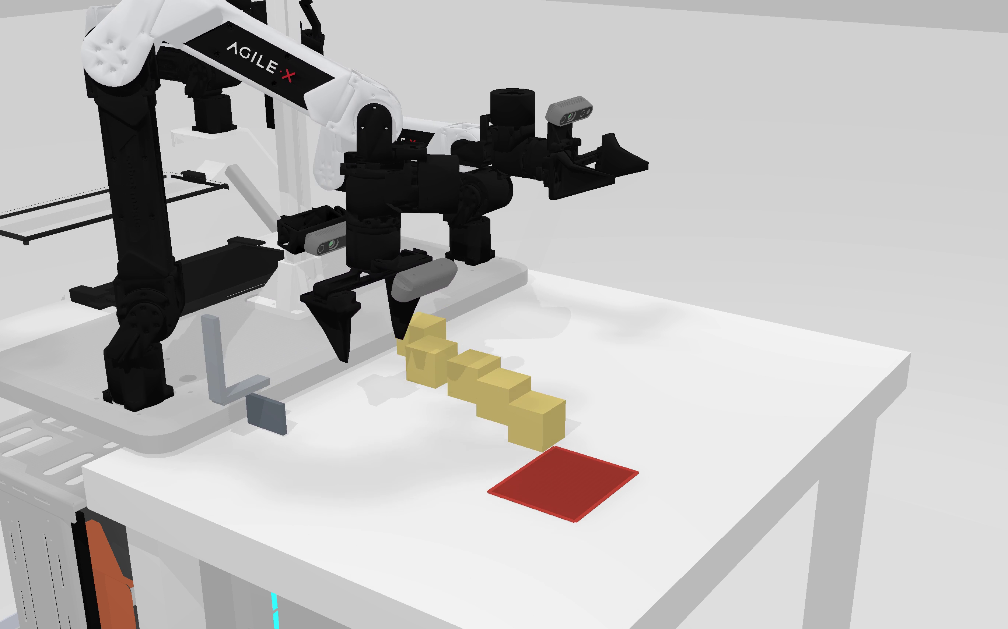
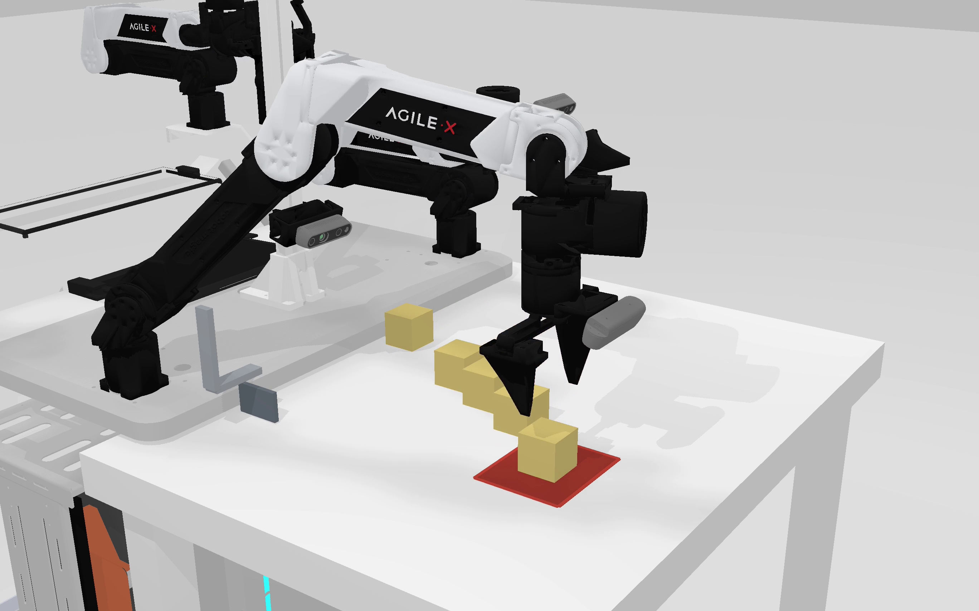
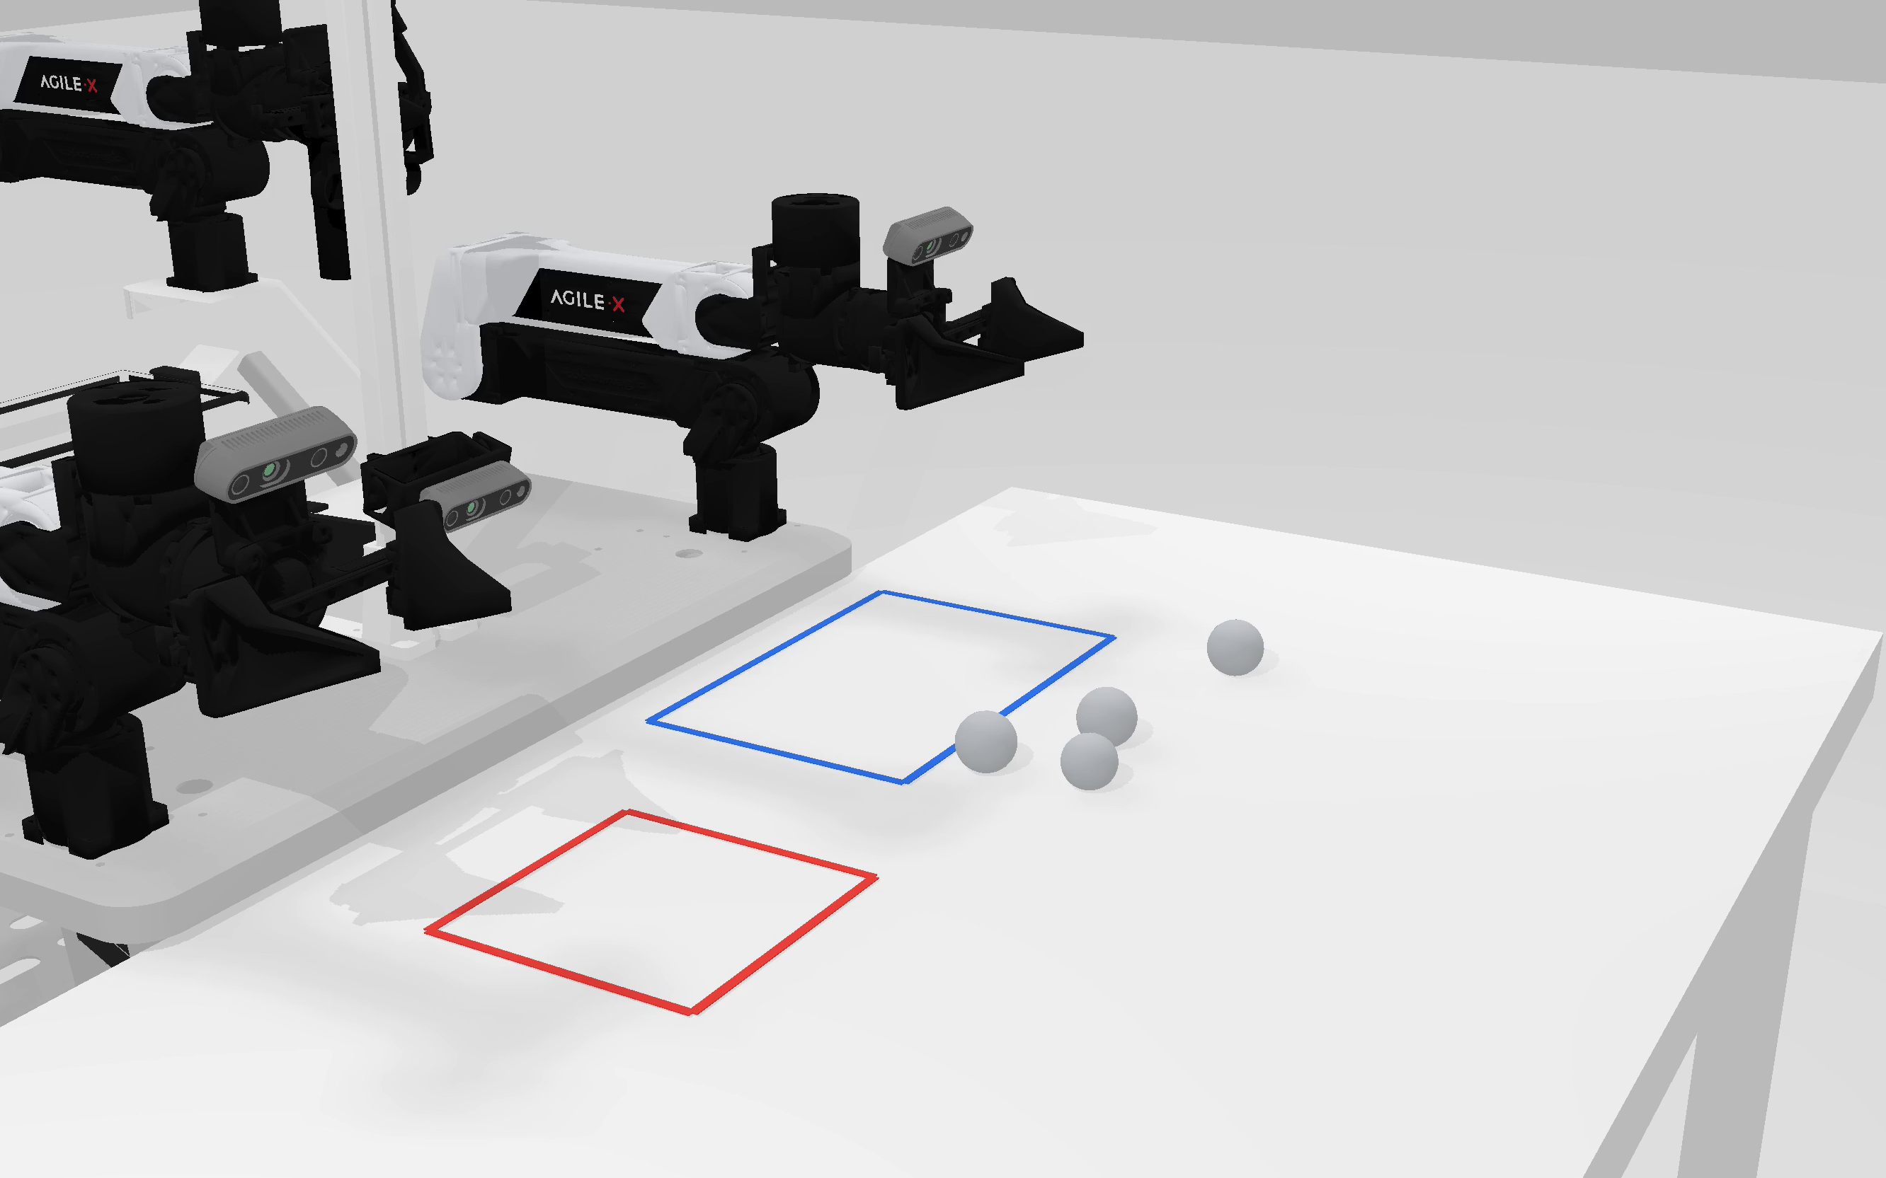
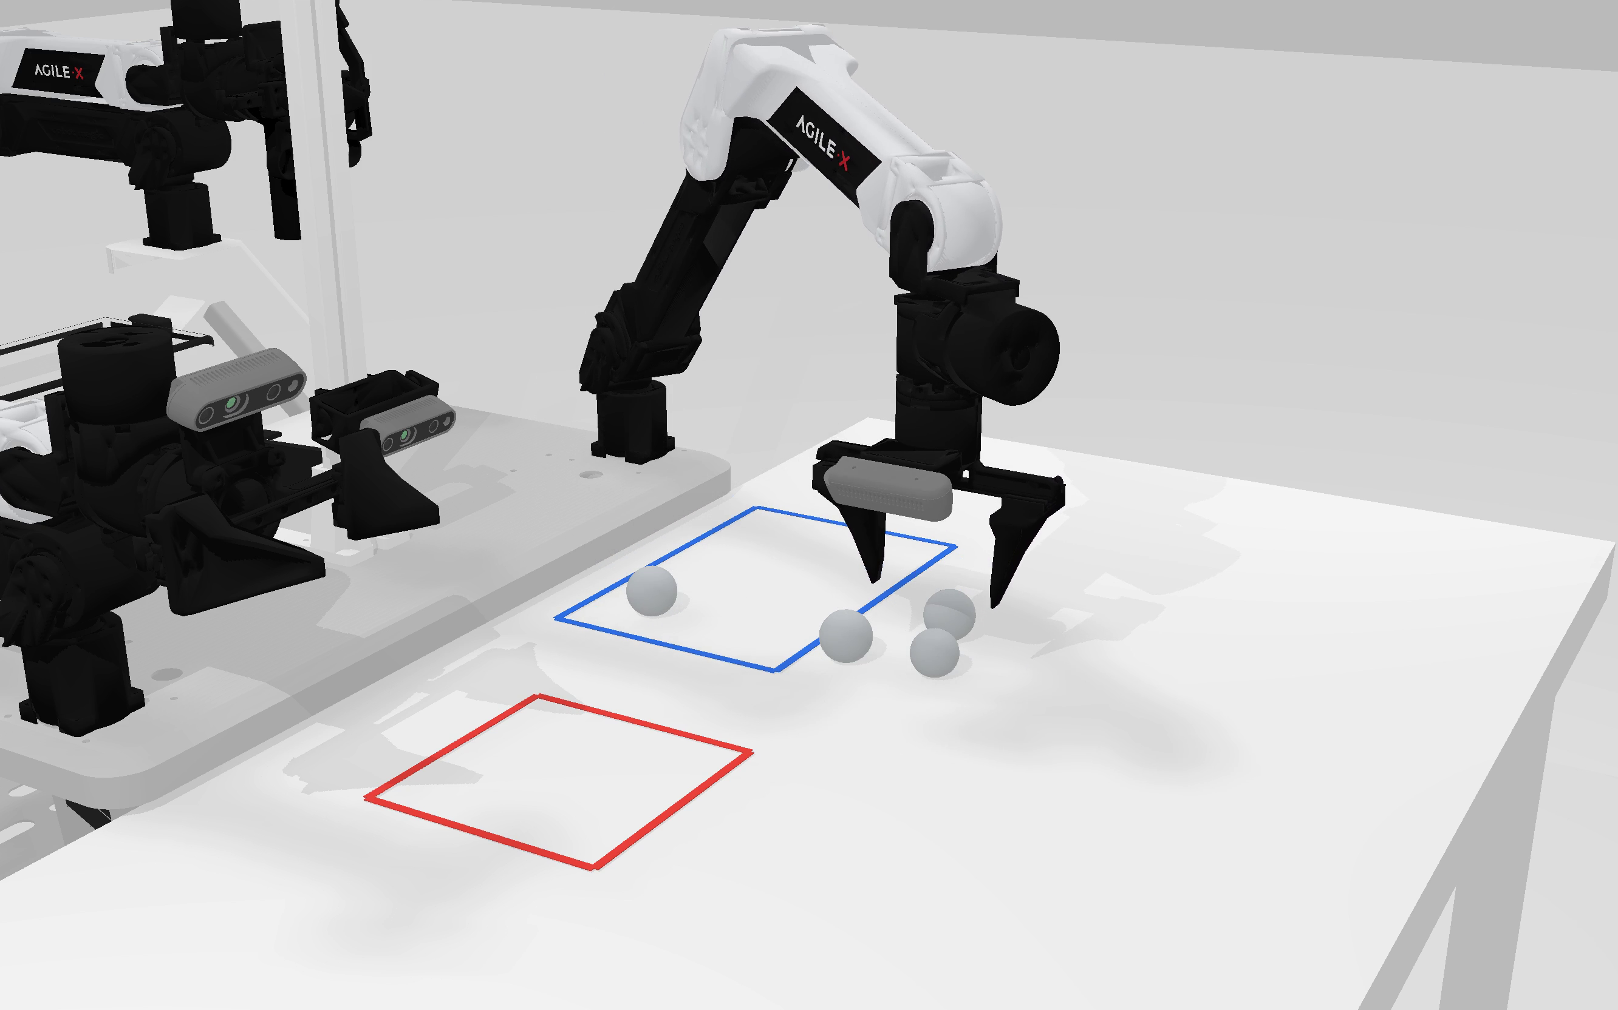
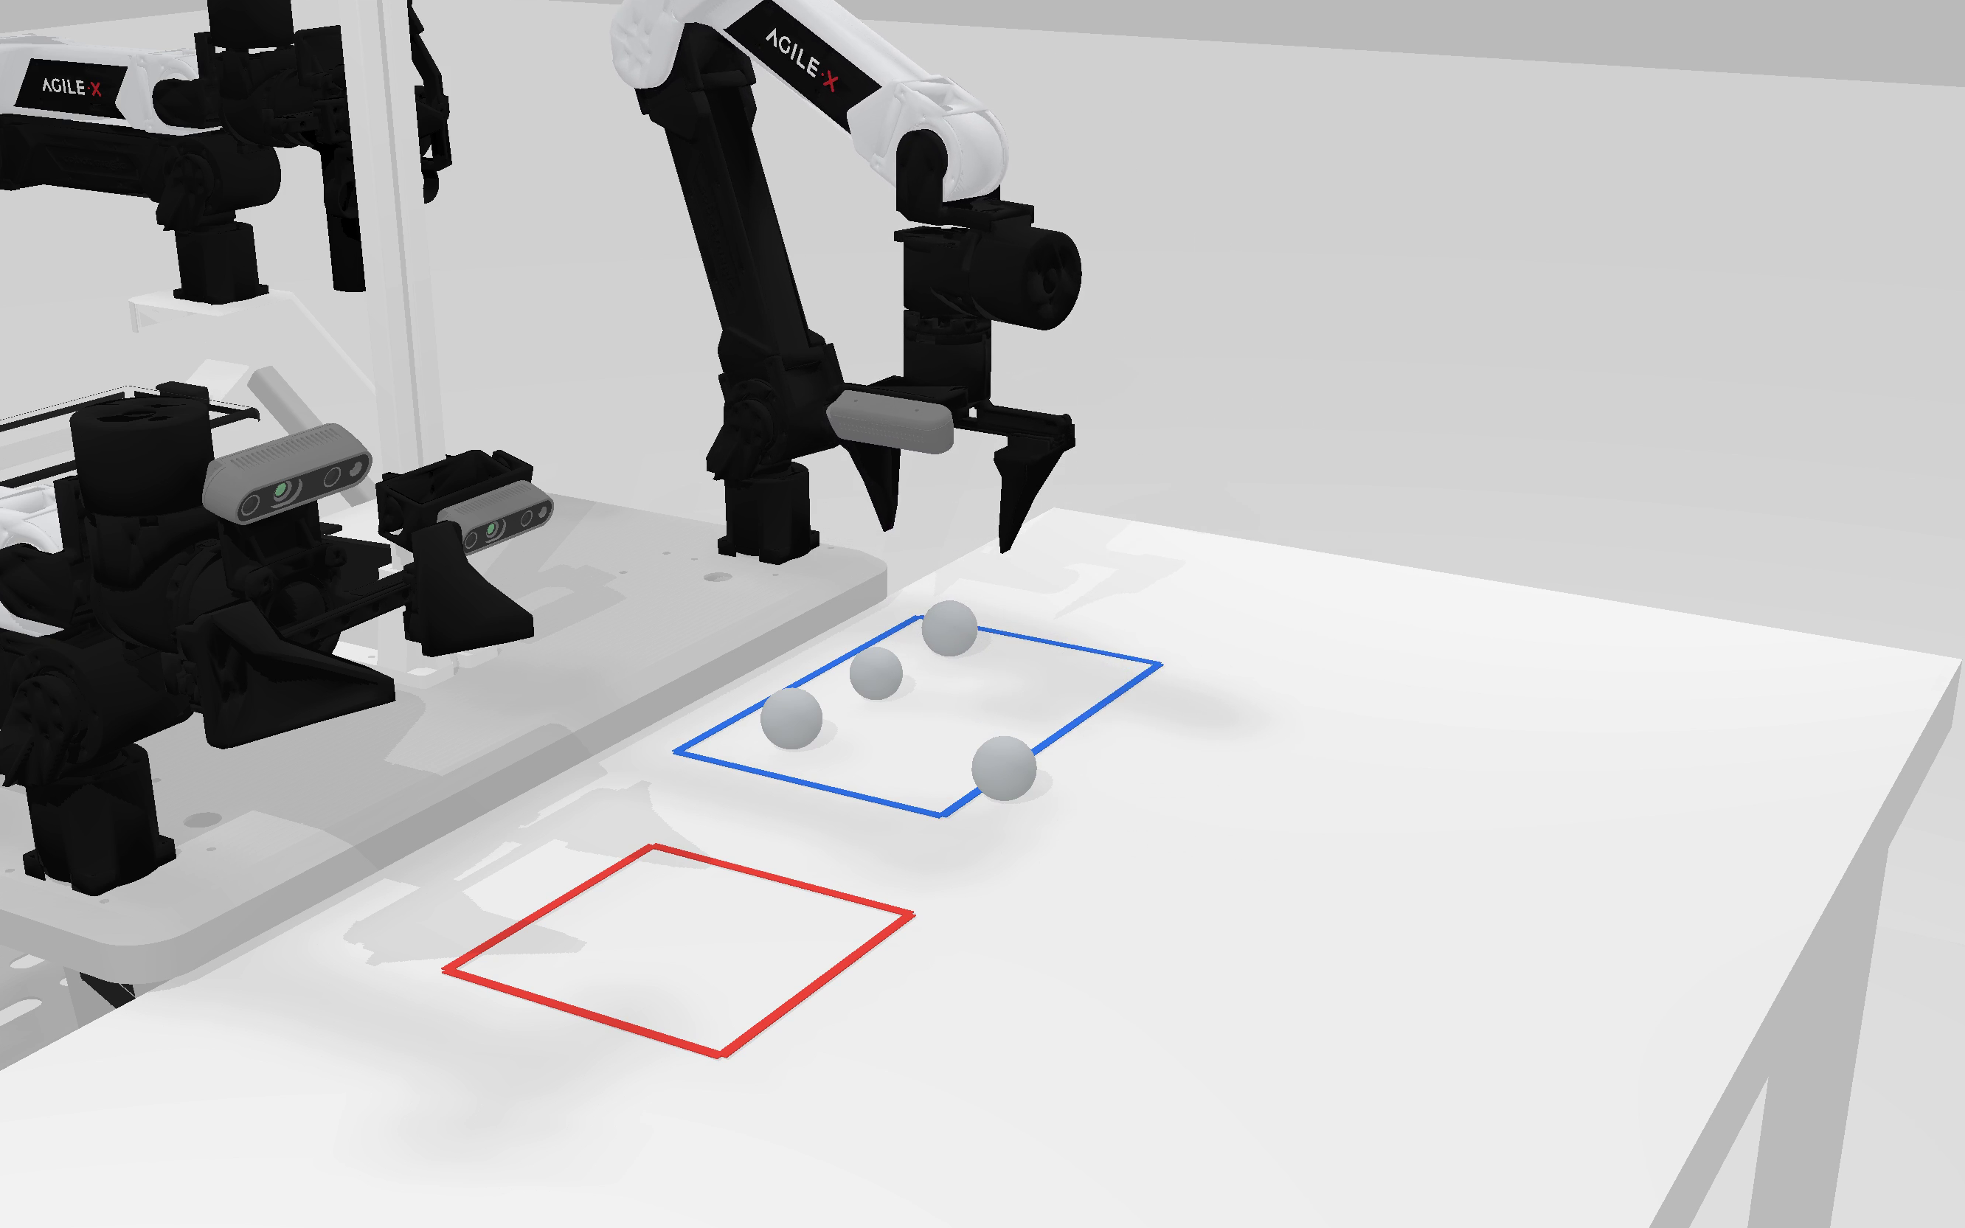
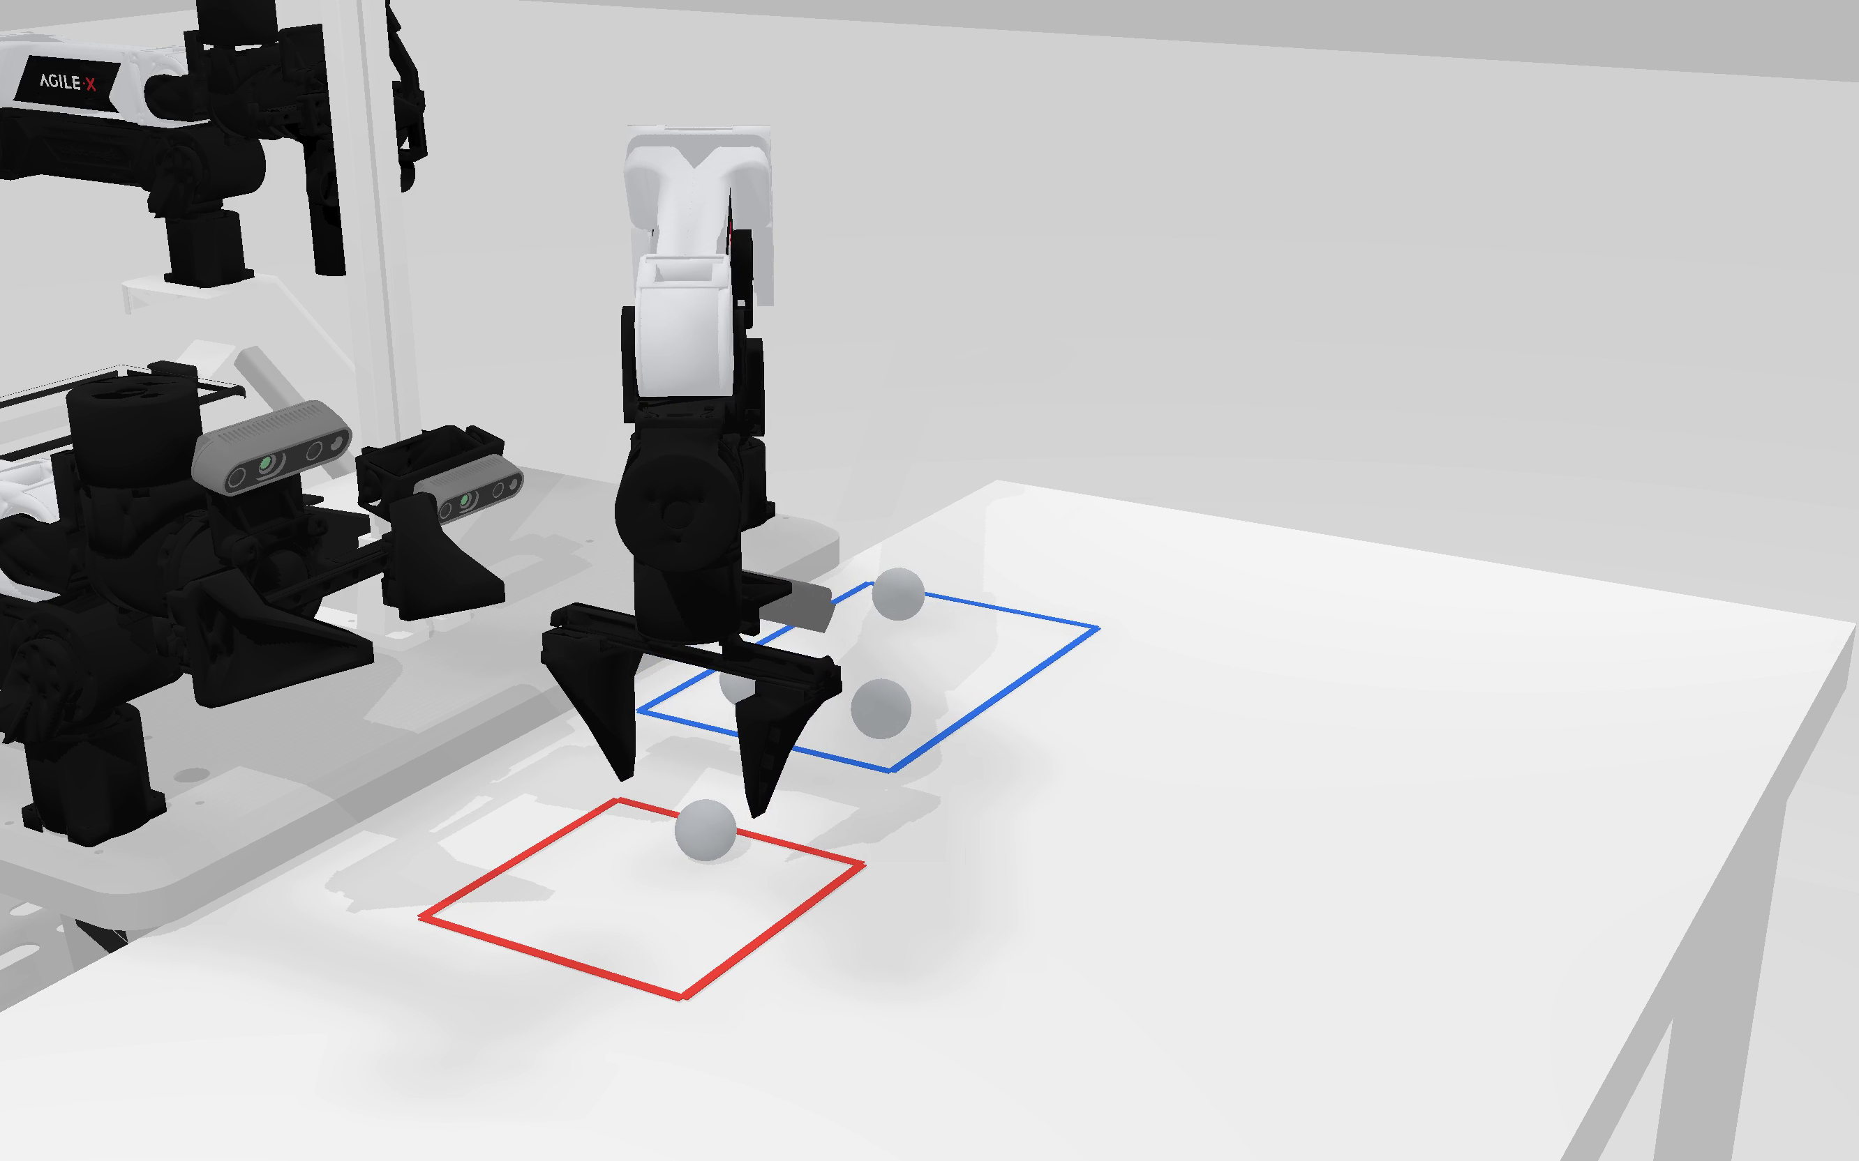
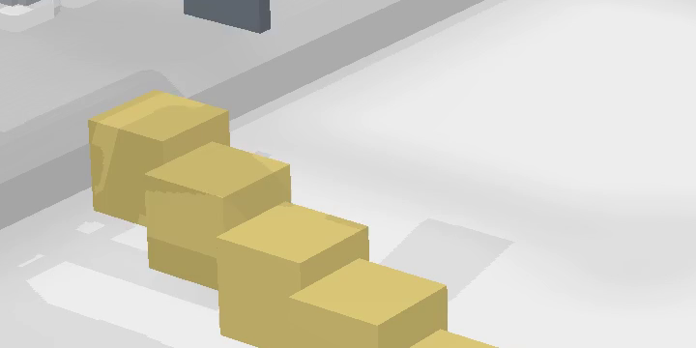
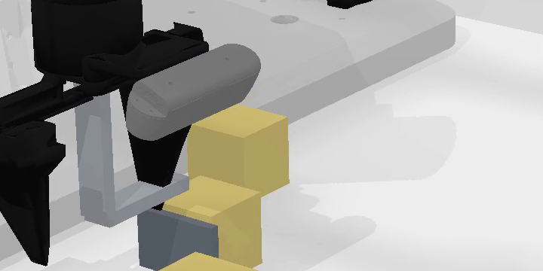
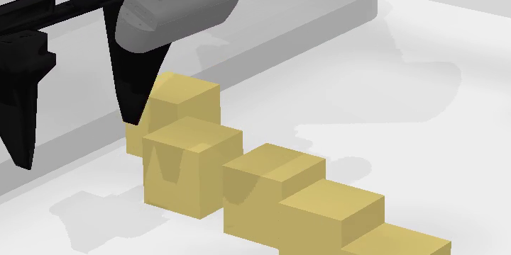
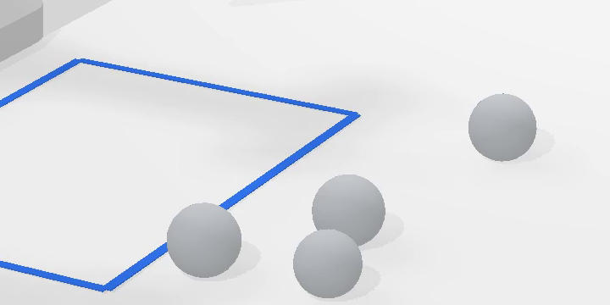
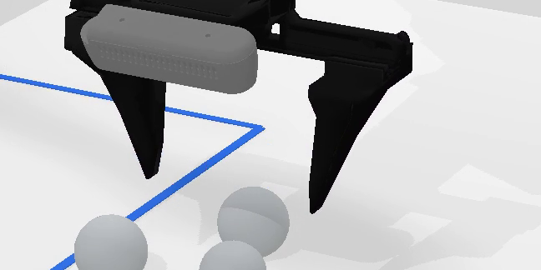
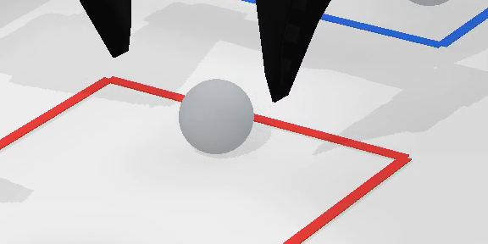
















OD1
Ramp catching
Motion to interception
OD2
Pendulum release
Motion to release timing
1
Observe
0.00s
2
Follow ramp
1.73s
3
Intercept
2.07s
4
Catch
2.17s
1
Observe
0.00s
2
Grasp tool
7.00s
3
Release
16.60s
4
Land
16.83s
PD1
Friction sorting
Push response to selection
PD2
Size sorting
Grasp response to selection
1
Observe
0.00s
2
Push
7.00s
3
Compare
22.67s
4
Sort
32.93s
1
Observe
0.00s
2
Grasp
13.17s
3
Compare
32.93s
4
Sort
72.20s
SD1
Ramp configuration
Configuration to rollout
SD2
Bank shot
Configuration to rebound
1
Observe
0.00s
2
Rotate
13.73s
3
Roll
28.67s
4
Arrive
29.33s
1
Observe
0.00s
2
Configure
10.10s
3
Strike
22.27s
4
Toward hole
23.33s
1.9x

Slide 3








Foresight Bench
OD1
Ramp-Split Interception
PD1
Friction Anomaly Sorting
SD1
Ramp Placement
Predict route and landing
2
Retrieve
Move and rotate the yellow ramp
1
Push & compare
Target pose
Robot-controlled pose
Highest friction
OD2
Timed Rope Cutting
PD2
Gripper-Based Size Sorting
SD2
Bank-Shot Routing
Time the blade actuation
1
Measure & compare
2
Retrieve outlier
Configure the rebound path
Swing
Size outlier
After cut
Compare gripper openings
Notes:
Editable reconstruction of the user-selected orange-trajectory ForesightBench figure. All readable labels, trajectories, arrows, dividers and simple highlights/target regions are native editable PowerPoint objects. Eight separately replaceable clean 3D scene assets preserve the selected illustration. Source: source.png supplied by user.

Slide 4
Foresight Bench
Ramp-Split Interception
PD1
Friction Anomaly Sorting
SD1
Ramp Placement
Predict route and landing
Move and rotate the yellow ramp
1
Push & compare
2
Retrieve
Highest friction
Timed Rope Cutting
PD2
Gripper-Based Size Sorting
SD2
Bank-Shot Routing
Time the blade actuation
2
Retrieve outlier
Configure the rebound path
1
Measure & compare
Size outlier
Swing
After cut
Compare gripper openings
Notes:
Editable reconstruction of the user-selected orange-trajectory ForesightBench figure. All readable labels, trajectories, arrows, dividers and simple highlights/target regions are native editable PowerPoint objects. Eight separately replaceable clean 3D scene assets preserve the selected illustration. Source: source.png supplied by user.

