Slide 1
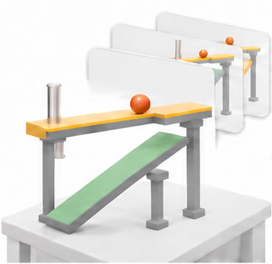
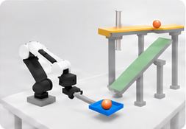

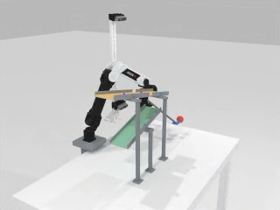
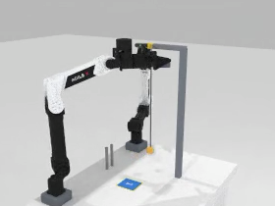
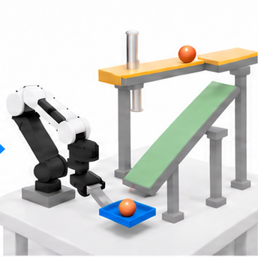
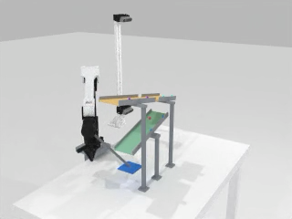
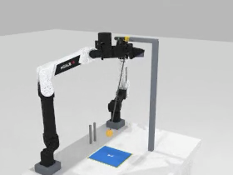
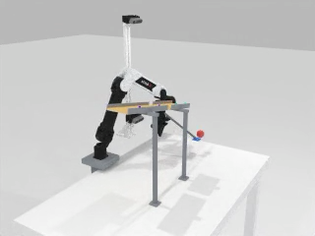
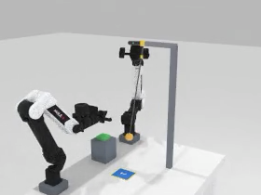

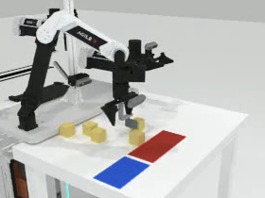
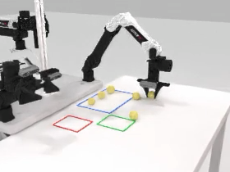
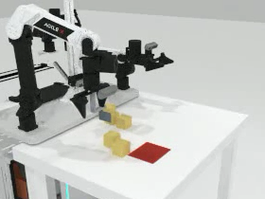
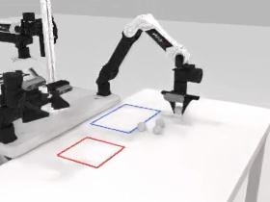
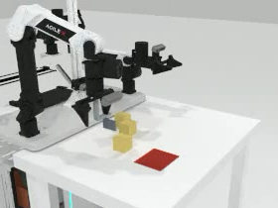
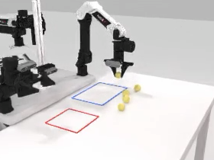
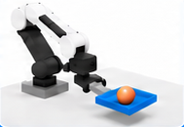
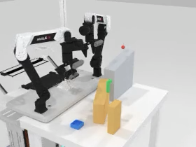
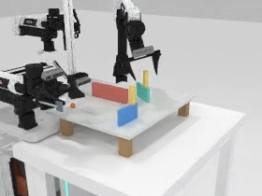
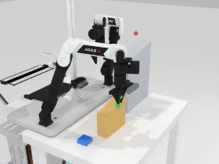
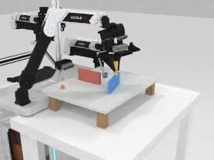
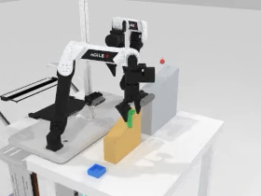
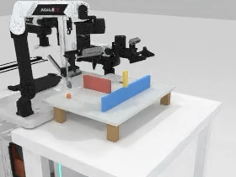
ForesightBench Data Construction Pipeline
1
Scene Construction
2
Expert Rollout
3
Validation
4
Data Integration
5
ForesightBench
Task success
Left wrist
OD1
Hard
OD2
Hard
Head
Medium
Medium
Easy
Easy
Valid state & action
r
Video / frame
consistency
Right wrist
x
PD1
Hard
PD2
Hard
0
Easy
Medium
Easy
Medium
Pass
State
30 Hz · 14D
SD1
SD2
Hard
Hard
Action
Easy
Medium
Easy
Medium
θ
t
Fail
“
Goal instruction
6 Tasks × 3 Difficulties
Geometry · Physics · Initial states
“Catch the ball with the tray.”
Train trajectories
Test scenes + prompts
Train scenes
Test scenes
Solve
Execute
Record
Rejected / logged
RGB + State + Action + Language
Policy
training
Trained
policy
Closed-loop
evaluation

