Slide 1
Training Support System
Group1

Slide 2
Member
1.Nguyễn Đình Thanh -HE161541
2.Cao Thanh Hải - HE163677
3.Vũ Quang Huy-HE163567
4.Nguyễn Đức Trung Thành-HE163697

Slide 3

Home Page

Slide 4
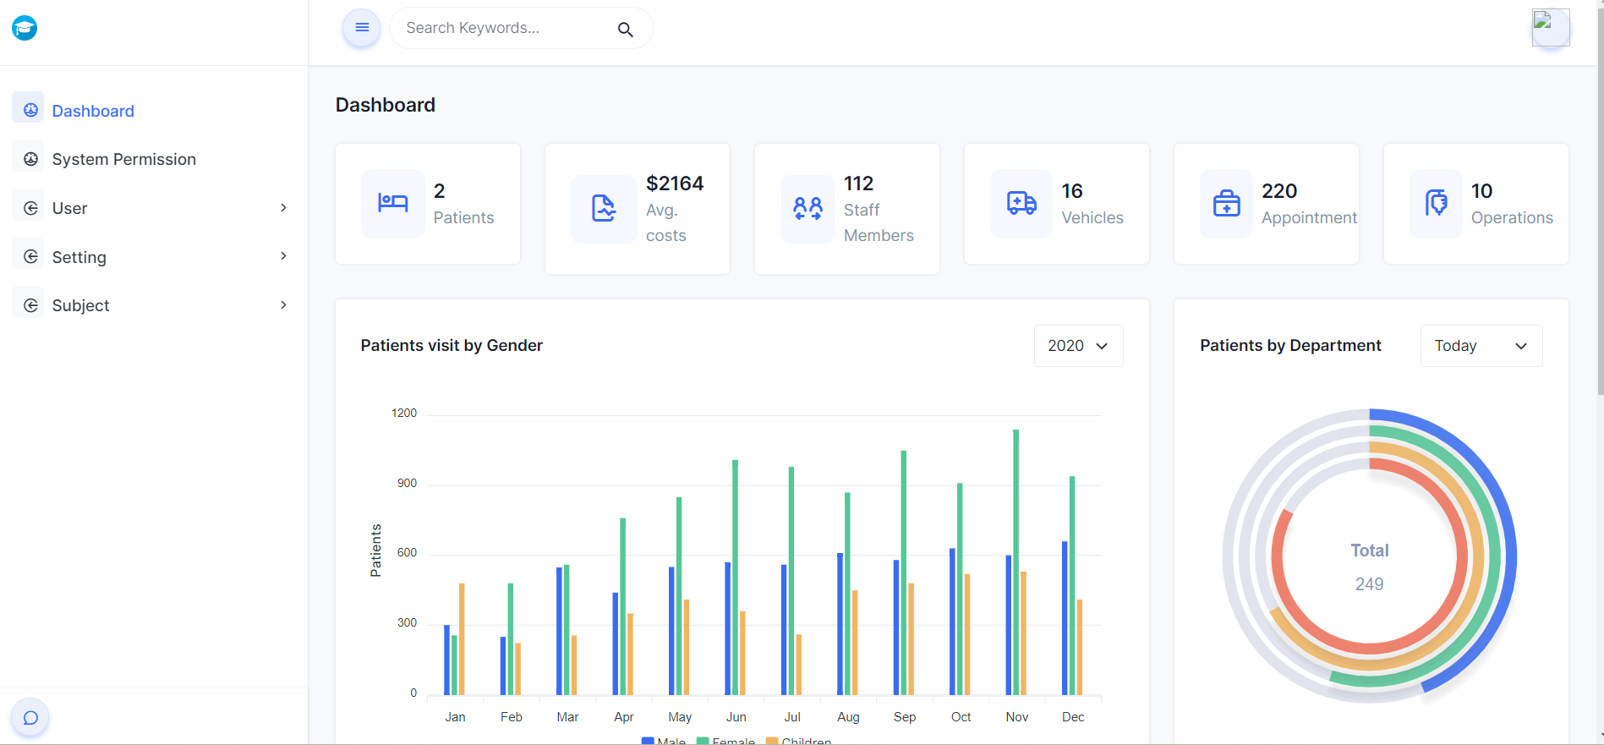
Admin Page

Slide 5
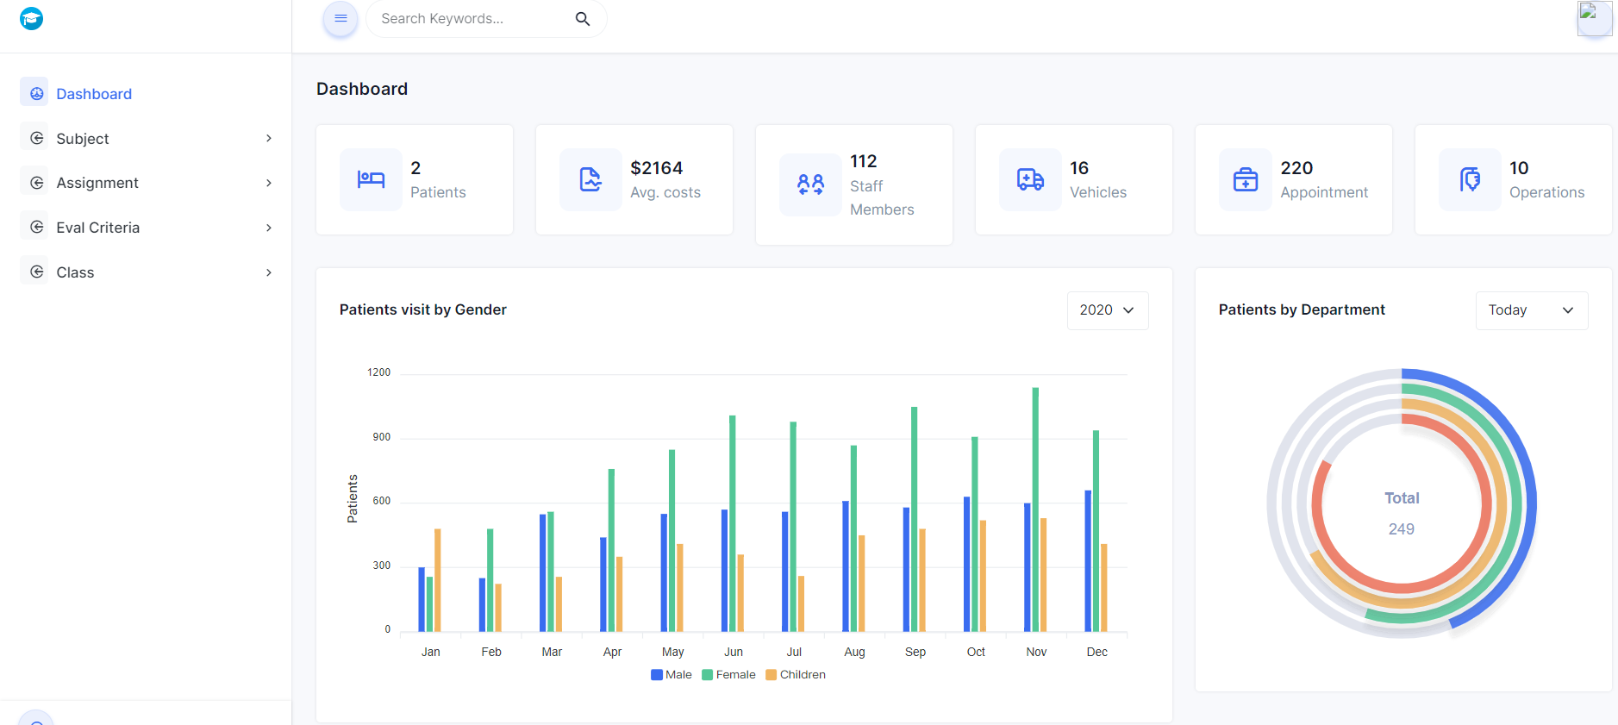
Manager

Slide 6
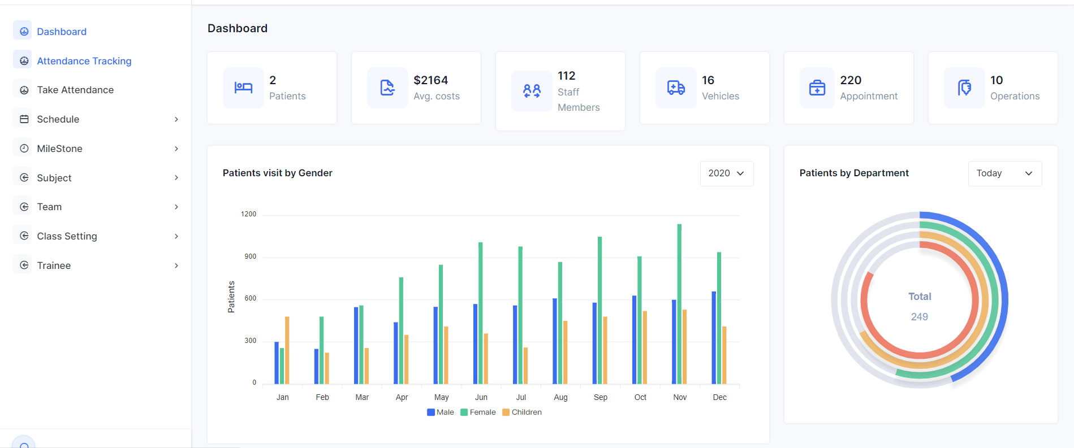
Trainer

Slide 7
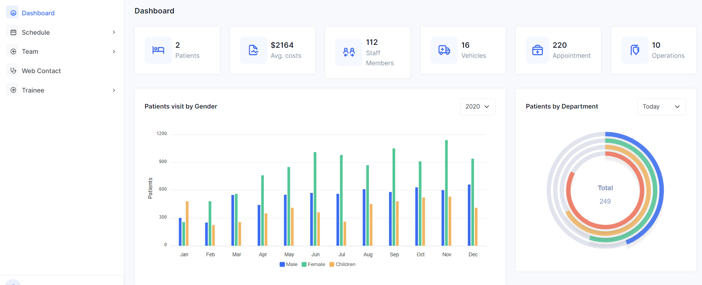
Supporter

Slide 8
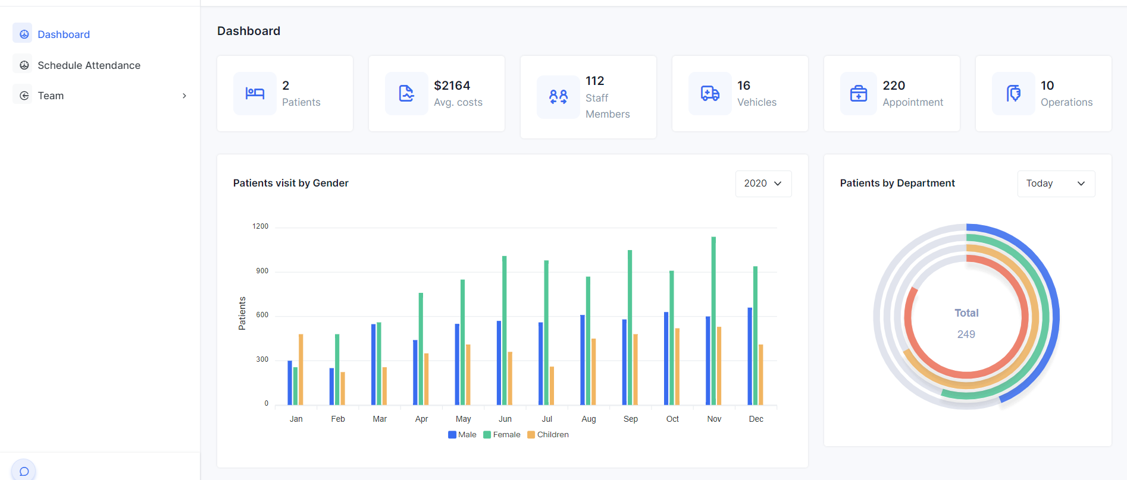
Trainee

Slide 9

Use Case Diagram

Slide 10
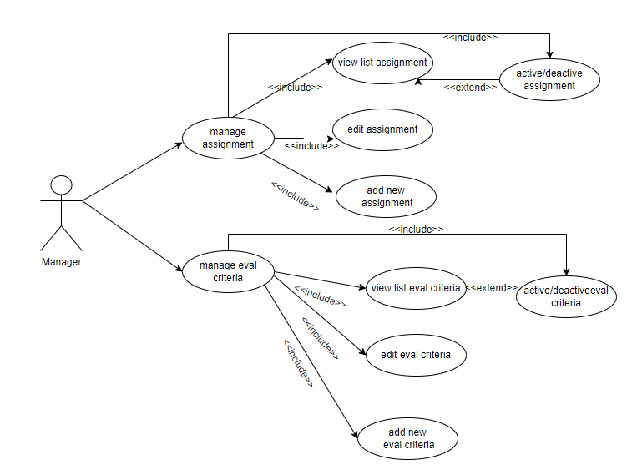
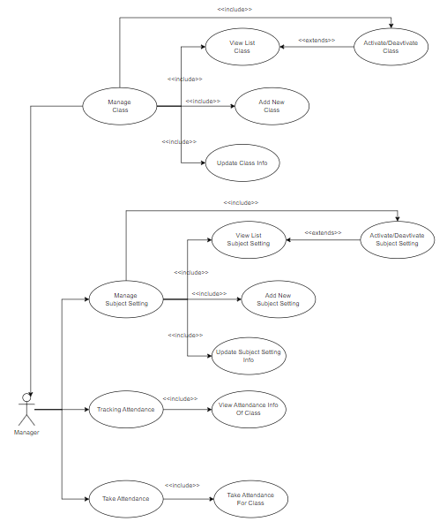
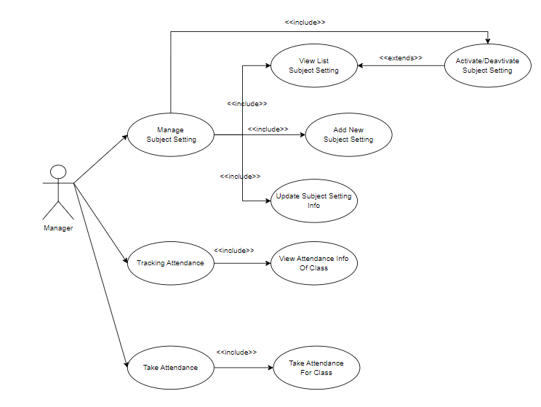

Slide 11
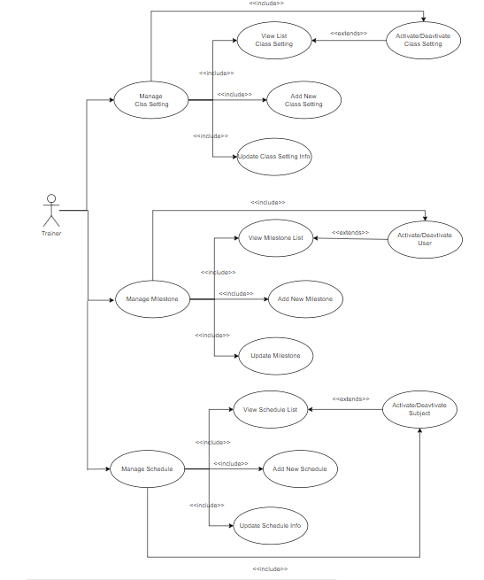
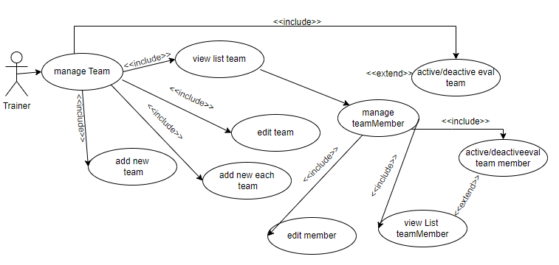

Slide 12


Slide 13
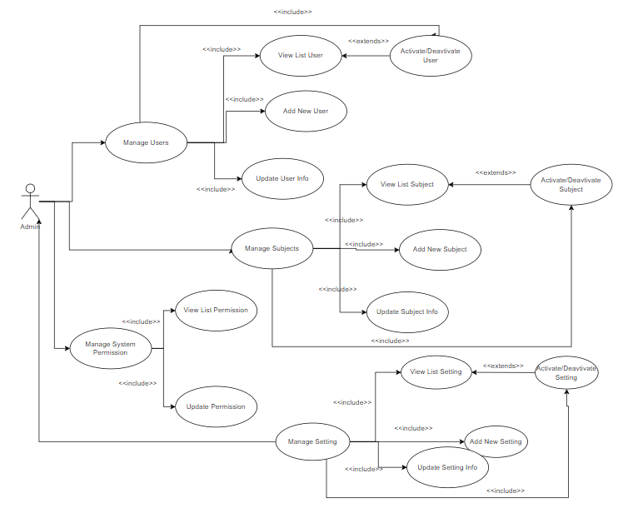

Slide 14
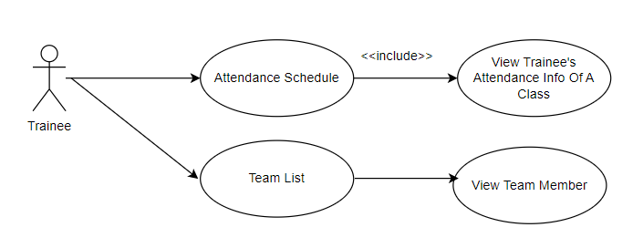

Slide 15
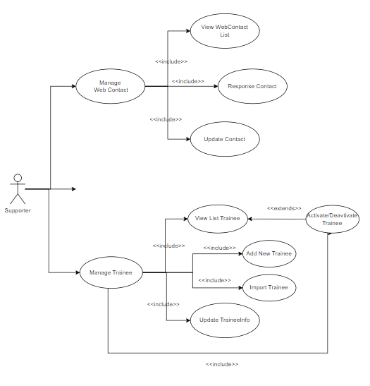
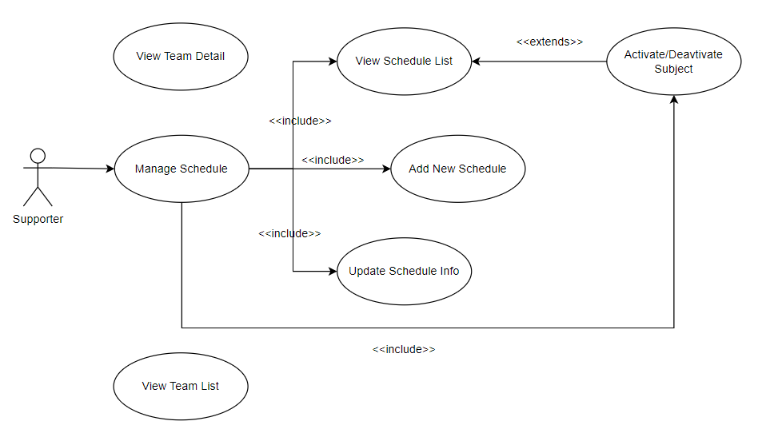

Slide 16
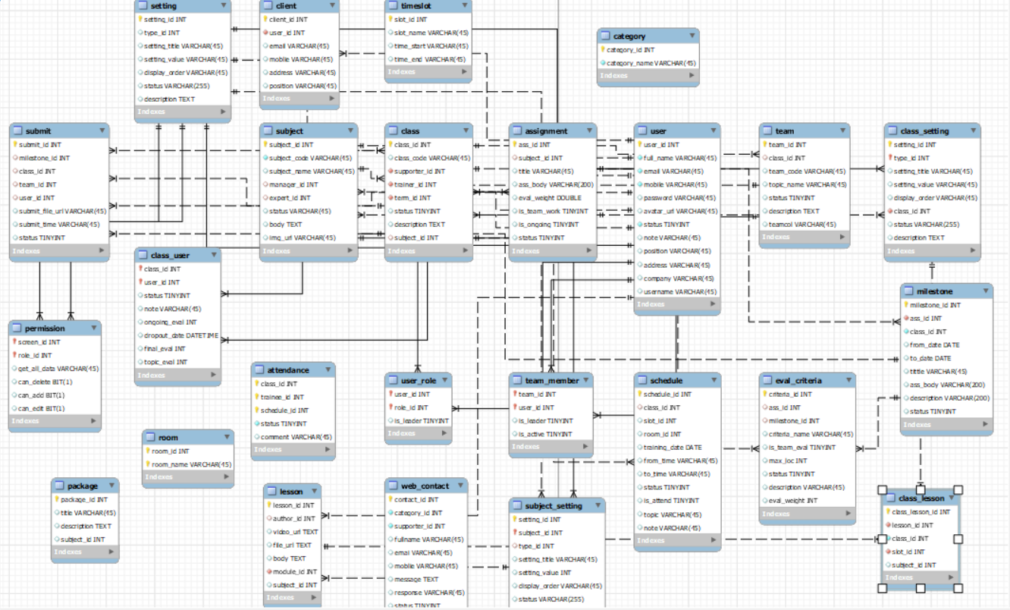
Data Schema

Slide 17
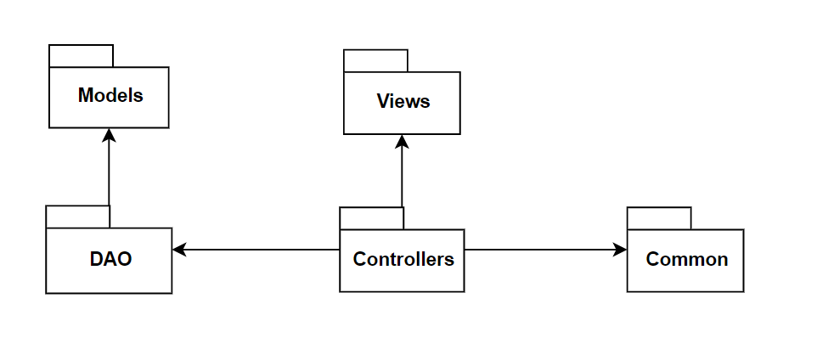
Code Package

