Slide 1
Chapter 16 Summary

Slide 2
Collection
Data types that hold references to other objects.
References to objects of any type
Has the is-a relationship with the type stored in collection.
Located in java.util. package

Slide 3
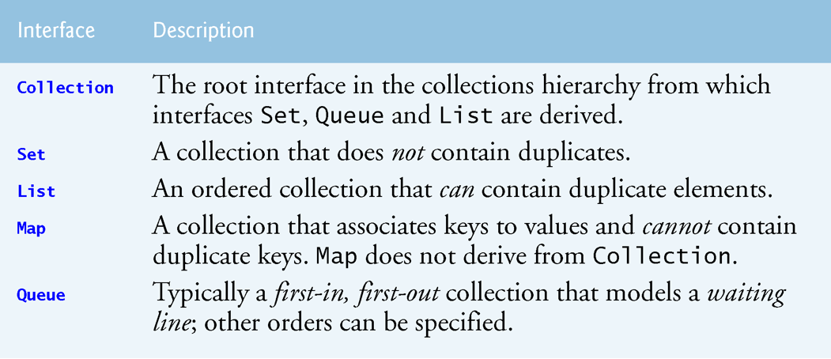
Collection List

Slide 4
Collections and Primitive Data Types
Each primitive type has a corresponding type-wrapper class
Boolean, Byte, Character, Double, Float, Integer, Long and Short.
Java.lang package
Enables you to manipulate primitive-type values as objects.
Collections cannot manipulate variables of primitive types.
Collection data types need type-wrapper classes
Each of the numeric type-wrapper classes extends class Number.
Final classes
Cannot extend them.

Slide 5
Boxing and Unboxing
Boxing converts a value of a primitive type to an object of type-wrapper class.
Unboxing converts an object of a type-wrapper class to a value primitive type.
Example:
Integer[] integerArray = new Integer[5]; // assign Integer 10 to integerArray[ 0 ] integerArray[0] = 10; //boxing // get int value of Integer int value = integerArray[0]; //unboxing

Slide 6
Interface Collection & Class Collections
Interface Collection contains bulk operations for adding, clearing and comparing objects in a collection.
A Collection can be converted to an array.
Interface Collection provides a method that returns an Iterator object, which allows a program to walk through the collection and remove elements from the collection during the iteration.
Class Collections provides static methods that search, sort and perform other operations on collections.

Slide 7
List Interface
Ordered Collection that can contain duplicate elements.
Indices are zero based.
Inherits methods from Collection
Contains methods for
Manipulating elements via their indices
Manipulating a specified range of elements
Searching for elements
Obtaining a List Iterator to access the elements.
Interface List is implemented by several classes, including ArrayList, LinkedList and Vector.
Autoboxing occurs when you add primitive-type values to objects of these classes, because they store only references to objects.

Slide 8
List Interface Derived Classes
Class ArrayList & Vector are resizable-array implementations of List.
Inserting an element between existing elements of an ArrayList or Vector is an inefficient operation.
A LinkedList enables efficient insertion (or removal) of elements in the middle of a collection, but is much less efficient than an ArrayList for jumping to a specific element in the collection.
The primary difference between ArrayList and Vector is that operations on Vectors are synchronized by default, whereas those on ArrayLists are not.
Unsynchronized collections provide better performance than synchronized ones.
For this reason, ArrayList is typically preferred over Vector in programs that do not share a collection among threads.

Slide 9
ArrayList and Iterator
List methods
add
adds an item to the end of a list.
size
returns the number of elements.
get
retrieves an individual element’s value from the specified index.
Collection method
Iterator
gets an Iterator for a Collection.

Slide 10
ArrayList and Iterator
Iterator methods
hasNext
determines whether there are more elements to iterate through.
Returns true if another element exists and false otherwise.
next
obtains a reference to the next element.
contains
determine whether a Collection contains a specified element.
remove
removes the current element from a Collection.

Slide 11
LinkedList
List methods
addAll
appends all elements of a collection to the end of a List.
listIterator
gets A List’s bidirectional iterator.
subList
obtains a portion of a List.
This is a so-called range-view method, which enables the program to view a portion of the list.
clear
remove the elements of a List.
size
returns the number of items in the List.

Slide 12
LinkedList
List methods
addLast
adds an element to the end of a List.
addFirst
adds an element to the beginning of a List.

Slide 13
LinkedList
List-Iterator method
set
replaces the current element to which the iterator refers with the specified object.
hasPrevious
determines whether there are more elements while traversing the list backward.
previous
gets the previous element from the list.

Slide 14
ArrayList vs LinkedList
Search
ArrayList
maintains index
LinkedList
Does not. Traversal through all the elements required for searching
Deletion
ArrayList
All elements need to be shifted after deletion
LinkedList
Each element of list has pointer to previous and next element. Deletion changes pointer (fast)

Slide 15
ArrayList vs LinkedList
Memory Overhead (comsumption)
ArrayList
maintains indexes and data
LinkedList
maintains data and two pointers
Use LinkedList if:
there are no large number of random access of element
there are a large number of add/remove operations

Slide 16
Lists ⬄ Arrays
Class Arrays provides static method asList to view an array as a List collection.
A List view allows user to manipulate the array as if it were a list.
useful for
adding the elements in an array to a collection
sorting array elements.
Any modifications made through the List view change the array, and any modifications made to the array change the List view.
Only operation permitted on the view returned by asList is set
UnsupportedOperationException if other operation attempted
List method toArray gets an array from a List collection.

Slide 17
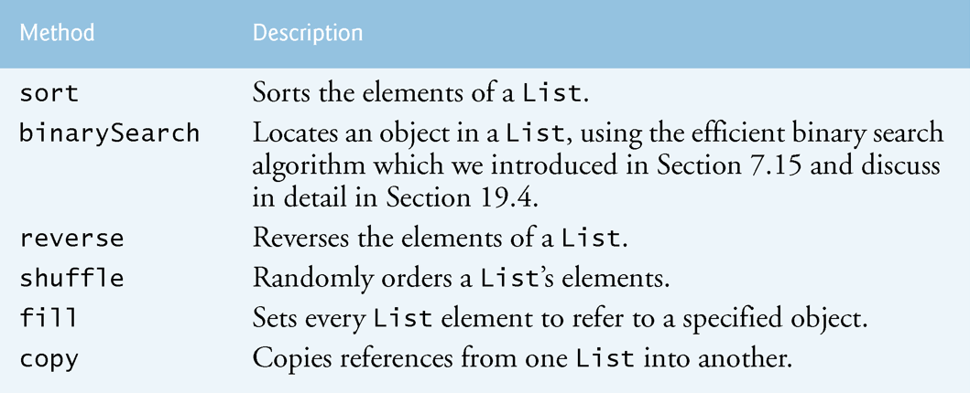
Collection Object Static Methods

Slide 18
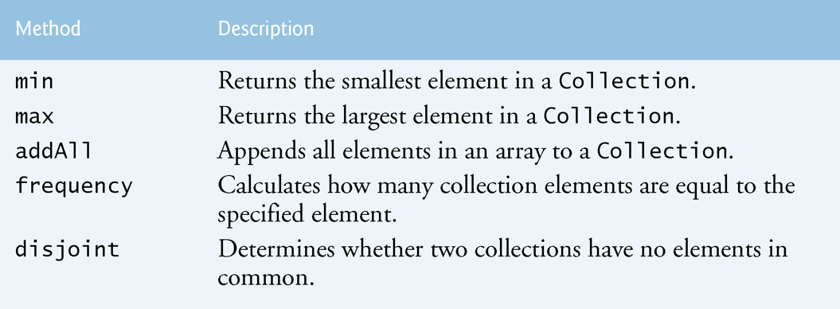
Collection Object Static Methods

Slide 19
Notes about Collection Methods
copy
takes two arguments—a destination List and a source List.
Each source List element is copied to the destination List.
The destination List must be at least as long as the source List;
IndexOutOfBoundsException occurs.
If the destination List is longer, the elements not overwritten are unchanged.

Slide 20
Queue Interface
Queue interface
java.util package
extends the Collection interface.
collection to hold the elements that follows the FIFO or the First-In-First-Out principle
Think check-out line
Ordered list of objects with 3 operations
Insert
Remove
Examine
PriorityBlockingQueue is thread safe implementation

Slide 21
Queue Interface
The Queue is used to insert elements at the end of the queue and removes from the beginning of the queue.
Queue supports all methods of Collection interface

Slide 22
Queue Interface Methods
add
add elements at the tail of queue.
At the end or according to the priority
peek
view the head of queue without removing it.
It returns Null if the queue is empty.
element
similar to peek() but throws NoSuchElementException when the queue is empty.
remove
removes and returns the head of the queue.
Throws NoSuchElementException when the queue is impty.
poll
removes and returns the head of the queue.
It returns null if the queue is empty.
size
return number of elements in the queue.

Slide 23
Priority Queue Class
PriorityQueue orders elements by their natural ordering.
Elements are inserted in priority order such that the highest-priority element (i.e., the largest value) will be the first element removed from the PriorityQueue.
Common PriorityQueue methods
offer
insert an element at the appropriate location based on priority order
Poll
remove the highest-priority element of the priority queue
Peek
get a reference to the highest-priority element of the priority queue
Clear
remove all elements in the priority queue
Size
get the number of elements in the queue.

Slide 24
Set Interface
An unordered Collection of unique elements
HashSet and TreeSet.
HashSet stores its elements in a hash table
TreeSet stores its elements in a tree.

Slide 25
Set Interface
SortedSet interface
extends Set
Sets that maintain their elements in sorted order.
Class TreeSet implements SortedSet.
TreeSet methods
headSet
gets a subset of the TreeSet in which every element is less than the specified value.
tailSet
gets a subset in which each element is greater than or equal to the specified value.
first, last
get the smallest and largest elements of the set, respectively.

Slide 26
HashSet Details
Uses a hash table for storage.
Inherits the AbstractSet class and implements Set interface.
Contains unique elements only.
Allows null value.
Not synchronized.
Elements inserted by hashcode.
Default capacity = 16
Default load factor = 0.75

Slide 27
Hashing
Hashing is a high-speed scheme for converting keys into unique array indices.
The load factor is the ratio of the number of occupied cells in the hash table to the total number of cells in the hash table.
CellsOccupied / totalCells
A hash table’s load factor affects the performance of hashing schemes.
The closer this ratio gets to 1.0, the greater the chance of collisions.

Slide 28
Hashing
High load factor
Better memory utilization
Not many unused hashing indices
Slower program execution
Higher chance of collisions
Low load factor
Poorer memory utilization
Many unused hashing indices
Faster program execution
Lower chance of collisions

Slide 29
HashSet vs Tree Set
HashSet
is much faster than TreeSet
does not guarantee ordering
performance depends capacity and the load factor
TreeSet
guarantees log(n) time basic operations (
add, remove and contains
guarantees elements of sorted
offers additional seek and retrieval features
Both HashSet and TreeSet guarantee
Unique values

Slide 30
Map Interface
key-value pair
Keys must be unique, but the values need not
If a Map contains both unique keys and unique values
deemed one-to-one mapping.
If only the keys unique
Deemed many-to-one mapping—many keys can map to one value.
Three of the several classes that implement interface Map are Hashtable, HashMap and TreeMap.
Hashtables and HashMaps store elements in hash tables, and TreeMaps store elements in trees.

Slide 31
Map Interface
Interface SortedMap extends Map
maintains its keys in sorted order—either the elements’ natural order or an order specified by a Comparator.
Class TreeMap implements SortedMap.

Slide 32
Map Interface Methods
containsKey
determines whether a key is in a map.
put
creates a new entry or replaces an existing entry’s value.
returns the key’s prior associated value, or null if the key was not in the map.
get
obtain the specified key’s associated value in the map.
size
returns the number of key/value pairs in the Map.
isEmpty
returns a boolean indicating whether the Map is empty.
HashMap method keySet returns a set of the keys.

