Slide 1
Chapter 17 Summary

Slide 2
Streams

Slide 3
Intro
Before Java SE 8
procedural programming, object-oriented programming and generic programming
Java SE 8
lambdas and streams=> functional programming
Benefit: write programs faster, simpler, more concisely & with fewer bugs

Slide 4
Stream Example
int total = 0; for (int number = 1; number <= 10; number++) { total += number; } Vs
int total = IntStream.rangeClosed(1, 10).sum();

Slide 5
Stream
A sequence of elements on which you perform tasks
Pipeline moves the stream’s elements through a sequence of tasks
Package location: java.util.stream.*
Primative data type streams
IntStream
DoubleStream
LongStream
Data Source = set of values = collection
Stream() method

Slide 6
Stream vs Iterator
Stream can perform internal iteration
iterate its elements itself.
Collections iterator
you have to implement the iteration of the elements yourself.

Slide 7
Stream features
Stream Processing
Method listeners called once per element on stream when it iterates
Multiple listeners = chain processing
Listeners can be aggregate
Operations / operators = method listeners
Non-Terminal operations = not last method listener
Method that adds a listener to the stream
Terminal operation = last method listener
starts the internal iteration of the elements, calls all the listeners, and returns a result

Slide 8
Stream Processing Phases
Processing the elements in the stream happens in two steps / phases:
Configuration
First the stream is configured.
Can consist of filters and mappings.
Also referred to as non-terminal operations.
Processing
doing something to the filtered and mapped objects.
No processing during the configuring calls.
Stream processing methods are also referred to as terminal operations.

Slide 9
Lambda

Slide 10
Lambda
Function not belonging to class
Anonymous method
Can be executed on demand
Can be declared as object
Used in functional programming with stream
Used as event listeners / callbacks
Syntax
(parameter_list ) -> { method_body }
(int x) -> {return x * 2;}
(x) -> {return x * 2;}

Slide 11
Lambda
Lambda expressions enable you to create methods that can be treated as data
You can:
pass lambdas as arguments to other methods (like map, or even other lambdas)
assign lambda expressions to variables for later use and
return lambda expressions from methods.

Slide 12
Lambda Condensed Syntax
A lambda’s parameter type(s) usually may be omitted
compiler infers the parameter and return types by the lambda’s context
If compiler cannot infer the parameter or return types
Error generated
If lambda body contains only one expression
return keyword, curly braces and semicolon may be omitted
(x) -> x * 2
If parameter list contains only one parameter
parentheses may be omitted
x -> x * 2
However, no params need parentheses
() -> System.out.println(“Hello World”)

Slide 13
Lazy & Eager Stream Operators
lazy evaluation
Intermediate operations
Each operation results in a new stream object
But does not perform any operations stream elements until a terminal operation
Allows library developers to optimize stream-processing performance
Example
You have 1,000,000 Person objects
Looking for the first one with the last name "Jones“
Processing can terminate as soon as the first match
Eager evaluation
Terminal operations
Perform operation when called

Slide 14
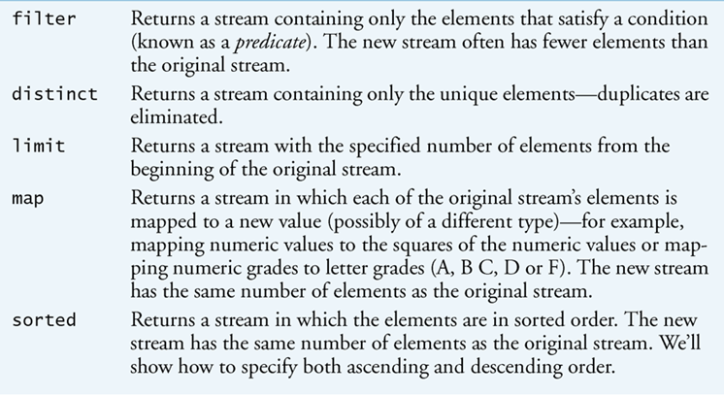
Common Intermediate Stream Operations

Slide 15
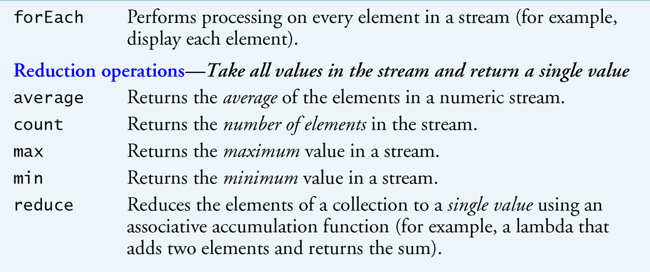
Common Terminal Operations

Slide 16
Collectors Object
Final class that extends Object class
All methods static
Provides reduction operations
Accumulating elements into collections
Summarizing elements according to various criteria

Slide 17
Filtering
filters elements to select those that match a condition
Predicate
System.out.println(
IntStream.rangeClosed(1, 10)
.filter(x -> x % 2 == 1)
.map( x -> x * 3)
.sum()
);

Slide 18
Stream Pipeline
Chain of operators on stream
Order matters
Intermediate vs terminal

Slide 19
Map vs Filter
Map
always return a 1:1 ratio of elements
Filter
creates intermediate stream
Intermediate stream values continue down stream pipeline

Slide 20
Method References
Lambda that calls another method
Replace the lambda with that method
mapToObj
Static method
Use static methods of objects

Slide 21
Optional data type
Container that declares that data value may be null
Extends Object
Equivalent to C# nullable
Terminal Operator return Optional data type
OptionalInt
OptionDouble

Slide 22
Note-Worthy Stream Methods
getAsInt(), getAsDouble()
returns single primitive data type
reduce(x, y)
Repetitive process
X = return value of previous calculations
Y = current stream element
reduce(identity, lambda)
Identity= the initial value and/or default result if no elements in the stream
lambda = lambda expression

Slide 23
Note-Worthy Stream Methods
summaryStatistics
IntSteam, DoubleSteam, LongStream
Returns IntSummaryStatistics or LongSummaryStatstics or DoubleSummaryStatics
Array of count, sum, min, average, max

