Slide 1
Chapter 17 Lambdas and Streams
Java How to Program, 11/e
Questions? E-mail paul.deitel@deitel.com

Slide 2
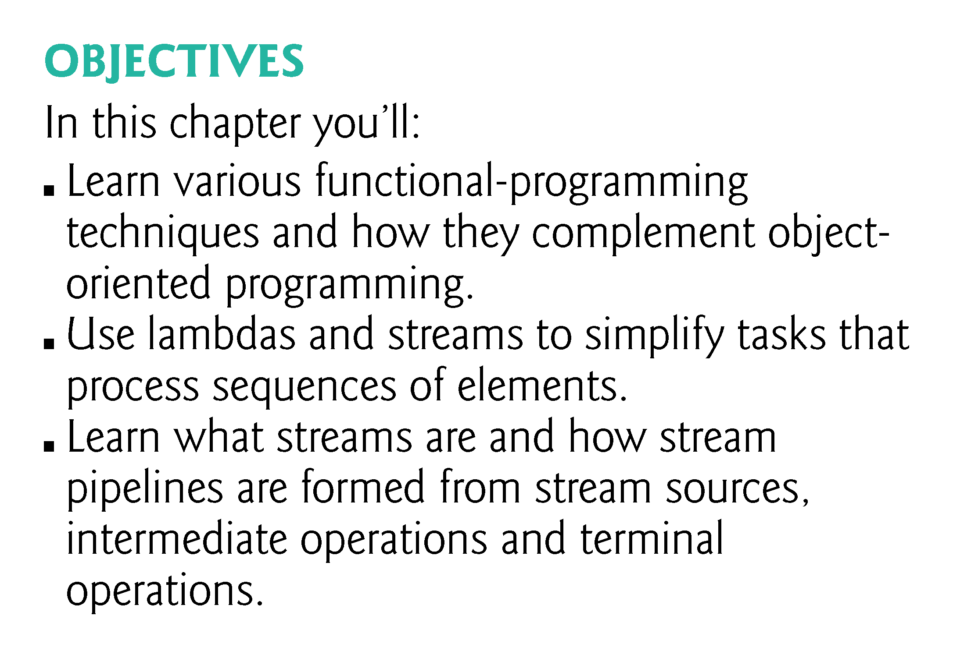

Slide 3
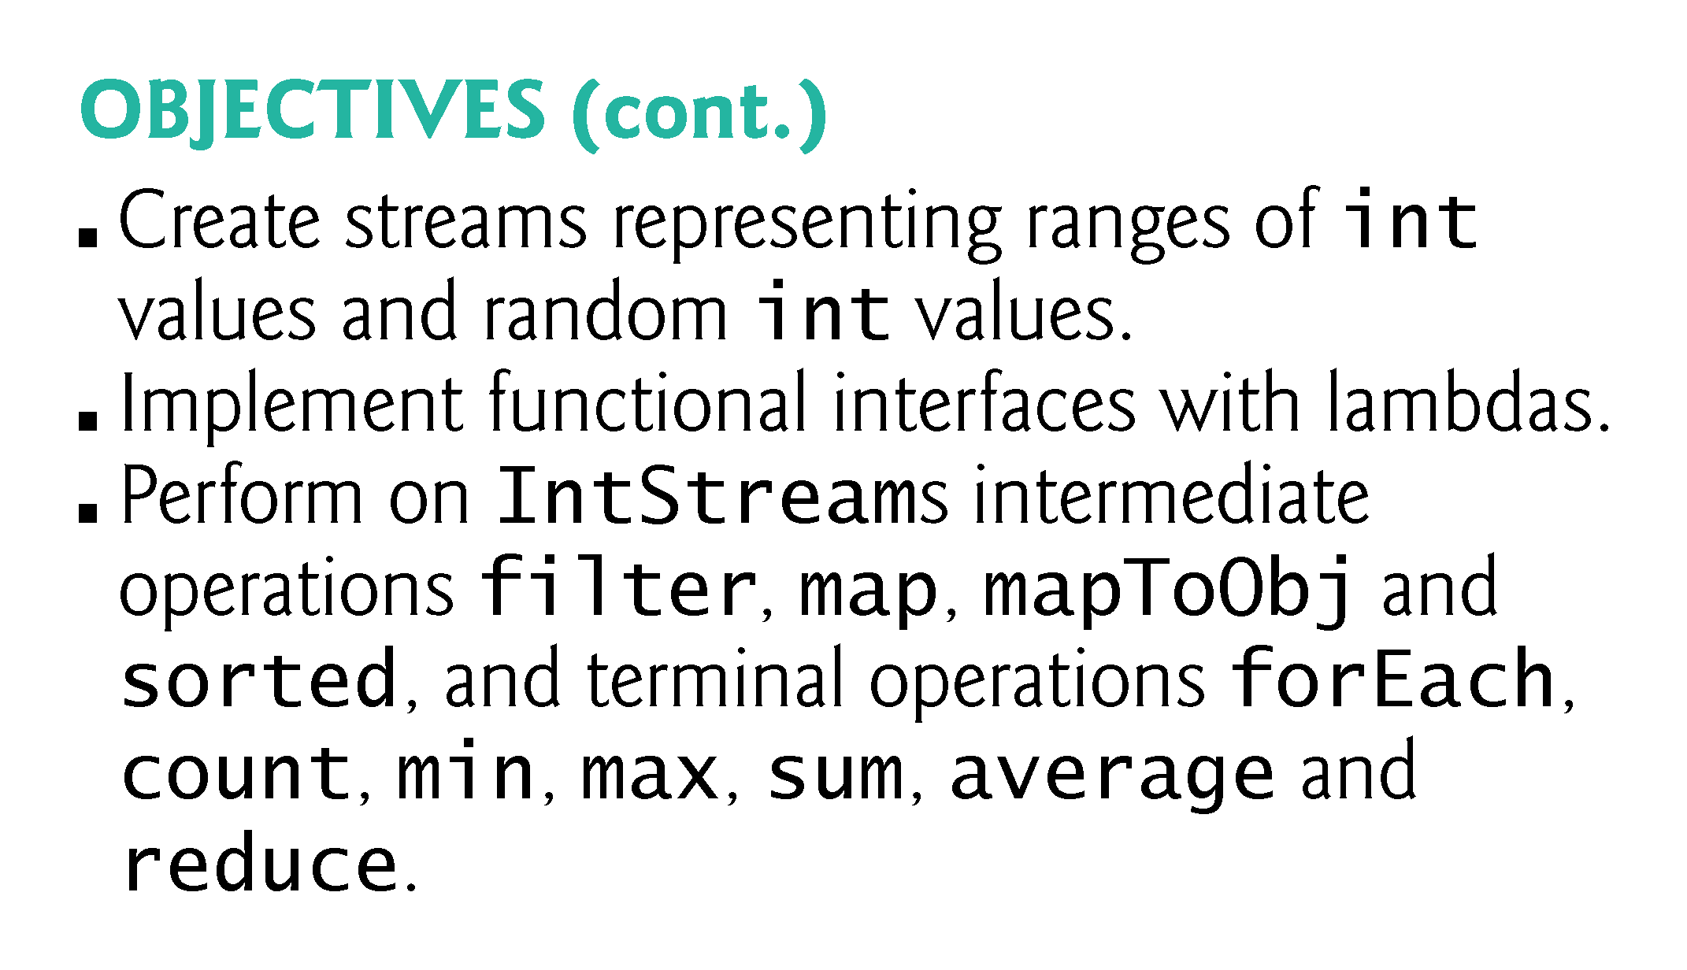

Slide 4
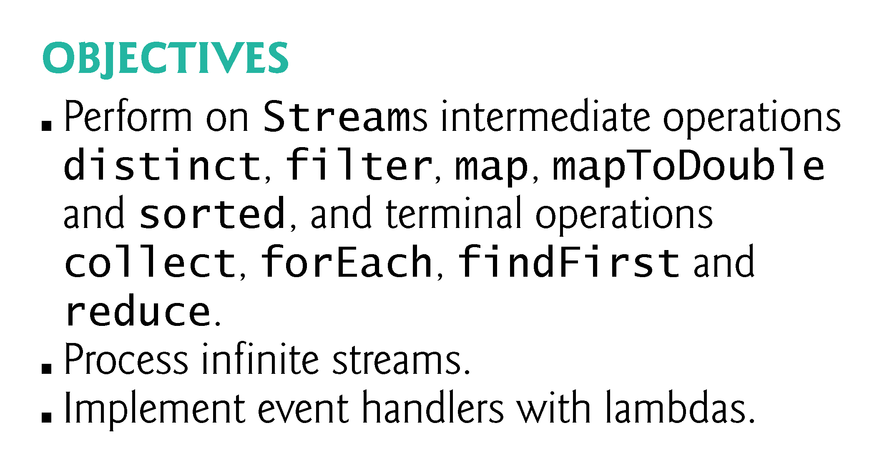

Slide 5
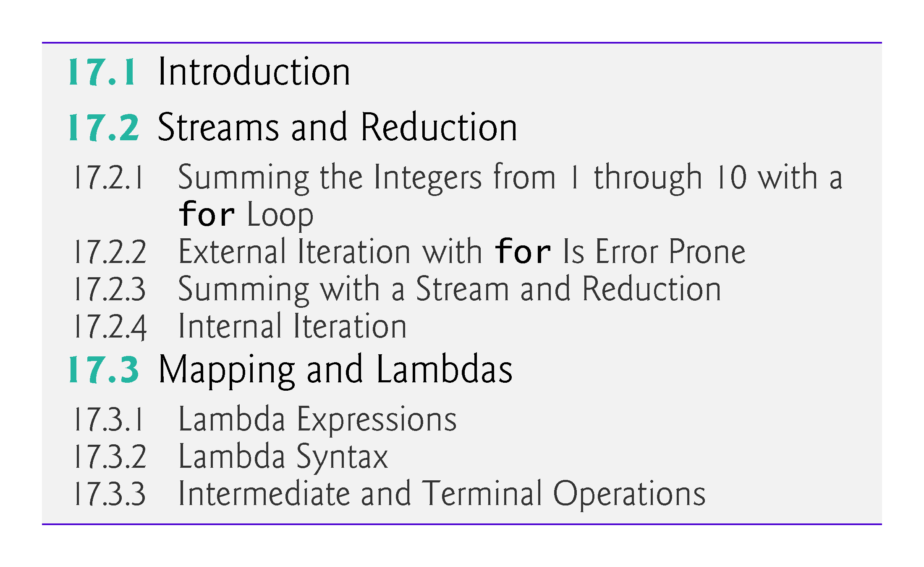

Slide 6
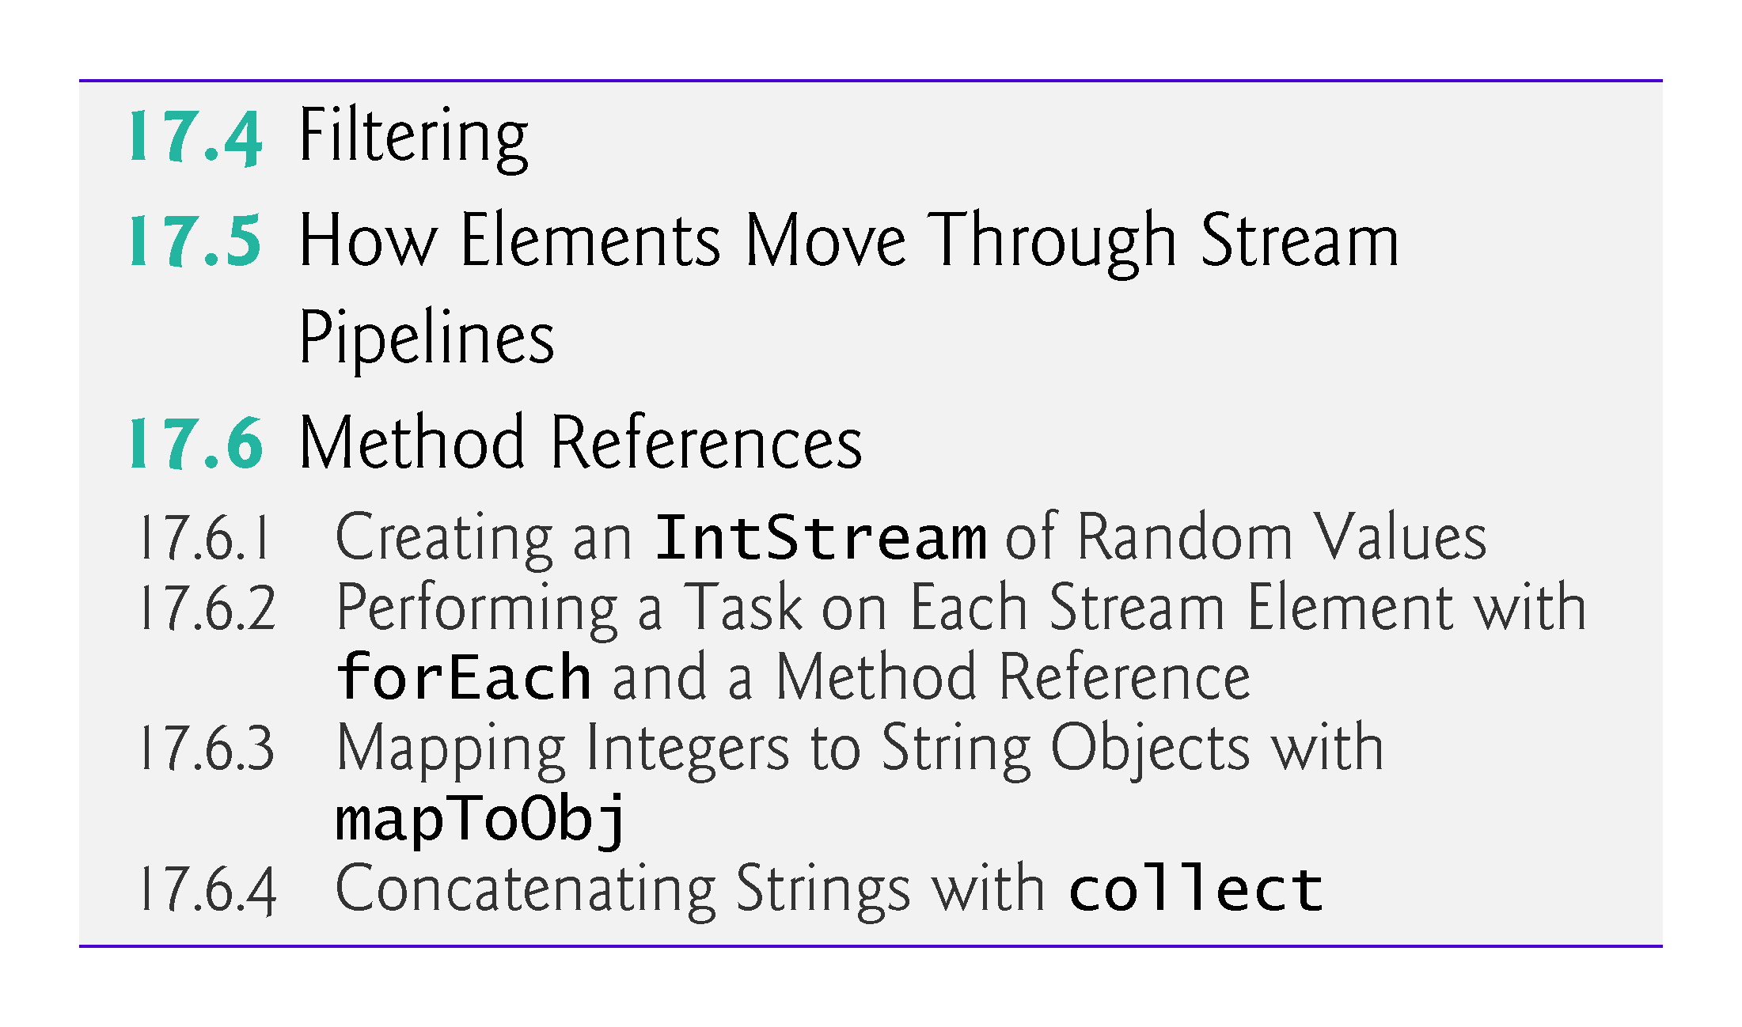

Slide 7
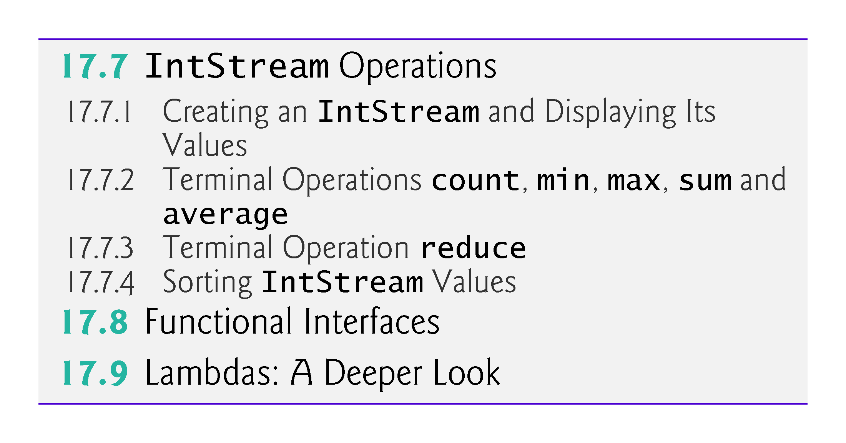

Slide 8
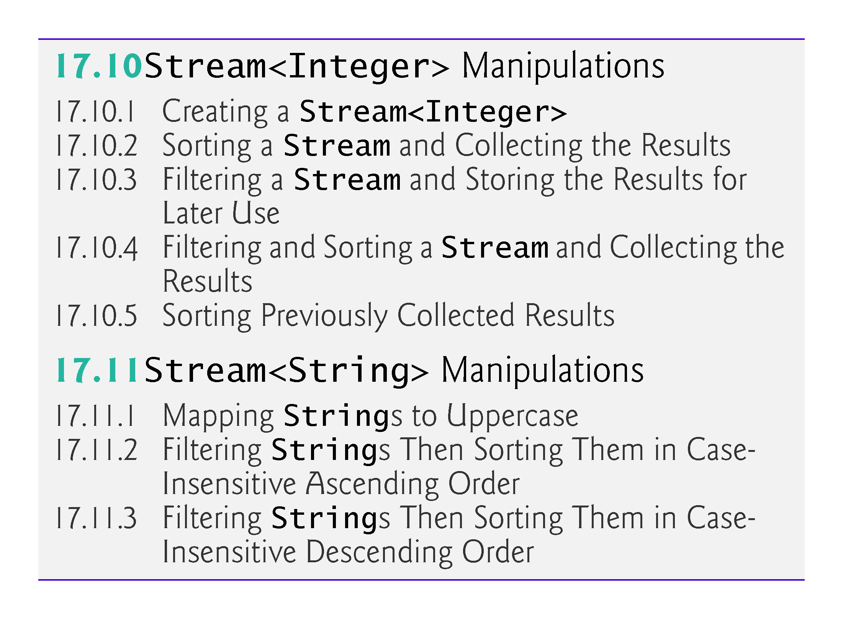

Slide 9
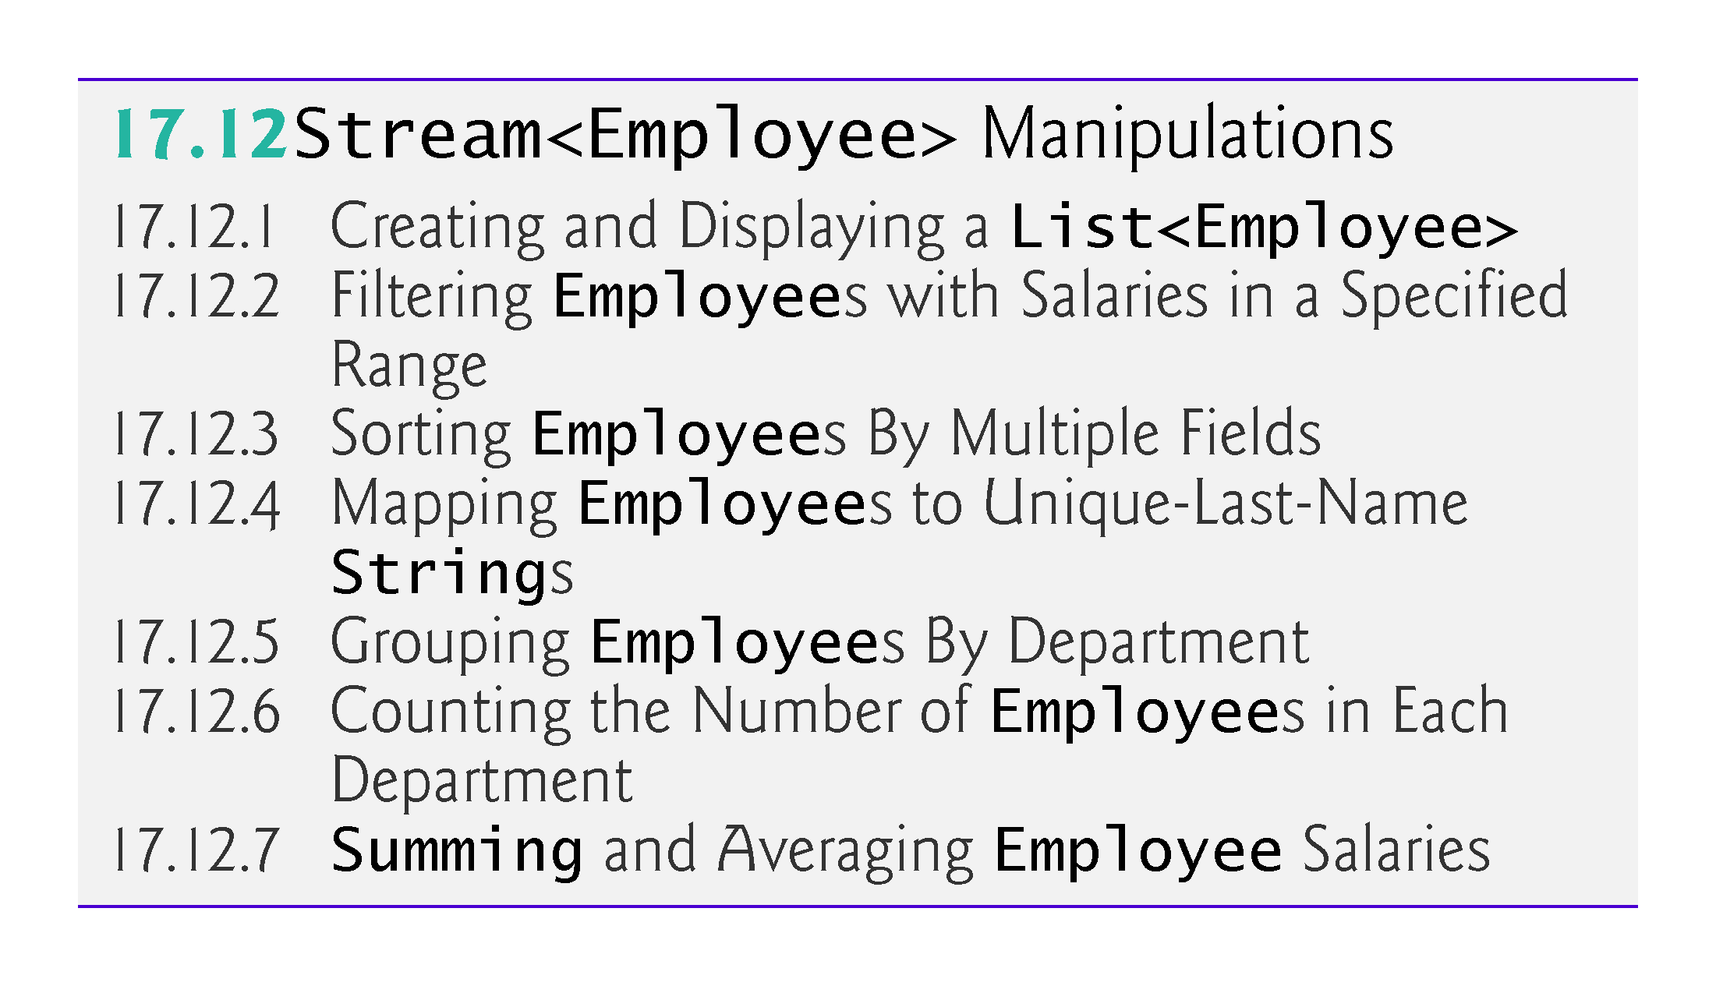

Slide 10
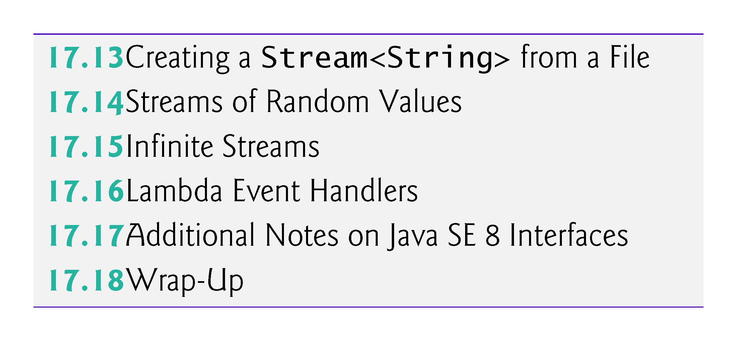

Slide 11
17.1 Introduction
The way you think about Java programming is about to change profoundly
Prior to Java SE 8, Java supported three programming paradigms—procedural programming, object-oriented programming and generic programming
Java SE 8 added lambdas and streams—key technologies of functional programming
In this chapter, we’ll use lambdas and streams to write certain kinds of programs faster, simpler, more concisely and with fewer bugs than with previous techniques
In Chapter 23, Concurrency, you’ll see that such programs can be easier to parallelize (i.e., perform multiple operations simultaneously) so that you can take advantage of multi-core architectures to enhance performance—a key goal of lambdas and streams

Slide 12
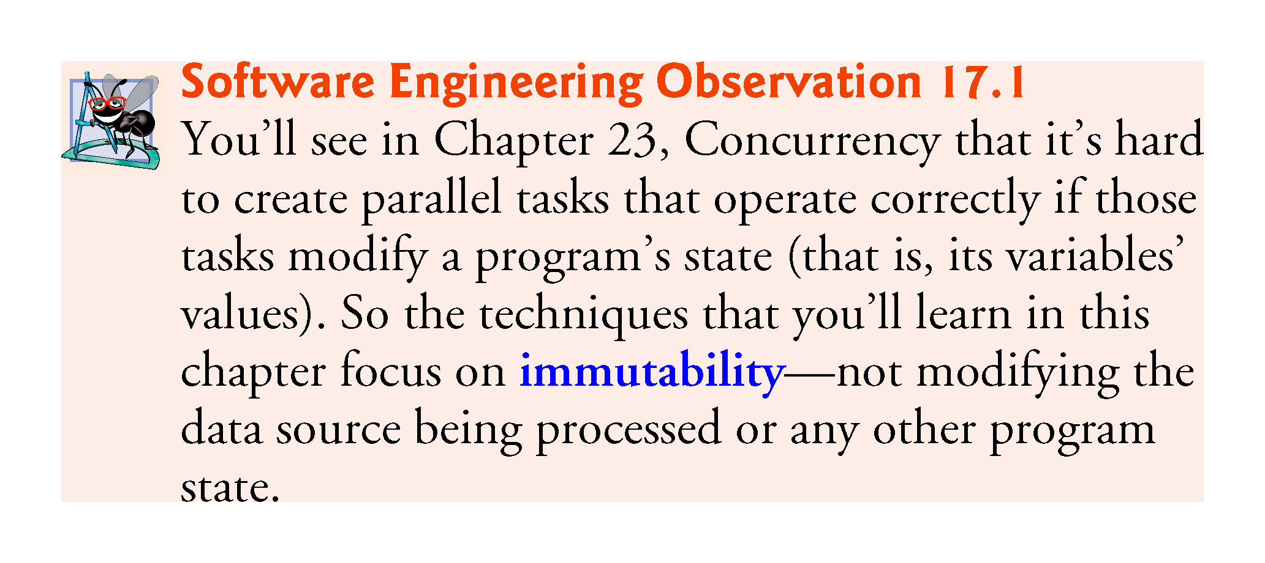

Slide 13
17.1 Introduction (cont.)
This chapter presents many examples of lambdas and streams (Fig. 17.1), beginning with several showing better ways to implement tasks you programmed in Chapter 5
The first several examples are presented in a manner that allows them to be covered in the context of earlier chapters
For this reason, some terminology is discussed later in this chapter
Figure 17.2 shows additional lambdas and streams coverage in later chapters

Slide 14
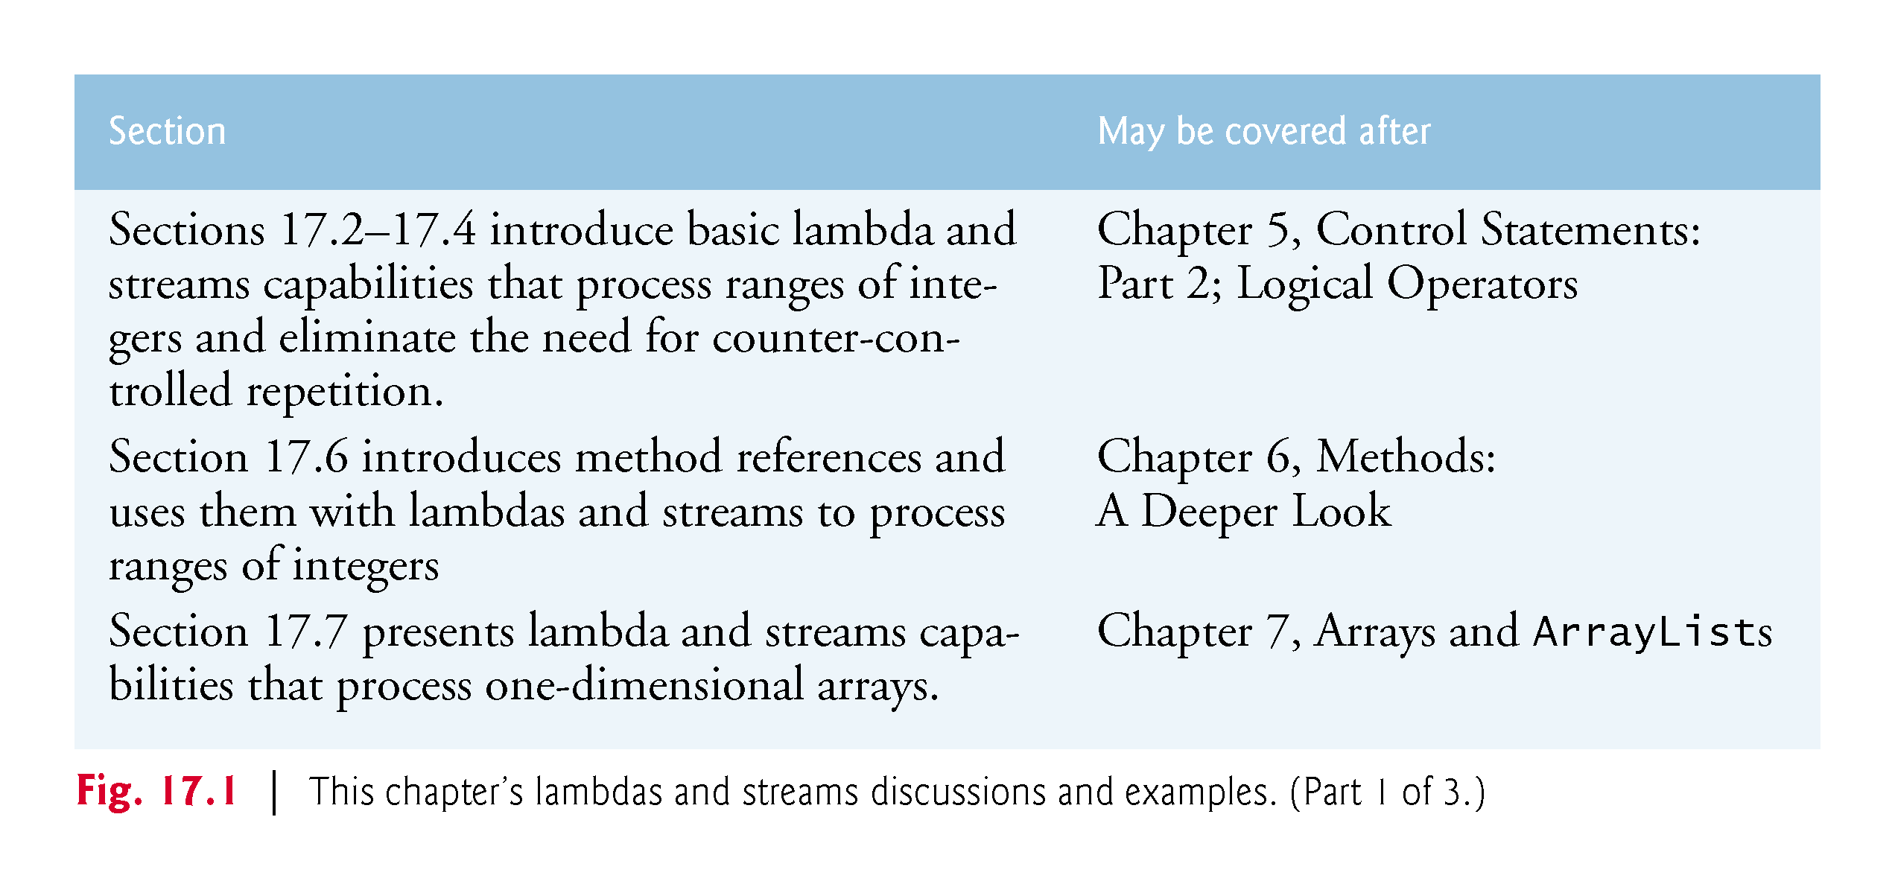

Slide 15
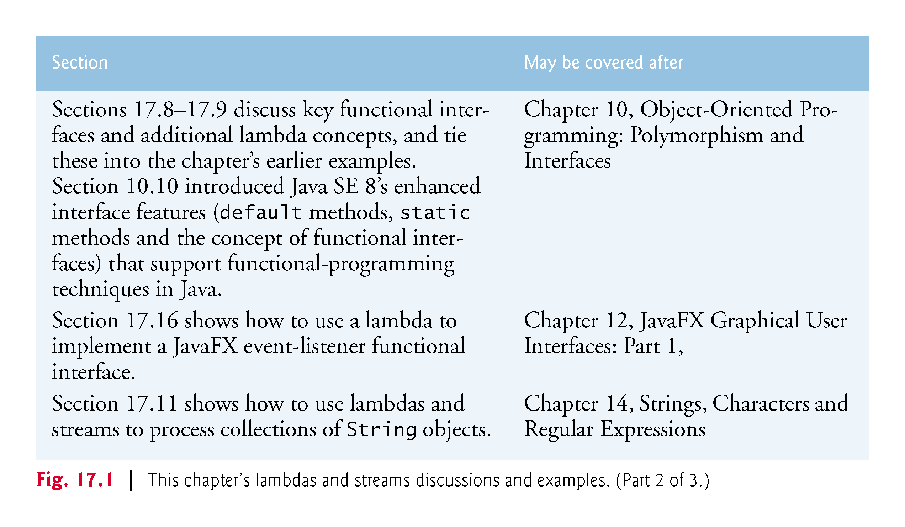

Slide 16
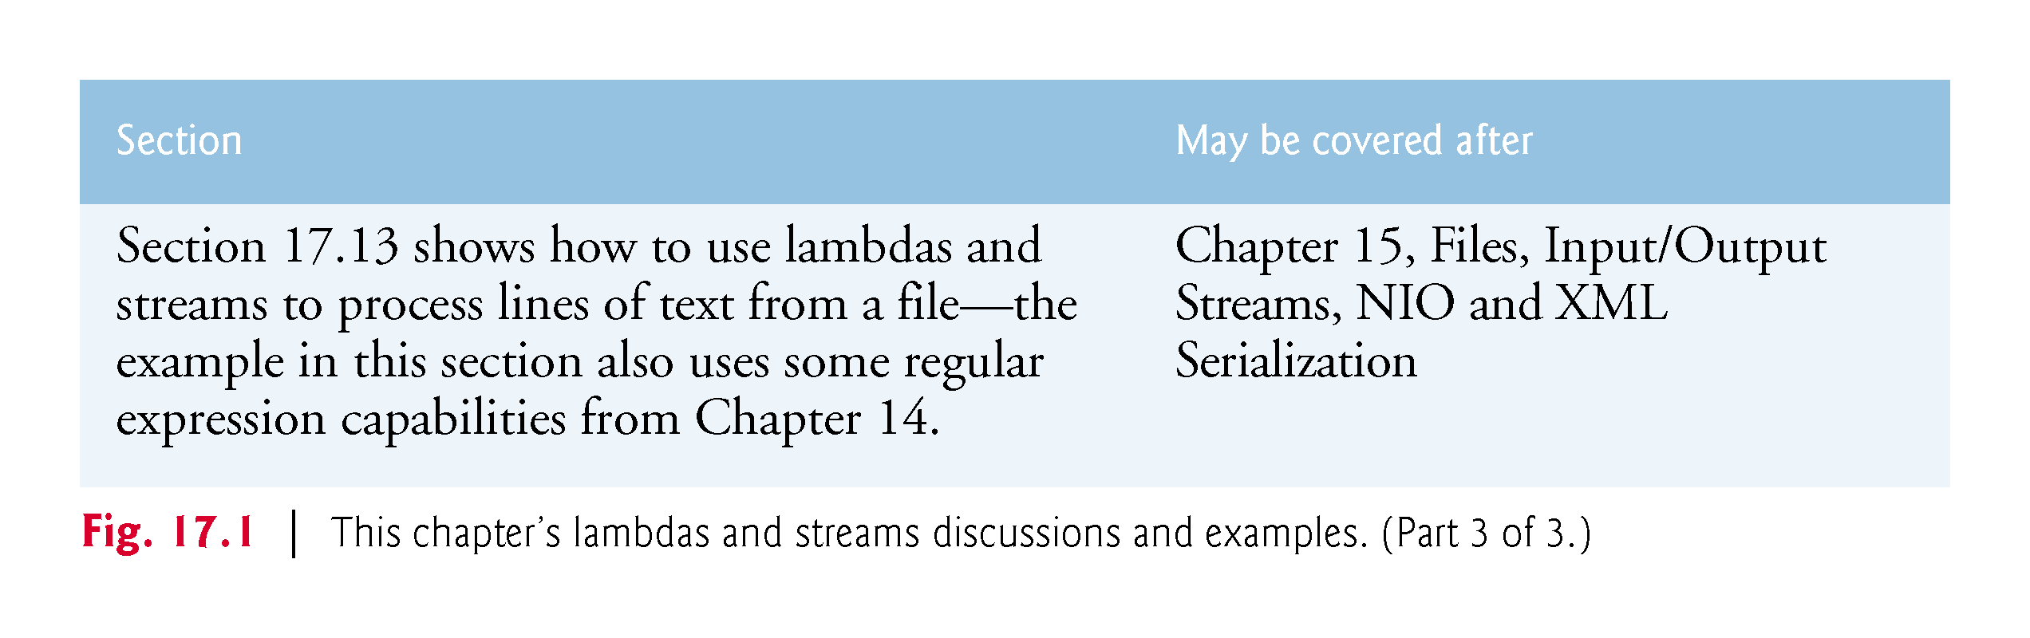

Slide 17
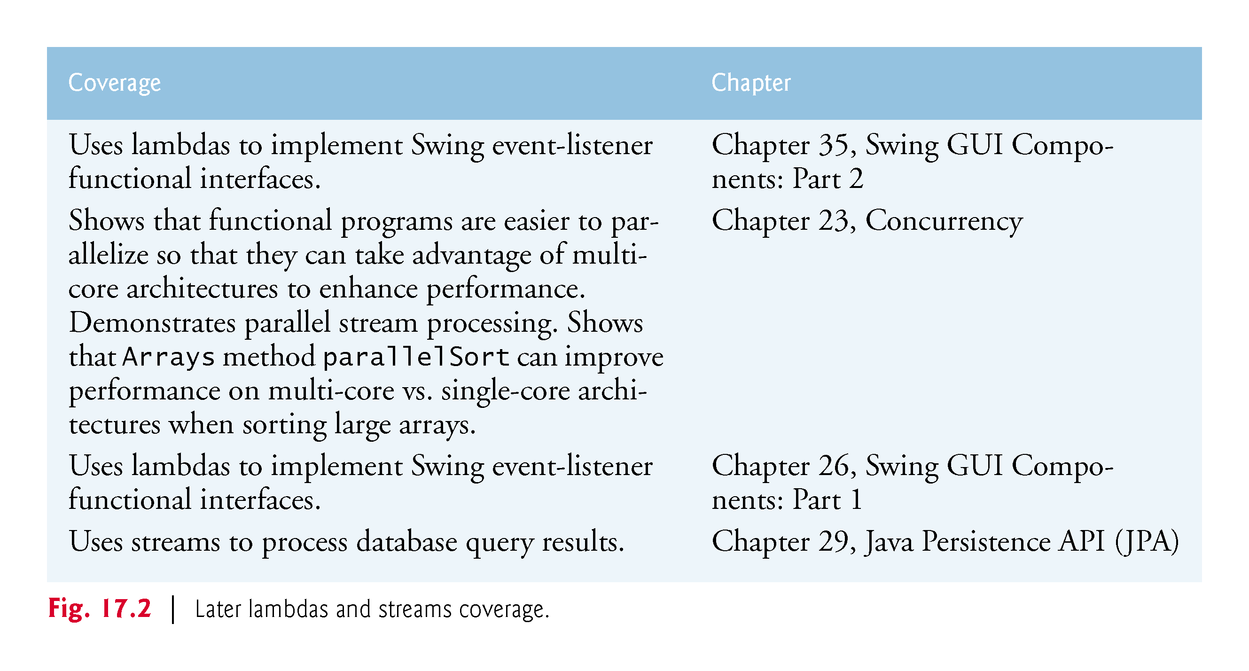

Slide 18
17.2 Streams and Reduction
[This section demonstrates how streams can be used to simplify programming tasks that you learned in Chapter 5, Control Statements: Part 2; Logical Operators.]
In counter-controlled iteration, you typically determine what you want to accomplish then specify precisely how to accomplish it using a for loop
In this section, we’ll investigate that approach, then show you a better way to accomplish the same tasks

Slide 19
17.2.1 Summing the Integers from 1 through 10 with a for Loop
Assume that what you want to accomplish is to sum the integers from 1 through 10
In Chapter 5, you saw that you can do this with a counter-controlled loop:
int total = 0; for (int number = 1; number <= 10; number++) { total += number; }
This loop specifies precisely how to perform the task—with a for statement that processes each value of control variable number from 1 through 10, adding number’s current value to total once per loop iteration and incrementing number after each addition operation
Known as external iteration, because you specify all the iteration details

Slide 20
17.2.2 External Iteration with for Is Error Prone
Let’s consider potential problems with the preceding code
As implemented, the loop requires two variables (total and number) that the code mutates (that is, modifies) during each loop iteration
Every time you write code that modifies a variable, it’s possible to introduce an error into your code
There are several opportunities for error in the preceding code

Slide 21
17.2.2 External Iteration with for Is Error Prone (cont.)
For example, you could:
initialize the variable total incorrectly
initialize the for loop’s control variable number incorrectly
use the wrong loop-continuation condition
increment control variable number incorrectly or
incorrectly add each value of number to the total
In addition, as the tasks you perform get more complicated, understanding how the code works gets in the way of understanding what it does
This makes the code harder to read, debug and modify, and more likely to contain errors

Slide 22
17.2.3 Summing with a Stream and Reduction
Let’s specify what to do rather than how to do it
In Fig. 17.3, we specify only what we want to accomplish—sum the integers from 1 through 10—then simply let Java’s IntStream class (package java.util.stream) deal with how to do it
The key to this program is the following expression in lines 9–10
IntStream.rangeClosed(1, 10) .sum()
Read as, “for the stream of int values in the range 1 through 10, calculate the sum” or more simply “sum the numbers from 1 through 10.” In this code, notice that there is neither a counter-control variable nor a variable to store the total—this is because IntStream conveniently defines rangeClosed and sum

Slide 23
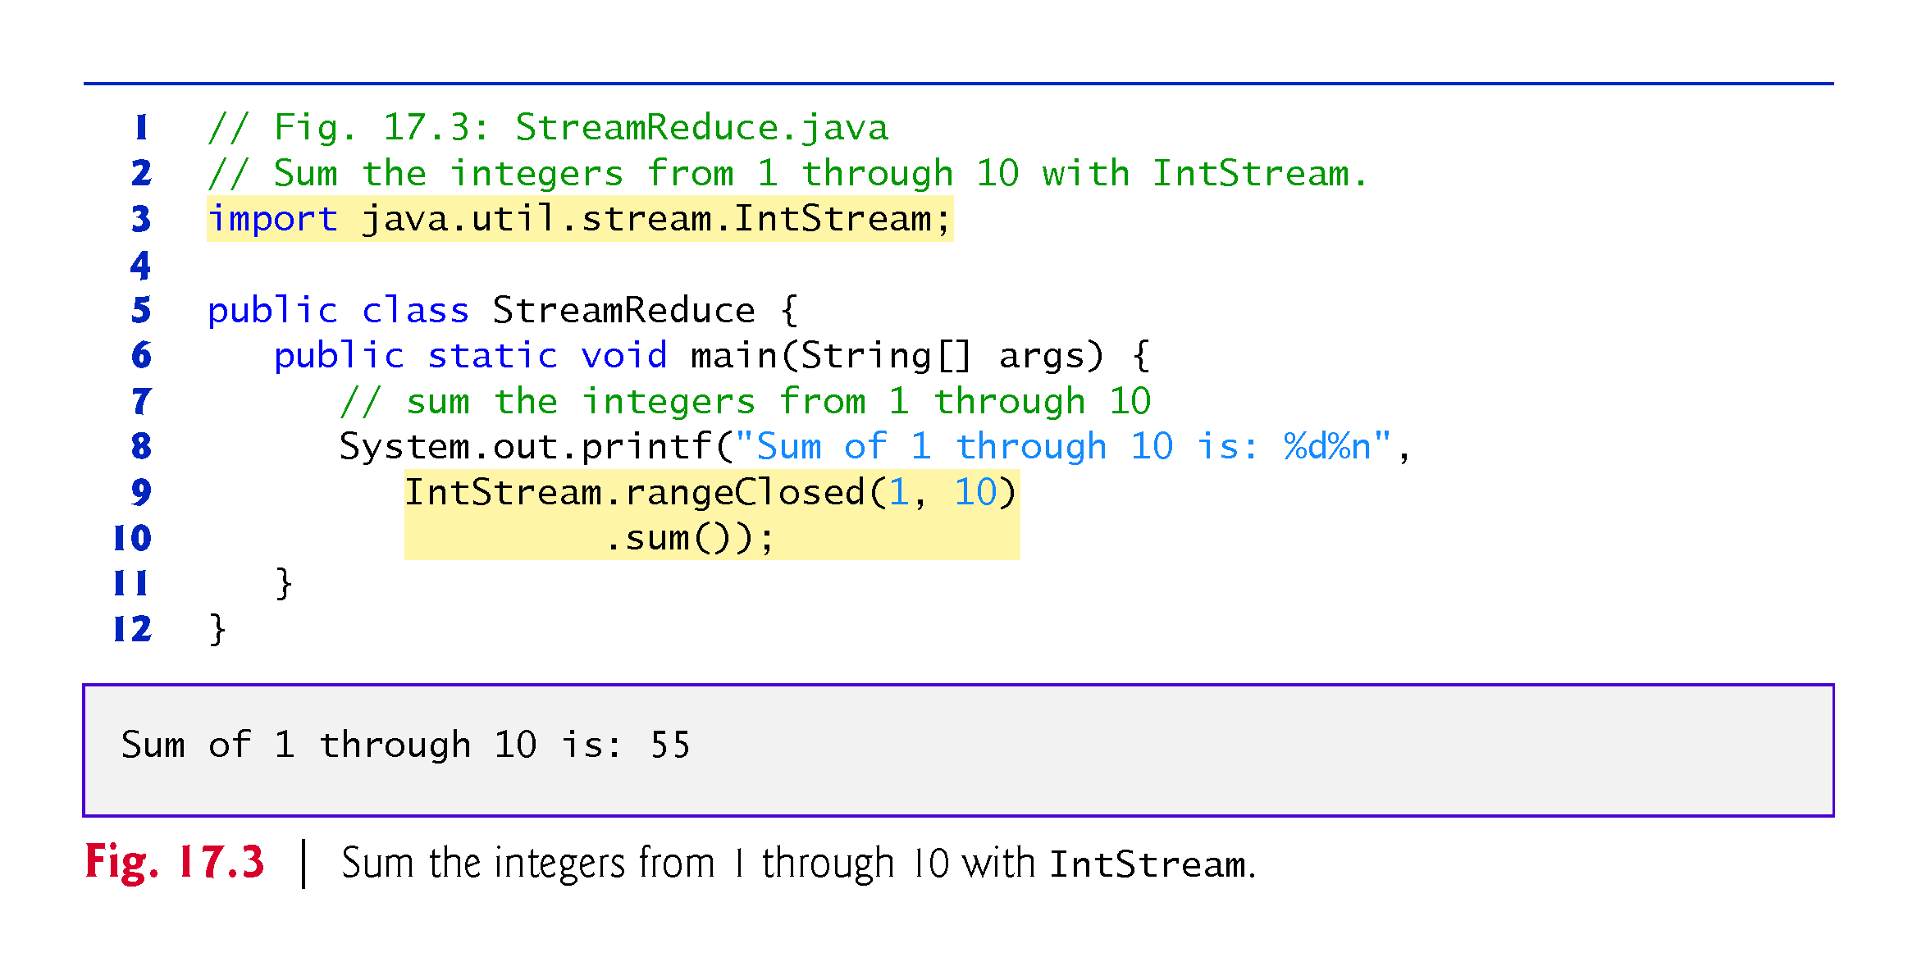

Slide 24
17.2.3 Summing with a Stream and Reduction (cont.)
Streams and Stream Pipelines
The chained method calls in lines 9–10 create a stream pipeline
A stream is a sequence of elements on which you perform tasks, and the stream pipeline moves the stream’s elements through a sequence of tasks (or processing steps)

Slide 25
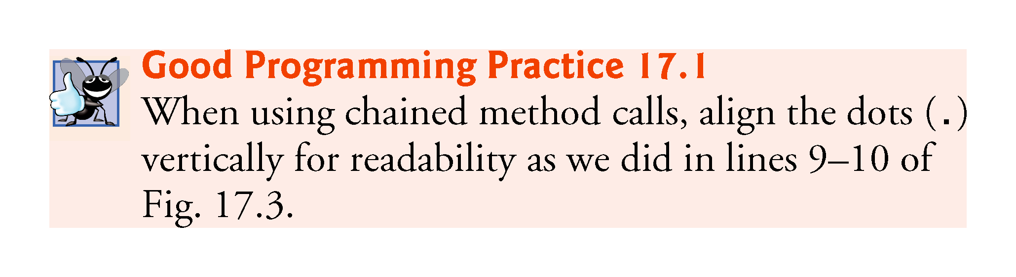

Slide 26
17.2.3 Summing with a Stream and Reduction (cont.)
Specifying the Data Source
A stream pipeline typically begins with a method call that creates the stream—this is known as the data source
Line 9 specifies the data source with the method call
IntStream.rangeClosed(1, 10)
Creates an IntStream representing an ordered range of int values
Here, we use the static method rangeClosed to create an IntStream containing the ordered sequence of int elements 1, 2, 3, 4, 5, 6, 7, 8, 9 and 10

Slide 27
17.2.3 Summing with a Stream and Reduction (cont.)
The method is named rangeClosed, because it produces a closed range of values—that is, a range of elements that includes both of the method’s arguments (1 and 10)
IntStream also provides method range, which produces a half-open range of values from its first argument up to, but not including, its second argument—for example,
IntStream.range(1, 10)
produces an IntStream containing the ordered sequence of int elements 1, 2, 3, 4, 5, 6, 7, 8 and 9, but not 10.

Slide 28
17.2.3 Summing with a Stream and Reduction (cont.)
Calculating the Sum of the IntStream’s Elements
Next, line 10 completes the stream pipeline with the processing step
.sum()
This invokes the IntStream’s sum instance method, which returns the sum of all the ints in the stream—in this case, the sum of the integers from 1 through 10
The processing step performed by method sum is known as a reduction—it reduces the stream of values to a single value (the sum)
This is one of several predefined IntStream reductions—Section 17.7 presents the predefined reductions count, min, max, average and summaryStatistics, as well as the reduce method for defining your own reductions

Slide 29
17.2.3 Summing with a Stream and Reduction (cont.)
Processing the Stream Pipeline
A terminal operation initiates a stream pipeline’s processing and produces a result
IntStream method sum is a terminal operation that produces the sum of the stream’s elements
Similarly, the reductions count, min, max, average, summaryStatistics and reduce are all terminal operations

Slide 30
17.2.4 Internal Iteration
The key to the preceding example is that it specifies what we want the task to accomplish—calculating the sum of the integers from 1 through 10—rather than how to accomplish it
This is an example of declarative programming (specifying what) vs. imperative programming (specifying how)
We broke the goal into two simple tasks—producing the numbers in a closed range (1–10) and calculating their sum
Internally, the IntStream (that is, the data source itself) already knows how to perform each of these tasks

Slide 31
17.2.4 Internal Iteration (cont.)
We did not need to specify how to iterate through the elements or declare and use any mutable variables
This is known as internal iteration, because IntStream handles all the iteration details—a key aspect of functional programming
Unlike external iteration with the for statement, the primary potential for error in line 9 of Fig. 17.3 is specifying the incorrect starting and/or ending values as arguments
Once you’re used to it, stream pipeline code also can be easier to read.

Slide 32
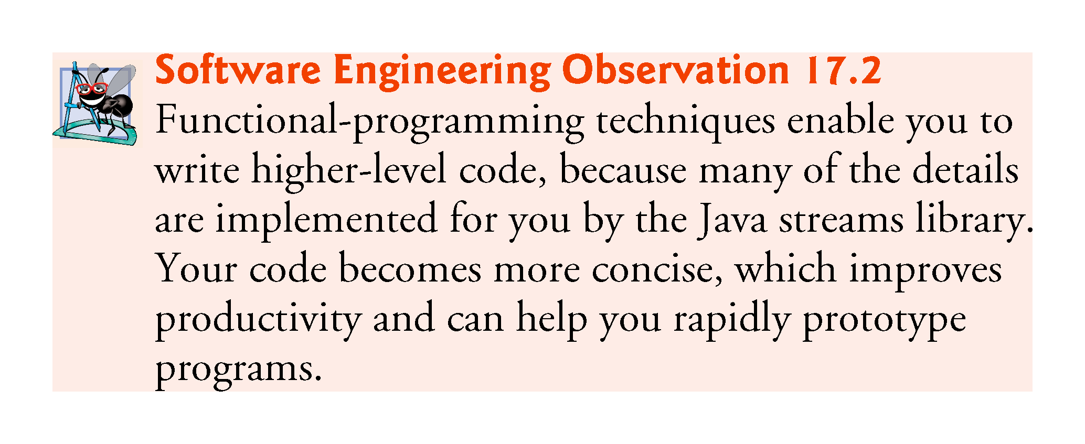

Slide 33
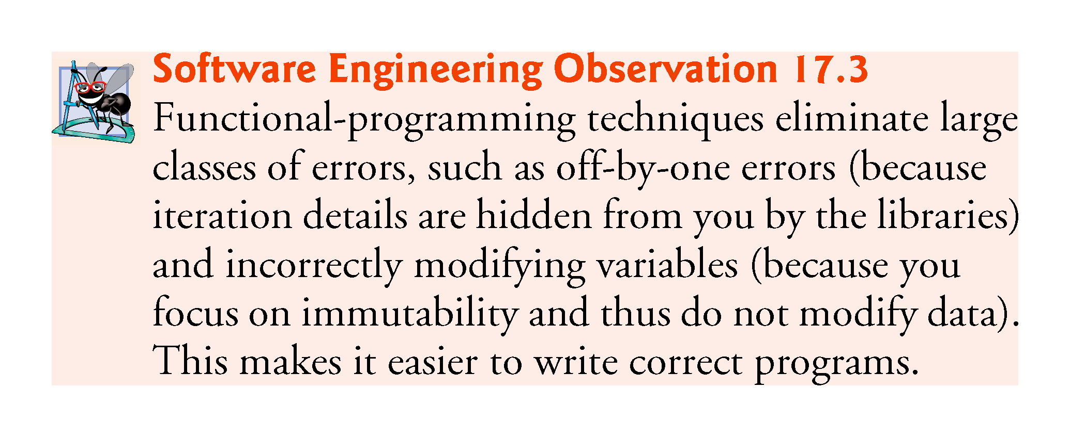

Slide 34
17.3 Mapping and Lambdas
[This section demonstrates how streams can be used to simplify programming tasks that you learned in Chapter 5.]
Most stream pipelines also contain intermediate operations that specify tasks to perform on a stream’s elements before a terminal operation produces a result.
In this example, we introduce a common intermediate operation called mapping, which transforms a stream’s elements to new values
The result is a stream with the same number of elements containing the transformation’s results
Sometimes the mapped elements are of different types from the original stream’s elements

Slide 35
17.3 Mapping and Lambdas (cont.)
To demonstrate mapping, let’s revisit the program of Fig. 5.5 in which we calculated the sum of the even integers from 2 through 20 using external iteration, as follows:
int total = 0;
for (int number = 2; number <= 20; number += 2) {
total += number;
}
Figure 17.4 reimplements this task using streams and internal iteration.

Slide 36
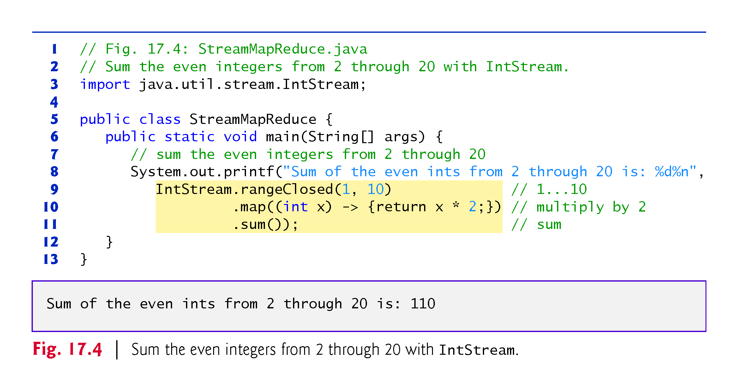

Slide 37
17.3 Mapping and Lambdas (cont.)
The stream pipeline in lines 9–11 performs three chained method calls:
Line 9 creates the data source—an IntStream containing the elements 1, 2, 3, 4, 5, 6, 7, 8, 9 and 10.
Line 10, which we’ll discuss in detail momentarily, performs a processing step that maps each element (x) in the stream to that element multiplied by 2. The result is a stream of the even integers 2, 4, 6, 8, 10, 12, 14, 16, 18 and 20.
Line 11 reduces the stream’s elements to a single value—the sum of the elements. This is the terminal operation that initiates the pipeline’s processing, then sums the stream’s elements.

Slide 38
17.3 Mapping and Lambdas (cont.)
The new feature here is the mapping operation in line 10, which in this case multiplies each stream element by 2
IntStream method map receives as its argument (line 10)
(int x) -> {return x * 2;}
You’ll see in the next section is an alternate notation for “a method that receives an int parameter x and returns that value multiplied by 2.”
For each element in the stream, map calls this method, passing to it the current stream element
The method’s return value becomes part of the new stream that map returns

Slide 39
17.3.1 Lambda Expressions
As you’ll see throughout this chapter, many intermediate and terminal stream operations receive methods as arguments
Method map’s argument in line 10
(int x) -> {return x * 2;}
is called a lambda expression (or simply a lambda), which represents an anonymous method—that is, a method without a name
Though a lambda expression’s syntax does not look like the methods you’ve seen previously, the left side does look like a method parameter list and the right side does look like a method body

Slide 40
17.3.1 Lambda Expressions (cont.)
Lambda expressions enable you to create methods that can be treated as data
You can:
pass lambdas as arguments to other methods (like map, or even other lambdas)
assign lambda expressions to variables for later use and
return lambda expressions from methods.
You’ll see that these are powerful capabilities

Slide 41
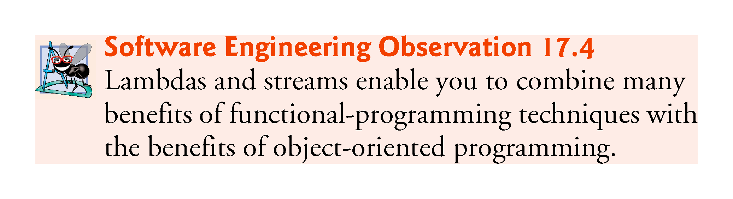

Slide 42
17.3.2 Lambda Syntax
A lambda consists of a parameter list followed by the arrow token (->) and a body, as in:
(parameterList) -> {statements}
Lambda in line 10 receives an int, multiplies its value by 2 and returns the result
(int x) -> {return x * 2;}
In this case, the body is a statement block that may contain statements enclosed in curly braces
The compiler infers from the lambda that it returns an int, because the parameter x is an int and the literal 2 is an int—multiplying an int by an int yields an int result
Lambdas specify parameters in a comma-separated list

Slide 43
17.3.2 Lambda Syntax (cont.)
The preceding lambda is similar to the following method but the lambda does not have a name and the compiler infers its return type
int multiplyBy2(int x) {
return x * 2;
}
There are several variations of the lambda syntax

Slide 44
17.3.2 Lambda Syntax (cont.)
Eliminating a Lambda’s Parameter Type(s)
A lambda’s parameter type(s) usually may be omitted, as in:
(x) -> {return x * 2;}
in which case, the compiler infers the parameter and return types by the lambda’s context—we’ll say more about this later
If for any reason the compiler cannot infer the parameter or return types (e.g., if there are multiple type possibilities), it generates an error.

Slide 45
17.3.2 Lambda Syntax (cont.)
Simplifying the Lambda’s Body
If the body contains only one expression, the return keyword, curly braces and semicolon may be omitted, as in:
(x) -> x * 2
In this case, the lambda implicitly returns the expression’s value

Slide 46
17.3.2 Lambda Syntax (cont.)
Simplifying the Lambda’s Parameter List
If the parameter list contains only one parameter, the parentheses may be omitted, as in:
x -> x * 2
Lambdas with Empty Parameter Lists
To define a lambda with an empty parameter list, use empty parentheses to the left of the arrow token (->), as in:
() -> System.out.println("Welcome to lambdas!")
Method References
In addition, to the preceding lambda-syntax variations, there are specialized shorthand forms of lambdas that are known as method references, which we introduce in Section 17.6.

Slide 47
17.3.3 Intermediate and Terminal Operations
In the stream pipeline shown in lines 9–11, map is an intermediate operation and sum is a terminal operation
Method map is one of many intermediate operations that specify tasks to perform on a stream’s elements

Slide 48
17.3.3 Intermediate and Terminal Operations (cont.)
Lazy and Eager Operations
Intermediate operations use lazy evaluation—each intermediate operation results in a new stream object, but does not perform any operations on the stream’s elements until a terminal operation is called to produce a result
This allows library developers to optimize stream-processing performance
For example, if you have 1,000,000 Person objects and you’re looking for the first one with the last name "Jones", rather than processing all 1,000,000 elements, stream processing can terminate as soon as the first matching Person object is found.

Slide 49
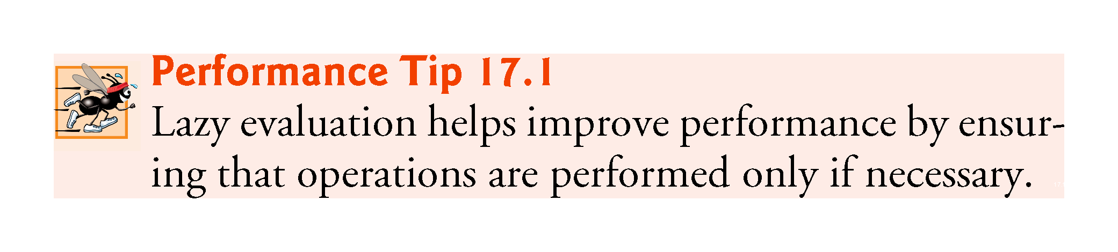

Slide 50
17.3.3 Intermediate and Terminal Operations (cont.)
Terminal operations are eager—they perform the requested operation when they’re called
We say more about lazy and eager operations as we encounter them throughout the chapter
You’ll see how lazy operations can improve performance in Section 17.5, which discusses how a stream pipeline’s intermediate operations are applied to each stream element
Figures 17.5 and 17.6 show some common intermediate and terminal operations, respectively

Slide 51
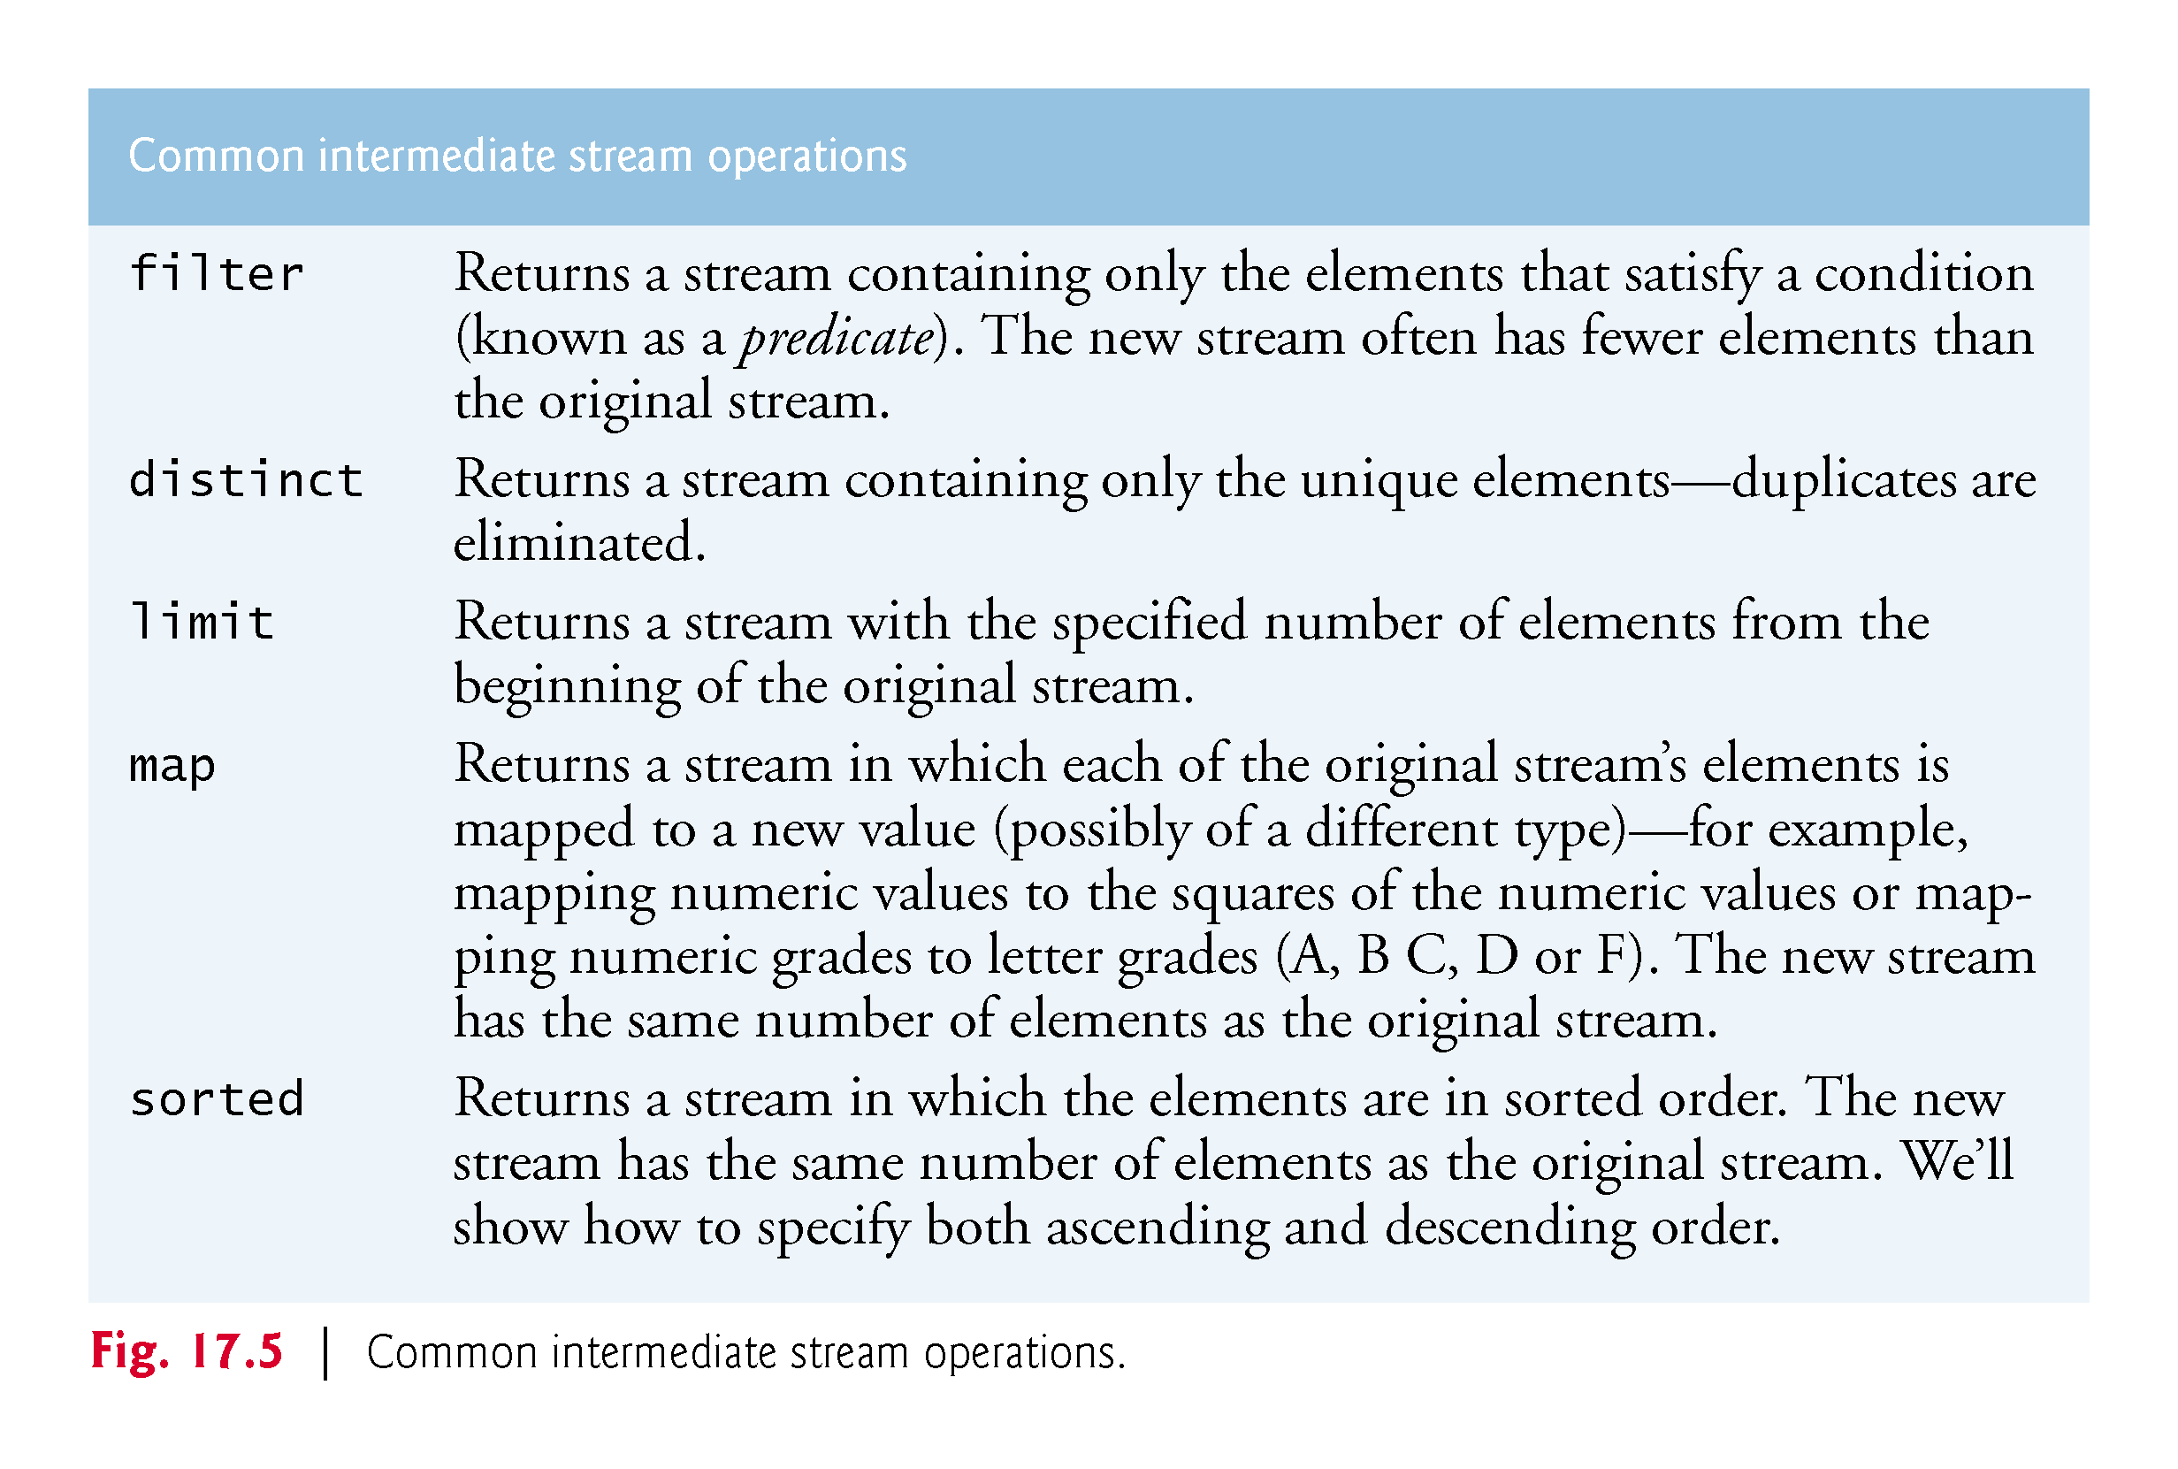

Slide 52
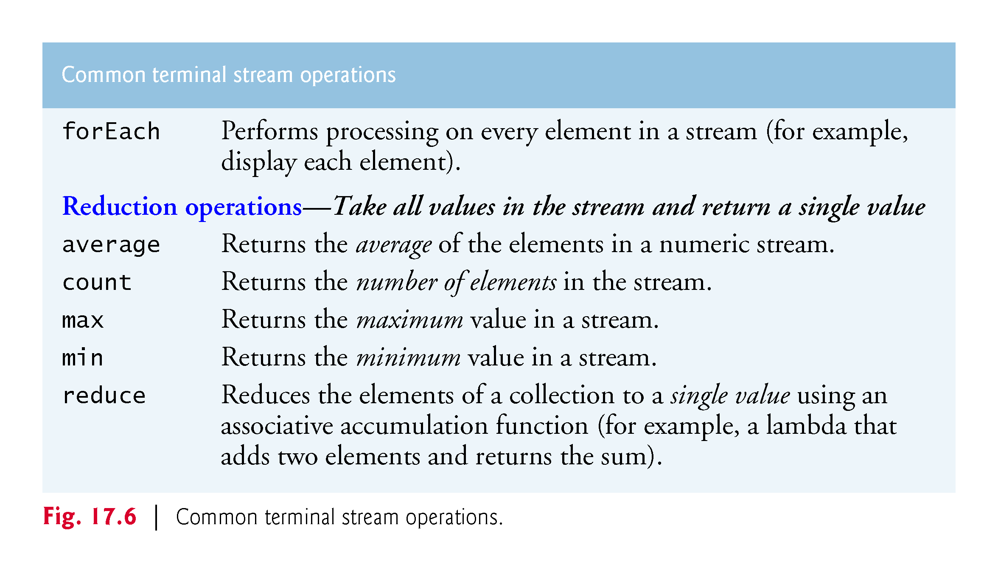

Slide 53
17.4 Filtering
[This section demonstrates how streams can be used to simplify programming tasks that you learned in Chapter 5]
Another common intermediate stream operation is filtering elements to select those that match a condition—known as a predicate
For example, the following code selects the even integers in the range 1–10, multiplies each by 3 and sums the results:
int total = 0; for (int x = 1; x <= 10; x++) { if (x % 2 == 0) { // if x is even total += x * 3; } }
Figure 17.7 reimplements this loop using streams

Slide 54
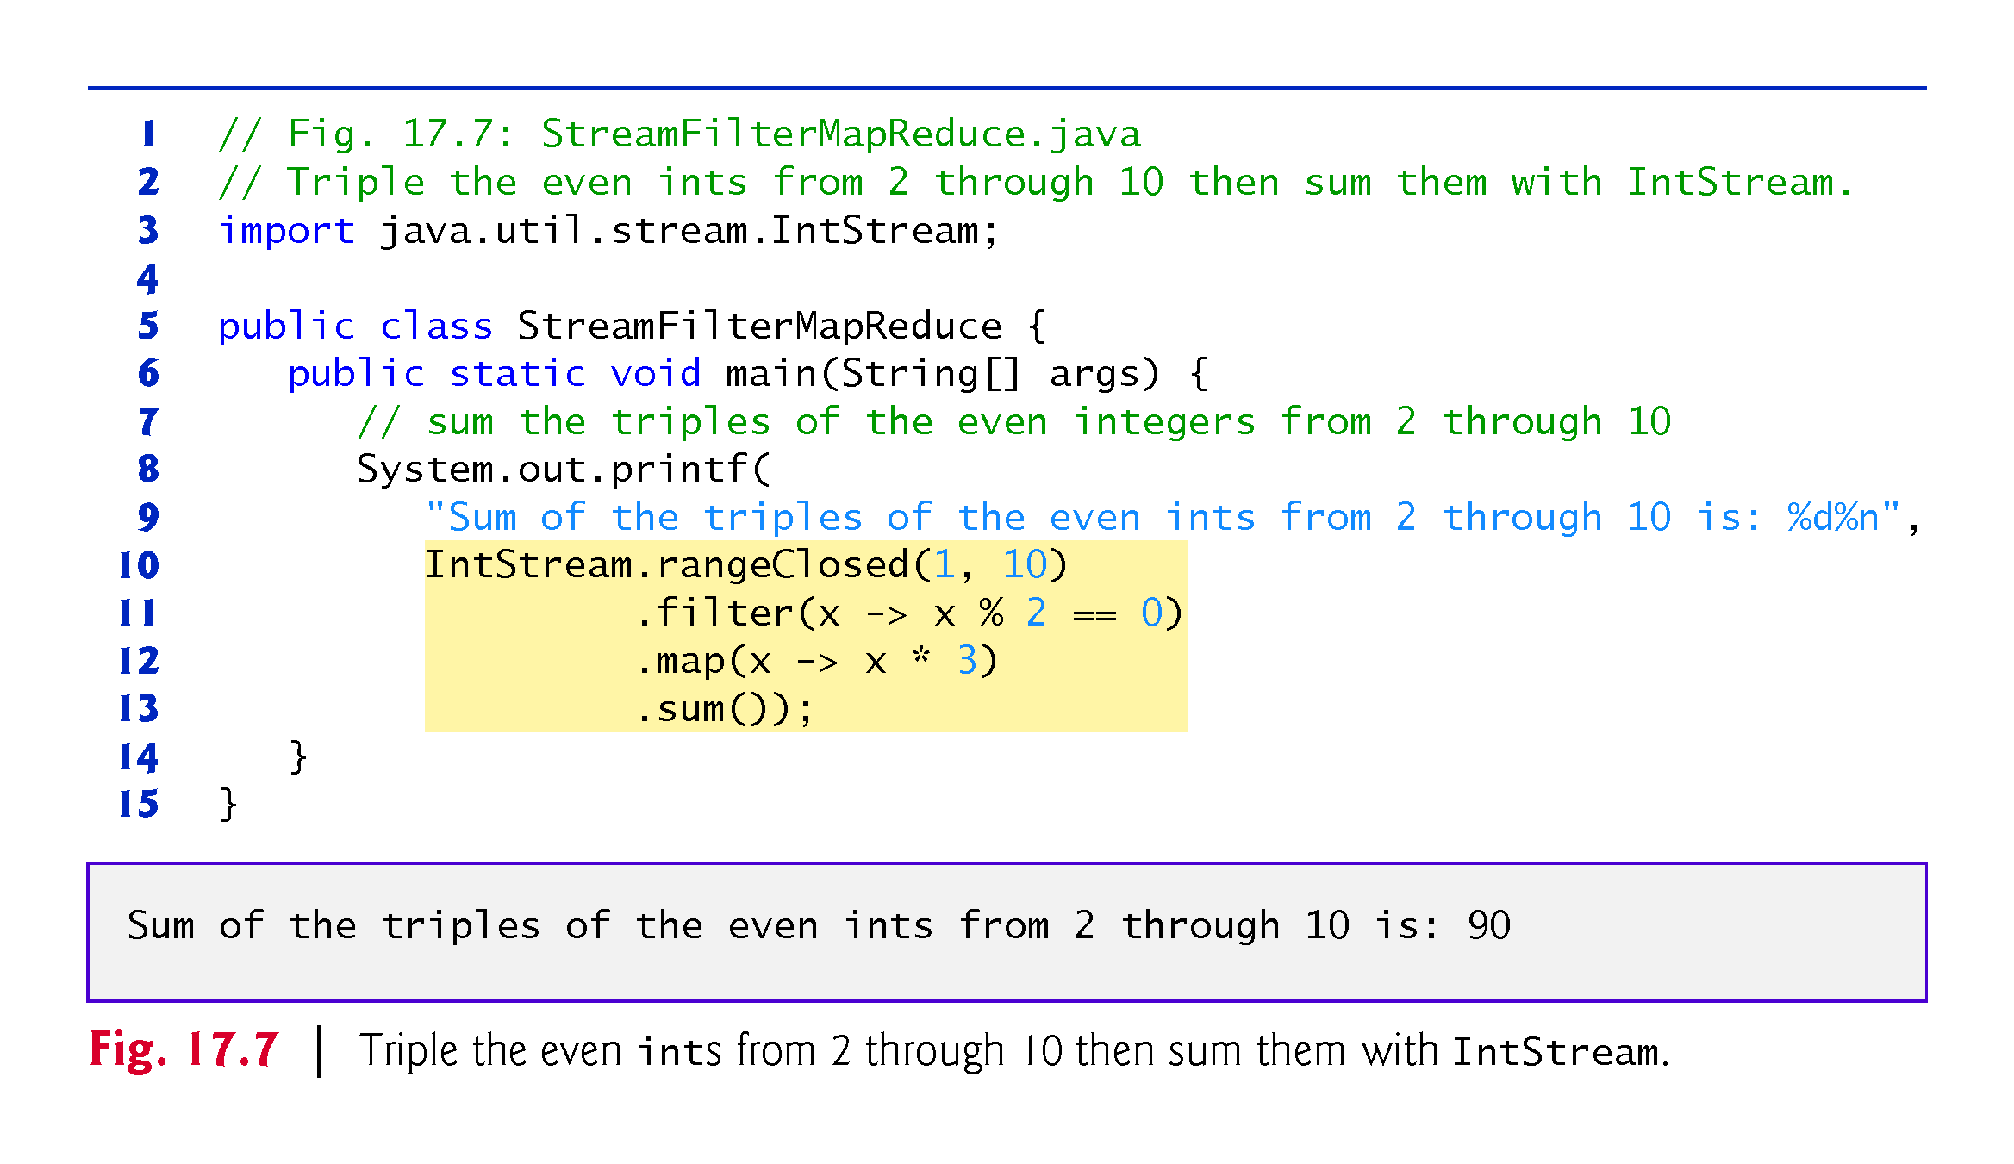

Slide 55
17.4 Filtering (cont.)
The stream pipeline in lines 10–13 performs four chained method calls:
Line 10 creates the data source—an IntStream for the closed range 1 through 10.
Line 11, which we’ll discuss in detail momentarily, filters the stream’s elements by selecting only the elements that are divisible by 2 (that is, the even integers), producing a stream of the even integers from 2, 4, 6, 8 and 10.
Line 12 maps each element (x) in the stream to that element times 3, producing a stream of the even integers from 6, 12, 18, 24 and 30.
Line 13 reduces the stream to the sum of its elements (90).
The new feature here is the filtering operation in line 11

Slide 56
17.4 Filtering (cont.)
IntStream method filter receives as its argument a method that takes one parameter and returns a boolean result
If the result is true for a given element, that element is included in the resulting stream
The lambda in line 11 determines whether its int argument is divisible by 2 (that is, the remainder after dividing by 2 is 0) and, if so, returns true; otherwise, the lambda returns false
x -> x % 2 == 0
For each element in the stream, filter calls the method that it receives as an argument, passing to the method the current stream element
If the method’s return value is true, the corresponding element becomes part of the intermediate stream that filter returns

Slide 57
17.4 Filtering (cont.)
Line 11 creates an intermediate stream representing only the elements that are divisible by 2
Line 12 uses map to create an intermediate stream representing the even integers (2, 4, 6, 8 and 10) that are multiplied by 3 (6, 12, 18, 24 and 30)
Line 13 initiates the stream processing with a call to the terminal operation sum
The combined processing steps are applied to each element, then sum returns the total of the elements that remain in the stream

Slide 58
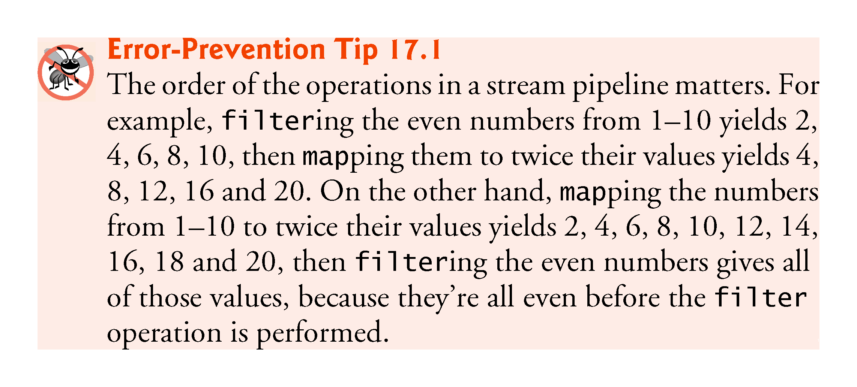

Slide 59
17.4 Filtering (cont.)
The stream pipeline shown in this example could have been implemented by using only map and sum
Exercise 17.18 asks you to eliminate the filter operation.

Slide 60
17.5 How Elements Move Through Stream Pipelines
Each new stream is simply an object representing the processing steps that have been specified to that point in the pipeline
Chaining intermediate-operation method calls adds to the set of processing steps to perform on each stream element
The last stream object in the stream pipeline contains all the processing steps to perform on each stream element.

Slide 61
17.5 How Elements Move Through Stream Pipelines (cont.)
When you initiate a stream pipeline with a terminal operation, the intermediate operations’ processing steps are applied for a given stream element before they are applied to the next stream element
So the stream pipeline in Fig. 17.7 operates as follows:
For each element
If the element is an even integer
Multiply the element by 3 and add the result to the total

Slide 62
17.5 How Elements Move Through Stream Pipelines (cont.)
Consider a modified version of Fig. 17.7’s stream pipeline in which each lambda displays the intermediate operation’s name and the current stream element’s value:
IntStream.rangeClosed(1, 10)
.filter(
x -> {
System.out.printf("%nfilter: %d%n", x);
return x % 2 == 0;
})
.map(
x -> {
System.out.println("map: " + x);
return x * 3;
})
.sum()

Slide 63
17.5 How Elements Move Through Stream Pipelines (cont.)
The modified pipeline’s output (we added the comments) shows that each even integer’s map step is applied before the next stream element’s filter step:
filter: 1 // odd so no map step is performed for this element
filter: 2 // even so a map step is performed next
map: 2
filter: 3 // odd so no map step is performed for this element
filter: 4 // even so a map step is performed next
map: 4
filter: 5 // odd so no map step is performed for this element

Slide 64
17.5 How Elements Move Through Stream Pipelines (cont.)
filter: 6 // even so a map step is performed next
map: 6
filter: 7 // odd so no map step is performed for this element
filter: 8 // even so a map step is performed next
map: 8
filter: 9 // odd so no map step is performed for this element
filter: 10 // even so a map step is performed next
map: 10

Slide 65
17.5 How Elements Move Through Stream Pipelines (cont.)
For the odd elements, the map step was not performed
When a filter step returns false, the element’s remaining processing steps are ignored because that element is not included in the results
(This version of Fig. 17.7 is located in a subfolder with that example.)

Slide 66
17.6 Method References
[This section demonstrates how streams can be used to simplify programming tasks that you learned in Chapter 6, Methods: A Deeper Look.]
For a lambda that simply calls another method, you can replace the lambda with that method’s name—known as a method reference
The compiler converts a method reference into an appropriate lambda expression
Like Fig. 6.6, Fig. 17.8 uses Secure-Random to obtain random numbers in the range 1–6
The program uses streams to create the random values and method references to help display the results
We walk through the code in Sections 17.6.1–17.6.4

Slide 67
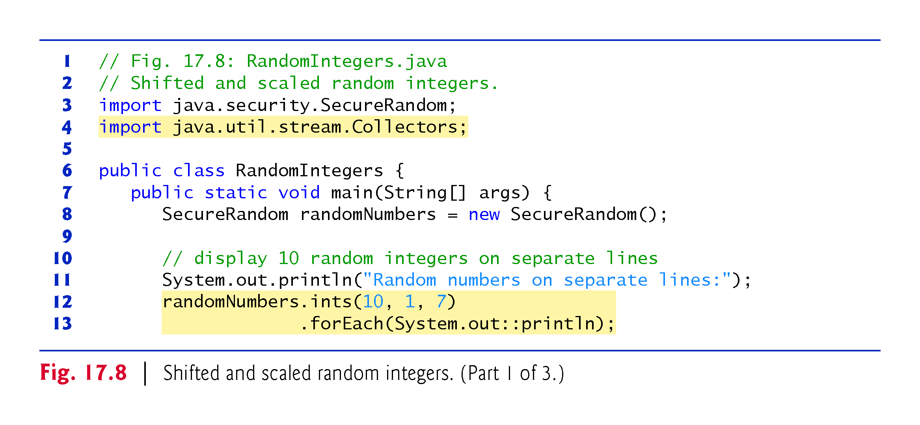

Slide 68
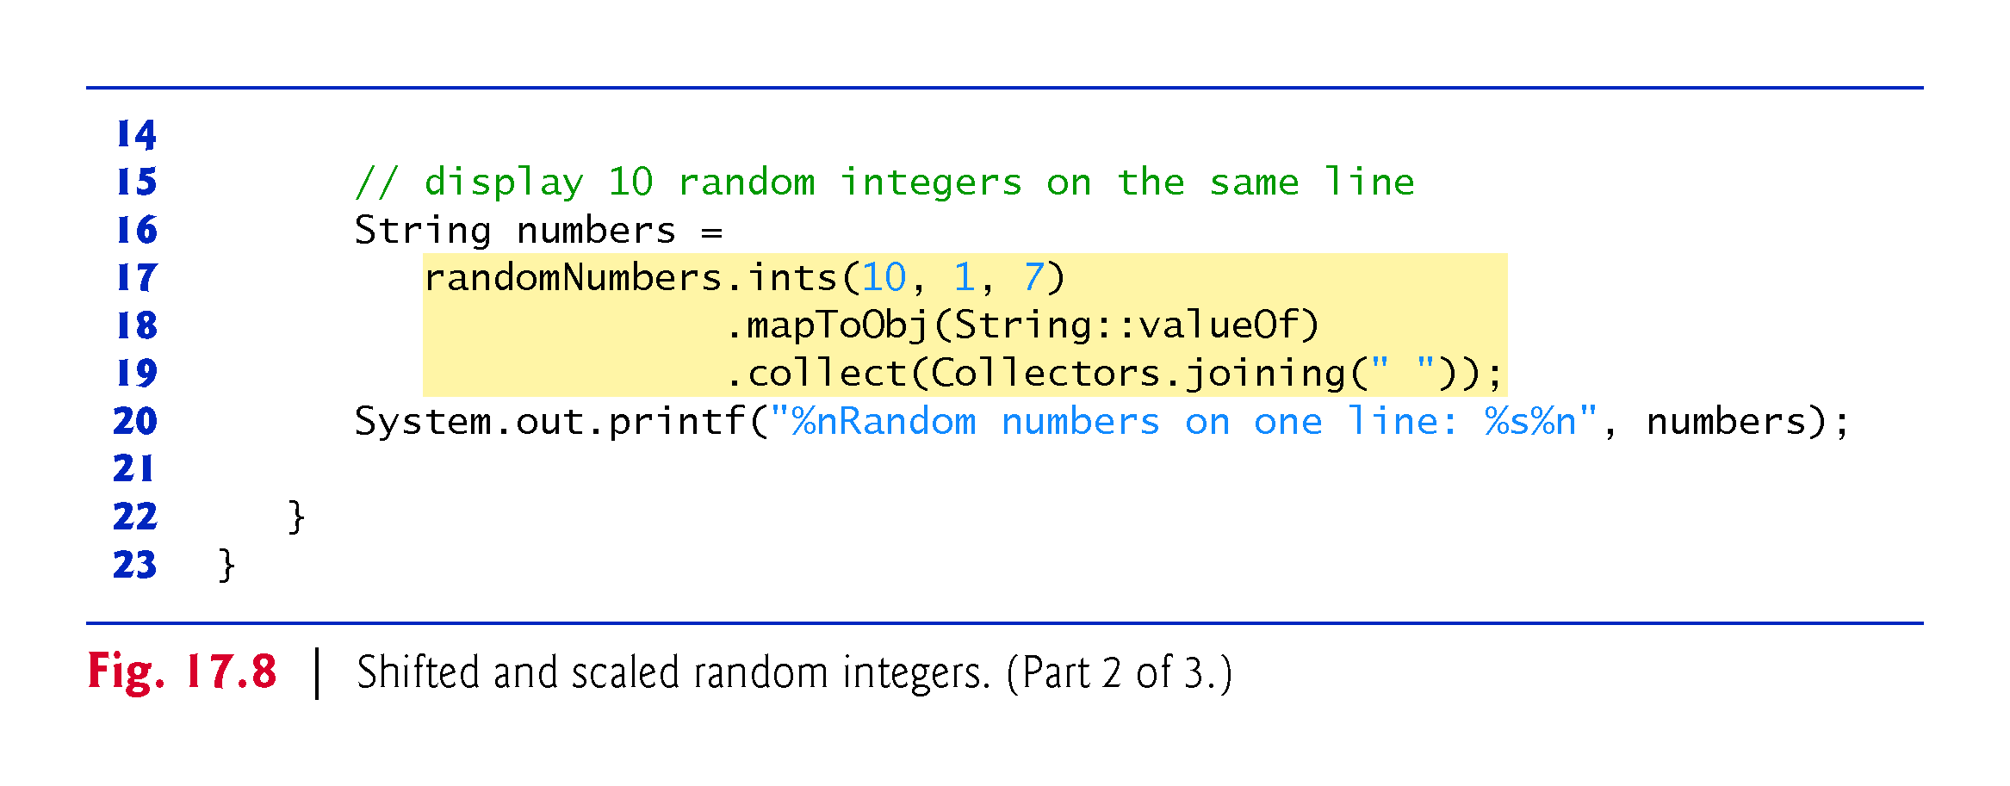

Slide 69
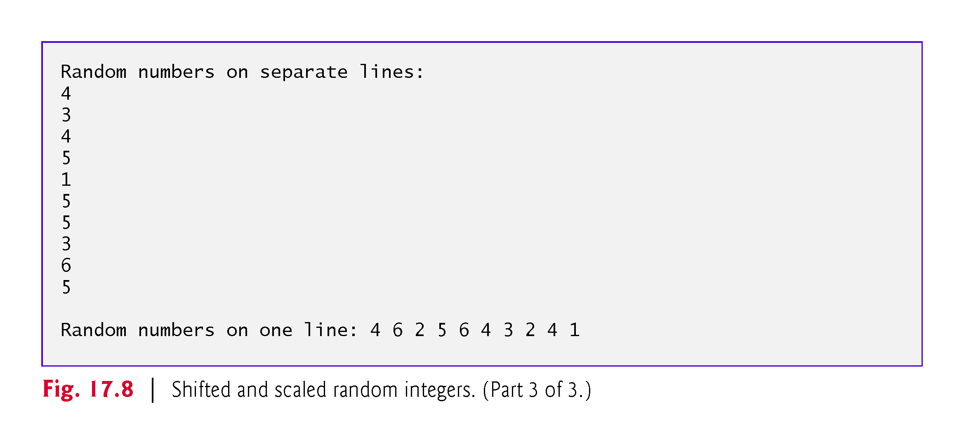

Slide 70
17.6.1 Creating an IntStream of Random Values
Class SecureRandom’s ints method returns an IntStream of random numbers
randomNumbers.ints(10, 1, 7)
creates an IntStream data source with the specified number of random int values (10) in the range starting with the first argument (1) up to, but not including, the second argument (7)
So, line 12 produces an IntStream of 10 random integers in the range 1–6.

Slide 71
17.6.2 Performing a Task on Each Stream Element with forEach and a Method Reference
Next, line 13 of the stream pipeline uses IntStream method forEach (a terminal- operation) to perform a task on each stream element
Method forEach receives as its argument a method that takes one parameter and performs a task using the parameter’s value
The argument to forEach in this case is a method reference—a shorthand notation for a lambda that calls the specified method
System.out::println

Slide 72
17.6.2 Performing a Task on Each Stream Element with forEach and a Method Reference (cont._
A method reference of the following form is a bound instance method reference—“bound” means the specific object to the left of :: (System.out) must be used to call the instance method to the right of :: (println)
objectName::instanceMethodName
The compiler converts System.out::println into a one-parameter lambda like the following that passes the lambda’s argument to the System.out object’s println instance method
x -> System.out.println(x)
The stream pipeline of lines 12–13 is equivalent to the following for loop:
for (int i = 1; i <= 10; i++) {
System.out.println(1 + randomNumbers.nextInt(6));
}

Slide 73
17.6.3 Mapping Integers to String Objects with mapToObj
The stream pipeline in lines 16–19
String numbers =
randomNumbers.ints(10, 1, 7)
.mapToObj(String::valueOf)
.collect(Collectors.joining(" "));
creates a String containing 10 random integers in the range 1–6 separated by spaces

Slide 74
17.6.3 Mapping Integers to String Objects with mapToObj (cont.)
The pipeline performs three chained method calls:
Line 17 creates the data source—an IntStream of 10 random integers from 1–6.
Line 18 maps each int to its String representation, resulting in an intermediate stream of Strings. The IntStream method map that we’ve used previously returns another IntStream. To map to Strings, we use instead the IntStream method mapToObj, which enables you to map from ints to a stream of reference-type elements-. Like map, mapToObject expects a one-parameter method that returns a result. In this example, mapToObj’s argument is a static method reference of the form ClassName::staticMethodName. The compiler converts String::valueOf (which returns its argument’s String representation) into a one-parameter lambda that calls valueOf, passing the current stream element as an argument, as in
x -> String.valueOf(x)
Line 19, which we discuss in more detail in Section 17.6.4, uses the Stream terminal operation collect to concatenate all the Strings, separating each from the next with a space. Method collect is a form of reduction because it returns one object—in this case, a String.
Line 20 then displays the resulting String.

Slide 75
17.6.4 Concatenating Strings with collect
Consider line 19 of Fig. 17.8
Stream terminal operation collect uses a collector to gather the stream’s elements into a single object—often a collection
Similar to a reduction, but collect returns an object containing the stream’s elements, whereas reduce- returns a single value of the stream’s element type
In this example, we use a predefined collector returned by the static Collectors method joining
This collector creates a concatenated String representation of the stream’s elements, appending each element to the String separated from the previous element by the joining method’s argument (in this case, a space)
Method collect then returns the resulting String
We discuss other collectors throughout this chapter

Slide 76
17.7 IntStream Operations
[This section demonstrates how lambdas and streams can be used to simplify programming tasks like those you learned in Chapter 7.]
Figure 17.9 demonstrates additional IntStream operations on streams created from arrays
The IntStream techniques shown in this and the prior examples also apply to LongStreams and DoubleStreams for long and double values, respectively
We walk through the code in Sections 17.7.1–17.7.4

Slide 77
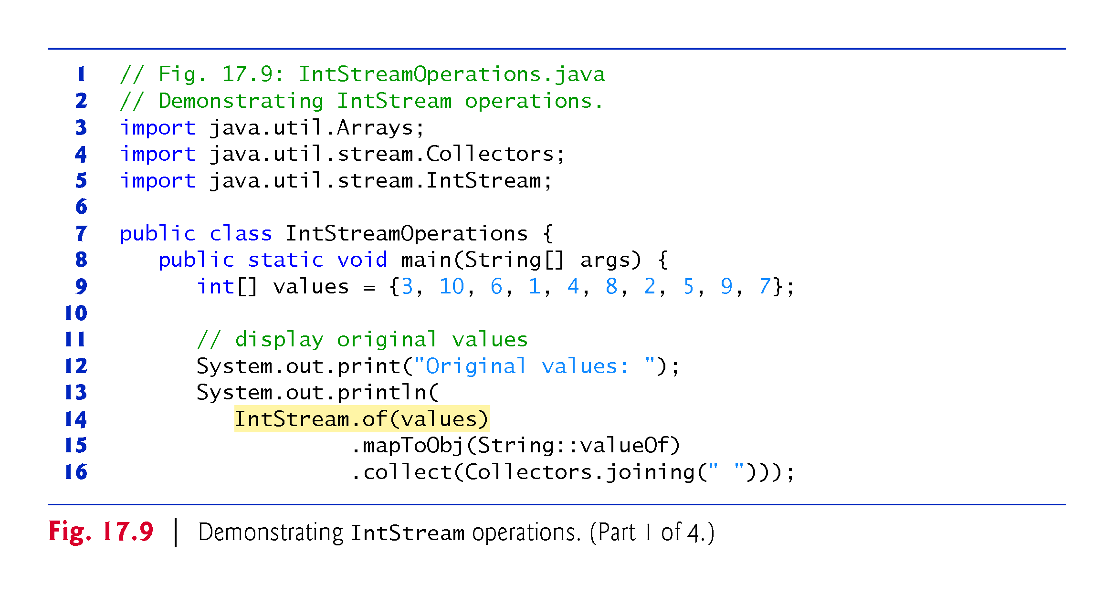

Slide 78
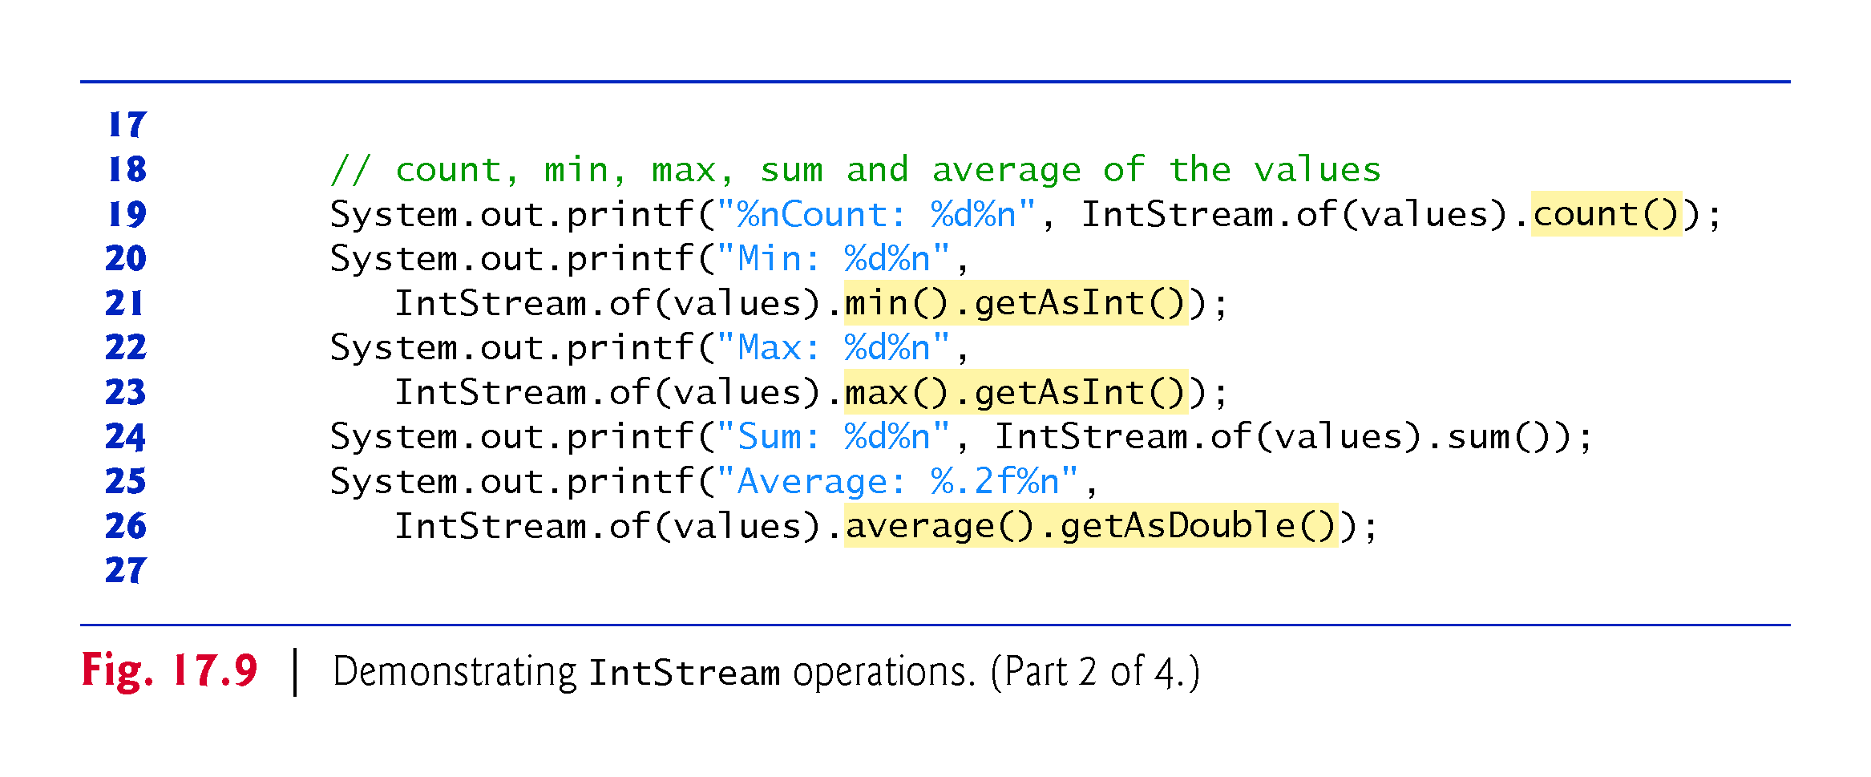

Slide 79
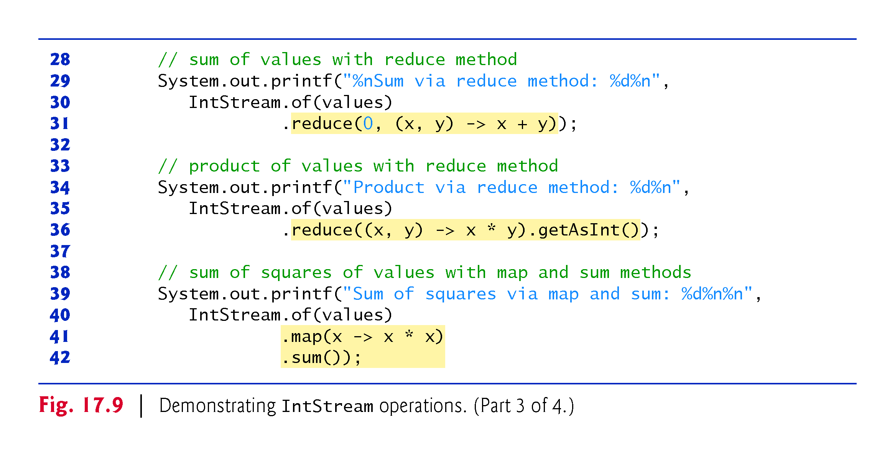

Slide 80
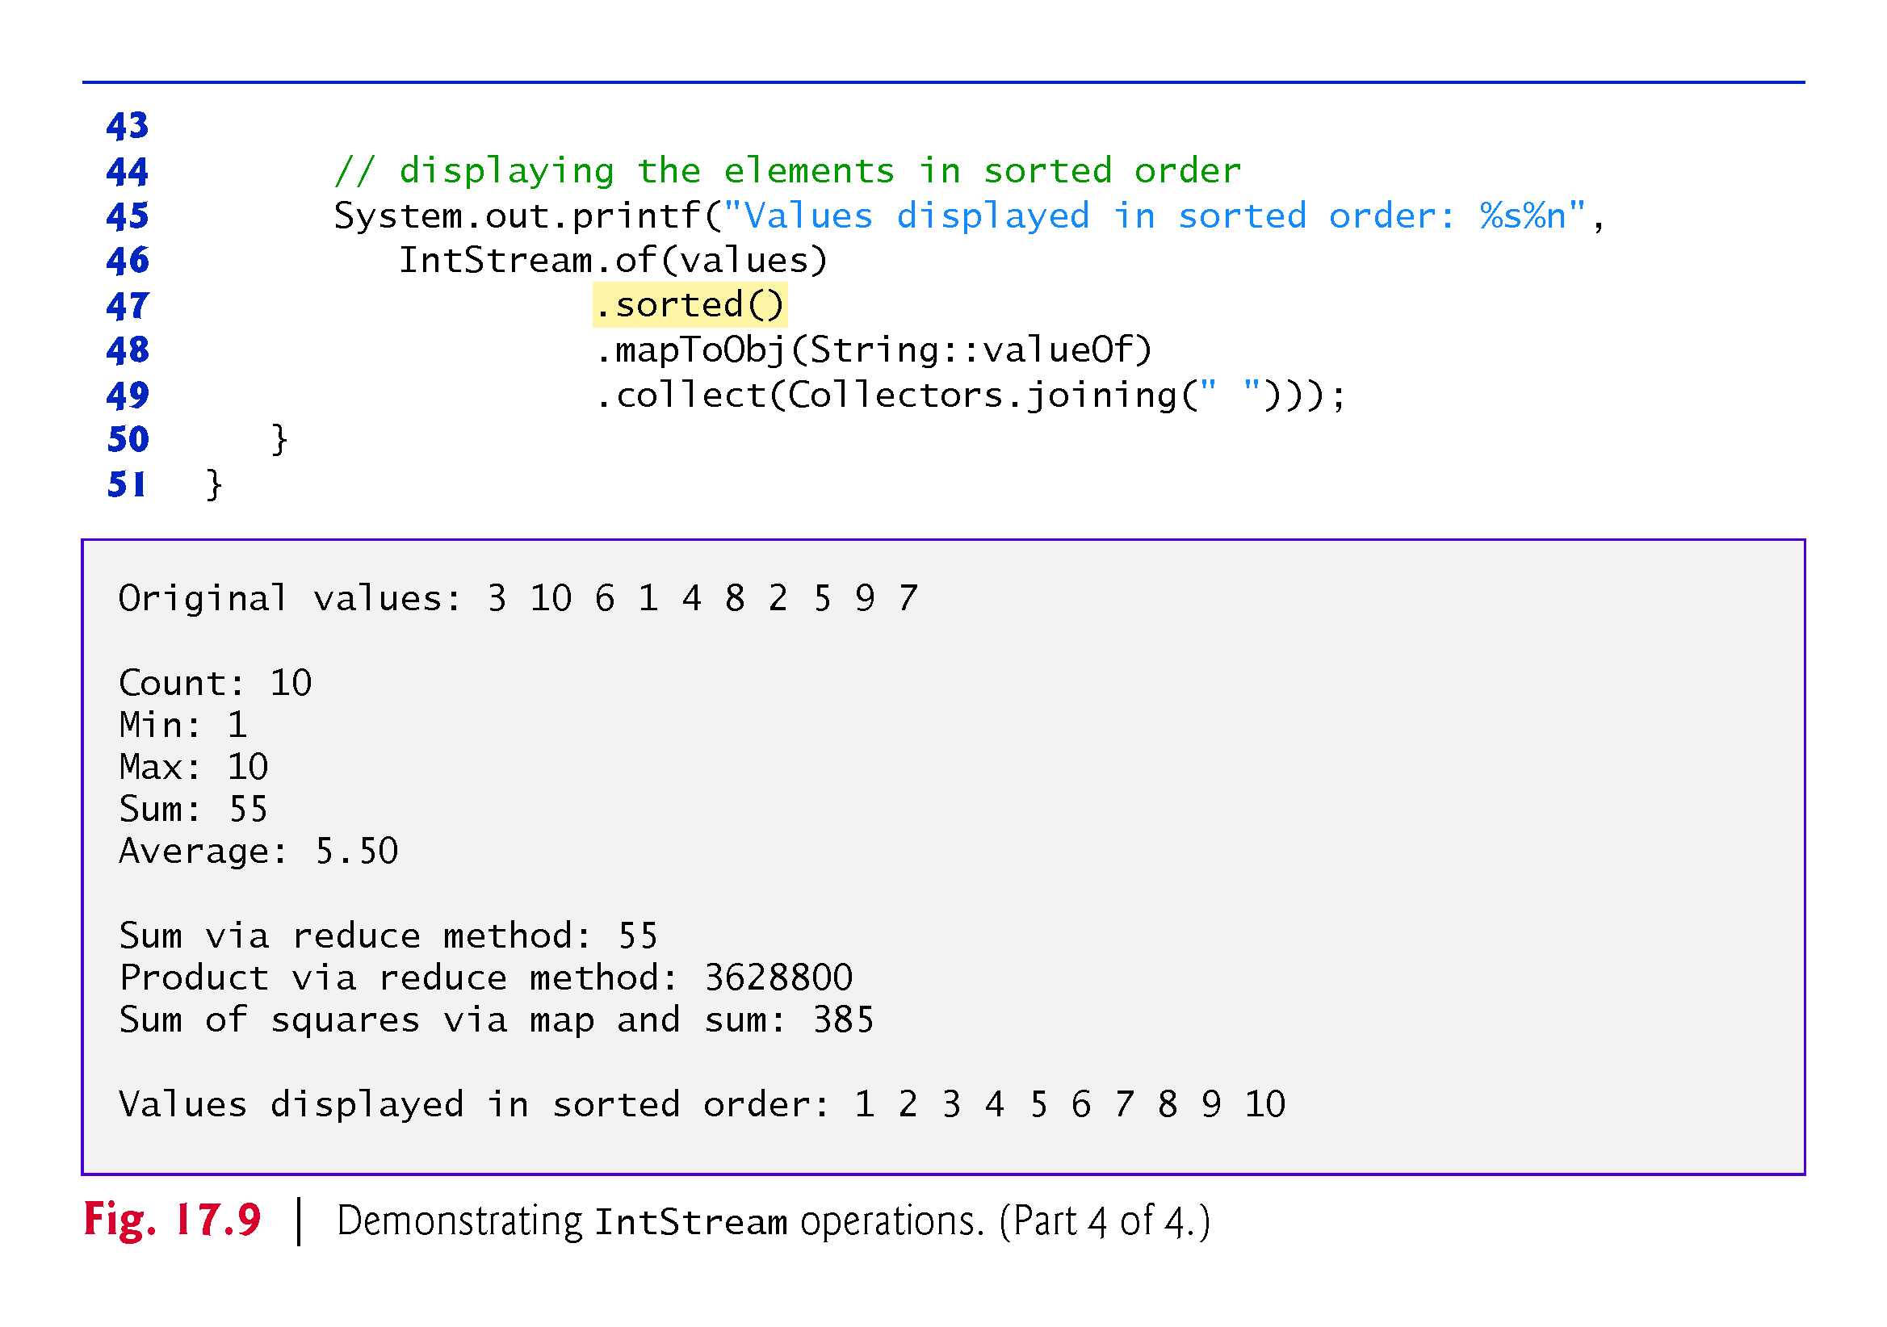

Slide 81
17.7.1 Creating an IntStream and Displaying Its Values
IntStream static method of (line 14) receives an int array argument and returns an IntStream for processing the array’s values
The stream pipeline in lines 14–16
IntStream.of(values)
.mapToObj(String::valueOf)
.collect(Collectors.joining(" ")));
displays the stream’s elements
First, line 14 creates an IntStream for the values array, then lines 15–16 use the mapToObj and collect methods as shown Fig. 17.8 to obtain a String representation of the stream’s elements separated by spaces

Slide 82
17.7.1 Creating an IntStream and Displaying Its Values (cont.)
This example repeatedly creates an IntStream from the array values using:
IntStream.of(values)
You might think that we could simply store the stream and reuse it
However, once a stream pipeline is processed with a terminal operation, the stream cannot be reused, because it does not maintain a copy of the original data source

Slide 83
17.7.2 Terminal Operations count, min, max, sum and average
Class IntStream provides various terminal operations for common stream reductions on streams of int values:
count (line 19) returns the number of elements in the stream.
min (line 21) returns an OptionalInt (package java.util) possibly containing the smallest int in the stream. For any stream, it’s possible that there are no elements in the stream. Returning OptionalInt enables method min to return the minimum value if the stream contains at least one element. In this example, we know the stream has 10 elements, so we call class OptionalInt’s getAsInt method to obtain the minimum value. If there were no elements, the OptionalInt would not contain an int and getAsInt would throw a NoSuchElementException. To prevent this, you can instead call method orElse, which returns the OptionalInt’s value if there is one, or the value you pass to orElse, otherwise.

Slide 84
17.7.2 Terminal Operations count, min, max, sum and average (cont.)
max (line 23) returns an OptionalInt possibly containing the largest int in the stream. Again, we call the OptionalInt’s getAsInt method to get the largest value, because we know this stream contains elements.
sum (line 24) returns the sum of all the ints in the stream.
average (line 26) returns an OptionalDouble (package java.util) possibly containing the average of the ints in the stream as a value of type double. In this example, we know the stream has elements, so we call class Optional-Double’s getAsDouble method to obtain the average. If there were no elements, the OptionalDouble would not contain the average and getAsDouble would throw a NoSuchElementException. As with OptionalInt, to prevent this exception, you can instead call method orElse, which returns the OptionalDouble’s value if there is one, or the value you pass to orElse, otherwise.

Slide 85
17.7.2 Terminal Operations count, min, max, sum and average (cont.)
Class IntStream also provides method summaryStatistics that performs the count, min, max, sum and average operations in one pass of an IntStream’s elements and returns the results as an IntSummaryStatistics object (package java.util)
Provides a significant performance boost over reprocessing an IntStream repeatedly for each individual operation
This object has methods for obtaining each result and a toString method that summarizes all the results
System.out.println(IntStream.of(values).summaryStatistics());
Produces for the array values in Fig. 17.9 IntSummaryStatistics{count=10, sum=55, min=1, average=5.500000, max=10}

Slide 86
17.7.3 Terminal Operation reduce
So far, we’ve presented various predefined IntStream reductions
You can define your own reductions via an IntStream’s reduce method—in fact, each terminal operation discussed in Section 17.7.2 is a specialized implementation of reduce
The stream pipeline in lines 30–31
IntStream.of(values)
.reduce(0, (x, y) -> x + y)
shows how to total an IntStream’s values using reduce, rather than sum

Slide 87
17.7.3 Terminal Operation reduce (cont.)
The first argument to reduce (0) is the operation’s identity value—a value that, when combined with any stream element (using the lambda in the reduce’s second argument), produces the element’s original value
For example, when summing the elements, the identity value is 0, because any int value added to 0 results in the original int value
Similarly, when getting the product of the elements the identity value is 1, because any int value multiplied by 1 results in the original int value.
Method reduce’s second argument is a method that receives two int values (representing the left and right operands of a binary operator), performs a calculation with the values and returns the result
A lambda with two or more parameters must enclose them in parentheses

Slide 88
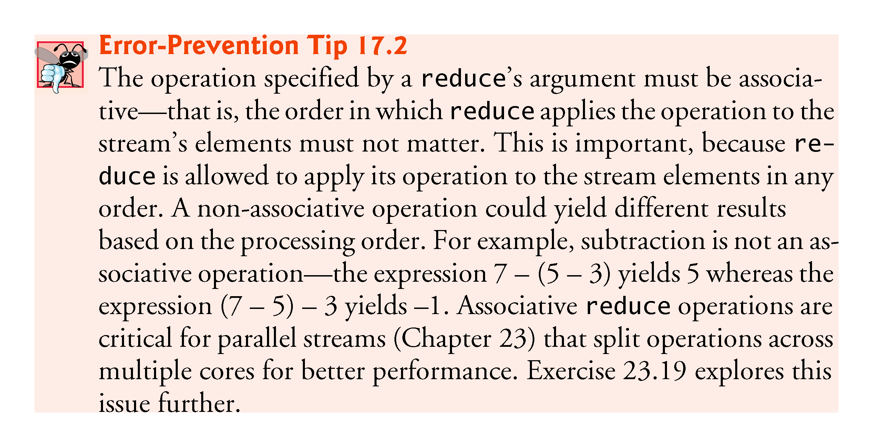

Slide 89
17.7.3 Terminal Operation reduce (cont.)
Based on the stream’s elements
3 10 6 1 4 8 2 5 9 7
the reduction’s evaluation proceeds as follows:
0 + 3 --> 3
3 + 10 --> 13
13 + 6 --> 19
19 + 1 --> 20
20 + 4 --> 24
24 + 8 --> 32
32 + 2 --> 34
34 + 5 --> 39
39 + 9 --> 48
48 + 7 --> 55
Notice that the first calculation uses the identity value (0) as the left operand and each subsequent calculation uses the result of the prior calculation as the left operand
The reduction process continues producing a running total of the IntStream’s values until they’ve all been used, at which point the final sum is returned.

Slide 90
17.7.3 Terminal Operation reduce (cont.)
Calculating the Product of the Values with Method reduce
The stream pipeline in lines 35–36
IntStream.of(values)
.reduce((x, y) -> x * y).getAsInt()
uses the one-argument version of method reduce, which returns an OptionalInt that, if the stream has elements, contains the product of the IntStream’s values; otherwise, the OptionalInt does not contain a result

Slide 91
17.7.3 Terminal Operation reduce (cont.)
Based on the stream’s elements
3 10 6 1 4 8 2 5 9 7
the reduction’s evaluation proceeds as follows:
3 * 10 --> 30
30 * 6 --> 180
180 * 1 --> 180
180 * 4 --> 720
720 * 8 --> 5,760
5,760 * 2 --> 11,520
11,520 * 5 --> 57,600
57,600 * 9 --> 518,400
518,400 * 7 --> 3,628,800

Slide 92
17.7.3 Terminal Operation reduce (cont.)
This process continues producing a running product of the IntStream’s values until they’ve all been used, at which point the final product is returned.
We could have used the two-parameter reduce method, as in:
IntStream.of(values)
.reduce(1, (x, y) -> x * y)
However, if the stream were empty, this version of reduce would return the identity value (1), which would not be the expected result for an empty stream

Slide 93
17.7.3 Terminal Operation reduce (cont.)
Summing the Squares of the Values
Now consider summing the squares of the stream’s elements
When implementing your stream pipelines, it’s helpful to break down the processing steps into easy-to-understand tasks
Summing the squares of the stream’s elements requires two distinct tasks:
squaring the value of each stream element
summing the resulting values.

Slide 94
17.7.3 Terminal Operation reduce (cont.)
Rather than defining this with a reduce method call, the stream pipeline in lines 40–42
IntStream.of(values)
.map(x -> x * x)
.sum());
uses the map and sum methods to compose the sum-of-squares operation
First map produces a new IntStream containing the original element’s squares, then sum totals the resulting stream’s elements.

Slide 95
17.7.4 Sorting IntStream Values
In Section 7.15, you learned how to sort arrays with the sort static method of class Arrays
You also may sort the elements of a stream
The stream pipeline in lines 46–49
IntStream.of(values)
.sorted()
.mapToObj(String::valueOf)
.collect(Collectors.joining(" ")));
sorts the stream’s elements and displays each value followed by a space

Slide 96
17.7.4 Terminal Operation reduce (cont.)
IntStream intermediate operation sorted orders the elements of the stream into ascending order by default
Like filter, sorted is a lazy operation that’s performed only when a terminal operation initiates the stream pipeline’s processing

Slide 97
17.8 Functional Interfaces
[This section requires the interface concepts introduced in Sections 10.9–10.10.]
Section 10.10 introduced Java SE 8’s enhanced interface features—default methods and static methods—and discussed the concept of a functional interface—an interface that contains exactly one abstract method (and may also contain default and static methods)
Such interfaces are also known as single abstract method (SAM) interfaces
Functional interfaces are used extensively in functional-style Java programming

Slide 98
17.8 Functional Interfaces (cont.)
Functional programmers work with so-called pure functions that have referential transparency—that is, they:
depend only on their parameters
have no side-effects and
do not maintain any state.
Pure functions are methods that implement functional interfaces—typically defined as lambdas, like those you’ve seen so far in this chapter’s examples
State changes occur by passing data from method to method
No data is shared

Slide 99
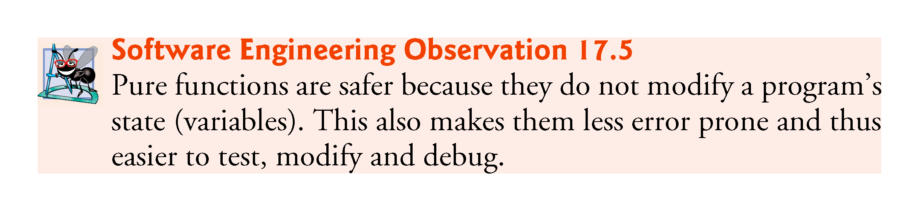

Slide 100
17.8 Functional Interfaces (cont.)
Functional Interfaces in Package java.util.function
Package java.util.function contains several functional interfaces
Figure 17.10 shows the six basic generic functional interfaces, several of which you’ve already used in this chapter’s examples
Throughout the table, T and R are generic type names that represent the type of the object on which the functional interface operates and the return type of a method, respectively

Slide 101
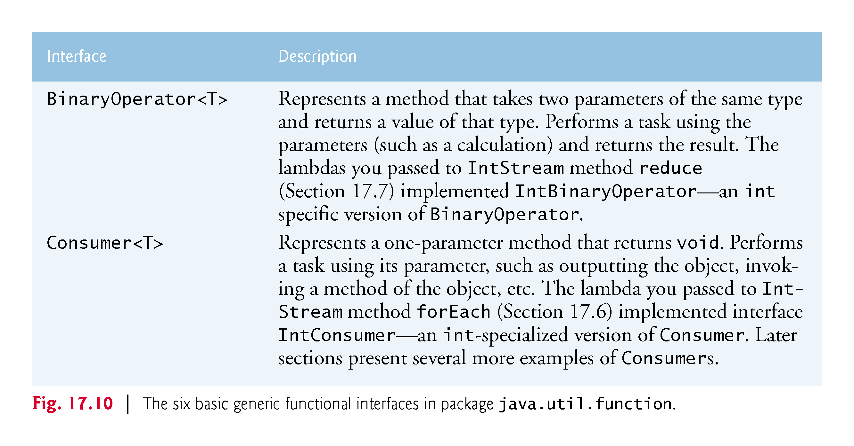

Slide 102
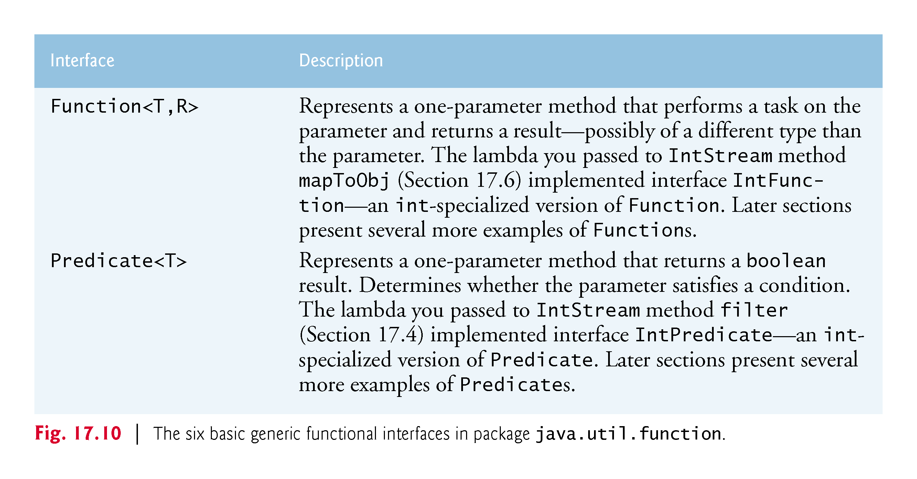

Slide 103
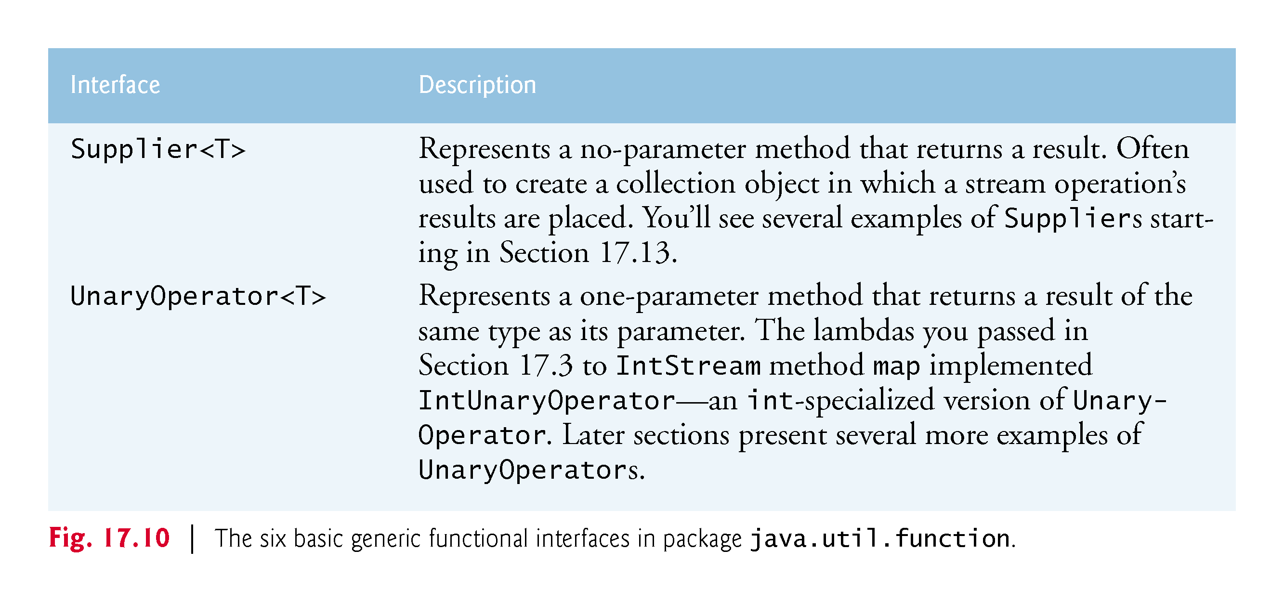

Slide 104
17.8 Functional Interfaces (cont.)
Many other functional interfaces in package java.util.function are specialized versions of those in Fig. 17.10
Most are for use with int, long and double primitive values
There are also generic customizations of Consumer, Function and Predicate for binary operations—that is, methods that take two arguments
For each IntStream method we’ve shown that receives a lambda, the method’s parameter is actually an int-specialized version of one of these interfaces

Slide 105
17.9 Lambdas: A Deeper Look
Type Inference and a Lambda’s Target Type
Lambda expressions can be used anywhere functional interfaces are expected
The Java compiler can usually infer the types of a lambda’s parameters and the type returned by a lambda from the context in which the lambda is used
This is determined by the lambda’s target type—the functional-interface type that’s expected where the lambda appears in the code
In the call to IntStream method map from Fig. 17.4 the target type is IntUnaryOperator, which represents a method that takes one int parameter and returns an int result
IntStream.rangeClosed(1, 10)
.map((int x) -> {return x * 2;})
.sum()
In this case, the lambda parameter’s type is explicitly declared to be int and the compiler infers the lambda’s return type as int, because that’s what an IntUnaryOperator requires.

Slide 106
17.9 Lambdas: A Deeper Look (cont.)
The compiler also can infer a lambda parameter’s type
For example, in the call to IntStream method filter from stream pipeline in Fig. 17.7 the target type is IntPredicate, which represents a method that takes one int parameter and returns a boolean result
IntStream.rangeClosed(1, 10)
.filter(x -> x % 2 == 0)
.map(x -> x * 3)
.sum()
In this case, the compiler infers the lambda parameter x’s type as int, because that’s what an IntPredicate requires
We generally let the compiler infer the lambda parameter’s type in our examples

Slide 107
17.9 Lambdas: A Deeper Look (cont.)
Scope and Lambdas
Unlike methods, lambdas do not have their own scope
So, for example, you cannot shadow an enclosing method’s local variables with lambda parameters that have the same names
A compilaton error occurs in this case, because the method’s local variables and the lambda parameters are in the same scope

Slide 108
17.9 Lambdas: A Deeper Look (cont.)
Capturing Lambdas and final Local Variables
A lambda that refers to a local variable from the enclosing method (known as the lambda’s lexical scope) is a capturing lambda
For such a lambda, the compiler captures the local variable’s value and stores it with the lambda to ensure that the lambda can use the value when the lambda eventually executes
This is important, because you can pass a lambda to another method that executes the lambda after its lexical scope no longer exists

Slide 109
17.9 Lambdas: A Deeper Look (cont.)
Any local variable that a lambda references in its lexical scope must be final
Such a variable either can be explicitly declared final or it can be effectively final (Java SE 8)
For an effectively final variable, the compiler infers that the local variable could have been declared final, because its enclosing method never modifies the variable after it’s declared and initialized

Slide 110
17.10 Stream<Integer> Manipulations
[This section requires the interface concepts introduced in Sections 10.9–10.10.]
A Stream performs tasks on reference-type objects
IntStream is simply an int-optimized Stream that provides methods for common int operations
Figure 17.11 performs filtering and sorting on a Stream<Integer>, using techniques similar to those in prior examples, and shows how to place a stream pipeline’s results into a new collection for subsequent processing
We’ll work with Streams of other reference types in subsequent examples

Slide 111
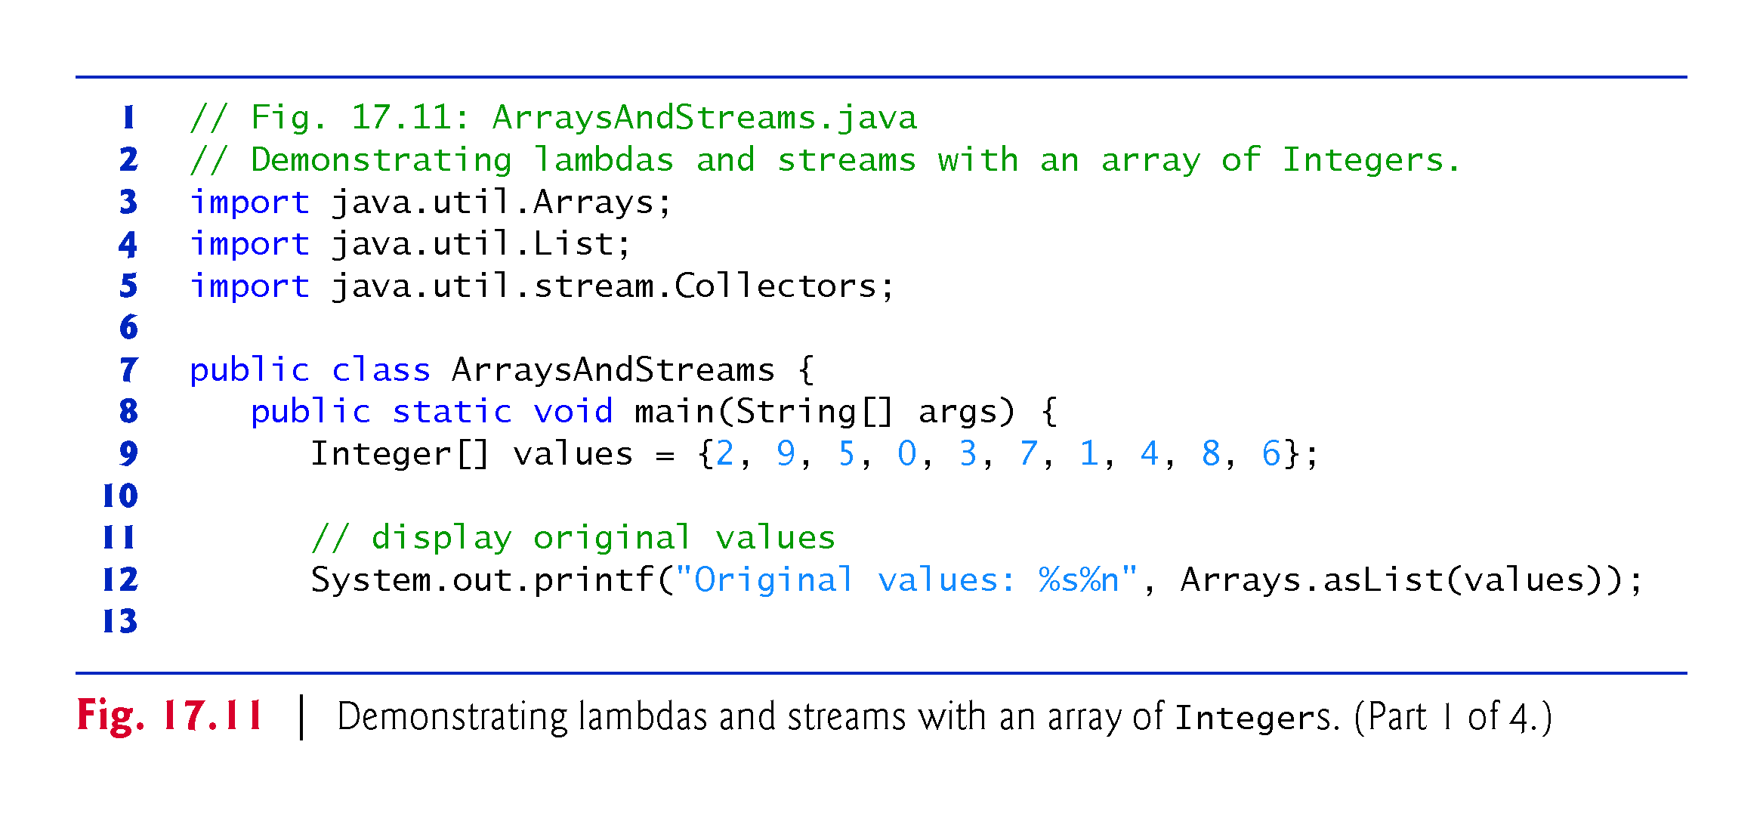

Slide 112
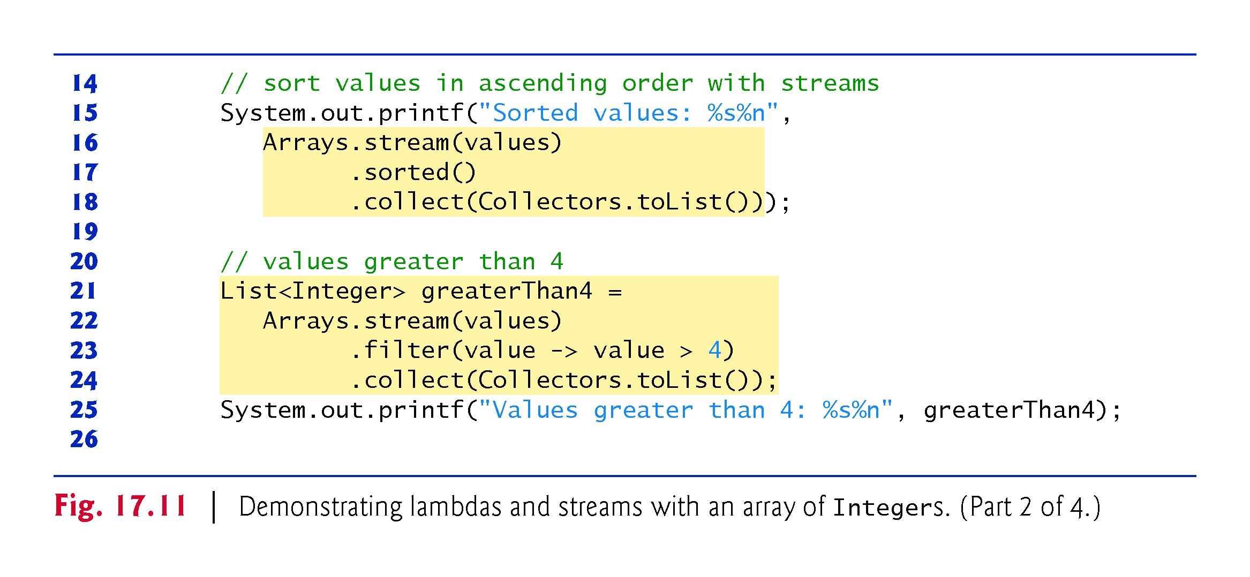

Slide 113
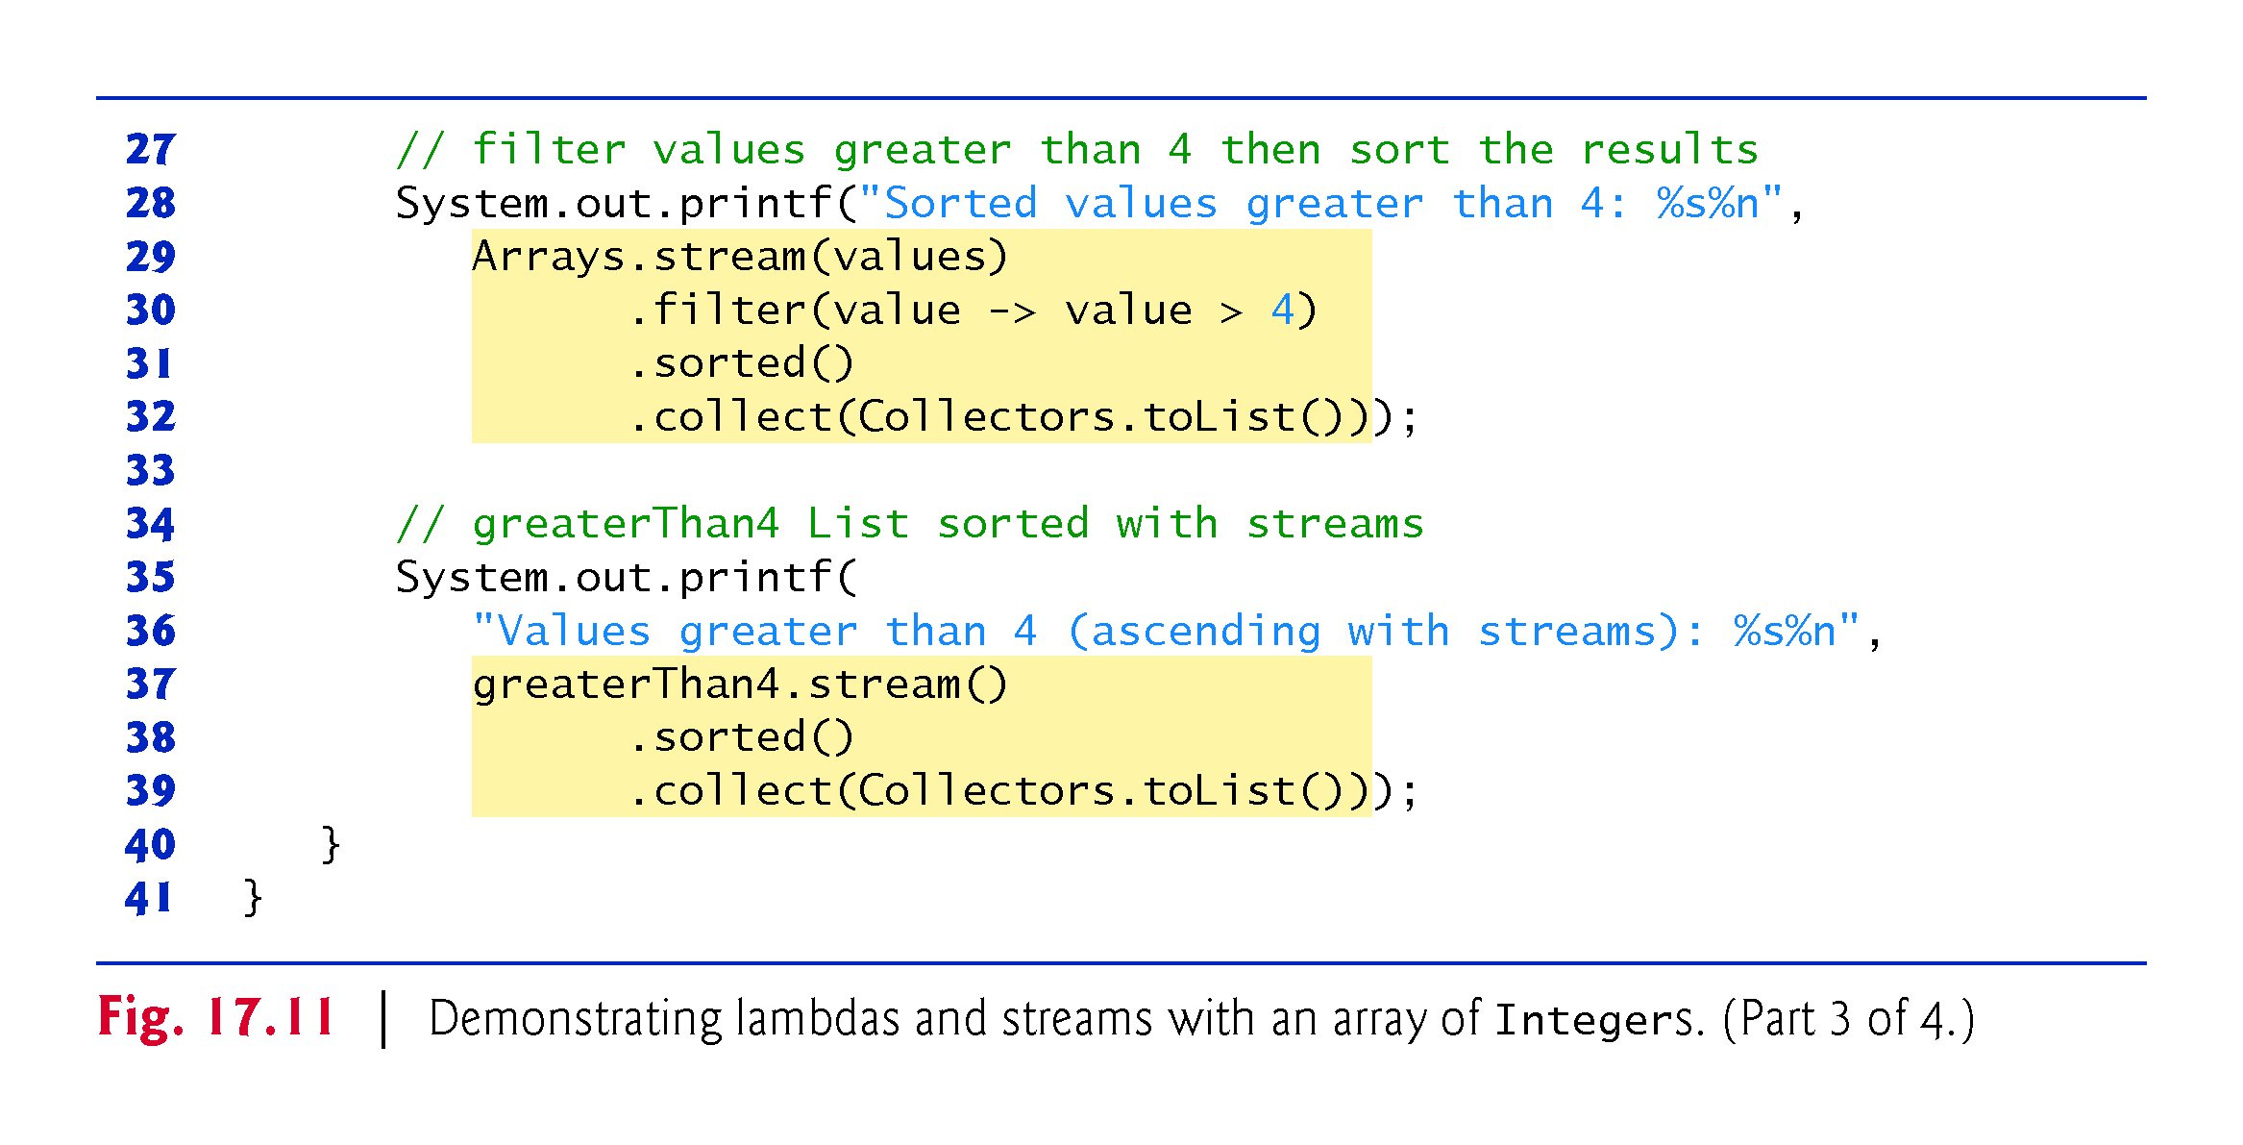

Slide 114
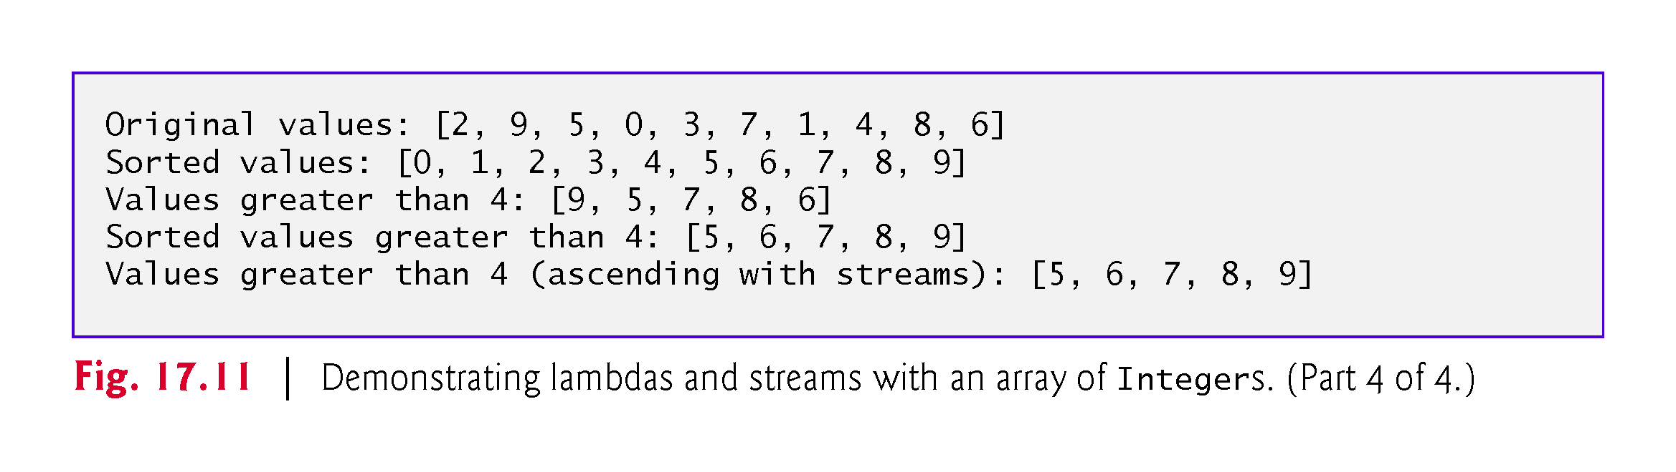

Slide 115
17.10 Stream<Integer> Manipulations (cont.)
We use the Integer array values (line 9) that’s initialized with int values—the compiler boxes each int into an Integer object
Line 12 displays the contents of values before we perform any stream processing
Arrays method asList creates a List<Integer> view of the values array
The generic interface List (discussed in more detail in Chapter 16) is implemented by collections like ArrayList (Chapter 7)
Line 12 displays the List<Integer>’s default String representation, which consists of square brackets ([ and ]) containing a comma-separated list of elements—we use this String representation throughout the example
We walk through the remainder of the code in Sections 17.10.1–17.10.5

Slide 116
17.10.1 Creating a Stream<Integer>
Class Arrays stream method can be used to create a Stream from an array of objects—for example, line 16 produces a Stream<Integer>, because stream’s argument is an array of Integers
Interface Stream (package java.util.stream) is a generic interface for performing stream operations on any reference type
The types of objects that are processed are determined by the Stream’s source.
Class Arrays also provides overloaded versions of method stream for creating IntStreams, LongStreams and DoubleStreams from int, long and double arrays or from ranges of elements in the arrays

Slide 117
17.10.2 Sorting a Stream and Collecting the Results
The stream pipeline in lines 16–18
Arrays.stream(values)
.sorted()
.collect(Collectors.toList())
uses stream techniques to sort the values array and collect the results in a List<Integer>
First, line 16 creates a Stream<Integer> from values
Next, line 17 calls Stream method sorted to sort the elements—this results in an intermediate Stream<Integer> with the values in ascending order

Slide 118
17.10.2 Sorting a Stream and Collecting the Results (cont.)
Creating a New Collection Containing a Stream Pipeline’s Results
When processing streams, you often create new collections containing the results so that you can perform operations on them later
To do so, you can use Stream’s terminal operation collect (Fig. 17.11, line 18)
As the stream pipeline is processed, method collect performs a mutable reduction operation that creates a List, Map or Set and modifies it by placing the stream pipeline’s results into the collection
You may also use the mutable reduction operation toArray to place the results in a new array of the Stream’s element type.

Slide 119
17.10.2 Sorting a Stream and Collecting the Results (cont.)
Creating a New Collection Containing a Stream Pipeline’s Results
The version of method collect in line 18 receives as its argument an object that implements interface Collector (package java.util.stream), which specifies how to perform the mutable reduction
Class Collectors (package java.util.stream) provides static methods that return predefined Collector implementations
Collectors method toList (line 18) returns a Collector that places the Stream<Integer>’s elements into a List<Integer> collection
In lines 15–18, the resulting List<Integer> is displayed with an implicit call to its toString method

Slide 120
17.10.2 Sorting a Stream and Collecting the Results (cont.)
Creating a New Collection Containing a Stream Pipeline’s Results
A mutable reduction optionally performs a final data transformation
For example, in Fig. 17.8, we called IntStream method collect with the object returned by Collectors method joining
This Collector uses a StringJoiner (package java.util) to concatenate the stream elements’ String representations, then called the StringJoiner’s toString method to transform the result into a String
For more predefined Collectors, visit:
https://docs.oracle.com/javase/8/docs/api/java/util/stream/Collectors.html

Slide 121
17.10.3 Filtering a Stream and Storing the Results for Later Use
The pipeline in lines 21–24 of Fig. 17.11 creates a Stream<Integer>, filters the stream to locate all the values greater than 4 and collects the results into a List<Integer->
List<Integer> greaterThan4 =
Arrays.stream(values)
.filter(value -> value > 4)
.collect(Collectors.toList());
Stream method filter’s argument implements the functional interface Predicate (package java.util.function), which represents a one-parameter method that returns a boolean indicating whether the parameter value satisfies the predicate
We assign the stream pipeline’s resulting List<Integer> to variable greaterThan4, which is used in line 25 to display the values greater than 4 and used again in lines 37–39 to perform additional operations on only the values greater than 4.

Slide 122
17.10.4 Filtering and Sorting a Stream and Collecting the Results
The stream pipeline in lines 29–32 displays the values greater than 4 in sorted order
Arrays.stream(values)
.filter(value -> value > 4)
.sorted()
.collect(Collectors.toList())
First, line 29 creates a Stream<Integer>
Then line 30 filters the elements to locate all the values greater than 4
Next, line 31 indicates that we’d like the results sorted
Finally, line 32 collects the results into a List<Integer>, which is then displayed as a String

Slide 123
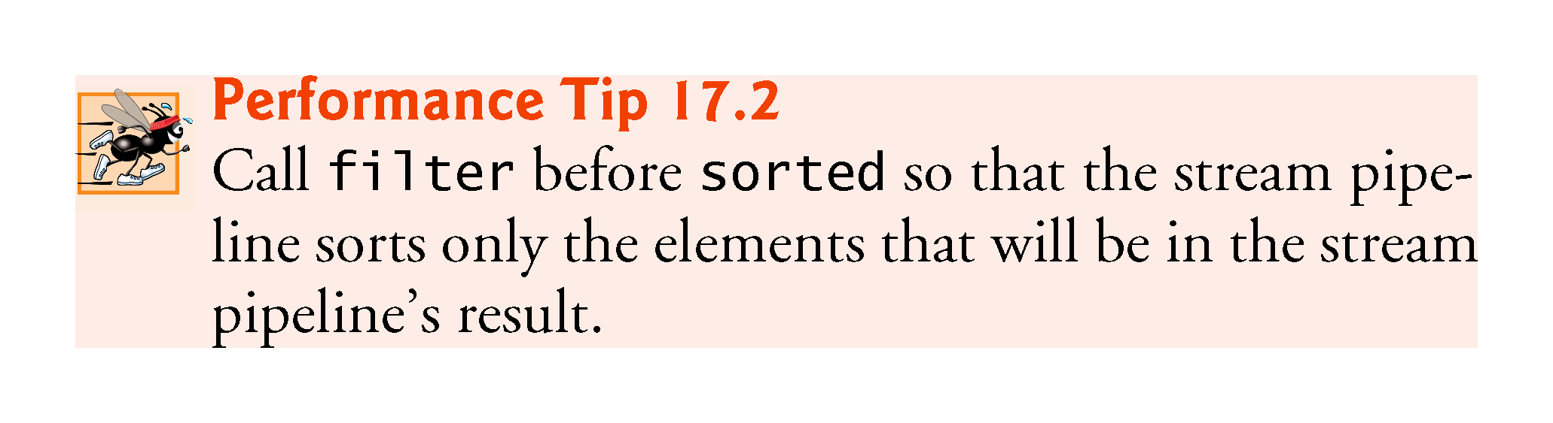

Slide 124
17.10.5 Sorting Previously Collected Results
The stream pipeline in lines 37–39 uses the greaterThan4 collection created in lines 21–24 to show additional processing on the results of a prior stream pipeline
greaterThan4.stream()
.sorted()
.collect(Collectors.toList()));
List method stream creates the stream
Then we sort the elements and collect the results into a new List<Integer> and display its String representation

Slide 125
17.11 Stream<String> Manipulations
[This section demonstrates how lambdas and streams can be used to simplify programming tasks that you learned in Chapter 14.]
So far, we’ve manipulated only streams of int values and Integer objects
Figure 17.12 performs similar stream operations on a Stream<String>
In addition, we demonstrate case-insensitive sorting and sorting in descending order
Throughout this example, we use the String array strings (lines 9–10) that’s initialized with color names—some with an initial uppercase letter
Line 13 displays the contents of strings before we perform any stream processing
We walk through the rest of the code in Sections 17.11.1–17.11.3

Slide 126
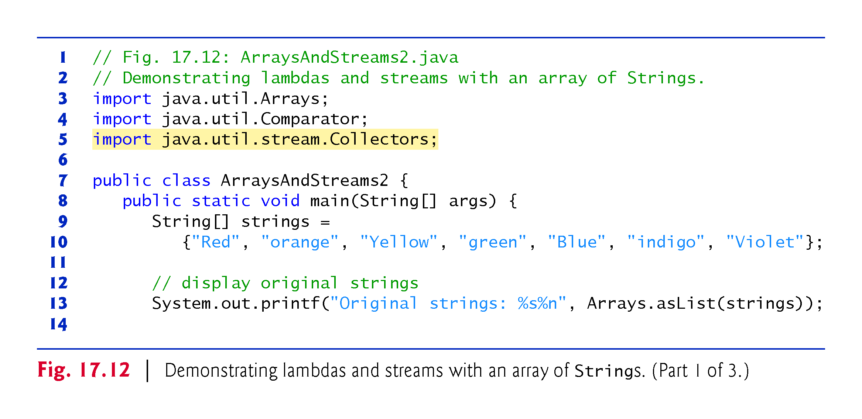

Slide 127
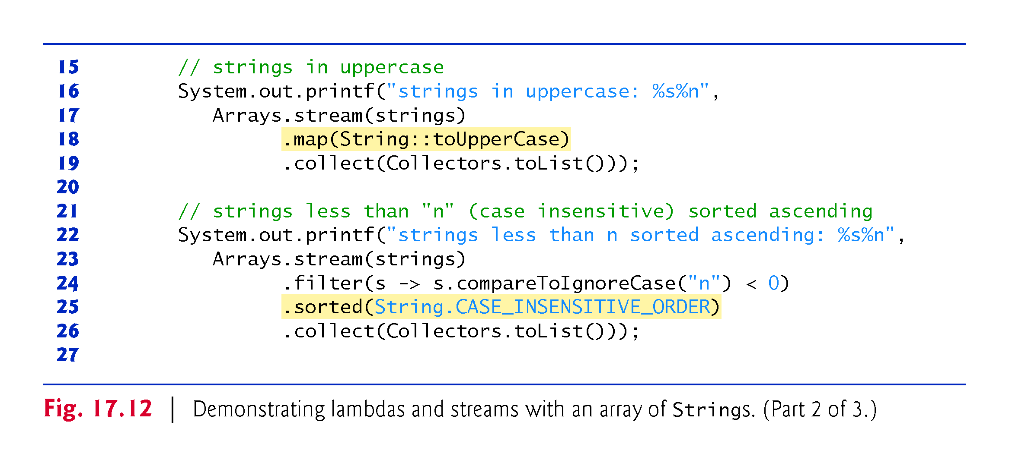

Slide 128
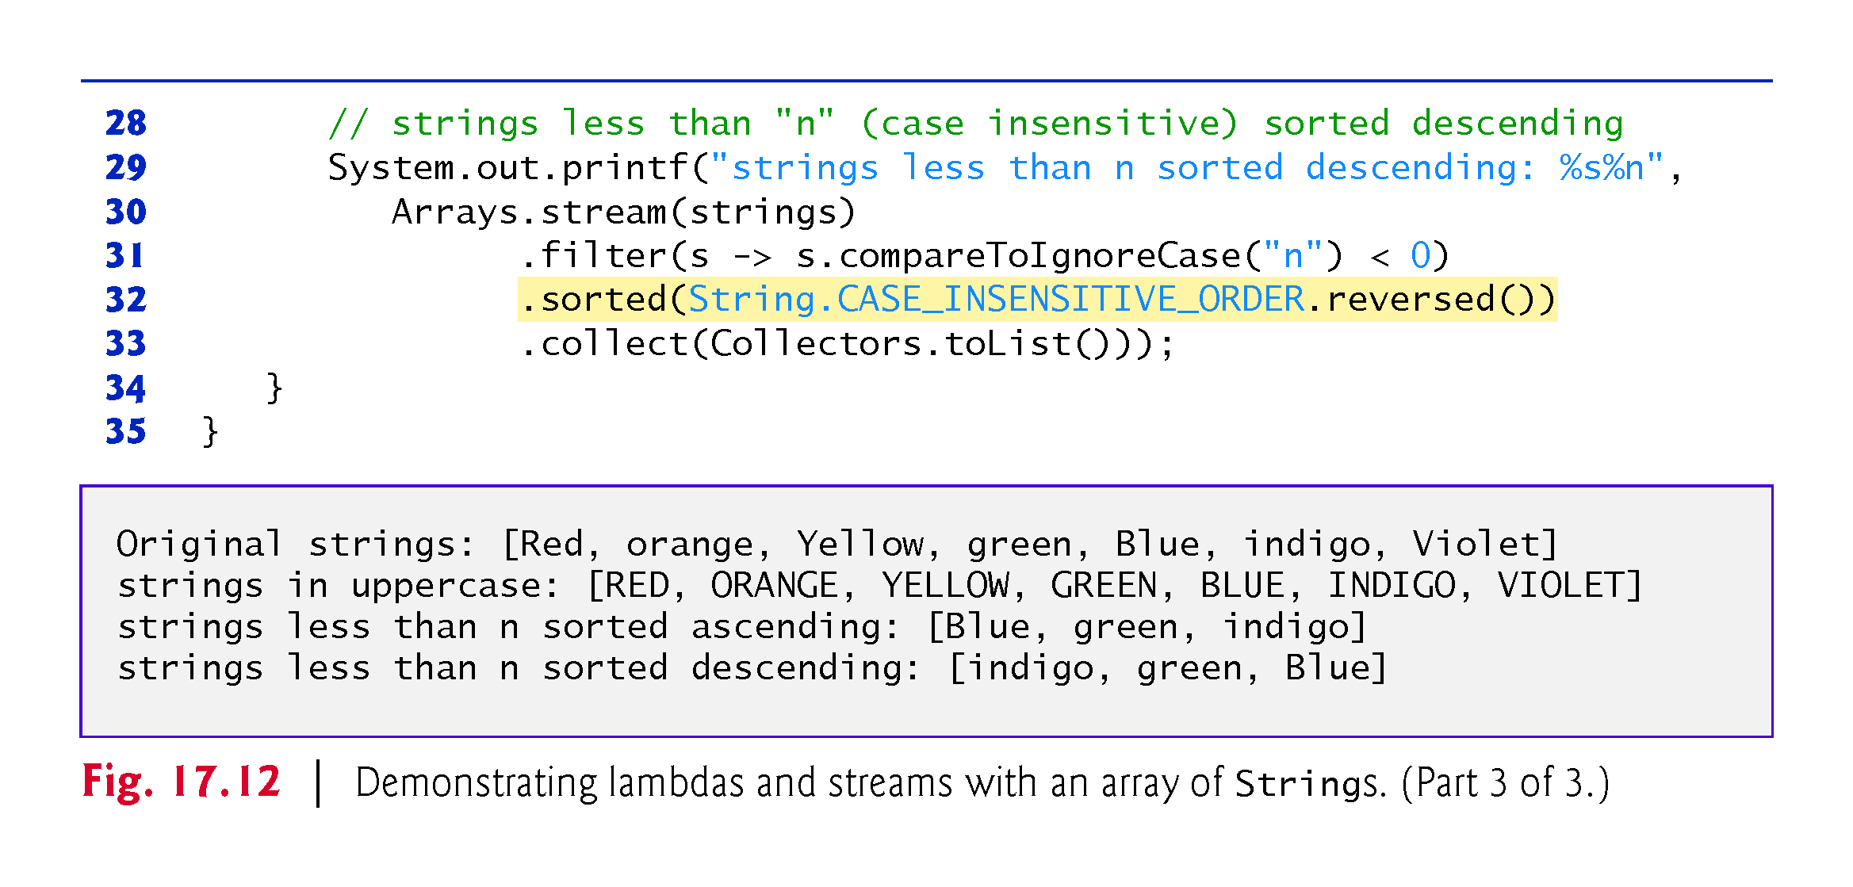

Slide 129
17.11.1 Mapping Strings to Uppercase
The stream pipeline in lines 17–19
Arrays.stream(strings)
.map(String::toUpperCase)
.collect(Collectors.toList()));
displays the Strings in uppercase letters
To do so, line 17 creates a Stream<String> from the array strings, then line 18 maps each String to its uppercase version by calling String instance method toUpperCase on each stream element

Slide 130
17.11.1 Mapping Strings to Uppercase (cont.)
Stream method map receives an object that implements the Function functional interface, representing a one-parameter method that performs a task with its parameter then returns the result
In this case, we pass to map an unbound instance method reference of the form ClassName::instanceMethodName (String::toUpperCase)
“Unbound” means that the method reference does not indicate the specific object on which the method will be called—the compiler converts this to a one-parameter lambda that invokes the instance method on the lambda’s parameter, which must have type ClassName
In this case, the compiler converts String::toUpperCase into a lambda like
s -> s.toUpperCase()
which returns the uppercase version of the lambda’s argument
Line 19 collects the results into a List<String> that we output as a String

Slide 131
17.11.2 Filtering Strings Then Sorting Them in Case-Insensitive Ascending Order
The stream pipeline in lines 23–26
Arrays.stream(strings)
.filter(s -> s.compareToIgnoreCase("n") < 0)
.sorted(String.CASE_INSENSITIVE_ORDER)
.collect(Collectors.toList())
filters and sort the Strings
Line 23 creates a Stream<String> from the array strings, then line 24 calls Stream method filter to locate all the Strings that are less than "n", using a case-insensitive comparison in the Predicate lambda

Slide 132
17.11.2 Filtering Strings Then Sorting Them in Case-Insensitive Ascending Order (cont.)
Line 25 sorts the results and line 26 collects them into a List<String> that we output as a String
In this case, line 25 invokes the version of Stream method sorted that receives a Comparator as an argument
A Comparator defines a compare method that returns a negative value if the first value being compared is less than the second, 0 if they’re equal and a positive value if the first value is greater than the second
By default, method sorted uses the natural order for the type—for Strings, the natural order is case sensitive, which means that "Z" is less than "a"
Passing the predefined Comparator String.CASE_INSENSITIVE_ORDER performs a case-insensitive sort

Slide 133
17.11.3 Filtering Strings Then Sorting Them in Case-Insensitive Descending Order
The stream pipeline in lines 30–33
Arrays.stream(strings)
.filter(s -> s.compareToIgnoreCase("n") < 0)
.sorted(String.CASE_INSENSITIVE_ORDER.reversed())
.collect(Collectors.toList()));
performs the same tasks as lines 23–26, but sorts the Strings in descending order
Functional interface Comparator contains default method reversed, which reverses an existing Comparator’s ordering
When you apply reversed to String.CASE_INSENSITIVE_ORDER, sorted performs a case-insensitive sort and places the Strings in descending order

Slide 134
17.12 Stream<Employee> Manipulations
[This section demonstrates how lambdas and streams can be used to simplify programming tasks that you learned in Chapter 16, Generic Collections.]
The previous examples in this chapter performed stream manipulations on primitive types (like int) and Java class library types (like Integer and String)
Of course, you also may perform operations on collections of programmer-defined types
The example in Figs. 17.13–17.21 demonstrates various lambda and stream capabilities using a Stream<Employee>
Class Employee (Fig. 17.13) represents an employee with a first name, last name, salary and department and provides methods for getting these values
In addition, the class provides a getName method (lines 39–41) that returns the combined first and last name as a String, and a toString method (lines 44–48) that returns a formatted String containing the employee’s first name, last name, salary and department

Slide 135
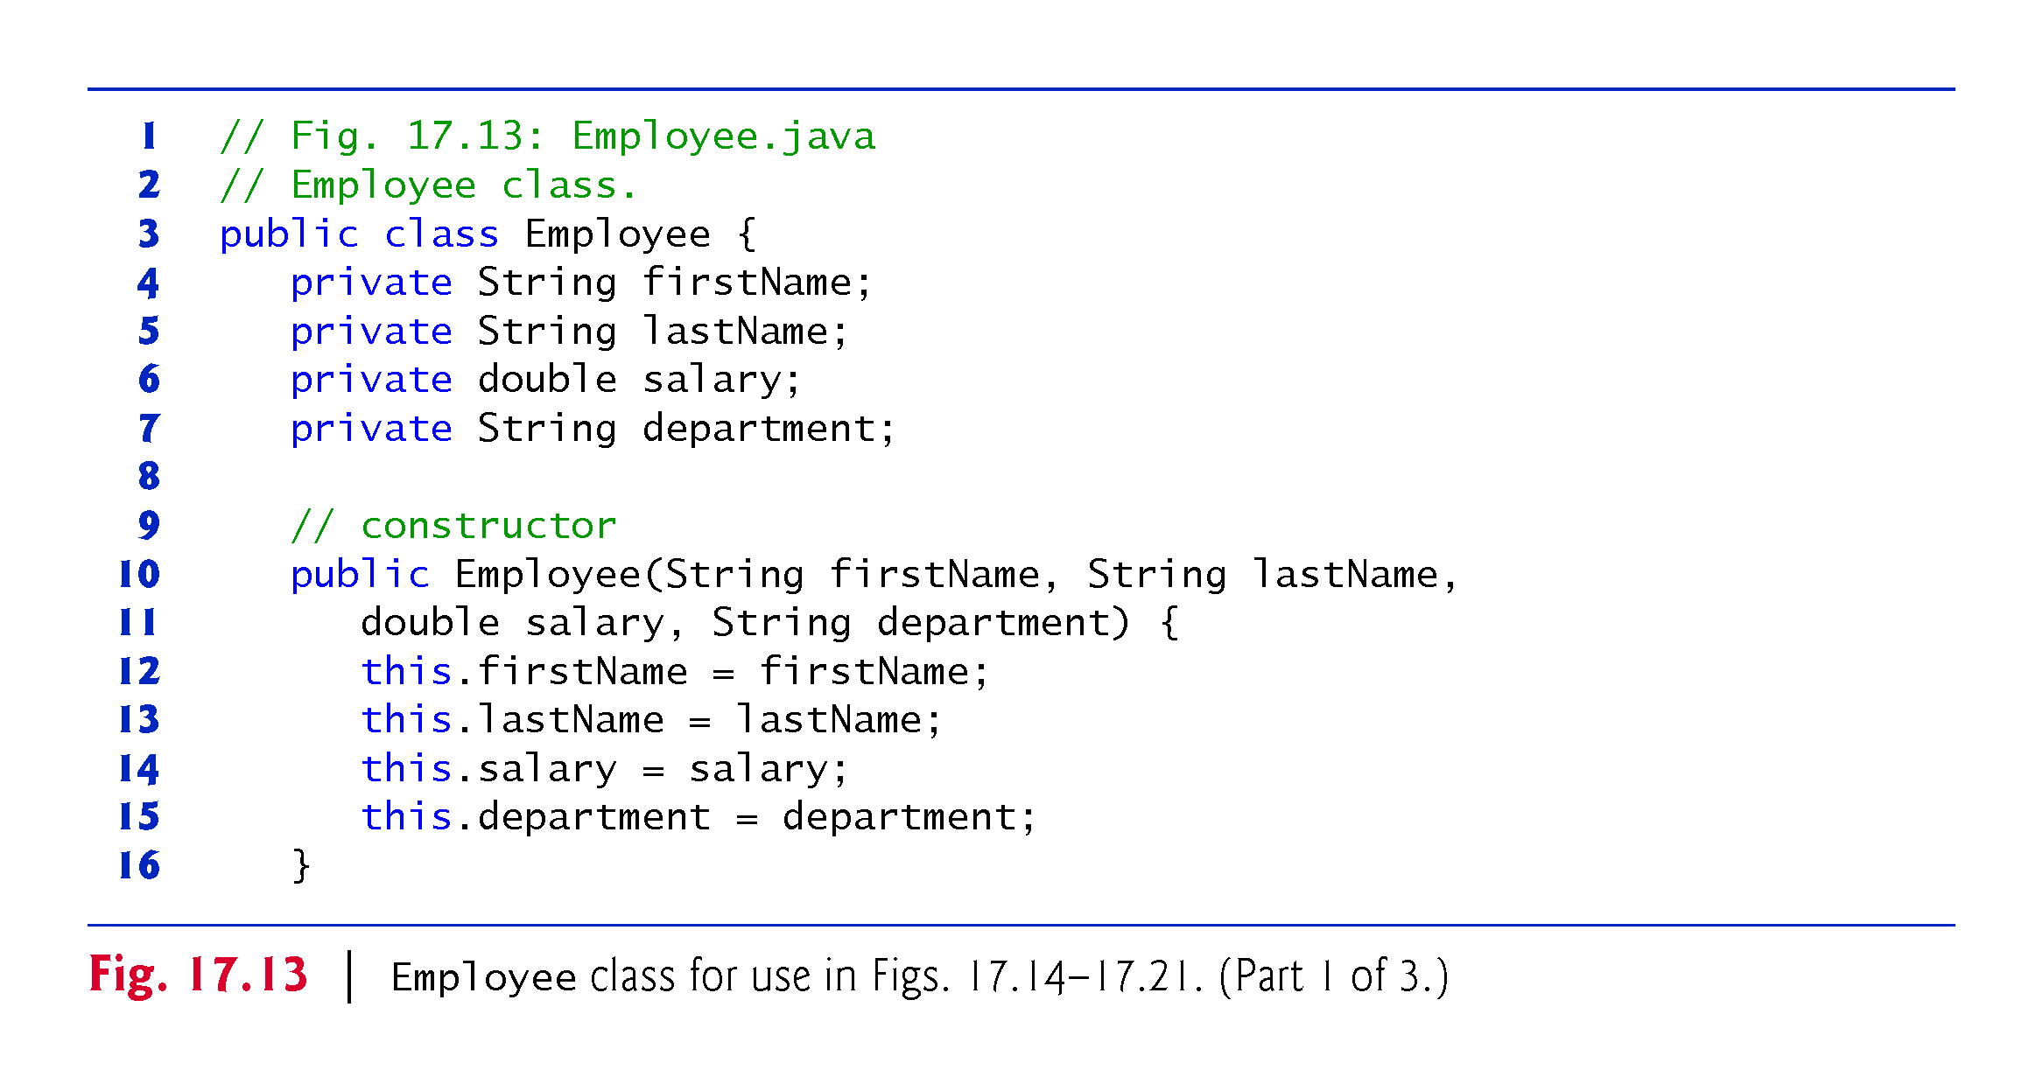

Slide 136
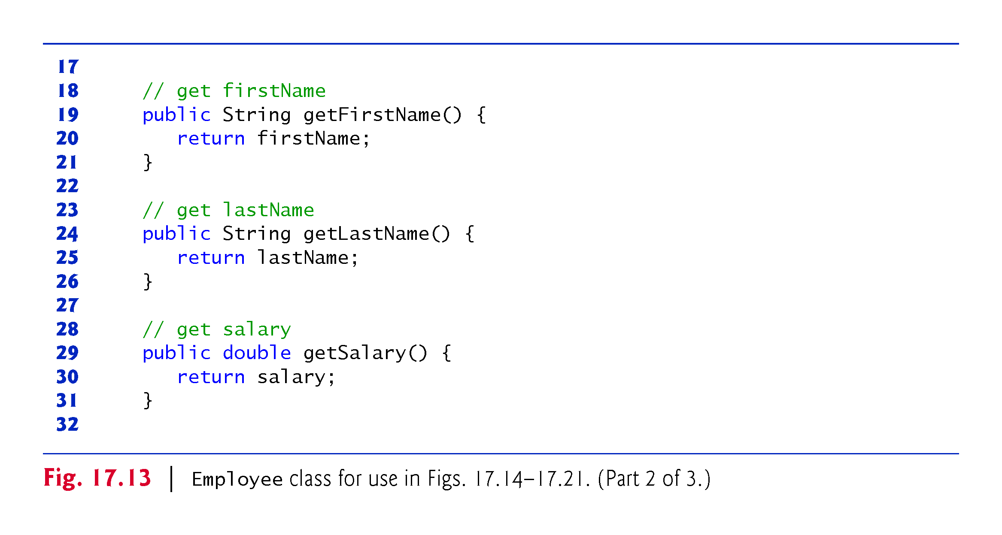

Slide 137
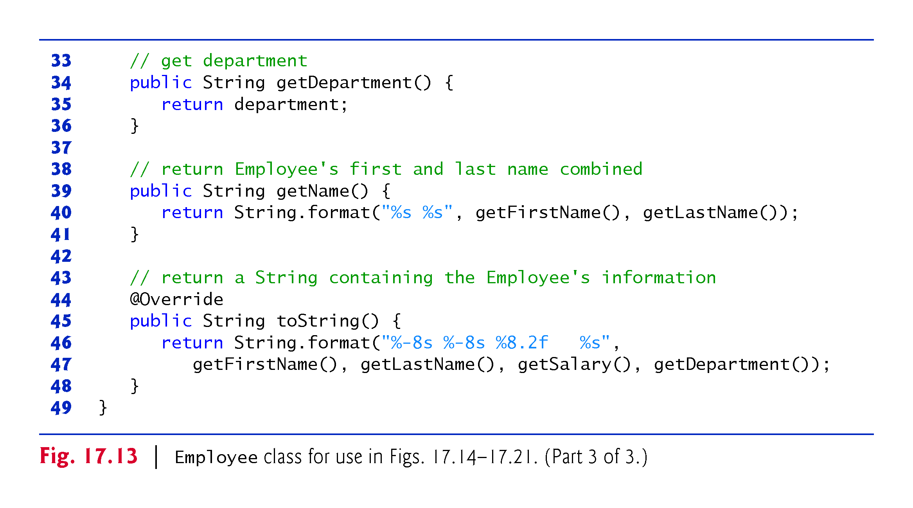

Slide 138
17.12.1 Creating and Displaying a List<Employee>
Class ProcessingEmployees (Figs. 17.14–17.21) is split into several figures so we can keep the discussions of the example’s lambda and streams operations close to the corresponding code
Each figure also contains the portion of the program’s output that correspond to code shown in that figure
Figure 17.14 creates an array of Employees (lines 15–22) and gets its List view (line 25)

Slide 139
17.12.1 Creating and Displaying a List<Employee> (cont.)
Line 29 creates a Stream<Employee>, then uses Stream method forEach to display each Employee’s String representation
Stream method forEach expects as its argument an object that implements the Consumer functional interface, which represents an action to perform on each element of the stream—the corresponding method receives one argument and returns void
The bound instance method reference System.out::println is converted by the compiler into a one-parameter lambda that passes the lambda’s argument—an Employee—to the System.out object’s println method
Figure 17.14’s output shows the results of displaying each Employee’s String representation (line 29)—in this case, Stream method forEach passes each Employee to the System.out object’s println method, which calls the Employee’s toString method

Slide 140
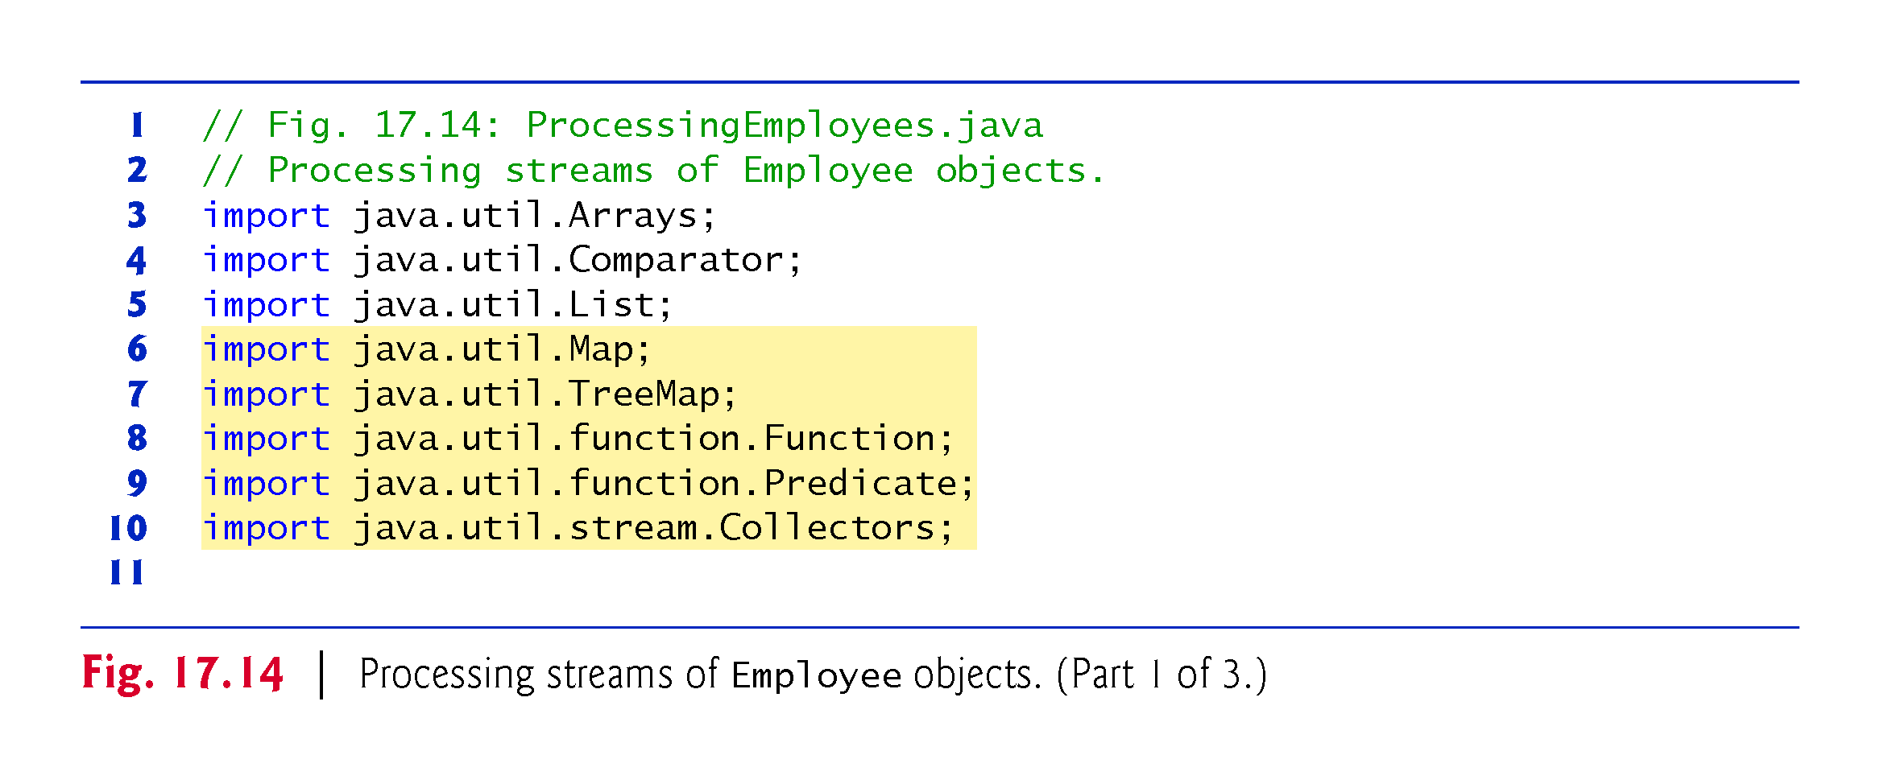

Slide 141
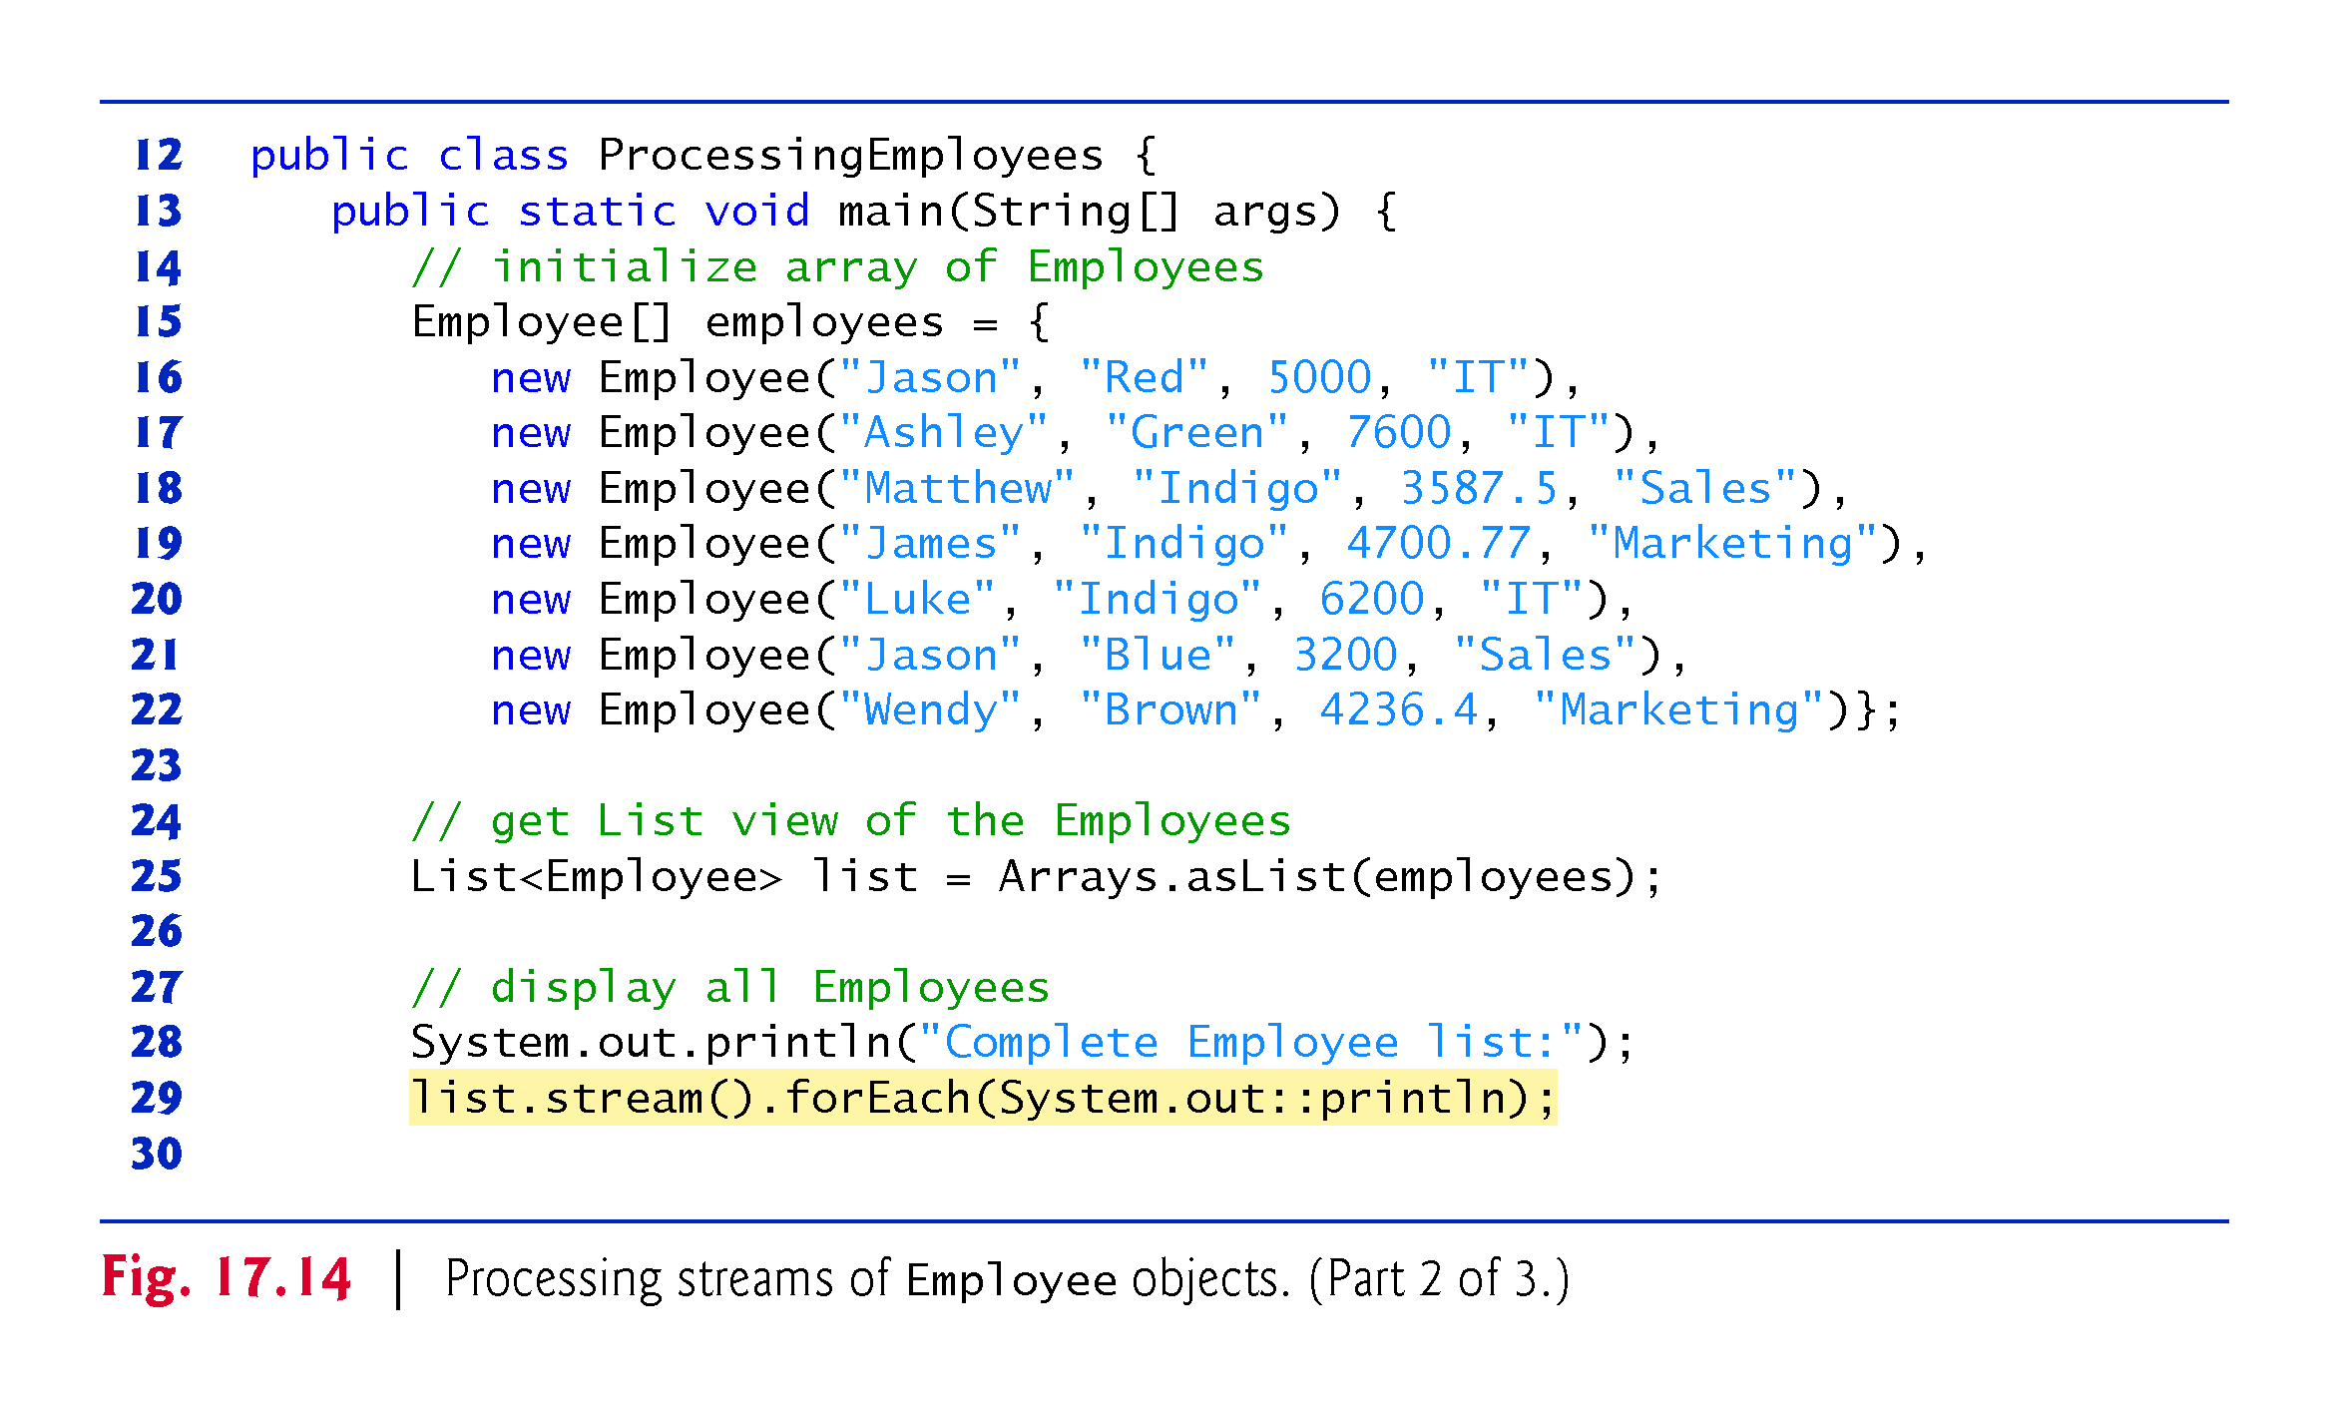

Slide 142


Slide 143
17.12.1 Creating and Displaying a List<Employee> (cont.)
Java SE 9: Creating an Immutable List<Employee> with List Method of
In Fig. 17.14, we first created an array of Employees (lines 15–22), then obtained a List view of the array (line 25)
Recall from Chapter 16 that in Java SE 9, you can populate an immutable List directly via List static method of, as in:
List<Employee> list = List.of(
new Employee("Jason", "Red", 5000, "IT"),
new Employee("Ashley", "Green", 7600, "IT"),
new Employee("Matthew", "Indigo", 3587.5, "Sales"),
new Employee("James", "Indigo", 4700.77, "Marketing"),
new Employee("Luke", "Indigo", 6200, "IT"),
new Employee("Jason", "Blue", 3200, "Sales"),
new Employee("Wendy", "Brown", 4236.4, "Marketing"));

Slide 144
17.12.2 Filtering Employees with Salaries in a Specified Range
So far, we’ve used lambdas only by passing them directly as arguments to stream methods
Figure 17.15 demonstrates storing a lambda in a variable for later use
Lines 32–33 declare a variable of the functional interface type Predicate<Employee> and initialize it with a one-parameter lambda that returns a boolean (as required by Predicate)
The lambda returns true if an Employee’s salary is in the range 4000 to 6000
We use the stored lambda in lines 40 and 47 to filter Employees

Slide 145


Slide 146


Slide 147
17.12.2 Filtering Employees with Salaries in a Specified Range (cont.)
The stream pipeline in lines 39–42 performs the following tasks:
Line 39 creates a Stream<Employee>.
Line 40 filters the stream using the Predicate named fourToSixThousand.
Line 41 sorts by salary the Employees that remain in the stream. To create a salary Comparator, we use the Comparator interface’s static method comparing, which receives a Function that performs a task on its argument and returns the result. The unbound instance method reference Employee::getSalary is converted by the compiler into a one-parameter lambda that calls getSalary on its Employee argument. The Comparator returned by method comparing calls its Function argument on each of two Employee objects, then returns a negative value if the first Employee’s salary is less than the second, 0 if they’re equal and a positive value if the first Employee’s salary is greater than the second. Stream method sorted uses these values to order the Employees.
Finally, line 42 performs the terminal forEach operation that processes the stream pipeline and outputs the Employees sorted by salary.

Slide 148
17.12.2 Filtering Employees with Salaries in a Specified Range (cont.)
Short-Circuit Stream Pipeline Processing
In Section 5.9, you studied short-circuit evaluation with the logical AND (&&) and logical OR (||) operators
One of the nice performance features of lazy evaluation is the ability to perform short-circuit evaluation—that is, to stop processing the stream pipeline as soon as the desired result is available
Line 48 of Fig. 17.15 demonstrates Stream method findFirst—a short-circuiting terminal operation that processes the stream pipeline and terminates processing as soon as the first object from the stream’s intermediate operation(s) is found

Slide 149
17.12.2 Filtering Employees with Salaries in a Specified Range (cont.)
Short-Circuit Stream Pipeline Processing
Based on the original list of Employees, the stream pipeline in lines 46–49
list.stream()
.filter(fourToSixThousand)
.findFirst()
.get()
which filters Employees with salaries in the range $4000–$6000—proceeds as follows:
The Predicate fourToSixThousand is applied to the first Employee (Jason- Red). His salary ($5000.00) is in the range $4000–$6000, so the Predicate returns true and processing of the stream terminates immediately, having processed only one of the eight objects in the stream.
Method findFirst then returns an Optional (in this case, an Optional<Employee>) containing the object that was found, if any. The call to Optional method get (line 49) returns the matching Employee object in this example. Even if the stream contained millions of Employee objects, the filter operation would be performed only until a match was found.

Slide 150
17.12.2 Filtering Employees with Salaries in a Specified Range (cont.)
Short-Circuit Stream Pipeline Processing
We knew from this example’s Employees that this pipeline would find at least one Employee with a salary in the range 4000–6000
So, we called Optional method get without first checking whether the Optional contained a result
If findFirst yields an empty Optional, this would cause a NoSuchElementException
Method findFirst is one of several search-related terminal operations
Figure 17.16 shows several similar Stream methods

Slide 151


Slide 152
17.12.3 Sorting Employees By Multiple Fields
Figure 17.17 shows how to use streams to sort objects by multiple fields
In this example, we sort Employees by last name, then, for Employees with the same last name, we also sort them by first name
To do so, we begin by creating two Functions that each receive an Employee and return a String:
byFirstName (line 52) is assigned a method reference for Employee instance method getFirstName
byLastName (line 53) is assigned a method reference for Employee instance method getLastName

Slide 153


Slide 154
17.12.3 Sorting Employees By Multiple Fields (cont.)
Next, we use these Functions to create a Comparator (lastThenFirst; lines 56–57) that first compares two Employees by last name, then compares them by first name
We use Comparator method comparing to create a Comparator that calls Function byLastName on an Employee to get its last name
On the resulting Comparator, we call Comparator method thenComparing to create a composed Comparator that first compares Employees by last name and, if the last names are equal, then compares them by first name

Slide 155
17.12.3 Sorting Employees By Multiple Fields (cont.)
Lines 62–64 use this new lastThenFirst Comparator to sort the Employees in ascending order, then display the results
We reuse the Comparator in lines 69–71, but call its reversed method to indicate that the Employees should be sorted in descending order by last name, then first name
Lines 52–57 may be expressed more concisely as:
Comparator<Employee> lastThenFirst =
Comparator.comparing(Employee::getLastName) .thenComparing(Employee::getFirstName);

Slide 156


Slide 157


Slide 158
17.12.3 Sorting Employees By Multiple Fields (cont.)
Aside: Composing Lambda Expressions
Many functional interfaces in the package java.util.function package provide default methods that enable you to compose functionality
For example, consider the interface IntPredicate, which contains three default methods:
and—performs a logical AND with short-circuit evaluation between the IntPredicate on which it’s called and the IntPredicate it receives as an argument.
negate—reverses the boolean value of the IntPredicate on which it’s called.
or—performs a logical OR with short-circuit evaluation between the IntPredicate on which it’s called and the IntPredicate it receives as an argument.

Slide 159
17.12.3 Sorting Employees By Multiple Fields (cont.)
You can use these methods and IntPredicate objects to compose more complex conditions
For example, consider the following two IntPredicates that are each initialized with lambdas:
IntPredicate even = value -> value % 2 == 0;
IntPredicate greaterThan5 = value -> value > 5;
To locate all the even integers greater than 5 in an IntStream, you could pass to IntStream method filter the following composed IntPredicate:
even.and(greaterThan5)
Like IntPredicate, functional interface Predicate represents a method that returns a boolean indicating whether its argument satisfies a condition
Predicate also contains methods and and or for combining predicates, and negate for reversing a predicate’s boolean value.

Slide 160
17.12.4 Mapping Employees to Unique-Last-Name Strings
You previously used map operations to perform calculations on int values, to convert ints to Strings and to convert Strings to uppercase letters
Figure 17.18 maps objects of one type (Employee) to objects of a different type (String)
The stream pipeline in lines 75–79 performs the following tasks:
Line 75 creates a Stream<Employee>.
Line 76 maps the Employees to their last names using the unbound instance-method reference Employee::getName as method map’s Function argument. The result is a Stream<String> containing only the Employees’ last names.
Line 77 calls Stream method distinct on the Stream<String> to eliminate any duplicate Strings—the resulting stream contains only unique last names.
Line 78 sorts the unique last names.
Finally, line 79 performs a terminal forEach operation that processes the stream pipeline and outputs the unique last names in sorted order.
Lines 84–87 sort the Employees by last name then, first name, then map the Employees to Strings with Employee instance method getName (line 86) and display the sorted names in a terminal forEach operation

Slide 161


Slide 162


Slide 163
17.12.5 Grouping Employees By Department
Previously, we’ve used the terminal stream operation collect to concatenate stream elements into a String representation and to place stream elements into List collections
Figure 17.19 uses Stream method collect (line 93) to group Employees by department

Slide 164


Slide 165


Slide 166
17.12.5 Grouping Employees By Department (cont.)
Recall that collect’s argument is a Collector that specifies how to summarize the data into a useful form
In this case, we use the Collector returned by Collectors static method groupingBy, which receives a Function that classifies the objects in the stream
The values returned by this Function are used as the keys in a Map collection
The corresponding values, by default, are Lists containing the stream elements in a given category
When method collect is used with this Collector, the result is a Map<String, List<Employee>> in which each String key is a department and each List<Employee> contains the Employees in that department

Slide 167
17.12.5 Grouping Employees By Department (cont.)
We assign this Map to variable groupedByDepartment, which we use in lines 94–100 to display the Employees grouped by department
Map method forEach performs an operation on each of the Map’s key–value pairs—in this case, the keys are departments and the values are collections of the Employees in a given department
The argument to this method is an object that implements functional interface BiConsumer, which represents a two-parameter method that does not return a result
For a Map, the first parameter represents the key and the second represents the corresponding value

Slide 168
17.12.6 Counting the Number of Employees in Each Department
Figure 17.20 once again demonstrates Stream method collect and Collectors static method groupingBy, but in this case we count the number of Employees in each department
The technique shown here enables us to combine grouping and reduction into a single operation

Slide 169


Slide 170
17.12.6 Counting the Number of Employees in Each Department (cont.)
The stream pipeline in lines 104–107 produces a Map<String, Long> in which each String key is a department name and the corresponding Long value is the number of Employees in that department
In this case, we use a version of Collectors static method groupingBy that receives two arguments:
the first is a Function that classifies the objects in the stream and
the second is another Collector (known as the downstream Collector) that’s used to collect the objects classified by the Function
We use a call to Collectors static method counting as the second argument
This resulting Collector reduces the elements in a given classification to a count of those elements, rather than collecting them into a List
Lines 108–110 then output the key–value pairs from the resulting Map<String, Long>

Slide 171
17.12.7 Summing and Averaging Employee Salaries
Previously, we showed that streams of primitive-type elements can be mapped to streams of objects with method mapToObj (found in classes IntStream, LongStream and DoubleStream)
Similarly, a Stream of objects may be mapped to an IntStream, LongStream or DoubleStream
Figure 17.21 demonstrates Stream method mapToDouble (lines 116, 123 and 129), which maps objects to double values and returns a DoubleStream
In this case, we map Employee objects to their salaries so that we can calculate the sum and average

Slide 172
17.12.7 Counting the Number of Employees in Each Department (cont.)
Method mapToDouble receives an object that implements the functional interface ToDoubleFunction (package java.util.function), which represents a one-parameter method that returns a double value
Lines 116, 123 and 129 each pass to mapToDouble- the unbound instance-method reference Employee::getSalary, which returns the current Employee’s salary as a double
The compiler converts this method reference into a one-parameter lambda that calls getSalary on its Employee argument

Slide 173
17.12.7 Counting the Number of Employees in Each Department (cont.)
Lines 115–117 create a Stream<Employee>, map it to a DoubleStream, then invoke DoubleStream method sum to total the Employees’ salaries
Lines 122–124 also sum the Employees’ salaries, but do so using DoubleStream method reduce rather than sum—note that the lambda in line 124 could be replaced with the static method reference
Double::sum
Class Double’s sum method receives two doubles and returns their sum

Slide 174
17.12.7 Counting the Number of Employees in Each Department (cont.)
Finally, lines 128–131 calculate the average of the Employees’ salaries using DoubleStream method average, which returns an OptionalDouble in case the DoubleStream does not contain any elements
Here, we know the stream has elements, so we simply call OptionalDouble method getAsDouble to get the result

Slide 175


Slide 176


Slide 177
17.13 Creating a Stream<String> from a File
Figure 17.22 uses lambdas and streams to summarize the number of occurrences of each word in a file, then display a summary of the words in alphabetical order grouped by starting letter
This is commonly called a concordance:
http://en.wikipedia.org/wiki/Concordance_(publishing)
Concordances are often used to analyze published works
For example, concordances of William Shakespeare’s and Christopher Marlowe’s works (among others) have been used to question whether they are the same person
Figure 17.23 shows the program’s output

Slide 178
17.13 Creating a Stream<String> from a File (cont.)
Line 14 of Fig. 17.22 creates a regular expression Pattern that we’ll use to split lines of text into their individual words
The Pattern \s+ represents one or more consecutive white-space characters—recall that because \ indicates an escape sequence in a String, we must specify each \ in a regular expression as \\
As written, this program assumes that the file it reads contains no punctuation, but you could use regular-expression techniques from Section 14.7 to remove punctuation

Slide 179


Slide 180


Slide 181


Slide 182
17.13 Creating a Stream<String> from a File (cont.)
Summarizing the Occurrences of Each Word in the File
The stream pipeline in lines 17–21 summarizes the contents of the text file "Chapter2Paragraph.txt" (which is located in the folder with the example) into a Map<String, Long> in which each String key is a word in the file and the corresponding Long value is the number of occurrences of that word
Map<String, Long> wordCounts =
Files.lines(Paths.get("Chapter2Paragraph.txt"))
.flatMap(line -> pattern.splitAsStream(line))
.collect(Collectors.groupingBy(String::toLowerCase,
TreeMap::new, Collectors.counting()));

Slide 183
17.13 Creating a Stream<String> from a File (cont.)
The pipeline performs the following tasks:
Line 18 calls Files method lines (added in Java SE 8) which returns a Stream<String> that reads lines of text from a file and returns each line as a String. Class Files (package java.nio.file) is one of many classes throughout the Java APIs which provide methods that return Streams.
Line 19 uses Stream method flatMap to break each line of text into its separate words. Method flatMap receives a Function that maps an object into a stream of elements. In this case, the object is a String containing words and the result is a Stream<String> for the individual words. The lambda in line 19 passes the String representing a line of text to Pattern method split-AsStream (added in Java SE 8), which uses the regular expression specified in the Pattern (line 14) to tokenize the String into its individual words. The result of line 19 is a Stream<String> for the individual words in all the lines of text. (This lambda could be replaced with the method reference pattern::splitAsStream.)

Slide 184
17.13 Creating a Stream<String> from a File (cont.)
Lines 20–21 use Stream method collect to count the frequency of each word and place the words and their counts into a TreeMap<String, Long>—a TreeMap because maintains its keys in sorted order. Here, we use a version of Collectors method groupingBy that receives three arguments—a classifier, a Map factory and a downstream Collector. The classifier is a Function that returns objects for use as keys in the resulting Map—the method reference String::toLowerCase converts each word to lowercase. The Map factory is an object that implements interface Supplier and returns a new Map collection—here we use the constructor reference TreeMap::new, which returns a TreeMap that maintains its keys in sorted order. The compiler converts a constructor reference into a parameterless lambda that returns a new TreeMap. Collectors.counting() is the downstream Collector that determines the number of occurrences of each key in the stream. The TreeMap’s key type is determined by the classifier Function’s return type (String), and the TreeMap’s value type is determined by the downstream collector—Collectors.counting() returns a Long.

Slide 185
17.13 Creating a Stream<String> from a File (cont.)
Displaying the Summary Grouped by Starting Letter
Next, the stream pipeline in lines 24–33 groups the key–value pairs in the Map wordCounts by the keys’ first letter:
wordCounts.entrySet()
.stream()
.collect(
Collectors.groupingBy(entry -> entry.getKey().charAt(0),
TreeMap::new, Collectors.toList()))
.forEach((letter, wordList) -> {
System.out.printf("%n%C%n", letter);
wordList.stream().forEach(word -> System.out.printf(
"%13s: %d%n", word.getKey(), word.getValue()));
});
This produces a new Map in which each key is a Character and the corresponding value is a List of the key–value pairs in wordCounts in which the key starts with the Character

Slide 186
17.13 Creating a Stream<String> from a File (cont.)
The statement performs the following tasks:
First we need to get a Stream for processing the key–value pairs in wordCounts. Interface Map does not contain any methods that return Streams. So, line 24 calls Map method entrySet on wordCounts to get a Set of Map.Entry objects that each contain one key–value pair from wordCounts. This produces an object of type Set<Map.Entry<String, Long>>.
Line 25 calls Set method stream to get a Stream<Map.Entry<String, Long>>.

Slide 187
17.13 Creating a Stream<String> from a File (cont.)
Lines 26–28 call Stream method collect with three arguments—a classifier, a Map factory and a downstream Collector. The classifier Function in this case gets the key from the Map.Entry then uses String method charAt to get the key’s first character—this becomes a Character key in the resulting Map. Once again, we use the constructor reference TreeMap::new as the Map factory to create a TreeMap that maintains its keys in sorted order. The downstream Collector (Collectors.toList()) places the Map.Entry objects into a List collection. The result of collect is a Map<Character, List<Map.Entry<String, Long>>>.

Slide 188
17.13 Creating a Stream<String> from a File (cont.)
Finally, to display the summary of the words and their counts by letter (i.e., the concordance), lines 29–33 pass a lambda to Map method forEach. The lambda (a BiConsumer) receives two parameters—letter and wordList represent the Character key and the List value, respectively, for each key–value pair in the Map produced by the preceding collect operation. The body of this lambda has two statements, so it must be enclosed in curly braces. The statement in line 30 displays the Character key on its own line. The statement in lines 31–32 gets a Stream<Map.Entry<String, Long>> from the wordList, then calls Stream method forEach to display the key and value from each Map.Entry object.

Slide 189
17.14 Streams of Random Values
Figure 6.7 summarized 60,000,000 rolls of a six-sided die using external iteration (a for loop) and a switch statement that determined which counter to increment
We then displayed the results using separate statements that performed external iteration
In Fig. 7.7, we reimplemented Fig. 6.7, replacing the entire switch statement with a single statement that incremented counters in an array—that version of rolling the die still used external iteration to produce and summarize 60,000,000 random rolls and to display the final results
Both prior versions of this example used mutable variables to control the external iteration and to summarize the results
Figure 17.24 reimplements those programs with a single statement that does it all, using lambdas, streams, internal iteration and no mutable variables to roll the die 60,000,000 times, calculate the frequencies and display the results

Slide 190


Slide 191


Slide 192


Slide 193
17.14 Streams of Random Values (cont.)
Class SecureRandom has overloaded methods ints, longs and doubles, which it inherits from class Random (package java.util)
These methods return an IntStream, a LongStream or a DoubleStream, respectively, that represent streams of random numbers
Each method has four overloads

Slide 194
17.14 Streams of Random Values (cont.)
We describe the ints overloads here—methods longs and doubles perform the same tasks for streams of long and double values, respectively:
ints()—creates an IntStream for an infinite stream (Section 17.15) of random int values.
ints(long)—creates an IntStream with the specified number of random ints.
ints(int, int)—creates an IntStream for an infinite stream of random int values in the half-open range starting with the first argument and up to, but not including, the second argument.
ints(long, int, int)—creates an IntStream with the specified number of random int values in the range starting with the first argument and up to, but not including, the second argument.
Line 13 uses the last overloaded version of ints (which we introduced in Section 17.6) to create an IntStream of 60,000,000 random integer values in the range 1–6.

Slide 195
17.14 Streams of Random Values (cont.)
Converting an IntStream to a Stream<Integer>
We summarize the roll frequencies in this example by collecting them into a Map<Integer, Long> in which each Integer key is a side of the die and each Long value is the frequency of that side
Unfortunately, Java does not allow primitive values in collections, so to summarize the results in a Map, we must first convert the IntStream to a Stream<Integer>
We do this by calling IntStream method boxed.

Slide 196
17.14 Streams of Random Values (cont.)
Summarizing the Die Frequencies
Lines 15–16 call Stream method collect to summarize the results into a Map<Integer, Long>
The first argument to Collectors method groupingBy (line 15) calls static method identity from interface Function, which creates a Function that simply returns its argument
This allows the actual random values to be used as the Map’s keys
The second argument to method groupingBy counts the number of occurrences of each key.

Slide 197
17.14 Streams of Random Values (cont.)
Displaying the Results
Lines 17–18 call the resulting Map’s forEach method to display the summary of the results
This method receives an object that implements the BiConsumer functional interface as an argument
Recall that for Maps, the first parameter represents the key and the second represents the corresponding value
The lambda in lines 17–18 uses parameter face as the key and frequency as the value, and displays the face and frequency.

Slide 198
17.15 Infinite Streams
A data structure, such as an array or a collection, always represents a finite number of elements—all the elements are stored in memory, and memory is finite
Of course, any stream created from a finite data structure will have a finite number of elements, as has been the case in this chapter’s prior examples
Lazy evaluation makes it possible to work with infinite streams that represent an unknown, potentially infinite, number of elements
For example, you could define a method nextPrime that produces the next prime number in sequence every time you call it
You could then use this to define an infinite stream that conceptually represents all prime numbers
However, because streams are lazy until you perform a terminal operation, you can use intermediate operations to restrict the total number of elements that are actually calculated when a terminal operation is performed

Slide 199
17.15 Streams of Random Values (cont.)
Consider the following pseudocode stream pipeline:
Create an infinite stream representing all prime numbers
If the prime number is less than 10,000
Display the prime number
Even though we begin with an infinite stream, only the finite set of primes less than 10,000 would be displayed
You create infinite streams with the stream-interfaces methods iterate and generate
For the purpose of this discussion, we’ll use the IntStream version of these methods

Slide 200
17.15 Streams of Random Values (cont.)
IntStream Method iterate
Consider the following infinite stream pipeline:
IntStream.iterate(1, x -> x + 1) .forEach(System.out::println);
IntStream method iterate generates an ordered sequence of values starting with the seed value (1) in its first argument
Each subsequent element is produced by applying to the preceding value in the sequence the -IntUnaryOperator specified as iterate’s second argument
The preceding pipeline generates the infinite sequence 1, 2, 3, 4, 5, …, but this pipeline has a problem
We did not specify how many elements to produce, so this is the equivalent of an infinite loop.

Slide 201
17.15 Streams of Random Values (cont.)
Limiting an Infinite Stream’s Number of Elements
One way to limit the total number of elements that an infinite stream produces is the short-circuiting terminal operation limit, which specifies the maximum number of elements to process from a stream
In the case of an infinite stream, limit terminates the infinite generation of elements
So, the following stream pipeline begins with an infinite stream, but limits the total number of elements produced to 10, so it displays the numbers from 1 through 10
IntStream.iterate(1, x -> x + 1)
.limit(10)
.forEach(System.out::println);
Similarly, the pipeline starts with an infinite stream, but sums only the squares of the integers from 1 through 10
IntStream.iterate(1, x -> x + 1)
.map(x -> x * x)
.limit(10)
.sum()

Slide 202


Slide 203
17.15 Streams of Random Values (cont.)
IntStream Method generate
You also may create unordered infinite streams using method generate, which receives an IntSupplier representing a method that takes no arguments and returns an int
If you have a SecureRandom object named random, the following stream pipeline generates and displays 10 random integers:
IntStream.generate(() -> random.nextInt())
.limit(10)
.forEach(System.out::println);
This is equivalent to
SecureRandom.ints()
.limit(10)
.forEach(System.out::println);

Slide 204
17.16 Lambda Event Handlers
Event-listener interfaces with one abstract method—like ChangeListener—are functional interfaces
For such interfaces, you can implement event handlers with lambdas
Consider the following Slider event handler from Fig. 12.23:
tipPercentageSlider.valueProperty().addListener(
new ChangeListener<Number>() {
@Override
public void changed(ObservableValue<? extends Number> ov,
Number oldValue, Number newValue) {
tipPercentage =
BigDecimal.valueOf(newValue.intValue() / 100.0);
tipPercentageLabel.setText(percent.format(tipPercentage));
}
}
);

Slide 205
17.16 Lambda Event Handlers (cont.)
The preceding handler be implemented more concisely with a lambda as
tipPercentageSlider.valueProperty().addListener(
(ov, oldValue, newValue) -> {
tipPercentage =
BigDecimal.valueOf(newValue.intValue() / 100.0);
tipPercentageLabel.setText(percent.format(tipPercentage)); });
For a simple event handler, a lambda significantly reduces the amount of code you need to write

Slide 206
17.17 Additional Notes on Java SE 8 Interfaces
Java SE 8 Interfaces Allow Inheritance of Method Implementations
Functional interfaces must contain only one abstract method, but may also contain default- methods and static methods that are fully implemented in the interface declarations
For example, the Function interface—which is used extensively in functional programming—has methods apply (abstract), compose (default), andThen (default) and identity (static)
When a class implements an interface with default methods and does not override them, the class inherits the default methods’ implementations

Slide 207
17.17 Additional Notes on Java SE 8 Interfaces (cont.)
An interface’s designer can now evolve an interface by adding new default and static methods without breaking existing code that implements the interface
For example, interface Comparator (Section 16.7.1) now contains many default and static methods, but older classes that implement this interface will still compile and operate properly in Java SE 8.
Recall that one class can implement many interfaces
If a class implements two or more unrelated interfaces that provide a default method with the same signature, the implementing class must override that method; otherwise, a compilation error occurs

Slide 208
17.17 Additional Notes on Java SE 8 Interfaces (cont.)
Java SE 8: @FunctionalInterface Annotation
You can create your own functional interfaces by ensuring that each contains only one abstract- method and zero or more default and/or static methods
Though not required, you can declare that an interface is a functional interface by preceding it with the @FunctionalInterface annotation
The compiler will then ensure that the interface contains only one abstract- method; otherwise, it will generate a compilation error.

