Slide 1
Chapter 3 Summary

Slide 2
Class Definitions
Template / Blueprint /Factory to produce copies of object
data type
Collection of properties and behaviors
Unique or compound entity
Instance variables, properties
Variables inside of class
Accessibility level
Data type
Variable name
Class methods
Accessors and mutators
Get and set instance variables
getInstanceVariableName / setInstanceVariableName

Slide 3
Class Methods
THIS (this.)
Refers to Instantiated object of class
Only needed if method param name is exact as instance variable
Params passed to method
Local scope
Variables declared in method body
Local scope

Slide 4
ClassTesters
Also known as ClassRunners
Used to run class to test cases

Slide 5
Scanner Object Methods
Nextline
Returns string of user input until return button pressed
Next
Collection of string separated by whitespace

Slide 6
Building (Constructing) Class
Constructor
Order form
Default empty constructor available IF no user-defined constructors present
Needs to be coded if so
Special options / cases up to programmer to define
No return type
Same name as class

Slide 7
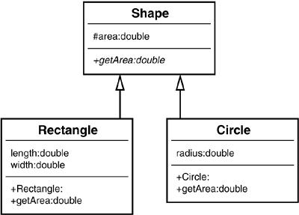
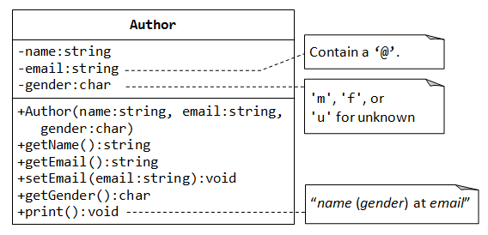
UML Diagram
Unified Modeling Language

Slide 8
UML
3 compartments
Top
Class name
Middle
Class instance variables
Bottom
Class methods
Include identifier names and data types
Name : DataType
Accessibility levels are symbols
+ - #
Public private protected

Slide 9
Primitive Types vs Reference Types
Primitive
Holds single value
All lowercase data type
Pass value of data
Has default value for instance variables 0, empty or false
Reference
Holds multiple values
Capitalized data type
Pass memory location
Default value of null

