Slide 1
Chapter 4 Summary

Slide 2
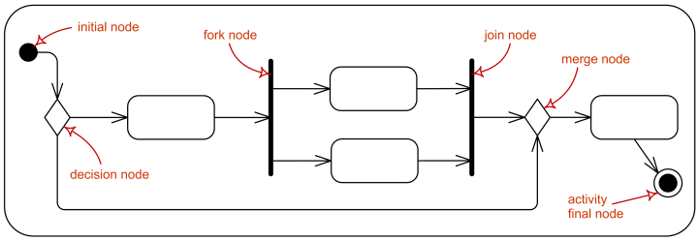
UML Diagrams
Control Flow
Initial = start of control flow
Decision = condition checker of if statement / for or while loop
Rounded rectangles = action taken if condition is met
Final node = end of control flow

Slide 3
If Statements
If (boolean expression) { statements}
else if (boolean expression) { statements}
else { statements }
Can include if statements within if statements (nested)

Slide 4
Ternary/Conditional Operator
Condensed if – else statements
Structure:
Calling statement = Boolean expression ? True_Statement : False_Statment
Statement is returned

Slide 5
While Iteration Statement
While (Boolean expression) { statements }
Ensure you initialize identifier outside of while body
#1 cause of infinite loop
Ensure you use correct relational operator if Boolean expression
Continue keyword
Skips to next iteration
Break keyword
Escapes from the iteration body

Slide 6
Pseudo Code
Point-form statements describing the sequence and actions of script
Helpful to outline and understand the logic before writing the code
Exhaustively plan before coding
“Measure twice, cut once”

Slide 7
Unary Operators
Also know as Increment / Decrement
Prefix
++a
--a
Updated value is available during on same statement
Postfix
a++
a--
Updated value is available in the next statement

Slide 8
Order of Operations
Unary postfix ( a++, a--)
Unary prefix ( ++a, --a )
Multiplicative ( * , / , % )
Additive ( + , - )
Relational ( < , <= , > , >=)
Equality ( == , !== )
Ternary / Conditional ( ? : )
Assignment ( = , += , *= , etc)

