Slide 1
Chapter 5 Summary

Slide 2
For Iteration Statement
3 statements
Initialization
Conditional statement
Final expression
All three optional
For (initial ; conditional ; final expression) { statements }
Final expression non-negative ? Increment : decrement
Can have multiple statements, separated by comma

Slide 3
Formatting Output
Printf()
%[Width_To_Consume(integer)] [.Percision] DATA_TYPE
Default alignment is right justified
Spacing is added to left side of output
Negative values makes alignment left justified
Spacing is added to right side of output

Slide 4
Default Imported Classes & Static Classes
All classes in package Java.lang imported by default
Example Math
Static Class
Class you can use without instantiating (creating an instance of) class

Slide 5
Do…while Iteration Statement
Similar to while iteration statement
Loop body always executes once
Condition is checked after loop body
Do{ statements } while (Boolean expression)

Slide 6
Switch Statements
Useful for determining specific values of identifier
For Value ranges, use if statements
Can group cases using “stack” cases
Equivalent to var == value_1 or var == value_2
Switch( identifier [ and operation]){ cases }
Cases
Case VALUE : (statements) break;
Break signifies end of case
Default case
Equivalent to ELSE in If statements

Slide 7
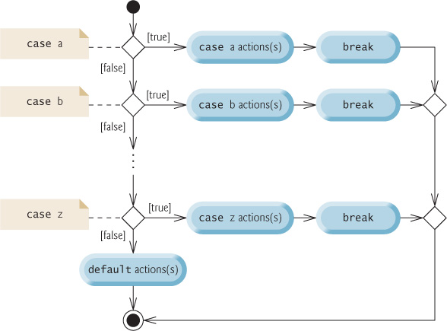
UML Diagram

Slide 8
Logical Operators
Conditional AND (&&)
All Boolean expressions must evaluate to true
Short-circuit evaluation
Conditional OR (||)
At least one Boolean expression must evaluate to true
Short-circuit evaluation
Boolean Logical AND(&)
All Boolean expressions must evaluate to true
All expressions evaluated

Slide 9
Logical Operators
Boolean Logical OR(|)
At least one Boolean expression must evaluate to true
All expressions evaluated
Boolean logical exclusive OR (^)
Use with two Boolean expressions
One expression is true, the other expression is false
Logical NOT (!)
Negates an Boolean value
! & ^ bitwise operators when applied to integral (number) values

Slide 10
Order of Operations
Unary postfix
Unary prefix
Multiplicative
Additive
Relational
Equality
Boolean logical AND
Boolean logical exclusive OR

Slide 11
Order of Operations
Boolean logical inclusive OR
Logical NOT
Conditional AND
Conditional OR
Conditional
assignment

