Slide 1
Chapter 10 Summary

Slide 2
Polymorphism
Greek word meaning multiple forms
Examples include
Overloading class methods
Overriding class methods

Slide 3
Abstract Class
A class that you cannot instantiate
Abstract class is used as a superclass
Abstract class may contain abstract method
Abstract method
Definition of method signature
<accessibility level> abstract <return type> <method name>( [ method params]);
Needs to be implemented by subclass
Can create variable of abstract class (such as array)

Slide 4
Relation Between Superclass and Subclass
Superclass has access to all its instance variables and class methods
Subclass has access to all its instance variables and class methods AND superclass instance variables and class methods that are not marked private
Superclass has no access to subclass instance variables and class methods

Slide 5
Final Methods and Classes
Can put ‘final’ modifier at class level and method levels
Classes marked as final cannot be extended
Methods marked as final cannot be overridden in a subclass

Slide 6
Interface
Define and standardize ways in which things such as people and systems can interact with one another
Usages
For assigning common functionality to a class
I.E. wheels, buttons, screen
Use keyword “implements”
Interface only contains:
method signatures that must be implemented by a class (must be public)
constants

Slide 7
Abstract class vs interface
Use interface if
No default implementation
Object relates to functionality of object

Slide 8
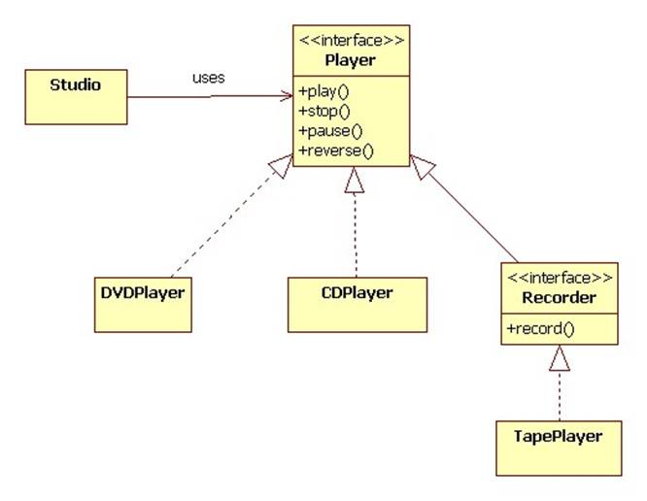
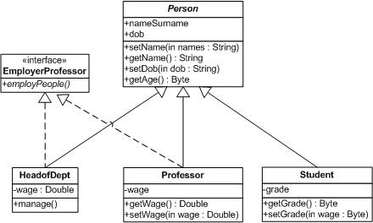
UML of Interfaces

Slide 9
Private Constructors
Prevent object instantiation
Share initialization code in constructors
Factory methods
Prototype to ensure object follows certain standard
Public static, returns instance of object

