Slide 1
Chapter 9 Summary

Slide 2
Inheritance
Definition
New class is created by acquiring existing class
Create class in terms of other class
Two parts:
Superclass
Base class
Subclass
Dirived class
Superclass
Parent class
Created first, less specific/ more general than sub class

Slide 3
Subclass
Child class
More specific than super class
Can have its own methods, instance variables
Inherits superclass instance variables and methods *
Can modify superclass methods
Also referred to as specialization

Slide 4
Superclass Categories
Direct superclass
Superclass from which subclass explicitly inherits
Aka, parent class
Indirect superclass
Any class above the direct superclass
Aka grandparent class
Class hierarchy
Defines the inheritance relationships among classes

Slide 5
Java and Inheritance
Java only supports single inheritance
Each class can be derived from exactly one other direct superclass
Reference / keyword for superclass in a subclass is “super”
This = current class
Super = parent class

Slide 6
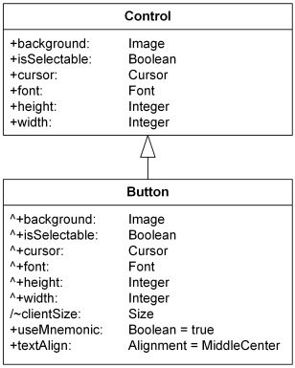
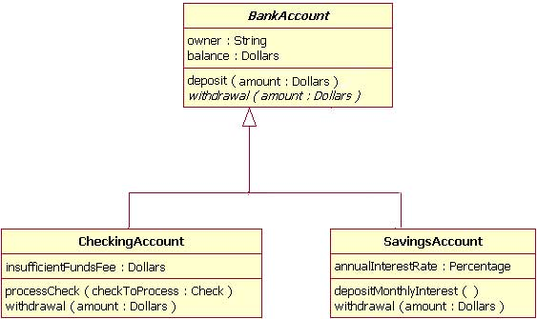
UML and Inheritance

Slide 7
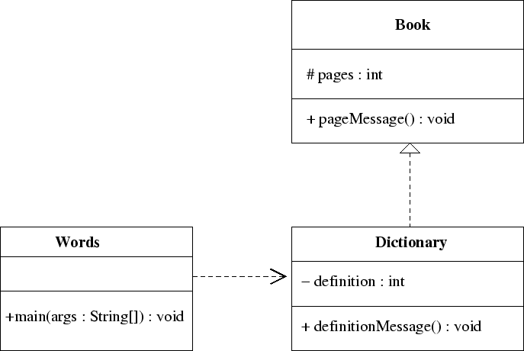
UML and Inheritance

Slide 8
Access Modifiers and Inheritance
Public
Available to that class and subclasses
Private
Only available to that class
Protected
Available to that class and subclasses

Slide 9
Creating and Overriding in Subclass
When creating a subclass, use the keyword extends
Class MySubClass extends MySuperClass{}
When overriding a superclass method in a subclass, use the “@Override” annotation for two reasons
Compiler checks that method exists in base class
Will catch accidental mis-spellings or case mis-matches
Will throw error if method does not exist in base class
Will evoke error if method signature not the same
Makes code more understanding
Indicates that you are not creating a new method but overriding a base method

Slide 10
Subclasses and Constructors
Each constructor must call a constructor of its super class
Implicitly
If not call is made to superclass, complier evokes the default constructor
If default constructor not found, exception thrown
Explicitly
By keyword super( [arguments] )

Slide 11
Object base class inherited methods
Equals : boolean
Determines if two objects point to same memory address by default
Should override to determine if contents of two objects are equal
Return type: boolean
hashCode : int
Integeer value for high-speed storage and retrieval that can be used for sorting/ hashing algorithms
getClass : String
Returns package.classname as string
toString : String
Returns getClass() @ hashCode() by default
Should override to more meaningful representation of object

