Slide 1
Chapter 15 Files, Input/Output Streams, NIO and XML Serialization
Java How to Program, 11/e
Questions? E-mail paul.deitel@deitel.com

Slide 2
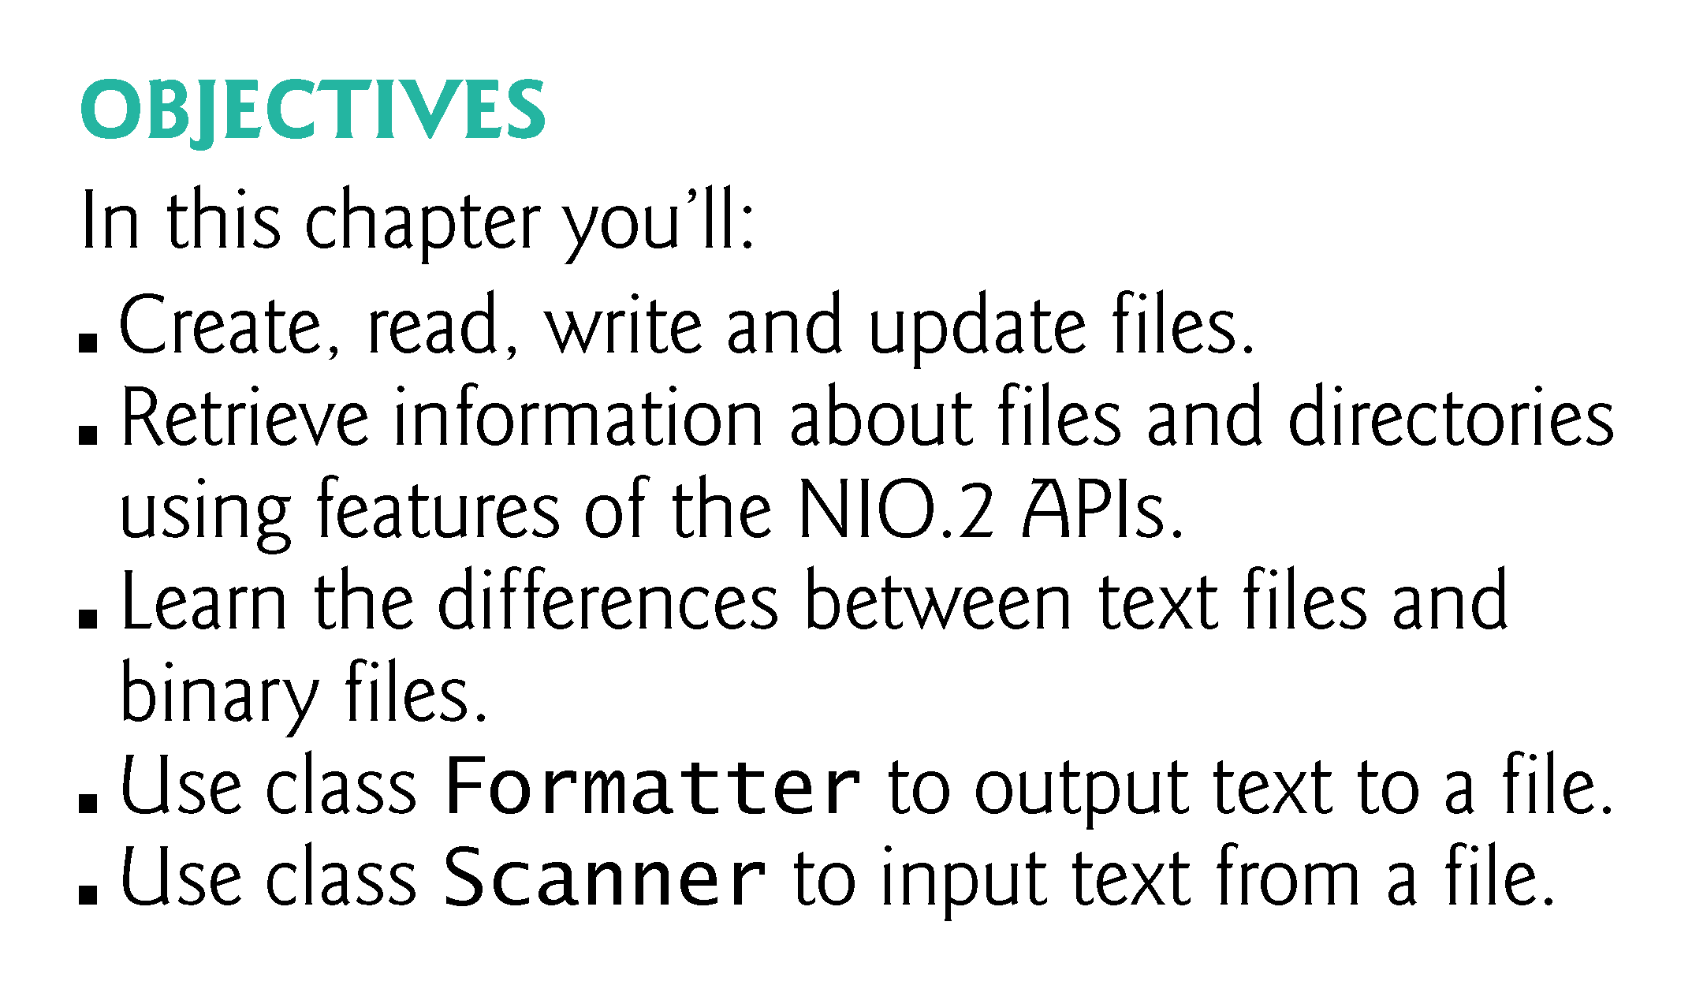

Slide 3
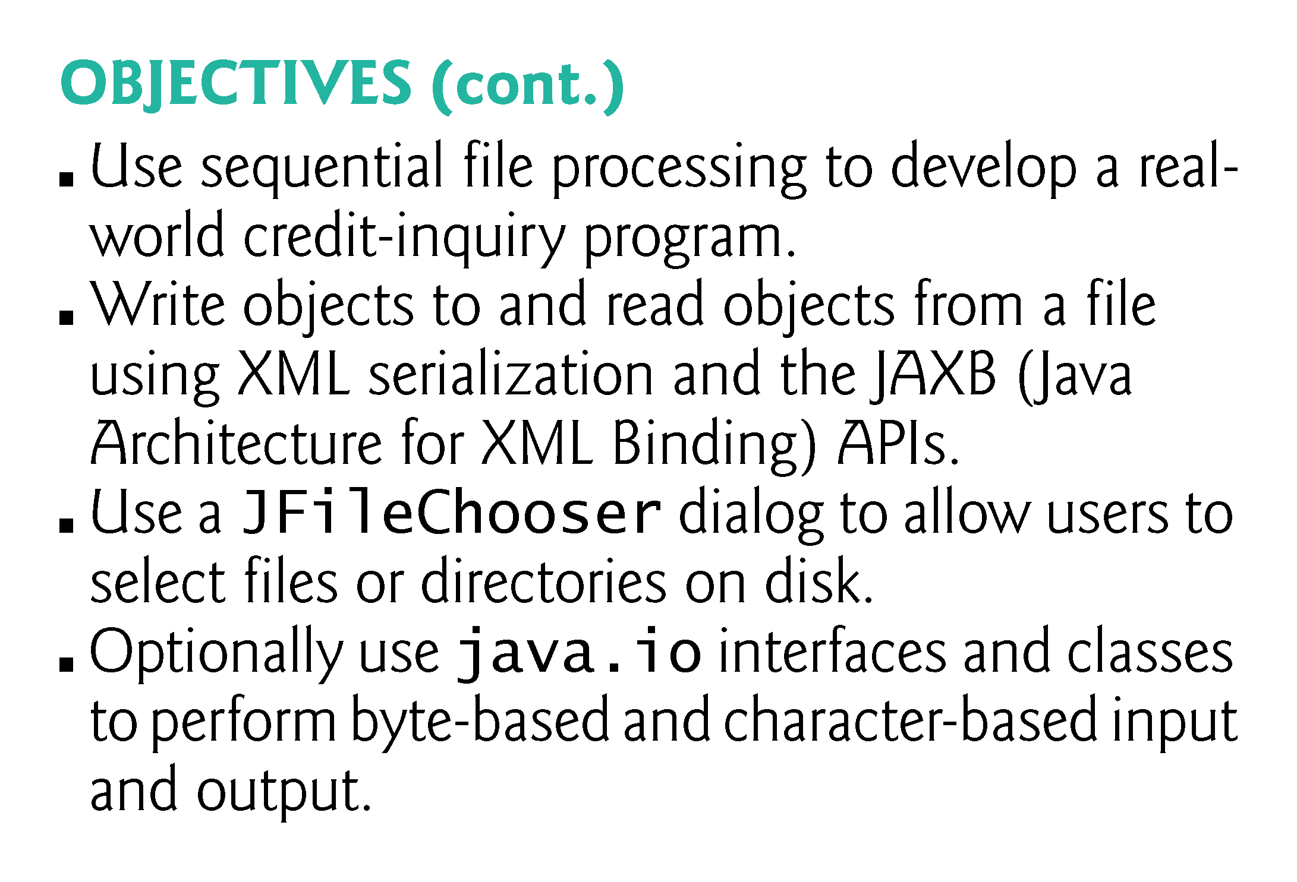

Slide 4
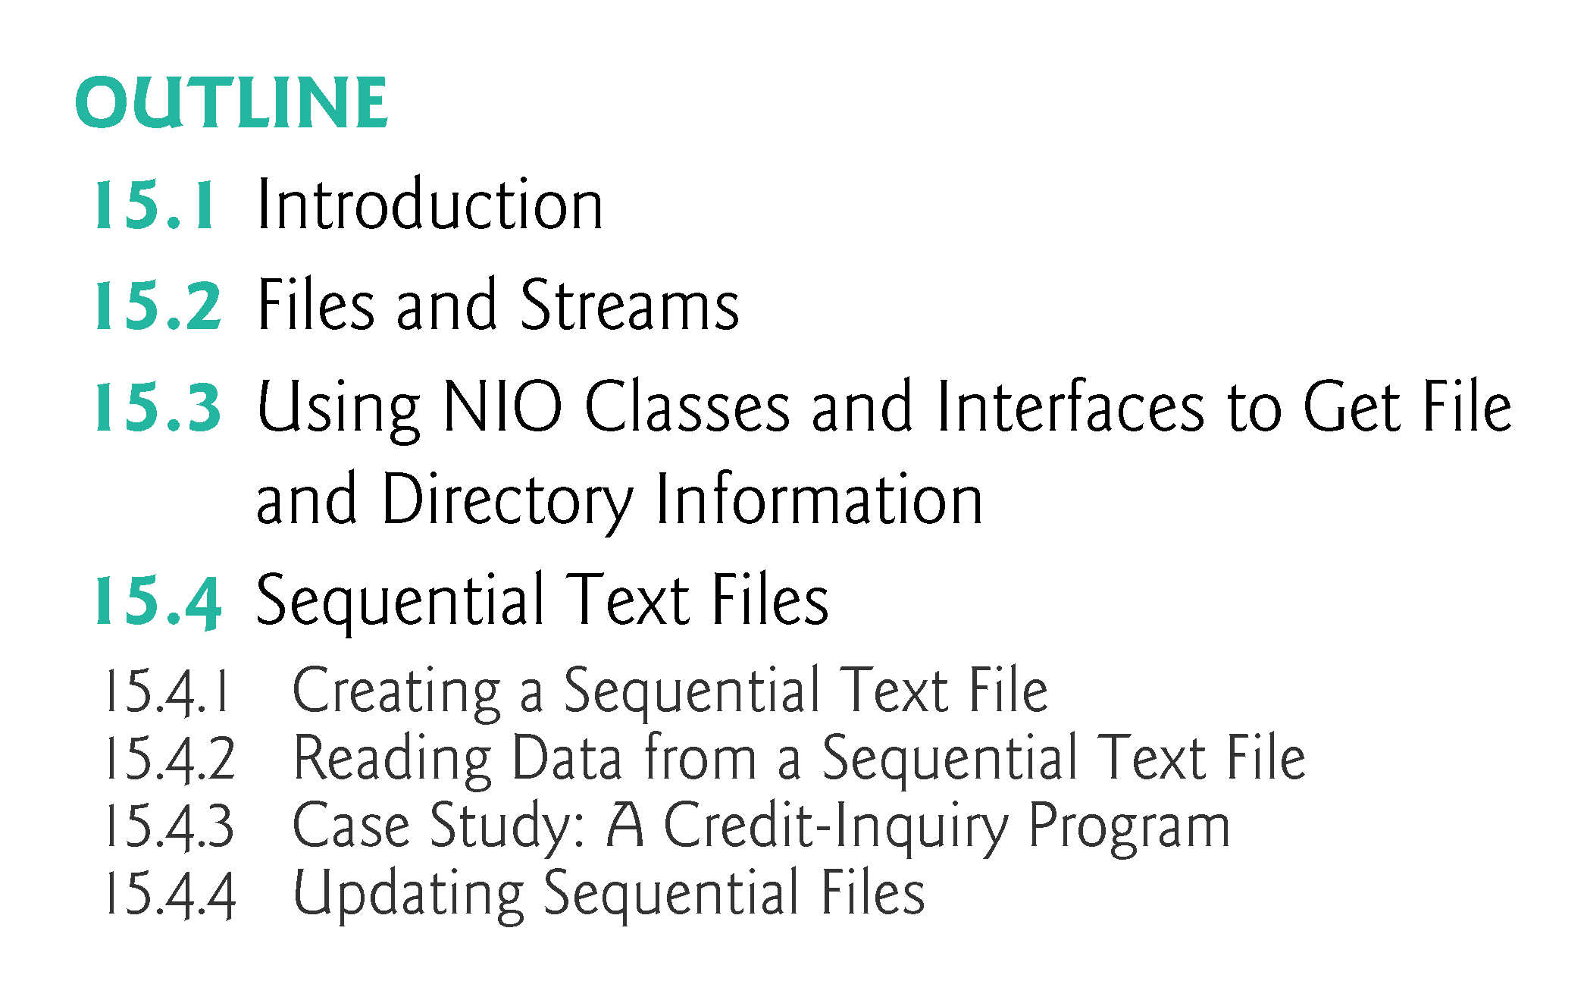

Slide 5
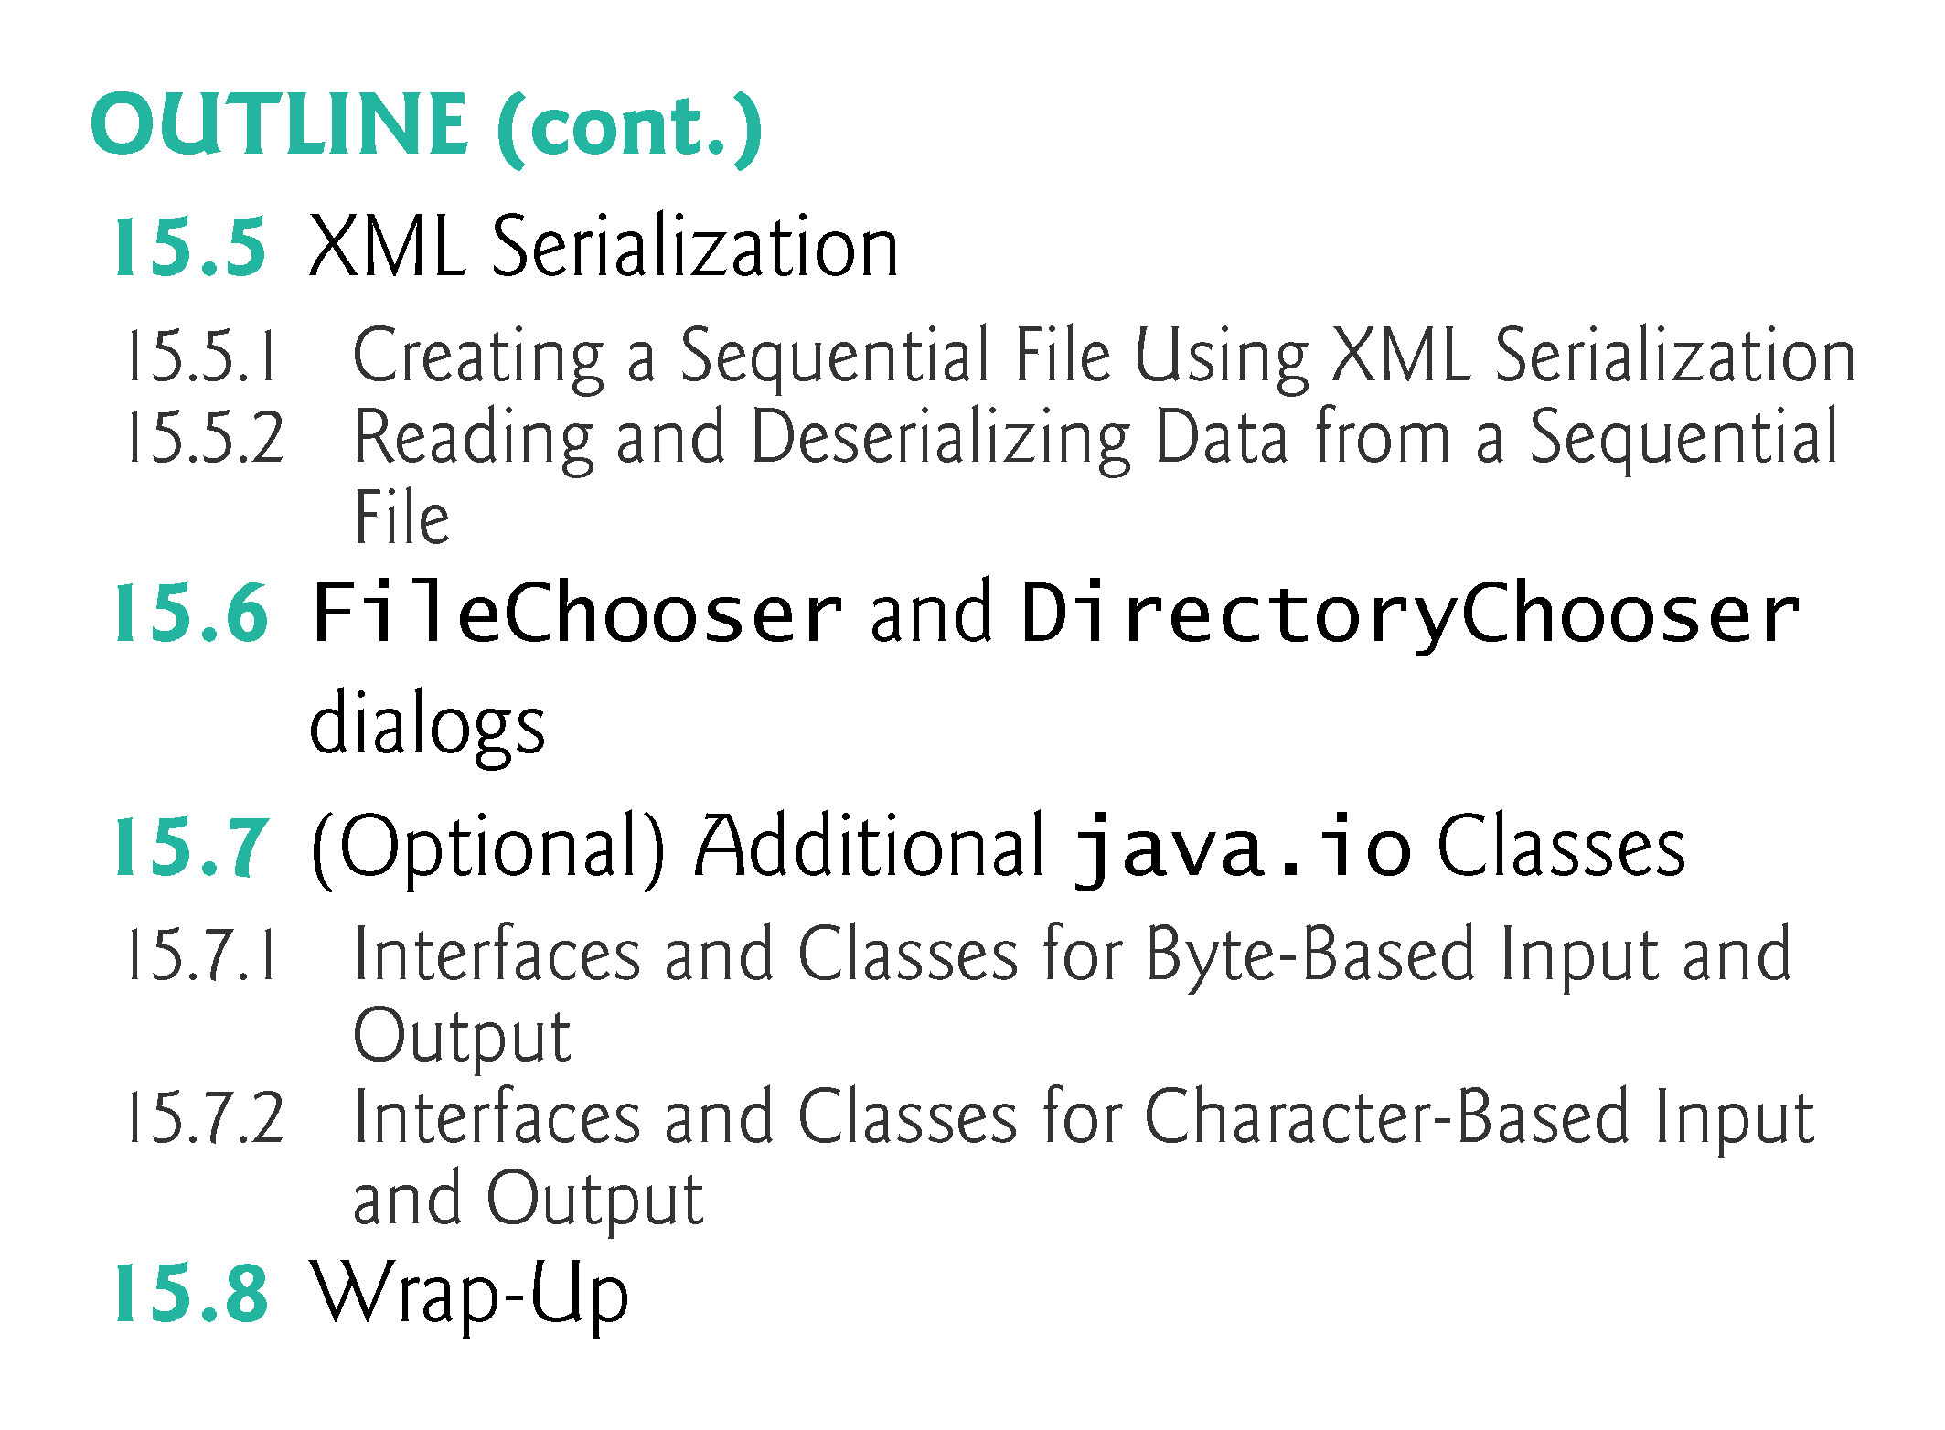

Slide 6
15.1 Introduction
Data stored in variables and arrays is temporary
It’s lost when a local variable goes out of scope or when the program terminates
For long-term retention of data, computers use files.
Computers store files on secondary storage devices
hard disks, flash drives, DVDs and more.
Data maintained in files is persistent data because it exists beyond the duration of program execution.

Slide 7
15.2 Files and Streams
Java views each file as a sequential stream of bytes (Fig. 15.1).
Every operating system provides a mechanism to determine the end of a file, such as an end-of-file marker or a count of the total bytes in the file that is recorded in a system-maintained administrative data structure.
A Java program simply receives an indication from the operating system when it reaches the end of the stream

Slide 8
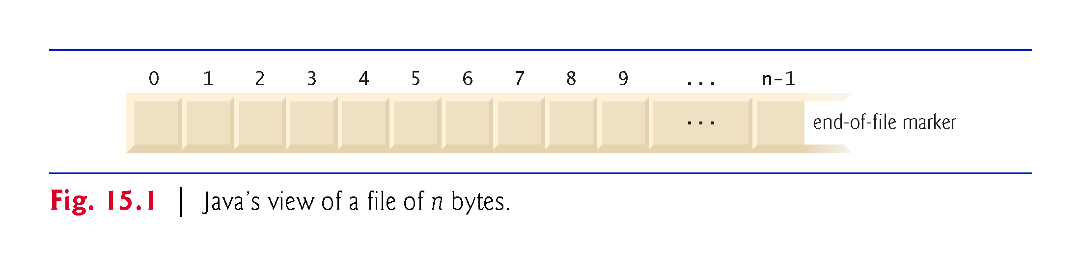

Slide 9
15.2 Files and Streams (cont.)
File streams can be used to input and output data as bytes or characters.
Byte-based streams output and input data in its binary format—a char is two bytes, an int is four bytes, a double is eight bytes, etc.
Character-based streams output and input data as a sequence of characters in which every character is two bytes—the number of bytes for a given value depends on the number of characters in that value.
Files created using byte-based streams are referred to as binary files.
Files created using character-based streams are referred to as text files. Text files can be read by text editors.
Binary files are read by programs that understand the specific content of the file and the ordering of that content.

Slide 10
15.2 Files and Streams (cont.)
A Java program opens a file by creating an object and associating a stream of bytes or characters with it.
Can also associate streams with different devices.
Java creates three stream objects when a program begins executing
System.in (standard input stream) object normally inputs bytes from the keyboard
Object System.out (the standard output stream object) normally outputs character data to the screen
Object System.err (the standard error stream object) normally outputs character-based error messages to the screen.
Class System provides methods setIn, setOut and setErr to redirect the standard input, output and error streams, respectively.

Slide 11
15.2 Files and Streams (cont.)
Java programs perform file processing by using classes from package java.io and the subpackages of java.nio.
Character-based input and output can be performed with classes Scanner and Formatter.
Class Scanner is used extensively to input data from the keyboard. This class can also read data from a file.
Class Formatter enables formatted data to be output to any text-based stream in a manner similar to method System.out.printf.

Slide 12
15.2 Files and Streams (cont.)
Java SE 8 Adds Another Type of Stream
Chapter 17, Java SE 8 Lambdas and Streams, introduces a new type of stream that’s used to process collections of elements (like arrays and ArrayLists), rather than the streams of bytes we discuss in this chapter’s file-processing examples.

Slide 13
15.3 Using NIO Classes and Interfaces to Get File and Directory Information
Interfaces Path and DirectoryStream and classes Paths and Files (all from package java.nio.file) are useful for retrieving information about files and directories on disk:
Path interface—Objects of classes that implement this interface represent the location of a file or directory. Path objects do not open files or provide any file-processing capabilities.
Paths class—Provides static methods used to get a Path object representing a file or directory location.

Slide 14
15.3 Using NIO Classes and Interfaces to Get File and Directory Information (Cont.)
Files class—Provides static methods for common file and directory manipulations, such as copying files; creating and deleting files and directories; getting information about files and directories; reading the contents of files; getting objects that allow you to manipulate the contents of files and directories; and more
DirectoryStream interface—Objects of classes that implement this interface enable a program to iterate through the contents of a directory.

Slide 15
15.3 Using NIO Classes and Interfaces to Get File and Directory Information (Cont.)
A file or directory’s path specifies its location on disk. The path includes some or all of the directories leading to the file or directory.
An absolute path contains all directories, starting with the root directory, that lead to a specific file or directory.
Every file or directory on a particular disk drive has the same root directory in its path.
A relative path is “relative” to another directory—for example, a path relative to the directory in which the application began executing.

Slide 16
15.3 Using NIO Classes and Interfaces to Get File and Directory Information (Cont.)
An overloaded version of Files static method get uses a URI object to locate the file or directory.
A Uniform Resource Identifier (URI) is a more general form of the Uniform Resource Locators (URLs) that are used to locate websites.
On Windows platforms, the URI
file://C:/data.txt
identifies the file data.txt stored in the root directory of the C: drive. On UNIX/Linux platforms, the URI
file:/home/student/data.txt
identifies the file data.txt stored in the home directory of the user student.

Slide 17
15.3 Using NIO Classes and Interfaces to Get File and Directory Information (Cont.)
Figure 15.2 prompts the user to enter a file or directory name, then uses classes Paths, Path, Files and DirectoryStream to output information about that file or directory.
A separator character is used to separate directories and files in a path.
On a Windows computer, the separator character is a backslash (\).
On a Linux or Mac OS X system, it’s a forward slash (/).
Java processes both characters identically in a path name.

Slide 18
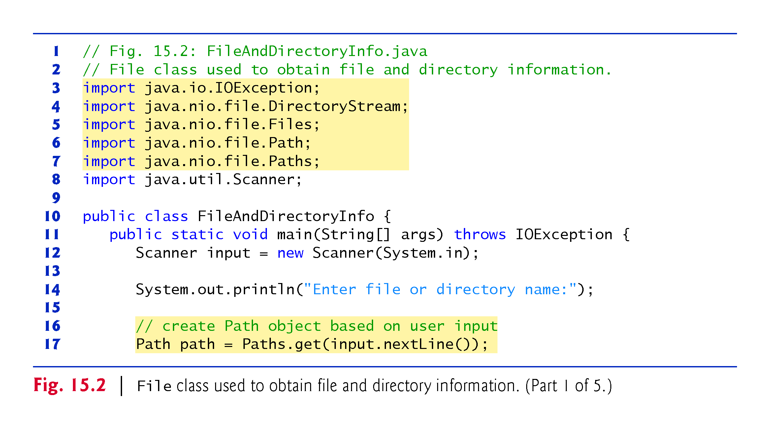

Slide 19
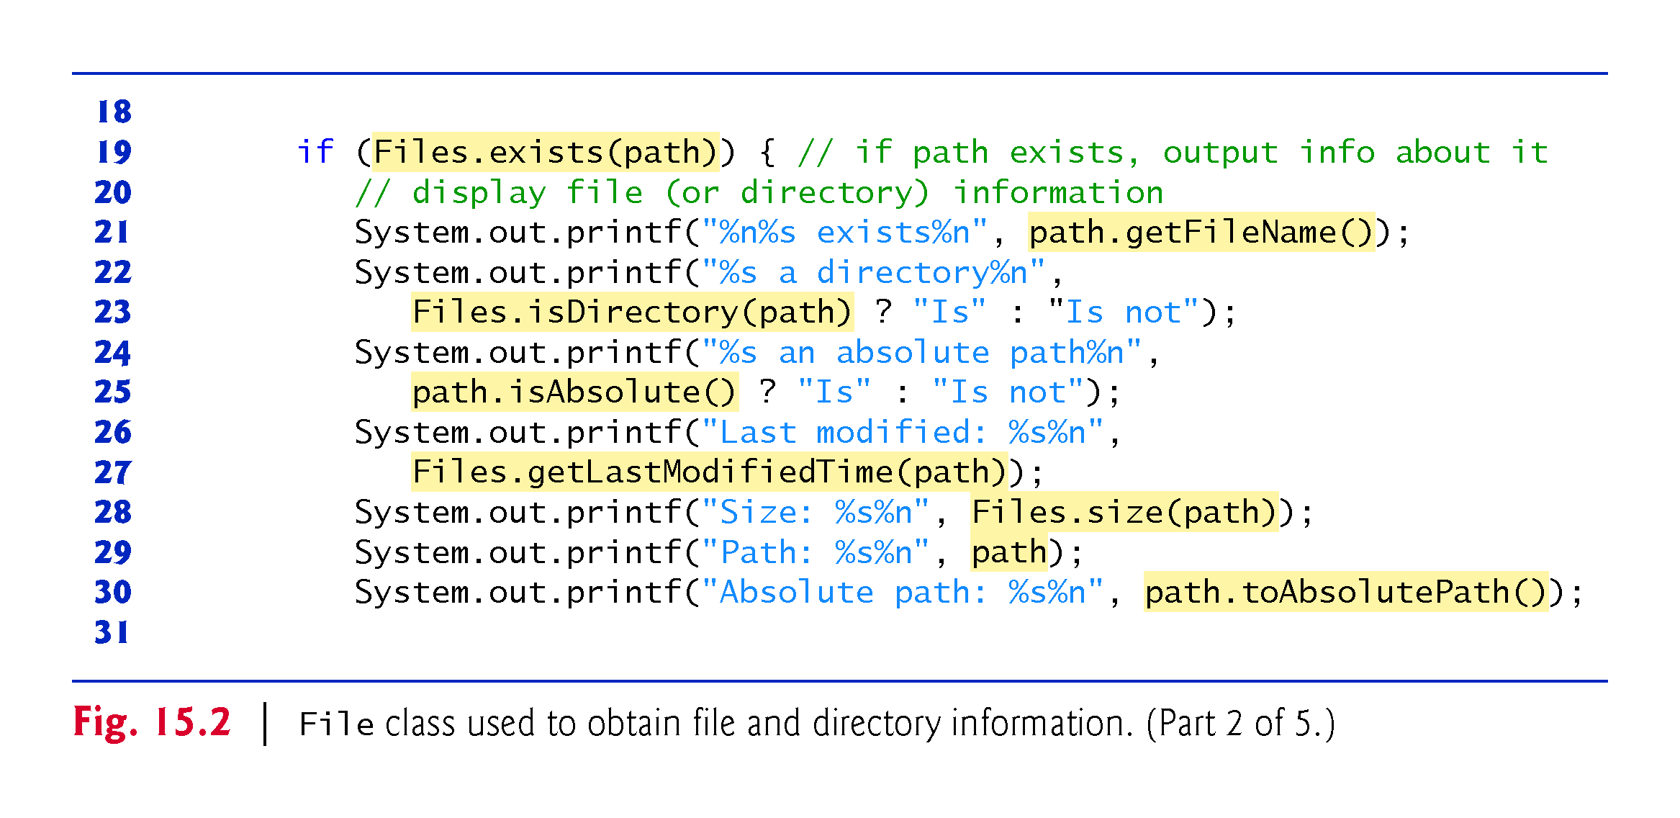

Slide 20
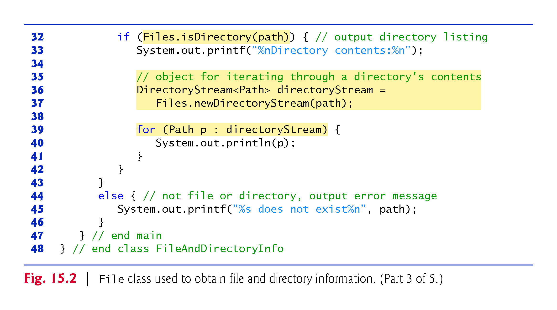

Slide 21
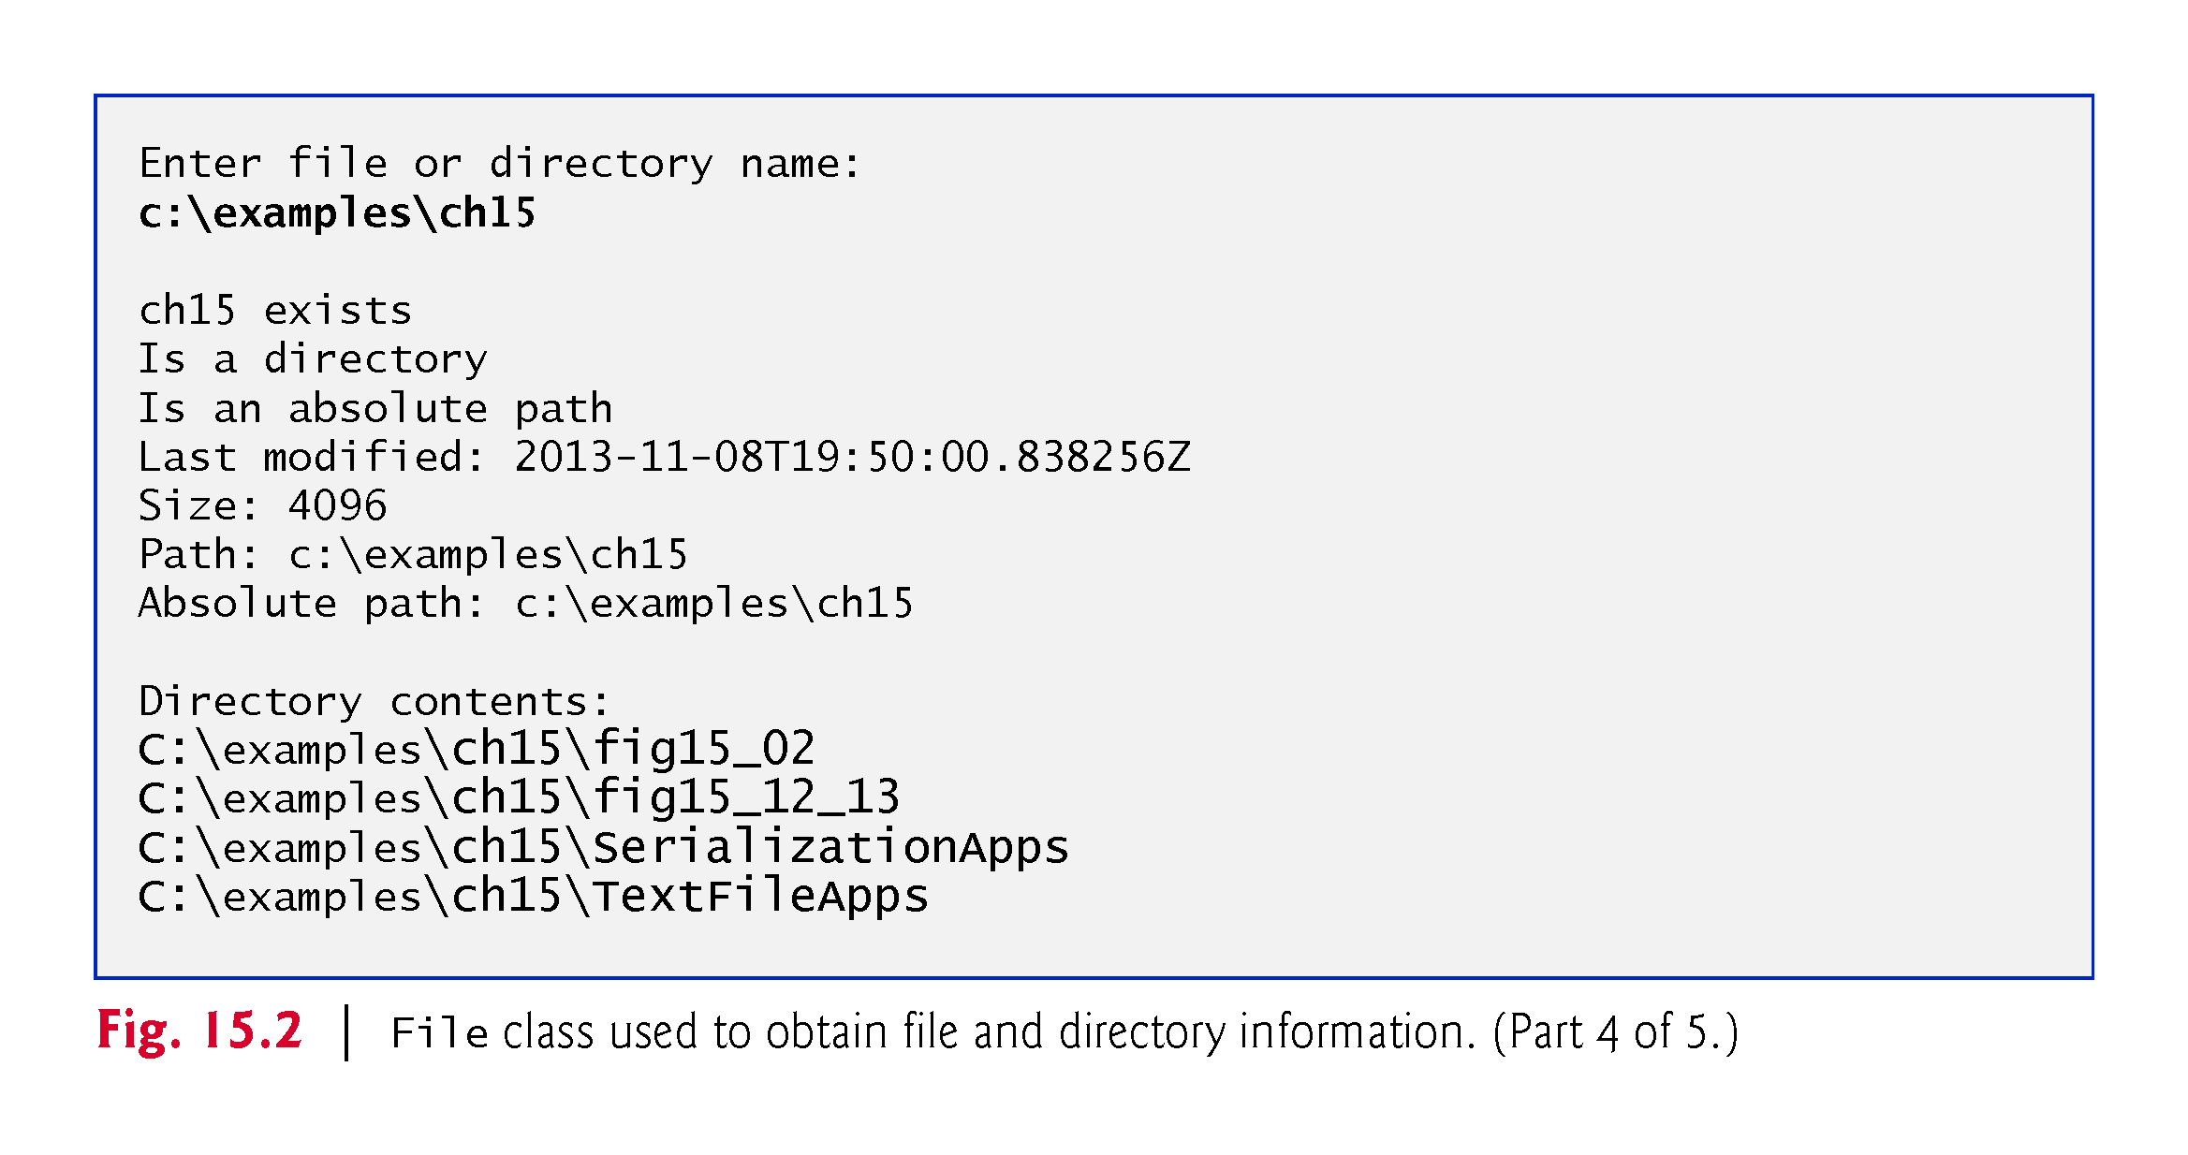

Slide 22
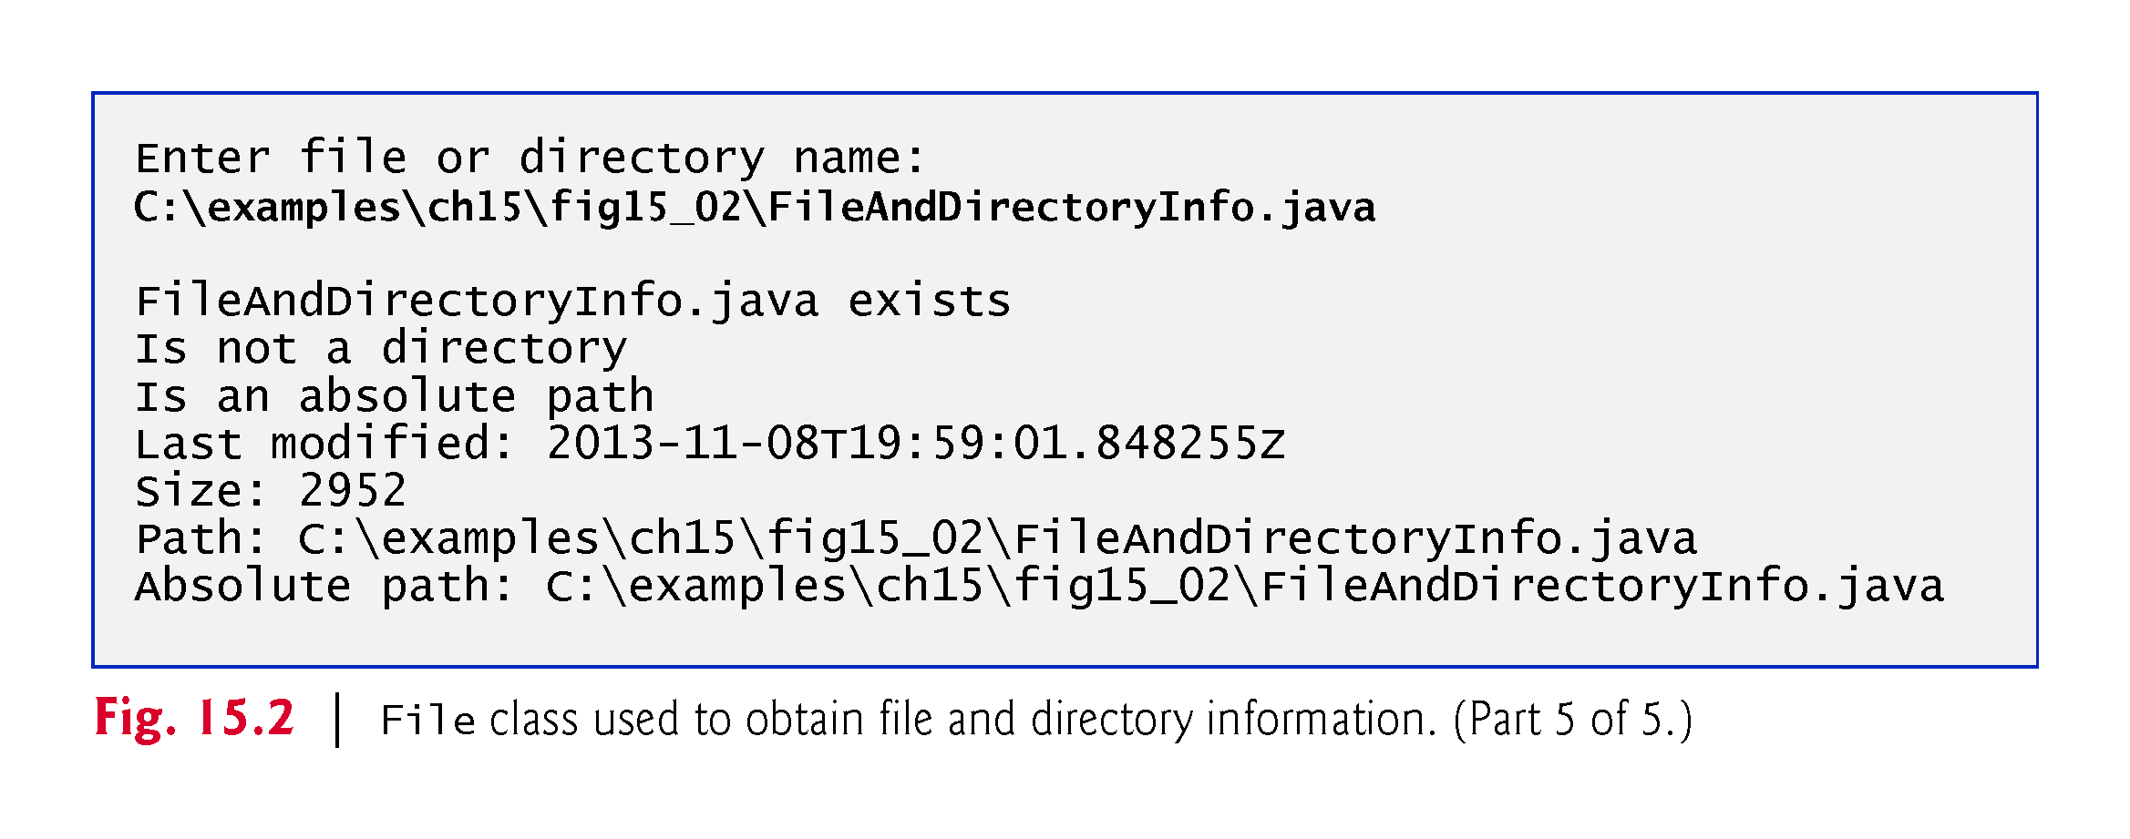

Slide 23
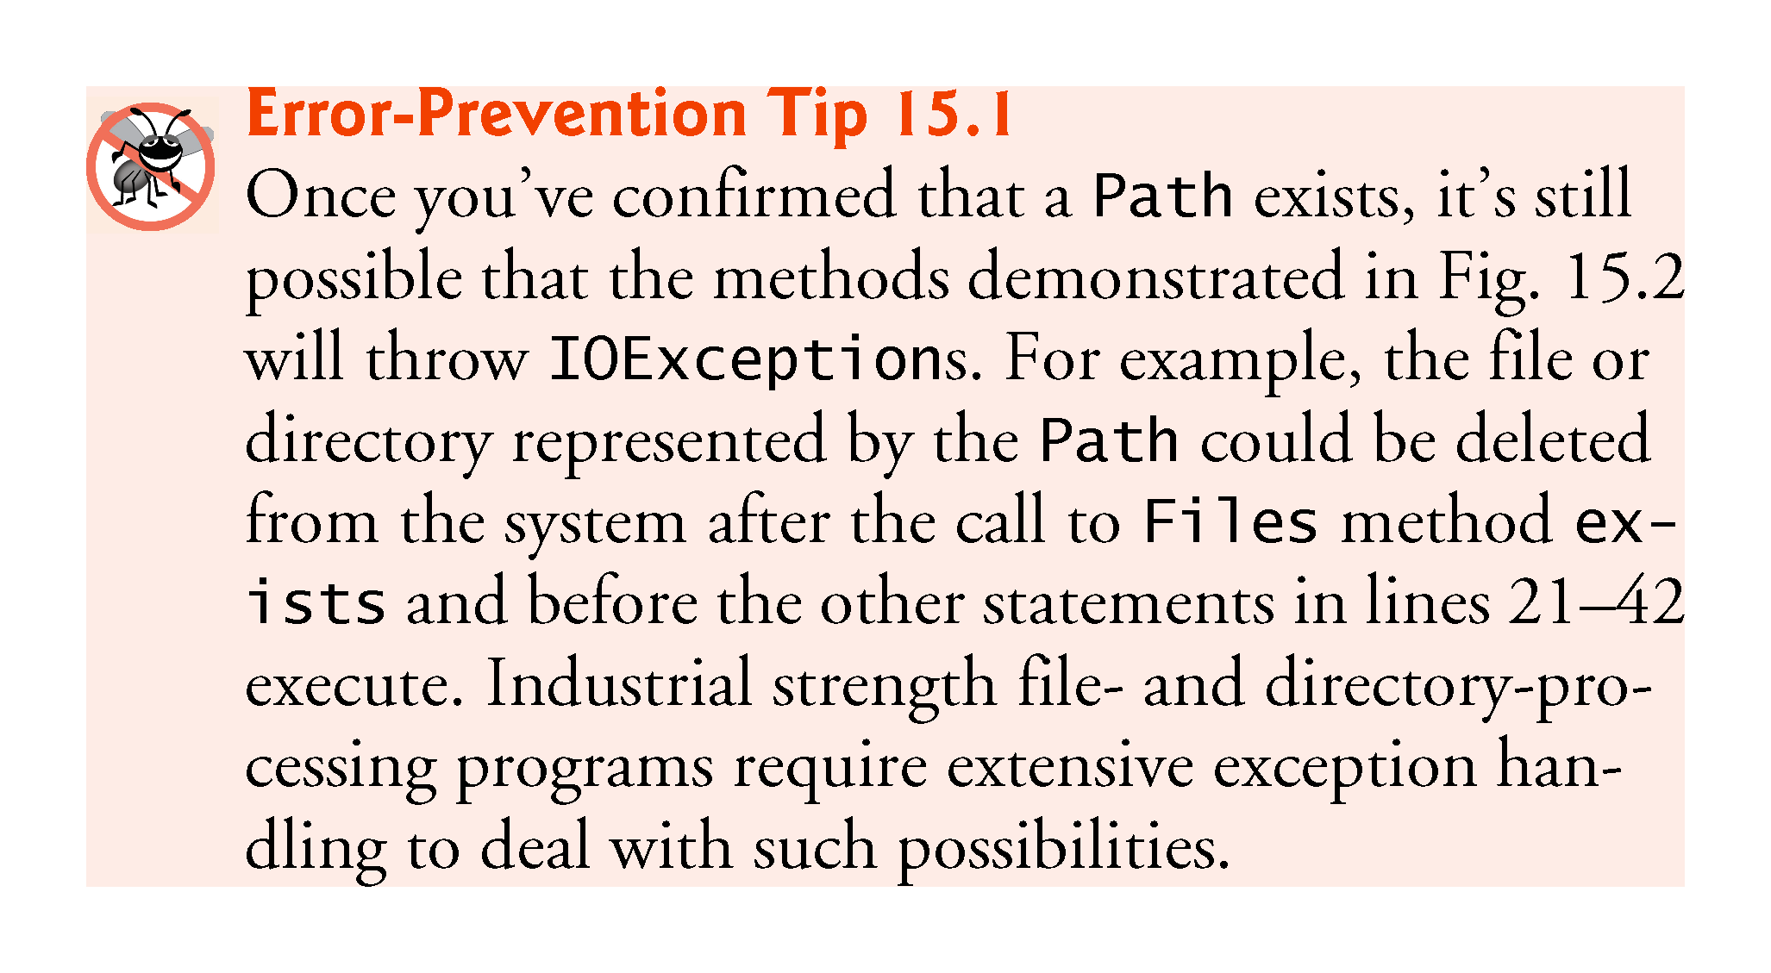

Slide 24
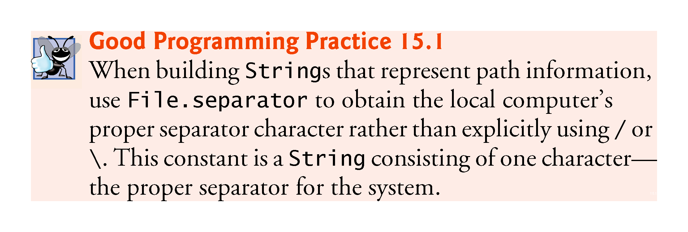

Slide 25
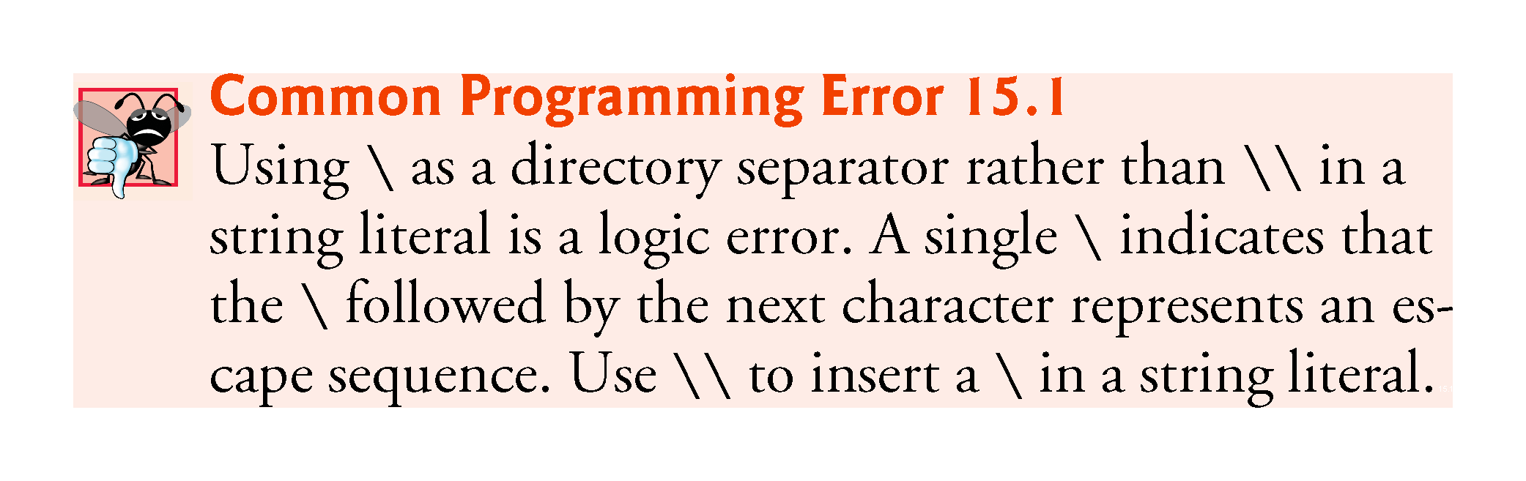

Slide 26
15.4 Sequential Text Files
Sequential-access files store records in order by the record-key field.
Text files are human-readable files.

Slide 27
15.4.1 Creating a Sequential Text File
Java imposes no structure on a file
Notions such as records do not exist as part of the Java language.
You must structure files to meet the requirements of your applications.

Slide 28
15.4.1 Creating a Sequential Text File (cont.)
Formatter outputs formatted Strings to the specified stream.
The constructor with one String argument receives the name of the file, including its path.
If a path is not specified, the JVM assumes that the file is in the directory from which the program was executed.
If the file does not exist, it will be created.
If an existing file is opened, its contents are truncated.

Slide 29
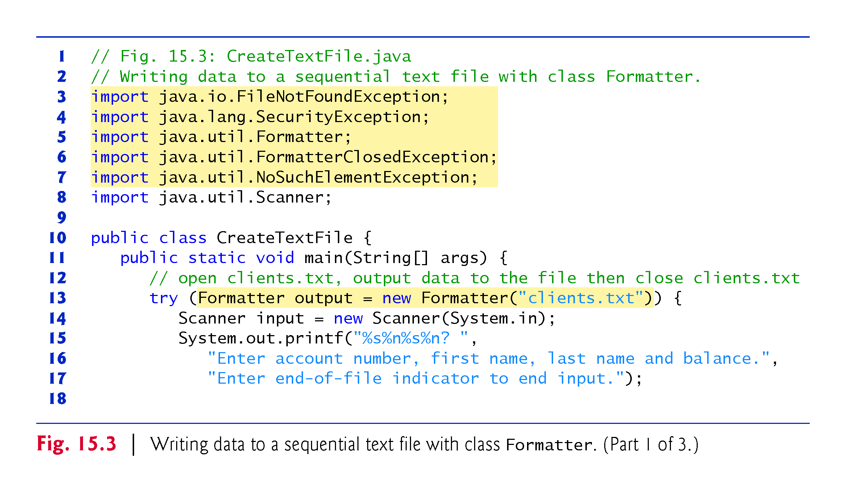

Slide 30
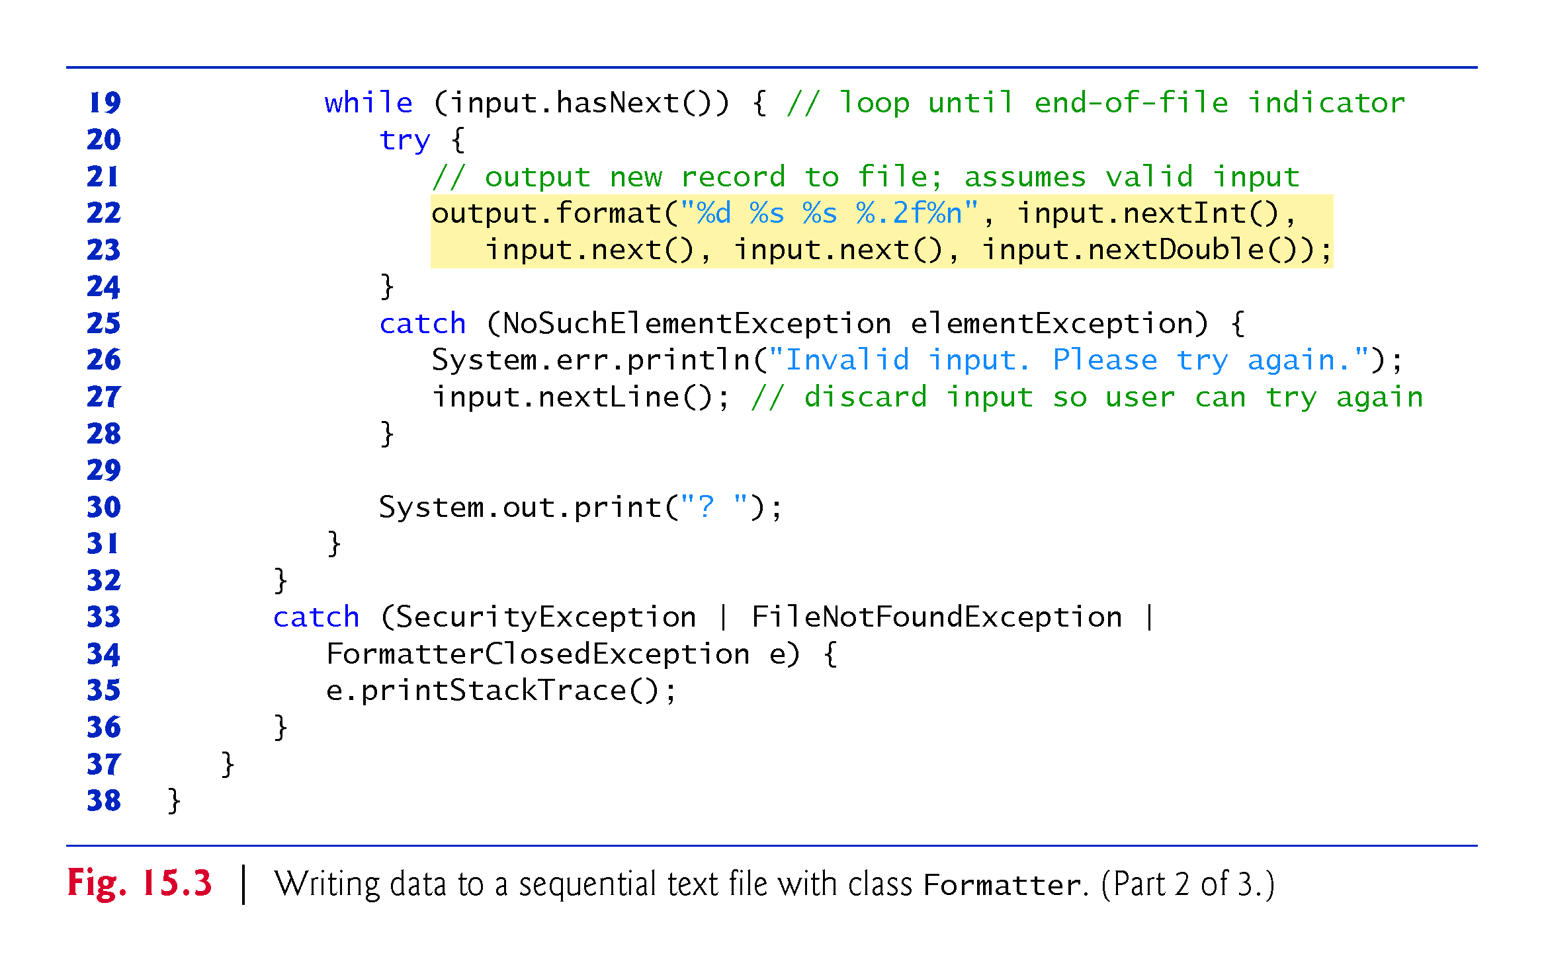

Slide 31
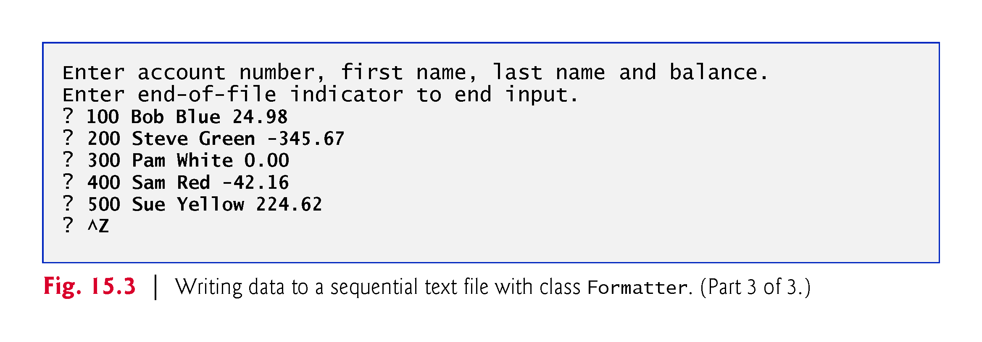

Slide 32
15.4.1 Creating a Sequential Text File (cont.)
A SecurityException occurs if the user does not have permission to write data to the file.
A FileNotFoundException occurs if the file does not exist and a new file cannot be created.
static method System.exit terminates an application.
An argument of 0 indicates successful program termination.
A nonzero value, normally indicates that an error has occurred.
The argument is useful if the program is executed from a batch file on Windows or a shell script on UNIX/Linux/Mac OS X.

Slide 33
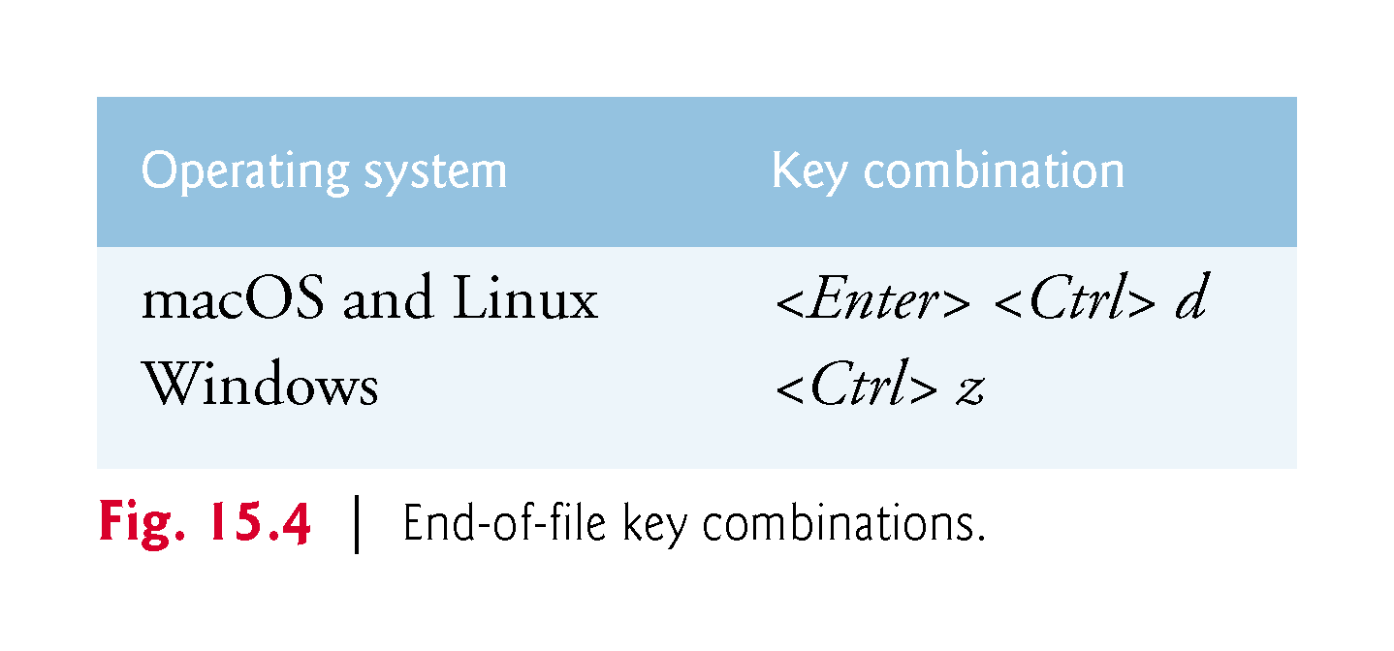

Slide 34
15.4.1 Creating a Sequential Text File (cont.)
Scanner method hasNext determines whether the end-of-file key combination has been entered.
A NoSuchElementException occurs if the data being read by a Scanner method is in the wrong format or if there is no more data to input.
Formatter method format works like System.out.printf
Formatter method close closes the file.
If method close is not called explicitly, the operating system normally will close the file when program execution terminates.

Slide 35
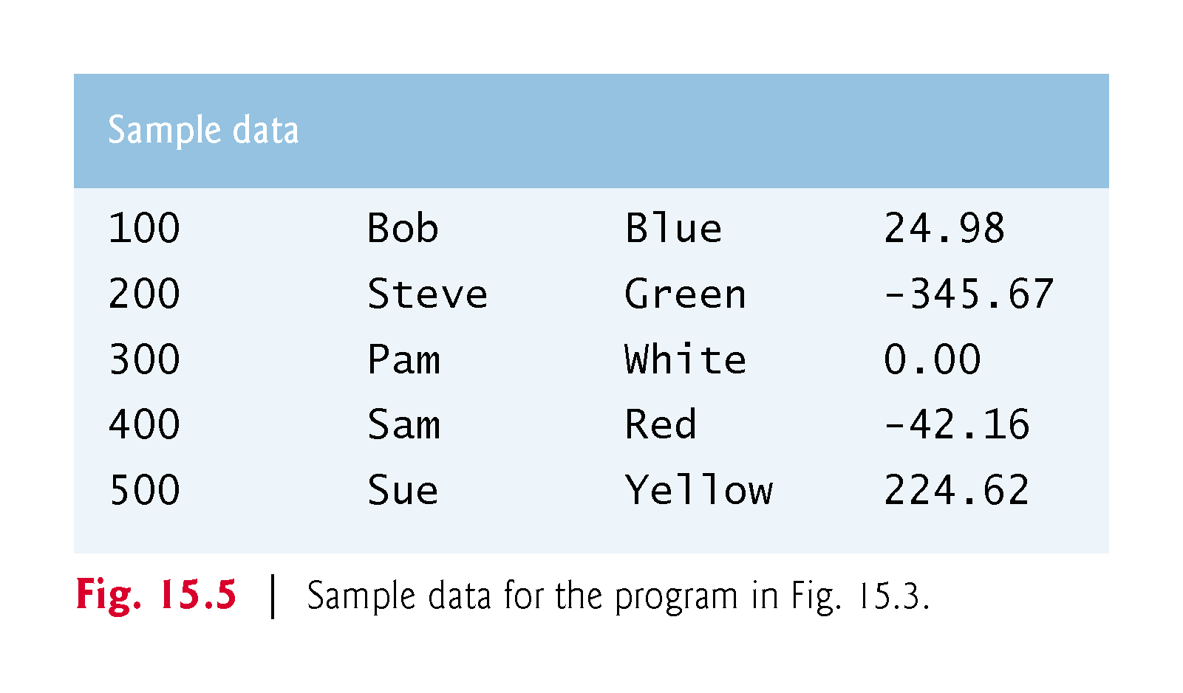

Slide 36
15.4.2 Reading Data from a Sequential Text File
The application (Fig. 15.6) reads records from the file "clients.txt" created by the application of Section 15.4.1 and displays the record contents. If a Scanner is closed before data is input, an IllegalStateException occurs.

Slide 37
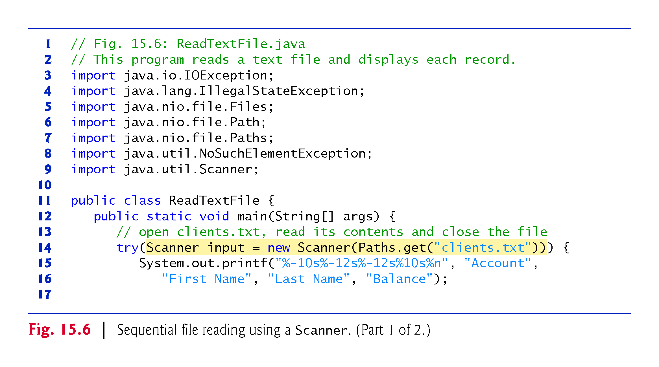

Slide 38
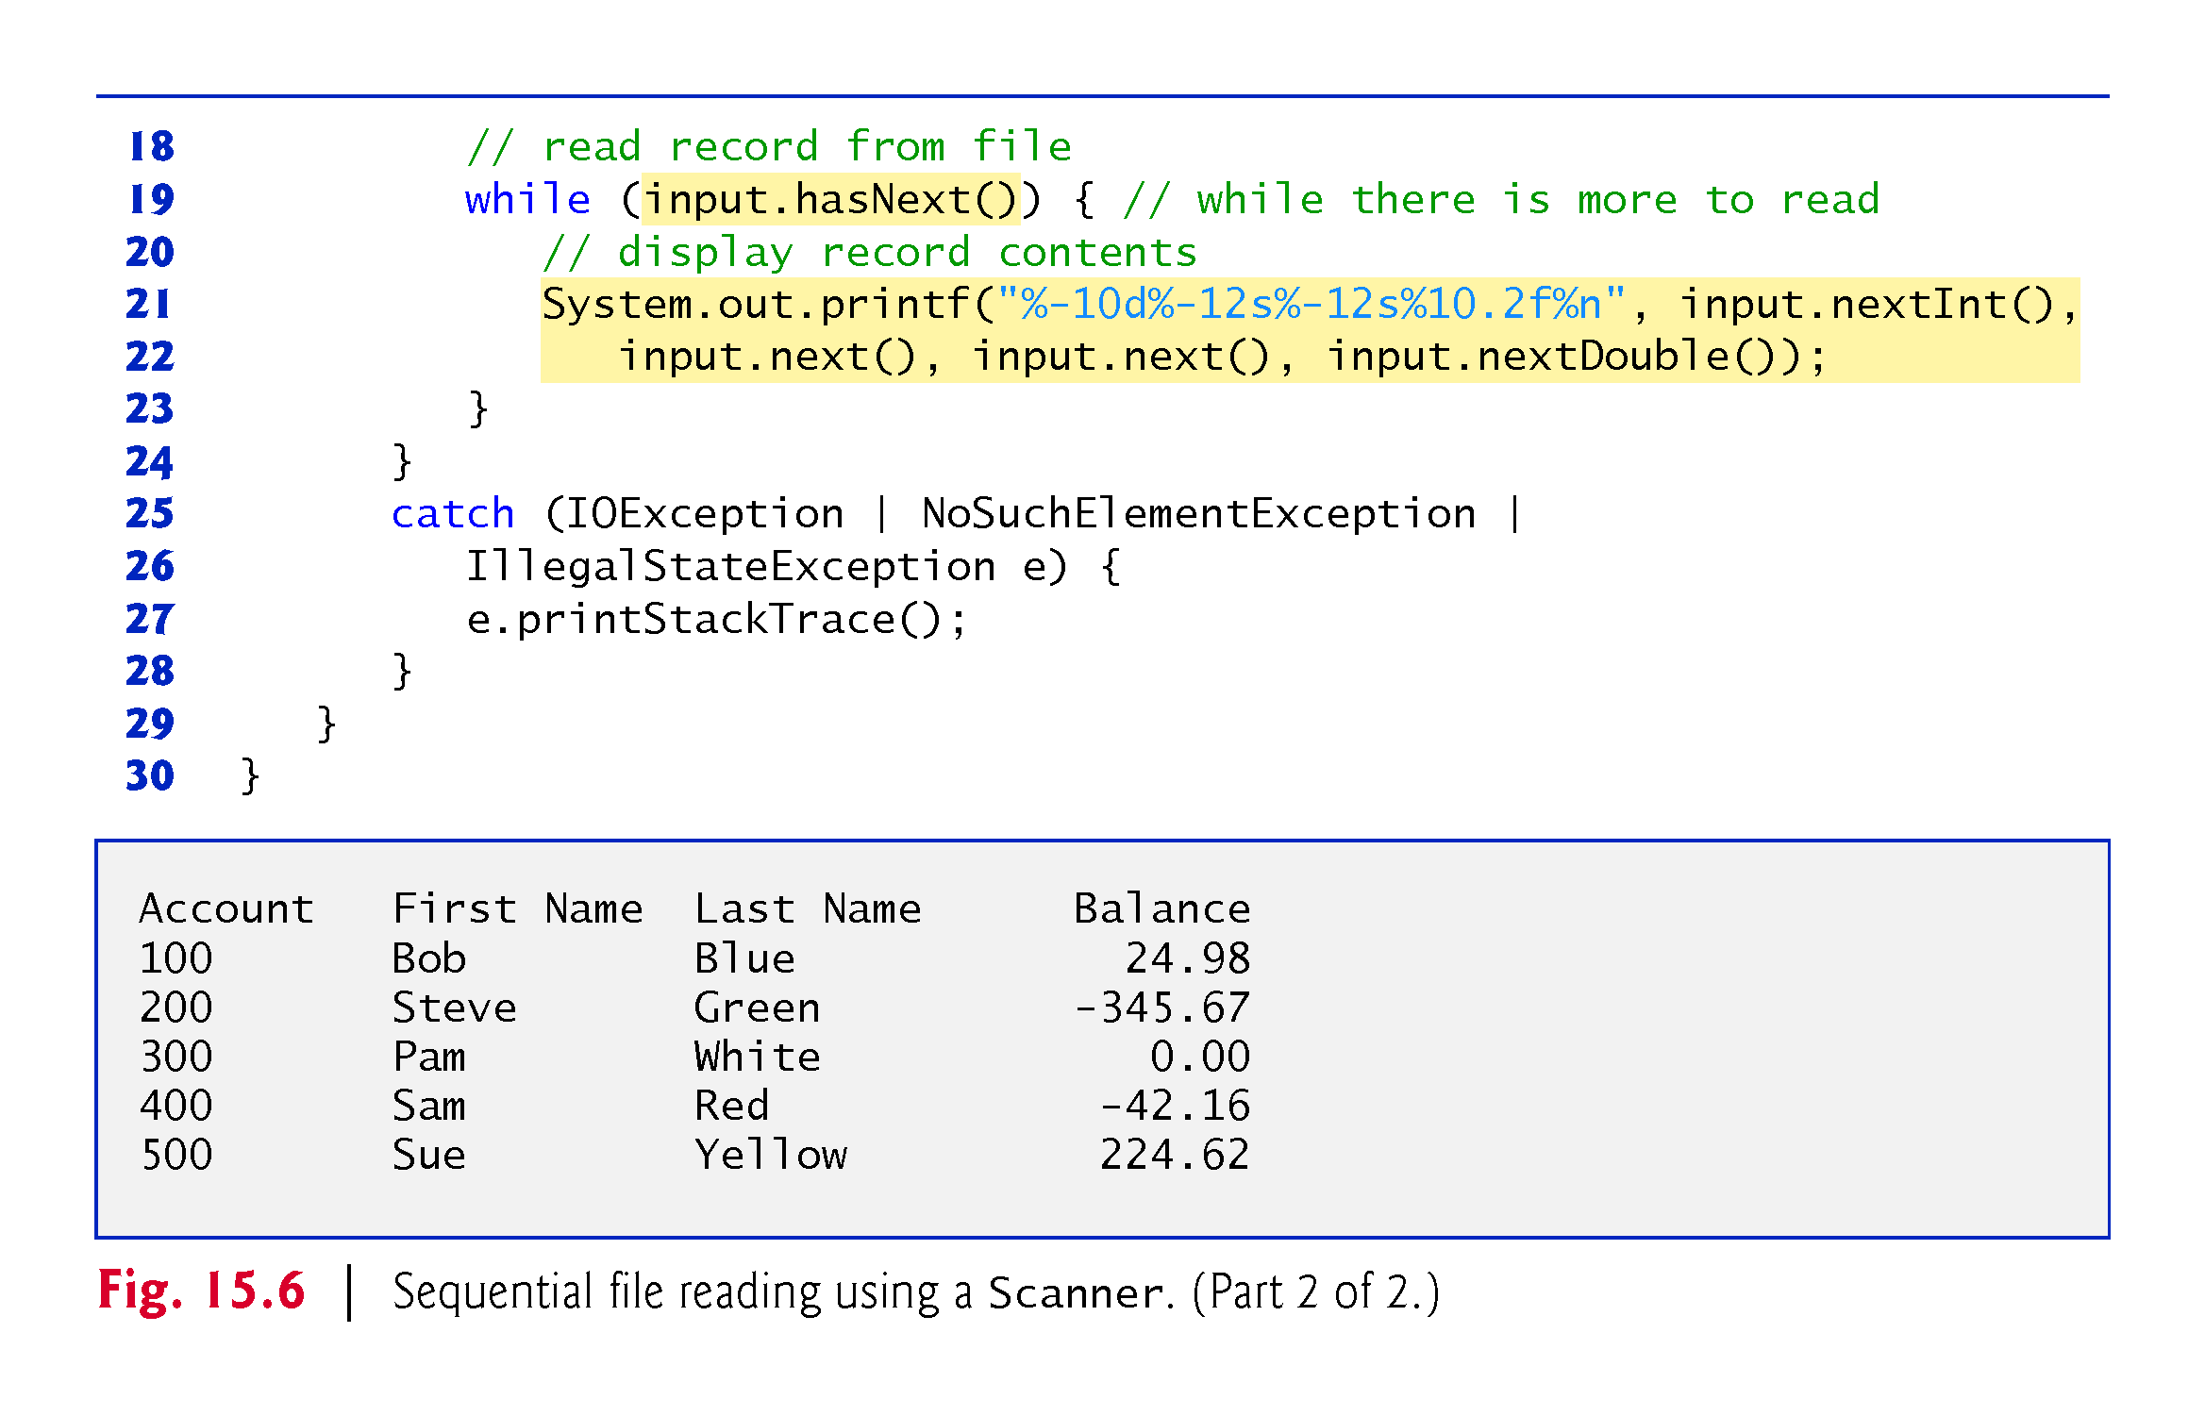

Slide 39
15.4.3 Case Study: A Credit-Inquiry Program
To retrieve data sequentially from a file, programs start from the beginning of the file and read all the data consecutively until the desired information is found.
It might be necessary to process the file sequentially several times (from the beginning of the file) during the execution of a program.
Class Scanner does not allow repositioning to the beginning of the file.
The program must close the file and reopen it.

Slide 40
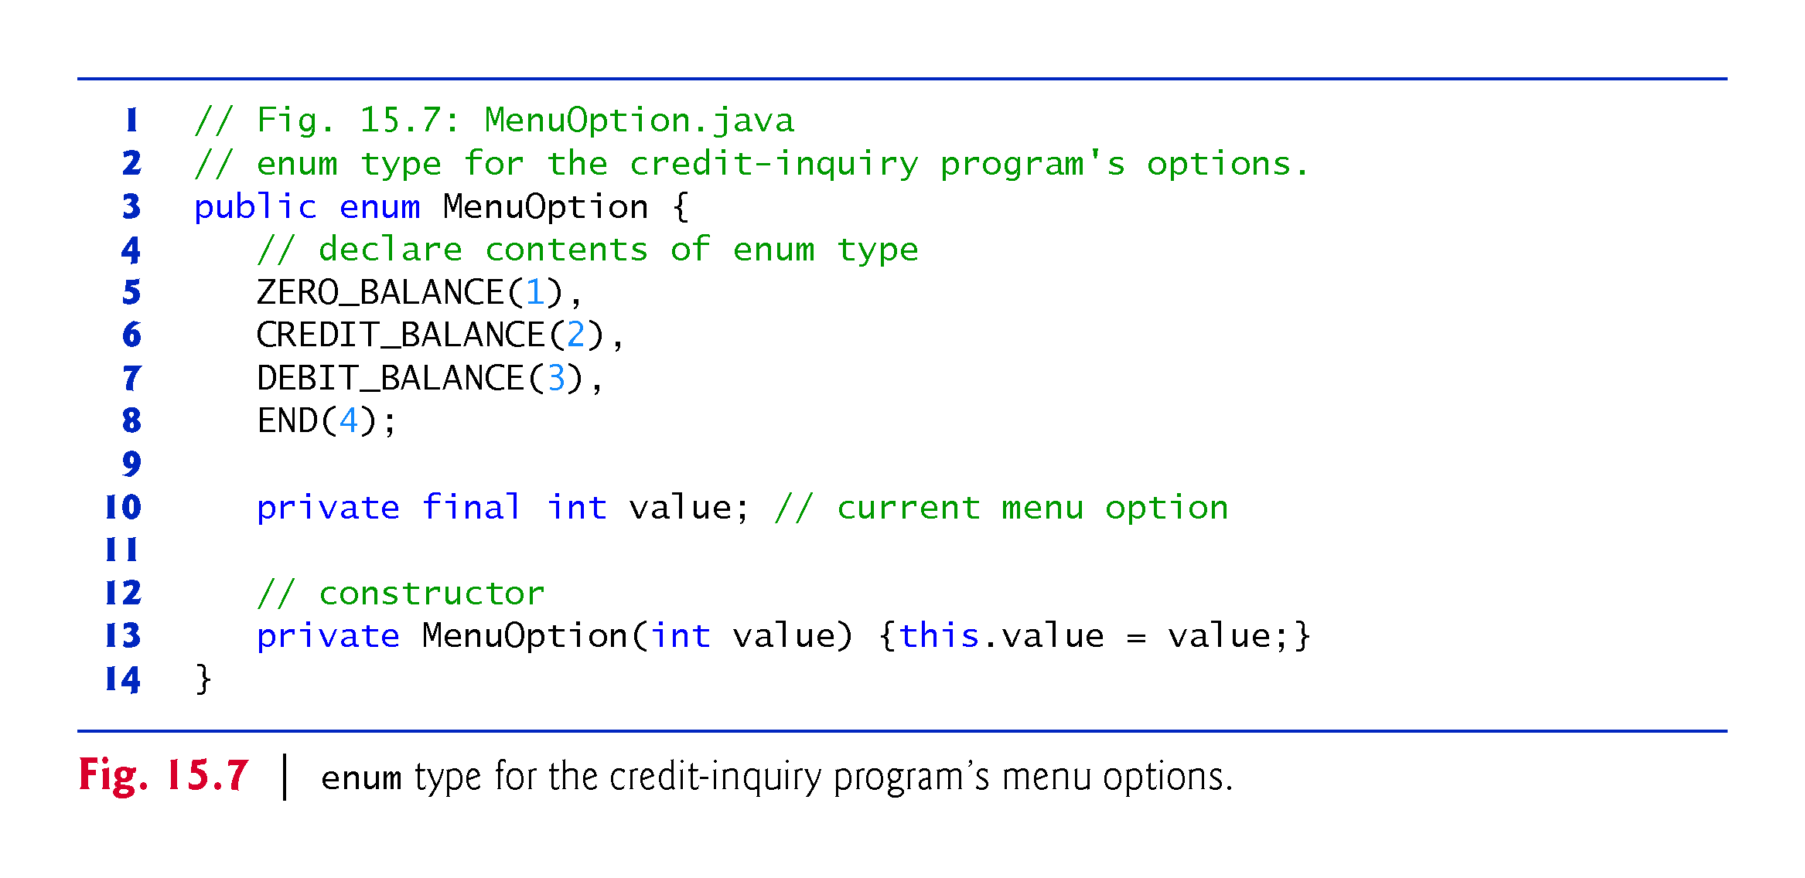

Slide 41
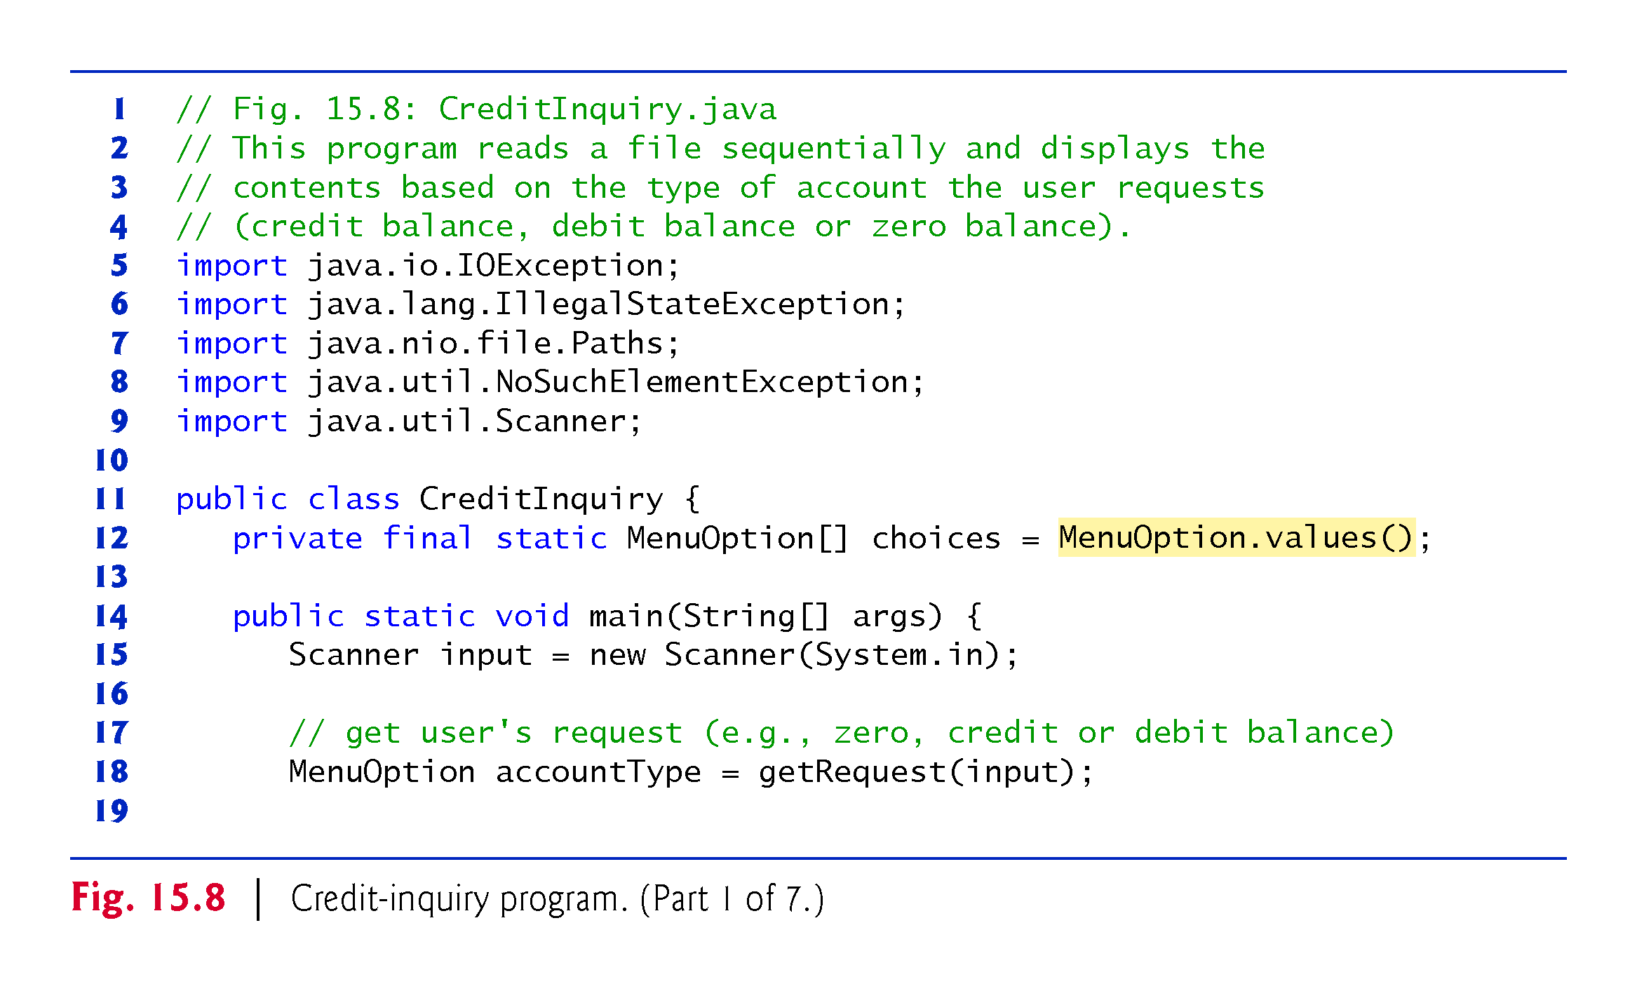

Slide 42
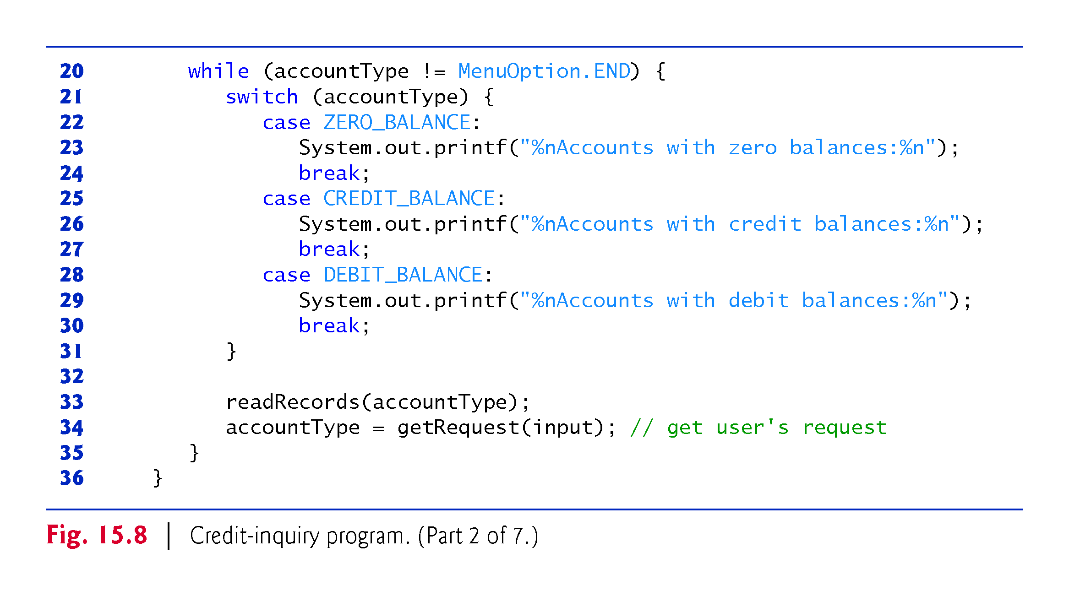

Slide 43
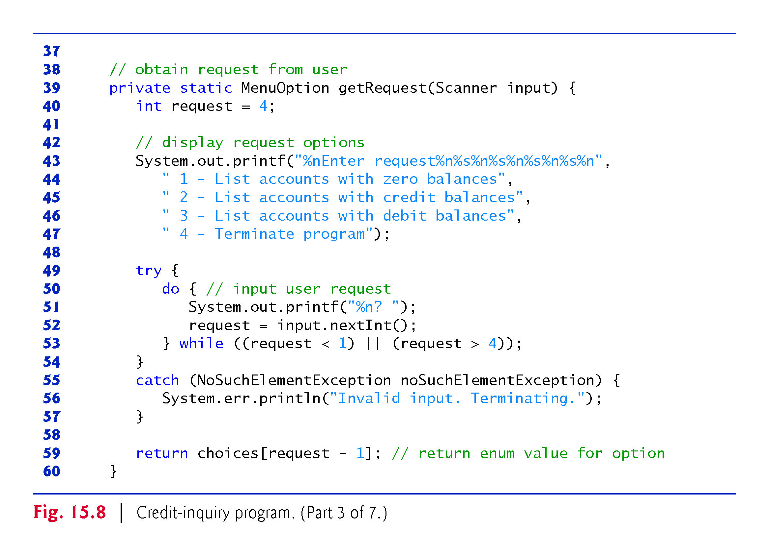

Slide 44
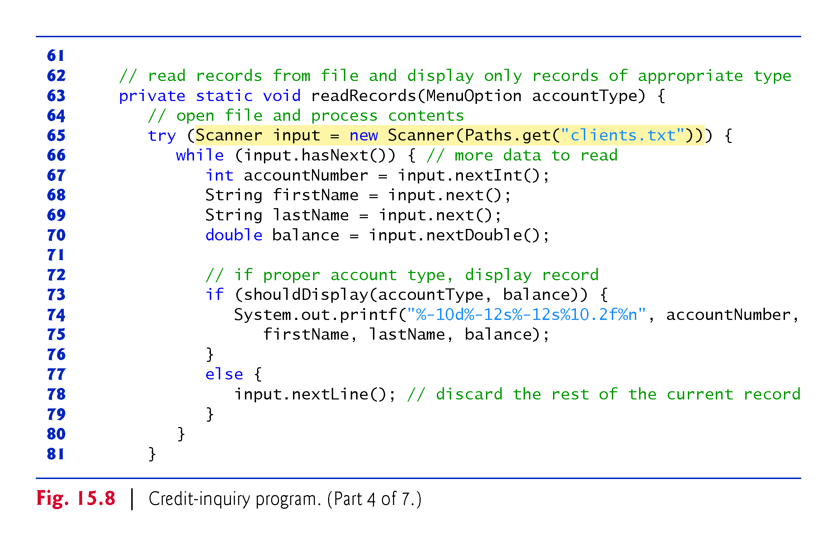

Slide 45
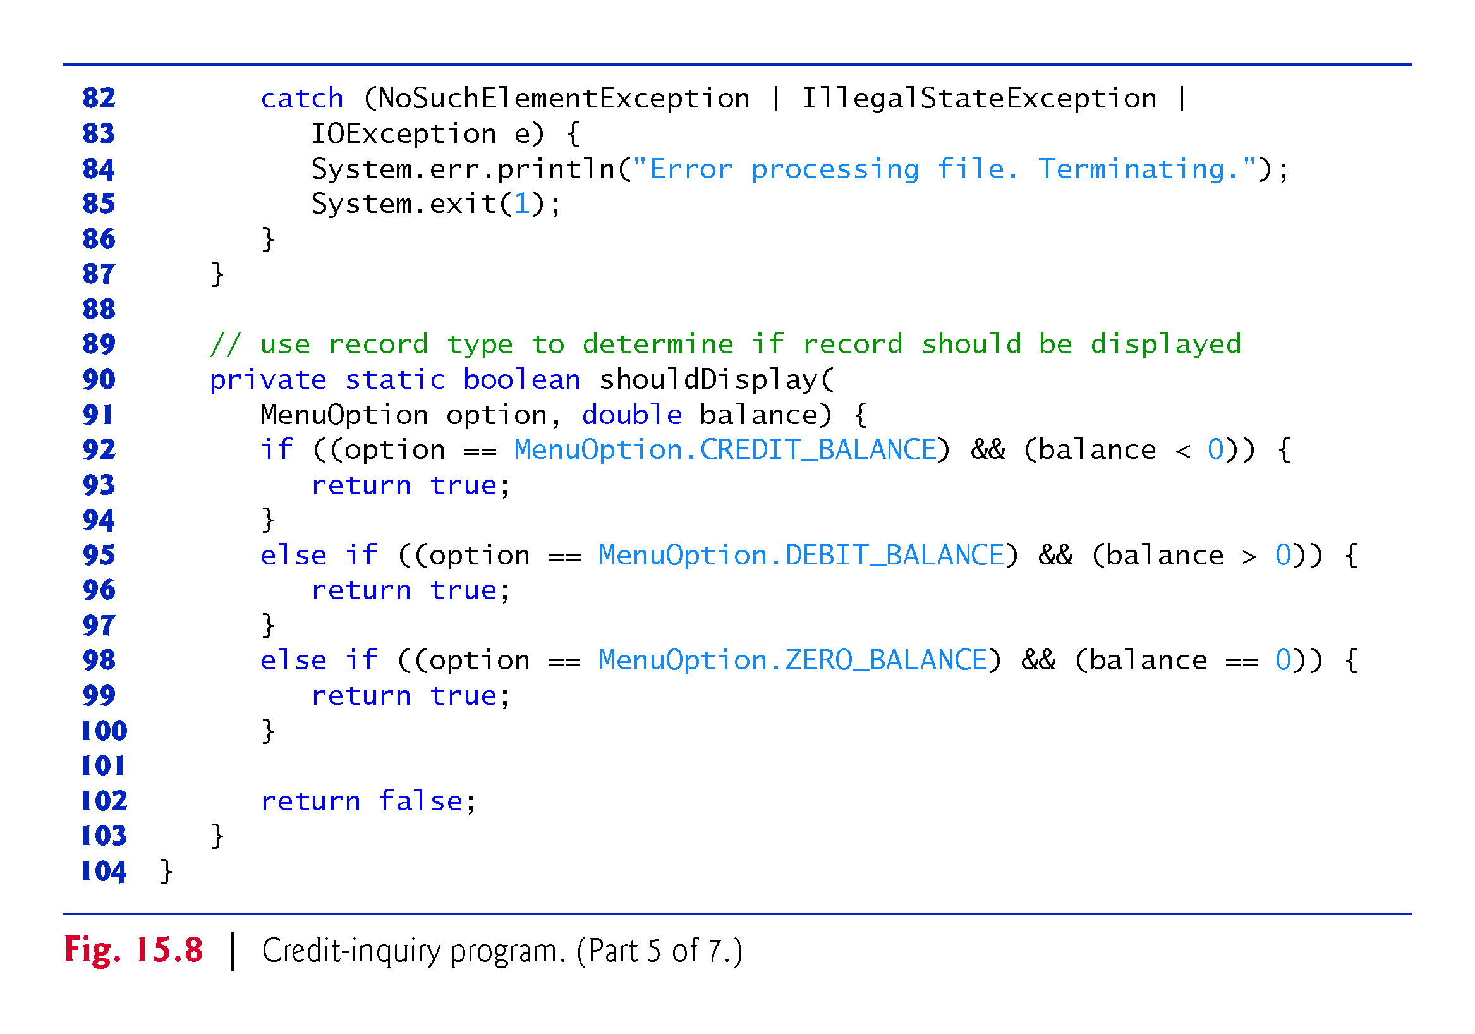

Slide 46
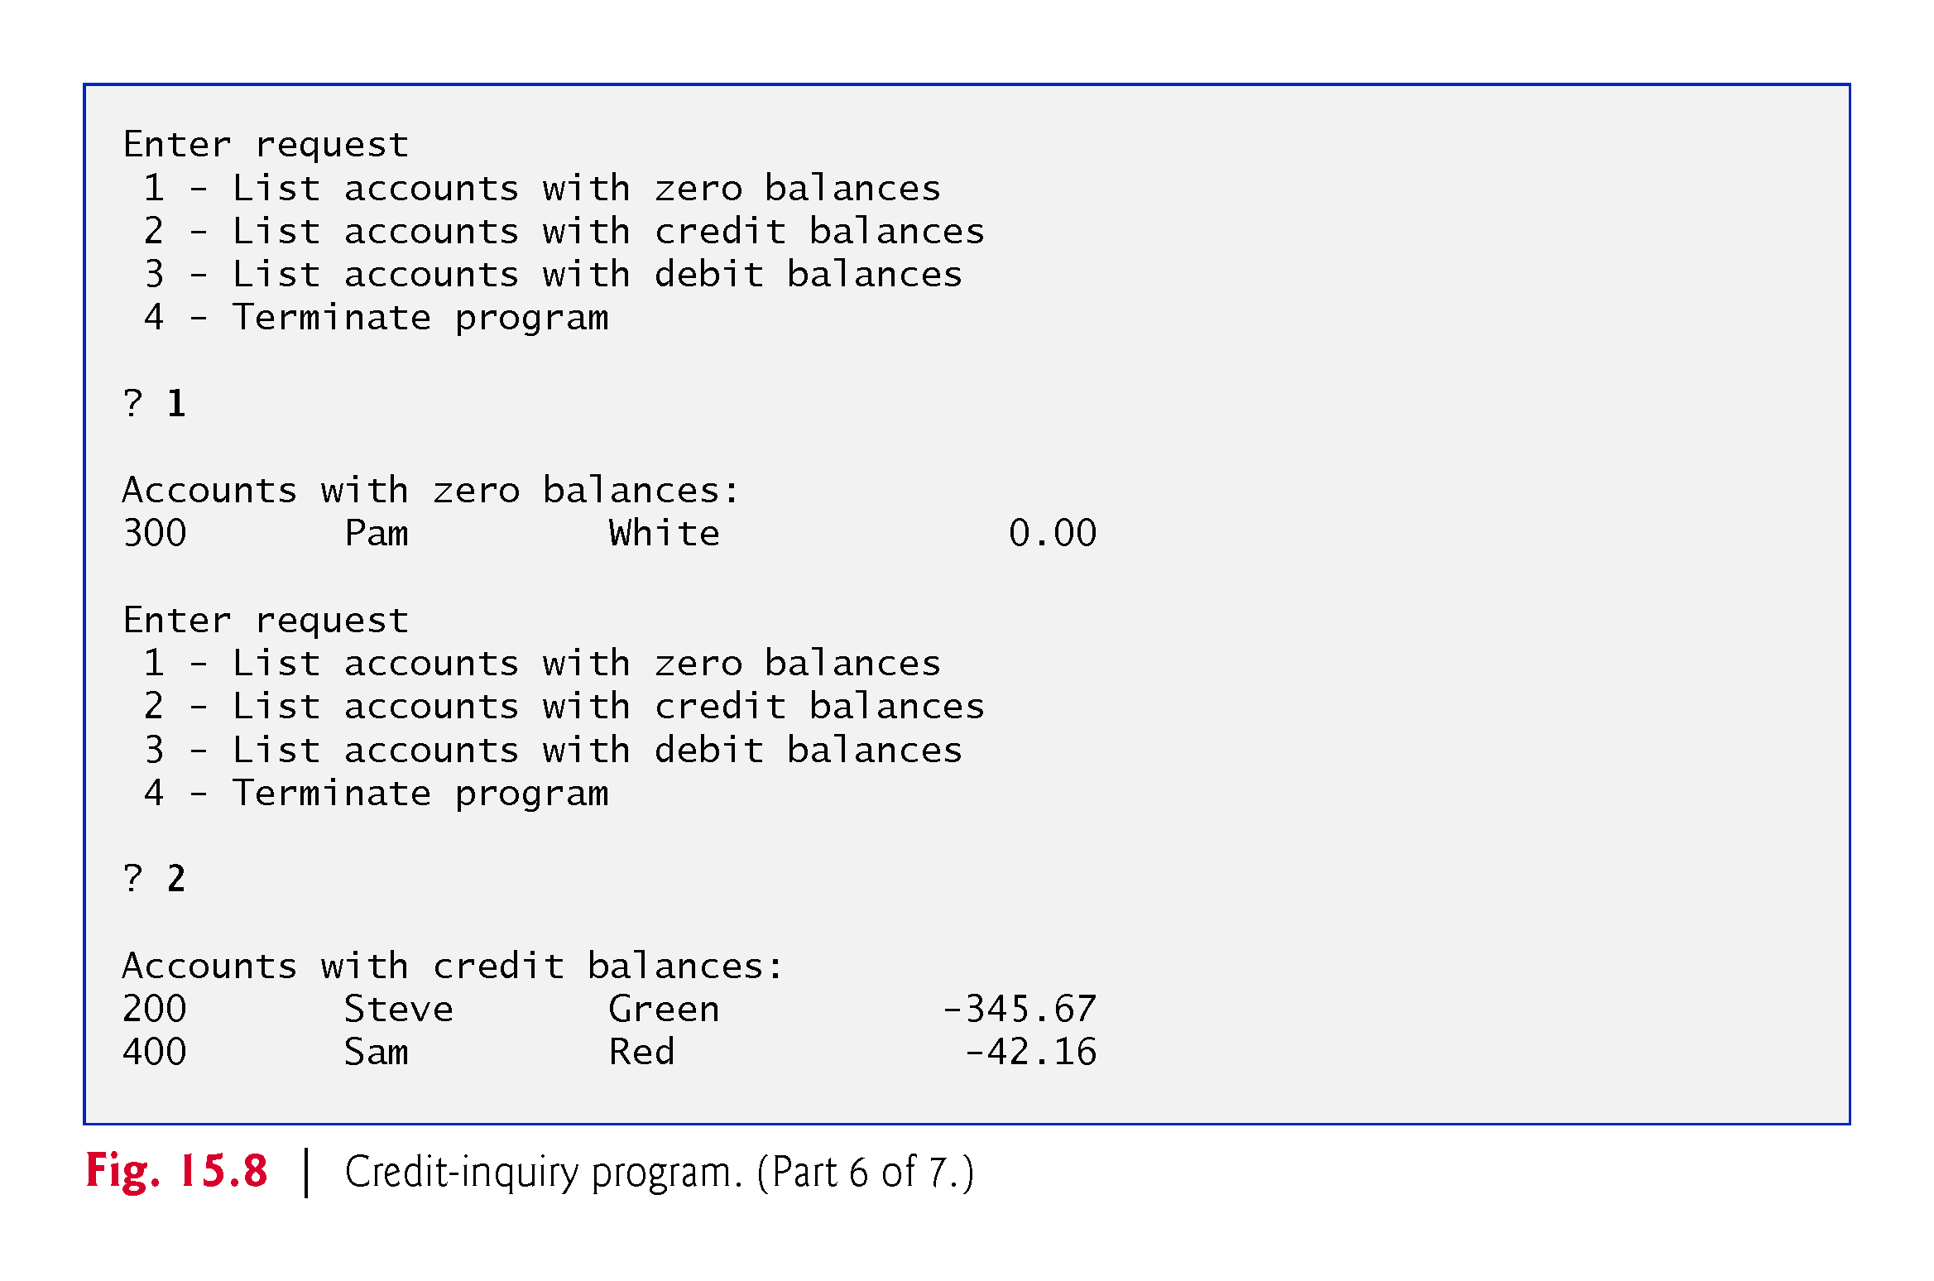

Slide 47
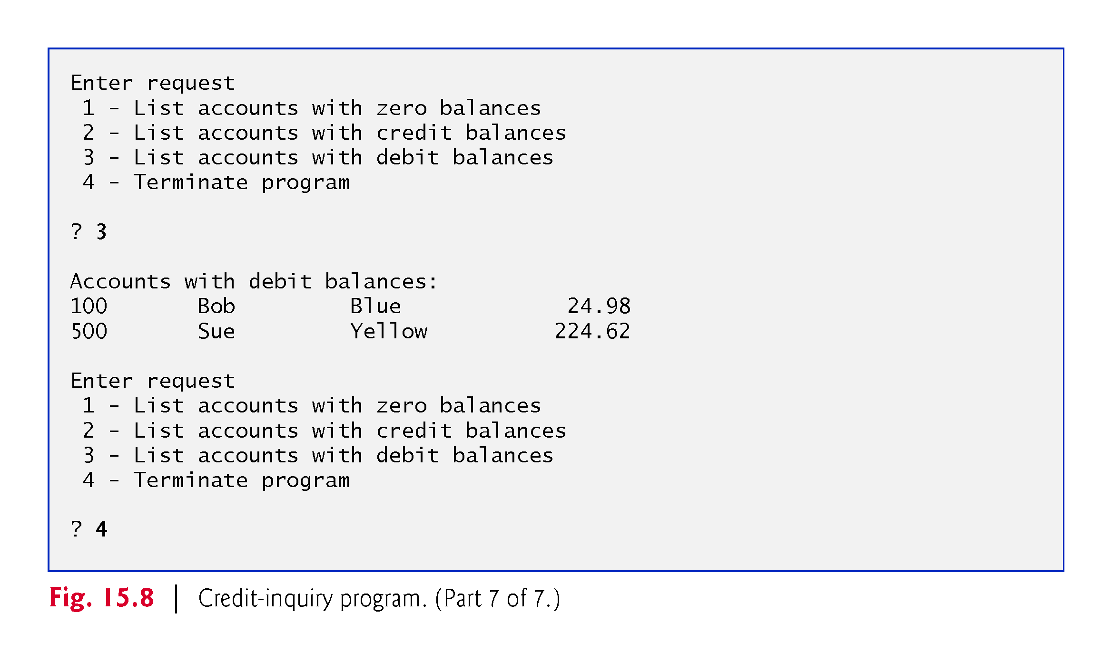

Slide 48
15.4.4 Updating Sequential Files
The data in many sequential files cannot be modified without the risk of destroying other data in the file.
If the name “White” needed to be changed to “Worthington,” the old name cannot simply be overwritten, because the new name requires more space.
Fields in a text file—and hence records—can vary in size.
Records in a sequential file are not usually updated in place. Instead, the entire file is rewritten.
Rewriting the entire file is uneconomical to update just one record, but reasonable if a substantial number of records need to be updated.

Slide 49
15.5 XML Serialization
Sometimes we want to write an entire object to or read an entire object from a file or over a network connection
XML (eXtensible Markup Language) is a widely used language for describing data
APIs for manipulating objects as XML are built into Java SE

Slide 50
15.5 XML Serialization
We’ll manipulate objects using JAXB (Java Architecture for XML Binding)
JAXB enables you to perform XML serialization—which JAXB refers to as marshaling
A serialized object is represented by XML that includes the object’s data
After a serialized object has been written into a file, it can be read from the file and deserialized—that is, the XML that represents the object and its data can be used to recreate the object in memory\

Slide 51
15.5.1 Creating a Sequential File Using XML Serialization
The serialization we show in this section is performed with character-based streams, so the result will be a text file that you can view in standard text editors.
Class Account (Fig. 15.9) encapsulates the client record information used by the serialization examples
Contains private instance variables account, firstName, lastName and balance (lines 4–7) and set and get methods for accessing these instance variables

Slide 52
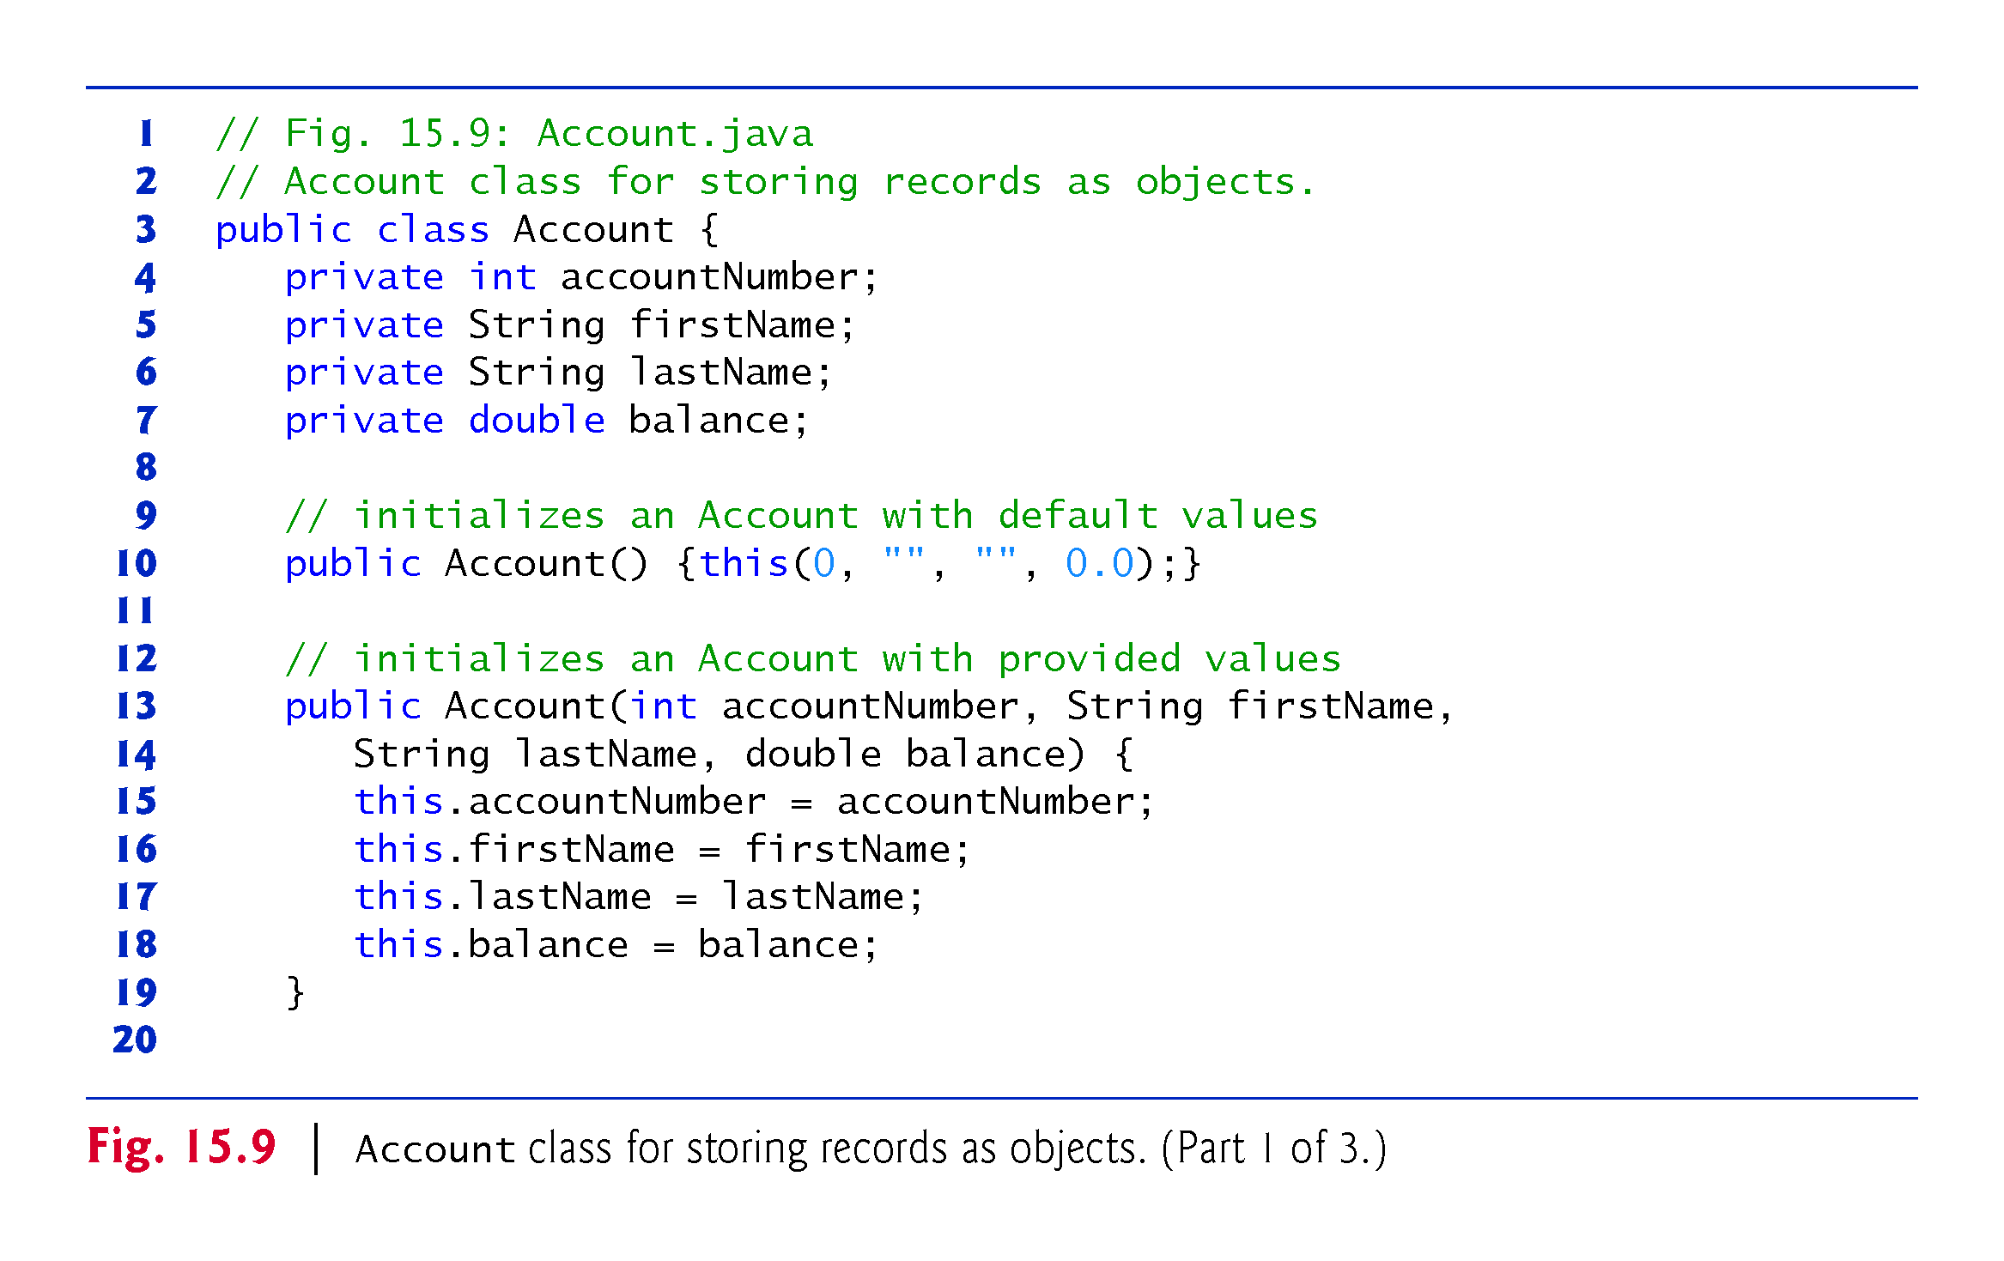

Slide 53
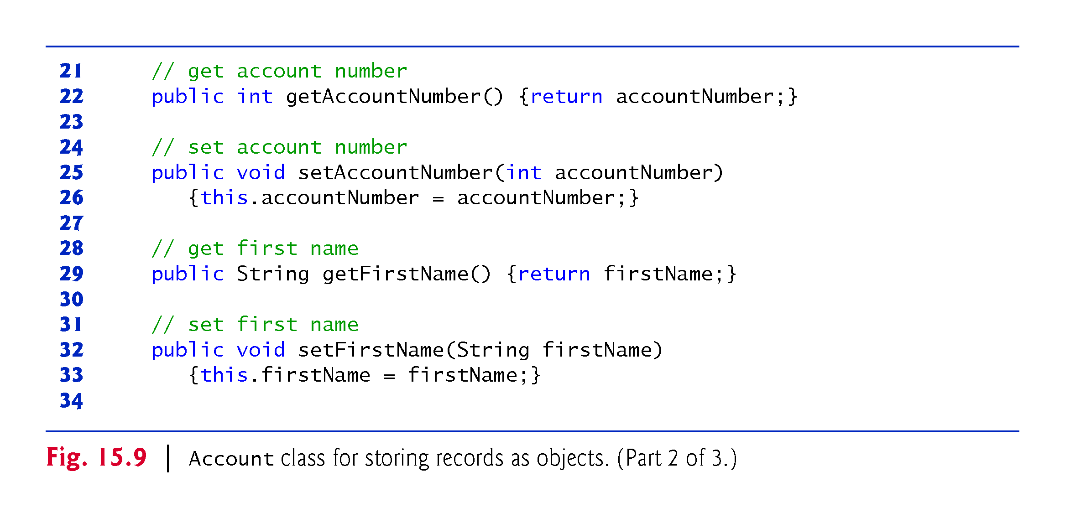

Slide 54
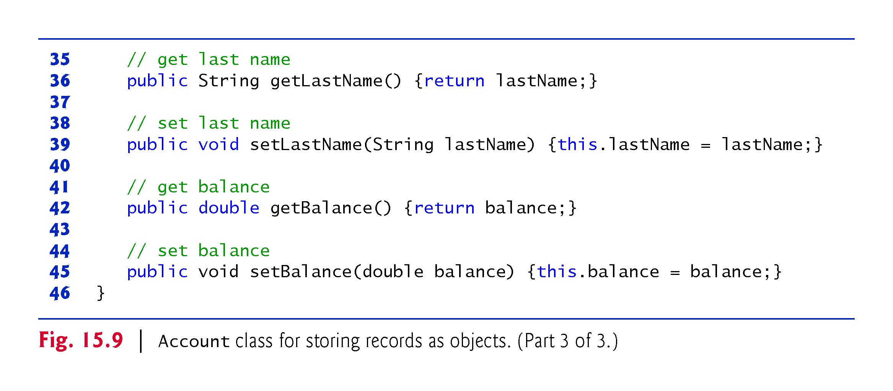

Slide 55
15.5.1 Creating a Sequential File Using XML Serialization (cont.)
Plain Old Java Objects
JAXB works with POJOs (plain old Java objects)—no special superclasses or interfaces are required for XML-serialization suppor
By default, JAXB serializes only an object’s public instance variables and public read–write properties.
Class Account defines a read–write properties accountNumber, firstName, lastName and balance
The class must also provide a public default or no-argument constructor to recreate the objects when they’re read from the file

Slide 56
15.5.1 Creating a Sequential File Using XML Serialization (cont.)
Declaring Class Accounts
Fig. 15.11 stores Account objects in a List<Account>, then serializes the entire List into a file with one operation
To serialize a List, it must be defined as an instance variable of a class.
For that reason, we encapsulate the List<Account> in class Accounts (Fig. 15.10).
Lines 9–10 declare and initialize the List<Account> instance variable

Slide 57
15.5.1 Creating a Sequential File Using XML Serialization (cont.)
Lines 9–10 declare and initialize the List<Account> instance variable accounts
JAXB enables you to customize many aspects of XML serialization, such as serializing a private instance variable or a read-only property
Annotation @XMLElement (line 9; package javax.xml.bind.annotation) indicates that the private instance variable should be serialized
The annotation is required because the instance variable is not public and there’s no corresponding public read–write property.

Slide 58
15.5.1 Creating a Sequential File Using XML Serialization (cont.)
To open the file, lines 14–15 call Files static method newBufferedWriter, which receives a Path specifying the file to open for writing ("clients.xml") and—if the file exists—returns a BufferedWriter that class JAXB will use to write text to the file
Existing files that are opened for output in this manner are truncated
Line 20 creates the Accounts object that contains the List<Account>. Lines 26–41 input each record, create an Account object (lines 29–30) and add to the List (line 33).

Slide 59
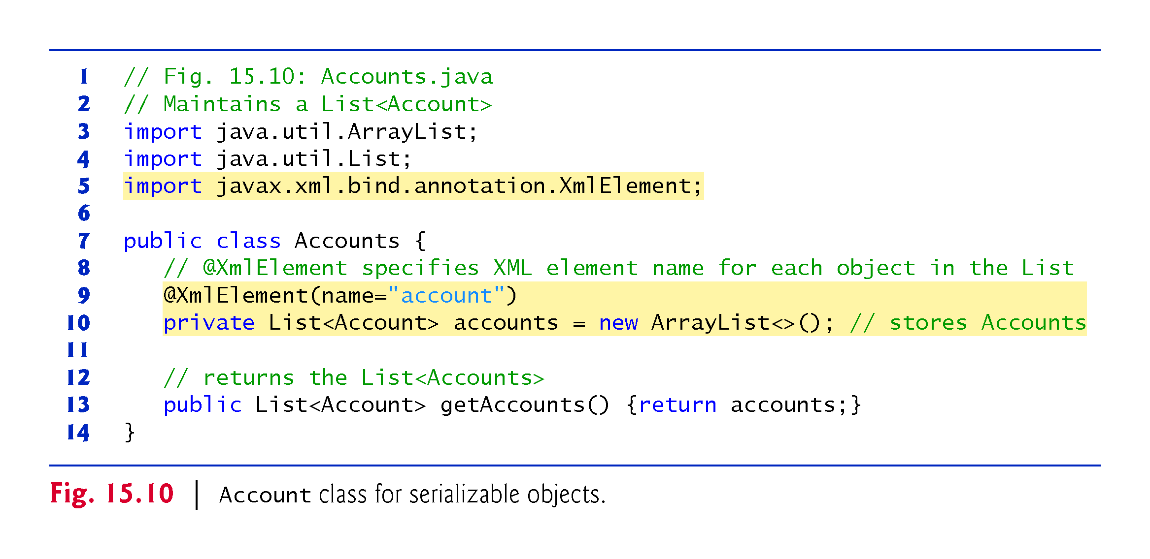

Slide 60
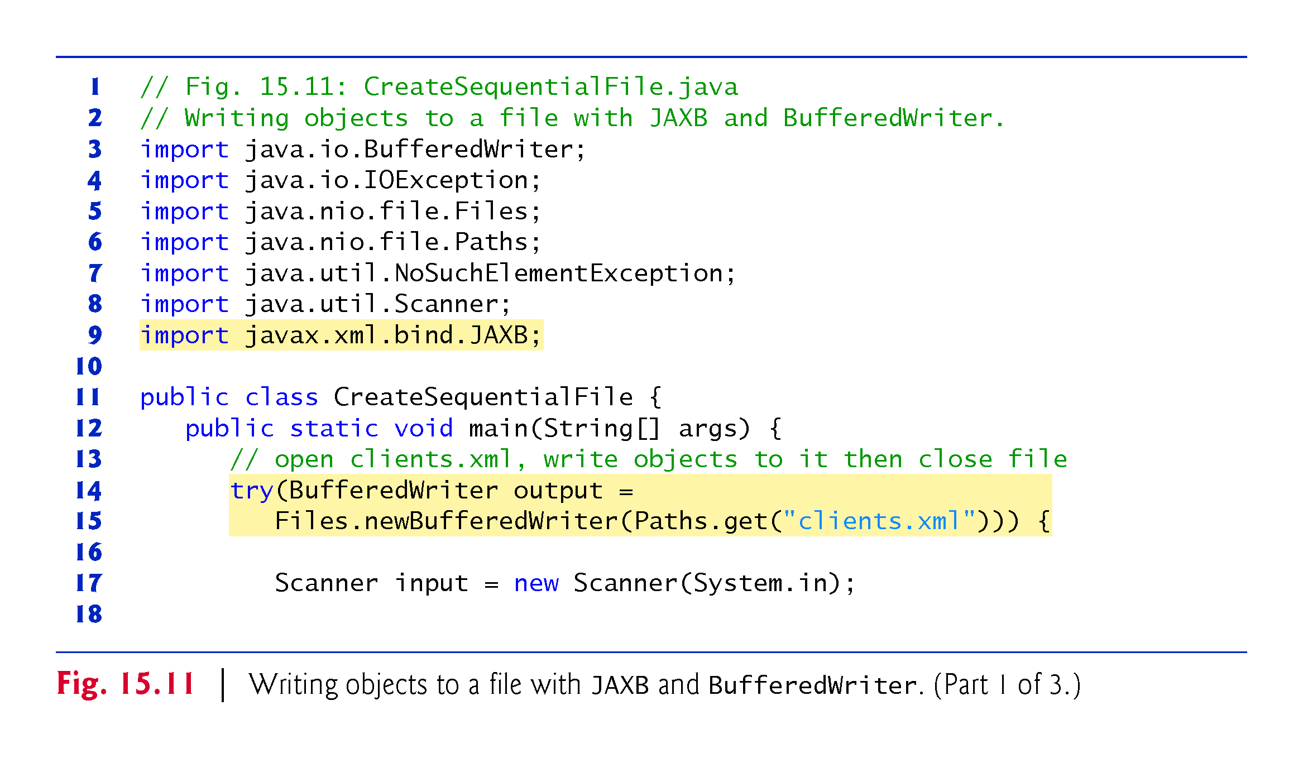

Slide 61
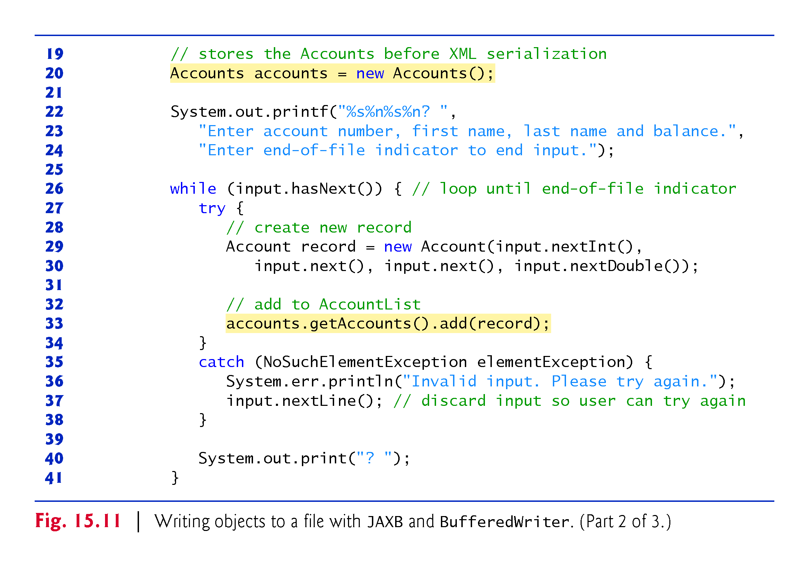

Slide 62
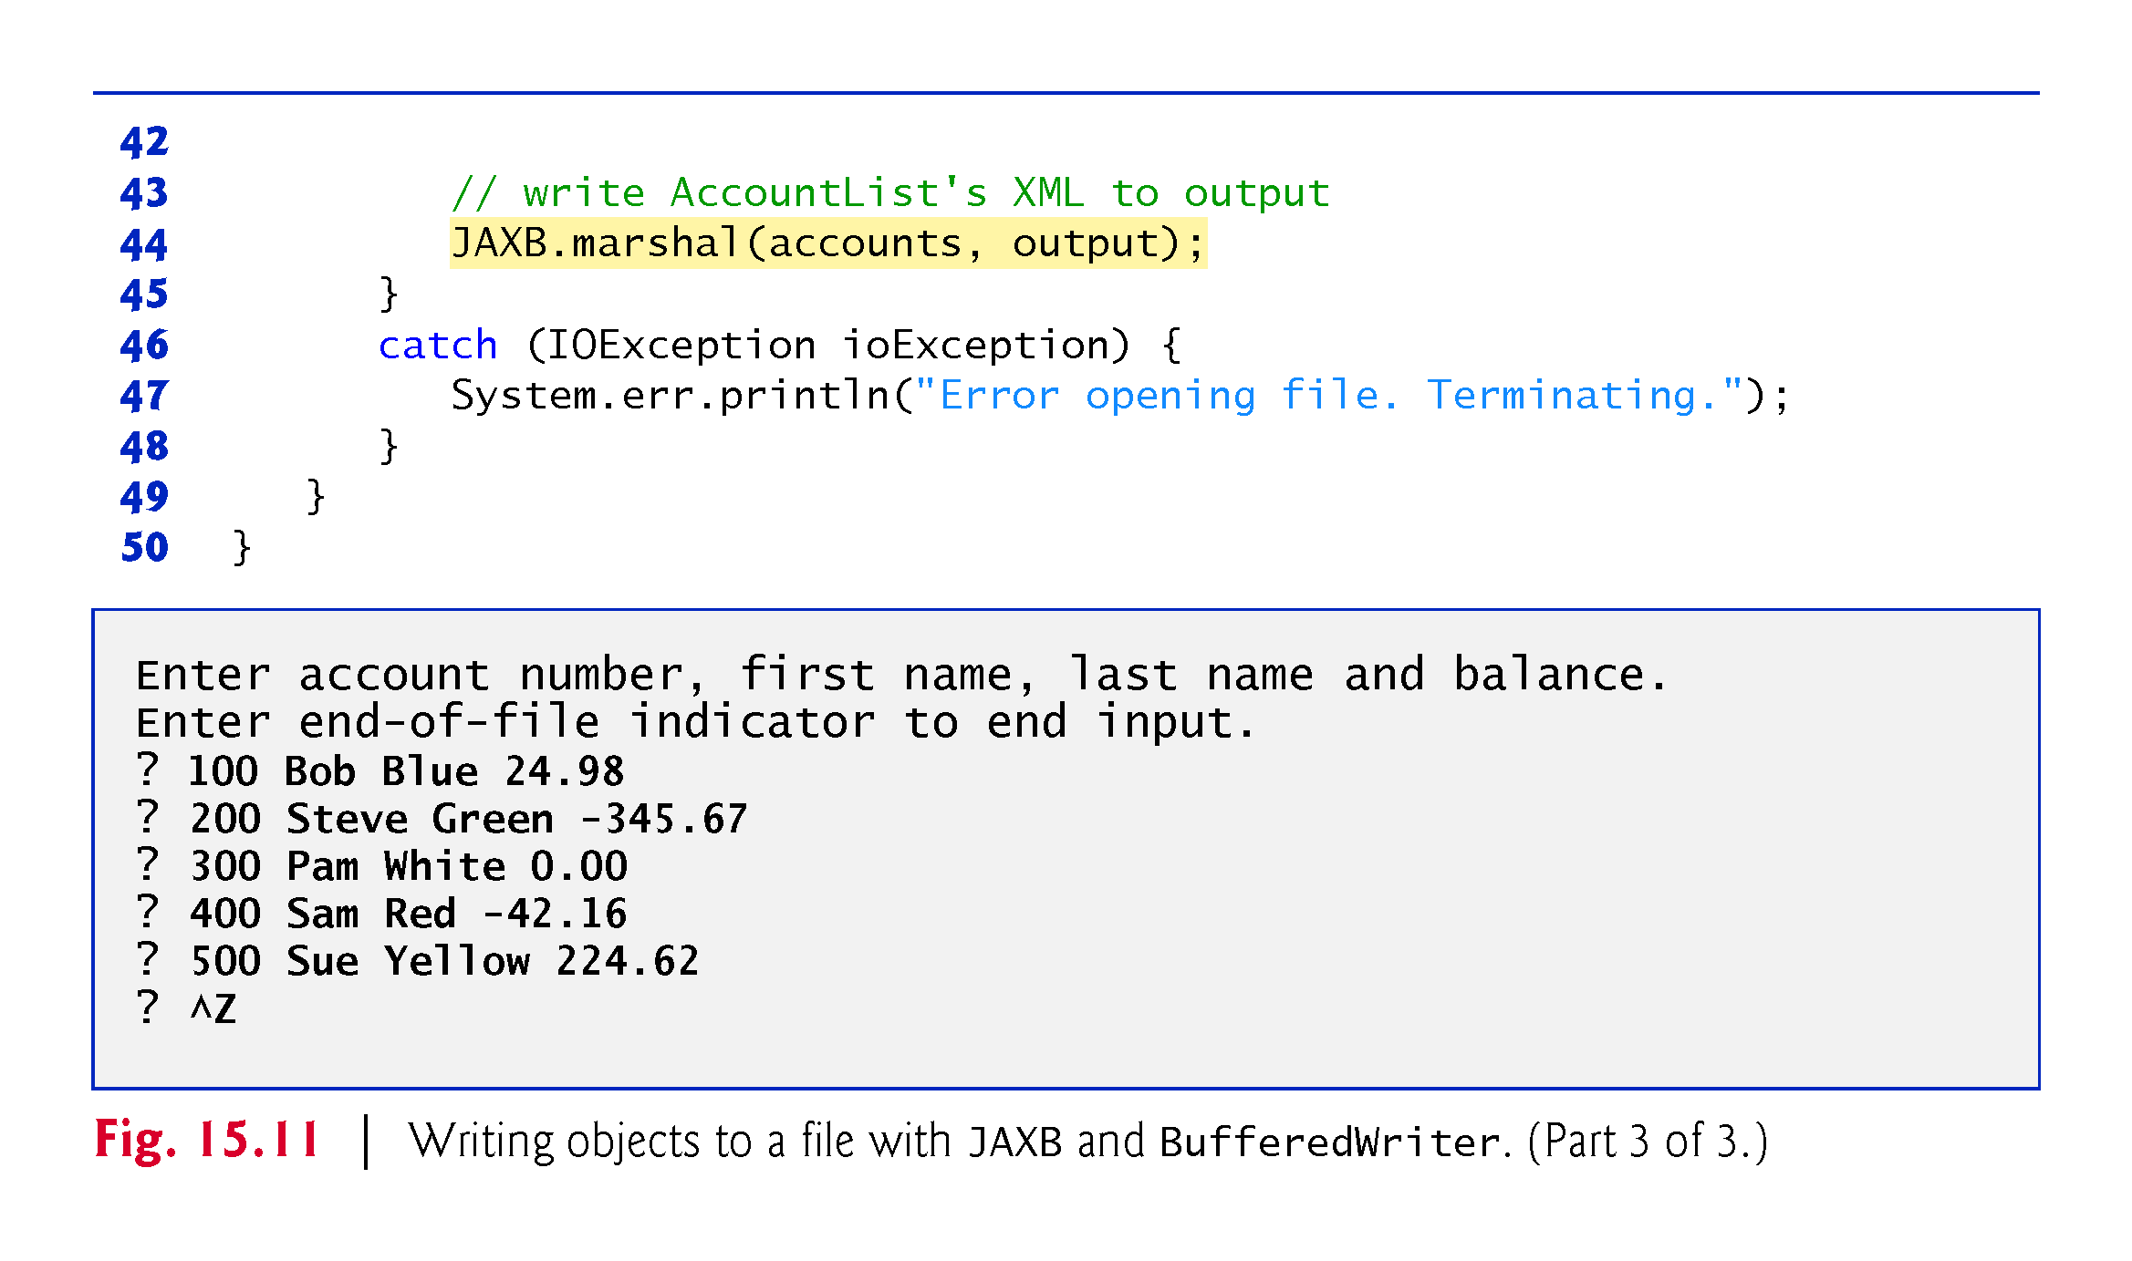

Slide 63
15.5.1 Creating a Sequential File Using XML Serialization (cont.)
When the user enters the end-of-file indicator to terminate input, line 44 uses JAXB static method marshal to serialize as XML the Accounts object containing the List<Account>
The first argument is the object to serialize
The second argument to this particular overload of method marshal is a Writer (package java.io) that’s used to output the XML—BufferedWriter is a subclass of Writer
The BufferedWriter obtained in lines 14–15 outputs the XML to a file
One statement writes the entire Accounts object and all of the objects in its List<Account>

Slide 64
15.5.1 Creating a Sequential File Using XML Serialization (cont.)
Fig. 15.12 shows the contents of the file clients.xml.
Though you do not need to know XML to work with this example, note that the XML is human readable.
When JAXB serializes an object of a class, it uses the class’s name with a lowercase first letter as the corresponding XML element name, so the accounts element represents the Accounts object.

Slide 65
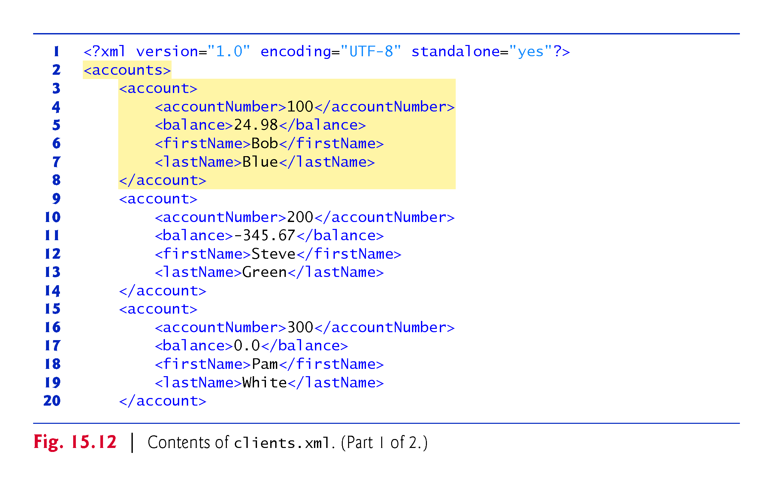

Slide 66
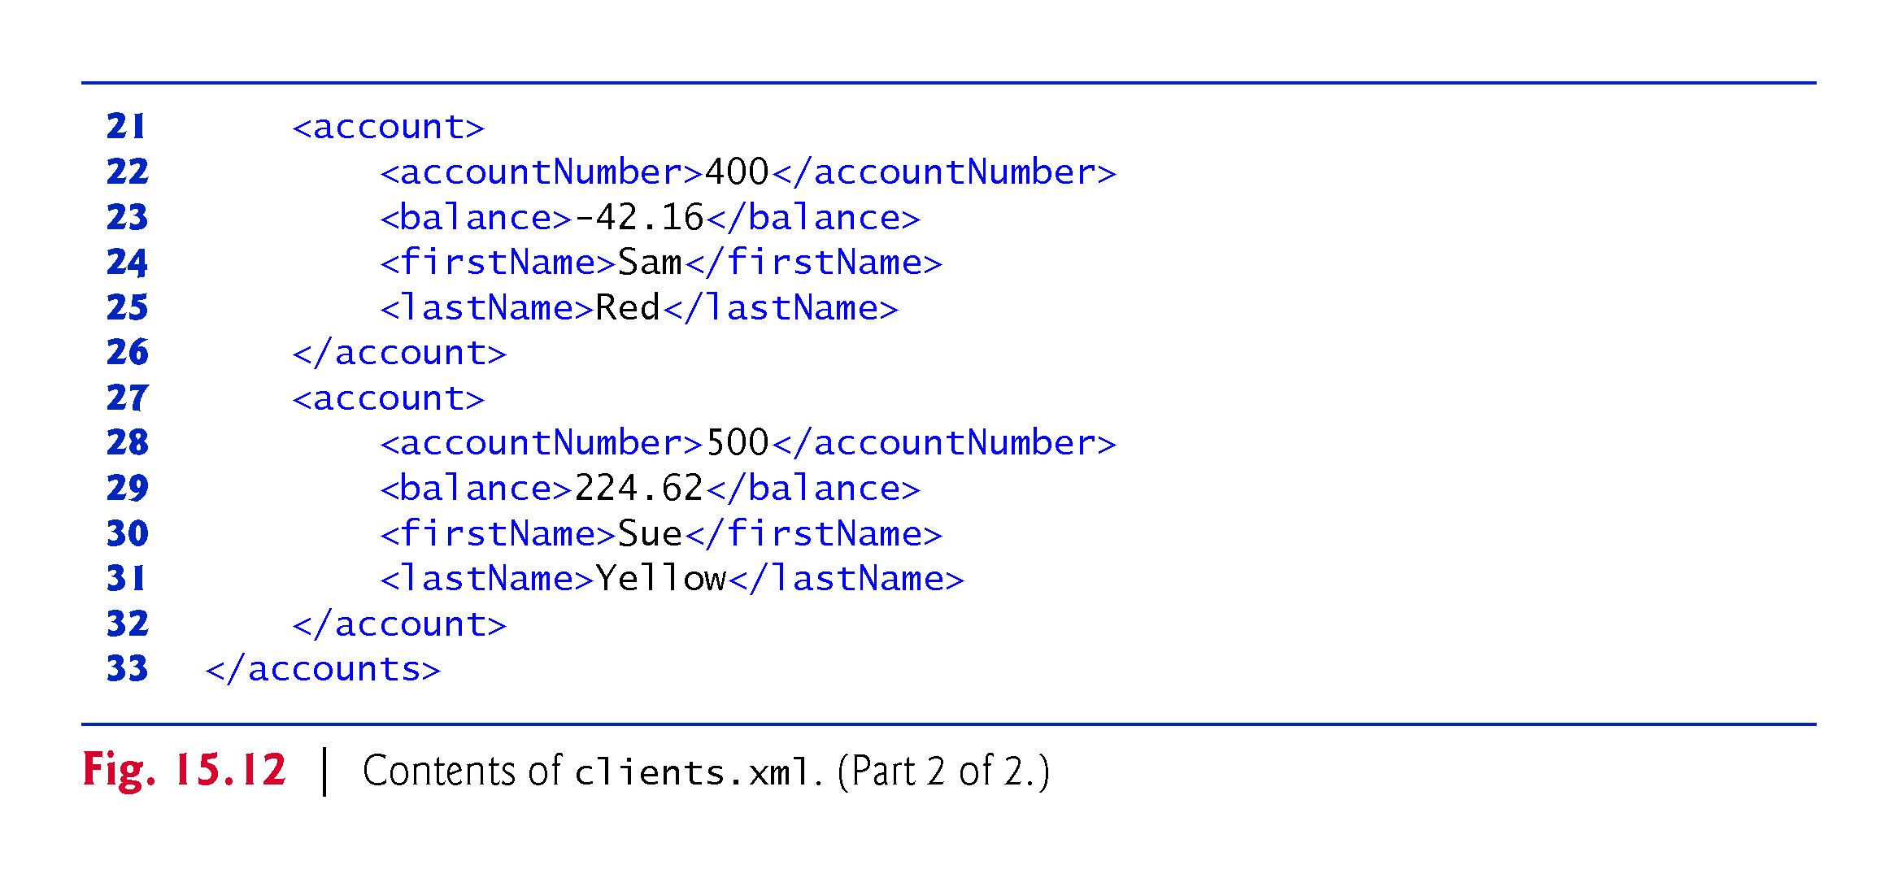

Slide 67
15.5.1 Creating a Sequential File Using XML Serialization (cont.)
Recall that line 9 in class Accounts preceded the List<Account> instance variable with the annotation
@XmlElement(name="account")
In addition to enabling JAXB to serialize the instance variable, this annotation specifies the XML element name ("account") used to represent each of the List’s Account objects in the serialized output.
Many other aspects of JAXB XML serialization are customizable. For more details, see
https://docs.oracle.com/javase/tutorial/jaxb/intro/

Slide 68
15.5.2 Reading and Deserializing Data from a Sequential File
In this section, we read serialized data from a file
Fig. 15.13 reads objects from the file, then displays the contents
The program opens the file for input by calling Files static method newBufferedReader, which receives a Path specifying the file to open and, if the file exists and no exceptions occur, returns a Buffered-Reader for reading from the file.

Slide 69
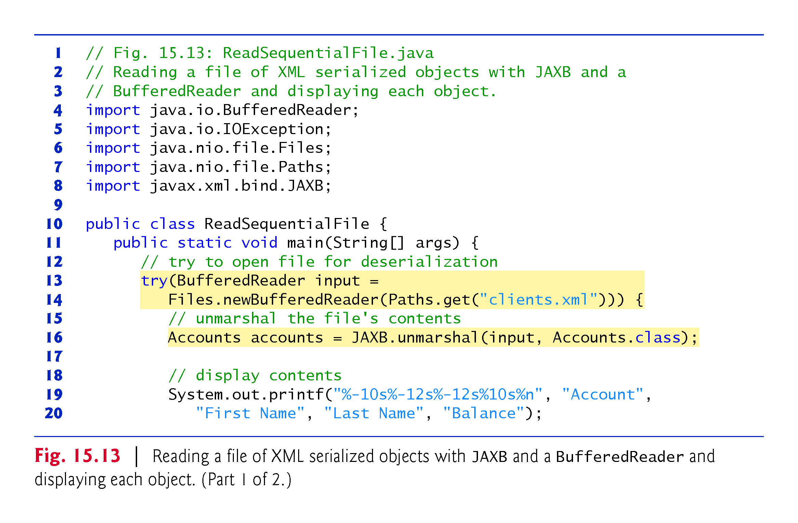

Slide 70
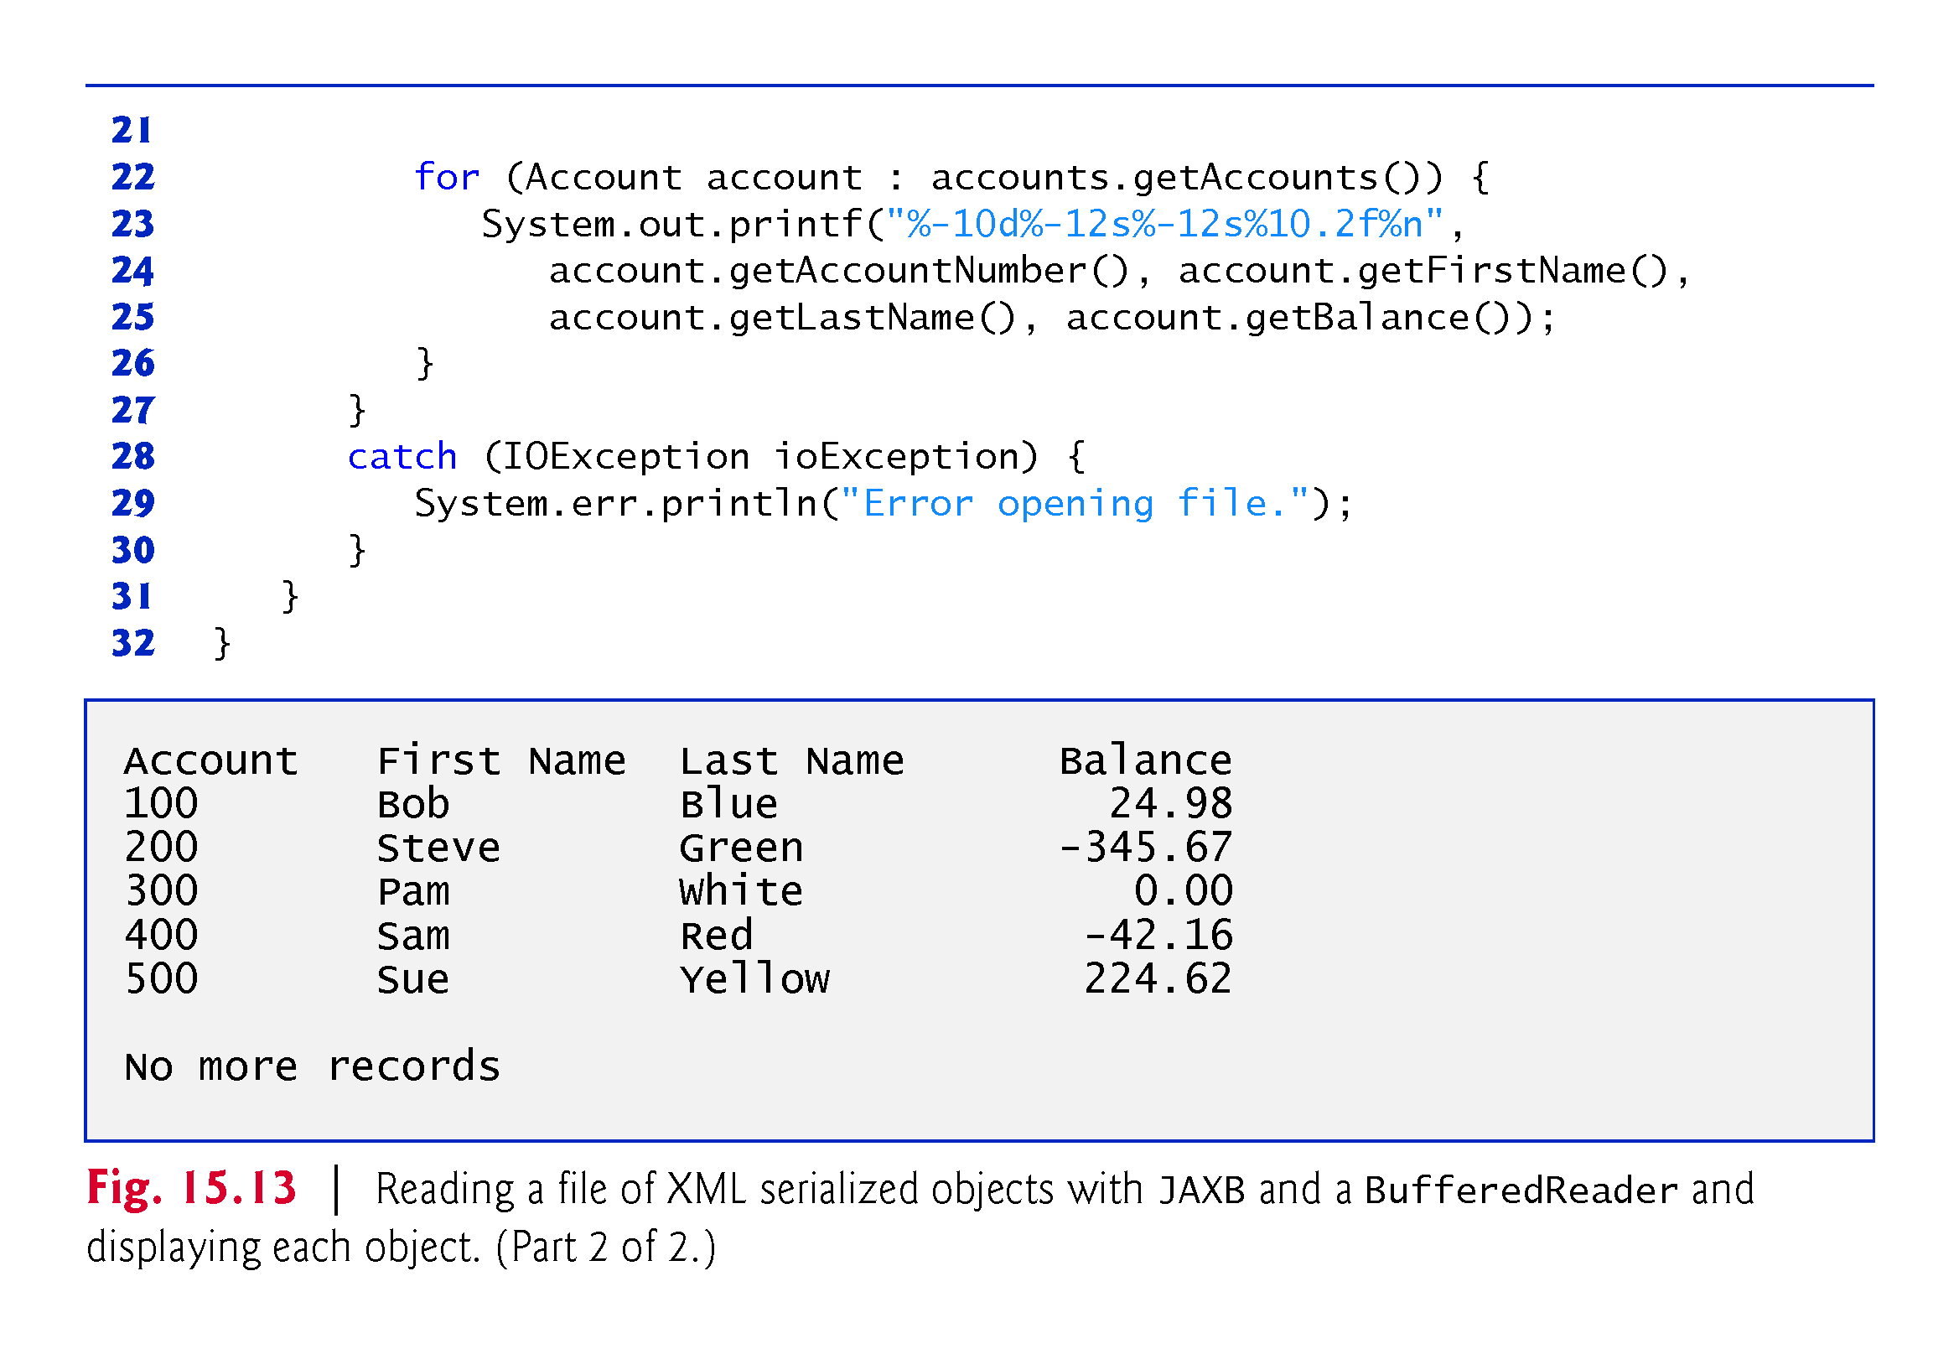

Slide 71
15.5.2 Reading and Deserializing Data from a Sequential File (cont.)
JAXB static method unmarshal reads the contents of clients.xml and convertw the XML into an Accounts object.
This overload of unmarshal reads XML from a Reader (package java.io) and creates an object of the type specified as the second argument
The BufferedReader reads text from a file.
Method unmarshal’s second argument is a Class<T> object (package java.lang) representing the type of the object to create
The notation Accounts.class is a Java compiler shorthand for
new Class<Accounts>
One statement reads the entire file and recreates the Accounts object

Slide 72
15.6 FileChooser and DirectoryChooser Dialogs
JavaFX classes FileChooser and DirectoryChooser (package javafx.stage) display dialogs that enable the user to select a file or directory, respectively
Class FileChooserTest (Fig. 15.14) launches the JavaFX application, using the same techniques you learned in Chapters 12–13
Class FileChooserTestController (Fig. 15.15) responds to the Buttons’ events
Both event handlers call method analyzePath (defined in lines 70–110) to determine whether a Path is a file or directory, display information about the Path and, if it’s a directory, list its contents

Slide 73
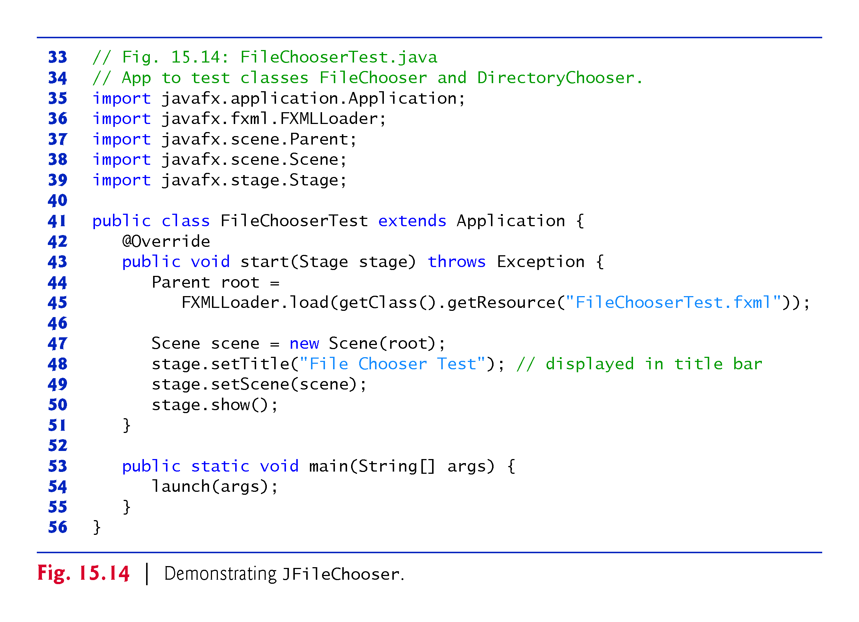

Slide 74
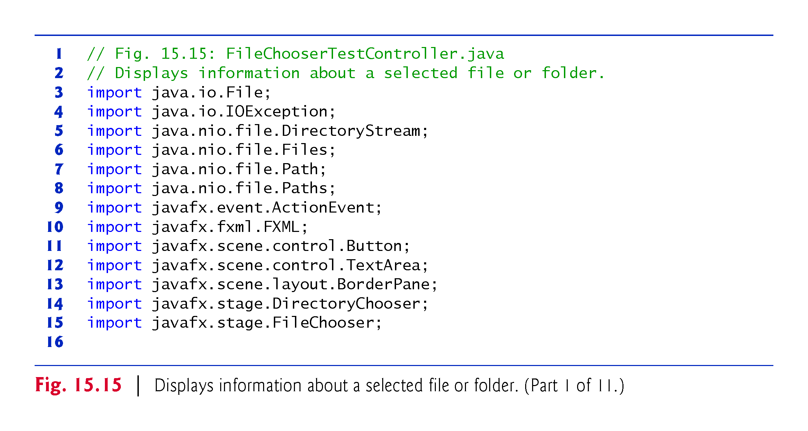

Slide 75
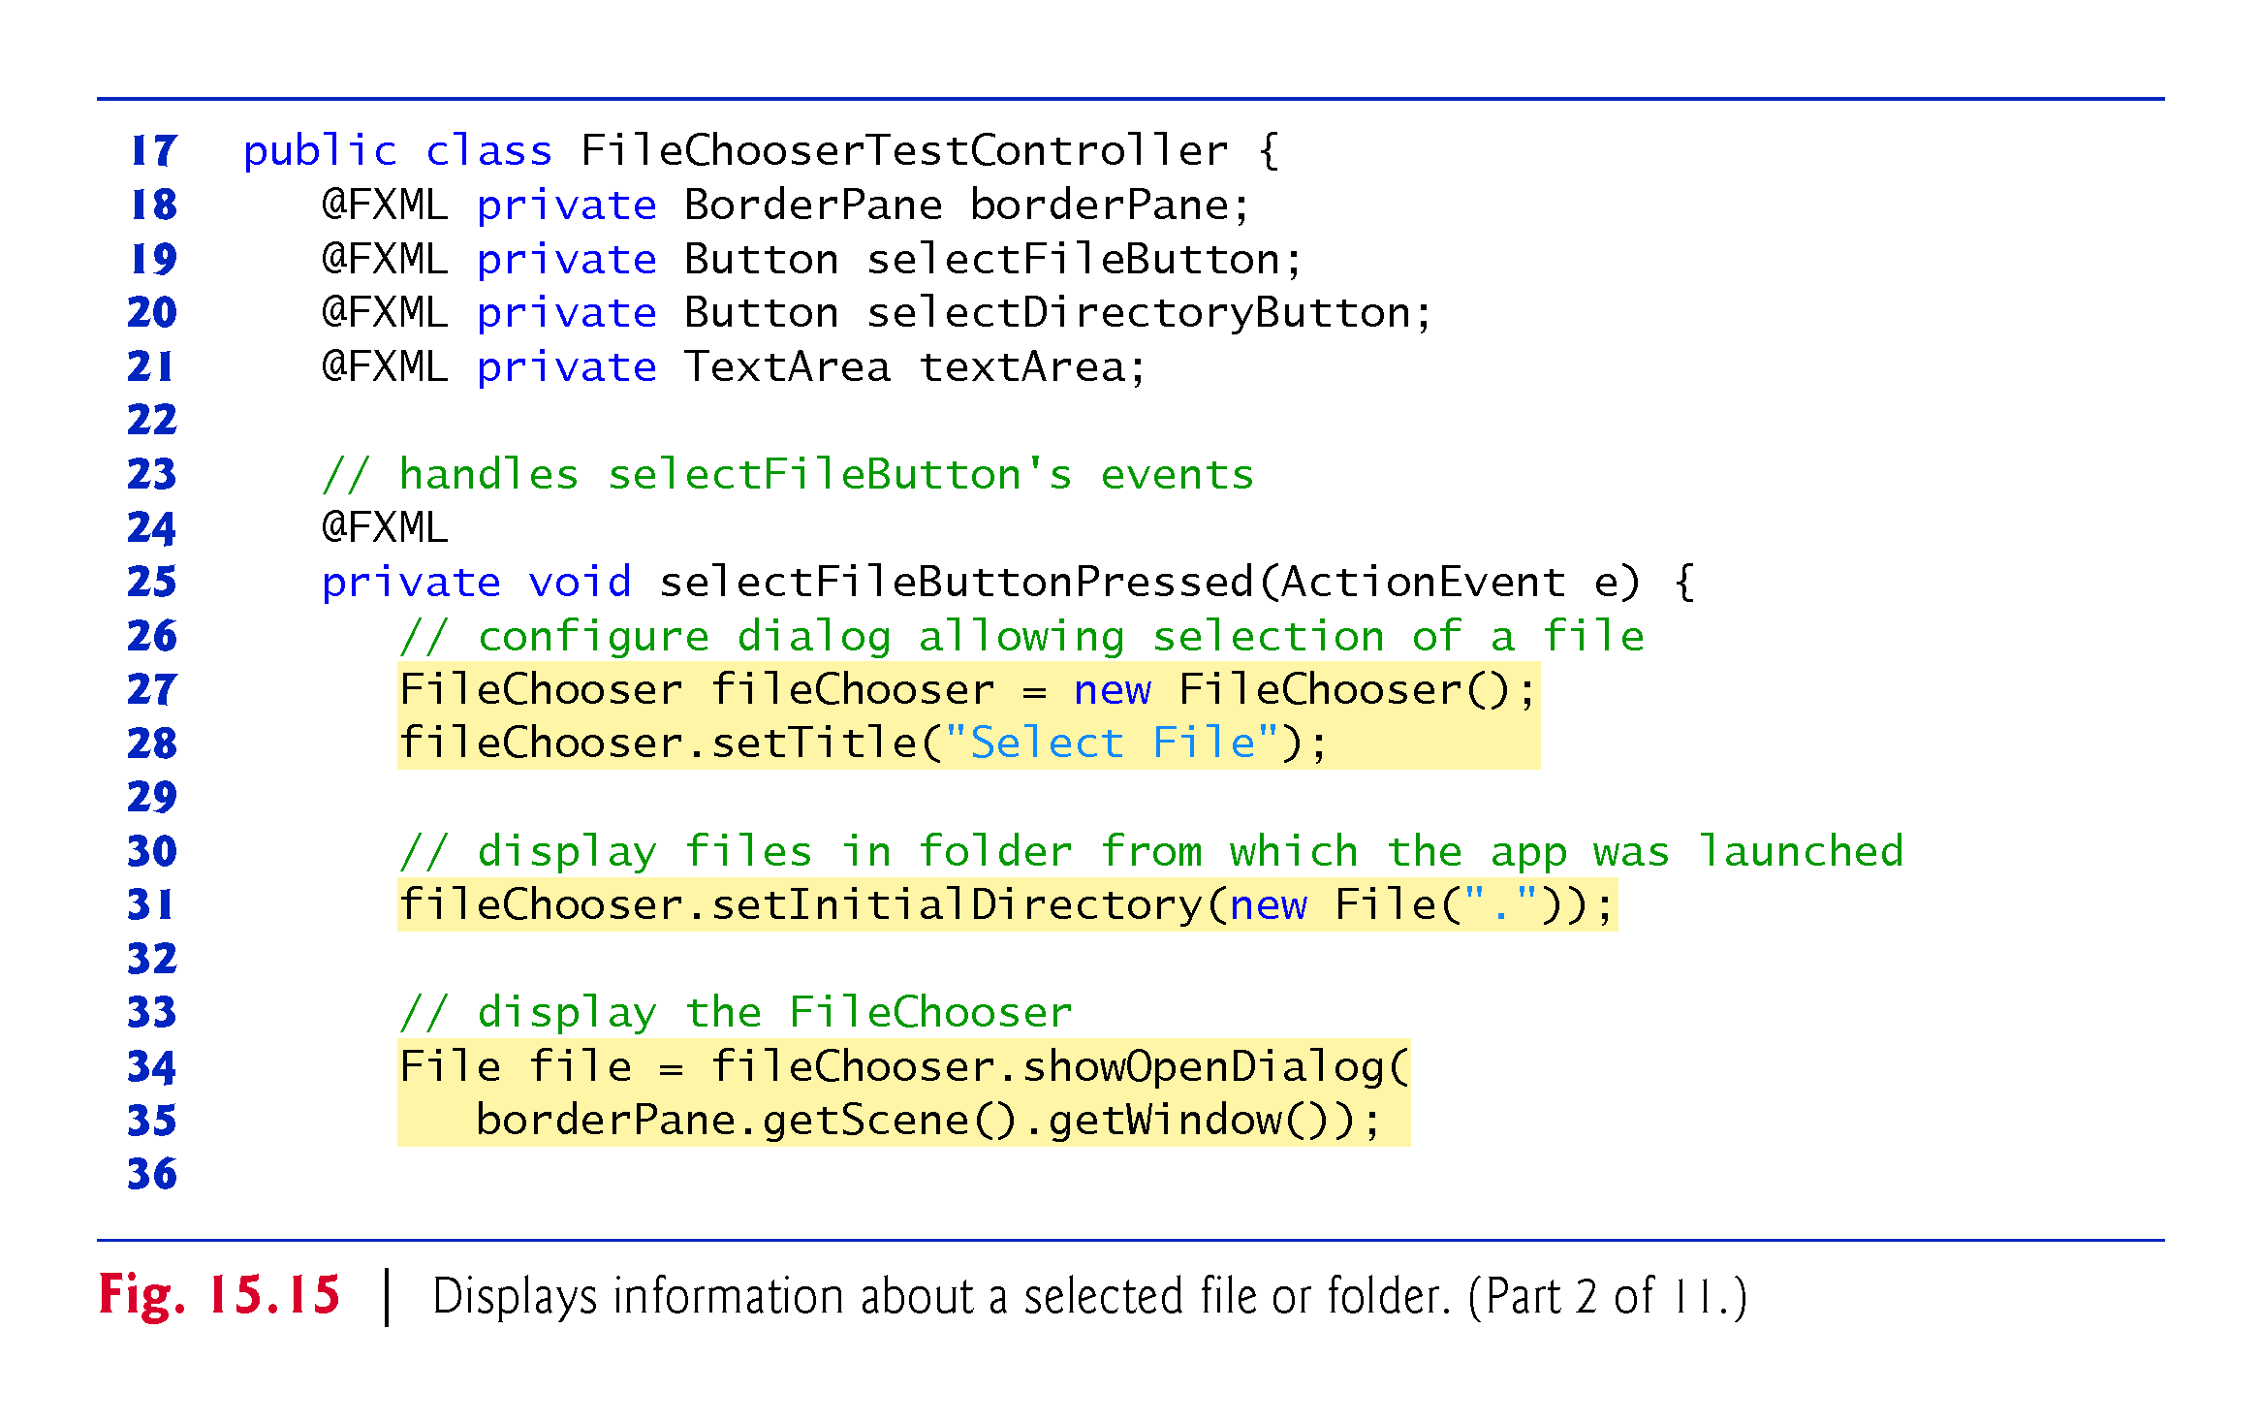

Slide 76
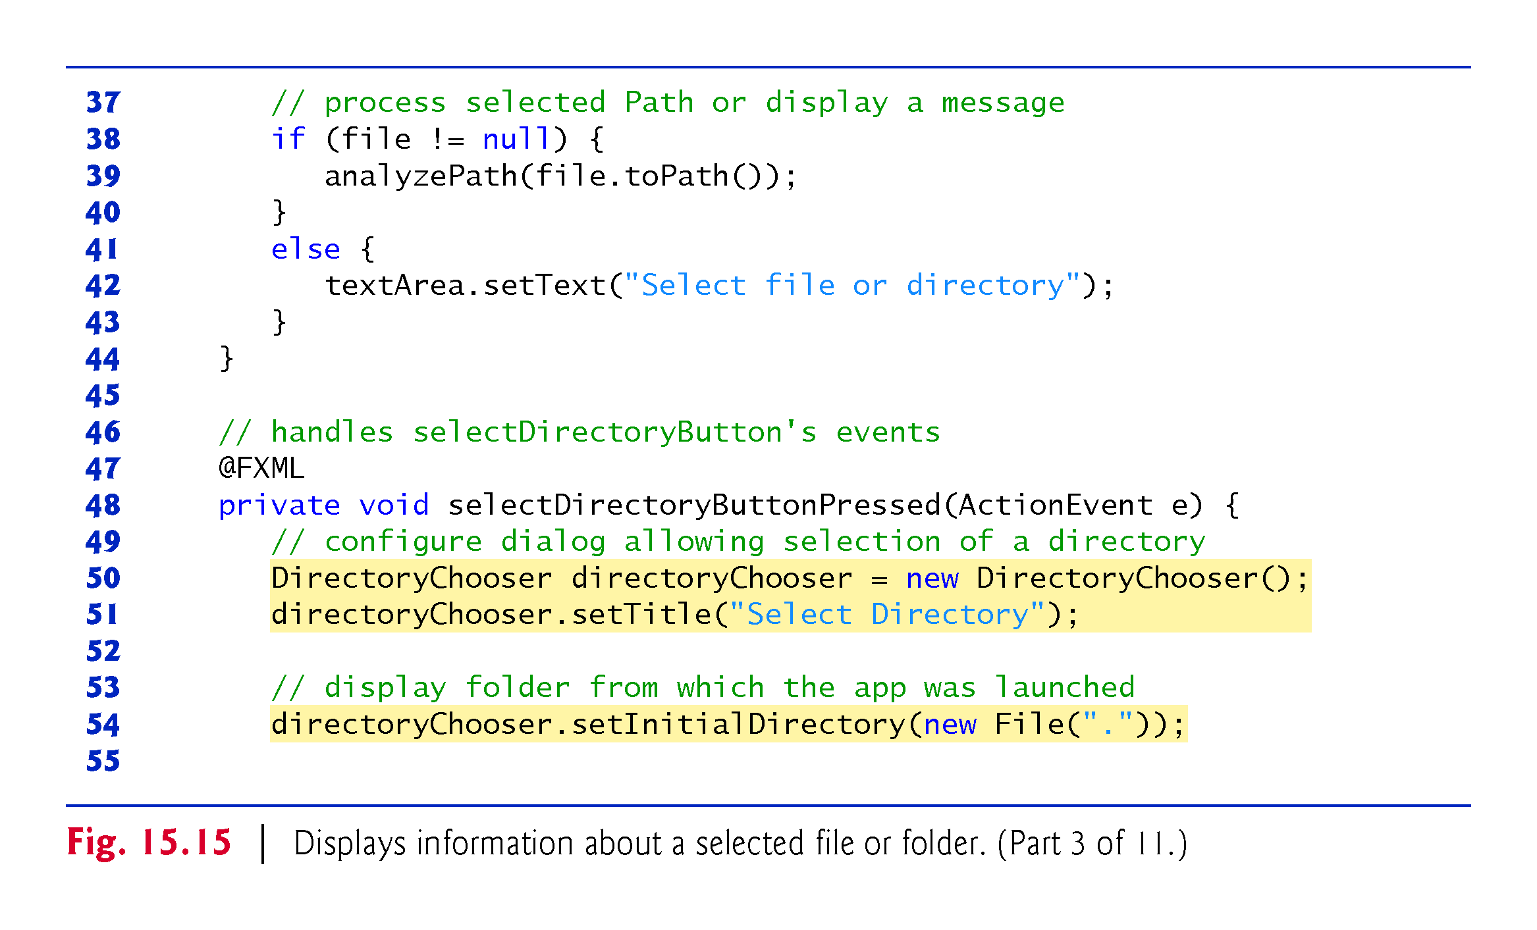

Slide 77
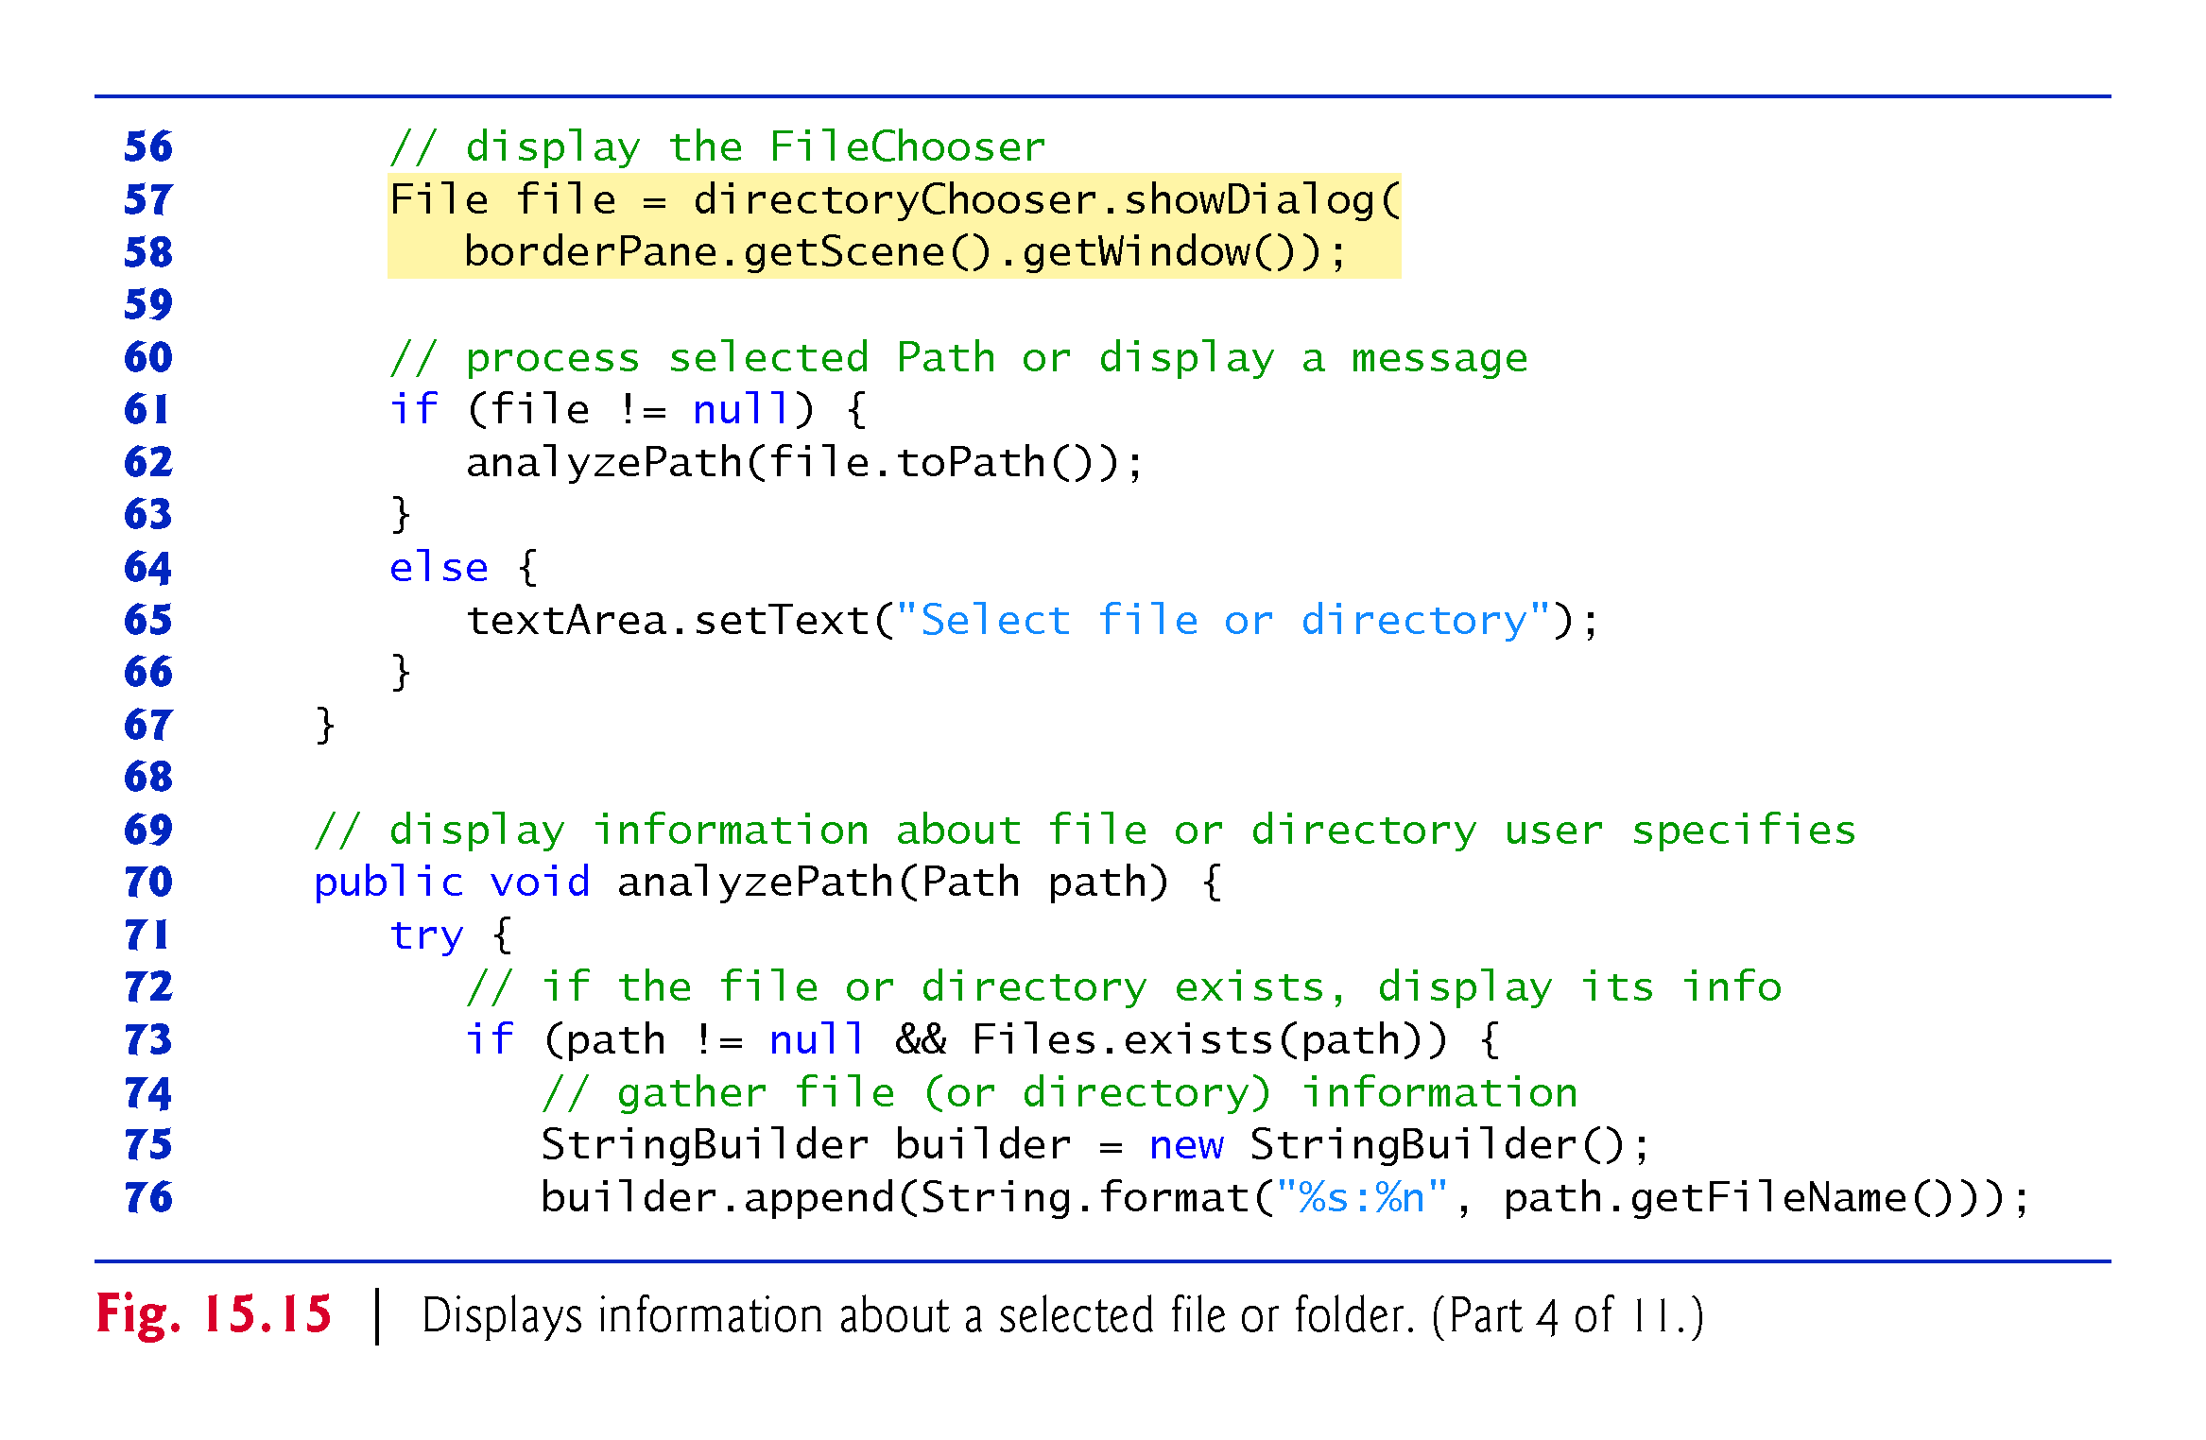

Slide 78
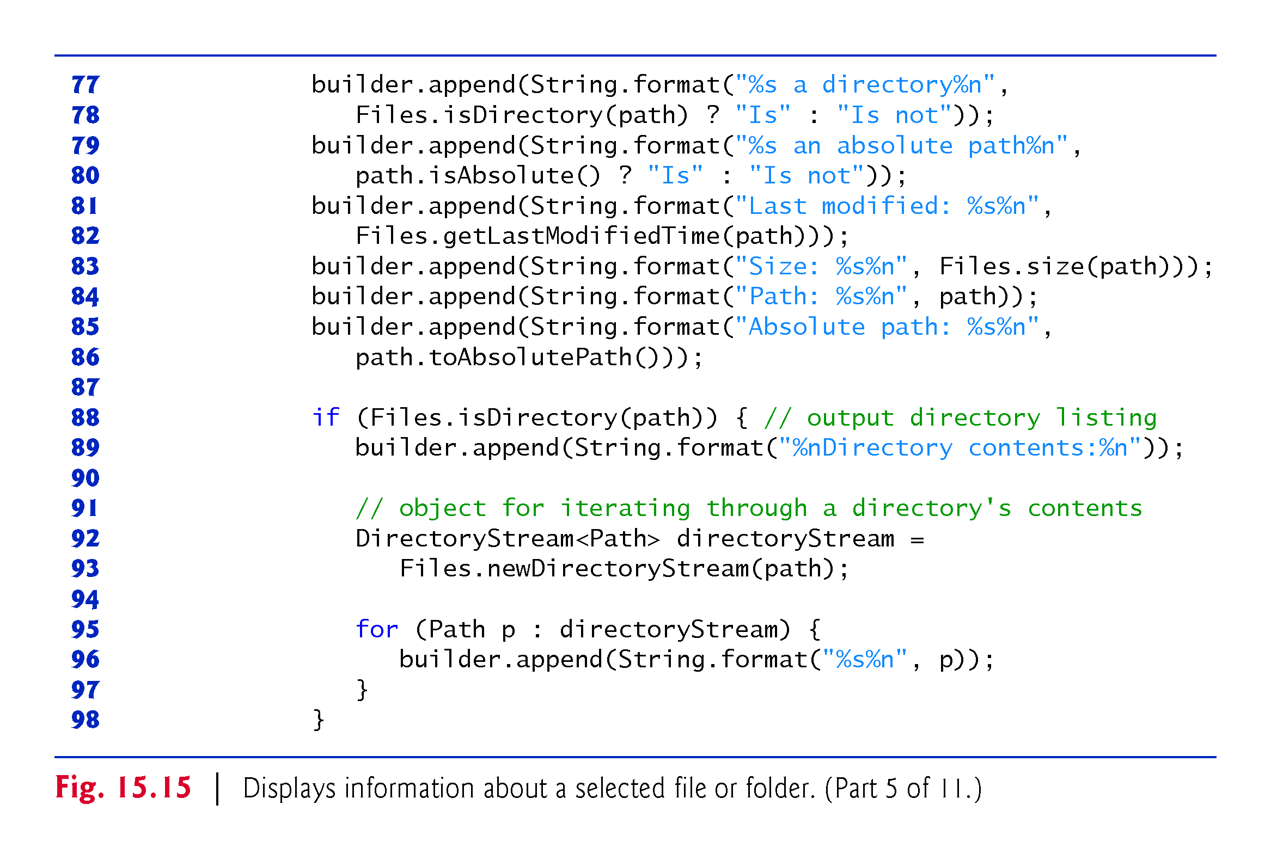

Slide 79
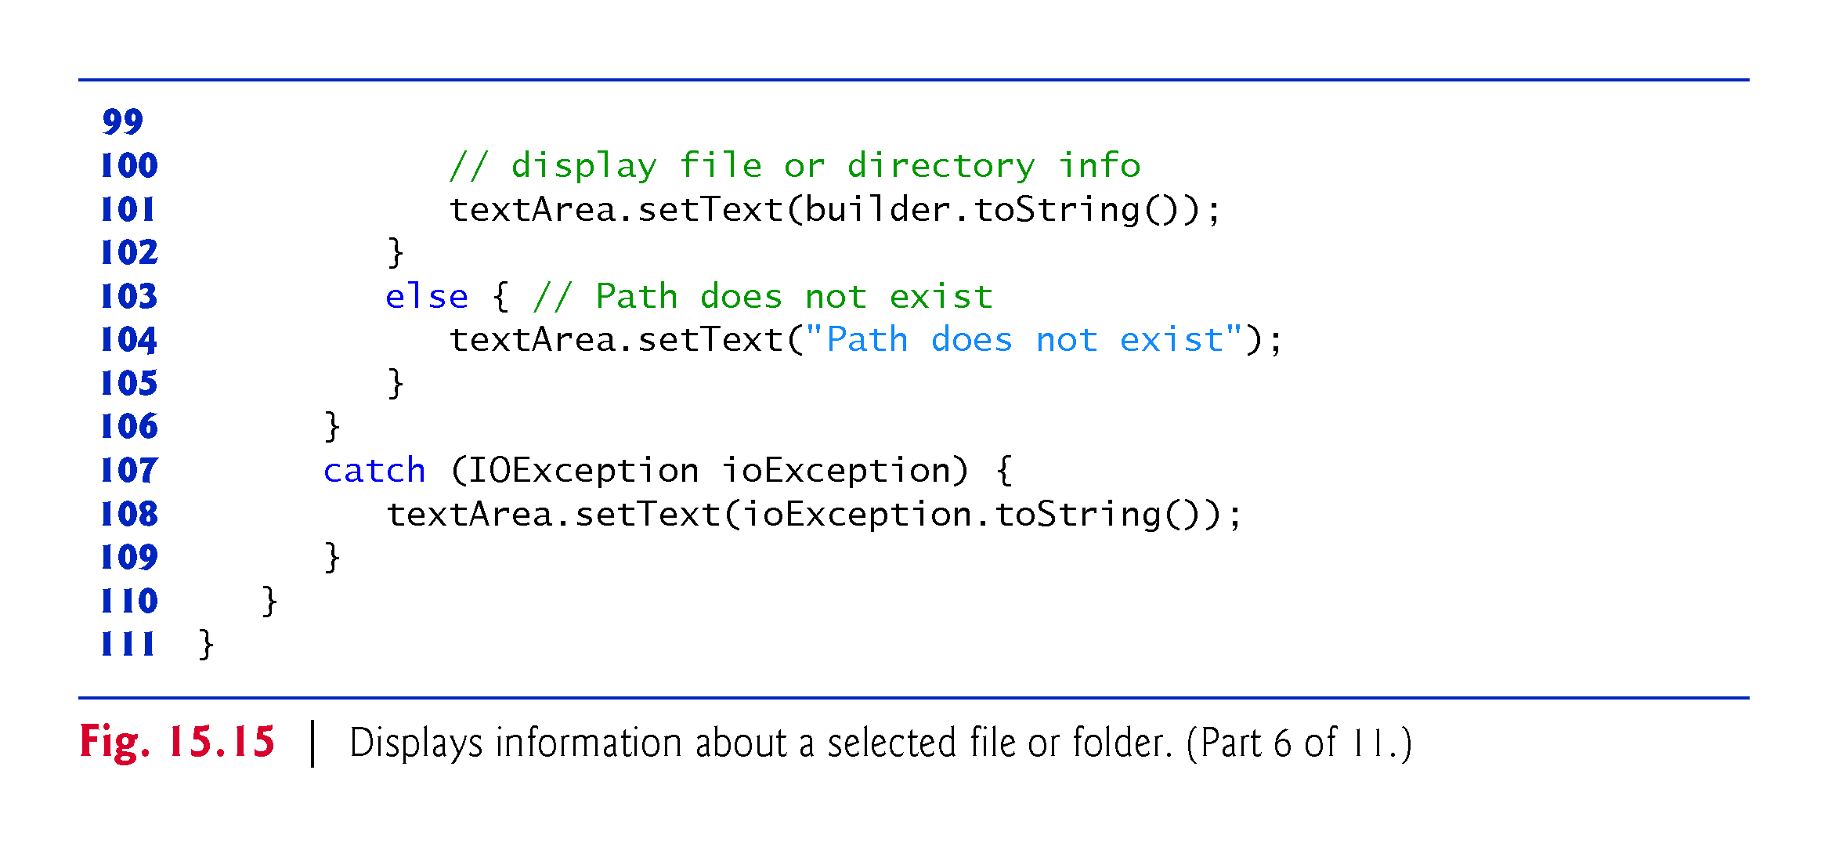

Slide 80
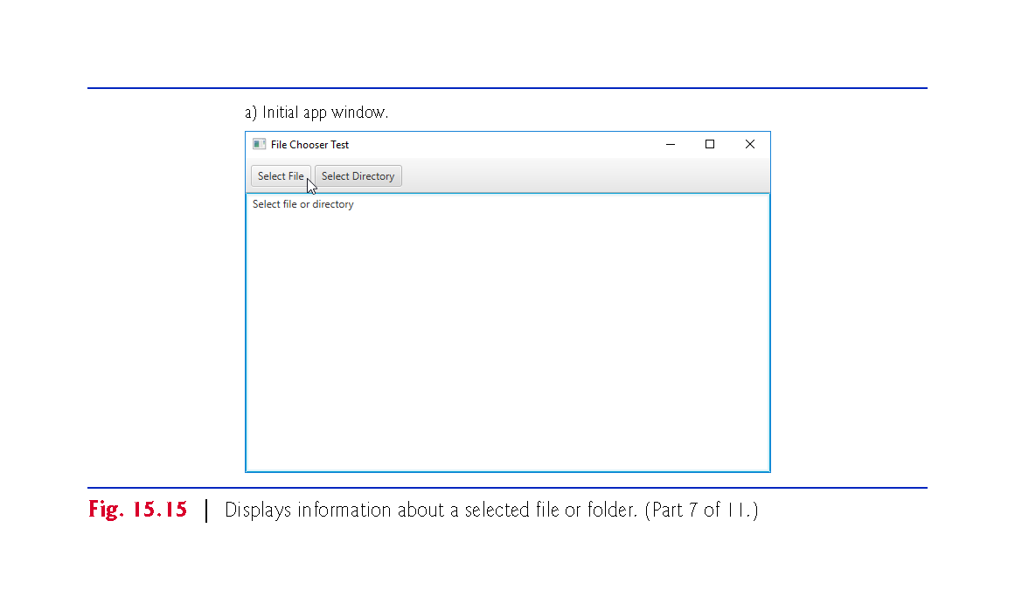

Slide 81
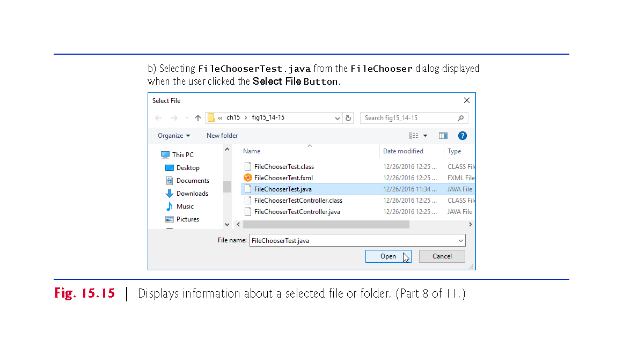

Slide 82
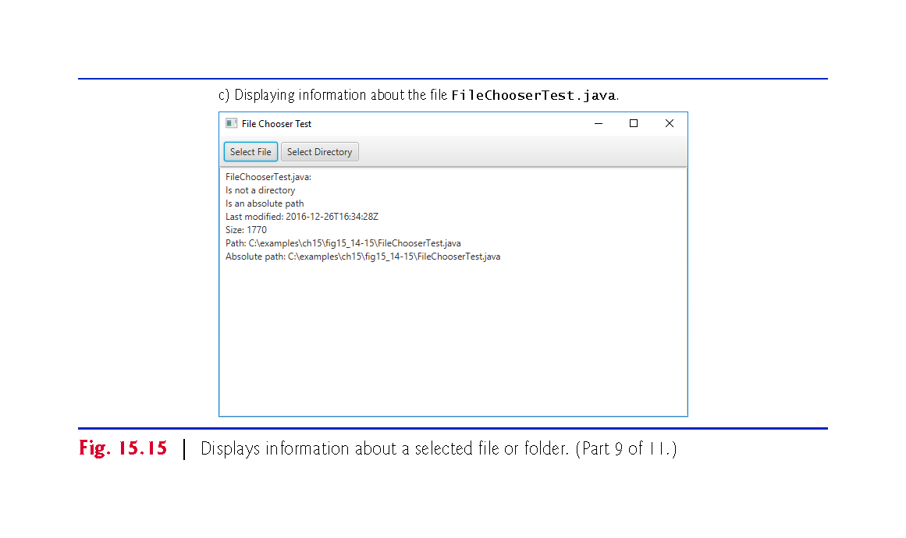

Slide 83
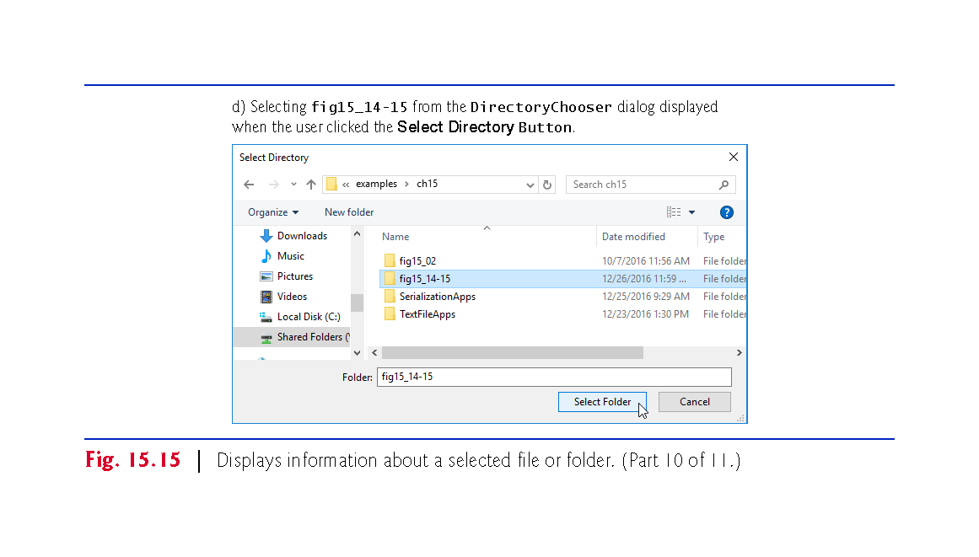

Slide 84


Slide 85
15.6 FileChooser and DirectoryChooser Dialogs (cont.)
Method selectFileButtonPressed
Creates, configures and displays a FileChooser.
Line 28 sets the text displayed in the FileChooser’s title bar.
Line 31 specifies the initial directory that should be opened when the FileChooser is displayed.
Method setInitialDirectory receives a File object representing the directory’s location—"." represents the current folder from which the app was launched.

Slide 86
15.6 FileChooser and DirectoryChooser Dialogs (cont.)
Method selectFileButtonPressed
Lines 34–35 display the FileChooser by calling its showOpenDialog method to display a dialog with an Open button for opening a file.
There’s also a showSaveDialog method that displays a dialog with a Save button for saving a file.
This method receives as its argument a reference to the app’s Window.
A non-null argument makes the FileChooser a modal dialog that prevents the user from interacting with the rest of the app until the dialog is dismissed—when the user selects a file or clicks Cancel.

Slide 87
15.6 FileChooser and DirectoryChooser Dialogs (cont.)
Method selectFileButtonPressed
To obtain the app’s Window, we use the borderPane’s getScene method to get a reference to its parent Scene, then Scene’s getWindow method to get a reference to the Window
Method showOpenDialog returns a File representing the selected file’s location, or null if the user clicks the Cancel button.

Slide 88
15.6 FileChooser and DirectoryChooser Dialogs (cont.)
Method selectDirectoryButtonPressed
Creates, configures and displays a DirectoryChooser.
DirectoryChooser method showDialog to display the dialog—there are not separate open and save dialogs for selecting folders.
Method showDialog returns a File representing the location of the selected directory, or null if the user clicks Cancel.

Slide 89
15.7 (Optional) Additional java.io Classes
This section overviews additional interfaces and classes (from package java.io).

Slide 90
15.7.1 Interfaces and Classes for Byte-Based Input and Output
InputStream and OutputStream are abstract classes that declare methods for performing byte-based input and output, respectively.
Pipes are synchronized communication channels between threads.
PipedOutputStream (a subclass of OutputStream) and PipedInputStream (a subclass of InputStream) establish pipes between two threads in a program.
One thread sends data to another by writing to a PipedOutputStream.
The target thread reads information from the pipe via a PipedInputStream.

Slide 91
15.7.1 Interfaces and Classes for Byte-Based Input and Output (cont.)
A FilterInputStream filters an InputStream, and a FilterOutputStream filters an OutputStream.
Filtering means simply that the filter stream provides additional functionality, such as aggregating bytes into meaningful primitive-type units.
FilterInputStream and FilterOutputStream are typically used as superclasses, so some of their filtering capabilities are provided by their subclasses.

Slide 92
15.7.1 Interfaces and Classes for Byte-Based Input and Output (cont.)
A PrintStream (a subclass of FilterOutputStream) performs text output to the specified stream.
System.out and System.err are PrintStream objects.

Slide 93
15.7.1 Interfaces and Classes for Byte-Based Input and Output (cont.)
Usually, programs read data as aggregates of bytes that form ints, floats, doubles and so on.
Java programs can use several classes to input and output data in aggregate form.
Interface DataInput describes methods for reading primitive types from an input stream.
Classes DataInputStream and RandomAccessFile each implement this interface to read sets of bytes and process them as primitive-type values.

Slide 94
15.7.1 Interfaces and Classes for Byte-Based Input and Output (cont.)
Interface DataOutput describes a set of methods for writing primitive types to an output stream.
Classes DataOutputStream (a subclass of FilterOutputStream) and RandomAccessFile each implement this interface to write primitive-type values as bytes.

Slide 95
15.7.1 Interfaces and Classes for Byte-Based Input and Output (cont.)
Buffering is an I/O-performance-enhancement technique.
With a BufferedOutputStream, each output operation is directed to a buffer
holds the data of many output operations
Transfer to the output device is performed in one large physical output operation each time the buffer fills.
The output operations directed to the output buffer in memory are often called logical output operations.
A partially filled buffer can be forced out to the device at any time by invoking the stream object’s flush method.
Using buffering can greatly increase the performance of an application.

Slide 96


Slide 97
15.7.1 Interfaces and Classes for Byte-Based Input and Output (cont.)
With a BufferedInputStream, many “logical” chunks of data from a file are read as one large physical input operation into a memory buffer.
As a program requests each new chunk of data, it’s taken from the buffer.
This procedure is sometimes referred to as a logical input operation.
When the buffer is empty, the next actual physical input operation from the input device is performed.

Slide 98
15.7.1 Interfaces and Classes for Byte-Based Input and Output (cont.)
Java stream I/O includes capabilities for inputting from byte arrays in memory and outputting to byte arrays in memory.
A ByteArrayInputStream (a subclass of InputStream) reads from a byte array in memory.
A ByteArrayOutputStream (a subclass of OutputStream) outputs to a byte array in memory.

Slide 99
15.7.1 Interfaces and Classes for Byte-Based Input and Output (cont.)
A SequenceInputStream (a subclass of InputStream) logically concatenates several InputStreams
The program sees the group as one continuous InputStream.
When the program reaches the end of one input stream, that stream closes, and the next stream in the sequence opens.

Slide 100
15.7.2 Interfaces and Classes for Character-Based Input and Output
The Reader and Writer abstract classes are Unicode two-byte, character-based streams.
Most of the byte-based streams have corresponding character-based concrete Reader or Writer classes.

Slide 101
15.7.2 Interfaces and Classes for Character-Based Input and Output (cont.)
Classes BufferedReader (a subclass of abstract class Reader) and BufferedWriter (a subclass of abstract class Writer) enable buffering for character-based streams.
Classes CharArrayReader and CharArrayWriter read and write, respectively, a stream of characters to a char array.
A LineNumberReader (a subclass of Buffered-Reader) is a buffered character stream that keeps track of the number of lines read.

Slide 102
15.7.2 Interfaces and Classes for Character-Based Input and Output (cont.)
An InputStream can be converted to a Reader via class InputStreamReader.
An OuputStream can be converted to a Writer via class OutputStreamWriter.
Class File-Reader and class FileWriter read characters from and write characters to a file.
Class PipedReader and class PipedWriter implement piped-character streams for transfering data between threads.
Class StringReader bStringWriter read characters from and write characters to Strings.
A PrintWriter writes characters to a stream.

