Slide 1
Chapter 23 Summary

Slide 2
Intro
Concurrency
Multiple computations making progress at once
Parallel
Multiple computation executing simultaneously.
Threads = execution of computations
Each thread has its own method-call stack and program counter
Multithreading
Thread executing concurrently with other threads while sharing application-wide resources such as memory and file handles

Slide 3
Why Use Threads?
To perform asynchronous or background processing
Increases the responsiveness of GUI applications
Take advantage of multiprocessor systems
Simplify program logic when there are multiple independent entities

Slide 4
What Happens After Thread call?
Two paths of execution
Execute the thread evoked
Follow the statement after the thread
There will be a separate stack and memory space for each thread.
Be Aware
Accessing common variables needs synchronization
Overuse of threads can hinder program performance

Slide 5
Concurrency API
Used for working with threads
Package java.util.concurrent
Released since Java 5
Thread support since JDK 1.0
Manages synchronization for programmer
collection classes and interfaces of Concurrency API
Advanced programming
synchronized keyword
Object methods wait, notify and notifyAll
Locks and Conditions

Slide 6
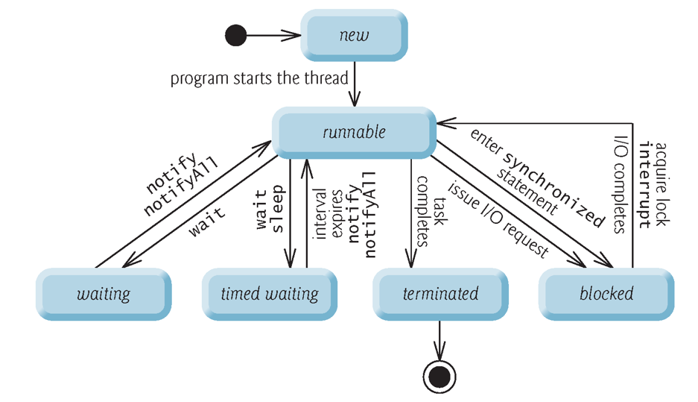
Thread States and Life Cycle

Slide 7
Thread State Details
new state
Starting point for new thread
When executed, goes into runnable state
runnable state
Thread is executing
Waiting state
On pause and waiting for another thread to perform a task

Slide 8
Thread State Details
Timed waiting state
Waiting state for a specified interval of time.
Transitions back to the runnable state when that time interval expires or when the event it’s waiting for occurs.
Cannot use a processor, even if one is available.
Sleeping thread remains in the timed waiting state for a designated period of time (called a sleep interval), after which it returns to the runnable state.
Blocked state
Thread is not able to immediately complete task.
Waits until that task completes.

Slide 9
Thread State Details
Terminated state
When thread successfully completes its task or otherwise terminates (perhaps due to an error).

Slide 10
Runnable State Details
Ready state
When a thread first transitions to the runnable state from the new state
Running state
Dispatching thread
when the operating system assigns it to a processor
Typically, each thread is given a a quantum or timeslice in which to perform its task.
thread scheduling
The process that an operating system uses to determine which thread to dispatch

Slide 11
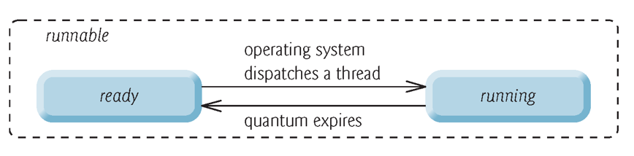
Runnable State Details Diagram

Slide 12
Thread Priorities and Thread Scheduling
Thread priority is order of schedule threads
Thread priorities cannot guarantee execution order
Timeslicing allows threads of equal priority to share a processor.
An operating system’s thread scheduler determines which thread runs next

Slide 13
Indefinite Postponement and Deadlock
Preemptive scheduling
When a higher-priority thread enters the ready state, os interrupts current thread
Many consecutive higher-priority threads could postpone of lower-priority threads.
Starvation
Indefinite postponement
Deadlock
Thread 1 waiting for Thread 2. Thread 2 waiting for Thread 1

Slide 14
Runnable Interface & Object
Runnable interface
Declares the single method run
Contains code that defines the task that a Runnable object should perform.
A Runnable object
a task that can execute concurrently with other tasks.
When a thread executing a Runnable is created and started, the thread calls the Runnable object’s run method, which executes in the new thread.

Slide 15
Creating a Thread
Methods
Extending Thread class
Implement Runnable Interface
Both entities located in java.util.lang

Slide 16
Extending Thread class
Class myThread extends Thread{}
Override the run() method.
Put thread code to be executed in run() method.
void start(): Creates a new thread and makes it runnable
Evoke thread by instantiatedObject.start()
Will evoke run()
void run(): The new thread begins its life inside this method.

Slide 17
Implementing Runnable Interace
Class myThread implements Runnable{}
Implement run() method of Runnable interface
Put thread code to be executed in run() method.
void start(): Creates a new thread and makes it runnable
Evoke thread by instantiatedObject.start()
Will evoke run()
void run(): The new thread begins its life inside this method.

Slide 18
Difference Between Thread & Runnable?
Extending Thread class
Cannot extend other classes
All methods available to override
Implementing Runnable Interface
avoids the single inheritance issue
Simpler code
Only few methods available

Slide 19
Thread Management
Thread Class, Runnable Interface good for few threads
More thread need management
Executors & ExecutorService Interface = solution
ramework for creating and managing threads

Slide 20
Executor Framework helps with…
Thread Creation
Various methods for single and pools (group) of threads
Thread Management
Manages life cycle => only submit() task for execution.
Task submission and execution
Provides methods for submitting tasks
Gives scheduling power (when and frequency) of tasks

Slide 21
Executor Interface
Executor creates and manages thread pools to execute Runnable
Executors can reuse existing threads
Improve performance by optimizing the number of threads.
Executor assigns every Runnable to execute() => an available threads in thread pool.
If no available threads, Executor either creates a new thread or waits for next available new thread

Slide 22
ExecutorService Interface
Extends Executor
Declares methods for managing the life cycle of an Executor.
Method newCachedThreadPool() returns an ExecutorService
Creates new threads as they’re needed by the application.
newSingleThreadExecutor(), newFixedThreadPool(poolSize)
Method shutdown() notifies the ExecutorService to stop accepting new tasks, but continues executing tasks that have already been submitted.

Slide 23
Thread Synchronization
When multiple threads running and attempt to read and write shared data concurrently two problems arise
Thread interference errors
Memory consistency errors

Slide 24
Thread interference errors
When multiple threads attempt to read and write shared variable concurrently
Read and write operations overlap in execution
Final outcome depends on the order of read & write execution
Unpredictable
Termed Race condition
Critical Section
Section of the code where a shared variable is accessed
Thread interference errors can be avoided by synchronizing access to shared variables

Slide 25
Memory Consistency Errors
When different threads have inconsistent views of the same data.
Happens when one thread updates some shared data
But this update is not propagated to other threads
End up using the old data.
Possible reasons?
Compiler optimizations by re-ordering instructions
Value is read from temp/cache location instead of main memory
Memory consistency errors can be avoided by added keyword “volatile” to variable
Tells compiler to not optimize variable

Slide 26
Synchronization
Thread interference and memory consistency errors can be avoided by ensuring
Only one thread can read and write a shared variable at a time.
When one thread is accessing a shared variable
Other threads should wait until the first thread is done.
Whenever any thread modifies a shared variable
Automatically establishes a happens-before relationship with subsequent reads and writes of the shared variable by other threads.
Java uses keyword “synchronized” to accomplish feat
Intrinsic lock

