Slide 1
Csharp 5- Classes and Objects
Kevin.Li@GeorgianCollege.ca

Slide 2
Outline
OOP
Class & Object
Inheritance
Interface
Exceptions

Slide 3
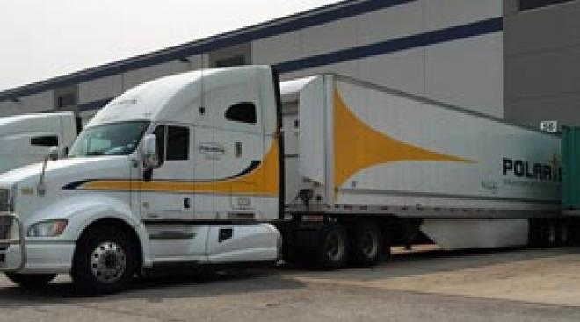

STORY
Notes:
Need a formal training session for the pick-up process! And more discussion and arguments!
Special devices?

Slide 4
Delivery order
Freight carrier:
Owner:
Consignee:
Shipping list:
Delivery instructions:
….....
bill of loading

Slide 5
1. Encapsulation, Inheritance, Polymorphism
Encapsulation means that a group of related properties, methods, and other members are treated as a single unit or object. -> to reuse codes
Inheritance describes the ability to create new classes based on an existing class.
Polymorphism means that you can have multiple classes that can be used interchangeably, even though each class implements the same properties or methods in different ways.(Poly = many, morph = form) ->polymorphic types and methods
Notes:
Class example: bill of loading(Form).

Slide 6
Find at least one example about the three words
Encapsulation:
Inheritance:
Polymorphism: virtual + override

Slide 7
2 Class and Object
A class is a building block of OOP. It is the way to bind the data and its logically related functions together.
A class is an abstract data type that can be treated like any other built in data type.

Slide 8
Classes describe the type of objects…
(Generally class itself cannot complete jobs)
…while objects are usable instances of classes.
Using the blueprint analogy, a class is a blueprint, and an object is a building made from that blueprint. (A house blueprint cannot be lived in…)

Slide 9
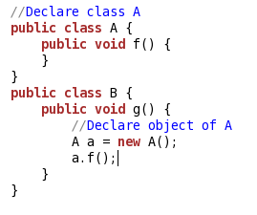
2.1 Defining Classes and Objects
Class is a User Defined Type in .NET
Object is an instance of a class created with “new” keyword

Slide 10
2.2 Methods
A method is an action that an object can perform. To define a method of a class:
class SampleClass
{
public int sampleMethod(string sampleParam)
{
// Insert code here
}
}

Slide 11
Method can return only a single value or a collection of values

Slide 12
Lab
Create your class and object to print current time (Instructor shows the steps firstly.)
Or Test the codes in the last slide (ClassA)
Would like to make sure everyone succeeded doing this task!

Slide 13
Method overloads
A class can have several implementations, or overloads, of the same method that differ in the number of parameters or parameter types
public int sampleMethod(string sampleParam) {};
public int sampleMethod(int sampleParam) {}
Public int sampleMethod(int param1,int param2){};
In most cases you declare a method within a class definition. However, both Visual Basic and C# also support extension methods that allow you to add methods to an existing class outside the actual definition of the class.

Slide 14
Real sample in ASP. NET MVC
public ActionResult GetAgenies() {
//show all agencies to select and notify
};
public ActionResult GetAgencies(string jobId) {
//all matched agencies for the current job posting
}
public ActionResult GetAgencies(string jobId, int topX ) {
//top 10 favorite agencies and matched, and then the remaining favorite
}
// all agencies not in the last list……………..
http://core.direqlink.com/Home/ClientJobRequest/157#

Slide 15
Why overloading, not a new method
The reason for this is to reduce the risk of the brittle base class problem, where the introduction of a new method to a base class could cause problems for consumers of classes derived from it.
(Not required in this class, but think about it.)

Slide 16
2.3 Constructors
Constructors are class methods that are executed automatically when an object of a given type is created. (Run before any other code)
Constructors usually Initialize the data members.
Support Overloading (Sample: your Win App)
To define a constructor for a class:
public class SampleClass {
int I;
public SampleClass() {
I = 1;
}
}

Slide 17
If a constructor is not declared , the complier provides one for you.
The default constructor creates the object but takes not action.
Member variables are initialized to innocuous values
Integers to 0 (Zero)
Strings to the empty string, etc.

Slide 18
2.4 Initializers
class A
{
private int x = 100; // initializers
}

Slide 19
2.5 Destructors
Destructors are used to destruct instances of classes.
In the .NET Framework, the garbage collector automatically manages the allocation and release of memory for the managed objects in your application.
Destructors are still needed to clean up any unmanaged resources that your application creates.
There can be only one destructor for a class.

Slide 20
https://docs.microsoft.com/en-us/dotnet/csharp/programming-guide/classes-and-structs/destructors
class Car
{
~Car() // finalizer
{
// cleanup statements...
}
}

Slide 21
2.6 The this Keyword
Refers to the current instance of an object
in a Winform app:
this.lableName.text = “new text content”;
this.pictureBox1.visible=true;

Slide 22
2.7 Nested class
A class defined within another class is called nested.
class Container
{
class Nested
{ // Add code here. }
}
To create an instance of the nested class, use the name of the container class followed by the dot and then followed by the name of the nested class:
Container.Nested nestedInstance = new Container.Nested();

Slide 23
2.8 Access modifiers
All classes and class members can specify what access level they provide to other classes by using access modifiers.
public: Access is not restricted.
protected: Access is limited to the containing class or types derived from the containing class.
internal: Access is limited to the current assembly.
protected internal: Access is limited to types derived from the containing class or the current assembly.
private: Access is limited to the containing type.
private protected: Access is limited to the containing class or types derived from the containing class within the current assembly

Slide 24
2.9 Static
Static class
Static member

Slide 25
Static class
a static class cannot be instantiated
can be used as a convenient container for sets of methods that just operate on input parameters and do not have to get or set any internal instance fields.
For example, in the .NET Framework Class Library, the static System.Math

Slide 26
Static members
Instance members vs Static members
Defining:
static class SampleClass {
public static string SampleString = "Sample String";
}

Slide 27
How to access
classInstance.memberName
Vs
ClassName.StaticMemeberName

Slide 28
Use static fields
For example to keep track of the number of instances
Cat.HowManyCats();// a static method printing

Slide 29
Static methods can access only static members.
A static class can only contain static members.
Try to avoid using static fields

Slide 30
2.10 Passing parameters
Passing value types or reference types
Passing value types as reference
Passing value types as reference with the key word: out
Explain and do labs in VS

Slide 31
2.11 Default parameters
public void ShowName(int id, bool showAlert=false)
{
if (showAccount)
{//Show an extra textbox }
} //call: ShowName(200) and ShowName(200,false) work
//default values must come at last
/*public void ShowName(bool showAccount=true, int id) cannot be complied*/
Example:
Show specific alert for users that changed the profile.

Slide 32
Default parameters provide opportunities to change your existing codes with extra parameters

Slide 33
2.12 Encapsulating with Properties
public int FooProperty { get; set; }
//so incredibly different than
public int FooField;

Slide 34
Properties combine aspects of both fields and methods.
To the user of an object, a property appears to be a field, accessing the property requires the same syntax.
To the implementer of a class, a property is one or two code blocks, representing a get accessor and/or a set accessor.

Slide 35
The code block for the get accessor is executed when the property is read;
The code block for the set accessor is executed when the property is assigned a new value.
A property without a set accessor is considered read-only.
A property without a get accessor is considered write-only.
A property that has both accessors is read-write.

Slide 36
Why use properties?
Advantages:
It allows for versioning if later you need extra logic. Adding logic to the getter or setter won't break existing code.
It allows data binding to work properly (most data binding frameworks don't work with fields).

Slide 37
Lab
https://docs.microsoft.com/en-us/dotnet/csharp/programming-guide/classes-and-structs/using-properties#example
Test the first example
Copy and debug to make work
Set a breakpoint at
counter = ++counter + NumberOfEmployees;
Run it and watch the values

Slide 38
3. Inheritance
Inheritance enables you to create new classes that reuse, extend, and modify the behavior that is defined in other classes.
The class whose members are inherited is called the base class, and the class that inherits those members is called the derived class.
A derived class can have only one direct base class

Slide 39
Derived
Base
class DerivedException : System.ApplicationException
{
public override string Message
{
get { return "An error occurred."; }
}
}
//
//
//
try
{
throw new DerivedException();
}
catch (DerivedException ex)
{
Console.WriteLine("Source: {0}, Error: {1}",
ex.Source, ex.Message);
}
Inherited Member

Slide 40
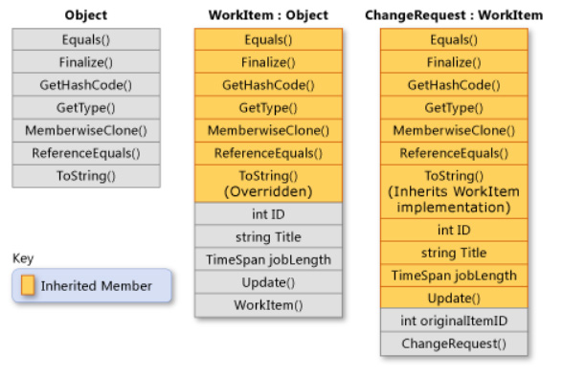
Base Class
Derived Class
Derived Class
Sample

Slide 41
4.Interfaces
Interfaces provide a way to achieve runtime polymorphism.
Using interfaces we can invoke functions from different classes through the same Interface reference
An interface is a reference type that consists of only abstract members.
When a class implements an interface, it must provide an implementation for all the members of the interface.
Classes can implement multiple interfaces.

Slide 42
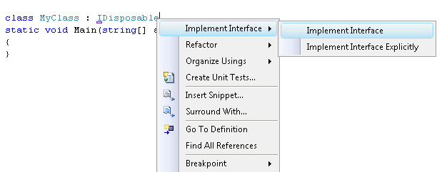
class MyClass : IDisposable
{
private FileStream _file;
public MyClass( FileStream fs)
{
_file = fs;
}
#region IDisposable Members
public void Dispose()
{
_file.Dispose();
}
#endregion
}
IDisposable is an interface that provides a single method, Dispose

Slide 43
Commonly Used Interfaces
Type | Description
IComparable | Provides type-specific comparison method, which enables sorting. Types, whose members can be ordered or sorted implement this interface. For instance all numeric and string classes
IDisposable | Provides for disposal of unmanaged objects such as open file. Large objects which consume a lot of resources can implement Idisposable to get rid of the unused resourses
IConvertible | Enables conversion to a base type
ICloneable | Enables creation of a copy of the current class instance
IEquatable | Allows to compare instances of a class for equality.
IFormattable | Provides a ToString() method which enables to convert a value into a formatted string

Slide 44
Creating Interface
interface IMessage
{ bool Send();
string Message { get; set; }
string Address { get; set; }
}
class EmailMessage : IMessage
{ public bool Send()
{
throw new Exception(“not implemented.");
}
public string Message
{ get{ throw new Exception(“ not implemented."); }
set{ throw new Exception(“ not implemented."); }
}
public string Address
{ get{ throw new Exception(“not implemented."); }
set{ throw new Exception(“is not implemented."); }
}
}

Slide 45
Extracting Interface
To extract an interface from an already defined custom class :
Right-click the class in Visual Studio.
Click Refactor and then click Extract Interface.
Specify the interface name, select the public members that should form the interface, and then click OK.

Slide 46
Lab & Assignment => tnemngissA
Requirement:
1. Create a class that can reverse an input string.
The class contains at least one constructor method to take the input string as the parameter, and another method to return the reversed string, and a private string field to save the input string.
Using the StringBuilder class gets certain scores, not using it will not get them.
2. Create another class or another project to call/use your first class.
Using it in another project will get higher scores.
Recommended: Please solve it on “PRACTICE ” first, before moving on to the solution.
Show your app (Console or Winform or Webform etc..) in the next class and I will mark for you.
String manipulations are typical interview questions. Please find your best solution.( This assignment only asks for the correct result. The interviewers may exam the efficiency.)

