Slide 1
Visual Studio and C#
CSharp -2
kevin.li@georgiancollege.ca
Notes:
1

Slide 2
Outline
Visual Studio
C#
Lab
Built in types
Int and String
Lab
Office 2007 键盘快捷方式
Notes:
2
Templates
Multiple projects and debug, start up project, debug 2nd
BreakPoints: Watch, local, Auto,
Shortcuts: Tag;
Search
Keywords, Name space, reference/web reference/service reference, Nugget,
Naming conventions.
Console: read write;
Statements; comments; regions;
Built-In types
Int
String
Lab

Slide 3
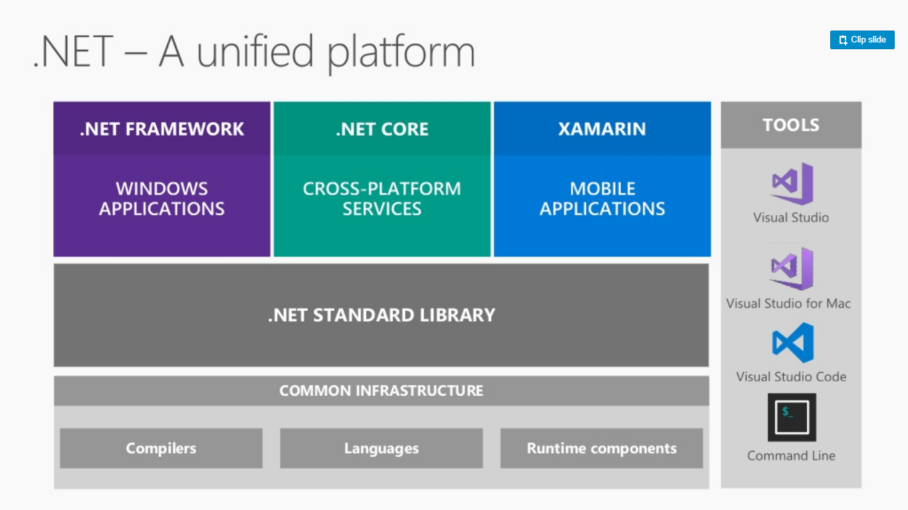

Slide 4
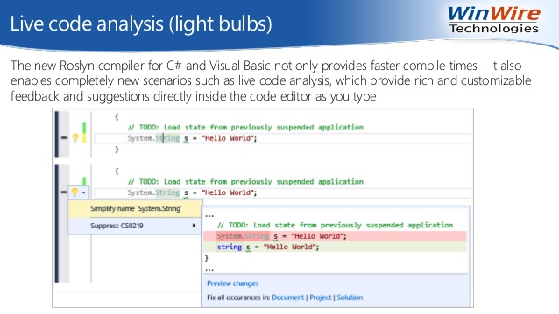
2.1 Visual Studio

Slide 5
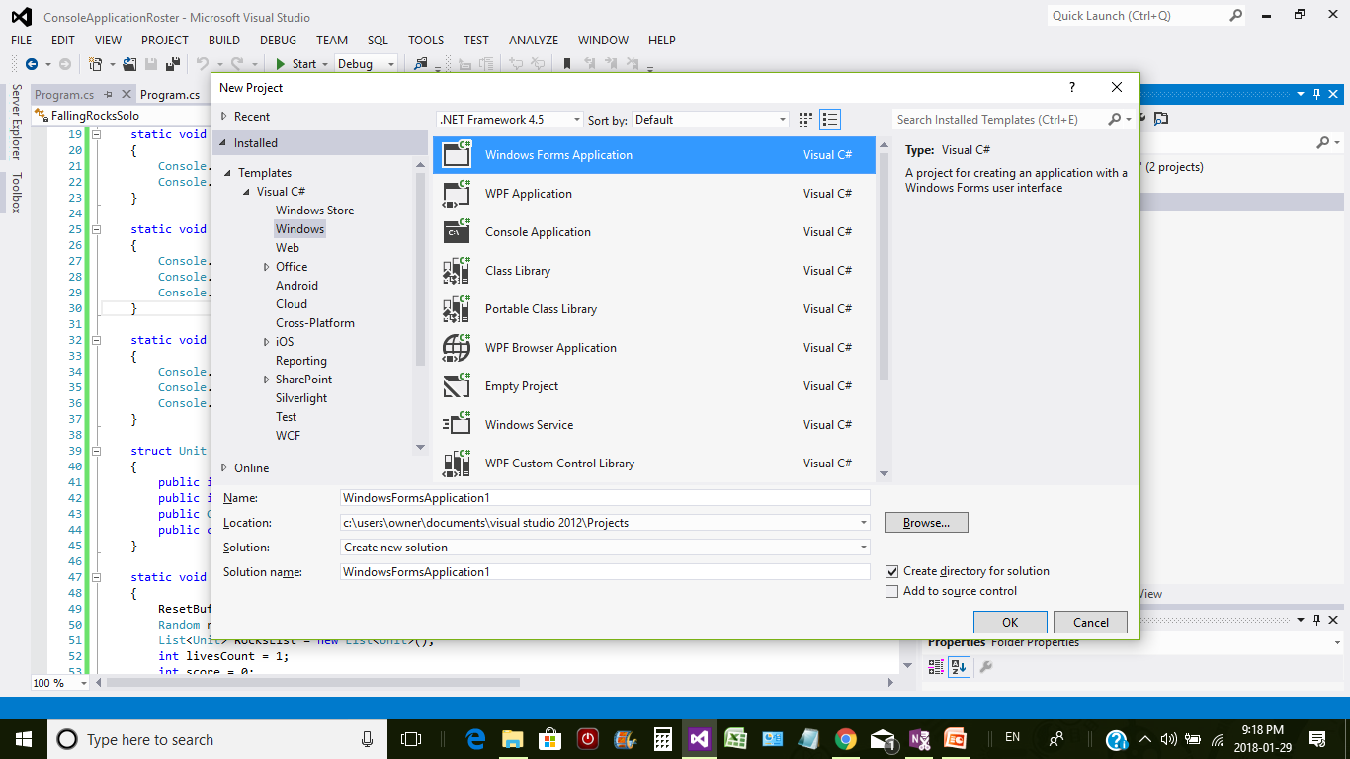
https://stackoverflow.com/questions/601974/clr-vs-jit

Slide 6
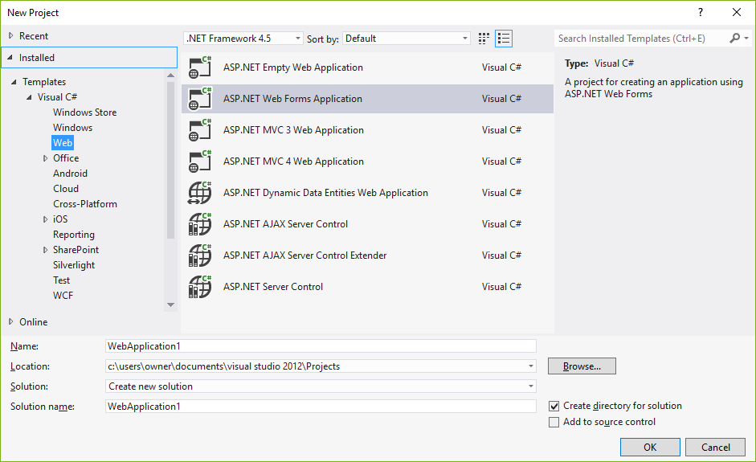
Office 2007 键盘快捷方式
Notes:
3

Slide 7
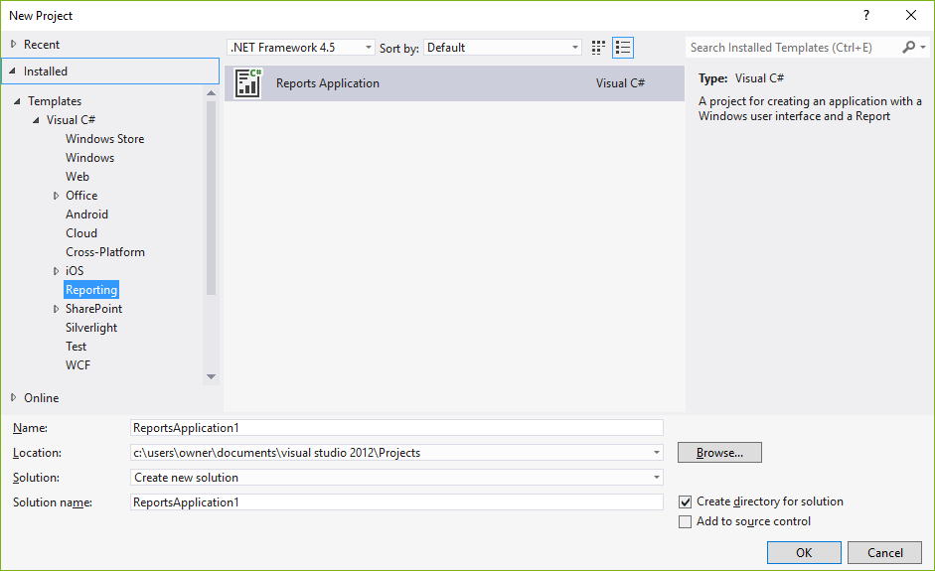

Slide 8
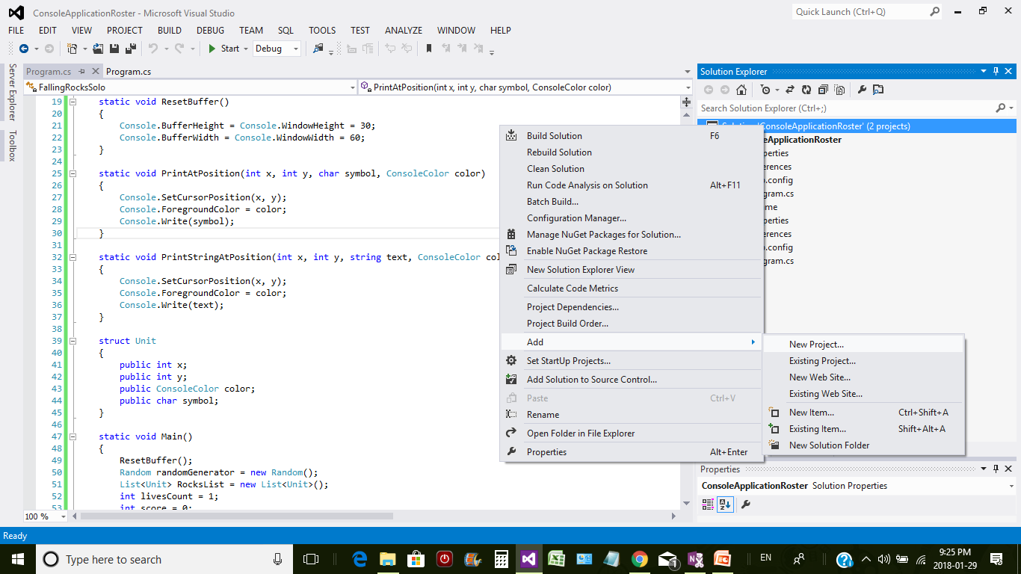
Notes:
4

Slide 9
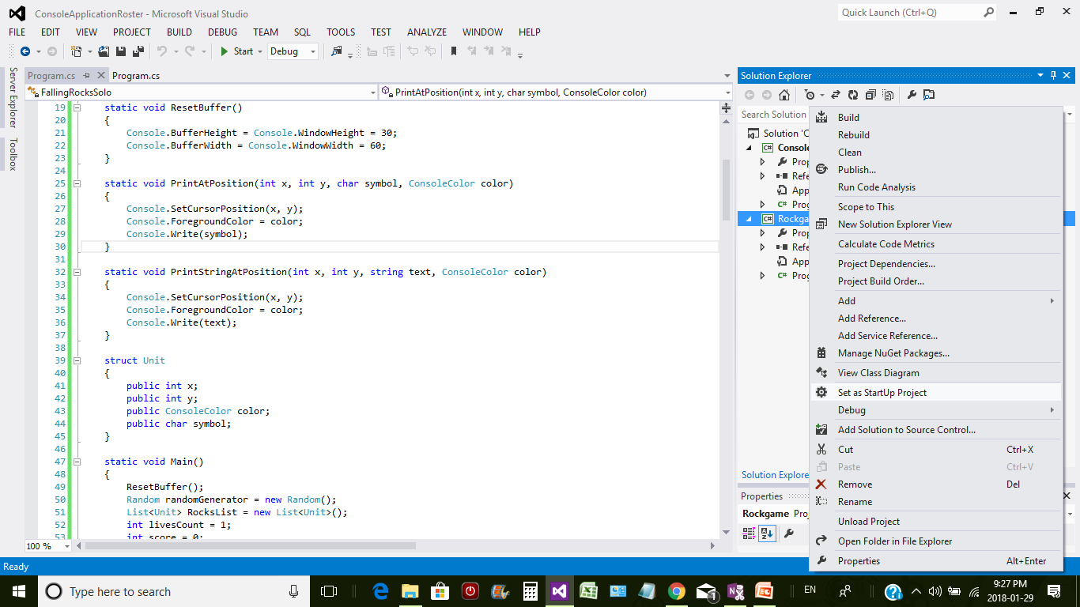
第 1 课
功能区简介
Notes:
5

Slide 10
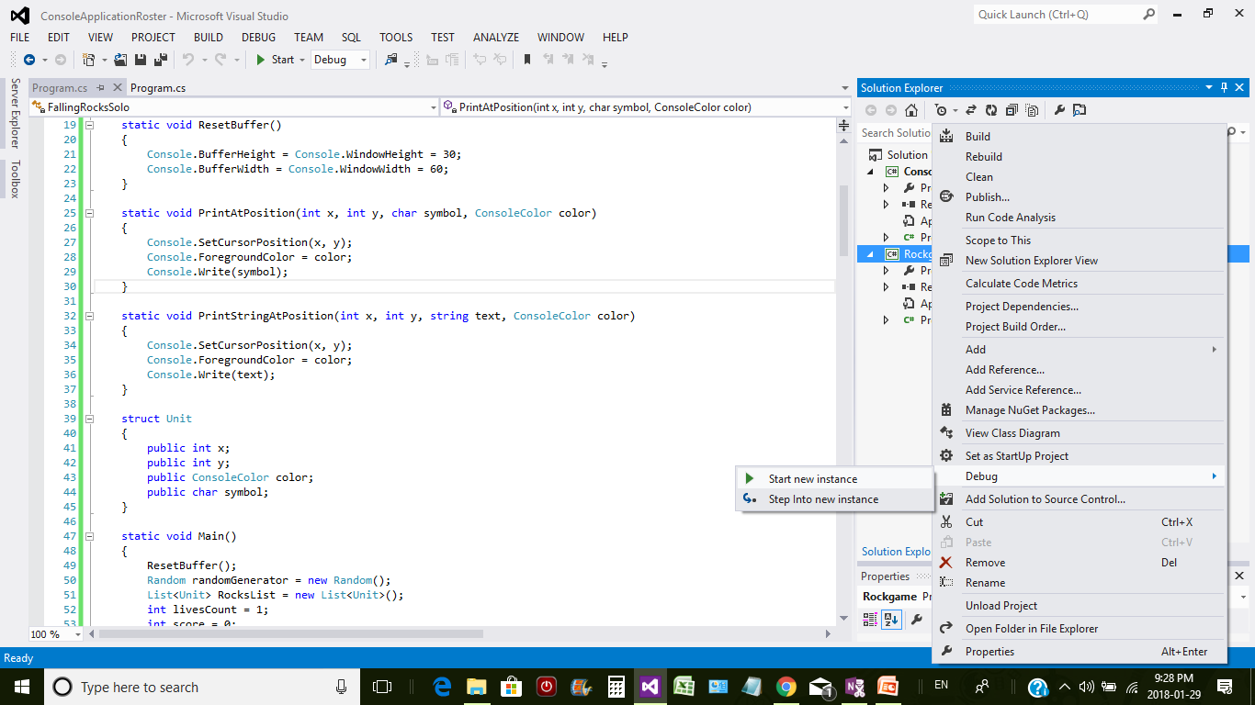
Office 2007 键盘快捷方式
Notes:
6
在功能区上，现已将命令和功能组合在一起，以反映它们的使用方法。这意味着您在工作时将只需执行很少的搜索。
功能区是下列 2007 Office system 程序的组成部分：Microsoft Office Word 2007、Microsoft Office Excel® 2007、Microsoft Office PowerPoint® 2007、Microsoft Office Access 2007 和 Microsoft Office Outlook® 2007。在 2007 Office 版本的所有“非功能区”程序中，键盘快捷方式的工作方式与以前完全相同。

Slide 11
Lab 1
Create a console/windows form project, print greetings. Run it.
Create the 2nd project in the same VS solution, show current time. Run it.
Can you show January 30, 2018 ***? (google it)
Console.WriteLine("Hello.");
Console.Read();
Console.WriteLine("This was printed at " + DateTime.Now);
Console.Read();
Notes:
7

Slide 12
Solution/Project Properties
Multiple start up projects.(eg. Web API + client app)
Application properties:
Check when the project cannot be compiled
Assemblies
Build and debug:
Configuration manager
Command arguments
Output window
Settings and Config files

Slide 13
Debug
Add variables in your sample codes
var name = "Dilpreet";
var lastName = "Kaur";
var fullname = name + " " + lastName;
Console.WriteLine(fullname);
Notes:
8

Slide 14
Break Points
Notes:
9
该图显示 Word 中的功能区。

Slide 15
Watch, local, Auto
Office 2007 键盘快捷方式
Notes:
10

Slide 16
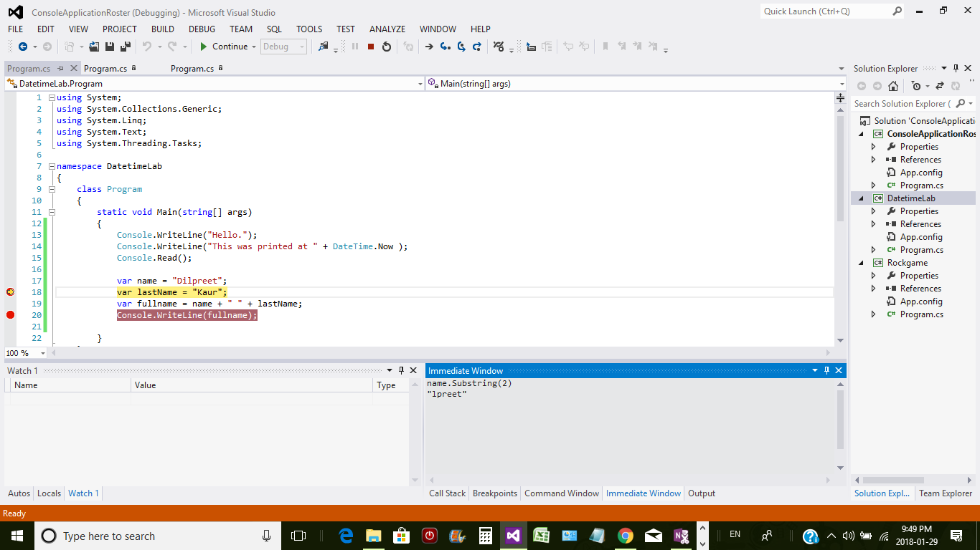
Immediate window
新的功能区程序包含两个额外的功能，它们将帮助您方便快捷地完成工作。
“快速访问工具栏”位于功能区的上方，其中包含您希望触手可及的命令。默认情况下，快速访问工具栏中包含“保存”、“撤消”和“重复”（或“恢复”）命令。但是，您可以使用所需的任何命令自定义该工具栏。
Office 2007 键盘快捷方式
Notes:
11

Slide 17
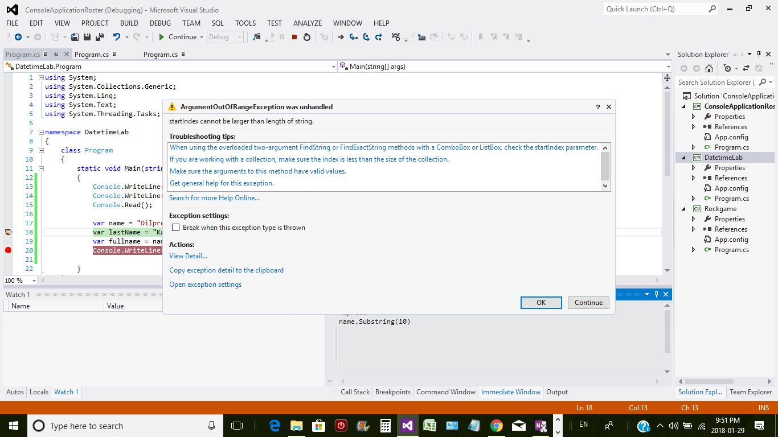
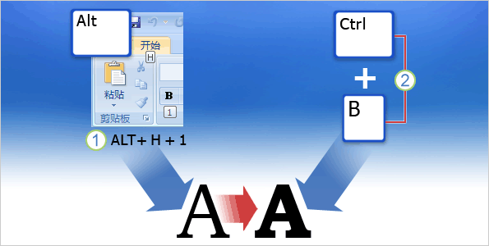
Immediate to verify/test
许多人都将“键盘快捷方式”视为用来执行某项操作的任意键击序列或组合。
通常，此定义是正确的。
但是，在本课中，我们将更精确地定义键盘快捷方式。
有两种基本类型的键盘快捷方式，本课将对它们进行介绍。 定义二者之间的区别非常重要，因为类型不同，工作方式也会有所不同。
Office 2007 键盘快捷方式
Notes:
12

Slide 18
Question
Requirement:
Show only the first 50 characters of any alert message, and a “…”
(to make the alert window small.)
Notes:
13
如果您熟悉旧形式（菜单项中带下划线的字母），请将键提示视为它们的新形式。您将在稍后部分中了解有关键提示的更多内容。

Slide 19
Daily operations
Ctrl+f: current document/project, solution
Tab (short cut)
Close all
Comment Out/ uncomment
Show all files /include new files
References
Nuget
Tools-Options: (Next page)
Notes:
14

Slide 20
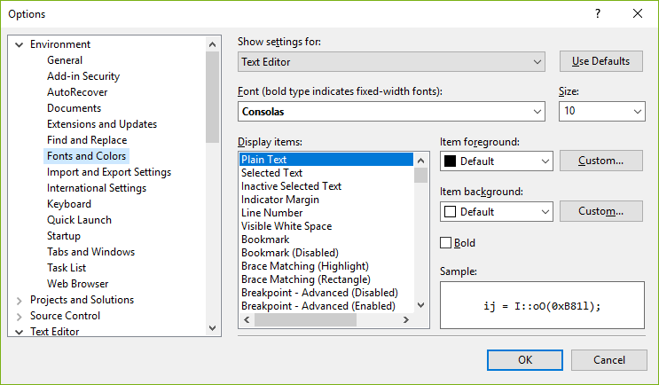
Notes:
15
本课程结尾的课程摘要卡包含指向“帮助”主题的链接，您可以在“帮助”主题中找到有关各种类型的键盘快捷方式的信息以及组合键列表。

Slide 21
2.2 Starting C#
using System;
namespace HelloWorldApplication { class HelloWorld { static void Main(string[] args) { /* my first program in C# */ Console.WriteLine("Hello World"); Console.ReadKey(); }
} }
Notes:
16

Slide 22
Basic rules
C# is case sensitive.
All statements and expression must end with a semicolon (;)
{} popsitions (different with JavaScript)
Avoid keywords
Intent styles
C# Coding Conventions (Next page)
Naming Conventions
Layout Conventions
Comments
Office 2007 键盘快捷方式
选项卡中包含执行特定任务最可能用到的几组命令。
Notes:
17

Slide 23
Naming Conventions
Variable name
Class name
Method name
(Read sample codes and learn)
Office 2007 键盘快捷方式
Notes:
18

Slide 24
Layout Conventions
smart indenting, four-character indents, tabs saved as spaces
Write only one statement per line.
Write only one declaration per line.
If continuation lines are not indented automatically, indent them one tab stop (four spaces).
在这里，可以找到用来执行以下操作的基本命令：打开、保存和打印文档；设置程序选项；编辑文件属性等。
Notes:
19

Slide 25
Commenting Conventions
Place the comment on a separate line, not at the end of a line of code.
Begin comment text with an uppercase letter.
End comment text with a period.
Insert one space between the comment delimiter (//) and the comment text
Do not create formatted blocks of asterisks around comments.
Office 2007 键盘快捷方式
Notes:
20

Slide 26
Comments lab
Single line
Section comments
XML comments
Codes region

Slide 27
Console: read & write
Console app
& Winform App (Show how to check the output)
Write and Writeline
Read: one character
ReadKey: to idenfify
ReadKey(Boolean)
ReadLine:
Read more details when you need them.
Office 2007 键盘快捷方式
Notes:
21

Slide 28
Built In Types
https://www.tutorialspoint.com/csharp/csharp_data_types.htm
https://msdn.microsoft.com/en-us/library/ya5y69ds(v=vs.120).aspx
Office 2007 键盘快捷方式
Notes:
45

Slide 29
Assignment 2 - Int and String Lab
Create a mulitple-project solution:
Objects:1st console provides options, user type one number.
Run the second application with the selected result.
(Which city would like to live? 1. Toronto 2. Barrie 3. New York
Or a restaurant menu....
Office 2007 键盘快捷方式
Notes:
46

Slide 30
Assignment 2 - Int and String Lab
Requirements:
This would be compeleted in 2 steps. The first step is required to be finished before the coming Wednesday.The 2nd step is required before 14 Feb. Initial codes would be provided.Please read the code and use them.
Step 1: Create a console applicaton. and a Windows Form Application in the same solution. Paste the codes and change in the console app to start the 2nd app. (No parameter is required for the 2nd app, only if start it automatically).
Office 2007 键盘快捷方式

Slide 31
Assignment 2 - Int and String Lab
Requirements:
Step 2: Insert 3 Picture box controls in the Windows Forms Application. Paste and edit the codes to make it be ready to show the selected picture. Test it.
Change the codes in the console app to start the windows form app and show different pictures.
(Will show the codes for step 2 in next class.)
Instructions for step 1 is following
Office 2007 键盘快捷方式

Slide 32
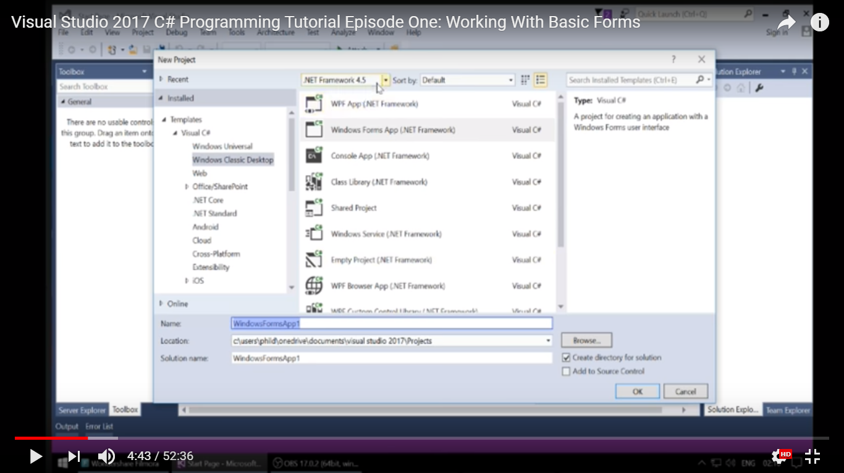
Assignment 2 - Int and String Lab
Instructions for step 1:
Office 2007 键盘快捷方式

Slide 33
Assignment 2 - Int and String Lab
Instructions for step 1:
The last screenshot shows where you can select the console application and Windows Froms application. Here is a 5-minutes vedio for your reference: https://www.youtube.com/watch?v=oIhNea3_vPw (Not same version, but you should be able to start.)
Office 2007 键盘快捷方式

