Slide 1
CSharp-3
Data Types and Declarations

Slide 2
Outline
1. Program Structure Review
Lab: Create a project; create the 2nd Project, Write codes, debug
2. Types
3. Value Types
4. Reference Types
5. Variables

Slide 3
Program Structure
The key organizational concepts in C# are programs, namespaces, types, members, and assemblies.
C# programs consist of one or more source files.
Programs declare types, which contain members and can be organized into namespaces.
Classes and interfaces are examples of types.
Fields, methods, properties, and events are examples of members.
When C# programs are compiled, they are physically packaged into assemblies. Assemblies typically have the file extension .exe or .dll, depending on whether they implement applications or libraries, respectively.
How?
Notes:
(TEXT ->SHAPE->VS)
https://docs.microsoft.com/en-us/dotnet/csharp/tour-of-csharp/program-structure

Slide 4
C# Programs
Source file(s)
Namespaces
Types ( eg. Classes and interfaces )
Members:
Fields, methods, properties, and events
Compiled
Assemblies (dll or exe files)
Notes:
Show dll and exe files in vs

Slide 5
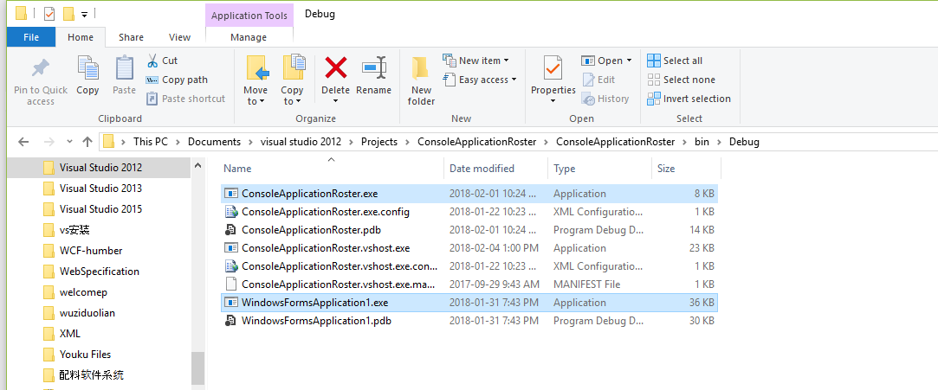
Assemblies – deliverable
Notes:
Double click and run them.
Others are for debugging purpose

Slide 6
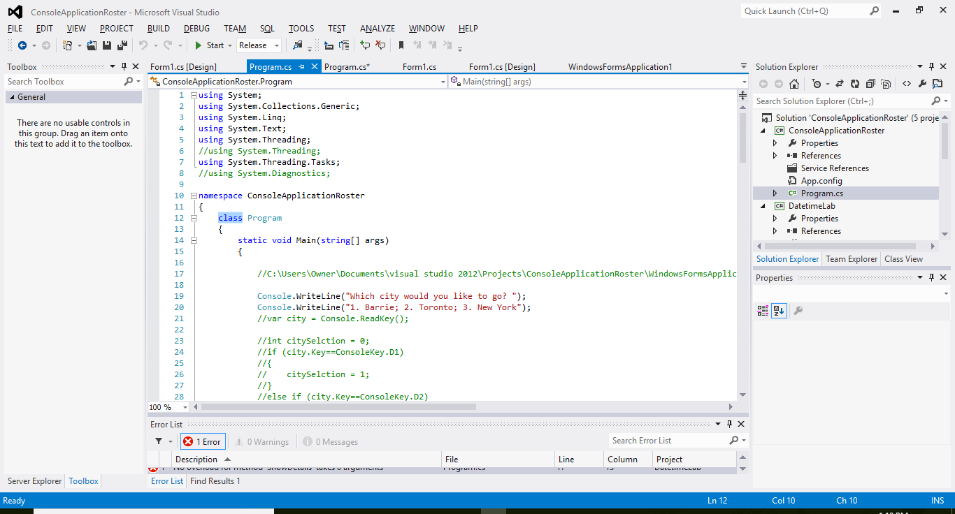
Source files
A method member: the name (identity) is Main

Slide 7
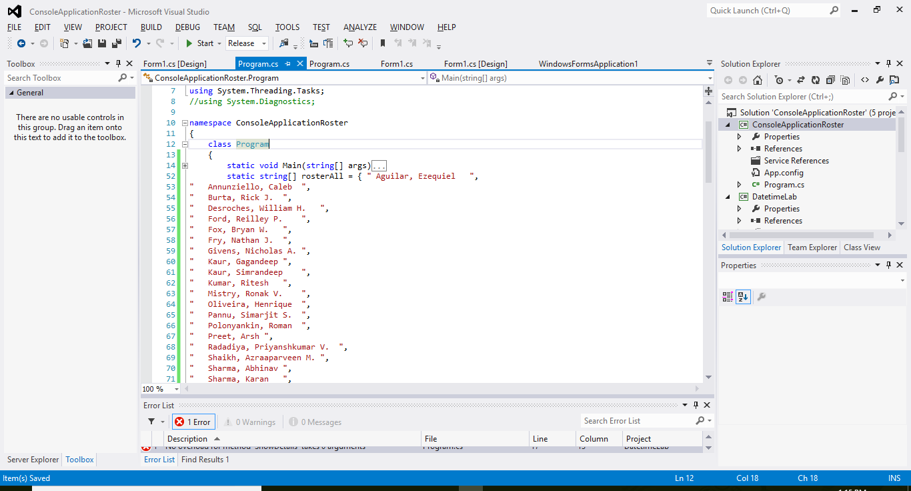
A field member of the class

Slide 8
Lab
Review Assignment 2: Step 1

Slide 9
2. Types
There are two kinds of types in C#: value types and reference types.
*Variables of value types directly contain their data
*variables of reference types store references to their data, being known as objects.
These would be asked in the test.

Slide 10
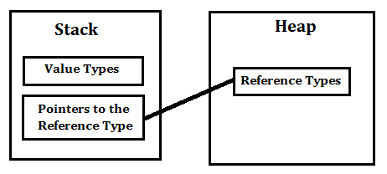
value types and reference types
Reference Type variables are stored in the heap
Value Type variables are stored in the stack.
Notes:
http://net-informations.com/faq/general/valuetype-referencetype.htm

Slide 11
value types and reference types
With reference types:
it is possible for two variables to reference the same object
and thus possible for operations on one variable
to affect the object referenced by the other variable.
With value types:
the variables each have their own copy of the data,
and it is not possible for operations on one to affect the other
(except in the case of ref and out parameter variables).

Slide 12
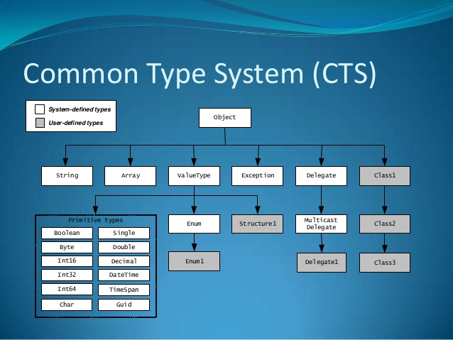

Slide 13
All the intrinsic types are value types except for Object and String
All user-defined types are reference types except for stucts

Slide 14
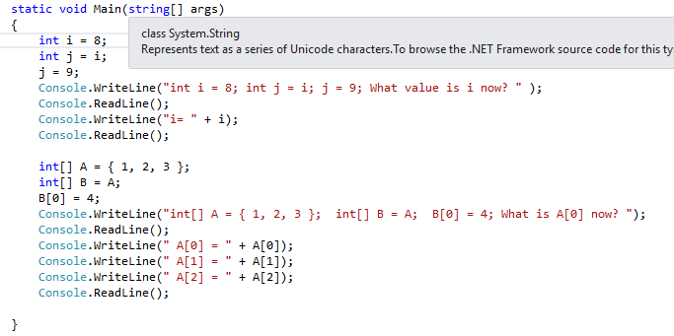
Value Type
Reference Type
These would be the test questions

Slide 15
VS lab
Test to change int and int[]

Slide 16
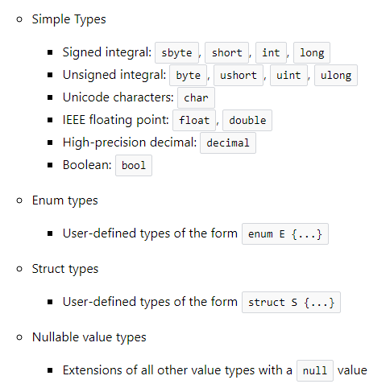
3. Value types

Slide 17
Initializing Value Types
Local variables in C# must be initialized before they are used.
int myInt;
myInt = 0;

Slide 18
Value types Lab
Simple types:
Console.WriteLine("int Max Value is " + int.MaxValue);
Console.WriteLine("int Min Value is " + int.MinValue);
Enum:
enum Day { Sat, Sun, Mon, Tue, Wed, Thu, Fri };
Console.WriteLine("1st day is " + Day.Sat);
Every enumeration type has an underlying type, which can be any integral type except char.
Usually it is best to define an enum directly within a namespace so that all classes in the namespace can access it with equal convenience. However, an enum can also be nested within a class or struct.

Slide 19
Value types Lab
Struct
typically used to encapsulate small groups of related variables, such as the coordinates of a rectangle
public struct Book
{
public decimal price;
public string title;
public string author;
}

Slide 20
Nullable value types
Allow you to assign null to value type variables
A nullable type can represent the correct range of values for its underlying value type, plus an additional null value.
Nullable<Int32>, pronounced "Nullable of Int32,"
int? For short (What is the default value? null)

Slide 21
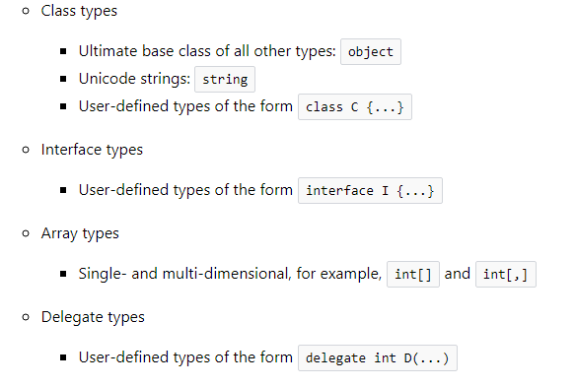
4. Reference types

Slide 22
4. Reference types
String
the string type represents a sequence of UTF-16 code units.
The + operator concatenates strings: string a = "good " + "morning";

Slide 23
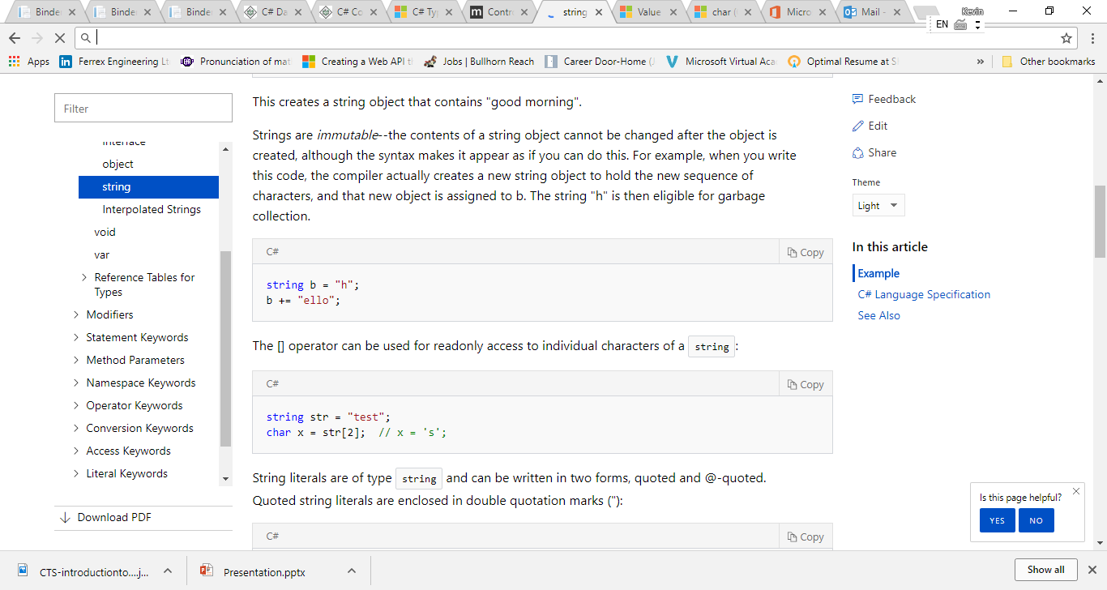

Slide 24
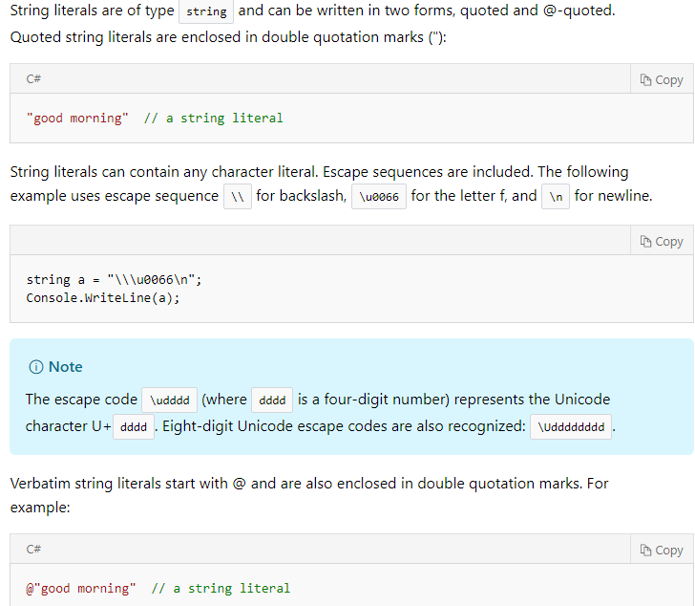

Slide 25
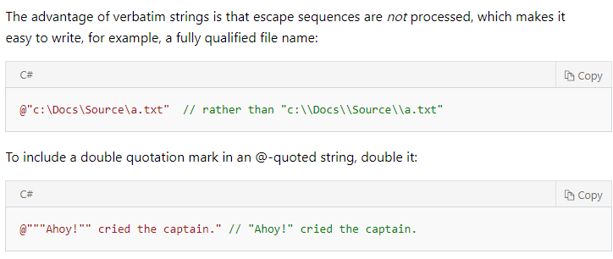

Slide 26
each operation that appears to modify a String object actually creates a new string.
Every time you use one of the methods in the System.String class, you create a new string object in memory, which requires a new allocation of space for that new object. In situations where you need to perform repeated modifications to a string, the overhead associated with creating a new String object can be costly.

Slide 27
System.Text.StringBuilder
StringBuilder Class represents a mutable string of characters.
Can be used when you want to modify a string without creating a new object. (In situations where you need to perform repeated modifications to a string)

Slide 28
5. Variables
A variable is nothing but a name given to a storage area that our programs can manipulate. (Variables represent storage locations)
Each variable in C# has a specific type, which determines the size and layout of the variable's memory the range of values that can be stored within that memory and the set of operations that can be applied to the variable.
There are several kinds of variables:
fields, array elements, local variables, and parameters.

Slide 29
Defining Variables
int i, j, k;
char c, ch;
float f;
double d;

Slide 30
Initializing Variables
int d = 3, f = 5; /* initializing d and f. */
int num;
num = Convert.ToInt32(Console.ReadLine());

Slide 31
6 Type Conversion
Implicit type conversion − These conversions are performed by C# in a type-safe manner. For example, are conversions from smaller to larger integral types and conversions from derived classes to base classes.
Explicit type conversion − These conversions are done explicitly by users using the pre-defined functions. Explicit conversions require a cast operator.

Slide 32
Implicit type conversion -
// Implicit conversion. A long can
// hold any value an int can hold, and more!
int num = 2147483647;
long bigNum = num;
If conversion is unavailable you’d know about it at compile time

Slide 33
Explicit type conversion - Cast
double d = 5673.74;
int i;
// cast double to int.
i = (int)d;

Slide 34
BOXING and Unboxing – Next time

Slide 35
Assignment 2 step2
The codes for the console app have been changed a little bit because I found someone could not run it:
var city = Console.ReadKey().KeyChar;
If you got errors and did research online, you may attach the links that helped you to get more cedits.

