Slide 1
Csharp – 4 - program flow

Slide 2
Outline
Assignment 2 Review
Boxing and Unboxing
Flow control
Lab

Slide 3
4.1 Assignment Review
Program Structure
Types
Value Types
Reference Types: String, Class
Conversions
Declaration
Assignment
Flows

Slide 4
Why do we need boxing and unboxing
For example, the old collection type ArrayList only eats objects. That is, it only stores references to somethings that live somewhere. Without boxing you cannot put an int into such a collection. But with boxing, you can.
(Now, in the days of generics you don't really need this)
https://stackoverflow.com/questions/2111857/why-do-we-need-boxing-and-unboxing-in-c
Test and Interview
Notes:
https://stackoverflow.com/questions/2111857/why-do-we-need-boxing-and-unboxing-in-c

Slide 5
4.2 Boxing and Unboxing
Boxing is the process of converting a value type to the type object or to any interface type implemented by this value type (Structure).
When the CLR boxes a value type, it wraps the value inside a System.Object and stores it on the managed heap. Unboxing extracts the value type from the object. (Microsoft)

Slide 6
int i = 123;
object o = i; // Implicit boxing
i = 456; // Change the contents of i
Console.WriteLine("The value-type value = {0}", i);
Console.WriteLine("The object-type value = {0}", o);
(Run it in VS; Explanation in next slide)

Slide 7
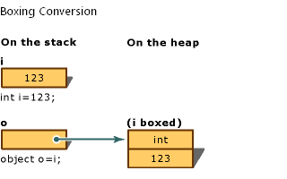
Memory Allocation in Boxing

Slide 8
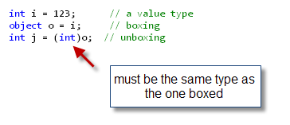
Quirks of Unboxing

Slide 9
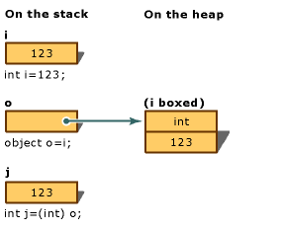
Memory Allocation of Unboxing

Slide 10
Boxing Performance
In relation to simple assignments, boxing and unboxing are computationally expensive processes.
When a value type is boxed, a new object must be allocated and constructed. To a lesser degree, the cast required for unboxing is also expensive computationally.

Slide 11
Unboxing (Cont’d)
Unboxing is an explicit conversion from the type object to a value type or from an interface type to a value type that implements the interface. An unboxing operation consists of:
Checking the object instance to make sure that it is a boxed value of the given value type.
Copying the value from the instance into the value-type variable.

Slide 12
Unboxing (Cont’d)
For the unboxing of value types to succeed at run time, the item being unboxed must be a reference to an object that was previously created by boxing an instance of that value type.
Attempting to unbox null causes a NullReferenceException.
Attempting to unbox a reference to an incompatible value type causes an InvalidCastException.

Slide 13
As Operator
Using the as operator differs from a cast in C# in three important ways:
It returns null when the variable you are trying to convert is not of the requested type or in it's inheritance chain, instead of throwing an exception.
It can only be applied to reference type variables converting to reference types.
Using as will not perform user-defined conversions, such as implicit or explicit conversion operators, which casting syntax will do.

Slide 14
The as operator is used to tell the application "I want you to try and convert this. It might not, and I know this, so don't throw an exception. I'll deal with it accordingly."

Slide 15
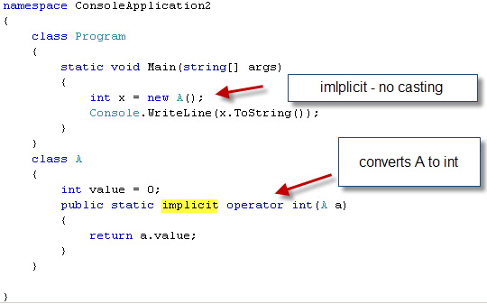
Implicit Conversion Operator

Slide 16
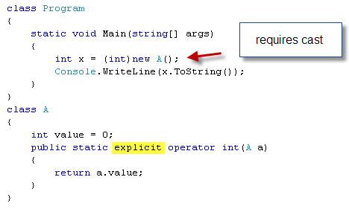
Explicit Conversion Operator

Slide 17
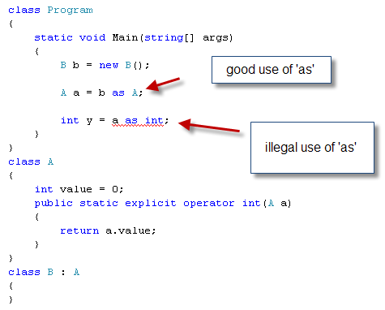
As example

Slide 18
Running the codes will be helpful to understand boxing and unboxing.

Slide 19
4.3 Flow control
Operators
Decision Making
Error handling

Slide 20
Operators
Arithmetic Operators
Relational Operators
Logical Operators
Bitwise Operators
Assignment Operators
Misc Operators

Slide 21
Arithmetic Operators
+ | Adds two operands | A + B = 30
- | Subtracts second operand from the first | A - B = -10
* | Multiplies both operands | A * B = 200
/ | Divides numerator by de-numerator | B / A = 2
% | Modulus Operator and remainder of after an integer division | B % A = 0
++ | Increment operator increases integer value by one | A++ = 11
-- | Decrement operator decreases integer value by one | A-- = 9

Slide 22
a++ vs ++a
Codes

Slide 23
Relational Operators
== | Checks if the values of two operands are equal or not, if yes then condition becomes true. | (A == B)
!= | Checks if the values of two operands are equal or not, if values are not equal then condition becomes true. | (A != B)
> | Checks if the value of left operand is greater than the value of right operand, if yes then condition becomes true. | (A > B)
< | Checks if the value of left operand is less than the value of right operand, if yes then condition becomes true. | A < B
>= | Checks if the value of left operand is greater than or equal to the value of right operand, if yes then condition becomes true. | (A >= B)
<= | Checks if the value of left operand is less than or equal to the value of right operand, if yes then condition becomes true. | (A <= B)

Slide 24
Logical Operators
&& | Called Logical AND operator. If both the operands are non zero then condition becomes true. | (A && B)
|| | Called Logical OR Operator. If any of the two operands is non zero then condition becomes true. | (A || B)
! | Called Logical NOT Operator. Use to reverses the logical state of its operand. If a condition is true then Logical NOT operator will make false. | !(A && B)

Slide 25
Bitwise Operators
p | q | p & q | p | q | p ^ q in one operand but not both
0 | 0 | 0 | 0 | 0
0 | 1 | 0 | 1 | 1
1 | 1 | 1 | 1 | 0
1 | 0 | 0 | 1 | 1

Slide 26
An Interview Question
Swapping two integer variables without an intermediary variable
Normal codes:
int i = 3; int j = 4; int x = i; i= j; j=x;
Bitwise version- Lab
A = A^B // A is now XOR of A and B
B = A^B // B is now the original A
A = A^B // A is now the original B

Slide 27
Learn more when you need it

Slide 28
Assignment Operators
= | Simple assignment operator, Assigns values from right side operands to left side operand | C = A + B assigns value of A + B into C
+= | Add AND assignment operator, It adds right operand to the left operand and assign the result to left operand | C += A is equivalent to C = C + A
……

Slide 29
Miscellaneous Operators
sizeof() | Returns the size of a data type. | sizeof(int), returns 4.
typeof() | Returns the type of a class. | typeof(StreamReader);
& | Returns the address of an variable. | &a; returns actual address of the variable.
* | Pointer to a variable. | *a; creates pointer named 'a' to a variable.
? : | Conditional Expression | If Condition is true ? Then value X : Otherwise value Y
is | Determines whether an object is of a certain type. | If( Ford is Car) // checks if Ford is an object of the Car class.
as | Cast without raising an exception if the cast fails. | Object obj = new StringReader("Hello");StringReader r = obj as StringReader;

Slide 30
??
// Set y to the value of x if x is NOT null; otherwise,
// if x == null, set y to -1.
int y = x ?? -1;

Slide 31
Null-conditional Operators (C# 6.0)
var length = customers?.Substring(2)

Slide 32
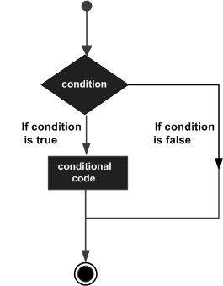
Decision Making

Slide 33
1 | if statementAn if statement consists of a boolean expression followed by one or more statements.
2 | if...else statementAn if statement can be followed by an optional else statement, which executes when the boolean expression is false.
3 | nested if statementsYou can use one if or else if statement inside another if or else ifstatement(s).
4 | switch statementA switch statement allows a variable to be tested for equality against a list of values.
5 | nested switch statementsYou can use one switch statement inside another switchstatement(s).

Slide 34
Study Some special cases
Lab:
int s = 6;
if (s==6)
{ Console.Write("==6"); }
else if (s>2)
{ Console.Write("s>9"); }
else
{ Console.WriteLine("3rd line fo conditions"); }

Slide 35
A typical test question
C# switch Statement with grouped cases
int caseSwitch = 1;
switch (caseSwitch)
{
case 1: //break;
case 2: Console.WriteLine("Case 2");
break;
default:
Console.WriteLine("Default case");
break;
}
What will you get?

Slide 36
In C# 6, the match expression must be an expression that returns a value of the following types:
a char.
a string.
a bool.
an integral value, such as an int or a long.
an enum value.
Starting with C# 7, the match expression can be any non-null expression.

Slide 37
Lab
Show dynamic welcome messages with
good morning/afternoon/evening
using the condition of the current time.

Slide 38
Loops
Learn by yourself
https://www.tutorialspoint.com/csharp/csharp_loops.htm
1 | break statement Terminatesthe loop or switch statement and transfers execution to the statement immediately following the loop or switch.
2 | continue statement Causes the loop to skip the remainder of its body and immediately retest its condition prior to reiterating.

Slide 39
Best Practice
Avoid multiple-nested loops!
(Reason: Learn Big O again if you forget)
( not required in this class:
Optimise your workflow
Change your data model
Use stored procedures to do heavy tasks)

Slide 40
Group Coding lab: select three checkboxes Click OK button to show a message box with the result text How many lines of codes for the button?
Invoice | Statement | ticket |  | Result
Yes | No | Yes |  | Invoice
Yes | No | No |  | Invoice
Yes | Yes | Yes |  | Invoice and Statement
Yes | Yes | No |  | Invoice and Statement
No | Yes | Yes |  | Statement and Ticket
No | Yes | No |  | Statement
No | No | Yes |  | Ticket

Slide 41
Error Handling
Next session

Slide 42
Assignment
Run and learn the codes I am sharing
Will do an in-class test next time
Do not need to submit.

