Slide 1
Programming in C# Class 1: Overview
Kevin.Li@GeorgianCollege.ca

Slide 2
https://www.linkedin.com/in/kevinca
Welcome to connect
Success Stories
https://www.linkedin.com/in/luluwheelan/
https://www.linkedin.com/in/hongjo-lim-a00562158/
https://www.linkedin.com/in/lynette-xie/

Slide 3
Outline
1. Syllabus, Lesson Outline, Text book
2. Student Survey
3. A real C# project introduction
4. .NET Framework overview
5. C# Overview
6. IDE
7. C# Program structure and Basic Syntax
8. Practice
Notes:
Say hello

Slide 4
Text book
Murach’s C# 2015
by Anne Boehm and Joel Murach 26 chapters, 884 pages, 378 illustrations Published January 2016 ISBN 978-1-890774-94-3
https://www.murach.com/shop/murach-s-c-2015-detail

Slide 5
First thing
Start to download/install Visual Studio

Slide 6
1. Lesson Outline
01.00.00 .NET Framework and Development Environment
02.00.00 Language/Grammar
03.00.00 Data Types and Declarations
04.00.00 Error Handling
05.00.00 Methods and Events
06.00.00 Class Modules and Objects
07.00.00 Flat Data Files
08.00.00 Database Connections

Slide 7
1. Lesson Outline
09.00.00 .NET Language-Integrated Query (LINQ)
10.00.00 Data Interchange Formats
11.00.00 Data Manipulation
12.00.00 Visual Form Design
13.00.00 Controls and Properties
Final Project
Mid-Term Test

Slide 8
My current C# project
System Integration

Slide 9



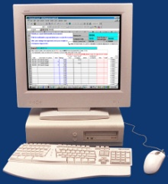










.NET Enterprise Vision
Users Any device, Any place, Any time
XML Web Services Integrate business applications and processes
Scheduling
Authentication
Notification
Back Office Heterogeneous application and server infrastructure
Customer
Service
Sales
ERP & Billing

Slide 10
.NET Enterprise Vision
Users Any device, Any place, Any time
XML Web Services /Web API
Scheduling
Authentication
Notification
Back Office Heterogeneous application and server infrastructure
Customer
Service
Sales
ERP & Billing

Slide 11
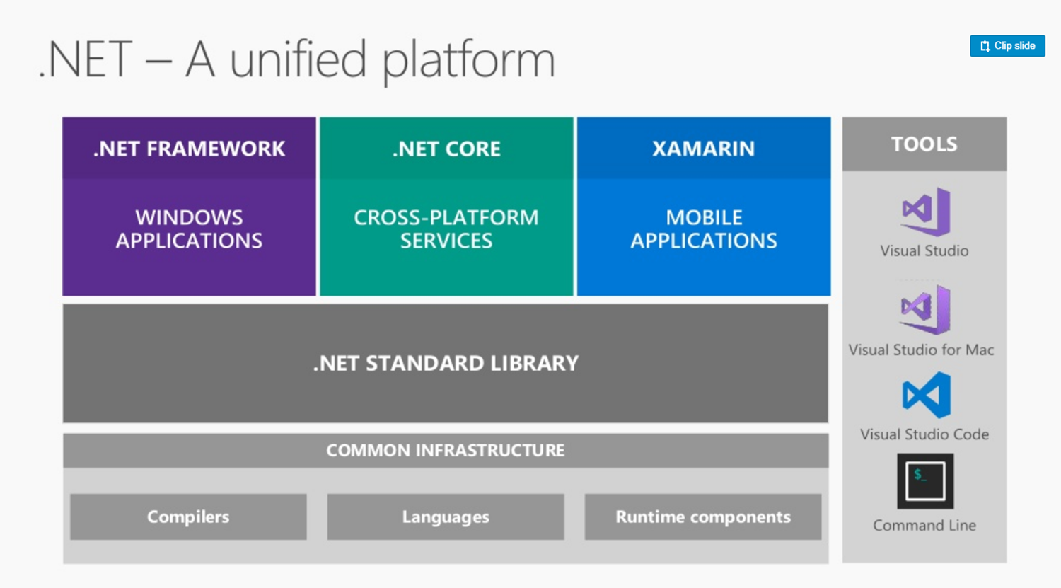

Slide 12
So what is .NET?
.NET is a platform that provides a standardized set of services.
It’s just like Windows, except distributed over the Internet.
It exports a common interface so that it’s programs can be run on any system that supports .NET.
A specific software framework
Includes a common runtime

Slide 13
.NET Framework
Programming model for .NET
Platform for running .NET managed code in a virtual machine
Provides a very good environment to develop networked applications and Web Services,
Cross platform mobile apps.
Provides programming API and unified language-independent development framework

Slide 14
The Core of .NET Framework: FCL & CLR
Common Language Runtime
Garbage collection
Language integration (eg: C#, VB.NET)
Multiple versioning support (no more DLL hell!) (eg:3rd party dlls)
Integrated security
Framework Class Library
Provides the core functionality:
ASP.NET, ^{ASP.NET MVC,} Web Services, ADO.NET, Windows Forms, IO, XML, etc.

Slide 15
.NET Framework Common Language Runtime
CLR manages code execution at runtime
Memory management, thread management, etc.
Common Language Runtime
Operating System

Slide 16
.NET Framework Base Class Library
Object-oriented collection of reusable types
Collections, I/O, Strings, …
.NET Framework (Base Class Library)
Common Language Runtime
Operating System

Slide 17
.NET Framework Data Access Layer
Access relational databases
Disconnected data model
Work with XML
ADO .NET and XML
.NET Framework (Base Class Library)
Common Language Runtime
Operating System

Slide 18
.NET Framework ASP.NET & Windows Forms
Create application’s front-end – Web-based user interface, Windows GUI, Web services, …
ASP .NET
Web Forms Web Services
Mobile Internet Toolkit
Windows
Forms
ADO .NET and XML
.NET Framework (Base Class Library)
Common Language Runtime
Operating System

Slide 19
.NET Framework Programming Languages
Use your favorite language
C++
C#
VB.NET
Perl
J#
…
ASP .NET
Web Forms Web Services
Mobile Internet Toolkit
Windows
Forms
ADO .NET and XML
.NET Framework (Base Class Library)
Common Language Runtime
Operating System

Slide 20
.NET Framework Visual Studio .NET
C++
C#
VB
Perl
J#
…
Visual Studio .NET
Common Language Specification
ASP .NET
Web Forms Web Services
Mobile Internet Toolkit
Windows
Forms
ADO .NET and XML
.NET Framework (Base Class Library)
Common Language Runtime
Operating System

Slide 21



.NET Framework Standards Compliance
C# Language – Submitted to ECMA
C++
C#
VB
Perl
J#
…
Visual Studio .NET
Common Language Specification
Open Language
Specification
ASP .NET
Web Services Web Forms
Mobile Internet Toolkit
Windows
Forms
Web services –
XML, SOAP-based
ADO .NET and XML
.NET Framework (Base Class Library)
XML-based
data access
Common Language Runtime
Operating System
Notes:
A Common Language Specification (CLS) is a document that says how computer programs can be turned into MSIL code.
Inside the .NET Framework
Standards Compliance
Microsoft .NET is built on standards. Both the Common Language Infrastructure, CLI and Visual C# have been submitted to the ECMA for approval and adoption. The data and Web services are built on XML and SOAP. (European Computer Manufacturers Association)
.Net Framework supports Web standards:
HTML- Hyper-Text Markup Language
XML - Extensible Markup Language, the universal format for structured documents and data on the Web.
WSDL- Web Services Description Language (WSDL)
SOAP - Simple Object Access Protocol, a simple, XML-based protocol for exchanging structured and type information on the Web. The protocol contains no application or transport semantics, which makes it highly modular and extensible. (SOAP currently still has no encryption support either)
XPATH - XML Path Language
XSLT - XSL Transformations (XSLT), is an XML-based language that enables you to transform one class of XML document to another.

Slide 22
Common Language Runtime
Manages running code – like a virtual machine
Threading
Memory management
No interpreter: JIT-compiler produces native code – during the program installation or at run time (https://en.wikipedia.org/wiki/Dynamic_Language_Runtime)
Fine-grained evidence-based security
Code access security
Code can be verified to guarantee type safety
No unsafe casts, no un-initialized variables and no out-of-bounds array indexing
Role-based security
Notes:
System.Security.Permissions.PrincipalPermission
The Common Language Runtime
Features
The Common Language Runtime (CLR) is the execution engine for .NET Framework applications.
It provides a number of services including:
Code management (loading and execution)
Application memory isolation
Verification of type safety
Conversion of IL to native code
Access to metadata (enhanced type information)
Managing memory for managed objects
Enforcement of Code Access Security
Exception handling including cross-language exceptions
Interoperation between managed code, COM objects and pre-existing DLLs (unmanaged code and data)
Automation of object layout
Support for developer services (profiling, debugging, etc.)
Native Code is code compiled to processor-specific machine code.
Managed Code runs under a "contract of cooperation" with the CLR and it must supply the metadata necessary for the CLR to provide services such as memory management, cross-language integration, Code Access Security and automatic lifetime control of objects. All code based on Microsoft Intermediate Language (MSIL) executes as managed code.
Microsoft Intermediate Language (MSIL) is used as the output of a number of compilers and as the input to a Just-In-Time (JIT) compiler. The CLR includes several JIT compilers for converting MSIL to native code.

Slide 23
Managed Code
Code that targets the CLR is referred to as managed code
All managed code has the features of the CLR
Object-oriented
Type-safe
Cross-language integration
Cross language exception handling
Multiple version support
Managed code is represented in special Intermediate Language (IL)
Notes:
https://stackoverflow.com/questions/2437469/what-is-type-safe-in-net

Slide 24
Automatic Memory Management
The CLR manages memory for managed code
All allocations of objects and buffers made from a Managed Heap
Unused objects and buffers are cleaned up automatically through Garbage Collection
Some of the worst bugs in software development are not possible with managed code
Leaked memory or objects
References to freed or non-existent objects
Reading of uninitialized variables
Pointerless environment

Slide 25
Multiple Language Support
CIL (MSIL or IL) – Intermediate Language
It is low-level (machine) language, like Assembler, but is Object-oriented
CTS is a rich type system built into the CLR
Implements various types (int, float, string, …)
And operations on those types
CLS is a set of specifications that all languages and libraries need to follow
This will ensure interoperability between languages

Slide 26
Intermediate Language
.NET languages are compiled to an Intermediate Language (IL)
Common Intermediate Language is also known as MSIL
CLR compiles IL in just-in-time (JIT) manner – each function is compiled just before execution
The JIT code stays in memory for subsequent calls
Recompilations of assemblies are also possible
Notes:
Is there any disadvantage?

Slide 27
Example of MSIL Code
.method private hidebysig static void Main() cil managed
{
.entrypoint
// Code size 11 (0xb)
.maxstack 8
IL_0000: ldstr "Hello, world!"
IL_0005: call void [mscorlib]System.Console::WriteLine(string)
IL_000a: ret
} // end of method HelloWorld::Main

Slide 28
Common Type System (CTS)
All .NET languages have the same primitive data types. An int in C# is the same as an int in VB.NET
When communicating between modules written in any .NET language, the types are guaranteed to be compatible on the binary level
Types can be:
Value types – passed by value, stored in the stack
Reference types – passed by reference, stored in the heap
Strings are a primitive data type now

Slide 29
C# Language
Object-oriented
Properties, Methods, Events
Attributes
All in one place, no header files etc.
Can be embedded in ASP pages
Everything really is an object
Primitive types aren’t magic
Unified type system == Deep simplicity
Improved extensibility and reusability

Slide 30
C# Language – Example
using System;
class HelloWorld
{
public static void main()
{
Console.WriteLine(“Hello, world!”);
}
}

Slide 31









Code Compilation and Execution
Compilation
Also called Assembly
(.EXE or
.DLL file)
Source Code
Language Compiler
Code
MSIL
Metadata
Before installation or the first time each method is called
Execution
Native
Code
JIT Compiler
Notes:
The Common Language Runtime Compilation and Execution
The above diagram illustrates the process used to compile and execute managed code, or code that uses the CLR. Source code written in Visual C#, Visual Basic .NET or another language that targets the CLR is first transformed into MSIL by the appropriate language compiler. Before execution, this MSIL is compiled by the Just-in-Time (JIT) complier into native code for the processor on which the code will operate. The default is to JIT compile each method when it is first called, but it is also possible to “preJIT” MSIL code to native code at assembly install-time. With this option, all methods are compiled before the application is loaded so as to avoid the overhead of JIT compilation on each initial method call. You use the Native Image Generator (Ngen.exe) to create a native image from a managed assembly and install it into the native image cache. Once the code is compiled and cached, the CLR does not need to re-compile the MSIL code until the assembly is updated, the Just-In-Time compiled code is removed from the cache, or the machine is restarted.
All languages targeting the CLR *should* exhibit a similar performance. While some compilers may produce better MSIL code, large variations in execution speed are unlikely.

Slide 32
Assemblies
DLL or EXE file
Smallest deployable unit in the CLR
Have unique version number
No version conflicts (known as DLL hell)
Contains IL code to be executed
Security boundary – permissions are granted at the assembly level
Type boundary – all types include the assembly name they are a part of
Self-describing manifest – metadata that describes the types in the assembly (https://docs.microsoft.com/en-us/dotnet/standard/assembly/manifest;https://docs.microsoft.com/en-us/dotnet/standard/assembly/view-contents)

Slide 33
Metadata in Assembly
Type Descriptions
Classes
Base classes
Implemented interfaces
Data members
Methods
Assembly Description
Name
Version
Culture
Other assemblies
Security Permissions
Exported Types
Notes:
Exported Types
: the types defined in this assembly that are visible outside the assembly.

Slide 34
Applications
One or more assemblies
Assemblies conflict resolution
Using metadata
Local (preferred)
Global Assembly Cache (GAC)
Different applications may use different versions of an assembly
Easier software updates
Easier software removal
Notes:
https://stackoverflow.com/questions/2660355/net-4-0-has-a-new-gac-why

Slide 35
Visual Studio .NET
Development tool that contains a rich set of productivity and debugging features
Supports managed and unmanaged applications
Supports C#, C++, VB.NET, …
Many useful tools and wizards
Windows Forms Designer
ASP.NET Web Forms Designer
Web Services support
SQL Server integration with ADO.NET and XML
Project templates can be installed
VS.NET is not part of the .NET Framework
Not necessary to build or run managed code
Because the .NET Framework SDK includes command line compilers

Slide 36
VS.NET – Single Development Environment & Skill Set
From Visual Studio.NET you can:
Write code
Design user interface
Study documentation
Debug
Test
Deploy
Same tools for all languages
Same tools for all platforms

Slide 37
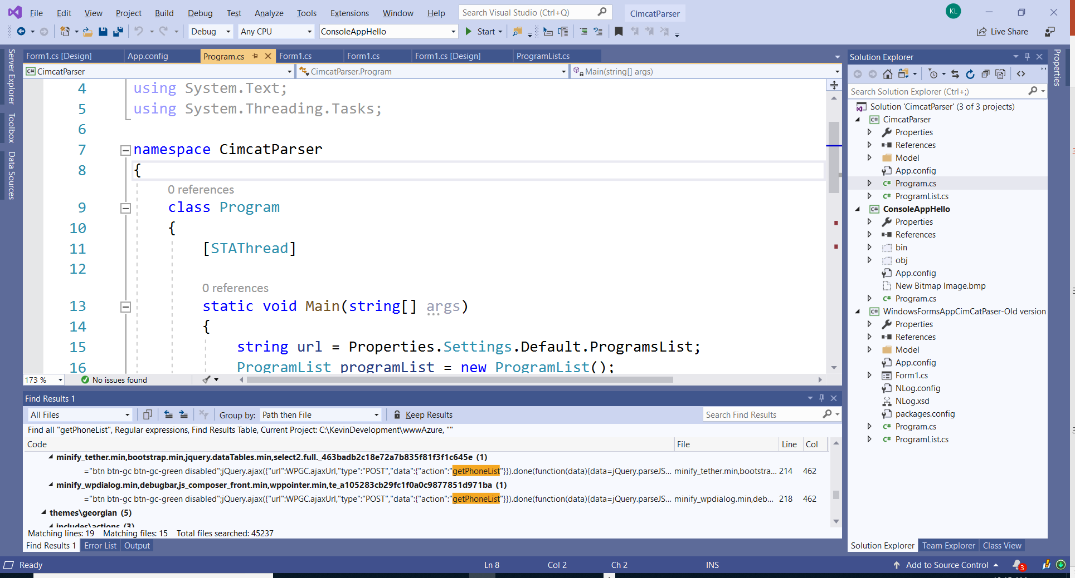
Visual Studio .NET

Slide 38
Sample codes
Program structure
Basic syntax
Project folders and files

Slide 39
Summary
.NET Framework is a code execution platform – the environment which .NET programs run
.NET Framework consists of two primary parts: Common Language Runtime and .NET Class Libraries
The CLS (Common Language Specification) allows different languages to interact seamlessly.
The CTS (Common Type System) allows all languages to share base data types.

Slide 40
Summary (2)
.NET languages are compiled to MSIL by their respective compilers
MSIL code is compiled to machine code by the JIT compiler
All .NET languages have equal access to the FCL (Framework Class Library) which is a rich set of classes for developing software

Slide 41
Assignment Requirements
Try to research and understand. Do not copy long standard texts.
Answer briefly in your own words so you can remember and talk about it when people ask ( in interviews).

Slide 42
Assignment 1
*What is CLR?
*What is CTS?
What is CLS?
*What is MSIL?
What is JIT?
*What is GAC?
What is managed code?
What is a garbage collector? Who manage it?

