Slide 1
Csharp class 11 database connections
Kevin.Li@GeorgianCollege.ca

Slide 2
Outline
ADO.net
WinForm sample
MVC sample

Slide 3
.NET data provider core objects

Slide 4
Data providers included with the .NET Framework

Slide 5
Class names for the data providers

Slide 6
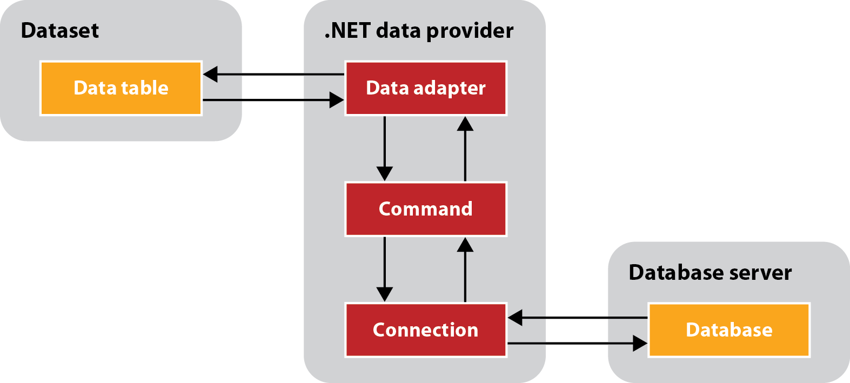
Basic ADO.NET components
ADO stands for ActiveX Data Objects.
ADO.NET is a database technology of .NET Framework used to connect application system and database server.

Slide 7
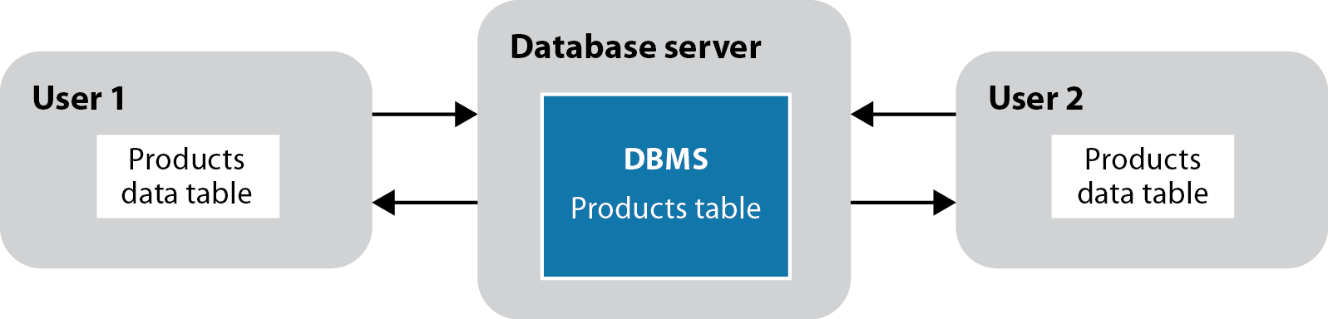
Two users who are working with copies of the same data

Slide 8
Concurrency concepts

Slide 9
Concurrency concepts (cont.)

Slide 10
How to avoid concurrency errors

Slide 11
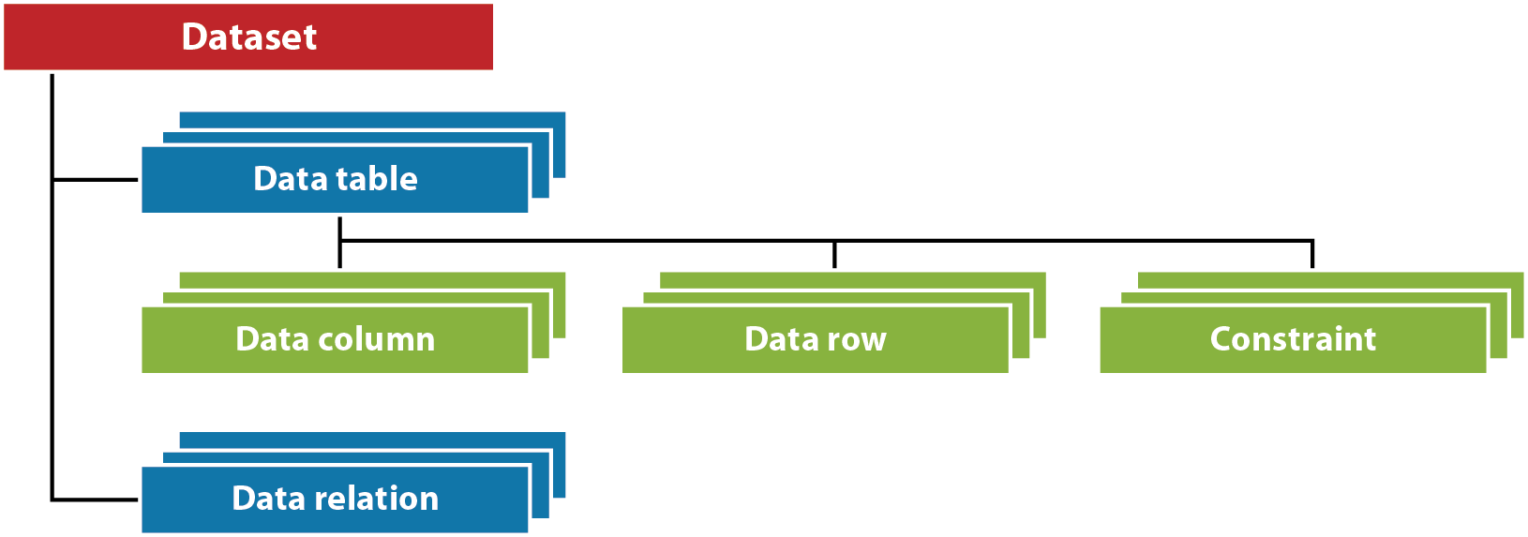
The basic dataset object hierarchy

Slide 12
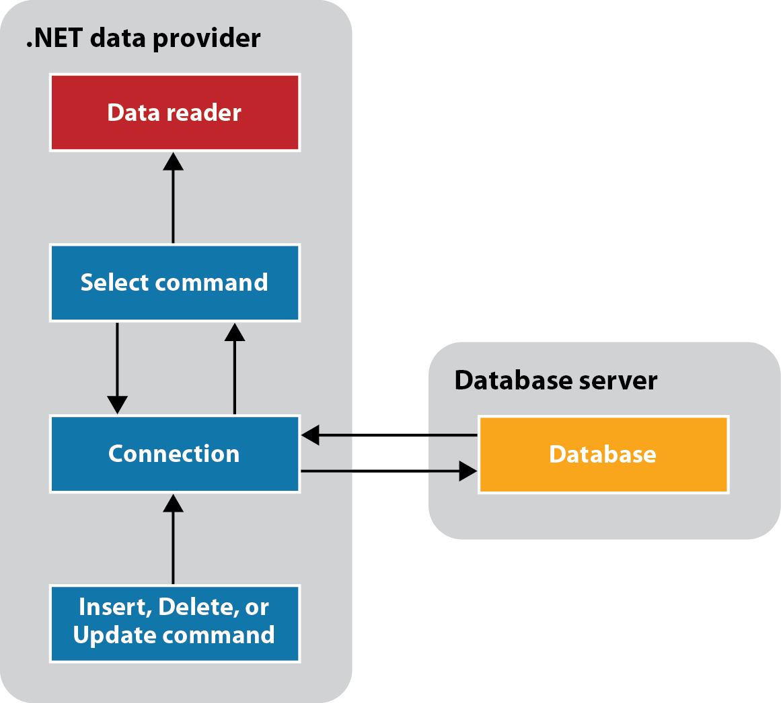
ADO.NET components for accessing a database directly

Slide 13
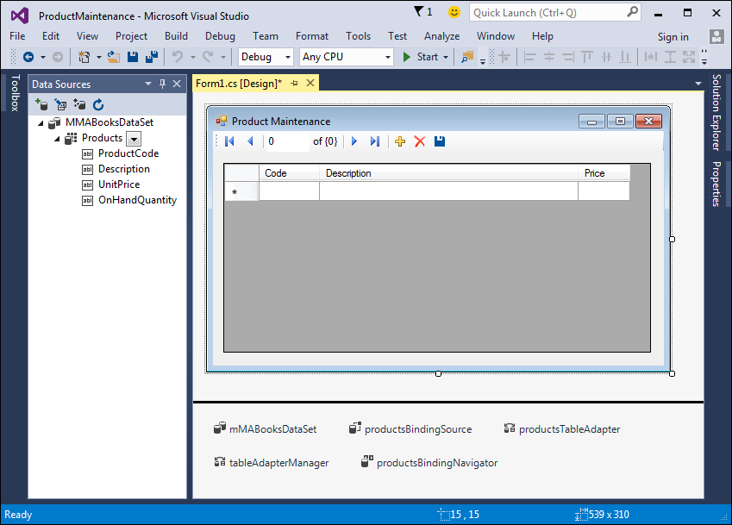
ADO.NET objects created using the Data Sources window

Slide 14
ADO.NET objects created using code
productsDataSet = productDataAdapter.Fill()

Slide 15
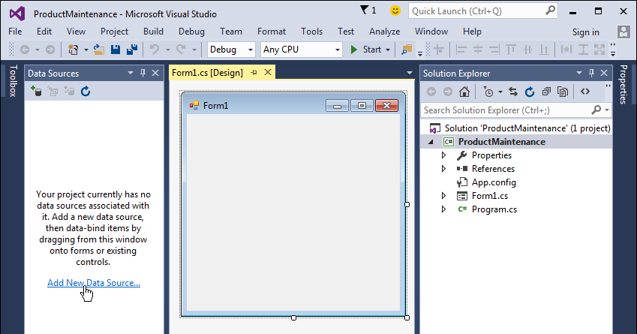
An empty Data Sources window

Slide 16
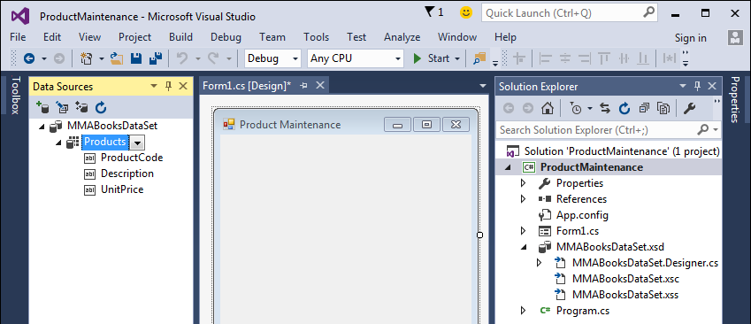
A Data Sources window after a data source has been added

Slide 17
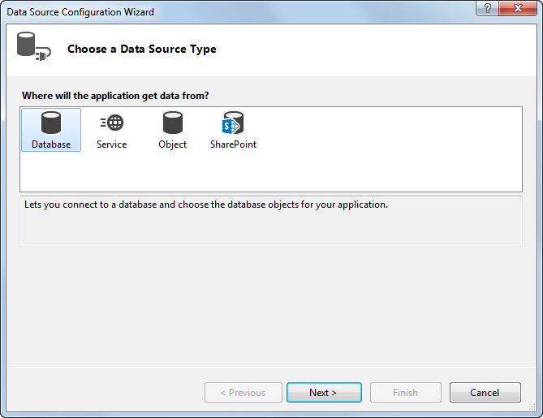
The Data Source Configuration Wizard: Step 1

Slide 18
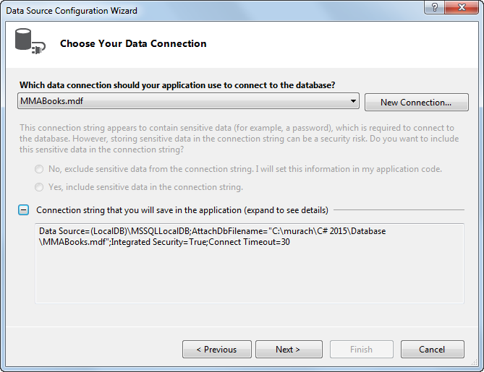
The Data Source Configuration Wizard: Step 2

Slide 19
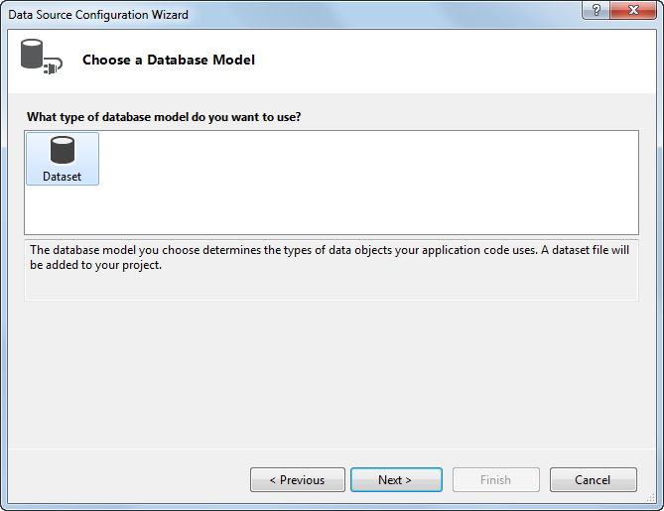
The Data Source Configuration Wizard: Step 3

Slide 20
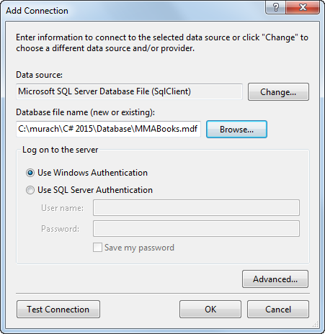
The Add Connection dialog box
Test firstly in SQL management studio if failed.

Slide 21
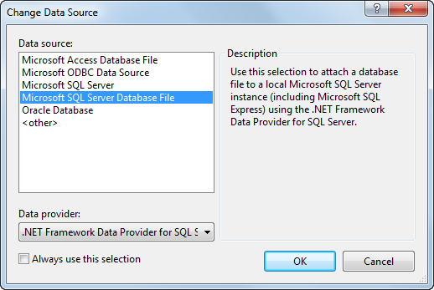
The Change Data Source dialog box

Slide 22
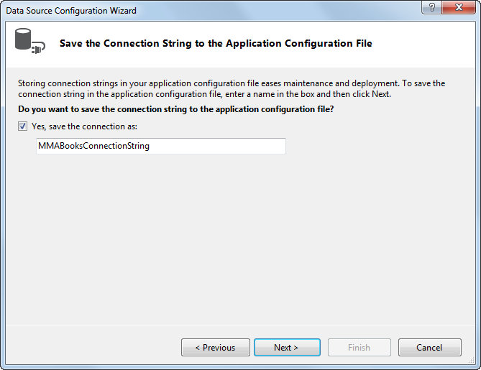
The Data Source Configuration Wizard: Step 4

Slide 23
The information that’s stored in the app.config file

Slide 24
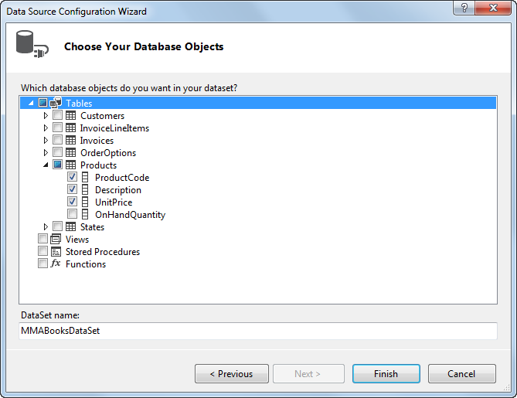
The Data Source Configuration Wizard: Step 5

Slide 25
How to work with columns that have default values

Slide 26
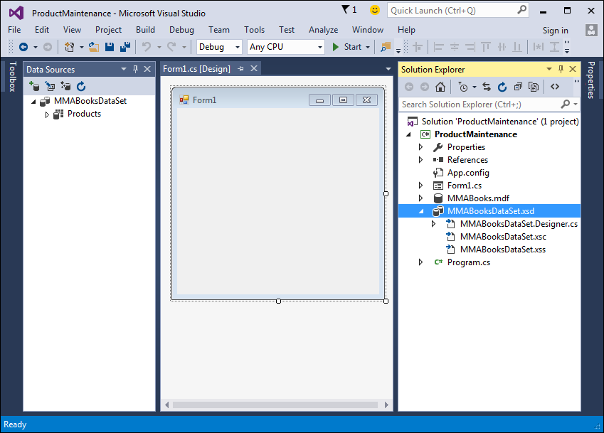
A project with a dataset defined by a data source

Slide 27
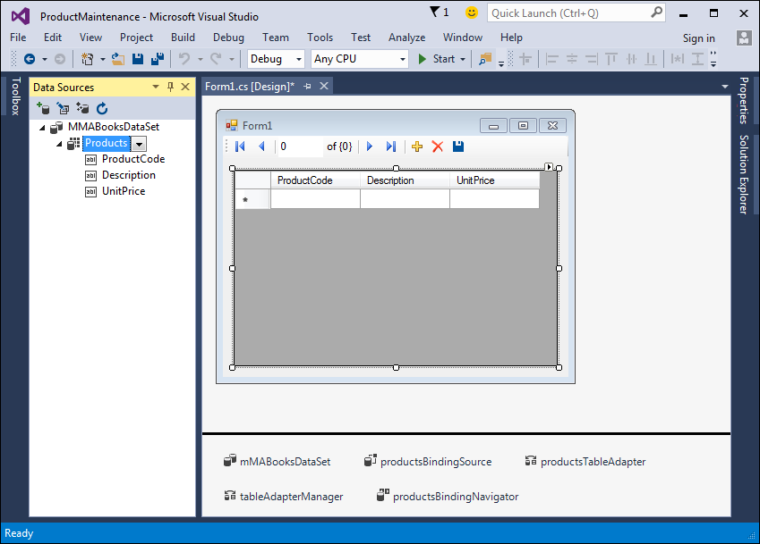
A form with the Products table dragged onto it

Slide 28
The controls and objects that are created when you drag a data source to a form

Slide 29
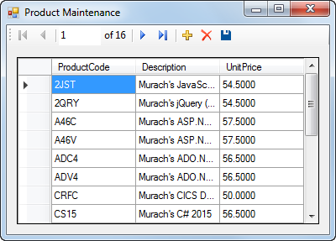
The user interface for the Product Maintenance application

Slide 30
The code that’s generated by Visual Studio

Slide 31
The syntax of the Fill method

Slide 32
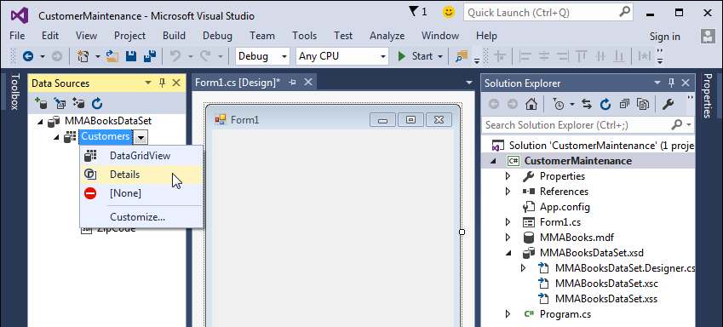
How to change the default control for a data table

Slide 33
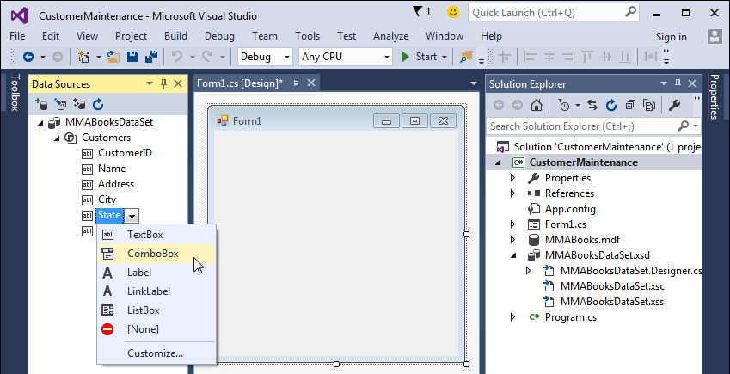
How to change the default control for a column in a data table

Slide 34
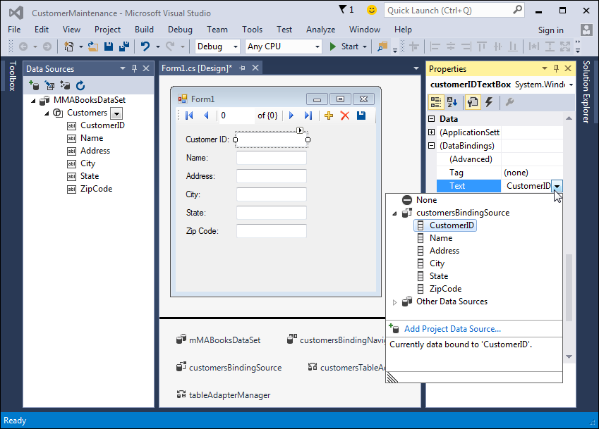
A form with the Customers table dragged onto it

Slide 35
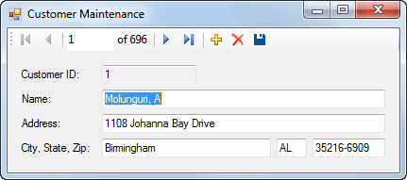
The user interface for the Customer Maintenance application

Slide 36
The code for the application

Slide 37
.NET data provider exception classes

Slide 38
Common members of the .NET data provider exception classes

Slide 39
Code that catches a SQL exception

Slide 40
Common ADO.NET exception classes

Slide 41
Code that handles ADO.NET errors

Slide 42
An event of the DataGridView control

Slide 43
Code that handles a data error for a DataGridView control

Slide 44
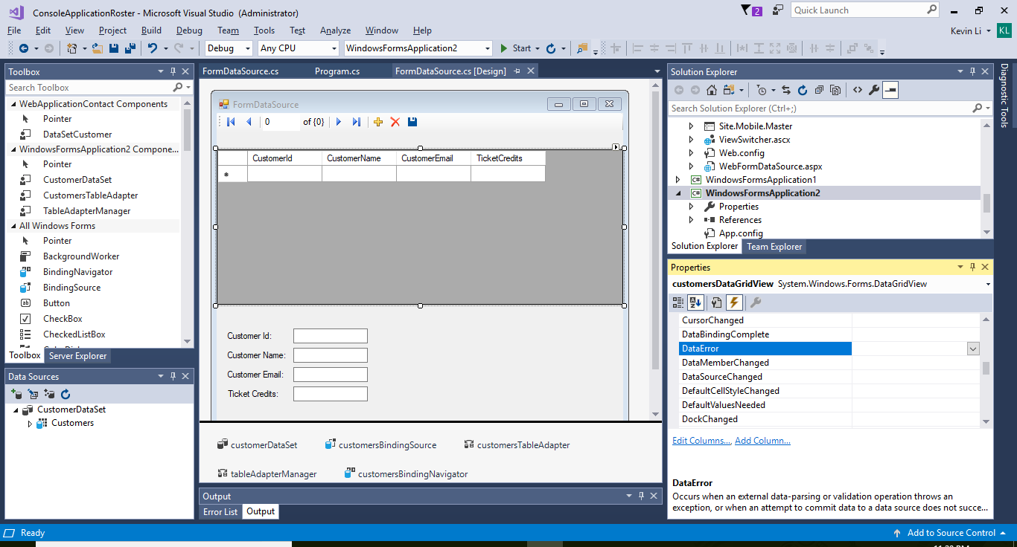

Slide 45
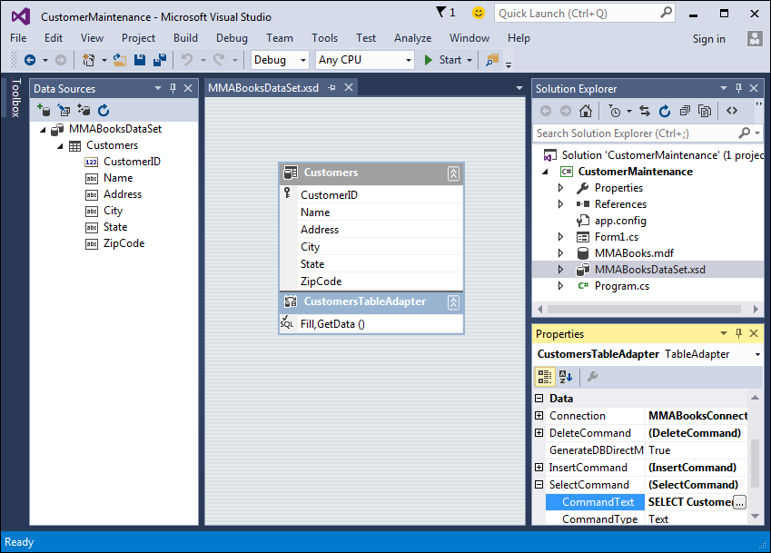
The schema displayed in the Dataset Designer

Slide 46
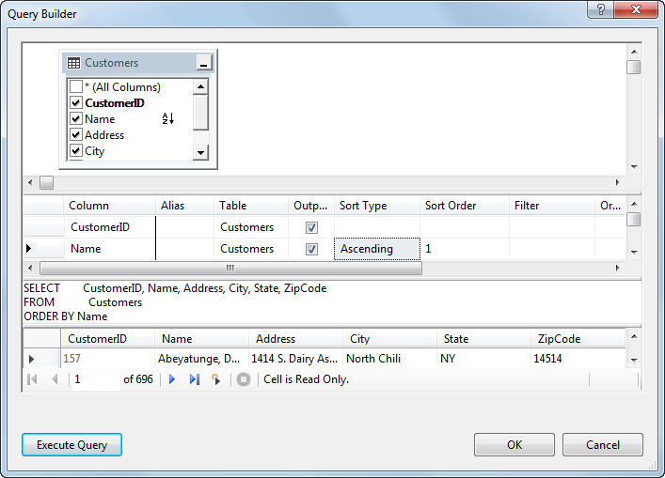
The Query Builder

Slide 47
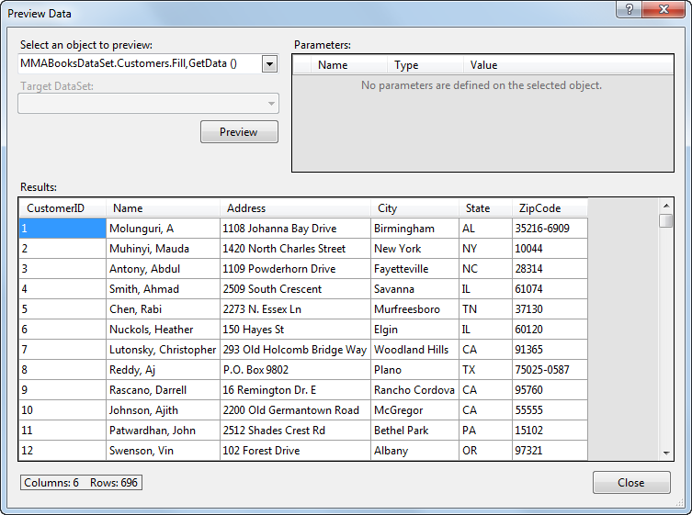
The Preview Data dialog box

Slide 48
Learn the data manipulation steps from the generated SQL queries.

Slide 49
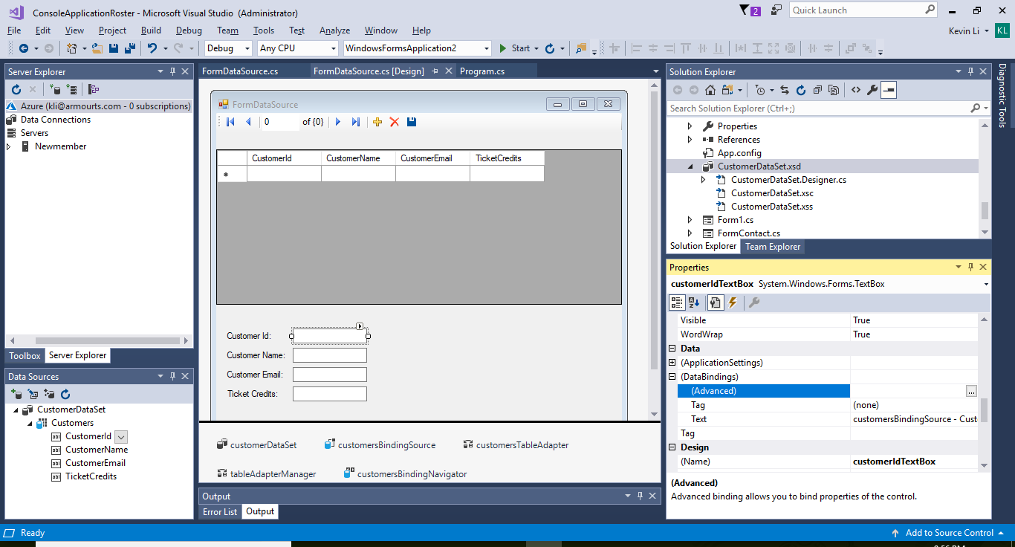

Slide 50
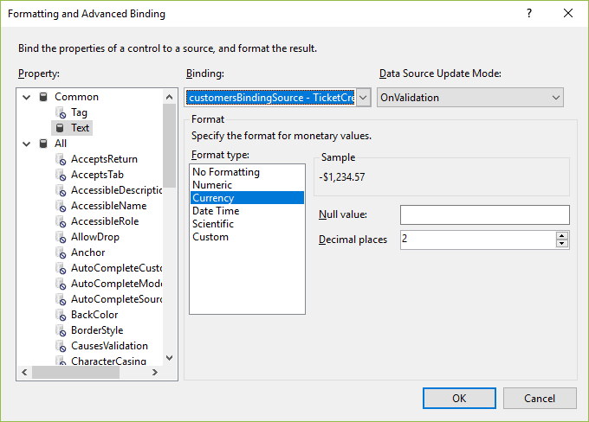

Slide 51
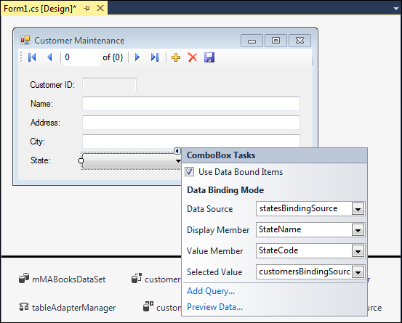
A combo box that’s bound to a data source

Slide 52
Combo box properties for binding

Slide 53
Common properties of the BindingSource class

Slide 54
Common methods of the BindingSource class

Slide 55
A statement that adds a new row to a data source

Slide 56
Code that moves to the next row and displays the position and count

Slide 57
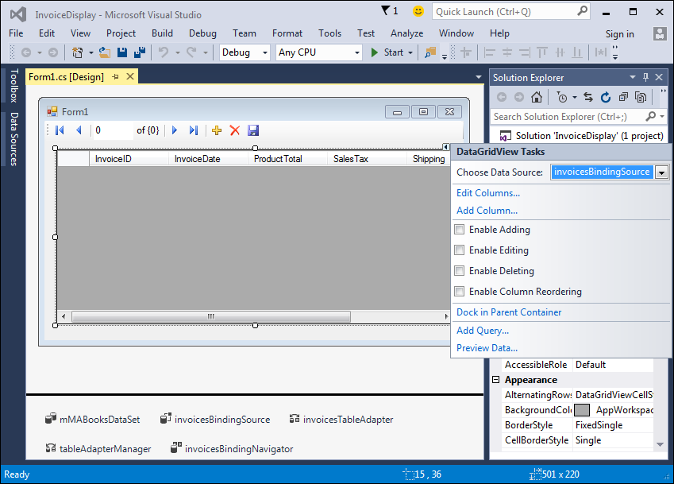
The smart tag menu for a DataGridView control

Slide 58
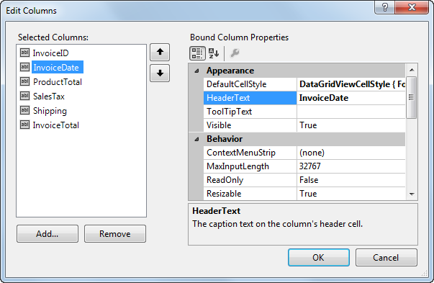
The dialog box for editing DataGridView columns

Slide 59
Common properties of a column

Slide 60
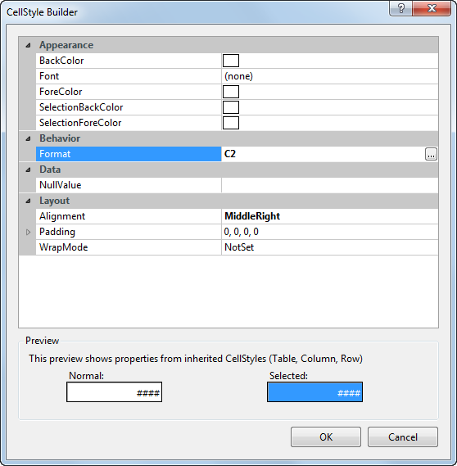
To format columns: The CellStyle Builder dialog box

Slide 61
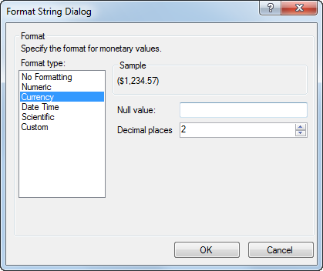
To format columns: The Format String dialog box

Slide 62
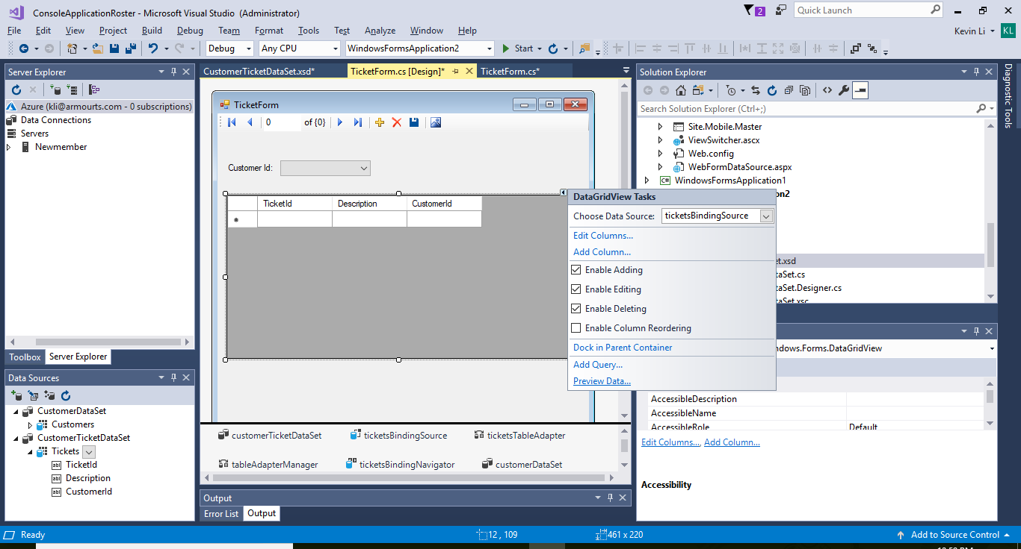

Slide 63
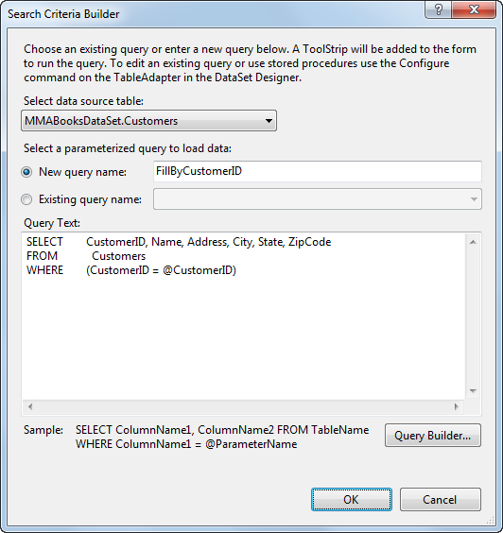
The dialog box for creating a parameterized query

Slide 64
Demo of aDO.net in a MVC/ASP. NET project

Slide 65
Last Assignment - ADO .NET
Create an app to do CRUD on your SQL database.
Basic requirements:
Create a table named with your name in your SQL database
Do at least one of the CRUD (Create, read, update and delete) to the SQL database.
Use the basic ADO. NET classes: SqlConnection, SqlCommand, SqlDataReader and/or SqlDataAdapter etc.
Please zip and upload your sources code files files(at least the one doing db connection.)
Options for higher scores:
All the CRUD
Use any of these:
Dataset classes
SqlCommand.Parameters
A separated class doing db connections and the CRUD commands
A data model class to hold your data

