Slide 1
Chapter 24

Slide 2
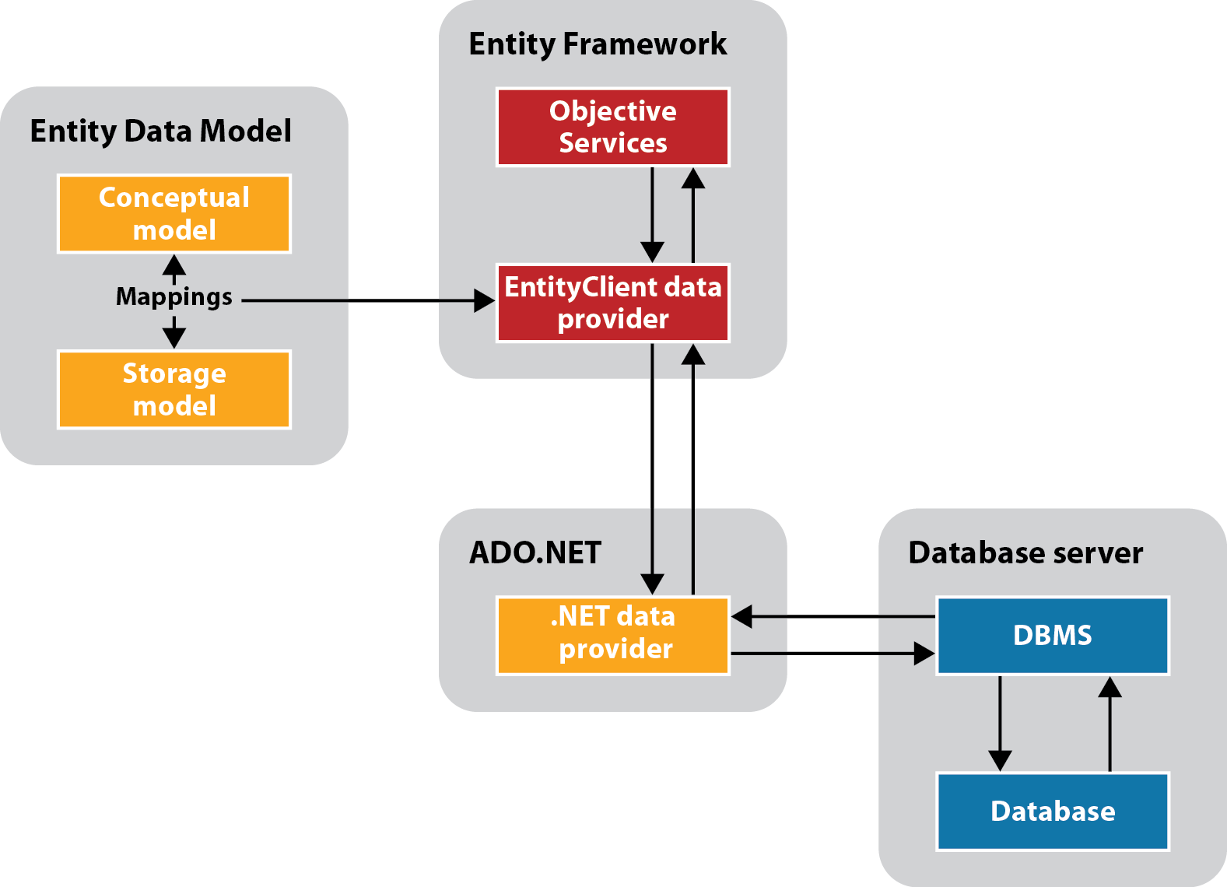
How the Entity Framework works

Slide 3
Entity Framework concepts
https://docs.microsoft.com/en-us/dotnet/framework/data/adonet/ef/terminology

Slide 4
Three ways to query a conceptual model
Linq to Entity is the easier way to build most queries and it's strongly typed
Notes:
Get familiar with the first to begin. Tell what you know in the interviews. There are far too many one person does not know.

Slide 5
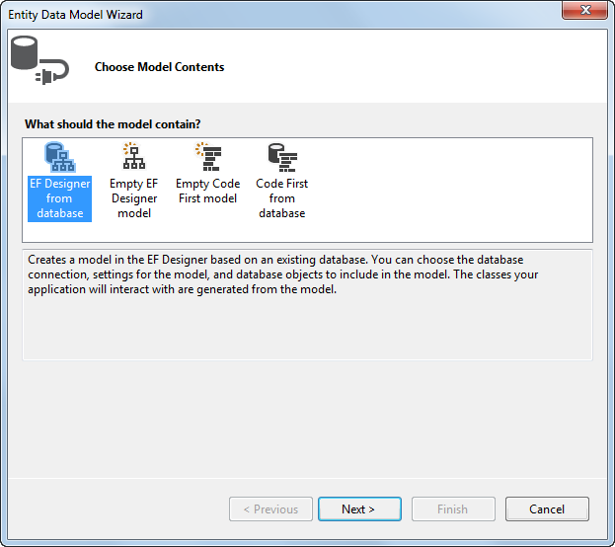
The Entity Data Model Wizard: Step 1

Slide 6
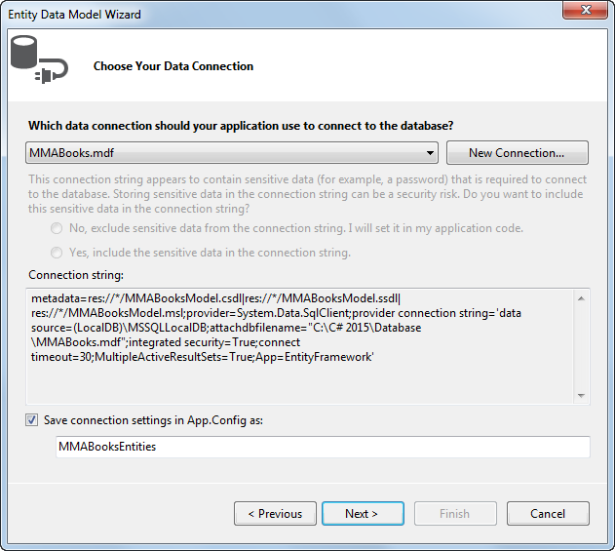
The Entity Data Model Wizard: Step 2

Slide 7
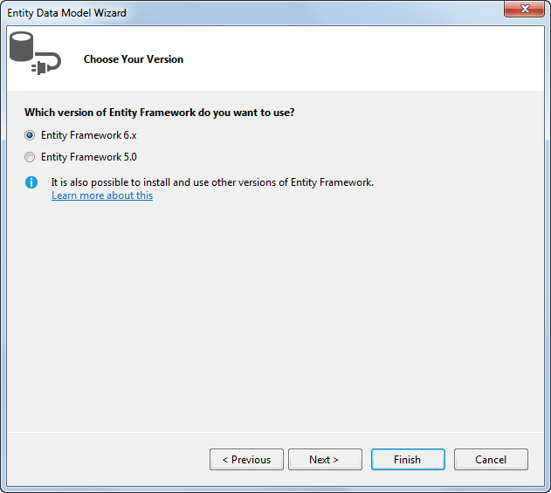
The Entity Data Model Wizard: Step 3

Slide 8
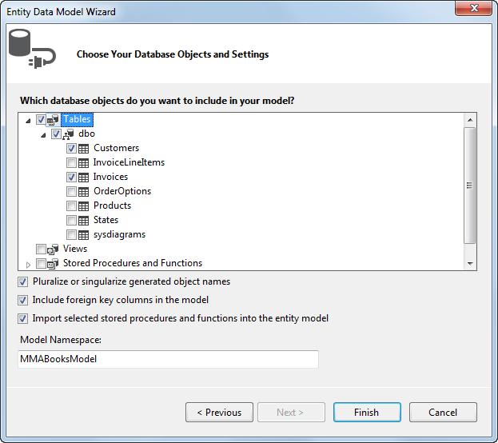
The Entity Data Model Wizard: Step 4

Slide 9
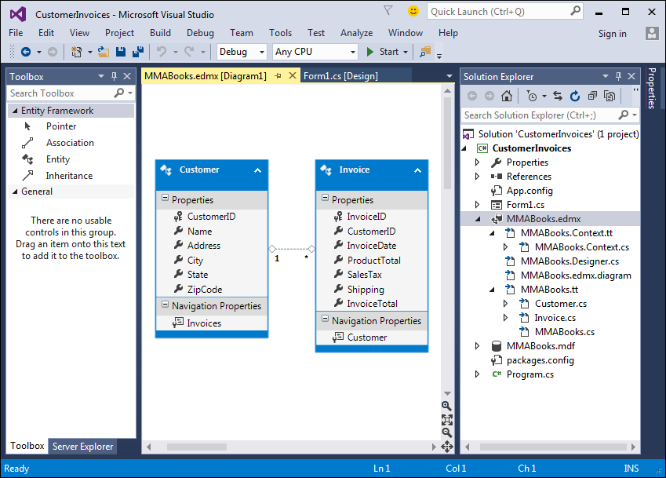
The Entity Data Model in the Entity Data Model Designer

Slide 10
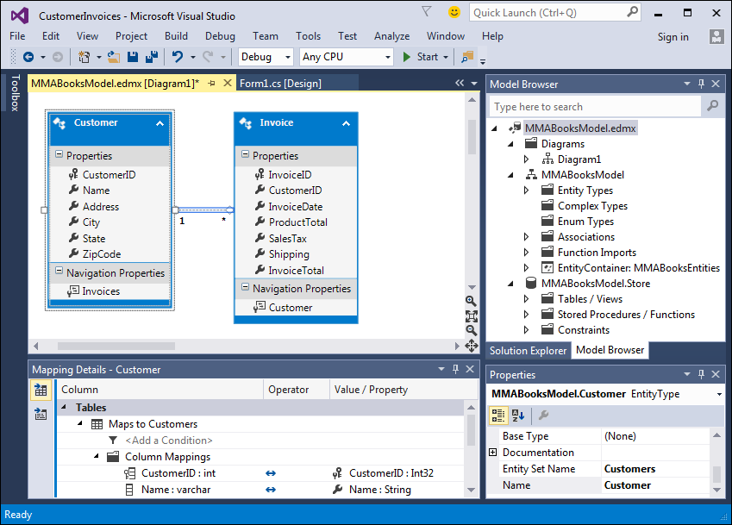
The Entity Data Model Designer

Slide 11
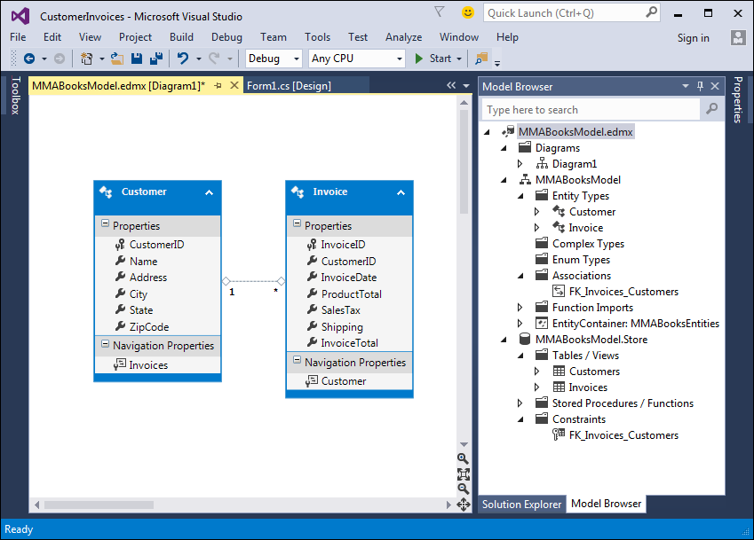
The Model Browser window with some of its nodes expanded

Slide 12
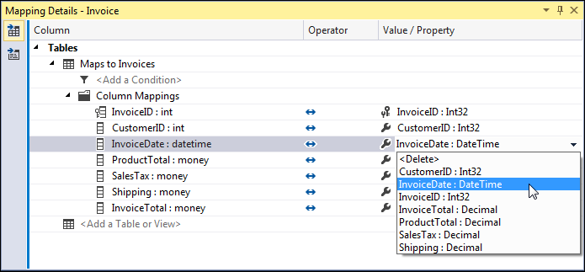
A Mapping Details window that displays the mappings for the Invoice entity

Slide 13
A LINQ query that gets data from the Invoices table

Slide 14
A LINQ query that gets data from the Invoices table (cont.)

Slide 15
A LINQ query that gets invoice data through the Customer object

Slide 16
A query expression that uses a navigation property to load related objects

Slide 17
Code that explicitly loads the objects on the many side of a relationship

Slide 18
Code that retrieves a customer row

Slide 19
Code that assigns an invoice to a different customer

Slide 20
Code that retrieves an invoice row and its related line item rows

Slide 21
Code that creates a new Invoice object

Slide 22
Code that creates a new InvoiceLineItem object

Slide 23
A try-catch statement that uses store wins for concurrency exceptions

Slide 24
Code in a catch block that uses client wins for concurrency exceptions
Notes:
The object exists but is not being tracked. An entity is in this state immediately after it has been created and before it is added to the object context. An entity is also in this state after it has been removed from the context by calling the Detach method or if it is loaded by using a NoTrackingMergeOption. There is no ObjectStateEntryinstance associated with objects in the Detached state.

Slide 25
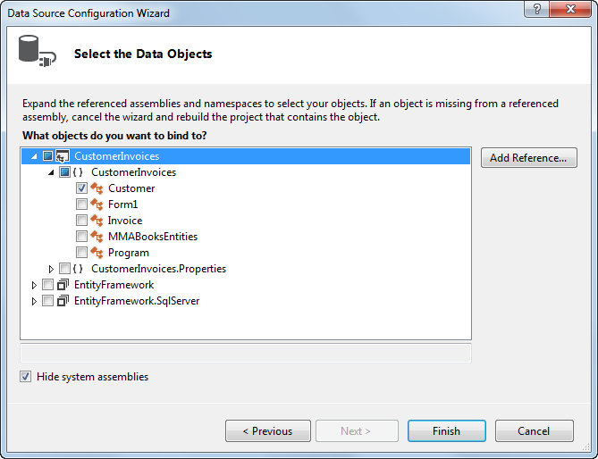
The Data Source Configuration Wizard: Step 2

Slide 26
Code that binds a combo box to an entity collection

Slide 27
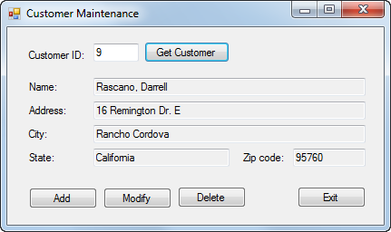
The Customer Maintenance Form

Slide 28
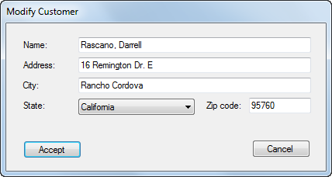
The Add/Modify Customer form

Slide 29
The default Entity Data Model

Slide 30
The code for the MMABooksEntity class

Slide 31
The Customer Maintenance form

Slide 32
The Customer Maintenance form (cont.)

Slide 33
The Customer Maintenance form (cont.)

Slide 34
The Customer Maintenance form (cont.)

Slide 35
The Customer Maintenance form (cont.)

Slide 36
The Customer Maintenance form (cont.)

Slide 37
The Add/Modify Customer form

Slide 38
The Add/Modify Customer form (cont.)

Slide 39
The Add/Modify Customer form (cont.)

Slide 40
The Add/Modify Customer form (cont.)

Slide 41
The Add/Modify Customer form (cont.)

Slide 42
LINQ Introduction

Slide 43
Some of the C# clauses for working with LINQ

Slide 44
Features of LINQ

Slide 45
The three stages of a query operation

Slide 46
A LINQ query that retrieves data from an array

Slide 47
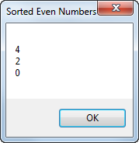
The resulting dialog box

Slide 48
The syntax of the from clause

Slide 49
An example that uses a generic list of invoices as the data source

Slide 50
An example that uses a generic list of invoices as the data source (cont.)

Slide 51
The syntax of the where clause

Slide 52
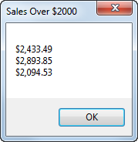
The resulting dialog box

Slide 53
An example that filters the generic list of invoices

Slide 54
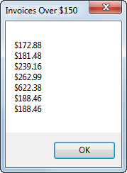
The resulting dialog box

Slide 55
The syntax of the orderby clause
How about orderby multiple fields? Try it in VS.

Slide 56
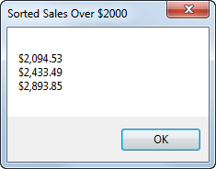
The resulting dialog box

Slide 57
An example that sorts the generic list of invoices

Slide 58
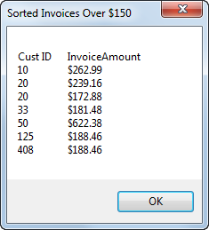
The resulting dialog box

Slide 59
Two ways to code the select clause

Slide 60
An example that selects key values from a sorted list

Slide 61
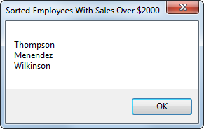
The resulting dialog box

Slide 62
A query expression that creates an anonymous type from the list of invoices

Slide 63
The basic syntax of the join clause

Slide 64
A query expression that joins data from the two data sources

Slide 65
Code that executes the query

Slide 66
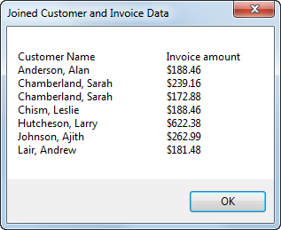
The resulting dialog box

Slide 67
An extension method that extends the String data type

Slide 68
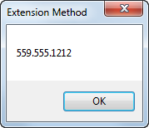
The resulting dialog box

Slide 69
Extension methods used to implement common C# clauses for LINQ
Extension methods enable you to add methods to existing types without creating a new derived type, recompiling, or otherwise modifying the original type. An extension method is a special kind of static method, but they are called as if they were instancemethods on the extended type.

Slide 70
The basic syntax of a lambda expression

Slide 71
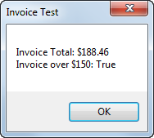
The resulting dialog box

Slide 72
A query that uses extension methods and lambda expressions

Slide 73
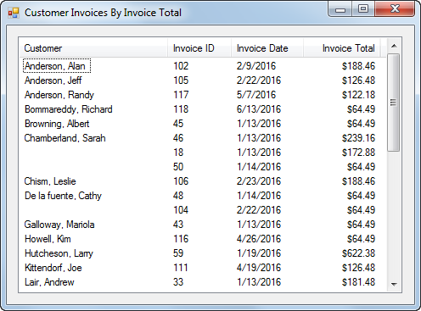
The Customer Invoice form

Slide 74
Customer Invoice form with generic lists

Slide 75
Customer Invoice form with generic lists (cont.)

Slide 76
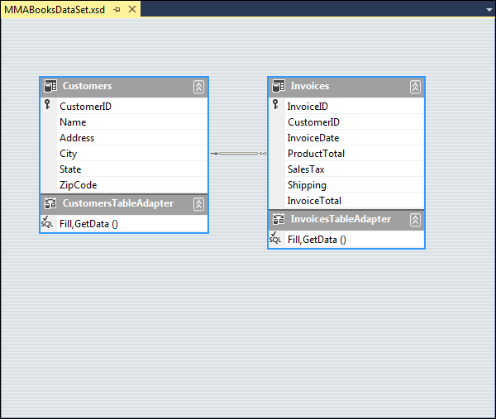
The dataset schema

Slide 77
Customer Invoice form with typed dataset

Slide 78
Customer Invoice form with typed dataset (cont.)

Slide 79
Lab: MVC with Entity Framework, doing CRUD
- Create Entity Models
Use models in the controller classes and views
Try LINQ
Try stored procedures to show report

Slide 80
More optional topics:
Threading
Destructor vs Dispose
Dynamic
Xamarin

Slide 81
Final projects plans
Projects: CRM, Grid game
Will upload basic requirements this weekend.
Discuss more details next week.
Upload codes in the last week.
Present in the last week or/and publish (optionally ).

