Slide 1
Csharp

Slide 2
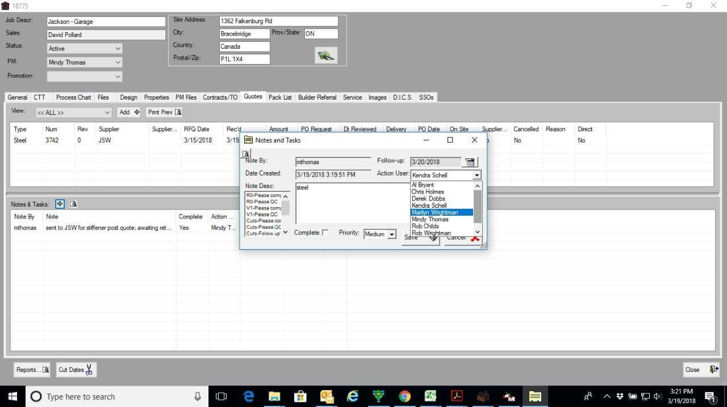

Slide 3
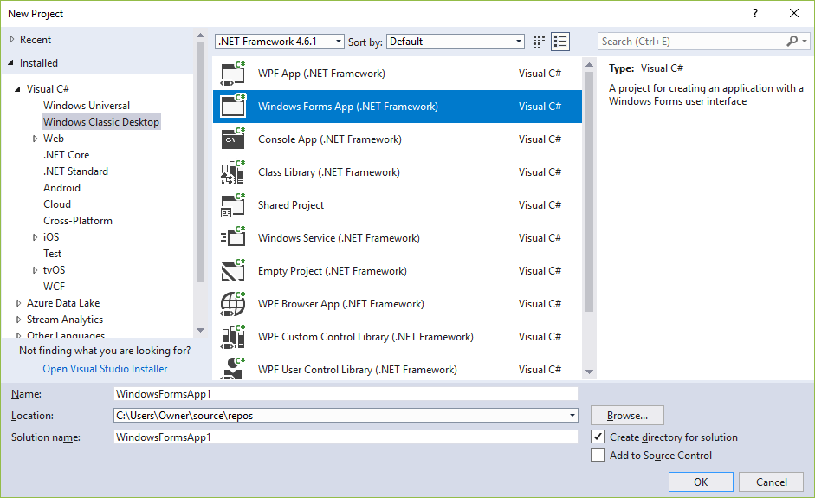
The New Project dialog box
(vs Win form class)

Slide 4
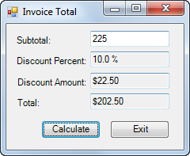
The Invoice Total form

Slide 5
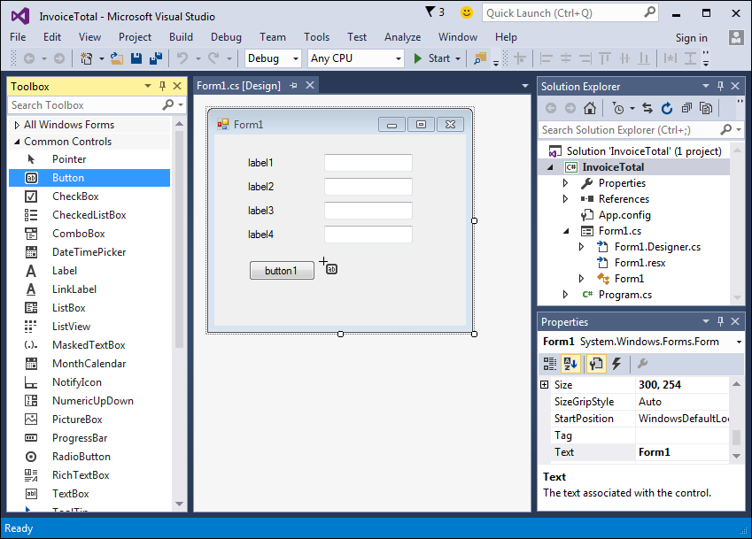
A form after some controls have been added to it

Slide 6
Three ways to add a control to a form

Slide 7
How to select and work with controls

Slide 8
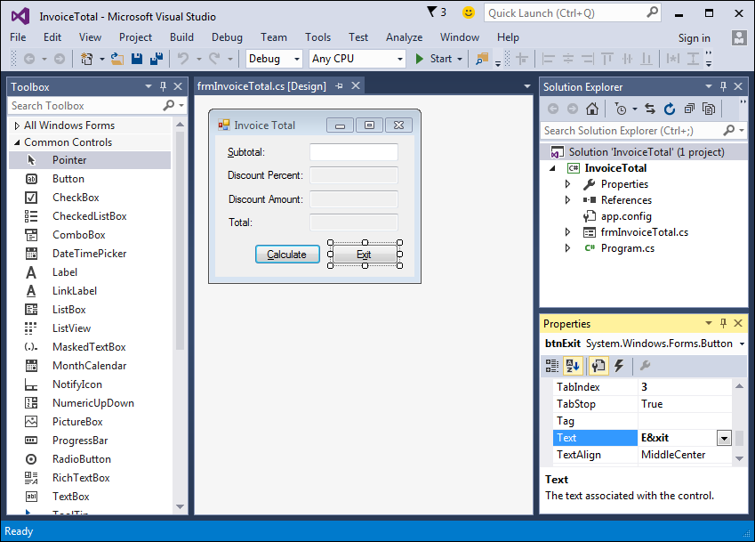
A form after the properties have been set

Slide 9
The Name property

Slide 10
The Text property

Slide 11
Other properties for forms

Slide 12
Other properties for controls

Slide 13
How to adjust the tab order

Slide 14
How to set access keys

Slide 15
How to set the Enter and Esc keys

Slide 16
The property settings for the Invoice Total form

Slide 17
The property settings for the controls

Slide 18
The property settings for the controls (cont.)

Slide 19
How to rename a file, project, or solution
(If you copied the exact codes of assignment samples)

Slide 20
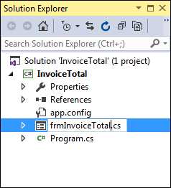
The Solution Explorer as a form file is being renamed

Slide 21
How to save a file, project, or solution

Slide 22
Objects and forms

Slide 23
The syntax for referring to a member of a class or object

Slide 24
Statements that refer to methods

Slide 25
How to enter member names when working in the Code Editor

Slide 26
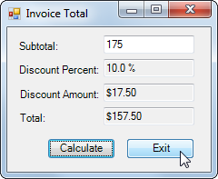
Event: The user clicks the Exit button

Slide 27
Common control events

Slide 28
How an application responds to events

Slide 29
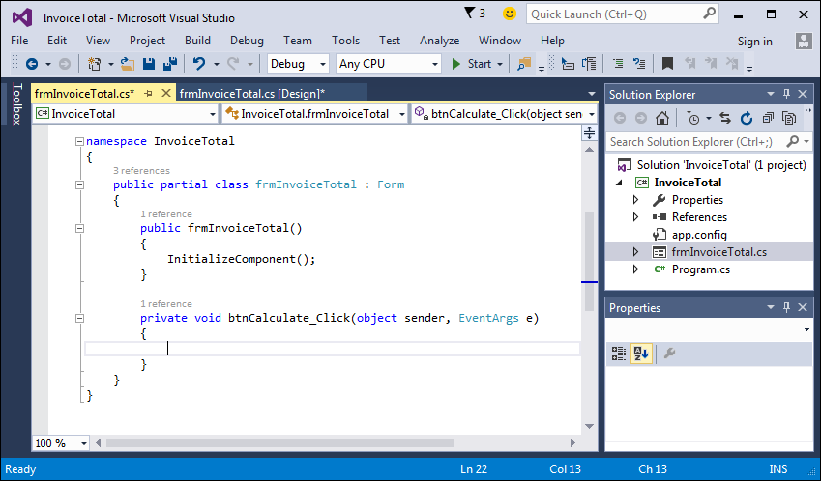
The method that handles the Click event of the Calculate button
Object
Event

Slide 30
How to handle the Click event of a button

Slide 31
The event handlers for the Invoice Total form

Slide 32
The event handlers for the Invoice Total form (cont.)

Slide 33
A method written in a readable style

Slide 34
A method written in a readable style (cont.)

Slide 35
A method written in a less readable style

Slide 36
Coding recommendations

Slide 37
A method with comments
OLD STYLE (Bad)

Slide 38
A method with comments (cont.)

Slide 39
How to code comments

Slide 40
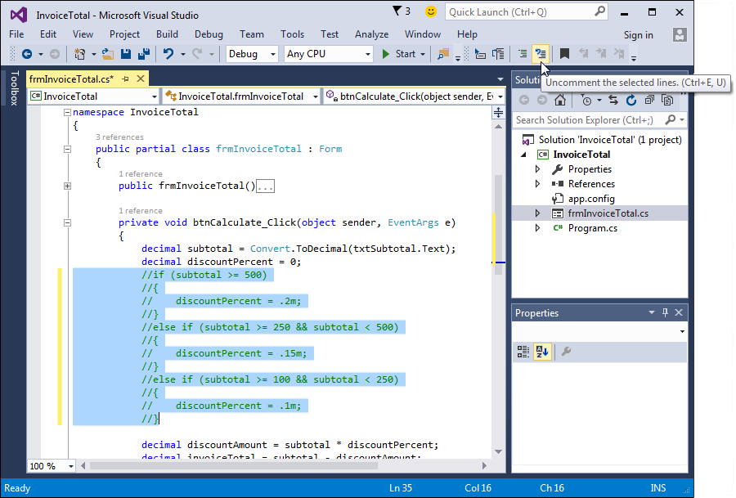
The Code Editor and the Text Editor toolbar

Slide 41
How to use the buttons of the Text Editor toolbar

Slide 42
How to collapse or expand regions of code

Slide 43
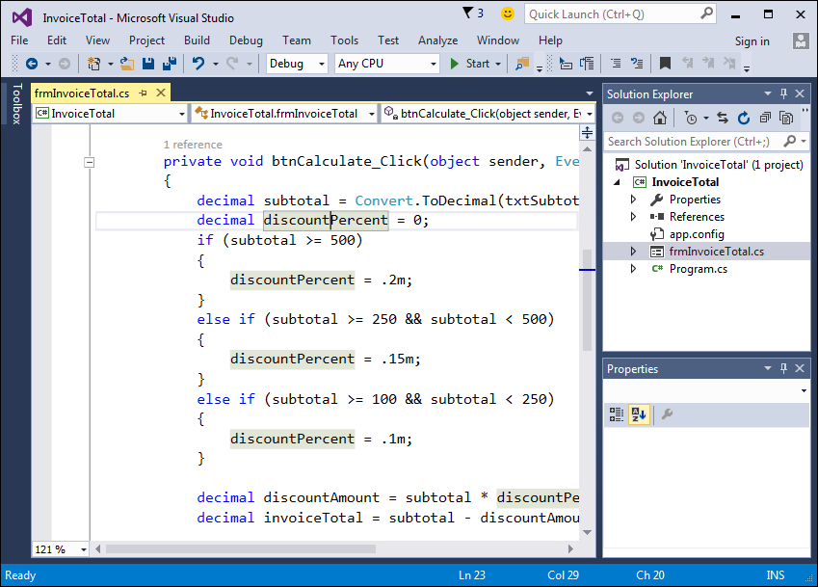
The Code Editor with enlarged text and a highlighted variable

Slide 44
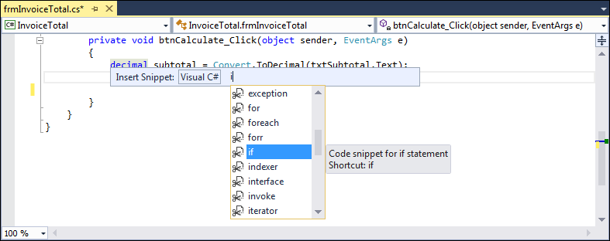
The default list of Visual C# code snippets

Slide 45
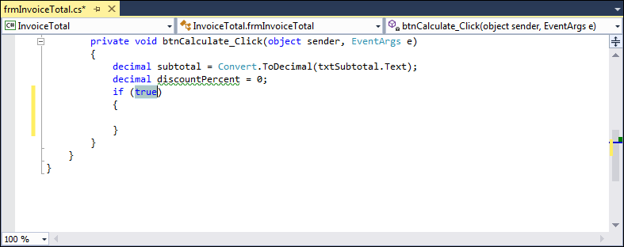
A code snippet after it has been inserted

Slide 46
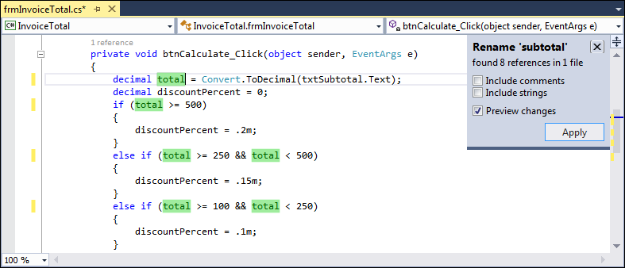
The options that are displayed when you rename a variable

Slide 47
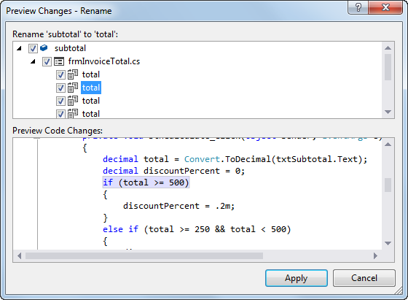
The Preview Changes - Rename dialog box

Slide 48
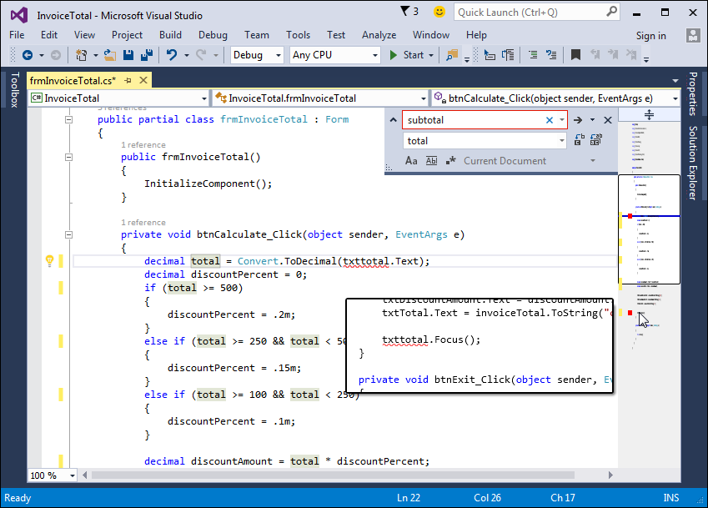
A scroll bar in map mode with annotations
https://docs.microsoft.com/en-us/visualstudio/ide/how-to-track-your-code-by-customizing-the-scrollbar?view=vs-2017xt

Slide 49
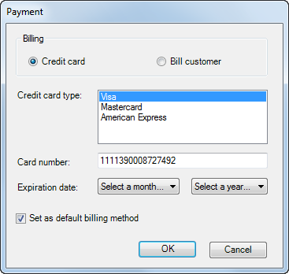
A form with five more types of controls

Slide 50
Common members of list box and combo box controls

Slide 51
Common properties of the Items collection

Slide 52
Code that loads a combo box with months

Slide 53
Code that loads a combo box with years

Slide 54
Code that clears and loads a list box of credit cards

Slide 55
Code that works with a combo box of names

Slide 56
A group box that contains two radio buttons

Slide 57
Code that sets the value of a radio button and check box

Slide 58
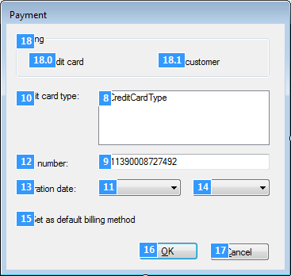
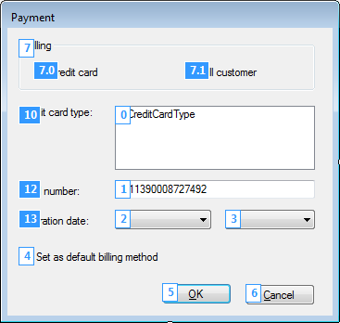
A form in Tab Order view before and after the tab order is changed

Slide 59
How to use Tab Order view

Slide 60
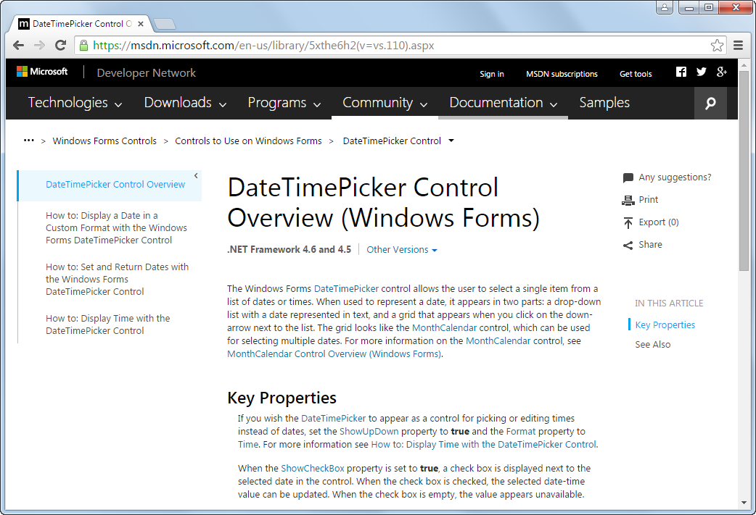
Help for the DateTimePicker control

Slide 61
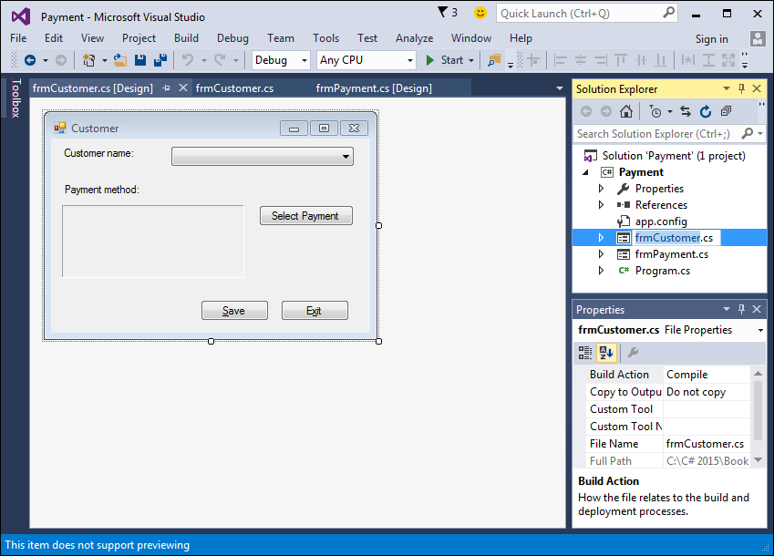
A project that contains two forms

Slide 62
How to change the name of a form

Slide 63
Code that defines the main entry point for an application

Slide 64
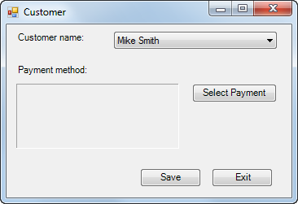
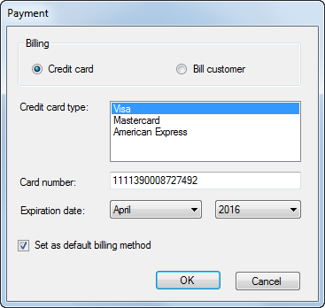
The Payment form displayed as a dialog box

Slide 65
Properties for creating custom dialog boxes

Slide 66
Code that creates and displays a custom dialog box

Slide 67
An enumeration that works with dialog boxes

Slide 68
A statement that sets the DialogResult property of a form

Slide 69
How to use the DialogResult enumeration

Slide 70
How to use the Tag property

Slide 71
The syntax for the Show method of the MessageBox class

Slide 72
A statement that displays a dialog box and gets the user response

Slide 73
A statement that checks the user response

Slide 74
The code for a dialog box that cancels the Closing event

Slide 75
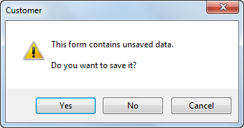
The dialog box that’s displayed

