Slide 1
Ionic Tutorial
200443723 – YuHsuan Huang

Slide 2
Outline
Introduction
Pros and cons
Installation
Create a New Project
Project Structure

Slide 3
What is Ionic
Ionic Framework is an open source UI toolkit for building performant, high-quality mobile and desktop apps.
Ionic Framework using web technologies — HTML, CSS, and JavaScript — with integrations for popular frameworks like, Angular, React, and Vue.
Ionic is basically an npm module, requiring Node.js installed to function as part of a large JavaScript ecosystem.
Besides, you can use Apache Cordova to accessing native functionality.
smartphone’s camera, gyroscope, or sensors
Notes:
Fast learn

Slide 4
Pros and Cons - Advantage
Ionic | Native
A single codebase across various platforms | Different systems need to learn different languages
Popular technologies and ease of learning | Popular technologies but not easy of learning
Wide range of integration capabilities and plugins | All programs need to be written by yourself
An extensive choice of UI elements and quick prototyping | Only provide a single style, you need to design your own
Testing convenience – test in browser | Need to install an emulator

Slide 5
Pros and Cons - Disadvantage
Performance is lacking with native applications
Plugin-dependent system
Possible security issues
Bigger application size
Notes:
In most cases, with the usual functionality, your performance will be good enough. In case of heavy applications like Snapchat that use augmented reality via smartphone cameras, or graphics-heavy apps (games, those rendering a lot of 3D models), it will make your app crawl.
Every time you build an application with Ionic, you are bound to use plugins to access native functionality. However, there are cases when you would not find a plugin or module. In case you need some highly specific feature or access to a non-standard piece of hardware, you will have to develop the plugin on your own.
When building hybrid applications, security is a common issue, as long as your app can be reverse engineered.
When you writing your app using HTML, CSS, and JavaScript means writing a lot of code and adding libraries, plugins, dependencies, etc., which make an app reasonably heavier than the native ones

Slide 6
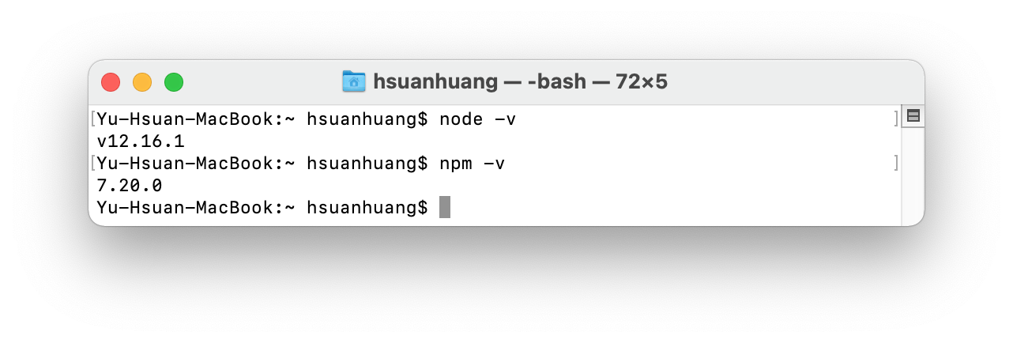
Installation
Almost all tooling for modern JavaScript projects is based in Node.js.
Make sure you already install Node.js and NPM(Node Package Manager)
$ node -v
$ npm –v
$ git --version (optional)

Slide 7
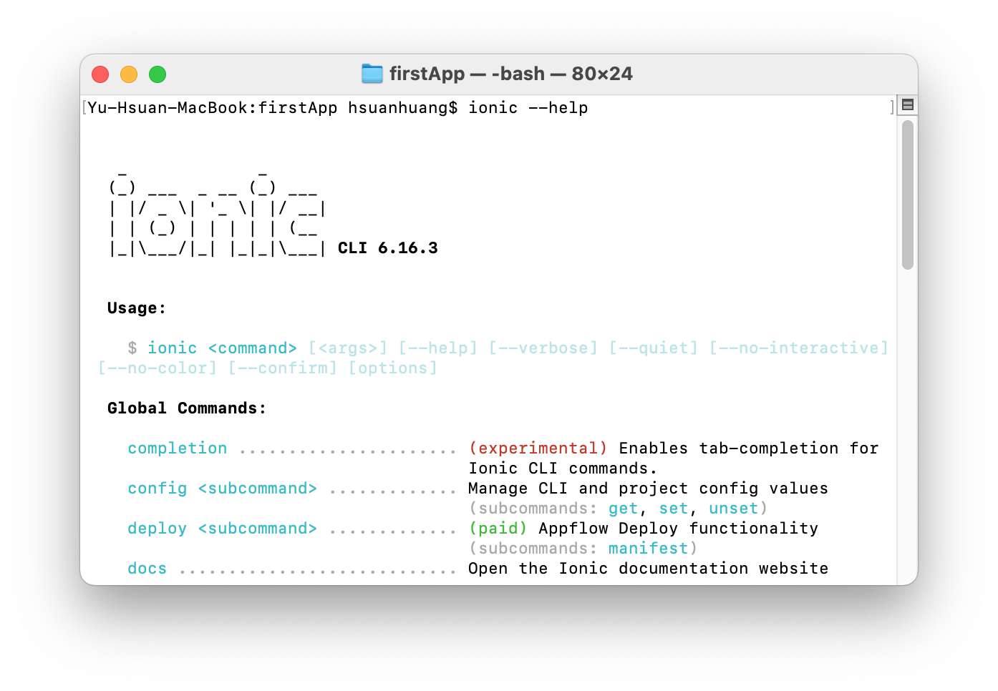
Installation
Install the Ionic CLI
$ npm install –g @ionic/cli
Uninstall the Ionci CLI
$ npm uninstall -g ionic

Slide 8
Before create a Project
Choose a framework you want to use:
Ionic + Angular
$ npm install @ionic/angular@latest --save
Ionic + React
$ npm install @ionic/react
$ npm install @ionic/react-router
Ionic + Vue
npm install @ionic/vue @ionic/vue-router

Slide 9
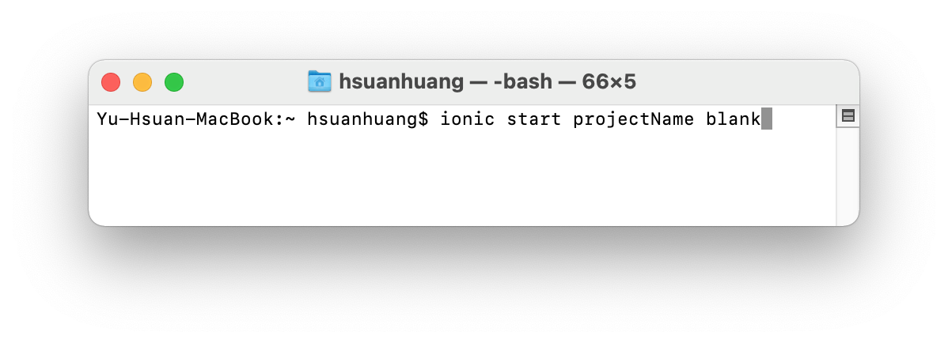
Create a new Project
It is really samiliar with Angular to create a new project.You can check the table to compare the commands between the Ionic and Angular.
Create a new project command:
ionic start [name] [template]
Ionic | Angular | Description
start | new | Create new Project
serve | serve | Start the development server
generate | generate | Create various types of objects
build | build | Build the project

Slide 10
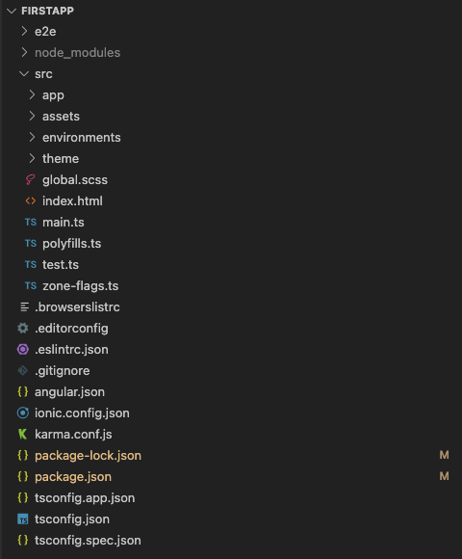
Project Structure
The majority of the app will be developed in the src/app/ directory.
The src/app/ directory contains the root app component and module as well as additional directories that contain app features such as pages, components, services, etc.

Slide 11
Let’s build a ionic project…

