Slide 1
Countdown Date App
200443723 – Yu-Hsuan Huang

Slide 2
Outline
Overview
Project Design
Functional Requirements
Database Design

Slide 3
Overview
In this project, I would like to build a untility application that remind the important dates for users.
You can use this App to countdown the coming days or calculate how long after the special/important days.
If you have finished these events, you also can stop count the days for the events.
The user able to create, edit, delete the events and able to set up the categories

Slide 4
Motivation
There are so many dates are important to us. The App can help us easily memories the dates
Example,
Merry anniversary
Friends birthday
Music concert date
iPhone publish date
How many days in Canda

Slide 5
Development Environment
Computer: Macbook Pro 13’’
macOS version: 11.4 Big Sur
IDE: Xcode 12.5.1
Programming Language: Swift
Target device: iPhone 12
Target iOS version: 14.5

Slide 6
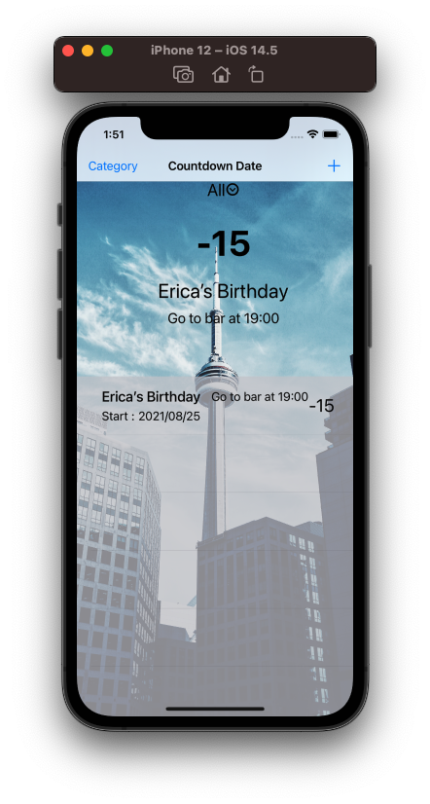
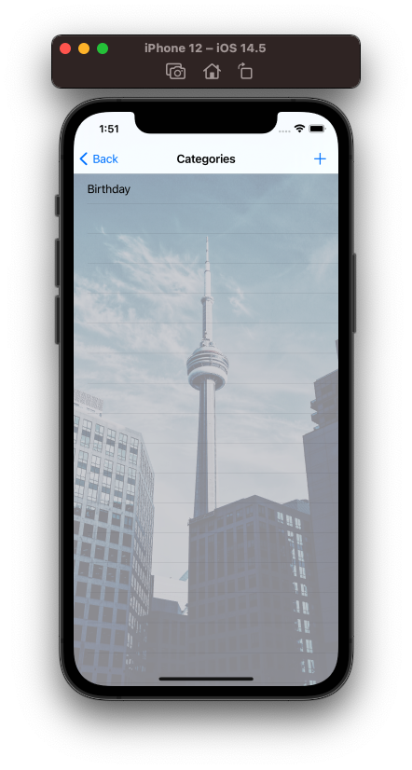
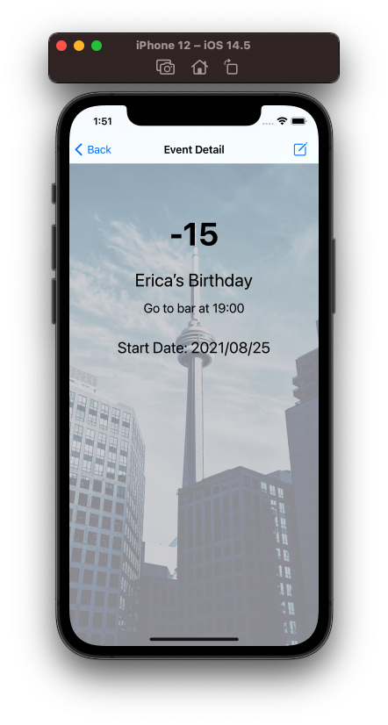
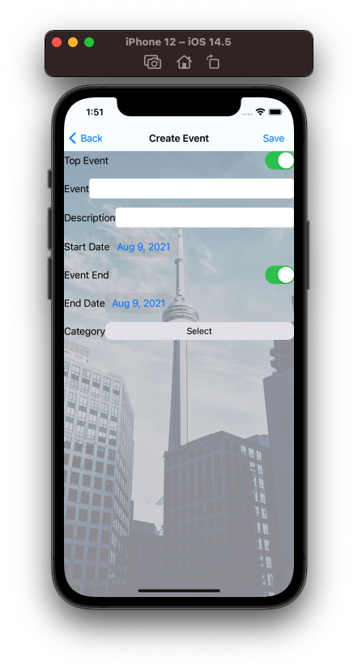
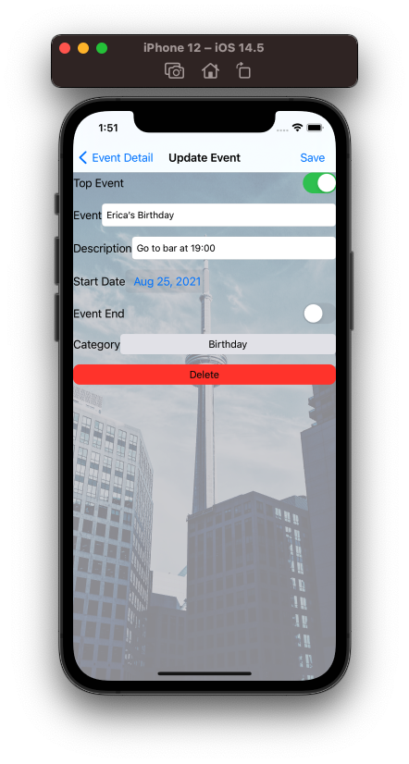
Design
Home
Category
Detail
Add
Edit

Slide 7
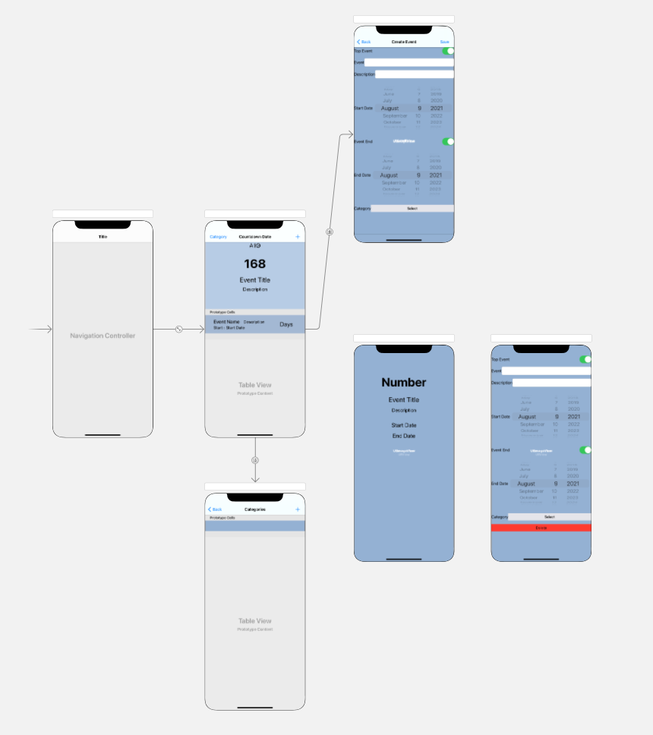
Design

Slide 8
Functions
Home Page
Display all event list or display the event list by category
Display ‘TOP EVENT’ on the home page
Click event item can show the event detail in event list
Click add button to add event
Click dropdown list to change the category

Slide 9
Functions
Add Event Page
Enter all event details, includes
name, description
start date, event end switch, end date,
category, top switch,
Can become to TOP EVENT to show on the home page
If the end switch turn ON, the countdown will stop

Slide 10
Functions
Edit Category page
Display all categories
Add category
Update category
Delete category

Slide 11
Functions
Event detail page
Click edit icon to edit event page

Slide 12
Functions
Edit event page
As same as add event page
Modify any event detail
Delete the event

Slide 13
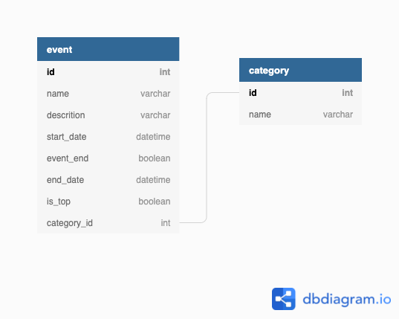
Database Design – Core Data
I create 2 tables to implement the App.
Event
Category

Slide 14
Thank You !!!

Slide 15
Reference
Countdown date app
https://apps.apple.com/tw/app/%E5%80%92%E6%95%B8%E6%97%A5/id988424260
Proto.io
https://proto.io
Dbdiagram.io
https://dbdiagram.io/home

