Slide 1
Agenda
Review\ Q&A last lecture and assignment1
Quiz (20 minutes)
Exceptions
Array
Array List
Enhanced for loop

Slide 2
Exceptions
What is an exception…???

Slide 3
Exception
It is an unexpected problem that arises during the execution of the program.
It terminates the program/application abnormally.

Slide 4
Error Vs. Exception
Error:- An Error indicates serious problem that a reasonable application should not try to catch.
Exception:- Exception indicates conditions that a reasonable application might try to catch.

Slide 5
Reasons for exception
Invalid data entered by user.
File cannot be found, that needs to be open
Lost of connection in the middle of communications or the JVM has ran out of memory.

Slide 6
Contd.,
Exceptions are caused due to:
User errors,
Programmer error
Physical resources that have failed

Slide 7
Categories of exception
There are 3 categories of exception
Checked Exception
Unchecked Exception
Errors

Slide 8
Checked exception
This type of exception is checked(notified) by the complier at the time of compilation, also called ‘compile time exceptions’.
These exceptions should be handled by programmer.
For example:
“IllegalArgumentException”
Entered integer where String is expected and vice a versa

Slide 9
Unchecked exceptions
Unchecked exception occurs at the time of execution. Also known as RunTime Exception.
These include programming bugs
These exceptions are ignored at the time of compilation.
For example:
Declaring an array of size 10 and trying to call 11th element
ArrayIndexOutOfBoundsException exception occurs.

Slide 10
Errors
These are not exception but problems that arise beyond the control of the user or the programmer.
Errors are typically ignored because we can rarely do anything about an error.
For example:
If a stack overflow occurs, an error will arise.
They are also ignored at the time of compilation.

Slide 11
Implementing Exceptions
Surround an error prone code with ‘try’ block.
try{ some error prone code }
Then specify the type of exception in the catch block, that you already know may occur, right after try block.
try{
some error prone code
}
catch( FileNotFoundException ex){
some more code to resolve or continue after error
}

Slide 12

What if we have multiple known exceptions

Slide 13
Multiple Catch Blocks
try{
some error prone code
}
catch( Exception1 ex1){
some more code to resolve or continue after error
}
catch( Exception2 ex2){
some more code to resolve or continue after error
}
catch( Exception3 ex3){
some more code to resolve or continue after error
}

Slide 14
finally block
The optional ‘finally’ block consists of the ‘finally’ keyword, followed by code enclosed in curly braces.
If it’s present , it’s placed after the last catch block.
If there are no catch blocks, the ‘finally’ block is required and immediately follows try block.

Slide 15
When the finally Block Execution
The ‘finally’ block will execute whether or not an exception is thrown in the corresponding try block.

Slide 16
Practice Question
Create a method name division() where you read two inputs from the user as ‘int’ type , then perform division of those numbers.
Handle the exception where user could try to divide the number by zero (0)
(hint: ArithmeticException)

Slide 17
Question 2
To the Employee class apply the exception to all the setter methods with their appropriate handling .

Slide 18
Learning
Arrays
Array List
Enhanced for loop

Slide 19
Arrays
Java provides a data structure, the array, which stores a fixed-size sequential collection of elements of the same data type.
An array is used to store a collection of data, but it is often more useful to think of an array as a collection of variables of the same data type.

Slide 20
Declaring Array Variables
To use an array in a program, you must declare a variable to reference the array, and you must specify the data type of array the variable can reference.
Syntax:
dataType[] arrayName; // preferred way. or
dataType arrayName[]; // works but not commonly used.

Slide 21
Example
double[] myArray; // preferred way. or
double myArray[]; // works but not commonly used.

Slide 22
Creating Arrays
You can create an array by using the new operator with the following syntax −
dataType[] arrayName = new dataType [arraySize];
For example:
int[] myArray = new int[10];
// Create the “myArray” Object.

Slide 23
Passing Arrays to Methods
To Pass an array arguments to a method, specify the name of the array without any bracket.
For Example,
if array hourlyTemperatures = new double[24];
Then the method call:
methodArray(hourlyTemperatures);
Passes the reference of array hourlyTemperatures to method methodArray

Slide 24
Contd.,
For method to receive an array reference through method call, the method’s parameter must specify an array parameter.
For Example:
void methodArray(double[] b )

Slide 25
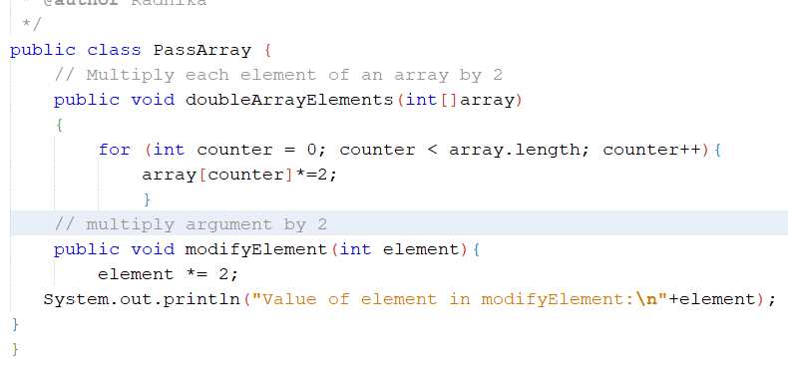
Demo code

Slide 26
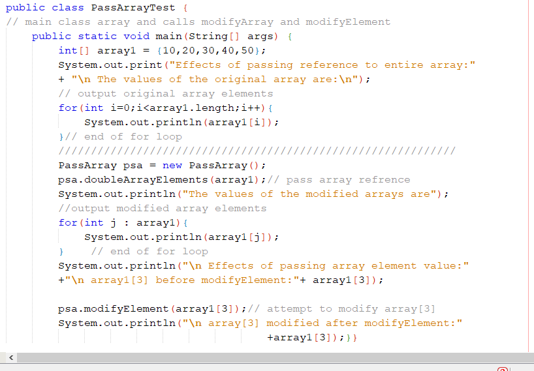
Main class

Slide 27
ArrayList
Generally we all know that, Java arrays are of a fixed length. After arrays are created, they cannot grow or shrink, which means that you must know in advance how many elements an array will hold.
Array lists are created with an initial size. When this size is exceeded, the collection is automatically enlarged. When objects are removed, the array may be shrunk.

Slide 28
Why ArrayList is better than Array?
The limitation with array is that it has a fixed length so if it is full you cannot add any more elements to it, likewise if there are number of elements gets removed from it the memory consumption would be the same as it doesn’t shrink.
On the other ArrayList can dynamically grow and shrink after addition and removal of elements . Apart from these benefits ArrayList class enables us to use predefined methods of it which makes our task easy.

Slide 29
Syntax
We can create an ArrayList by writing a simple statement like this:--
>> ArrayList<String> alist = new ArrayList<String>();
This statement creates an ArrayList with the name alist with type “String”.
The type determines which type of elements the list will have. Since this list is of “String” type, the elements that are going to be added to this list will be of type “String”.

Slide 30
Demo Code

Slide 31
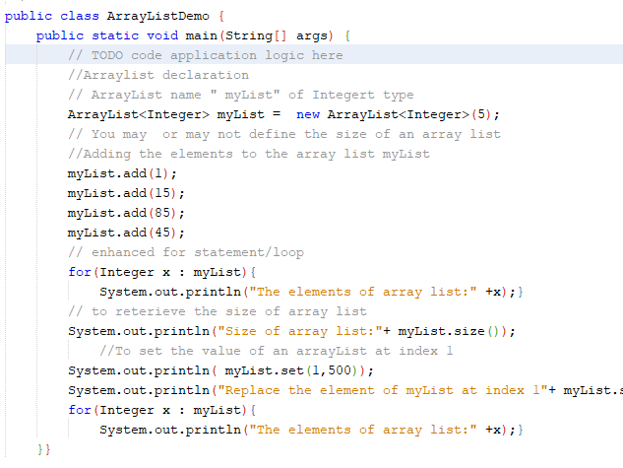

Slide 32
Enhanced ‘for’ statement
The enhanced for statement iterates through the elements of an array without using a counter, thus avoiding the possibility of “stepping outside” the array.
Counting details are hidden from you in the enhanced for statement:

Slide 33
Syntax
for( parameter : arrayName)
{
Statement;
}
parameter has a type and an identifier (e.g., int number)
arrayName is the array through which to iterate.

Slide 34
Contd.,
for( int counter = 0; counter < arrayName.length; counter++)
{
total += array[ counter ]
}
The above for statement is hidden in the enhanced for statement.

Slide 35
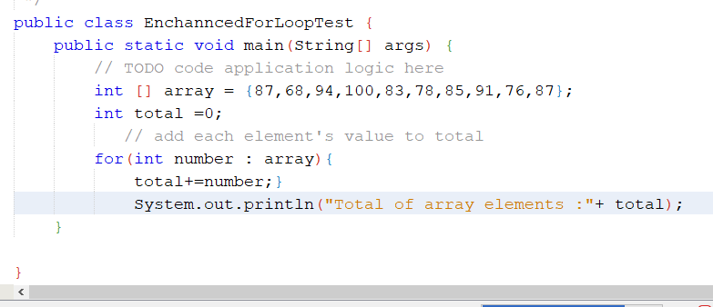
Demo code, enhanced for statement

