Slide 1
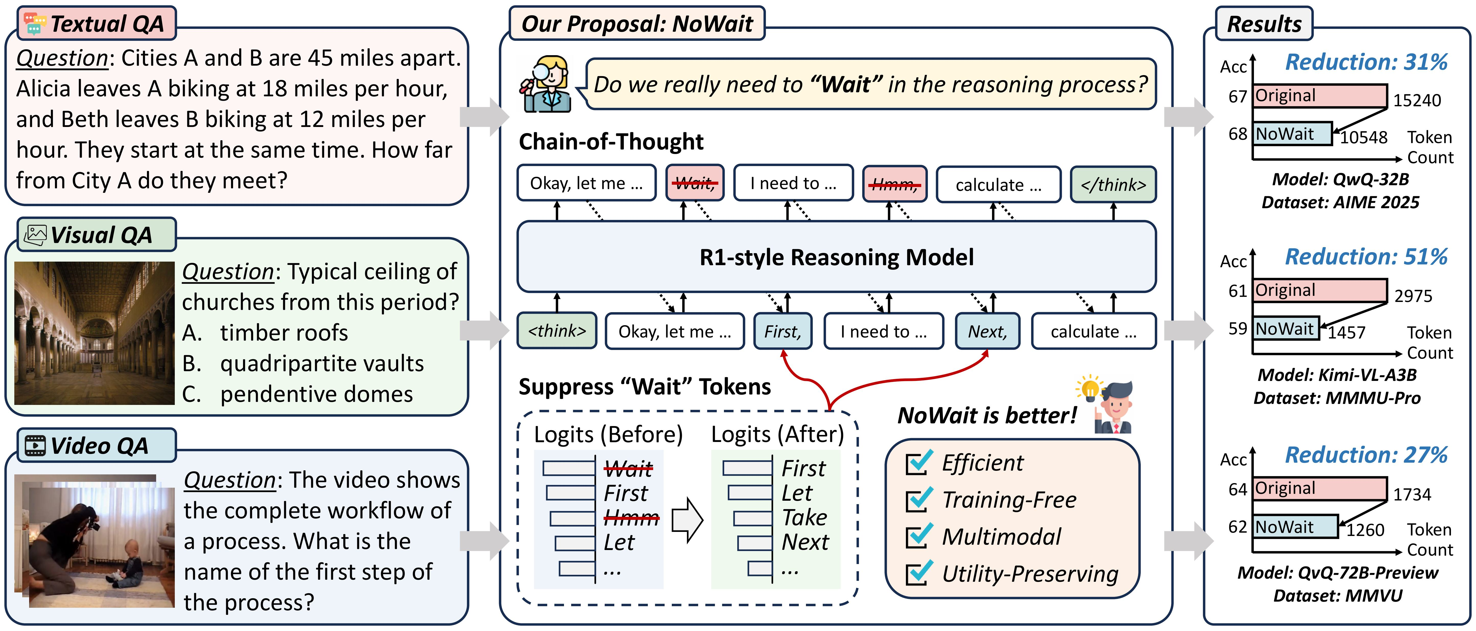
Wait, We Don’t Need to “Wait”! Removing Thinking Tokens
Improves Reasoning Efficiency

Slide 2



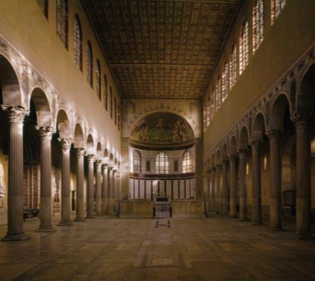




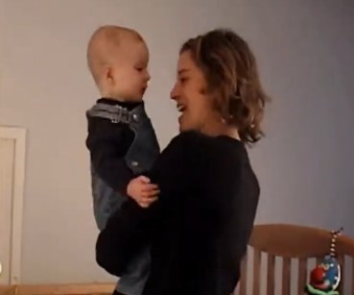


Textual QA
Our Proposal: NoWait
Results
Question: Cities A and B are 45 miles apart. Alicia leaves A biking at 18 miles per hour, and Beth leaves B biking at 12 miles per hour. They start at the same time. How far from City A do they meet?
Acc
67
Reduction: 31%
Do we really need to “Wait” in the reasoning process?
Original
15240
Chain-of-Thought
68
NoWait
10548
Token Count
Okay, let me …
Wait,
I need to …
Hmm,
calculate …
</think>
Model: QwQ-32B Dataset: AIME 2025
Visual QA
R1-style Reasoning Model
Acc
61
Reduction: 51%
Question: Typical ceiling of churches from this period?
Original
2975
timber roofs
quadripartite vaults
pendentive domes
</think>
Okay, let me …
First,
I need to …
Next,
calculate …
59
NoWait
1457
Token Count
Suppress “Wait” Tokens
Model: Kimi-VL-A3B
Dataset: MMMU-Pro
NoWait is better!
Efficient Training-Free Multimodal
Utility-Preserving
Video QA
Logits (Before) Logits (After)
Acc 64
Reduction: 27%
Question: The video shows the complete workflow of a process. What is the name of the first step of the process?
Wait First Hmm Let
...
First Let Take Next
...
Original
1734
1260 Token Count
62
NoWait
Model: QvQ-72B-Preview Dataset: MMVU

Slide 3
配色方案
(247,205,204)
#F7CDCC
(212,231,211)
#D4E7D3
(207,231,235)
#CFE7EB
(252,240,231)
#FCF0E7
(253,246,245)
#FDF6F5
(239,248,236)
#EFF8EC
(237,244,249)
#EDF4F9
(255,247,224)
#FFF7E0

